Slide 1

The Revelation of Jesus Christ
A study of the book
of Revelation

Slide 2

“The Worship of Jesus Christ”
Revelation 5:1-14

Slide 3
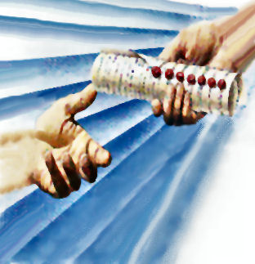
“And I saw in the right hand of him that sat on the throne a book written within and on the backside, sealed with seven seals.”

Slide 4
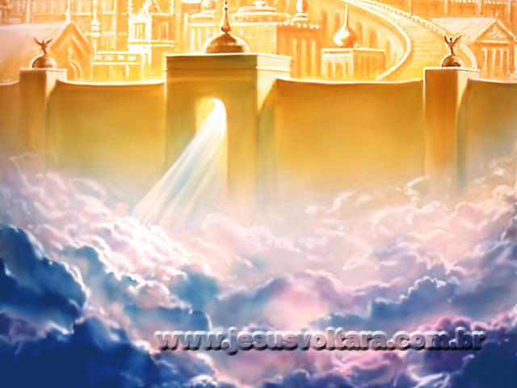
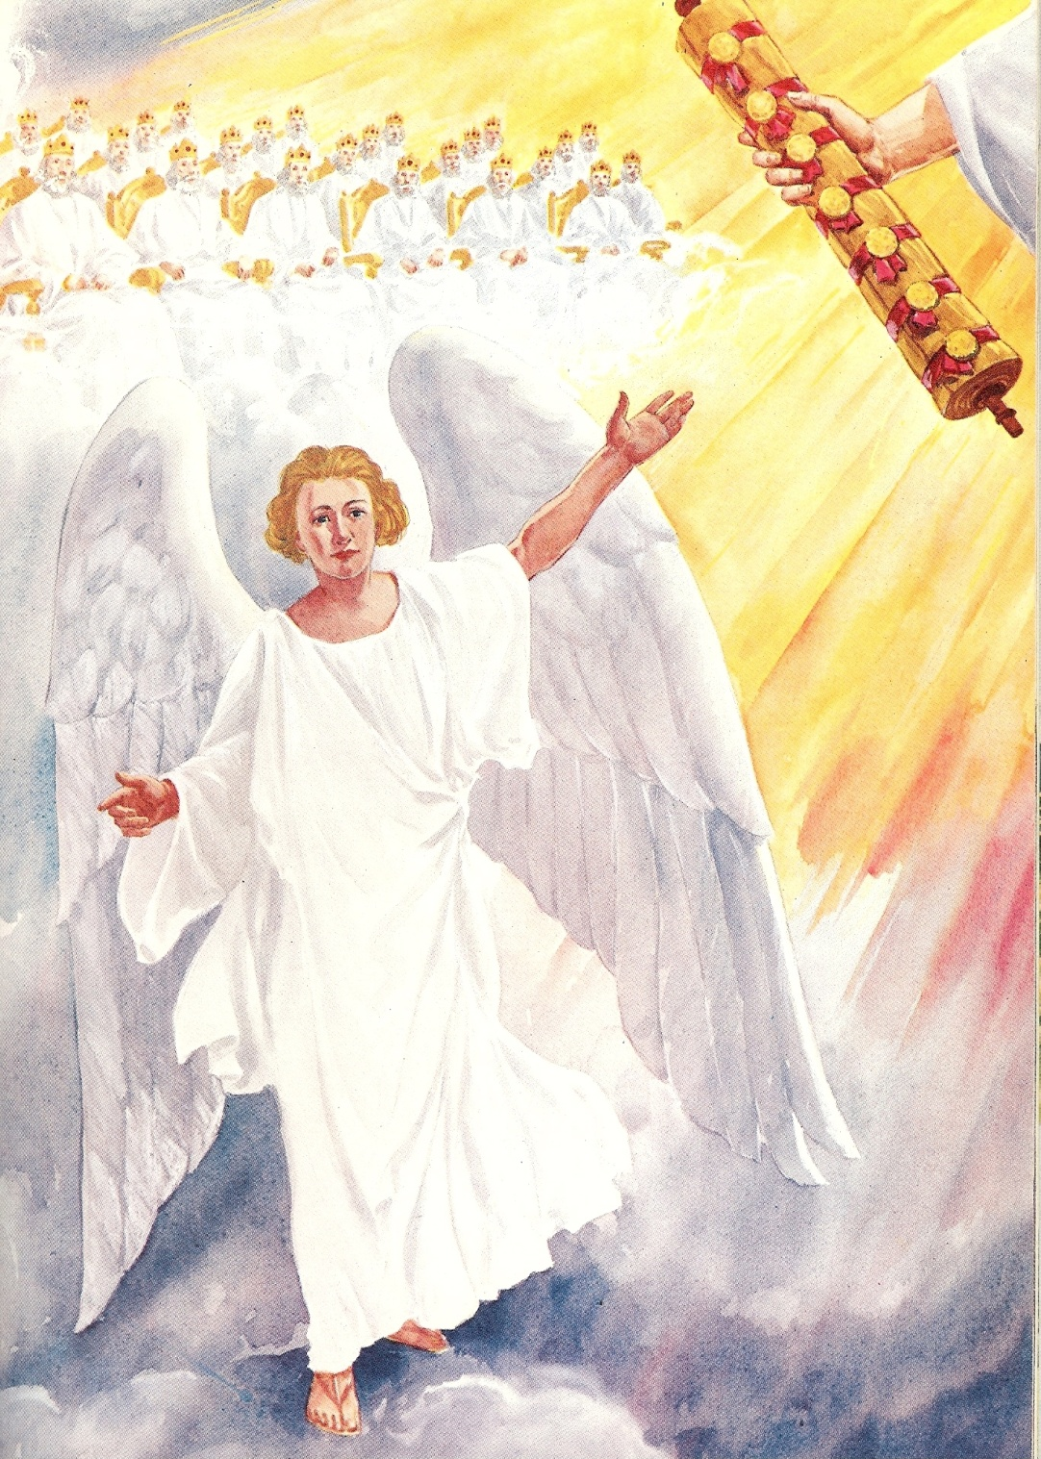
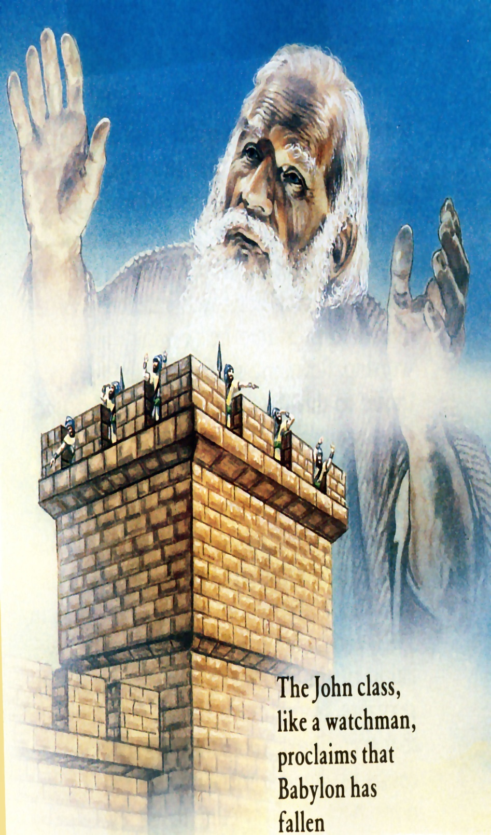
“And I saw a strong angel proclaiming with a loud voice, Who is worthy to open the book, and to loose the seals thereof?”

Slide 5
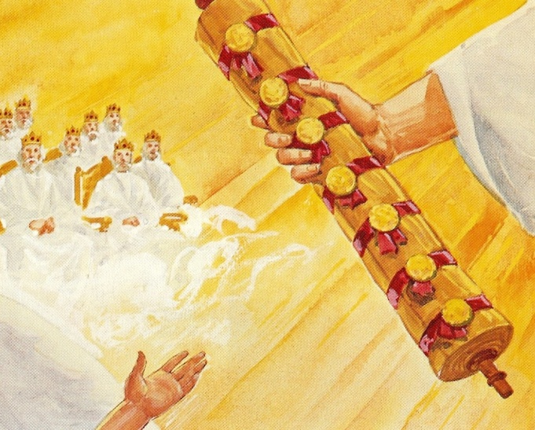
The book sealed with seven seals
The content of the book has been a mystery –
“Go thy way, Daniel: for the words are closed up and sealed till the time of the end.” (Daniel 12:9)
The content of the book is revealed in succession as the seals are broken and the message is disclosed -

Slide 6
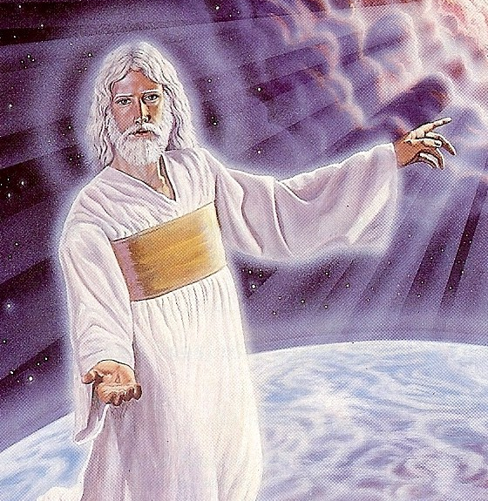
Seven seals show that the book is large and contains a great deal of material in it concerning end time events –
Seven seals show security of the book –
God has sealed the book in order to keep the events of the end times from beginning until the one who is worthy steps forth and takes the book from His hand -

Slide 7
The seven seals show that the book is the last will and testament of God –
In the Roman world a man’s last will and testament had to be witnessed by seven persons, and each had to attach his personal seal to the document. The will could only be opened by the recipient of the will.
This book contains God’s will for those who have rejected Him – (Revelation 6-21)
This book contains God’s will for those who have received Him – (Revelation 4-21)

Slide 8
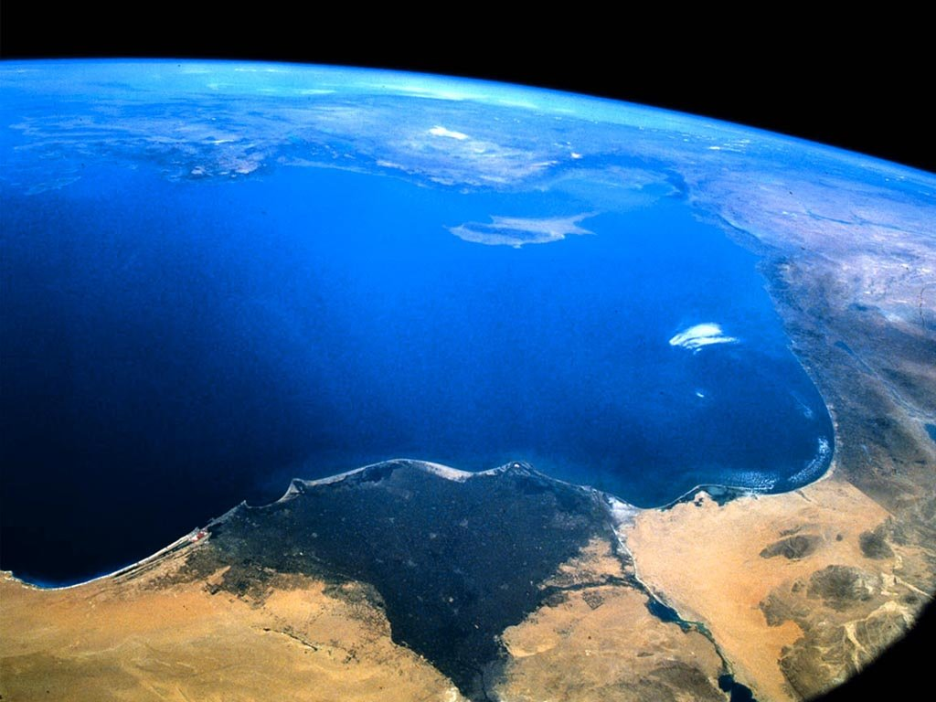
The seven sealed book is the title deed to the earth -
“The earth is the Lord’s, and the fullness thereof…” (Psalms 24:1)
“Thou hast created all things, and for thy pleasure they are and were created.” (Revelation 4:11)

Slide 9
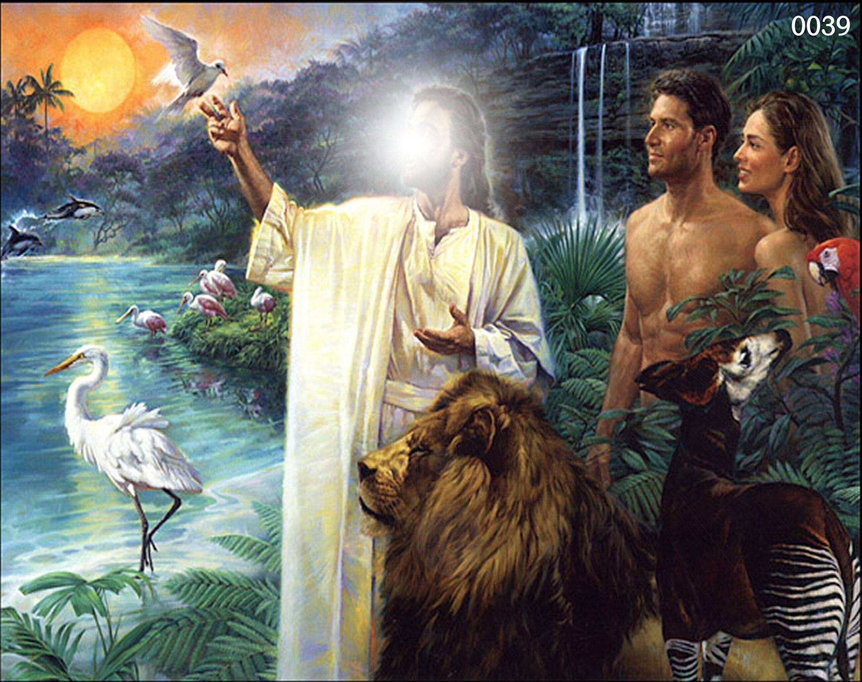
“And God blessed them, and God said unto them, Be fruitful, and multiply, and replenish the earth, and subdue it: and have dominion over the fish of the sea, and over the fowl of the air, and over every living thing that moveth upon the earth.” (Genesis 1:28)

Slide 10
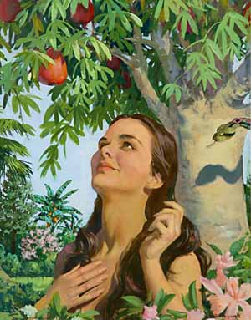
"Now the serpent was more subtile than any beast of the field which the Lord God had made. And he said unto the woman, Yea, hath God said, Ye shall not eat of every tree of the garden?" (Gen. 3:1)

Slide 11
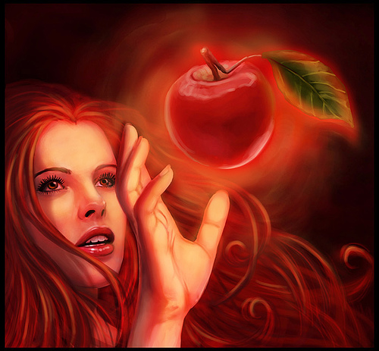
"And when the woman saw that the tree was good for food, and that it was pleasant to the eyes, and a tree to be desired to make one wise, she took of the fruit thereof and did eat…”

Slide 12
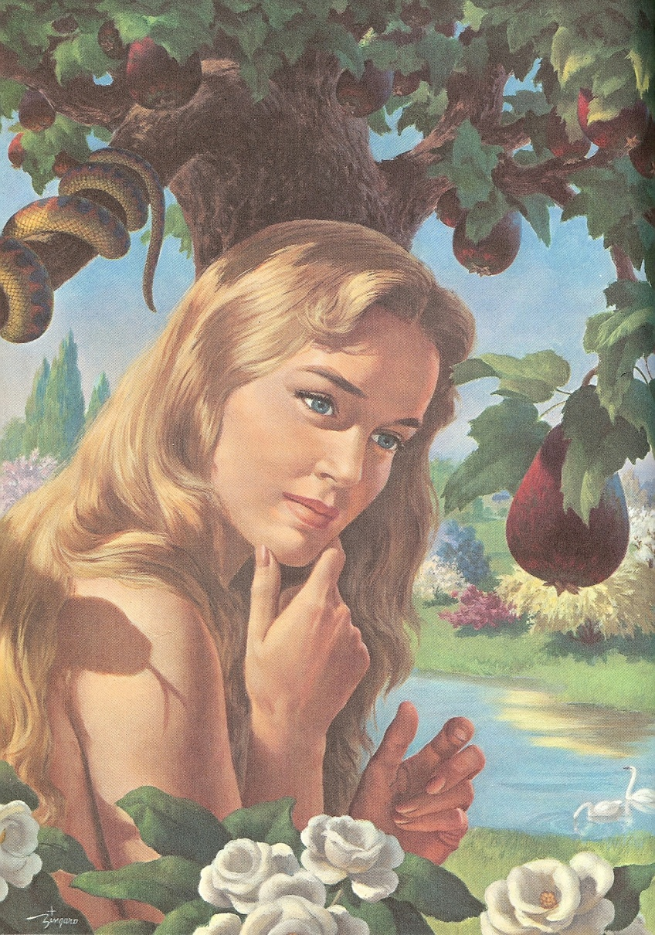
Satan’s Threefold Temptation
Lust of the flesh – “…saw that the tree was good for food…”
Lust of the eyes – “…and that it was pleasant to the eyes…”
Pride of life – “…and a tree to be desired to make one wise…”
“She took of the fruit thereof, and did eat…”

Slide 13
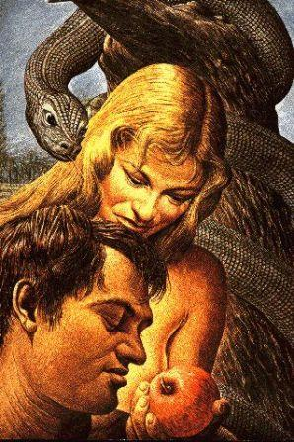
“…and gave also unto her husband with her; and he did eat."
(Gen. 3:6)

Slide 14
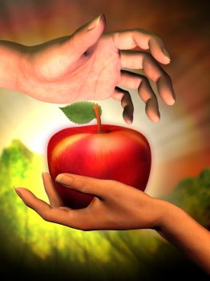
(I Tim. 2:14)
“And Adam was not deceived, but the woman being deceived was in the transgression.”

Slide 15
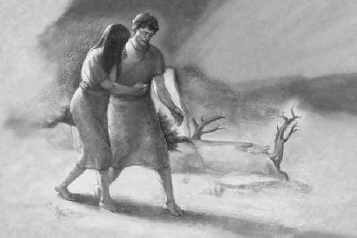
“The Consequences of the Fall”

Slide 16
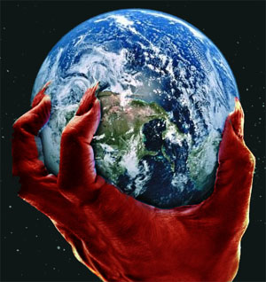
II Cor. 4:4 “In whom the god of this world hath blinded the minds of them which believe not, lest the light of the glorious gospel of Christ, who is the image of God, should shine unto them.”
Eph 2:2 “Wherein in time past ye walked according to the course of this world, according to the prince of the power of the air, the spirit that now worketh in the children of disobedience.”
John 14:30 “Hereafter I will not talk much with you: for the prince of this world cometh, and hath nothing in me.”

Slide 17
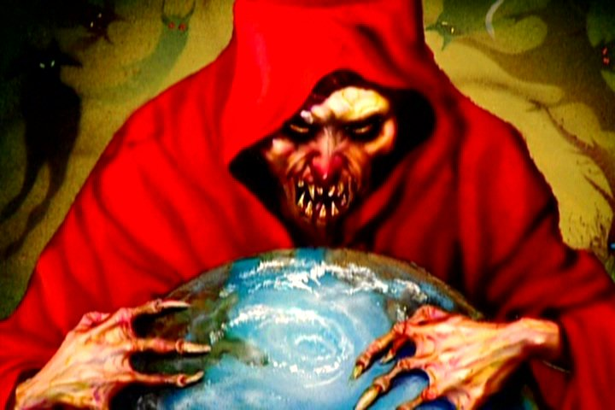
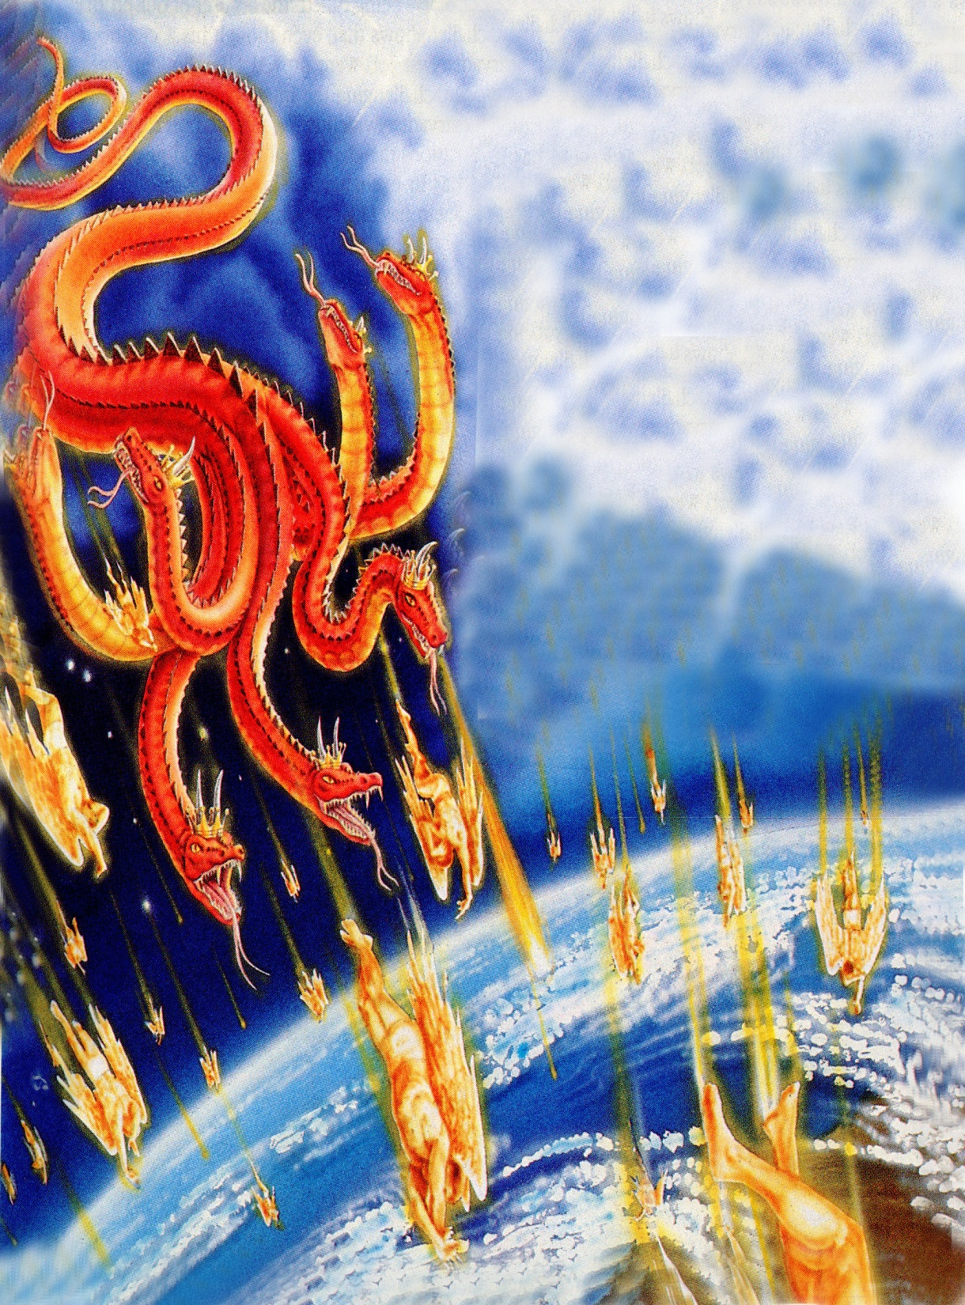
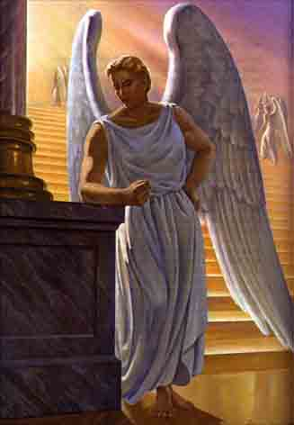
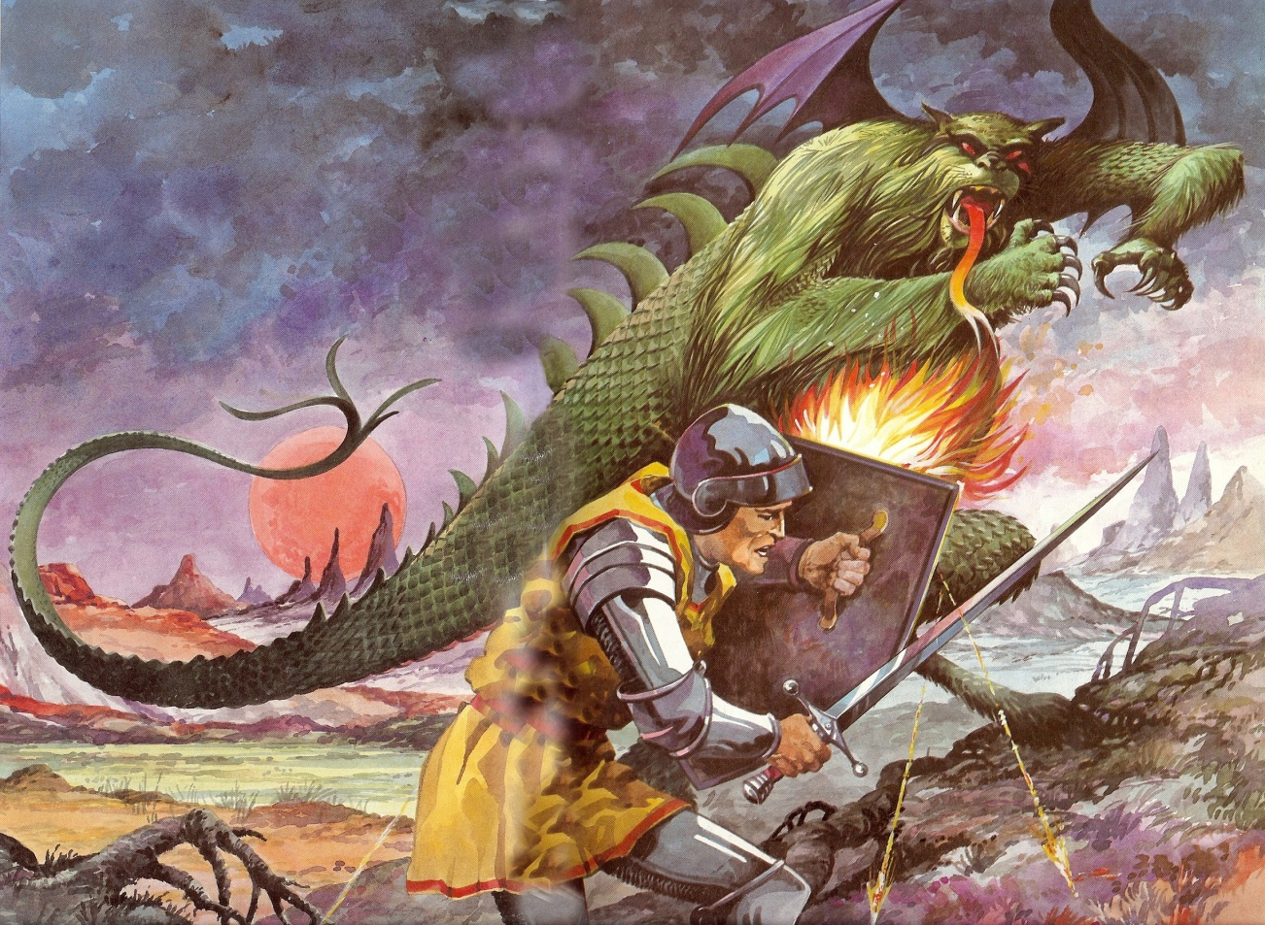

Slide 18
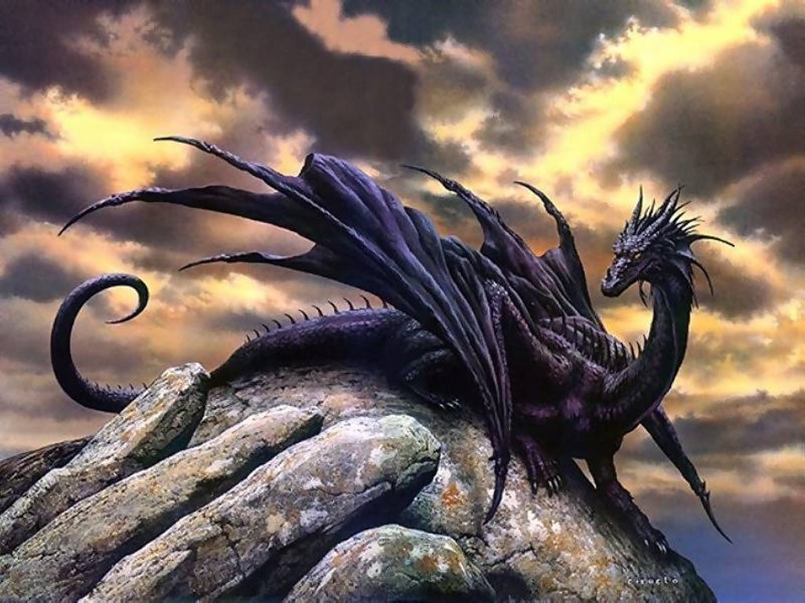

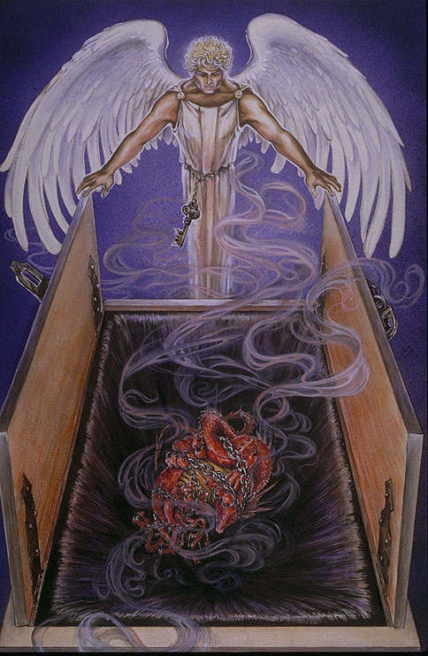
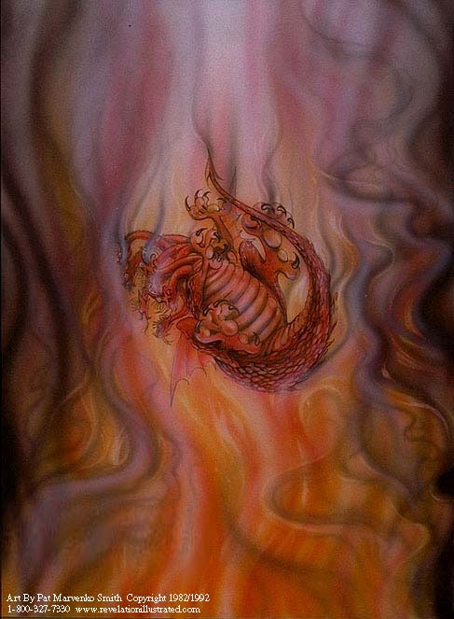
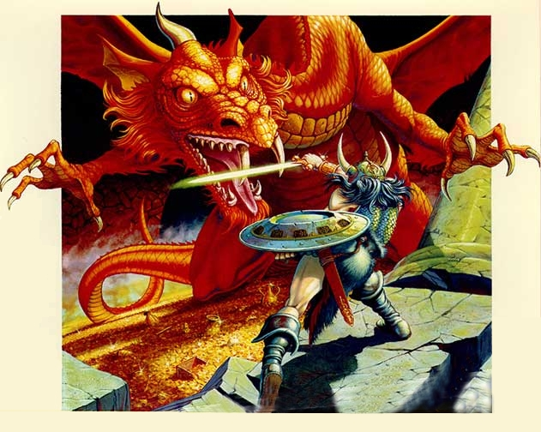

Slide 19
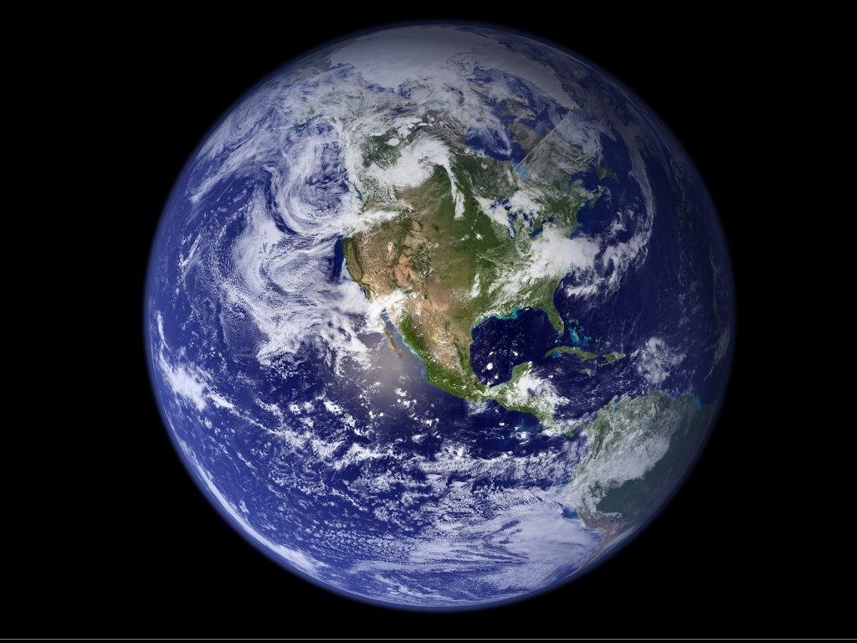
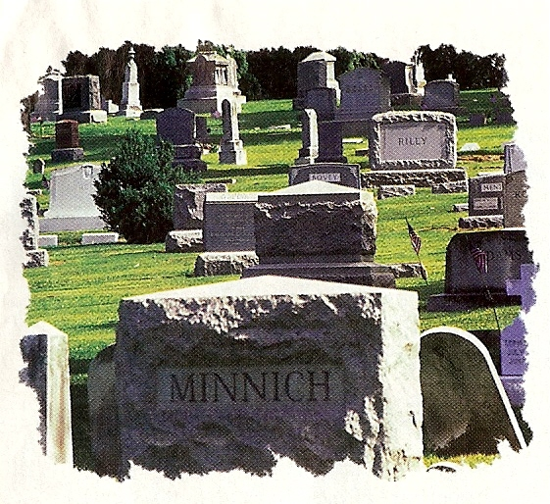
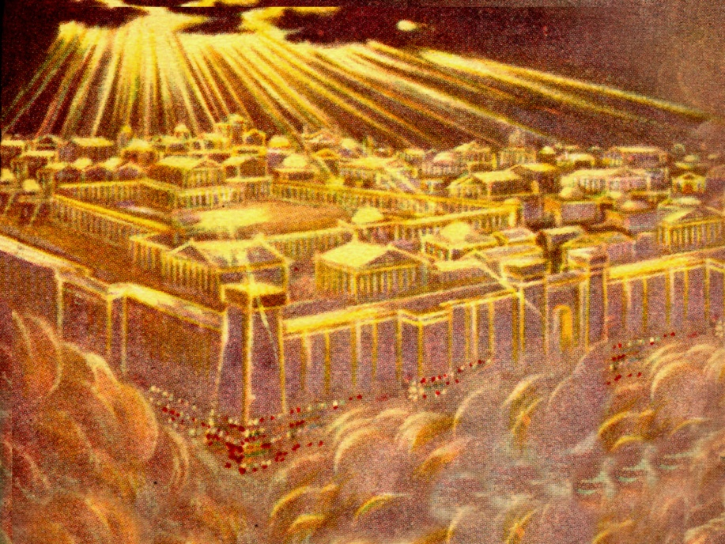
The Search Begins
“Who is worthy”
No person in heaven was found worthy –
No person on earth was found worthy –
No person under the earth was found worthy -

Slide 20
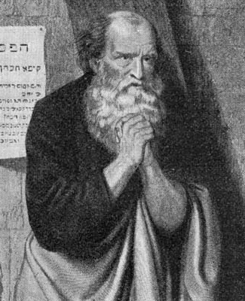
“And I wept much, because no man was found worthy to open and to read the book, neither to look thereon.”

Slide 21
“And one of the elders saith unto me, Weep not: behold, the Lion of the tribe of Juda, the Root of David, hath prevailed to open the book, and to loose the seven seals thereof.”

Slide 22
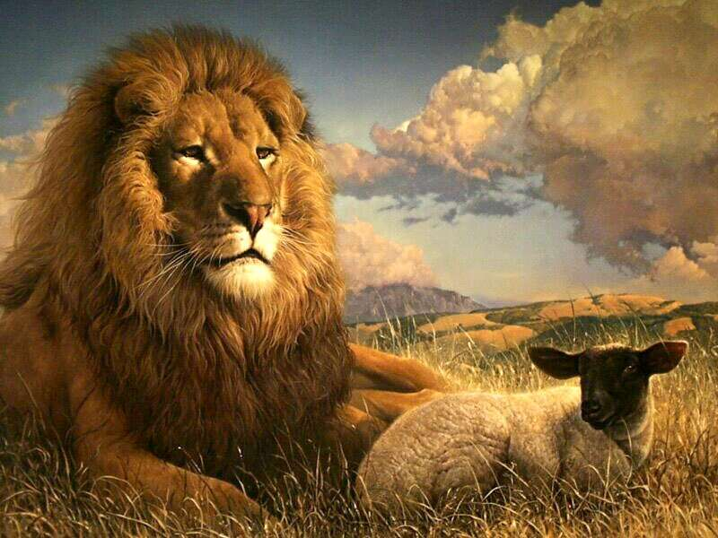
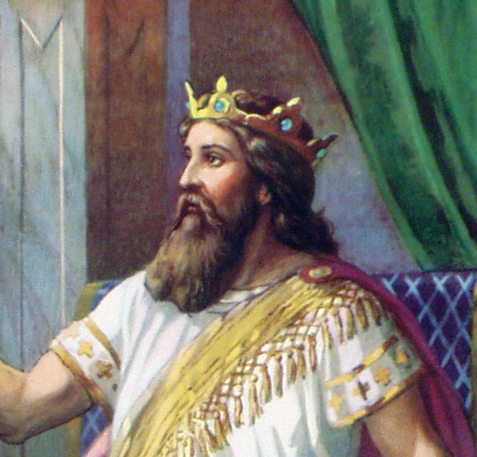
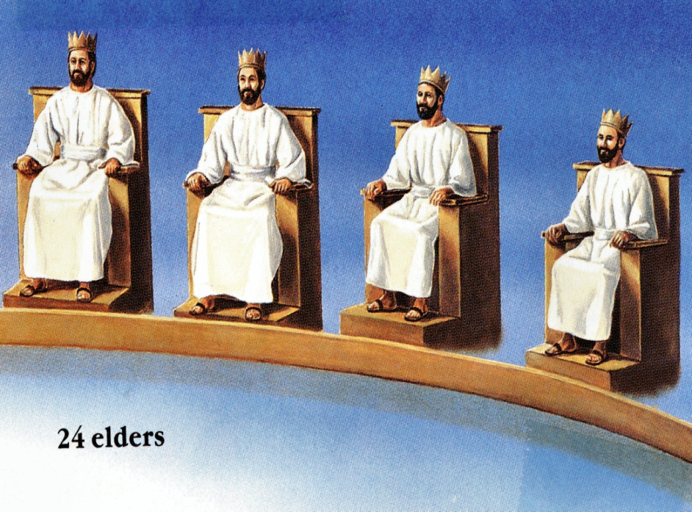

Slide 23
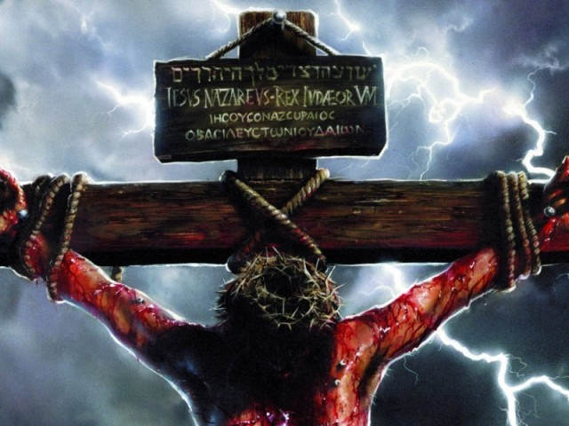
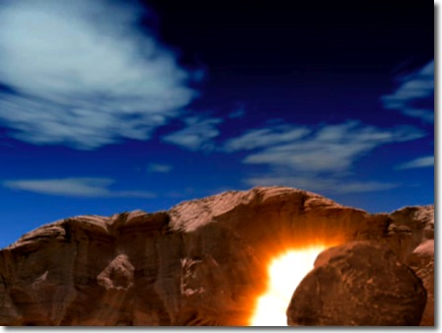
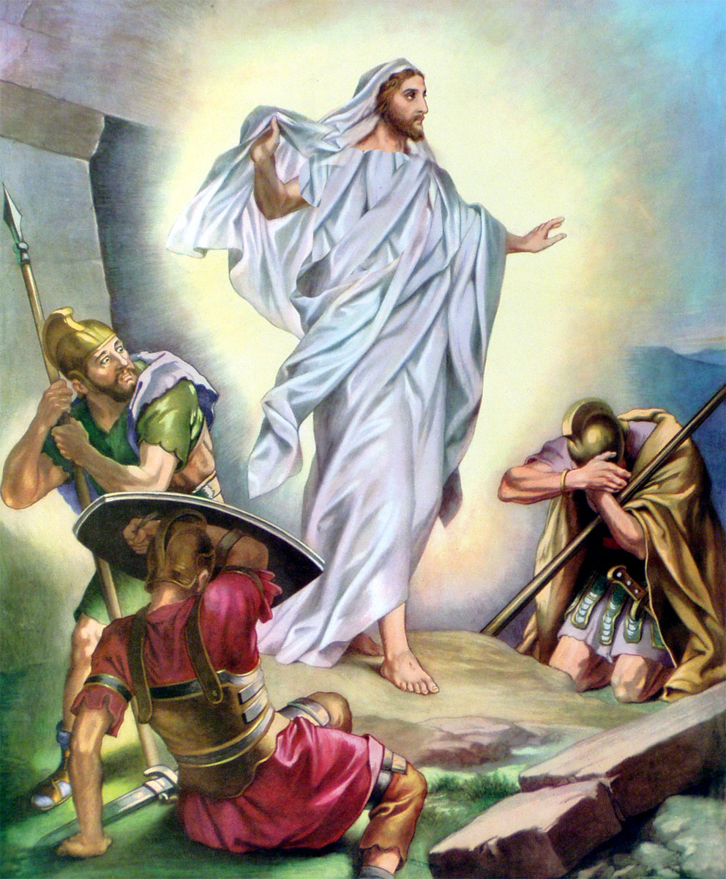
“He (Jesus) hath prevailed…”

Slide 24
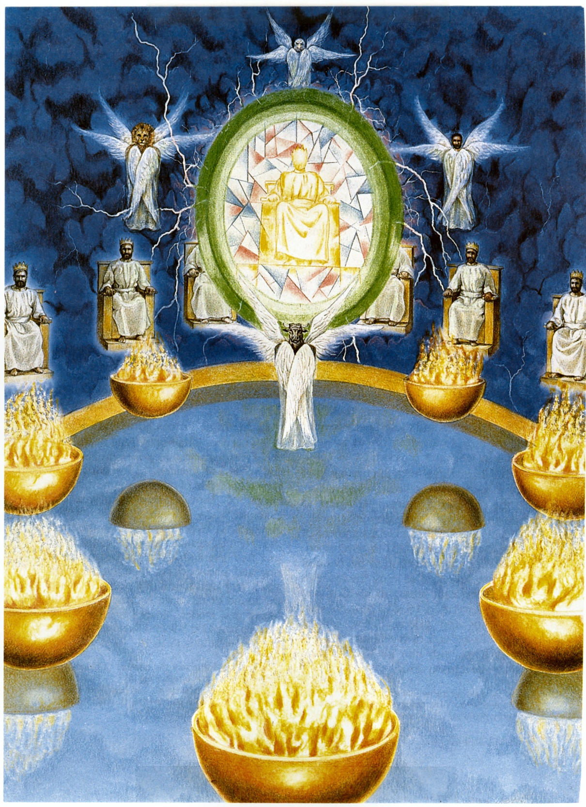
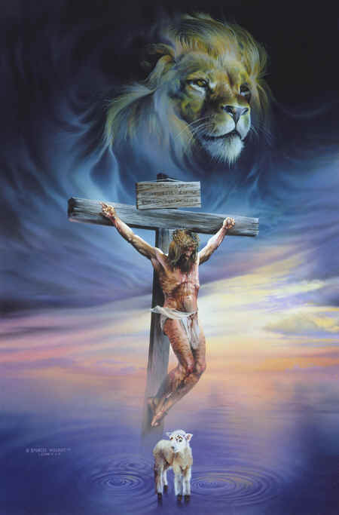
“And I beheld, and, lo, in the midst of the throne and of the four beasts, and in the midst of the elders, stood a Lamb as it had been slain.”

Slide 25
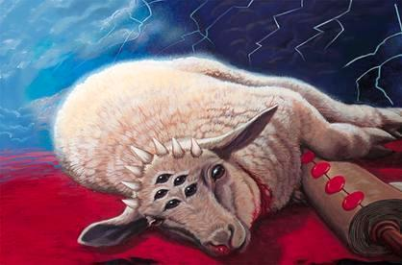
“Having seven horns and seven eyes, which are the seven Spirits of God sent forth into all the earth.”

Slide 26
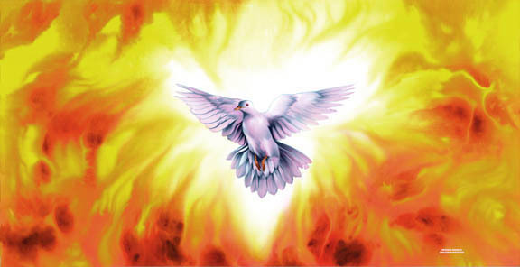
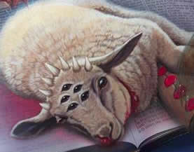

Slide 27
“Thou art worthy”
Jesus Christ is the very center and focus of attention in heaven –
Every eye and thought is upon Him –
He is at the right hand of God – (equality) “I and my Father are one…”
He is the centerpiece of heaven – “…and in the midst …”
He is the central figure on the stage of the universe -

Slide 28
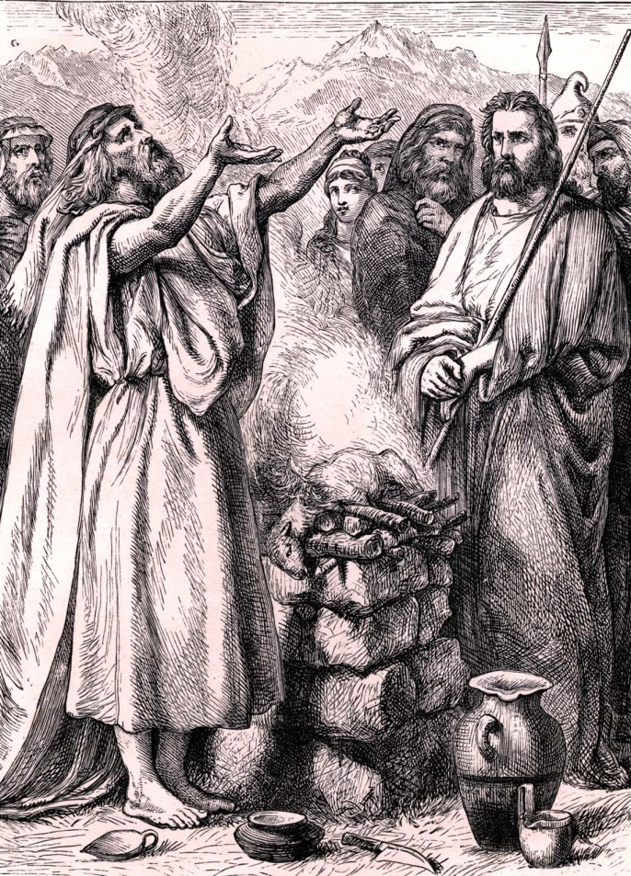
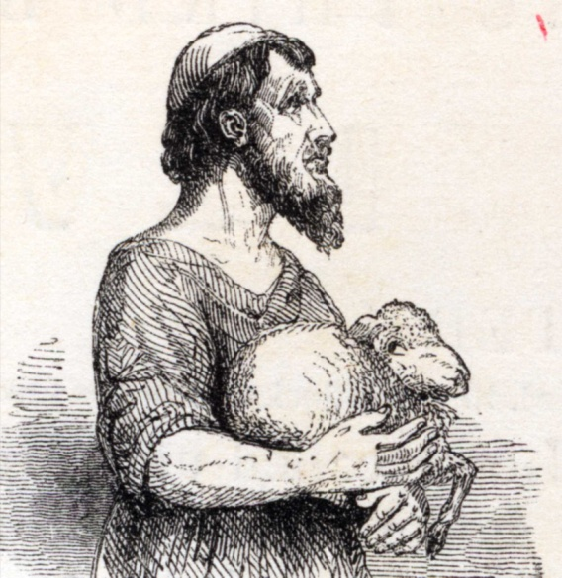
He is the sacrificial Lamb of God who has been slain – “Behold the Lamb of God, which taketh away the sin of the world…”

Slide 29
He is the omnipotent power of the universe – “King of kings and Lord of lords…”
Seven horns symbolize complete and perfect strength and power – “All power is given unto me in heaven and on earth…”
Seven eyes represent His complete and perfect omniscience – “The eyes of the Lord are in every place…the eyes of the Lord preserve knowledge…the eyes of the Lord are upon the righteous…the eyes of the Lord, which run to and fro through the whole earth…In Him are hid all the treasures of wisdom and knowledge…”

Slide 30
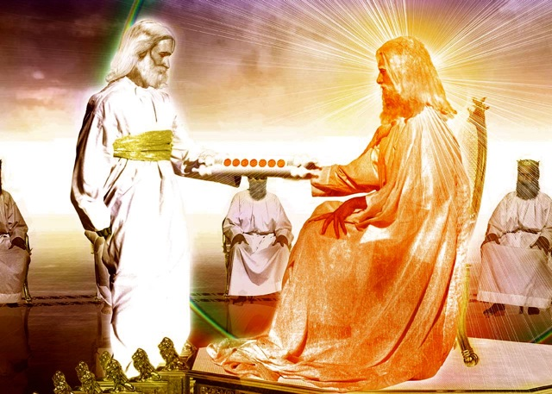
“And he came and took the book out of the right hand of Him that sat upon the throne….”

Slide 31
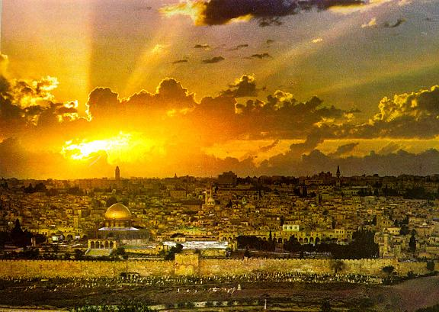
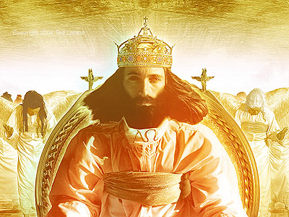
“The kingdoms of this world are become the kingdoms of our Lord, and of His Christ; and He shall reign for ever and ever.” (Revelation 11:5)

Slide 32
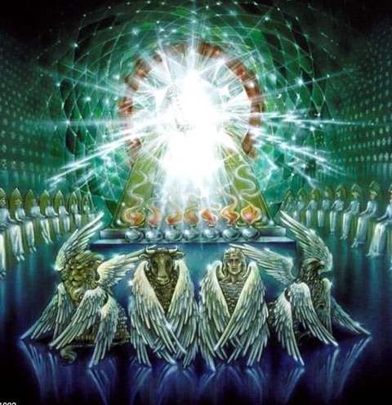
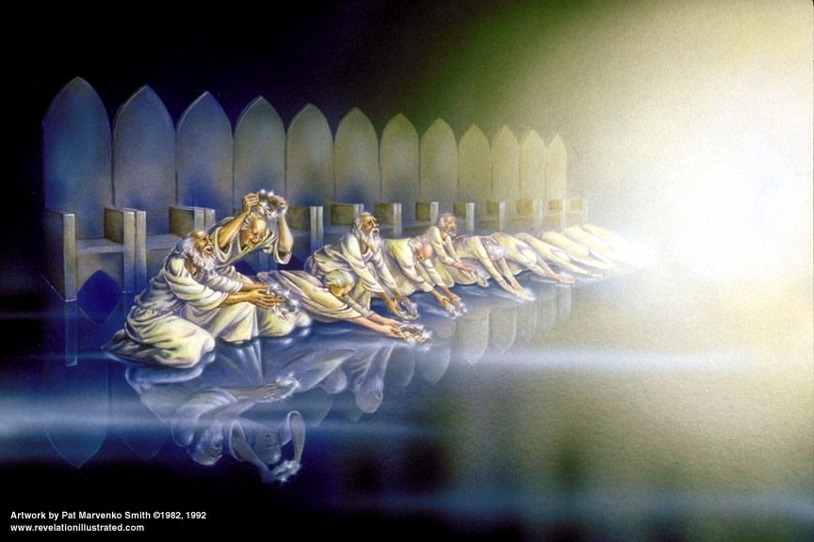
Heaven Erupts in Praise
The four beast fall down –
The four and twenty elders fall down -

Slide 33
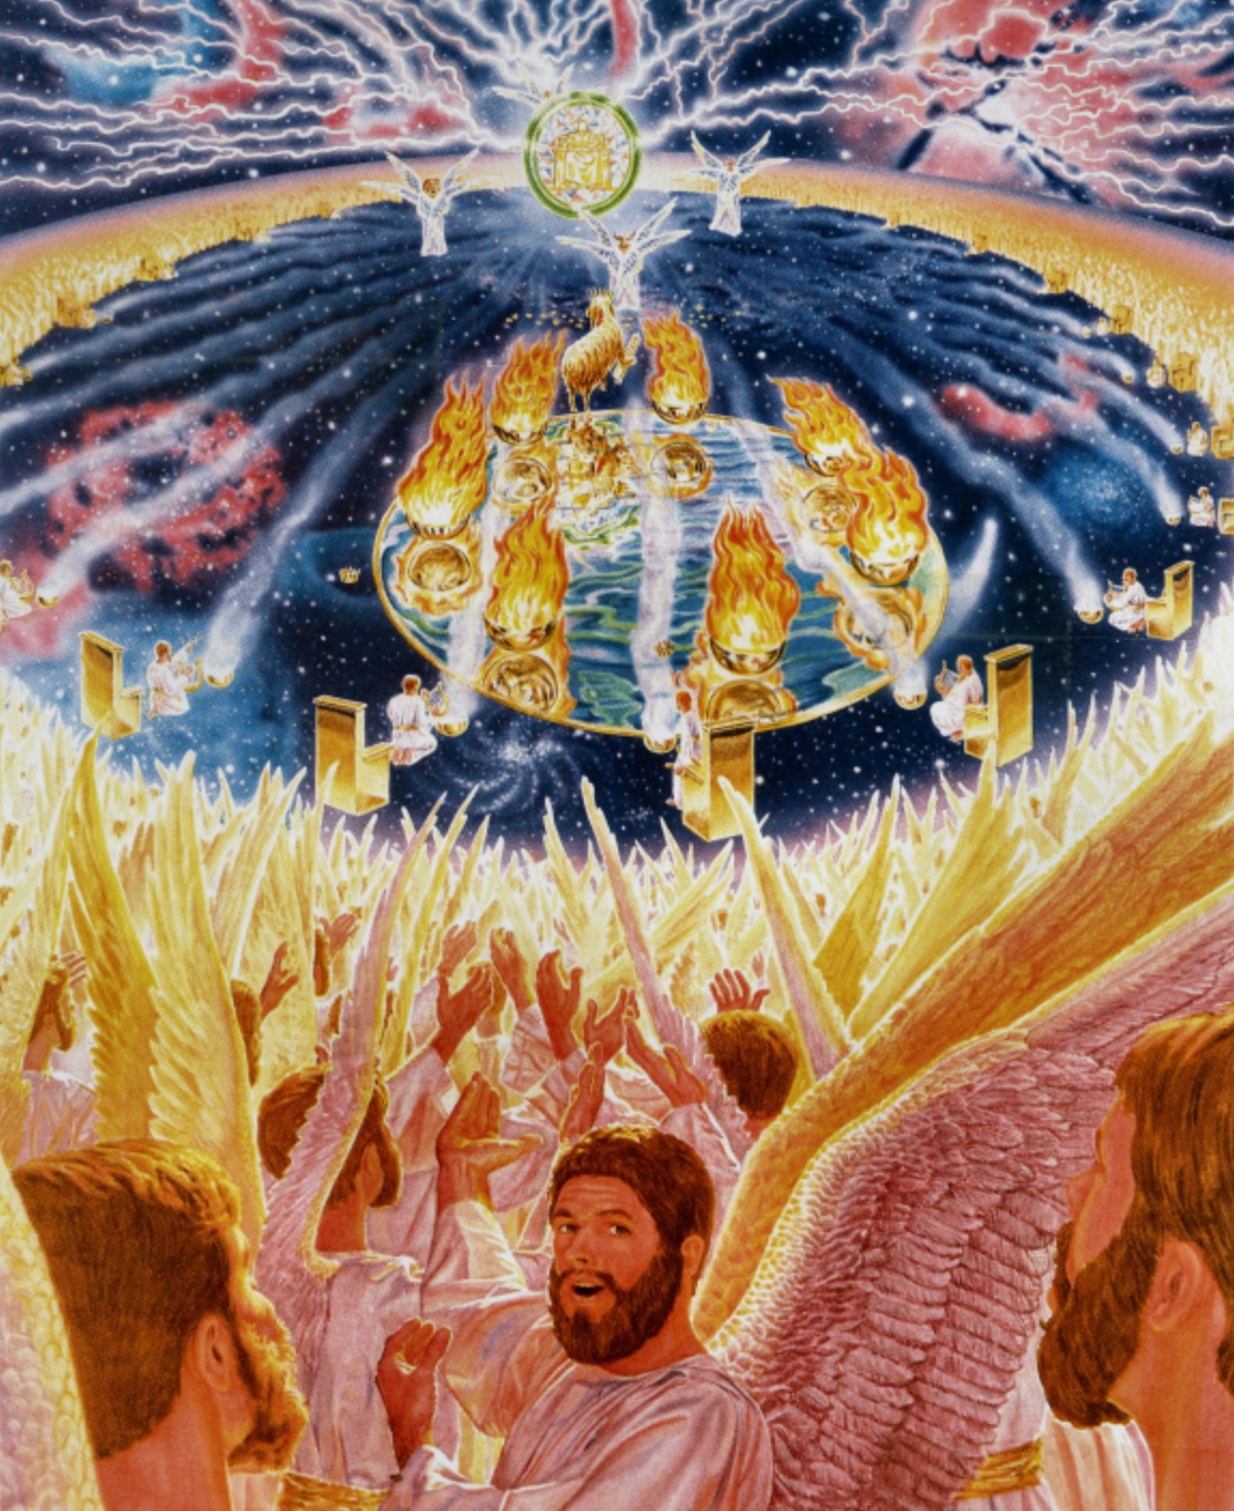
“Thou art worthy”

Slide 34
“And when he had taken the book, the four beasts and four and twenty elders fell down before the Lamb, having every one of them harps, and golden vials full of odours, which are the prayers of saints.”

Slide 35
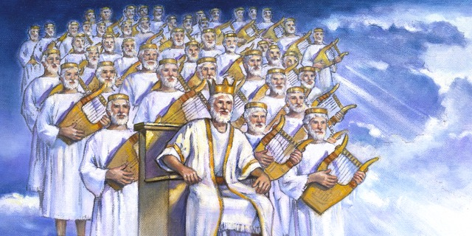
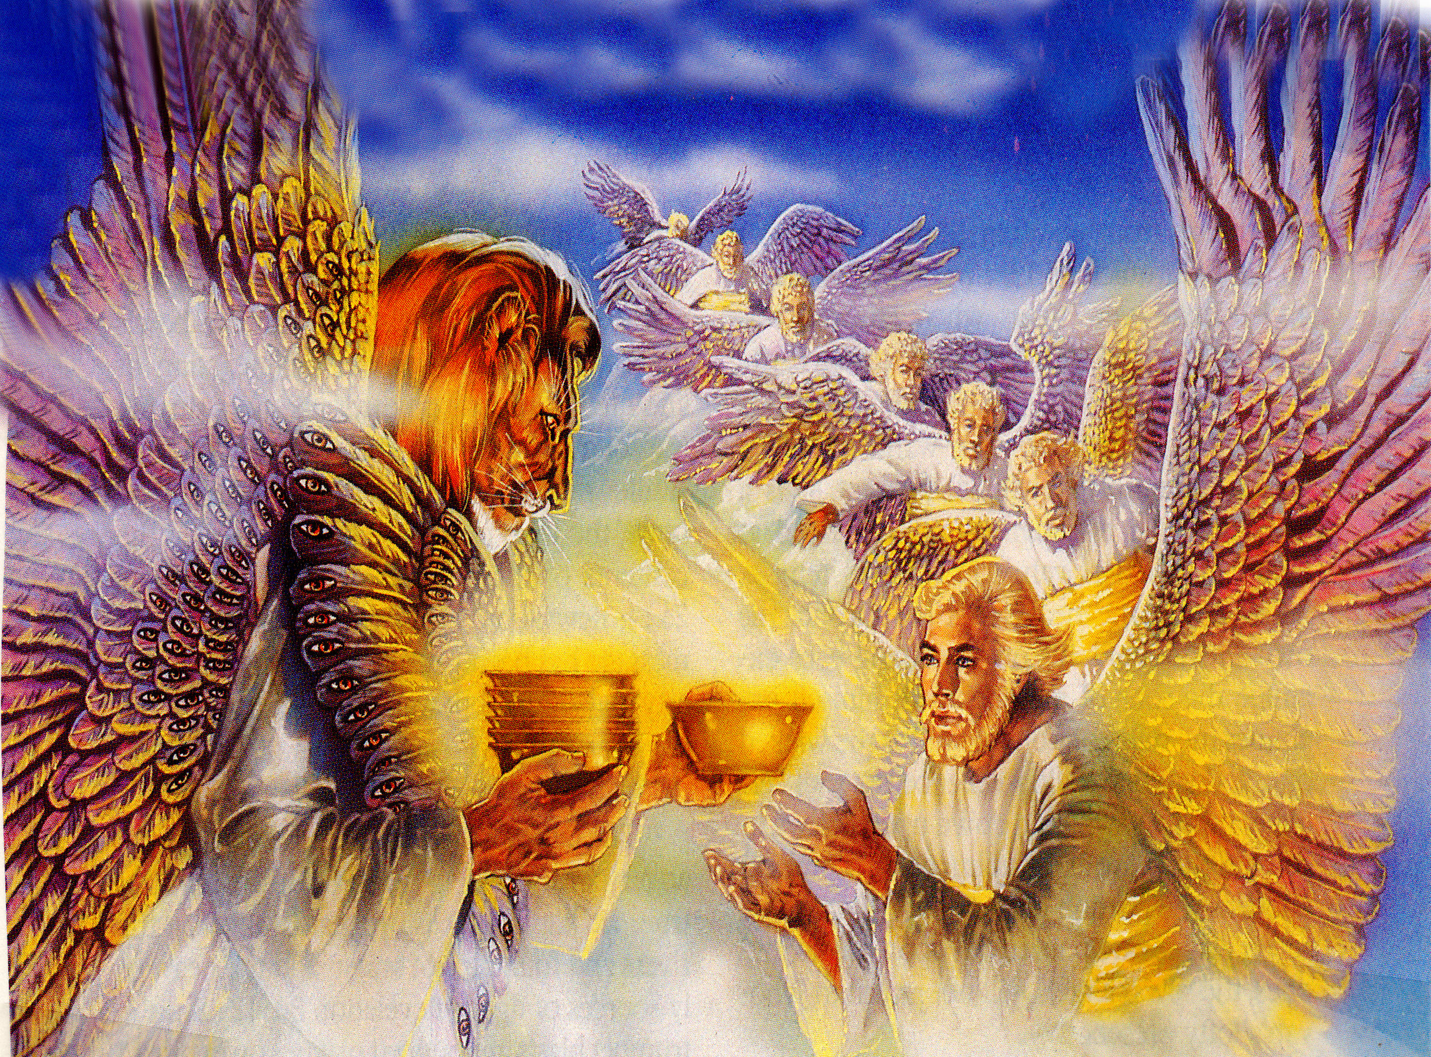

Slide 37
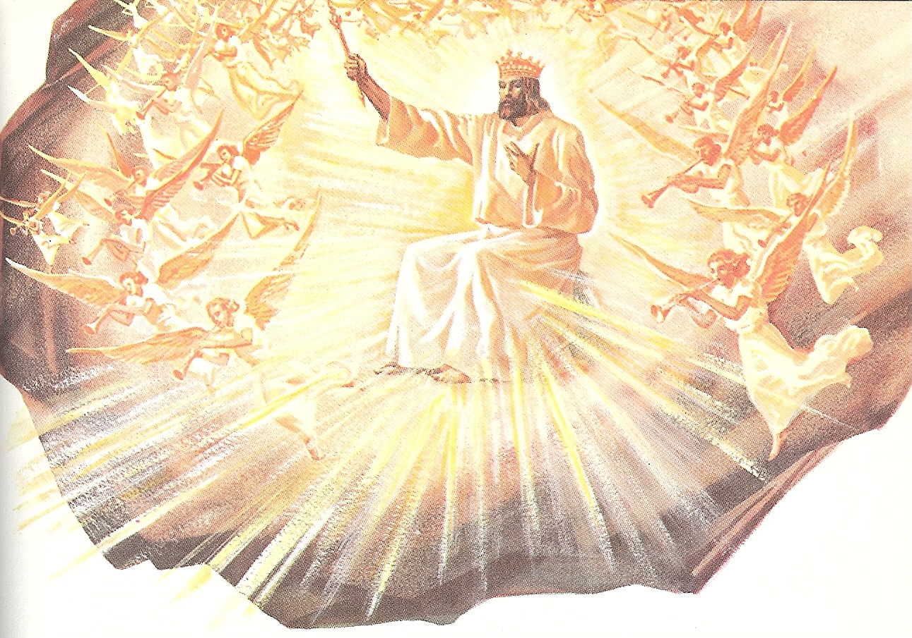

Slide 38
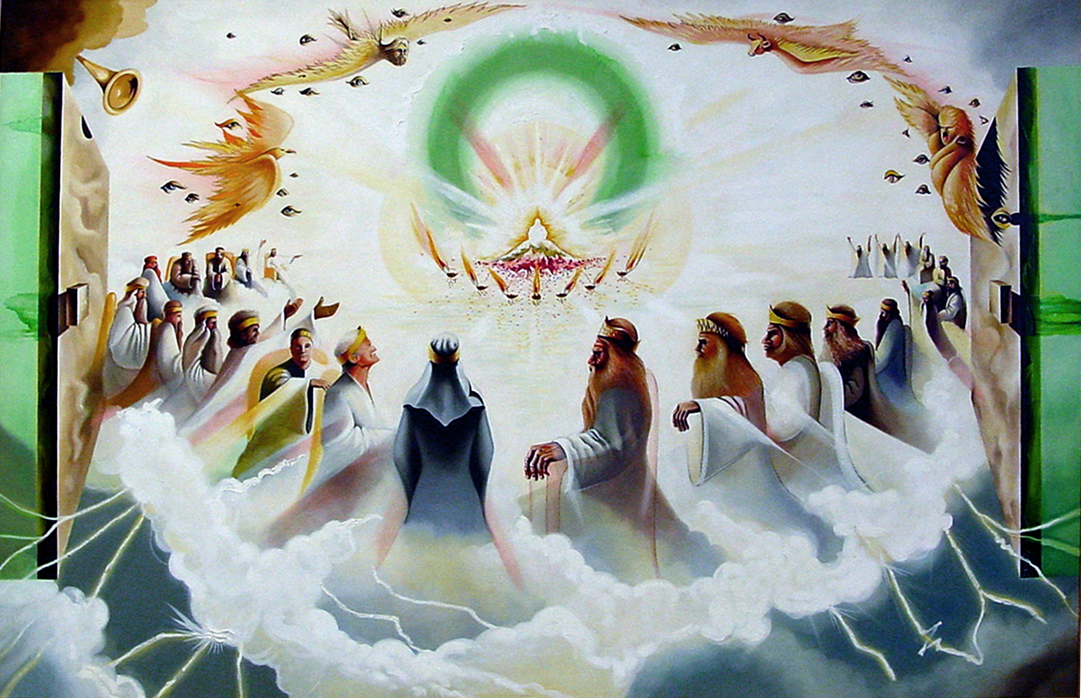
“And they sung a new song, saying, Thou are worthy to take the book, and to open the seals thereof: for thou wast slain, and hast redeemed us to God by thy blood…”

Slide 39



Slide 40

“Thou hast redeemed us to God…out of every kindred, tongue, people, and nation…”

Slide 41


“Thou hast made us unto our God kings and priests…
and we shall reign on the earth.”

Slide 42
“And I beheld, and I heard the voice of many angels round about the throne and the beasts and the elders: and the number of them was ten thousand times ten thousand, and thousands of thousands. Saying with a loud voice, Worthy is the Lamb that was slain to receive power, and riches, and wisdom, and strength, and honour, and glory, and blessing.”

Slide 43


Slide 44

10 Reasons for Praise
(Revelation 5:4-13)

Slide 45
Praise Him because He was slain for man and has redeemed man – Romans 5:9
Praise Him because of His universal salvation – Romans 10:13
Praise Him because He has given believers a great gift of royalty – Matthew 25:23
Praise Him because of His omnipotent power – Matthew 28:18

Slide 46
Praise Him because of His riches – Ephesians 3:8
Praise Him because of His wisdom – I Corinthians 1:30
Praise Him because of His strength – Luke 1:37
Praise Him because of His honor – Philippians 2:9-11
Praise Him because of His glory – Psalms 29:2
Praise Him for His blessing – Psalms 100:4

Slide 47

“And every creature which is in heaven, and on the earth, and under the earth, and such as are in the sea, and all that are in them, heard I (I heard) saying, Blessing, and honour, and glory, and power, be unto him that sitteth upon the throne, and unto the Lamb for ever and ever. And the four beasts said, Amen.”

Slide 48

“… And the four and twenty elders fell down and worshipped him that liveth for ever and ever.”

