Slide 1
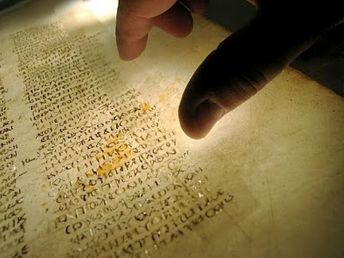
Has God Preserved His Word?
(Part 1)

Slide 2
The Doctrine of the Bible is the most Important of all Bible Doctrines. (Bibliology)
If the Bible that we hold in our hands is not the inspired, infallible, inerrant, authoritative, eternal Word of the living God then man does not possess the Word of God.
If we do not possess the very Words of God then we cannot say “Thus saith the Lord…” (3,800 times) “The word of the Lord” (331 times) “The word of God” (109 times)

Slide 3
If the Bible is not the Word of God then we cannot trust any of its teachings (Doctrines)
  II Tim. 3:16 “All Scripture is given by inspiration of God and is profitable for doctrine…”
  Reveals the revelation of God to man
  Reveals God’s lessons for mankind/how to live life
  Reveals God the creator of all things
  Reveals God’s relationship to His creation
  Reveals the character of God – Who God is
  Reveals God’s purpose for mankind - Creation/Salvation
  Reveals everything God wants us to know about life and eternity

Slide 4
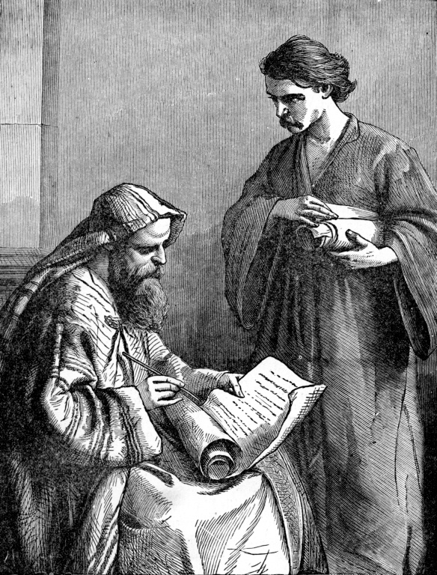
“Study to show thyself approved unto God…Meditate upon these things…give attendance to reading, to exhortation, to doctrine…take heed unto thyself and unto the doctrine…”

Slide 5
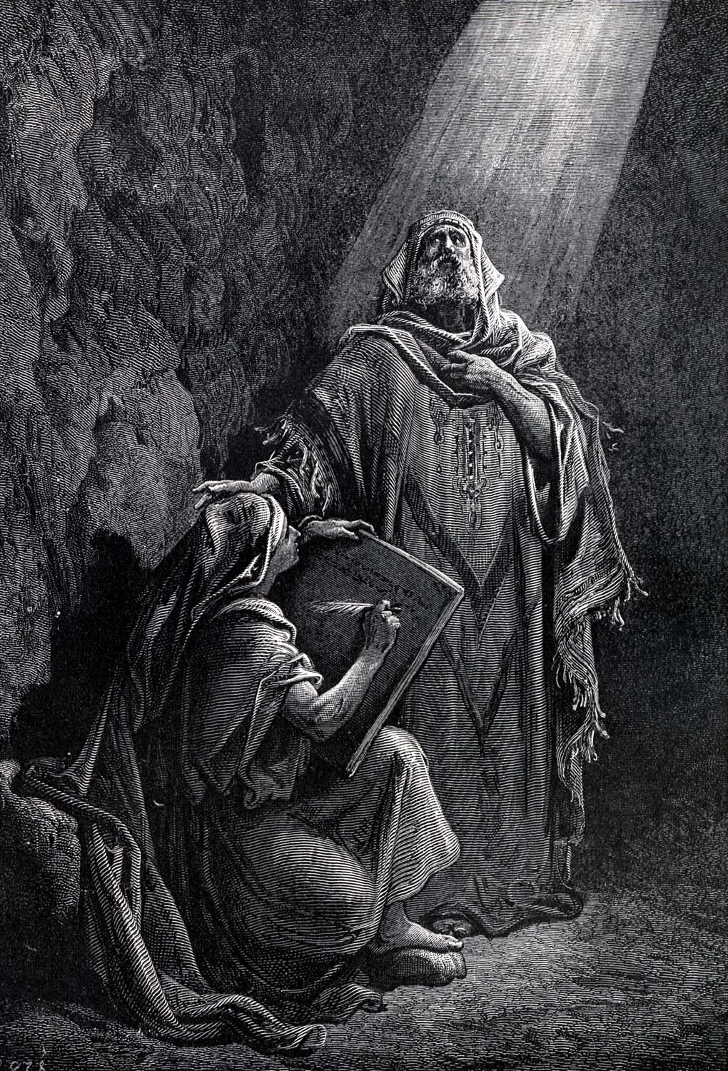
“Thy words were found, and I did eat them; and thy word was unto me the joy and rejoicing of mine heart…”

Slide 6

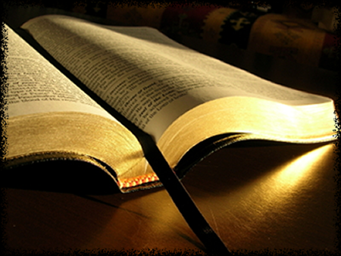
God’s Commandments
Concerning His Word
Read it - Neh. 8:8
Study it – II Tim. 2:15
Memorize it – Jer. 15:16
Hide it in our hearts - Psalm 119:11
Meditate upon it – Josh. 1:8
Believe it – John 5:47
Obey it teachings – I Sam. 12:15
Preach it – II Tim. 4:2
Proclaim it to others – Jer. 11:6

Slide 7

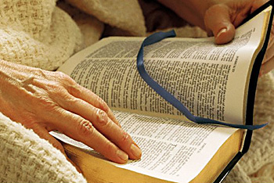
Overview of Bible Doctrines
Doctrine of Scripture (Bibliology)
Doctrine of God (Theology)
Doctrine of Jesus Christ (Christology)
Doctrine of the Hoy Spirit (Pneumatology)
Doctrine of man (Anthropology)
Doctrine of sin (Hamartiology)
Doctrine of salvation (Soteriology)
Doctrine of the church (Ecclesiology)
Doctrine of angels (Angelology)
Doctrine of prophecy (Eschatology)

Slide 8
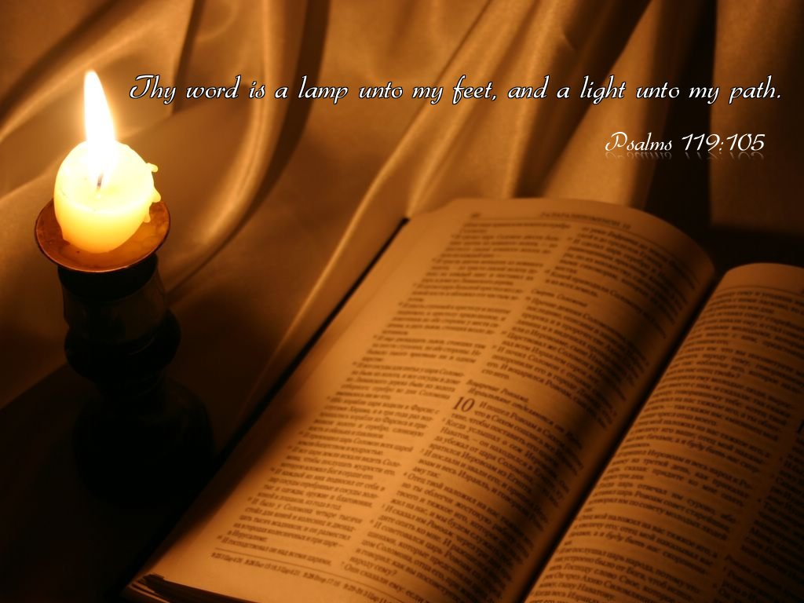
The Bible clarifies for us what we ought to believe and why we ought to believe it.

Slide 9
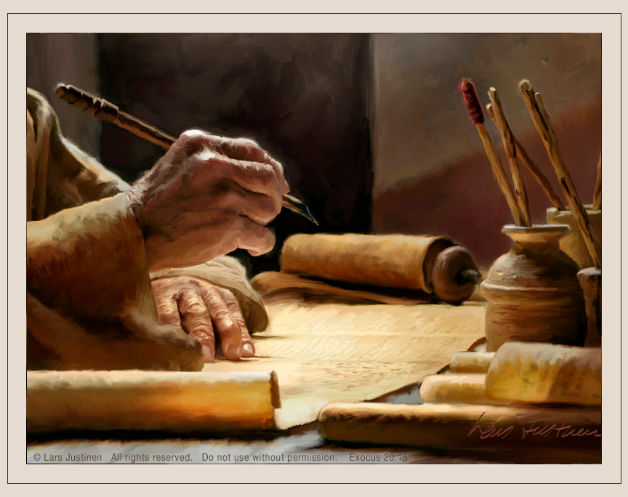
The Bible is the only book on earth written by God
“Holy men of God spake as they were moved by the Holy Spirit…The Lord gave the word and great was the company of those that published it…”

Slide 10
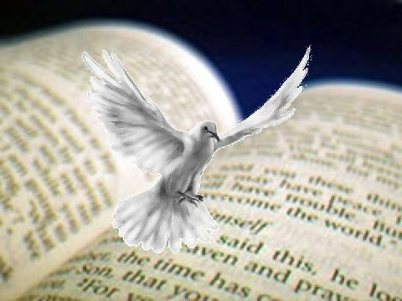
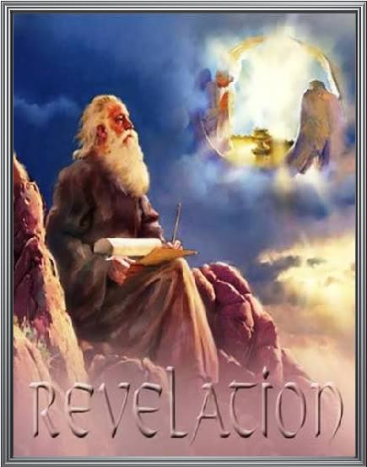
God breathed out His words to men over a period of about 1500 year.
Approximately 40 specially chosen and prepared men of God who wrote down the Holy Scriptures in both the Old and New Testaments.
39 books in the Old Testament
27 books in the New Testament

Slide 11
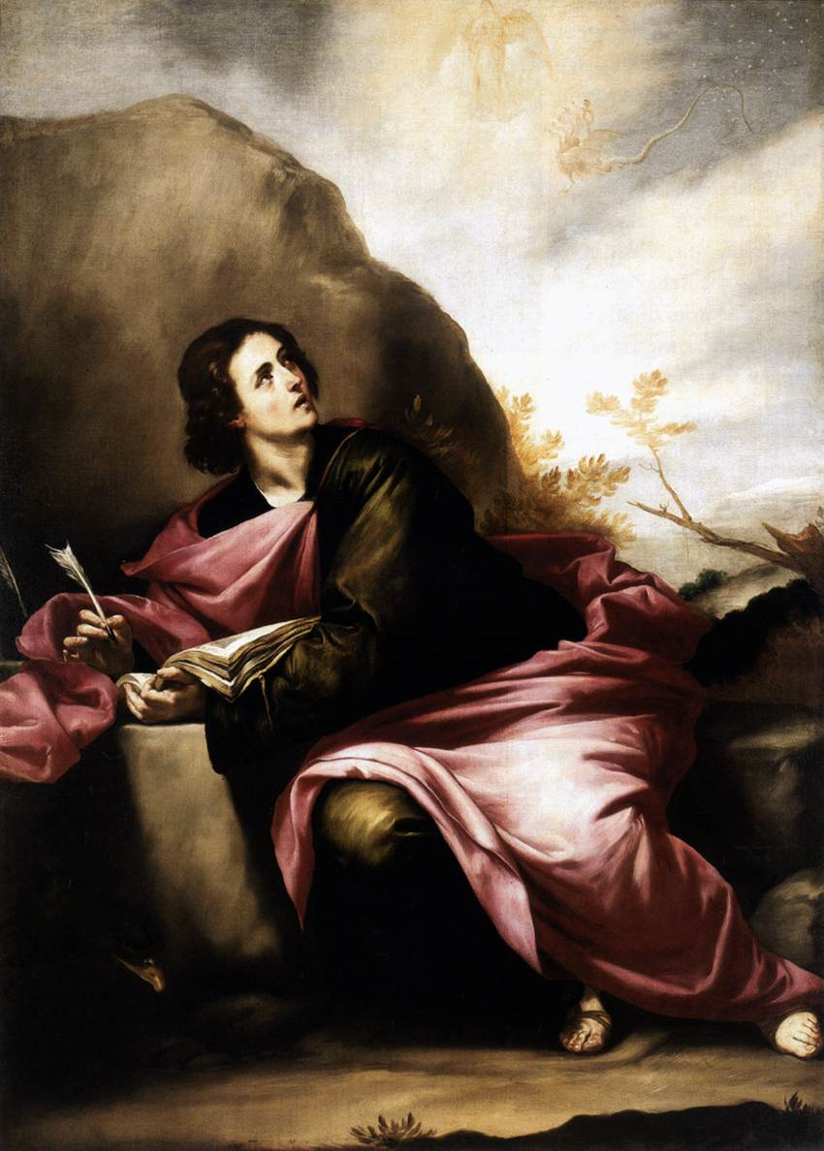
How Did God Write the Bible?
  Revelation – (Rev. 1:1) (From God to Man)
Note: Ten times in the New Testament the Bible is referred as “The revelation of God…”
“Revelation of the mysteries of God…Revelation of the Lord Jesus Christ…Revelation of the will of God…Revelation of the knowledge of God…Revelation of the righteousness judgments of God…”

Slide 12
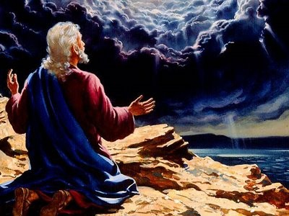
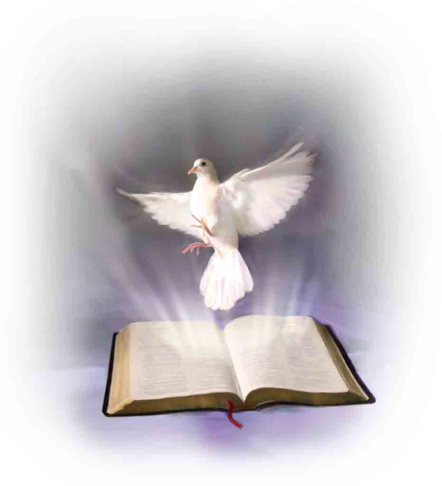
Paul the penman of 14 of the 27
New Testament books said
“But I certify you, brethren, that the gospel which was preached of me is not after man. For I neither received it of man, neither was I taught it, but by the revelation of Jesus Christ…” (Gal. 1:12-13)
“How that by revelation he made known unto me the mystery. Whereby when ye read, ye may understand my knowledge in the mystery of Christ. Which in other ages was not made known unto the sons of men, as it is now revealed unto his holy apostles and prophets by the Spirit…” (Eph. 3:3-4)

Slide 13
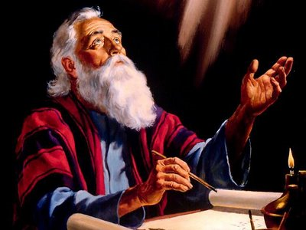
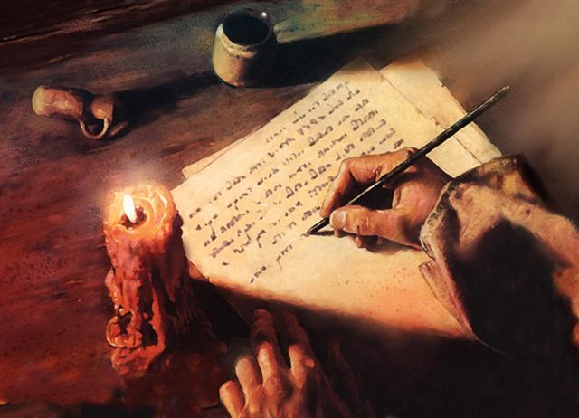
Inspiration – (From man to paper)
II Tim. 3:16 “All scripture is given by inspiration of God.”
Job 32:8 “The inspiration of the Almighty giveth them understanding.”

Slide 14
We believe in the plenary inspiration of the Bible –
Plenary inspiration = Full/Complete “All the Bible is inspired, every word is breathed out by God…” (From Gen. 1:1 – Rev. 22:21)
Jesus said - “Man shall not live by bread alone, but by every word that proceedeth out of the mouth of God…”
Solomon said – “Every word of God is pure…” (Prov. 30:5)

Slide 15
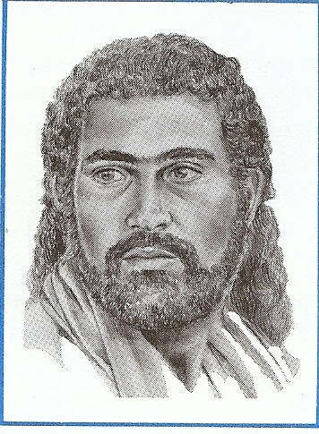
Referring to the writings of David the Apostle Luke said – “This Scripture (writings) which the Holy Ghost by the mouth of David spake…”

Slide 16
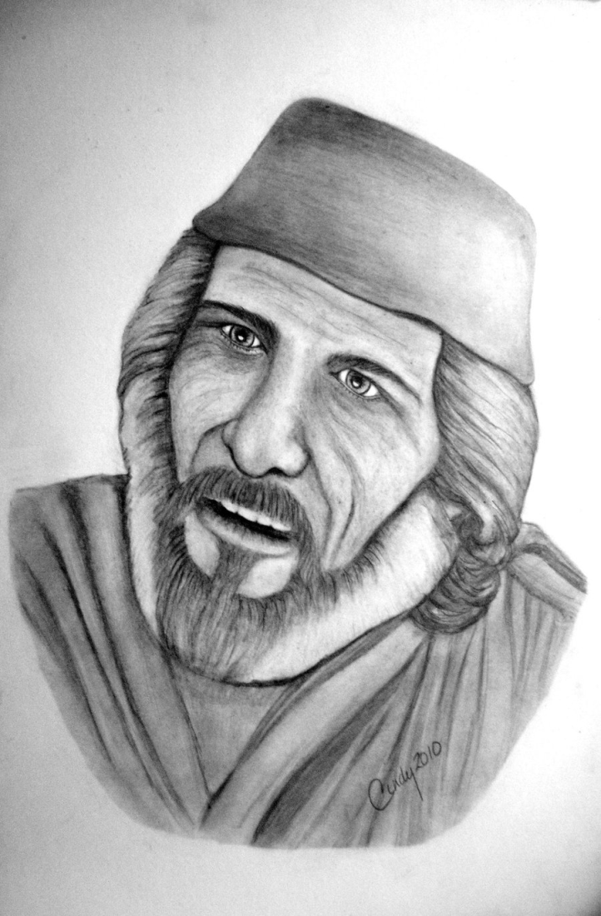
Samuel
“The Spirit of the Lord spake by me, and his word was in my tongue…”

Slide 17
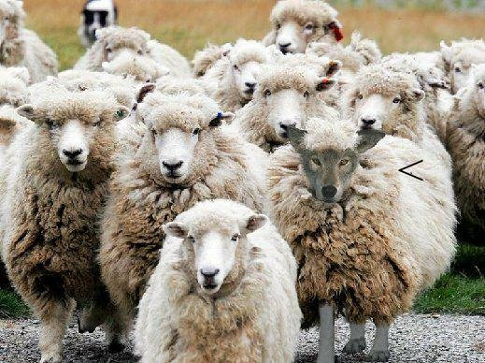
We do not believe in Partial inspiration –
False teaching – II Peter 3:15-17 “Our beloved brother Paul also according to the wisdom given unto him hath written unto you; As also in all his epistles, speaking in them of these things; in which are some things hard to be understood, which they that are unlearned and unstable wrest, as they do also the other scriptures, unto their own destruction. Ye therefore, beloved, seeing ye know these things before, beware lest ye also, being led away with the error of the wicked, fall from your own stedfastness.”
“All scripture (every word) is given by inspiration of God…”

Slide 18
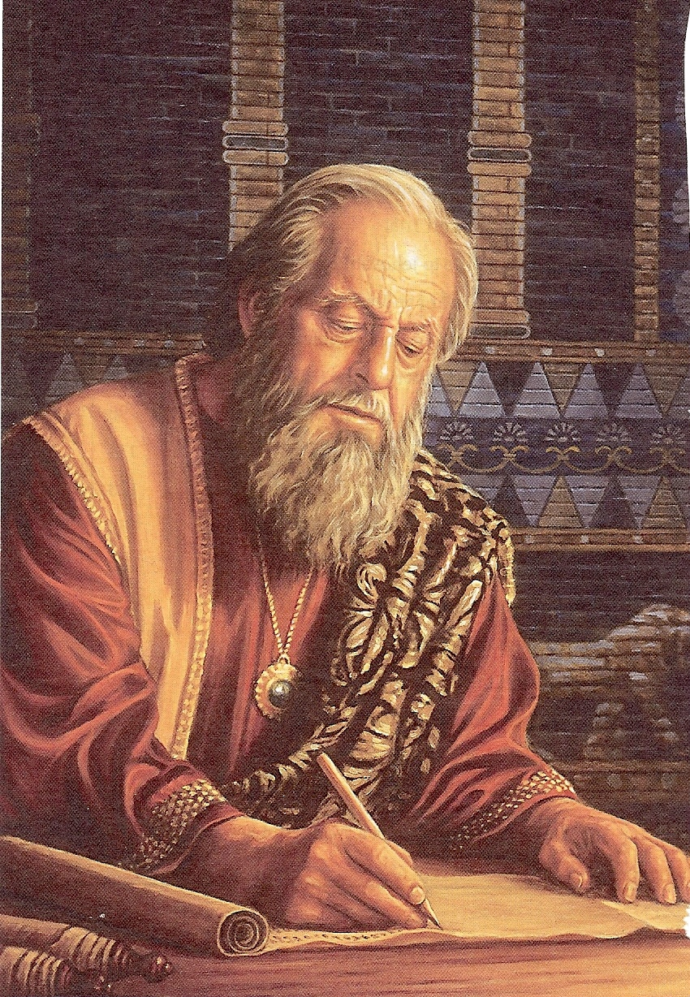
We believe in the verbal inspiration of the Bible -
Verbal inspiration has to do with the actual formation and use of the words themselves.
The “Verbal” concept of inspiration contends that the Spirit of God guided the holy writers to record the very words of God.
God used the background, personalities, talents of the holy writers.
Divine supervision was present so that the exact messages that God intended was recorded in the Scriptures.

Slide 19
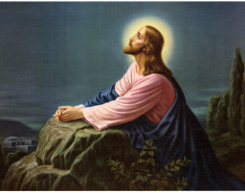
Jesus
“For I have given unto them thy words which thou gavest me; and they have received them…It is the spirit that quickeneth; the words that I speak unto you, they are spirit and they
are life…”

Slide 20
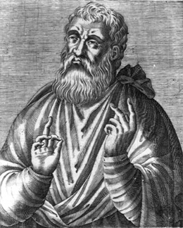
“I am writing to persuade you that you have not understood anything of the Scriptures, I will remind you that the Psalms were dictated to David by the Holy Spirit…”
Justin Martyr

Slide 21
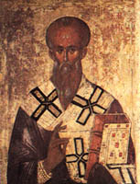
Clement of Rome
“Take up the epistle of the blessed Apostle Paul. What did he write to you at the time when the gospel first began to be preached? Truly, under the inspiration of the Spirit he wrote to you…”

Slide 22
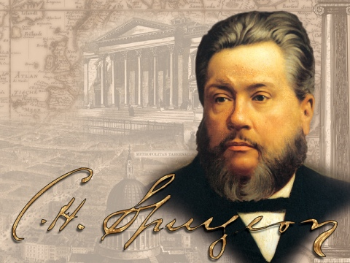
Spurgeon
“The Bible is the writing of the living God: Each letter was penned with an Almighty finger; each word in it dropped from the everlasting lips; each sentence was dictated by the Holy Spirit…”

Slide 23
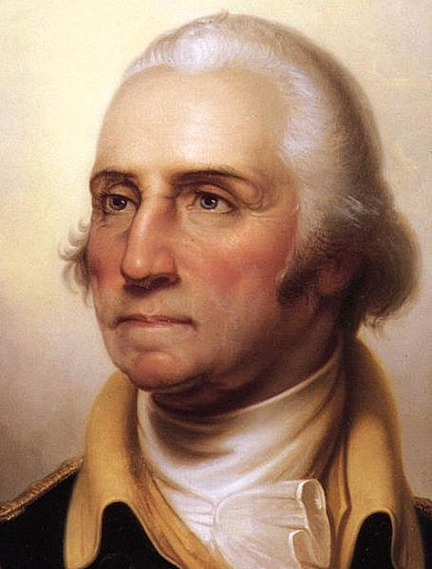
George Washington
“It is impossible to rightly govern the world without God and the Bible…”

Slide 24
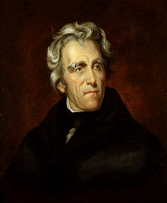
Andrew Jackson
“That book, sir is the rock on which our republic rest…”

Slide 25
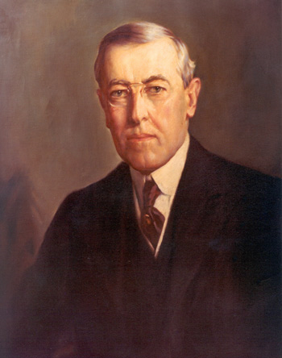
Woodrow Wilson
“The Bible is the word of life. It is a picture of the human heart displayed for all ages and all sorts of conditions of men. I feel sorry for the men who do not read the Bible every day. I wonder why they deprive themselves of its strength and pleasures.”

Slide 26
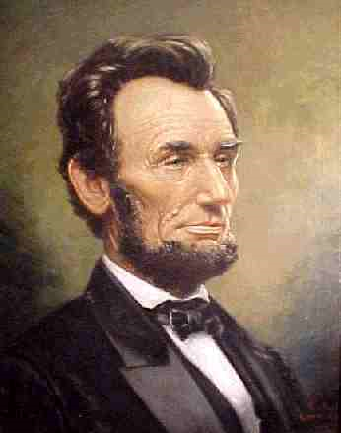
Abraham Lincoln
“I believe the Bible is the best gift God has ever given to man. All the good from the Savior of the world is communicated to us through this book…”

Slide 27
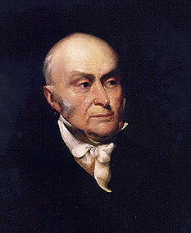
John Quincy Adams
“So great is my veneration for the Bible that the earlier my children begin to read it the more confident will be my hope that they will prove useful citizens of their country and respectable members of society. I have for many years made it a practice to read through the Bible once every year…”

Slide 28
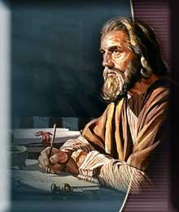
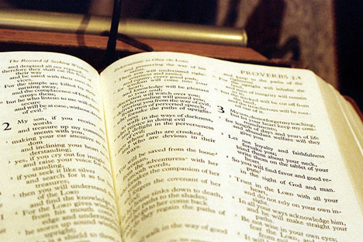
The word “Scripture” means – The actual writings of God.
We believe in the word-for-word inspiration of Scripture.
We do not believe that God simply inspired “thoughts” or “concepts” –

Slide 29
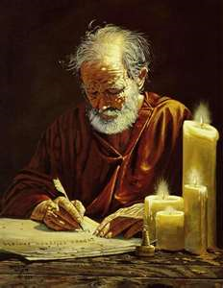
Paul
“Which things also we speak (Scripture) not in the words which man’s wisdom teacheth, but (the words) which the Holy Ghost teacheth…”

Slide 30
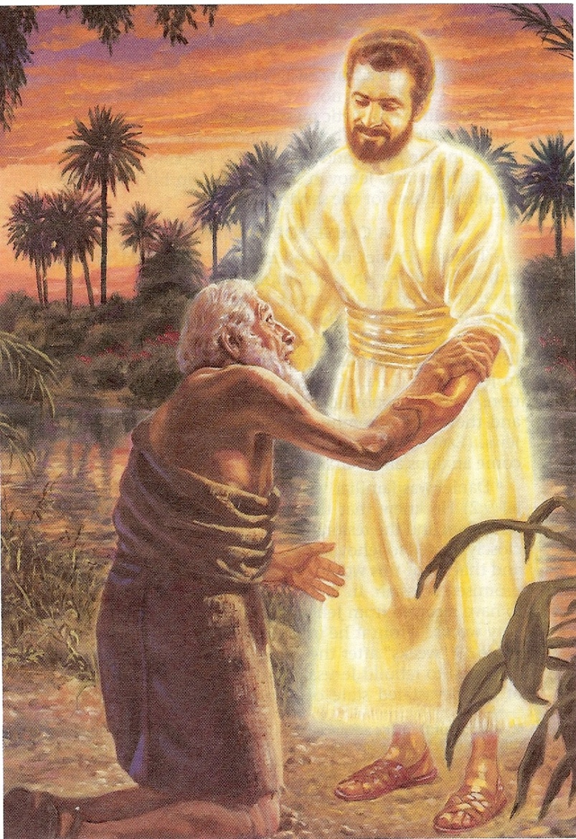
Daniel
“I Daniel was grieved in my spirit in the midst of my body, and the visions of my head troubled me. I came near unto one of them (angel) that stood by, and asked him the truth of all this. So he told me, and made me know the interpretation of the things…I was astonished at the vision, but none understood it…And I heard but I understood not: Then said I O my Lord what shall be the end of these things? And he said, go thy way Daniel for the words are closed up and sealed till the time of the end…”

Slide 31
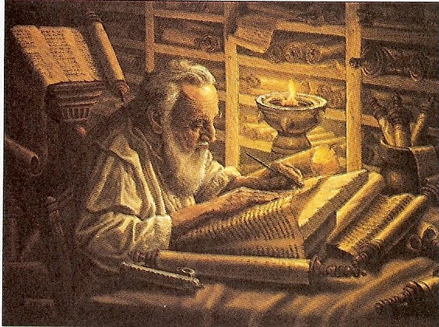
How could Daniel put the thoughts or concepts of God into his own words if he did not understand what he was writing?
God had to dictate to him every word!!!

Slide 32
Jesus – “Sanctify them through thy truth: thy word is truth…”
Isaiah said – “His word shall not return unto Him void, but it shall accomplished that which He pleases, and it shall prosper in the thing whereto he sent it…”
Jeremiah said – “Is not my word like a fire? Saith the Lord; and like a hammer that breaketh the rock in pieces…”
David said – “How shall a young man cleanse his way? By taking heed thereto according to thy word…”
Peter said – “As new born babes, desire the sincere milk of the word that ye may grow thereby…”
Hebrews says – “For the word of God is quick and powerful and sharper than any twoedged sword…”

Slide 33
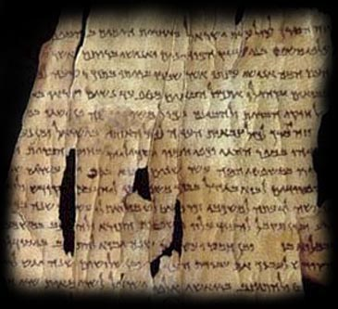
“All (plenary) Scripture (verbal) is given by inspiration of God…”

Slide 34
Is inspiration still going on today?
“Thou shalt not add thereto nor diminish from it…add thou not unto his words…if any man shall add unto these things, God shall add unto him the plagues that are written in this book. And if any man shall tak away from the words of the book of this prophecy, God shall take away his part out of the book of life and out of the holy city from the things which are written in this book…”

Slide 35
Liberals – take away from the Word of God
Legalist – add to the Word of God
Literalist – accept the Word of God
Satan’s attack has always been and always will be against the Word of God. He wants us to believe that we do not possess the very words of God – “Yea hath God said…ye shall not surely die…”
We have the Word of God – “More sure word of prophecy” (Read II Peter 1:16-21)

Slide 36
God has promised to preserve
His word for all generations?
What does the Bible say about preservation – Ps. 12:6-7; 33:11; 100:5; 119:89; Isa. 40:8 I Peter 1:25
“The words of the Lord are pure words: as silver tried in a furnace of earth, purified seven times. Thou shalt keep them, O Lord, thou shalt preserve them from this generation forever…The counsel of the Lord standeth forever, the thoughts of his heart to all generations…His truth endureth to all generations…forever, O Lord, thy word is settled in heaven, thy faithfulness is unto all generations…The grass withereth, the flower fadeth, but the word of our God shall stand forever…but the word of the Lord endureth forever…”

Slide 37
What did Jesus say about inspiration – John 17:17 ; John 5:46-47; Luke 16:31; Matt. 4:4
“Thy word is truth…For had ye believed Moses ye would have believed me: for he wrote of me. But if ye believe not his writings, how shall ye believe my words…And he said unto him, if they hear not Moses and the prophets, neither will they be persuaded, though one rose from the dead…Man shall not live by bread alone, but by every word that proceedeth out of the mouth of God.”

Slide 38
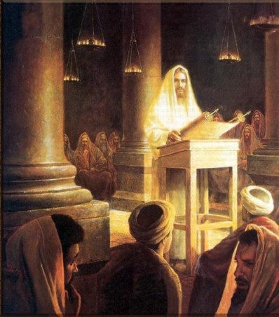
Over and over again in the teaching and preaching ministry of the Lord Jesus he quoted from the Old Testament Scriptures – “It is written”
35 direct Old Testament references quoted by Christ in his teaching and preaching.

Slide 39
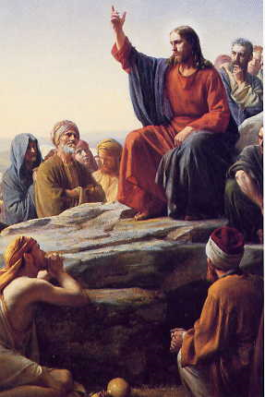
Not only did Jesus quote the Old Testament Scriptures he often referred to the stories of the Old Testament as actual events that happened –
Creation, marriage, flood, destruction of Sodom, Lots wife, Jonah, repentance of the city of Nineveh, healing of Naaman’s leprosy, the brazen serpent etc.

Slide 40
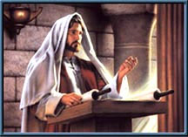
What did Jesus say about preservation?
Matt. 4:4; 5:18, 24:35; Luke 16:17; John 10:35
“For verily I say unto you. Till heaven and earth pass, one jot or one tittle shall in no wise pass from the law, till all be fulfilled…Heaven and earth shall pass away but my words shall not pass away…It is easier for heaven and earth to pass, than one tittle of the law to fail...The scriptures cannot be broken…”

Slide 41
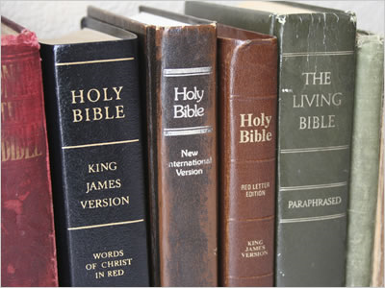
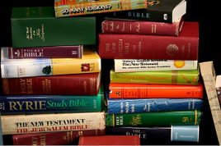
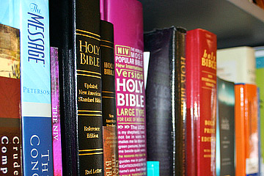
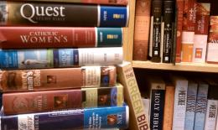
In What Version Has
God Preserved His Word?
450 Versions of the English Bible

