Slide 1
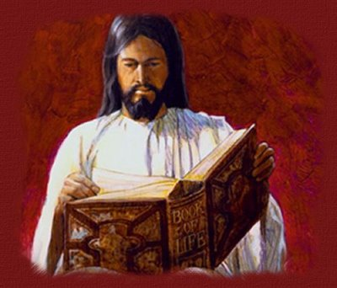
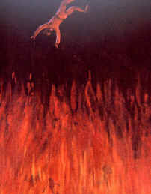
“And whosoever was not found written in the book of life was cast into the lake of fire.” Rev. 20:15

Slide 2
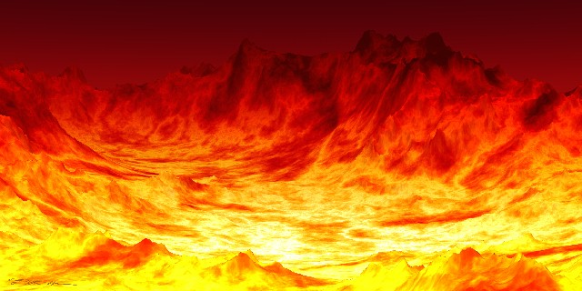
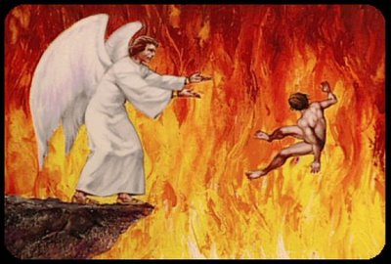

Slide 3
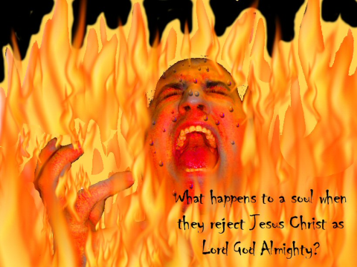

Slide 4
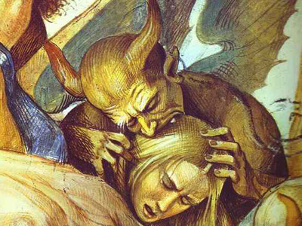
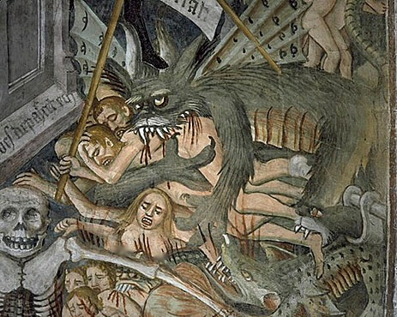
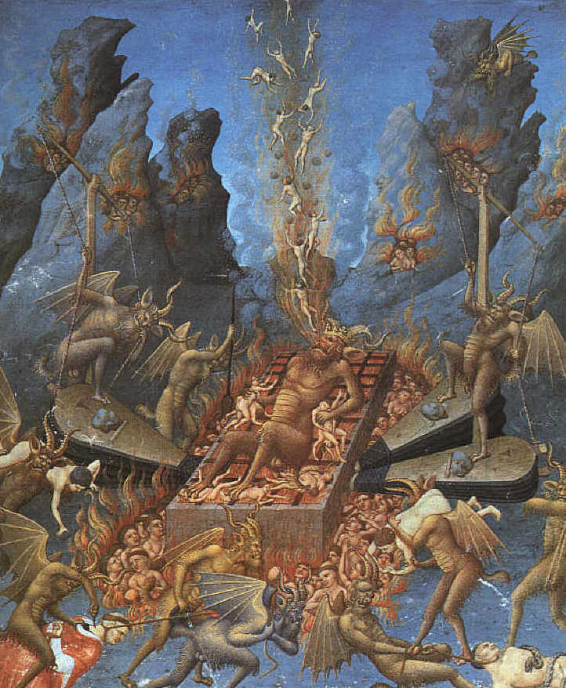
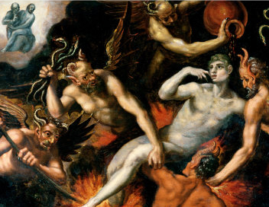
“For a fire is kindled in mine anger, and shall burn unto the lowest hell…They shall be burnt with hunger, and devoured with burning heat, and with bitter destruction: I will also send the teeth of beasts upon them, with the poison of serpents…” (Deut. 32)

Slide 5
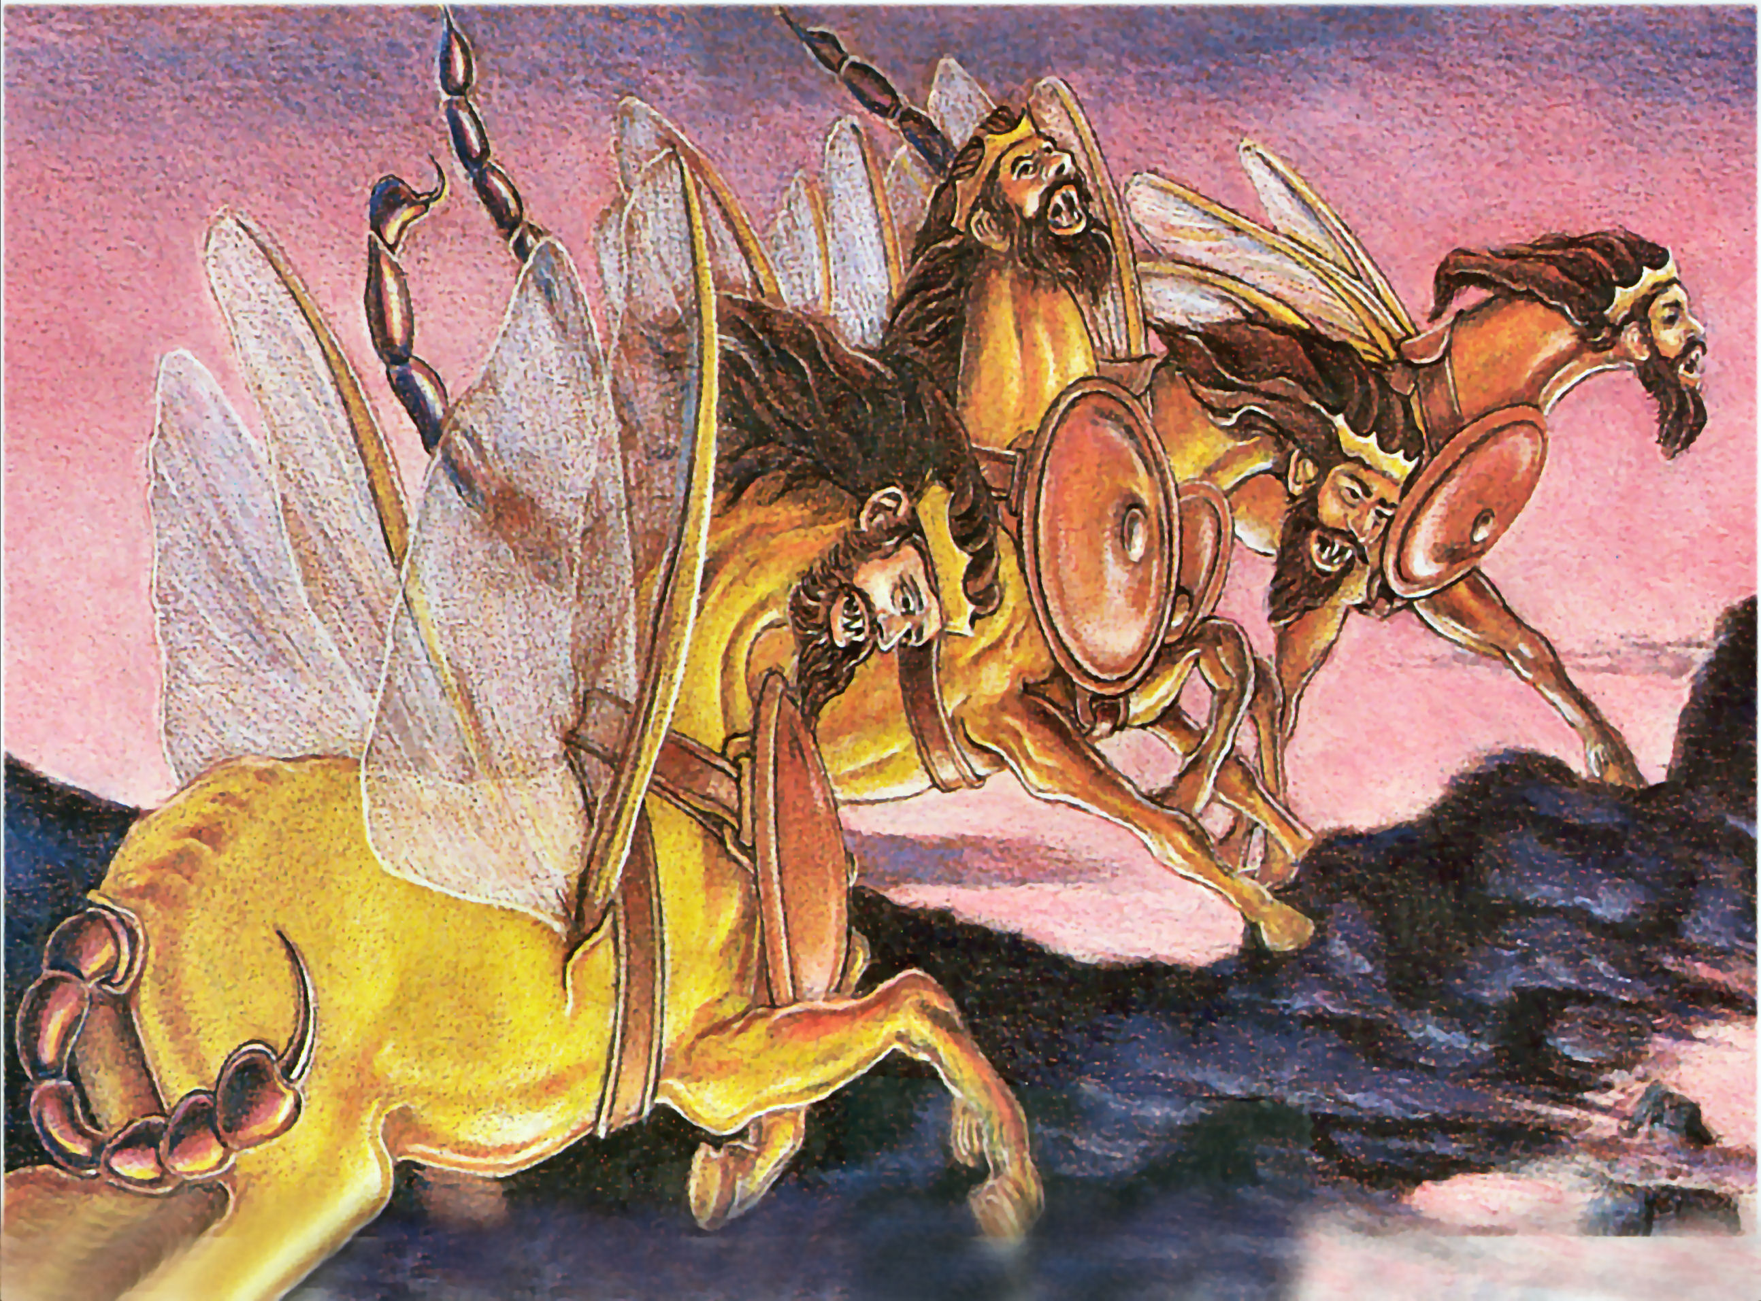

Slide 6
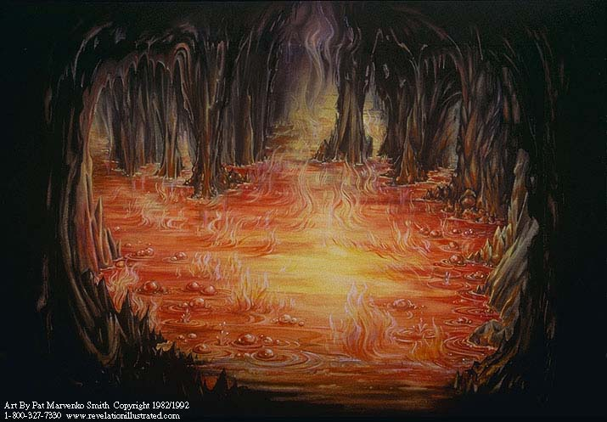

“And they shall be gathered together, as prisoners are gathered in the pit, and shall be shut up in the prison…” (Isa. 24:22)

Slide 7
Sin

Slide 8
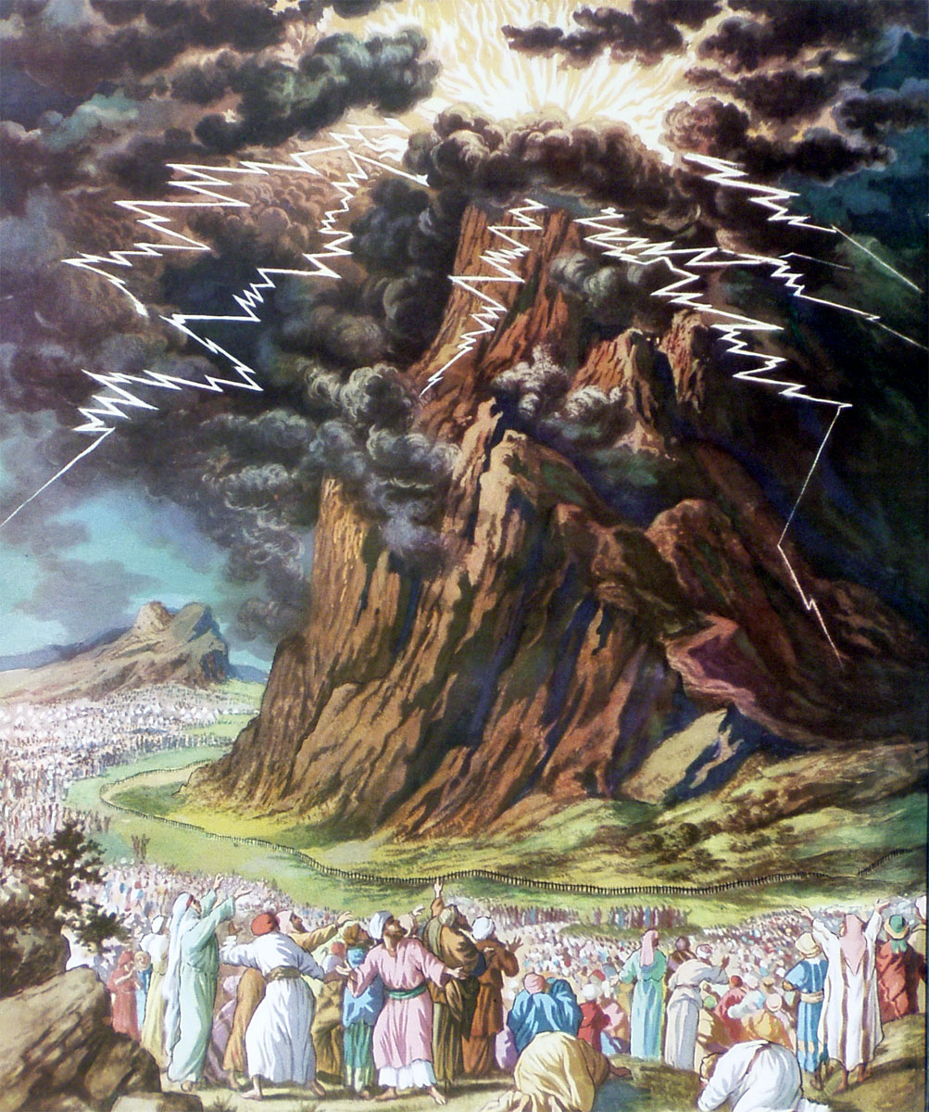

Slide 9
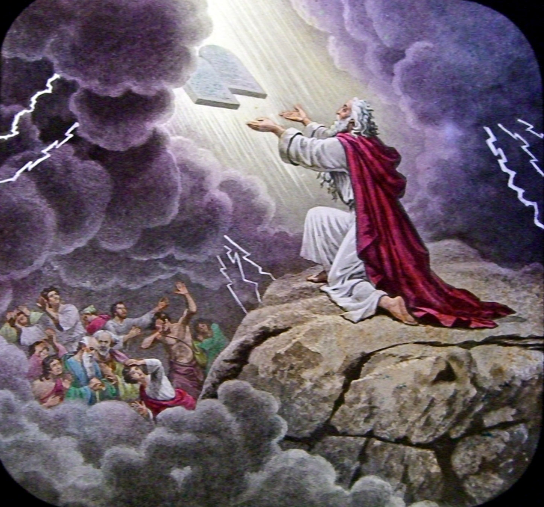

Slide 10
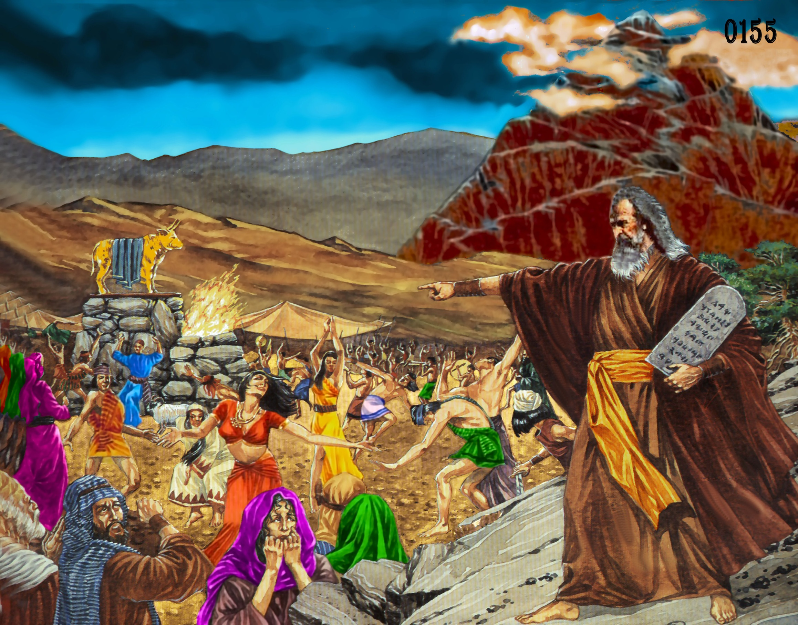

Slide 11
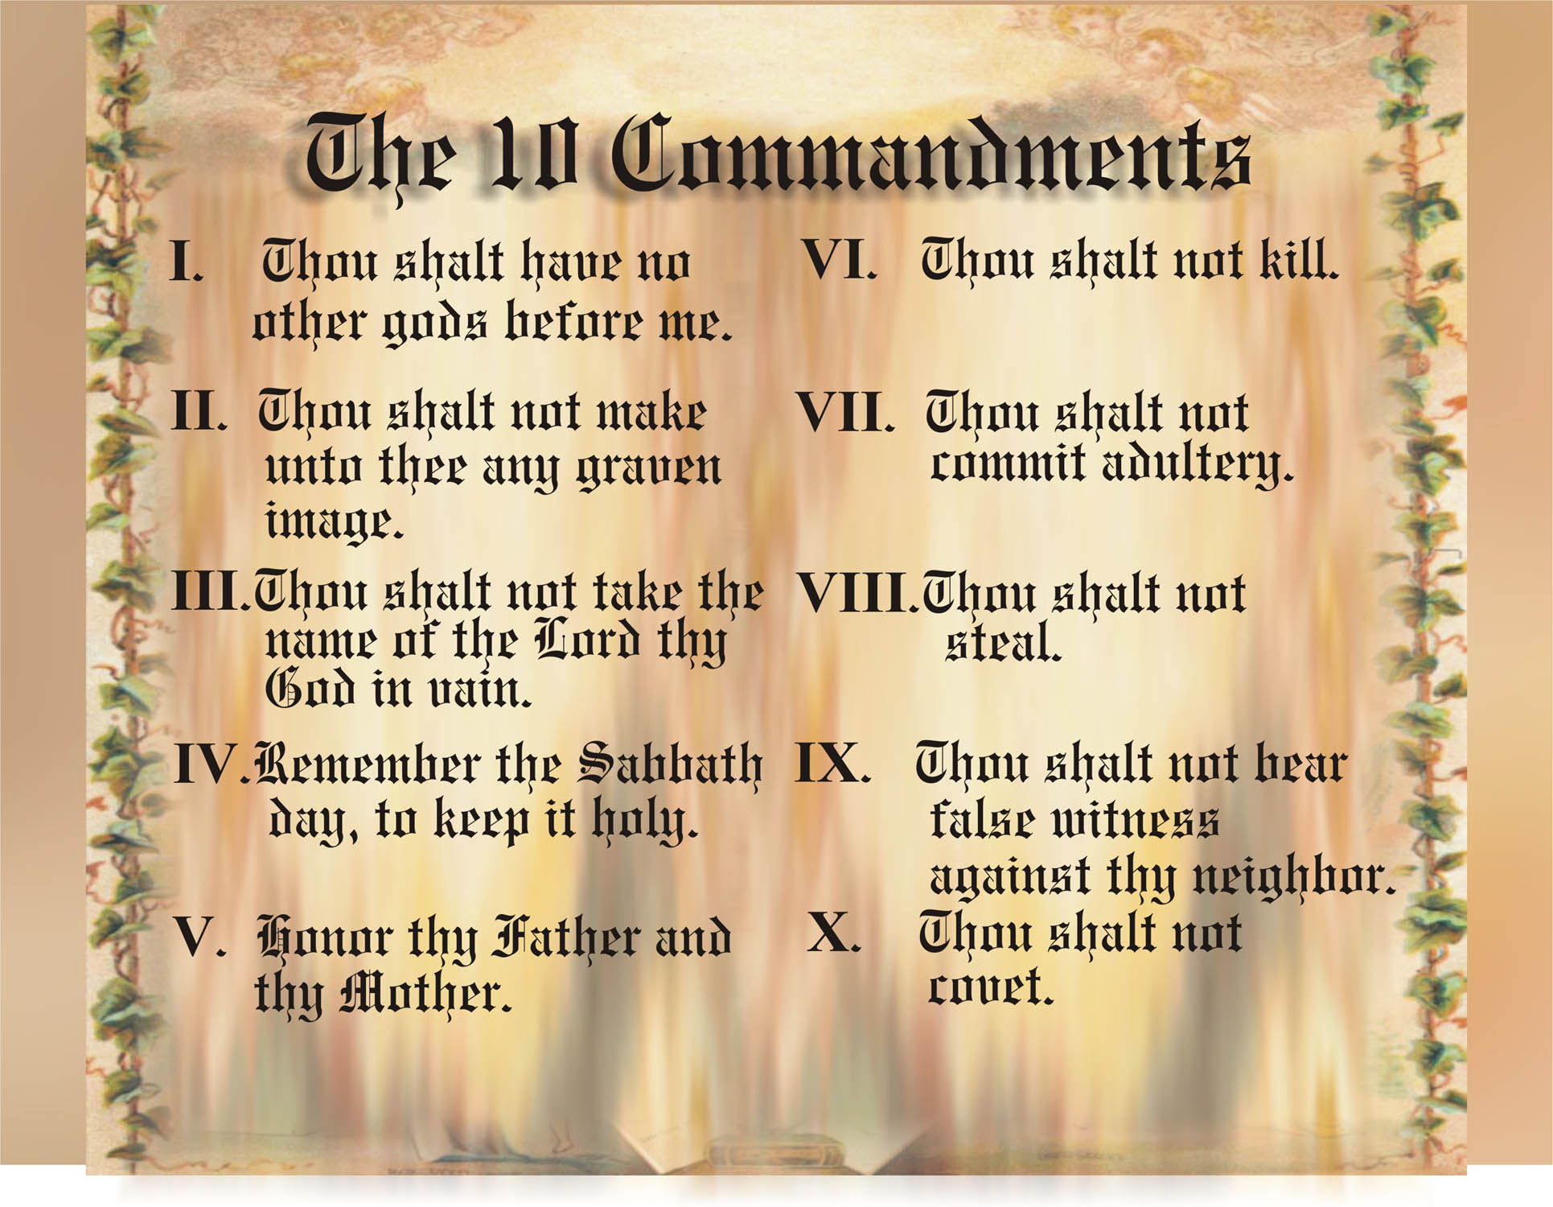

Slide 12
I John 3:4 “Whosoever committeth sin transgresseth also the law: for sin is the transgression of the law.”
Romans 3:19 “Now we know that what things soever the law saith, it saith to them who are under the law: that every mouth may be stopped, and all the world may become guilty before God.”

Slide 13
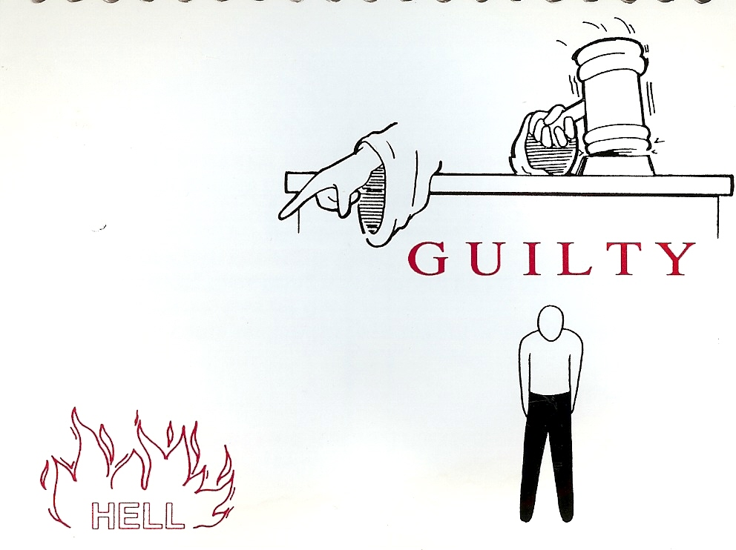
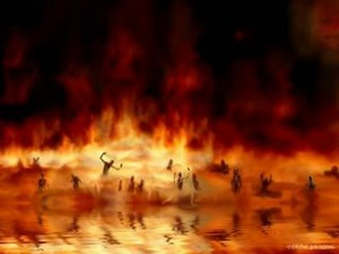

Slide 14


Slide 15
“As it is written, There is none righteous, no, not one: There is none that understandeth, there is none that seeketh after God.
They are all gone out of the way, they are together become unprofitable; there is none that doeth good, no, not one.”
(Romans 3:10-12)

Slide 16
“And there shall in no wise enter into it (Heaven) any thing that defileth, neither whatsoever worketh abomination, or maketh a lie: but they which are written in the Lamb's book of life.”
(Revelation 21:27)

Slide 17


Slide 18
“God who hath reconciled us to himself by Jesus Christ, and hath given to us the ministry of reconciliation. Now then we are ambassadors for Christ, as though God did beseech you by us: we pray you in Christ's stead, be ye reconciled to God.” (II Cor. 5:18, 20)

Slide 19

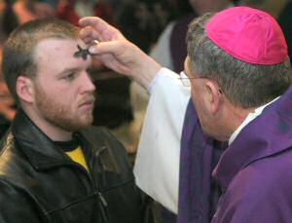
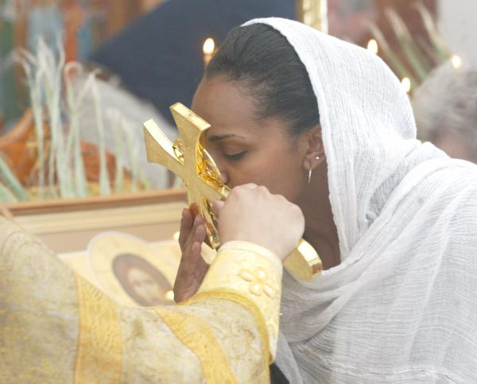
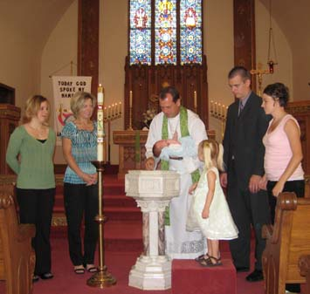

Slide 20
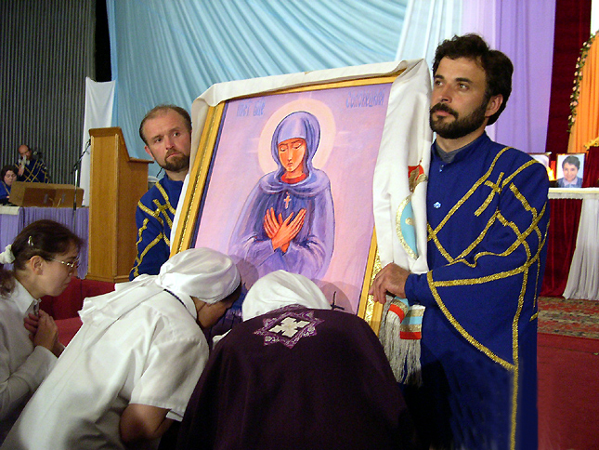

Slide 21
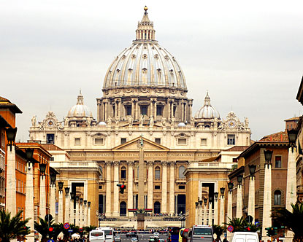
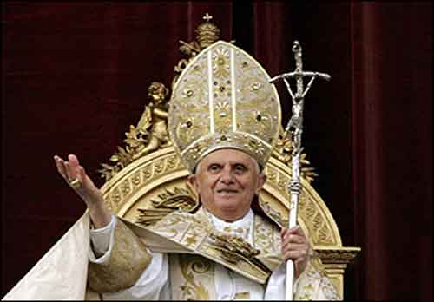

Slide 22
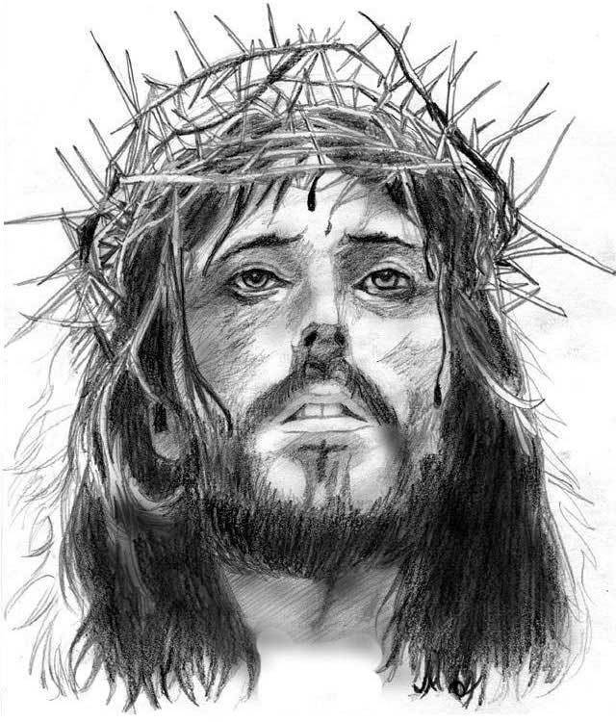
“Jesus saith unto him, I am the way, the truth, and the life: no man cometh unto the Father, but by me.” John 14:6
“Neither is there salvation in any other: for there is none other name under heaven given among men, whereby we must be saved.”
Acts 4:12

Slide 23
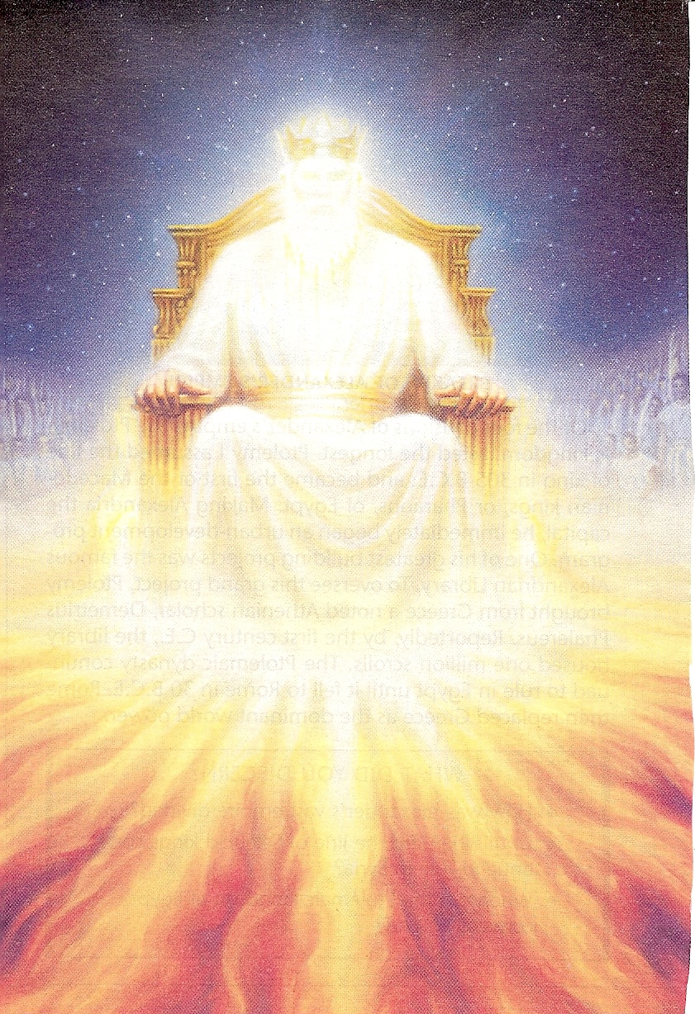
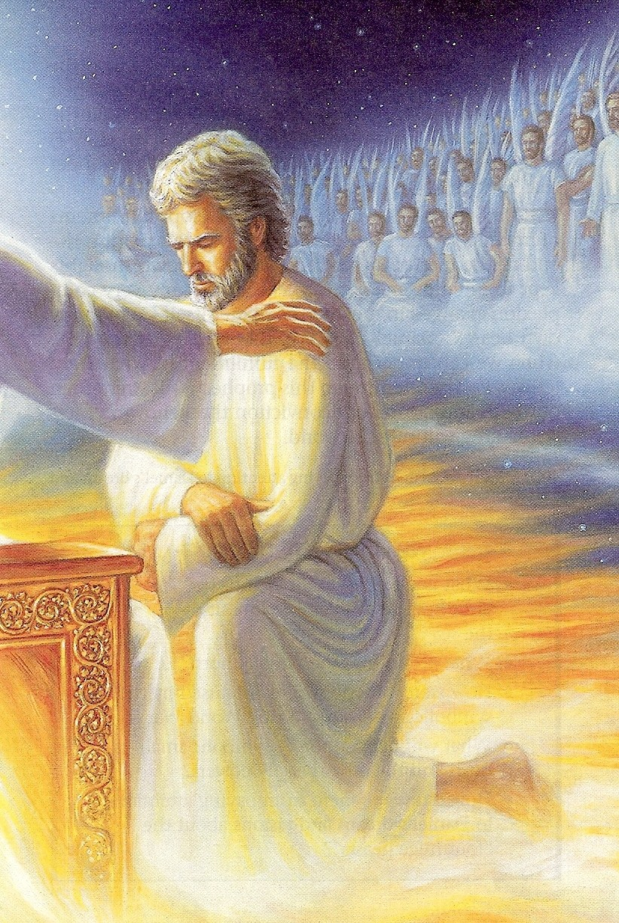
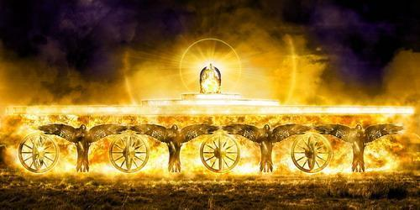
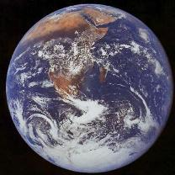

Slide 24
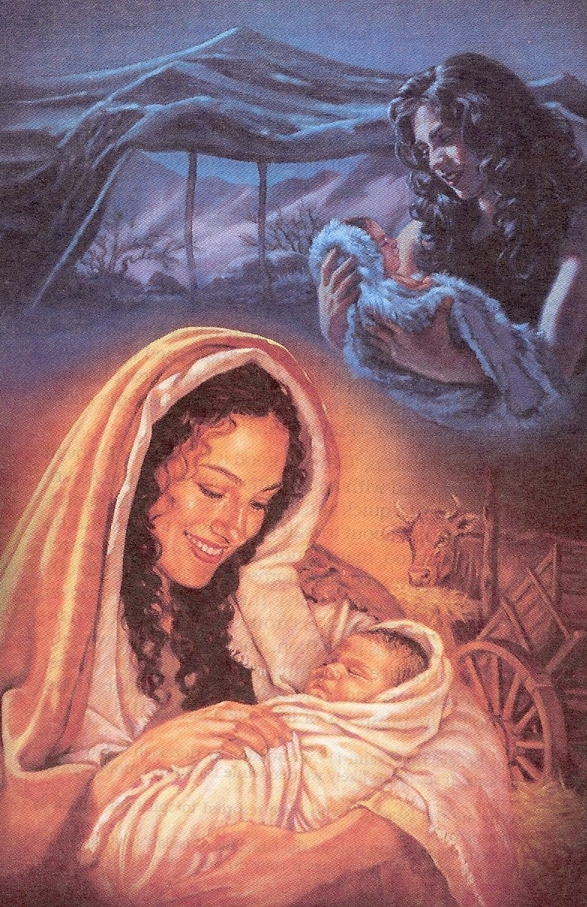

Slide 25
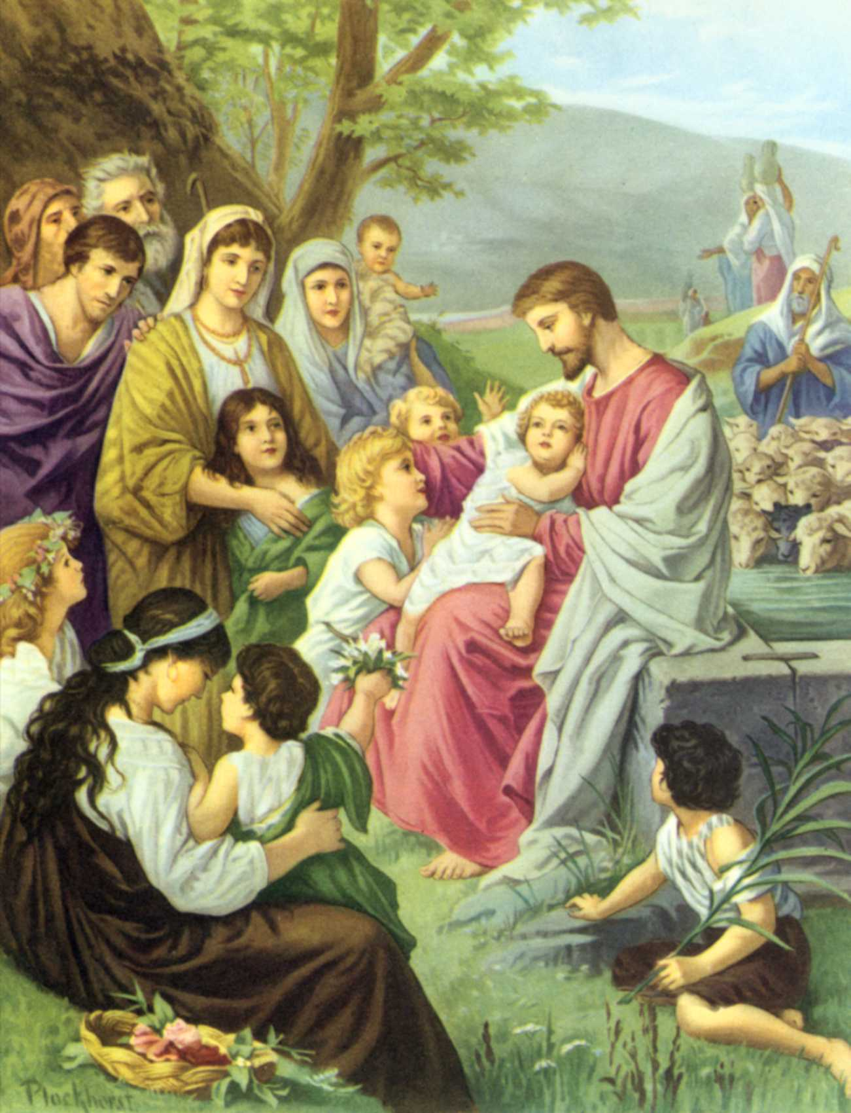

Slide 26
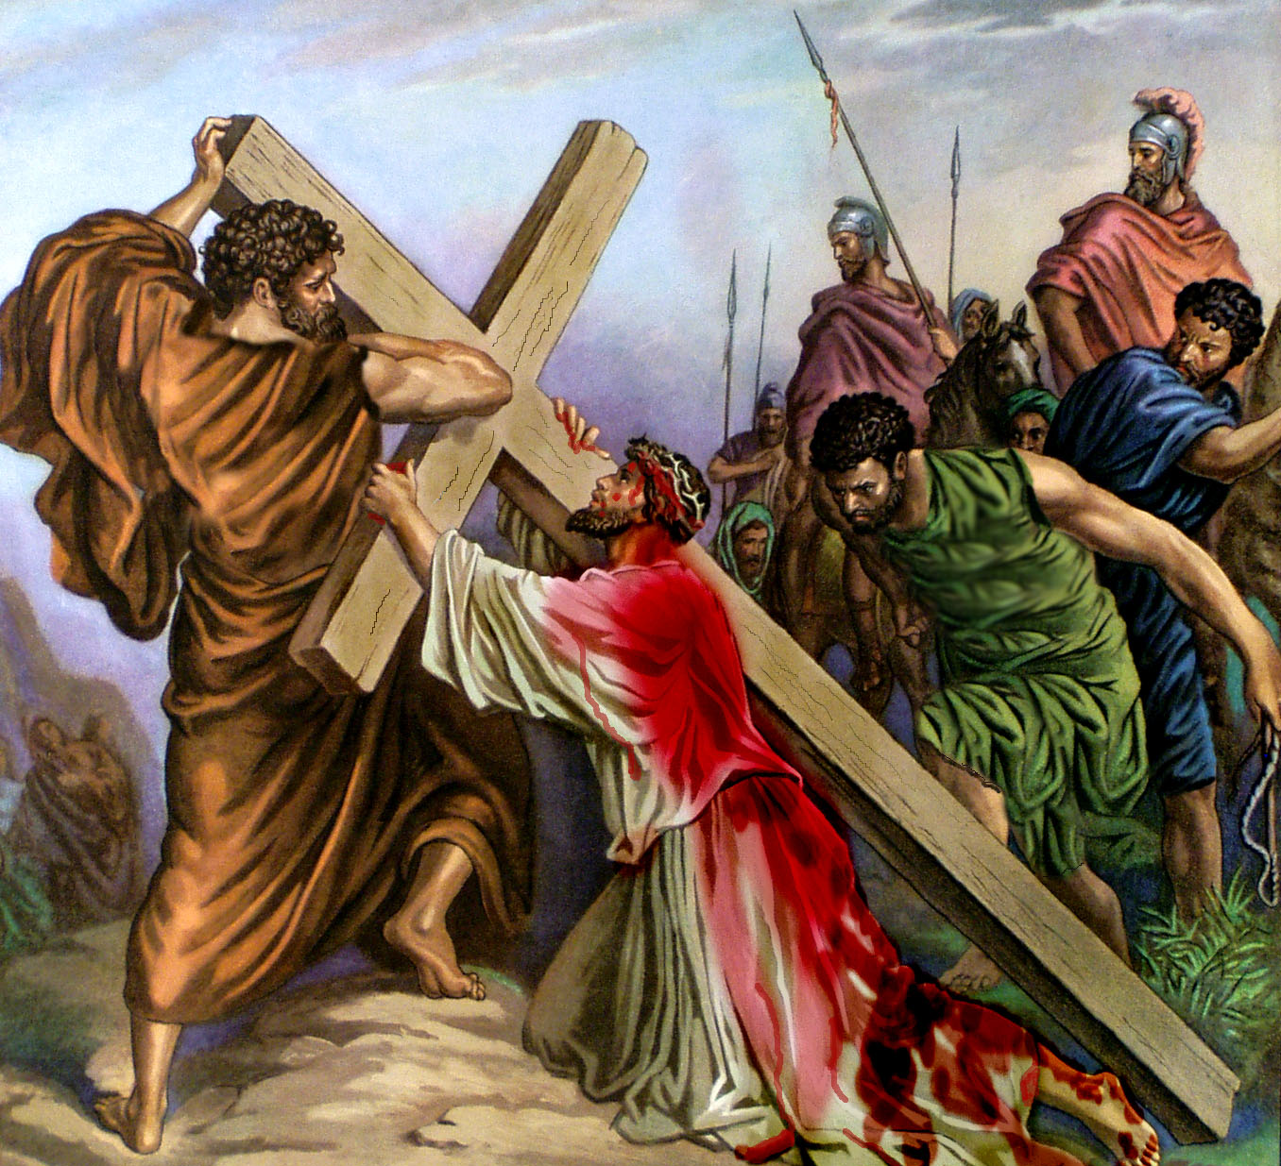

Slide 27
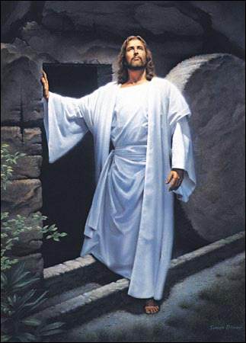

Slide 28
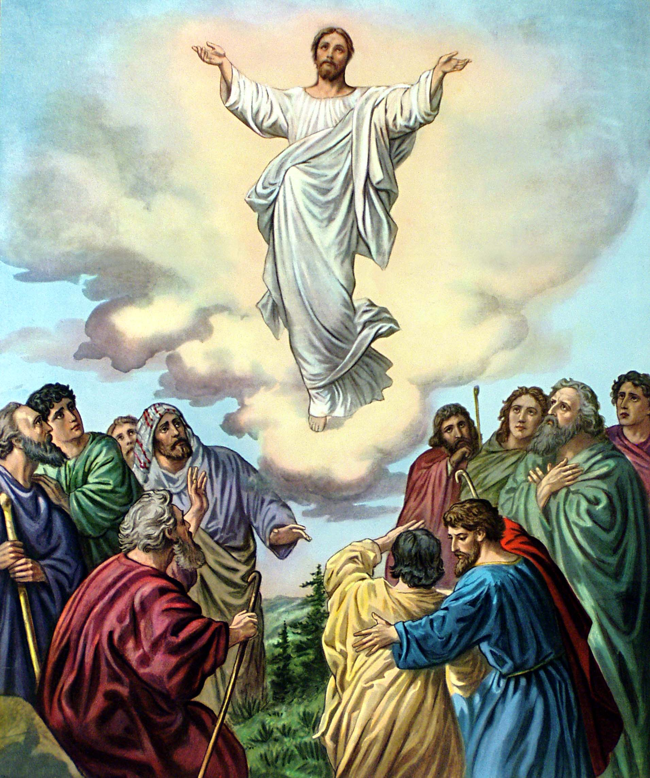

Slide 29
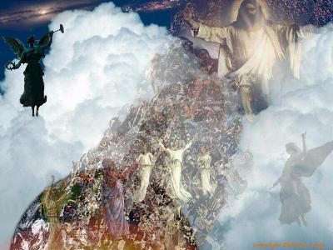

Slide 30
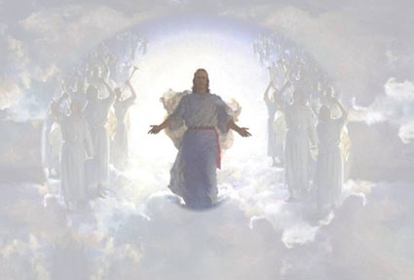
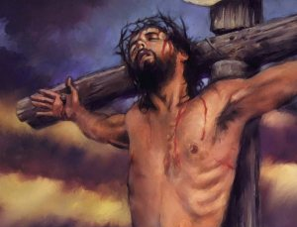
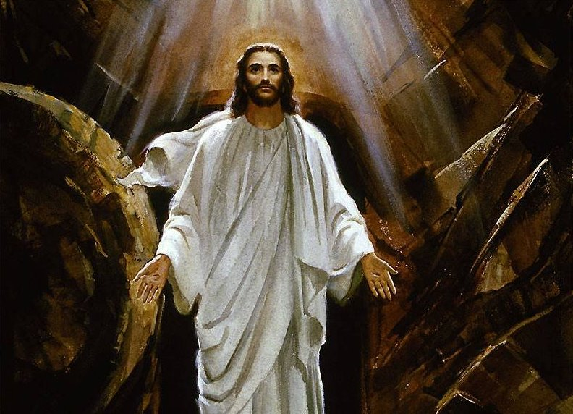
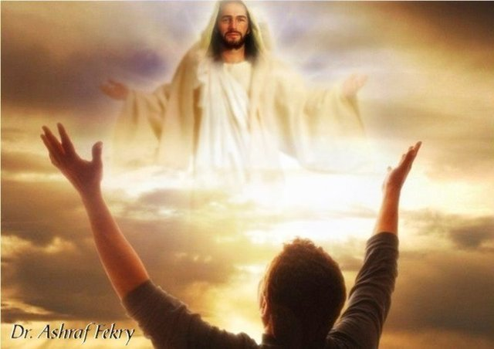

Slide 31
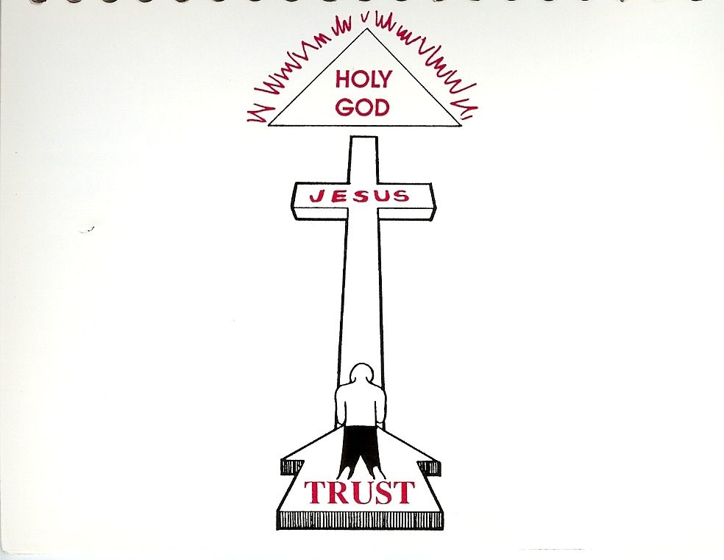
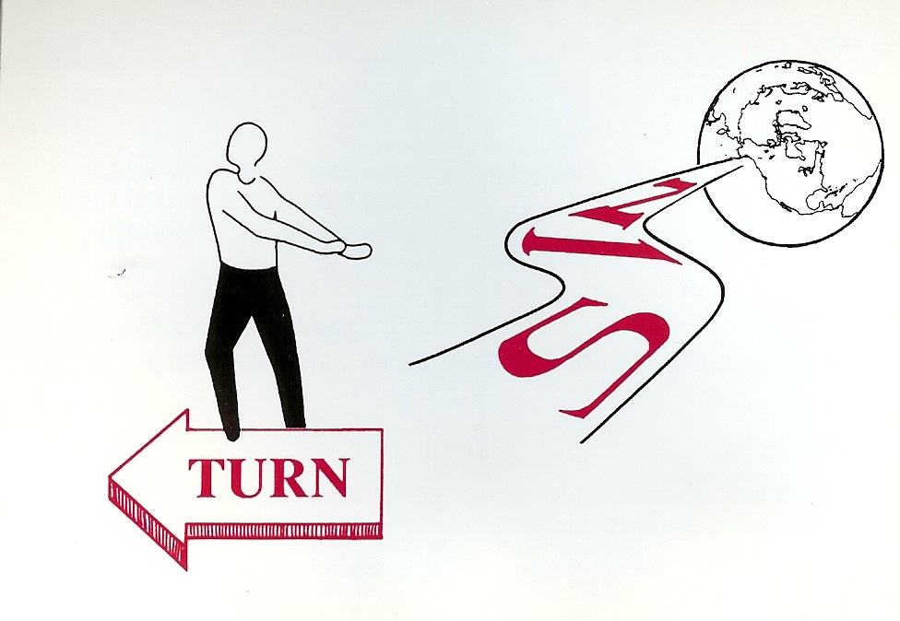

Slide 33
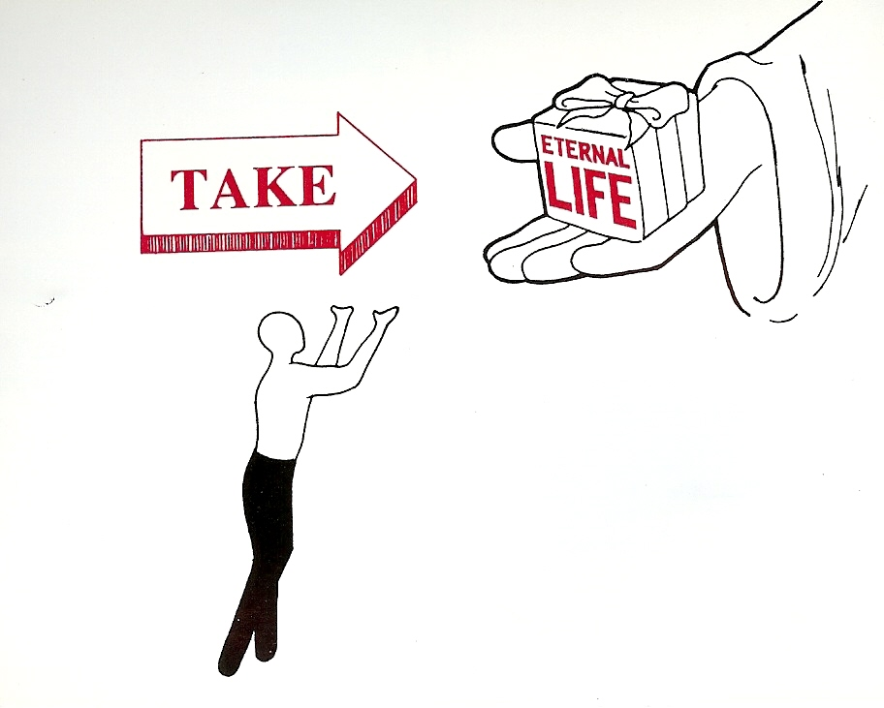

Slide 34
“For by grace are ye saved through faith; and that not of yourselves: it is the gift of God: Not of works, lest any man should boast.”
(Ephesians 2:8-9)

Slide 35
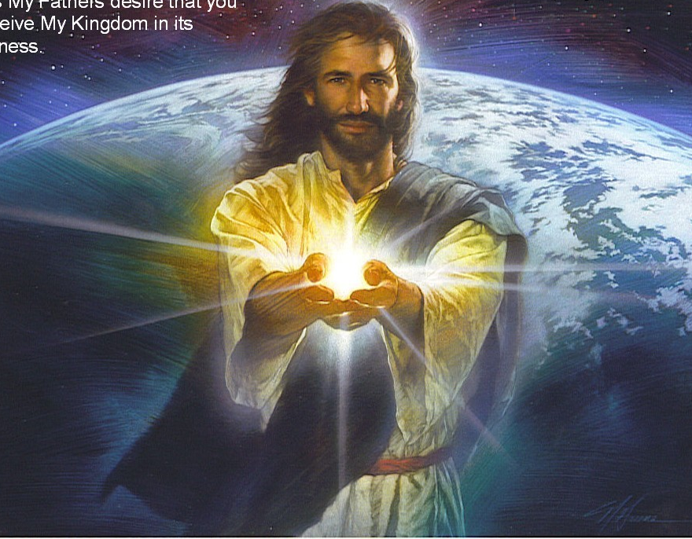


Slide 36
“How shall we escape, if we neglect so great salvation?”
(Heb. 2:3)

Slide 37
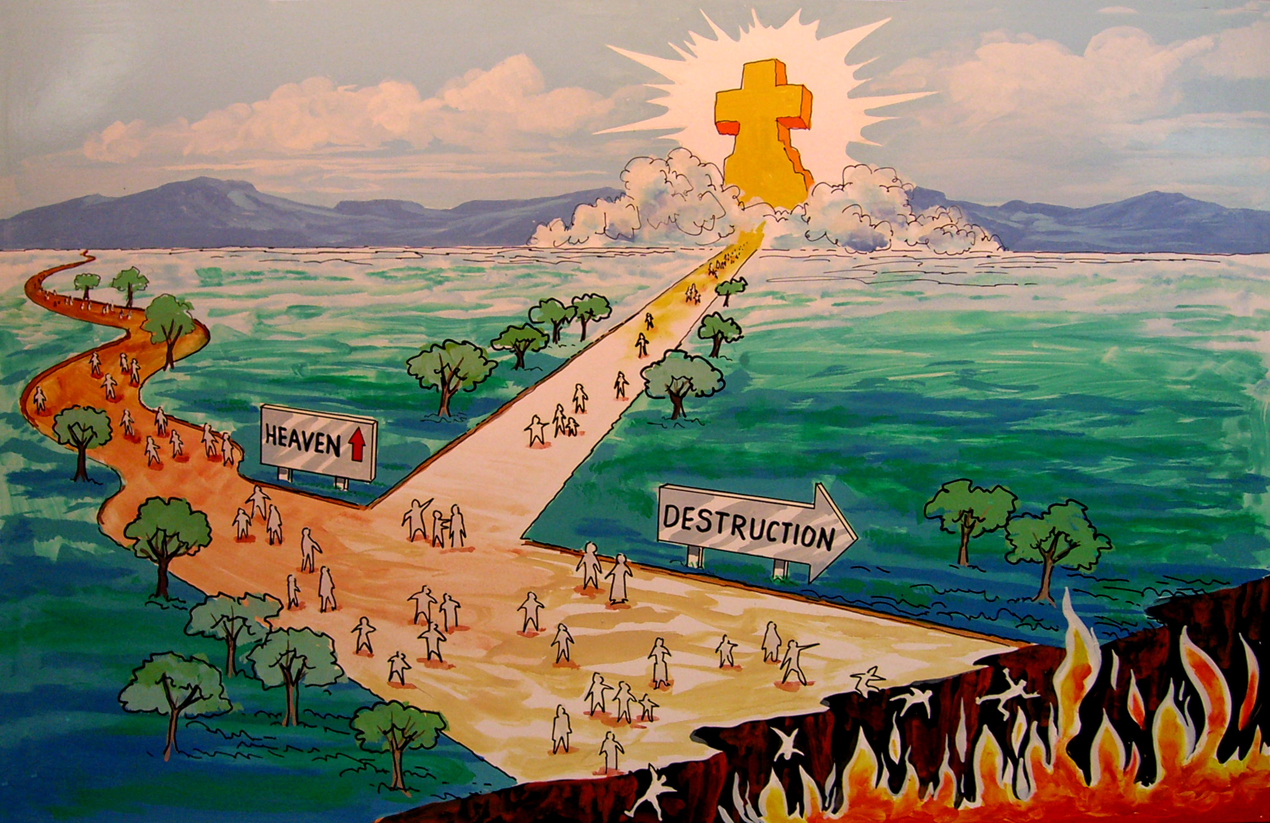
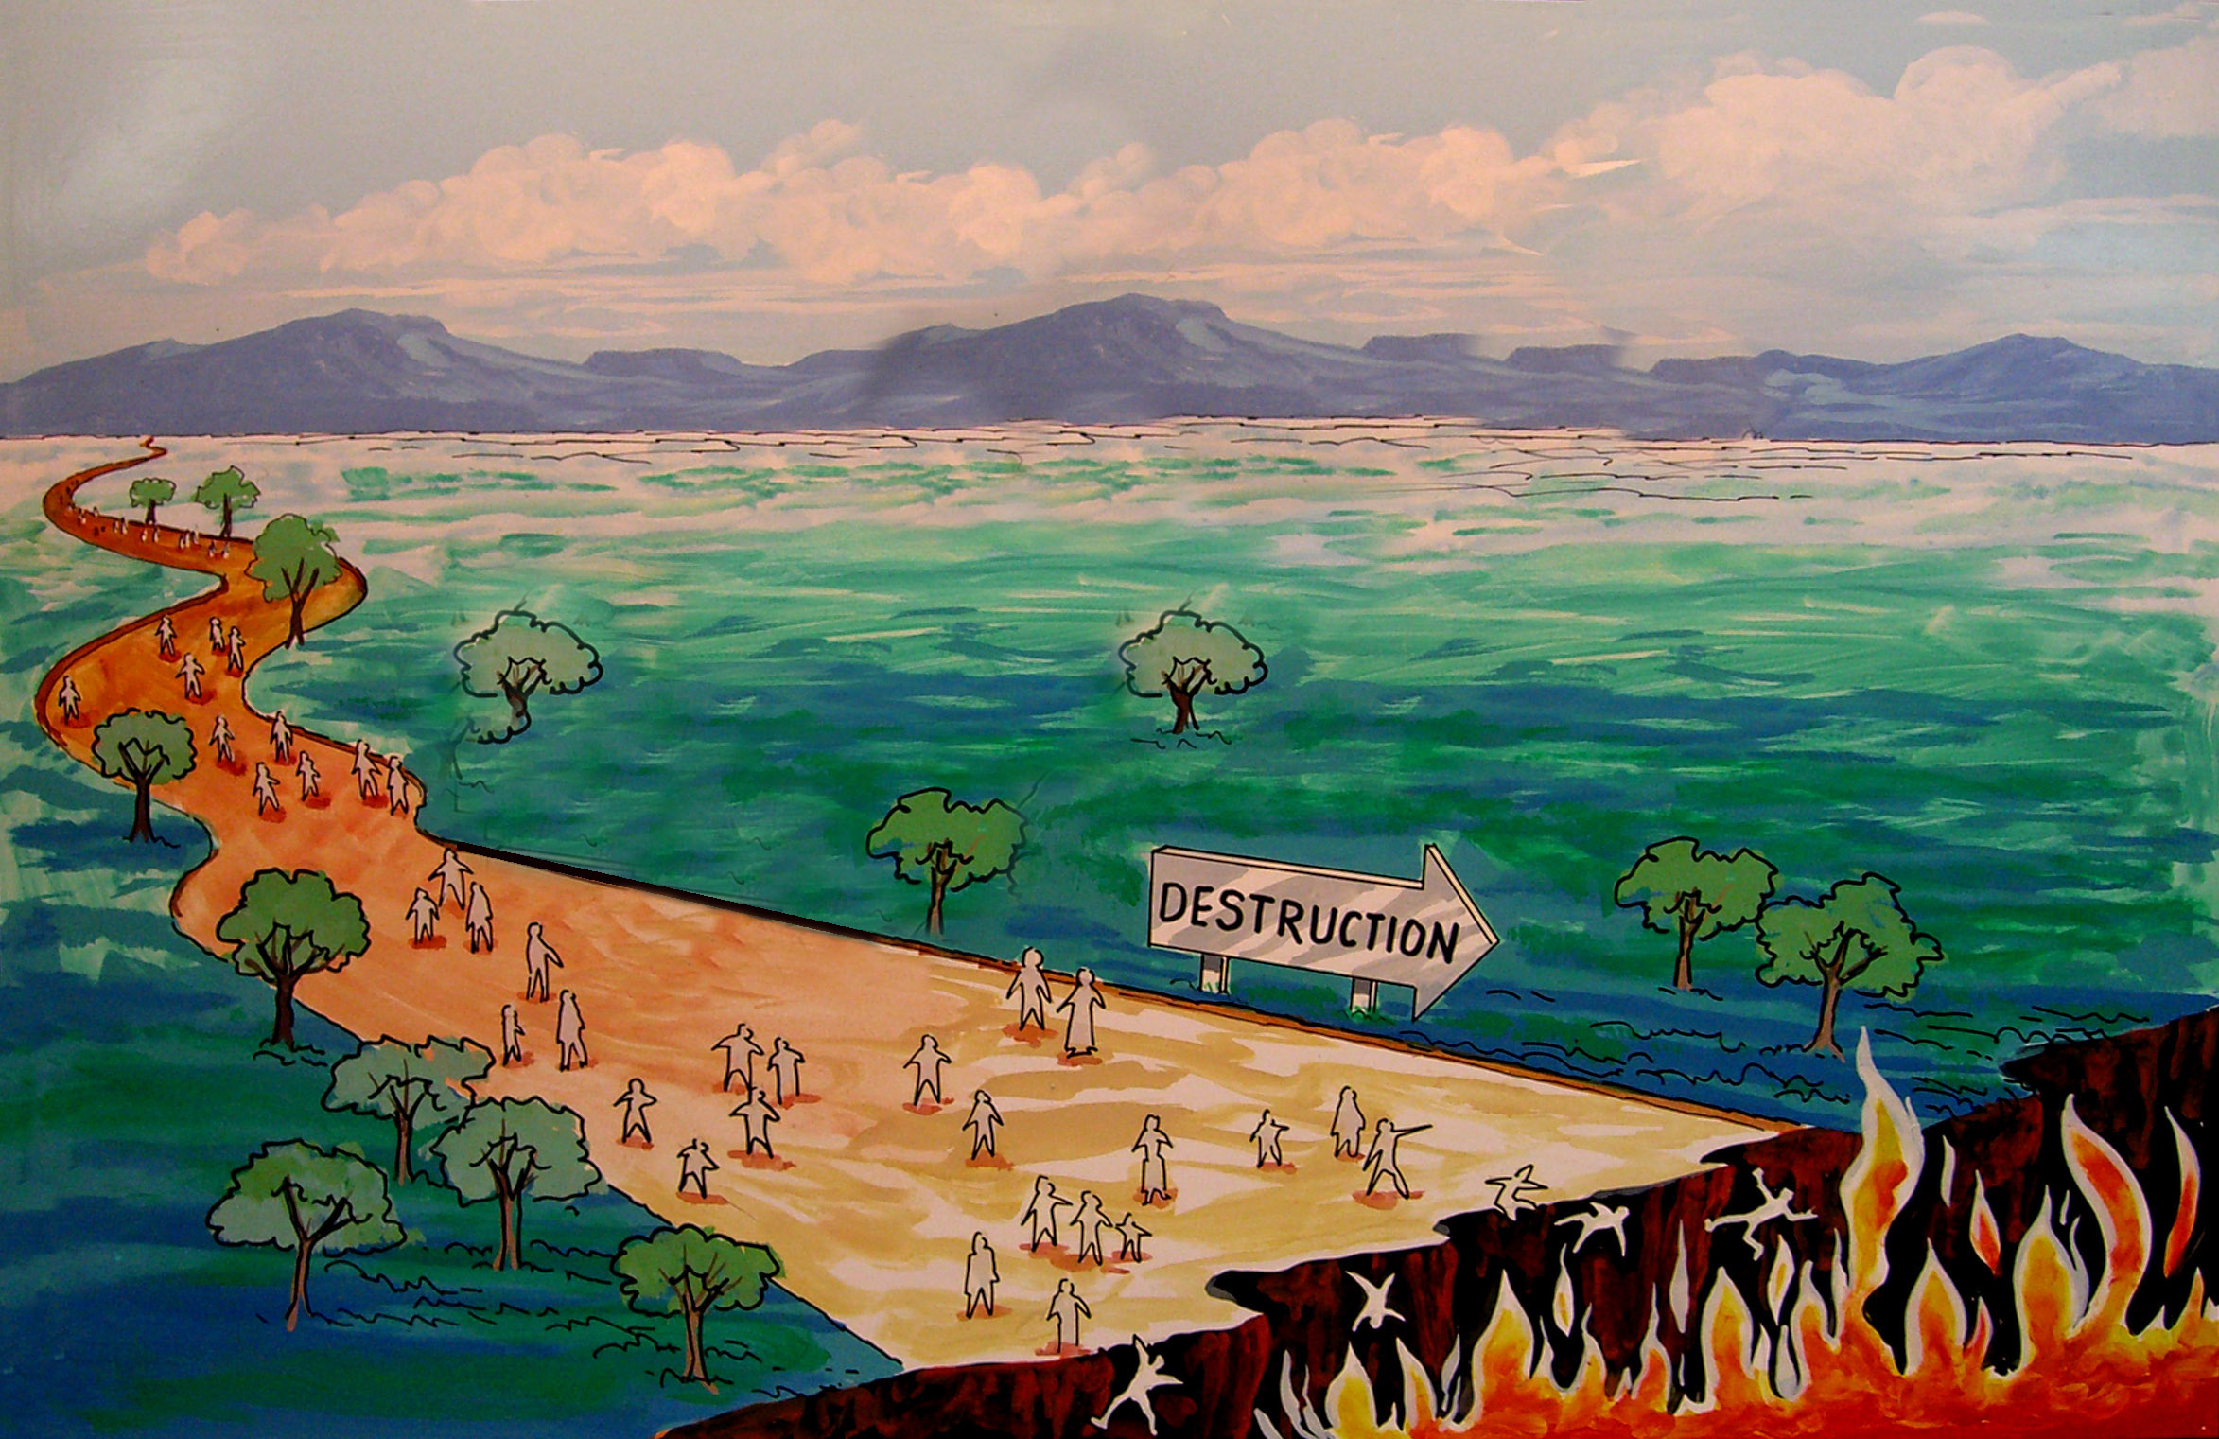

Slide 38
“For God hath not appointed us to wrath, but to obtain salvation by our Lord Jesus Christ.”
(I Thess. 5:9)

Slide 39
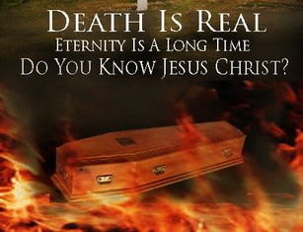

Slide 40
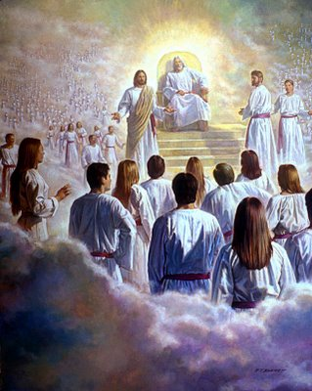
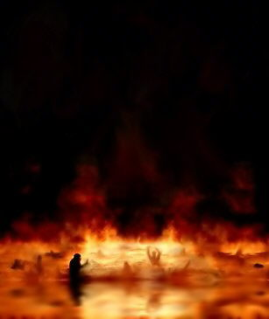

Slide 41
“The Lord is not slack concerning his promise, as some men count slackness; but is longsuffering to us-ward, not willing that any should perish, but that all should come
to repentance.”
(II Pet. 3:9)

Slide 42
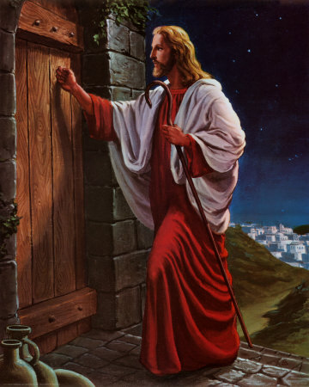

Slide 43
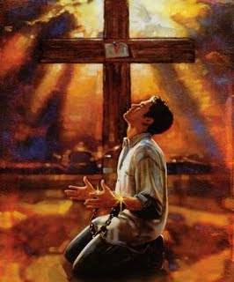

Slide 44
Sin

Slide 45


Slide 46
