Slide 1
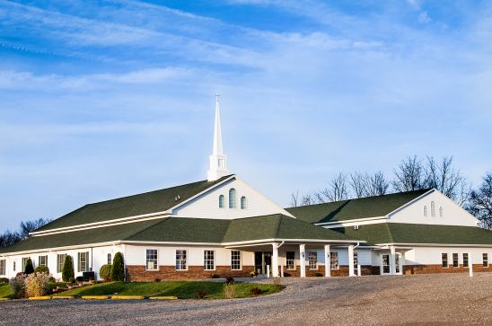
The Doctrine of the Church
The Purpose of the Church

Slide 2


Slide 3
The ekklesia (Church)of the New Testament refers to a organize band of baptized believers who regularly assemble for Doctrine, Fellowship, Breaking of Bread, Prayers and Worship. The Church is led by pastors and served by deacons, for the following purpose.

Slide 4
The purpose of the Church considered from a negative viewpoint.

Slide 5
The main focus or purpose of the Church is not to win souls resulting in the saving of the world.
The leaven of Matthew 13:33 is certainly not a picture of the gospel permeating and purifying society, thus turning it into the golden age of the millennium.
To the contrary, leaven always represents sin – (I Cor. 5:5-8)
The world is going to become much worse before it gets better - (II Tim. 3:1-7; II Pet. 3:1-5)

Slide 6

Great Commission is the Mission of the Church but it is not the Main Purpose of the Church

Slide 7
The main purpose of the church is not to serve the world.
Nowhere in the New Testament is the Church told to lobby for stronger pollution laws, march for civil rights, stage protest against the government and unrighteous laws, or seek to eradicate hunger and poverty, etc. – (Psalm 82:3)
The Church should preach against the sins of society but this is not to be its main focus – (II Tim. 4:1-4)
This is not, of course, to say that individual believers cannot be involved in social action which are supported and encouraged by their Church.
The Church and Believers should be Salt and Light – (Matt. 5:13-14)

Slide 8
The main purpose of the Church is not to fight the world.
There are occasions when local Churches simply must stand up and thunder out against immorality and sin (Prophets).
The Church’s main ministry is not to expend all its energies and resources fighting all the ills of the world – (Eph. 6:10-18)
I Tim. 6:12 “Fight the good fight of faith, lay hold on eternal life, whereunto thou art also called, and hast professed a good profession before many witnesses.”

Slide 9


Slide 10
The main purpose of the Church is not to imitate the world.
The idea that the Church must become like the world to reach the world is WRONG!
I John 2:15 “Love not the world, neither the things that are in the world. If any man love the world, the love of the Father is not in him.”
John 15:19 “If ye were of the world, the world would love his own: but because ye are not of the world, but I have chosen you out of the world, therefore the world hateth you.”

Slide 11
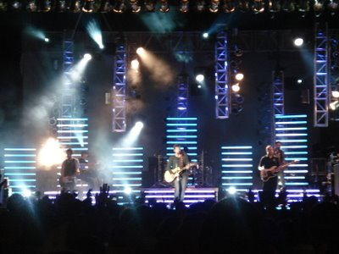
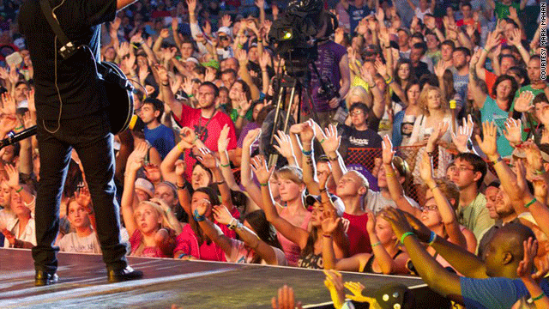

II Cor. 6:17 “Wherefore come out from among them, and be ye separate, saith the Lord, and touch not the unclean thing; and I will receive you.”

Slide 12
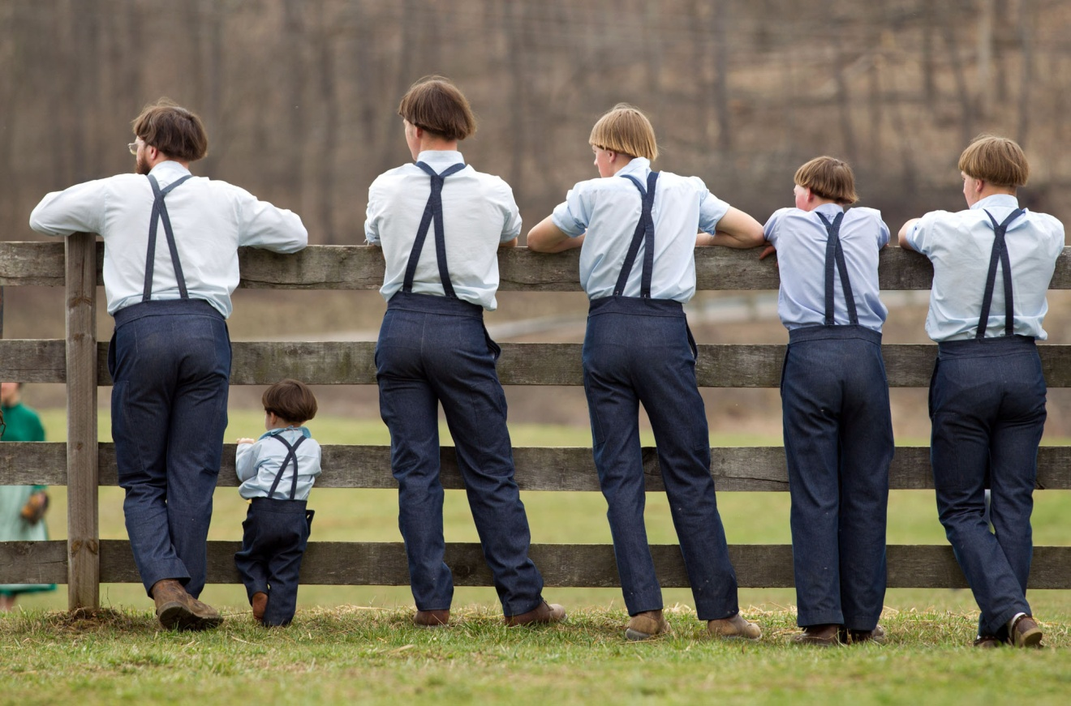
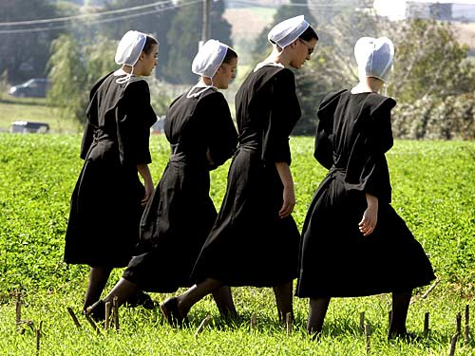
The purpose of the Church is not to isolate itself from the world.

Slide 13
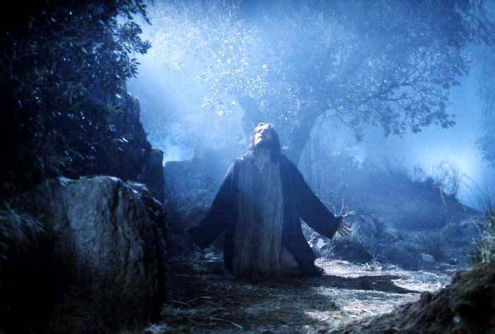
“I have given them thy word; and the world hath hated them, because they are not of the world, even as I am not of the world. I pray not that thou shouldest take them out of the world, but that thou shouldest keep them from the evil. They are not of the world, even as I am not of the world. Sanctify them through thy truth: thy word is truth. As thou hast sent me into the world, even so have I also sent them into the world. And for their sakes I sanctify myself, that they also might be sanctified through the truth.”
(John 17:14-19)

Slide 14
The purpose of the Church considered from a positive viewpoint.

Slide 15
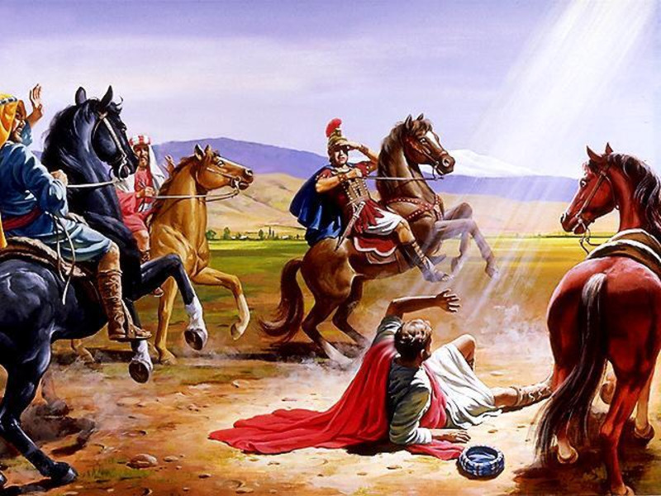
The Passion of the Apostle Paul
“Planting Local Churches”
The driving force behind his evil actions prior to conversion was to destroy every single local church (Acts 8:3)
The burning purpose after his salvation was to start local churches (Acts 14:23)

Slide 16
The sole reason for his second missionary trip was to establish the Churches he started on his first missionary trip (Acts 15:36, 41; 16:5)
His heaviest burden was for the welfare of those local churches (II Cor. 11:28)
Of his thirteen known New Testament epistles, nine are directly written to local churches, and three to pastors of local churches.
In his epistles he gave detailed instruction concerning the worship services (I Cor. 11:1-16), communion (I Cor. 11:17-34), use of spiritual gifts (I Cor. 12), the responsibilities of pastors and deacons (I Tim. 3; Titus 1) ect.

Slide 17
The facts are that Christ has literally loaded down His Church with many responsibilities and tasks.

Slide 18

The church is to love the Lord with all our heart
“Jesus said unto him, Thou shalt love the Lord thy God with all thy heart, and with all thy soul, and with all thy mind. This is the first and great commandment.” (Matt. 22:37-38)
"Nevertheless I have somewhat against thee, because thou hast left thy first love" (Rev. 2:4)

Slide 19


The church is to display God’s wisdom to angels and His grace to the lost
(Eph. 2:7; 3:10; I Pet. 2:9)

Slide 20


Slide 21

The church is to evangelize the world
(Matt. 28:19, 20; Mark 16:15; Luke 24:47; John 20:21; Acts 1:8)

Slide 22

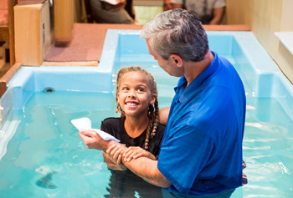
The church is to Baptize believers
(Matt. 28:19)

Slide 23





The church is to instruct believers
(Matt. 28:19; Phil. 4:8-9; I Tim. 4:6;
5:17; II Tim. 2:2, 24-25)

Slide 24
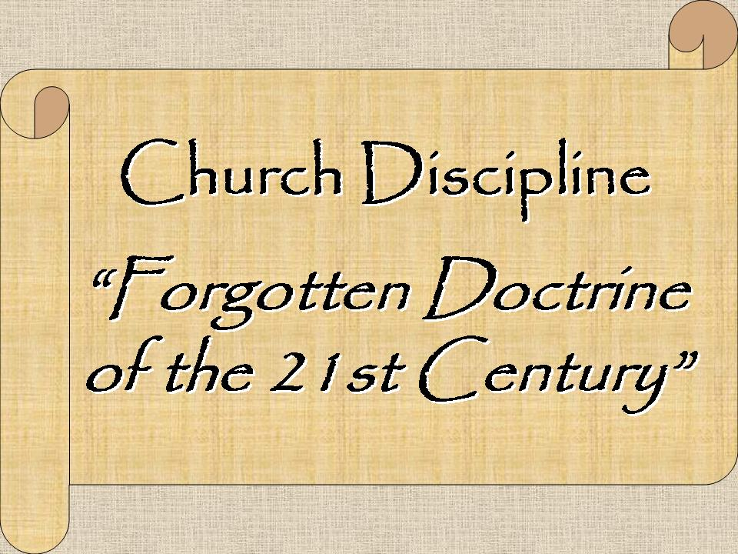
The church is to discipline members
(Matt. 18:17; Rom. 16:17; I Cor. 5:1-13; Gal. 6:1; II Thess. 3:6, 14; Titus 3:10, 11; II John 1:10)

Slide 25
The church is to provide fellowship for believers (Acts 2:42; 1 Cor. 1:9; 2 Cor. 8:4; 13:14; Gal. 2:9; Phil. 1:5; 2:1; I John 1:3, 6-7)
The basis of Christian fellowship—the Person of Christ (I John 1:3)
The nature of Christian fellowship—sharing (Acts 2:44-47; 4:32, 34-35)
The dangers of losing Christian fellowship—sin/disunity (I Cor. 10:16, 21)

Slide 26


Slide 27
Confess our faults (Jas. 5:16)
Rebuke sin in each other (Eph. 5:11; I Tim. 5:20)
Forgive one another (II Cor. 2:6, 8; Eph. 4:32; Col. 3:13)
Restore one another (Gal. 6:1)
Bear one another’s burdens (Gal. 6:2)
Prefer the weaker brother (Rom. 14:13; 15:1)
Comfort and exhort each other (I Thess. 4:18; 5:11)
Pray one for another (Jas. 5:16)
Edify one another (Rom. 14:19; Heb. 10:24)
Admonish one another (Rom. 15:14; Col. 3:16)

Slide 28
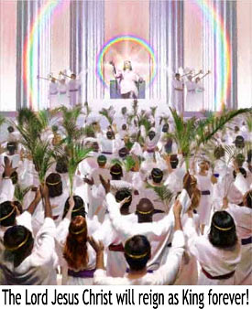
The church is to prepare rulers for the millennial kingdom
(Rom. 8:17; II Tim. 2:12)

Slide 29


The church is to act as a restraining and enlightening force in this present world
(Matt. 5:13-16; 2 Thess. 2:6-7;
Gen. 18:22-23; 19:12-25)

Slide 30

What is the Main
Purpose for the Church

Slide 31


Slide 32

“Thou art worthy, O Lord, to receive glory and honour and power: for thou hast created all things, and for thy pleasure they are and were created.” (Rev. 4:11)

Slide 33
“Unto him be glory in the church by Christ Jesus throughout all ages, world without end. Amen.” (Eph 3:21)
“And he is the head of the body, the church: who is the beginning, the firstborn from the dead; that in all things he might have the preeminence.” (Col 1:18)

Slide 34


