Slide 1
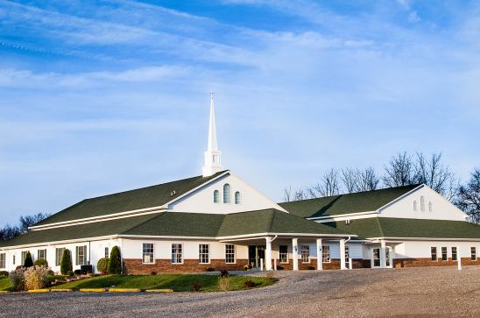
The Doctrine of the Church
The Government of the Church

Slide 2
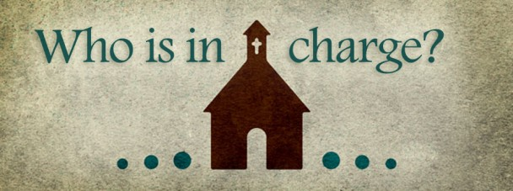
The Government (Polity) of the Church

Slide 3
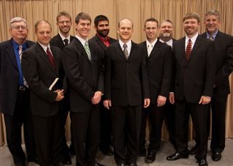
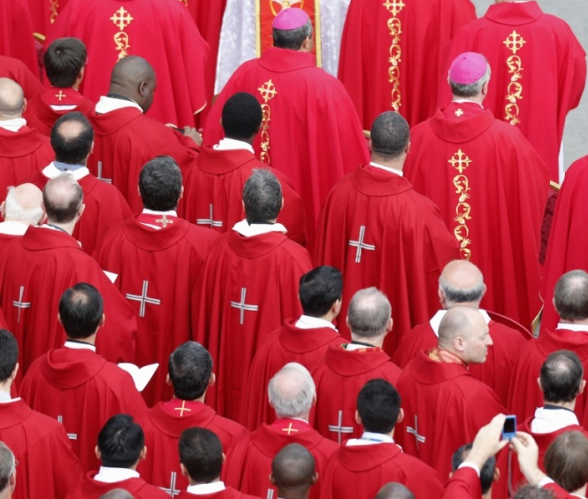
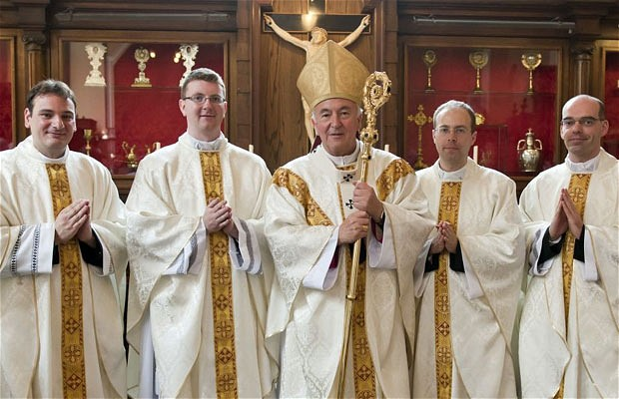
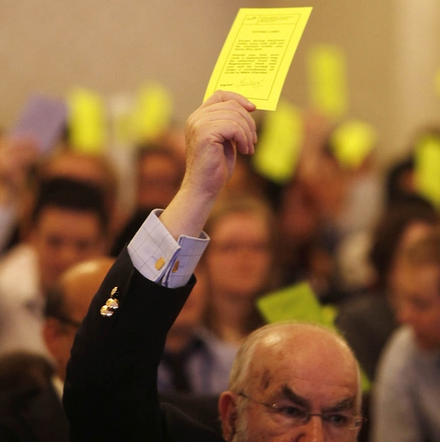
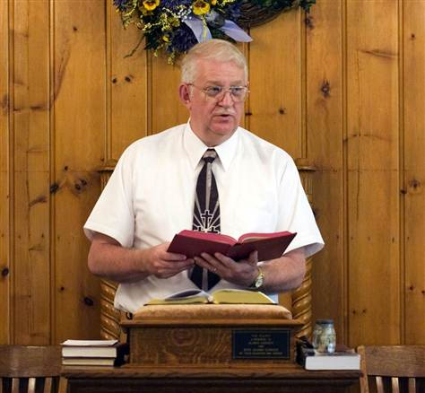
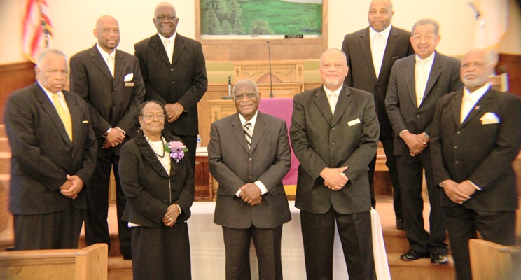
Within the confines of organized Christianity today four separate church systems of government exist.

Slide 4
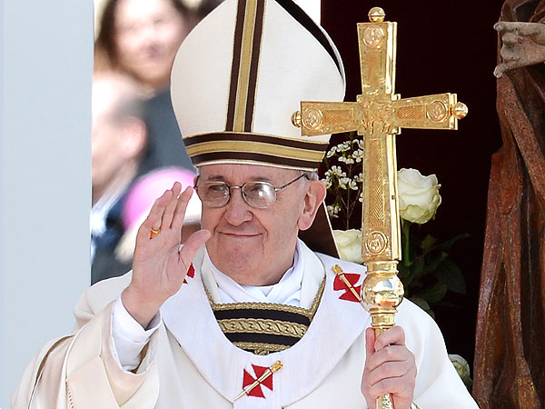
The hierarchical form of government
This is also known as the Episcopal system, taken from the Greek word episkopos, translated in the New Testament by the two English words –
"overseer" (Acts 20:28)
"bishop" (Phil 1:2; 1 Tim. 3:2; Titus 1:7; 1 Pet. 2:25)
Roman Catholic
Episcopal
Anglican
Greek Orthodox
Eastern Orthodox
Orthodox Presbyterian
Orthodox = Traditionally accepted and approved forms of doctrine, philosophy, ideology

Slide 5
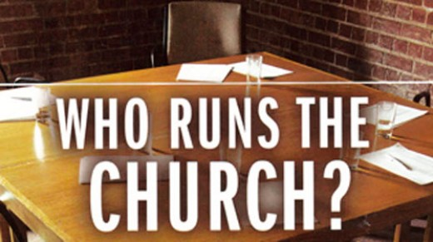
A Hierarchy controls churches and their ministries.
The church is not seen as –
Local
Independent
Autonomist – The right of self-government
Churches are governed by a Pope, Bishops, Priest, Pastoral Board, etc.
The right to ordain other bishops and ordain both priests and deacons belongs only to the bishops themselves not the Local church.
Church Pastors and leaders are appointed by a hierarchy not the local church.
Churches are controlled by an outside hierarchy.

Slide 6
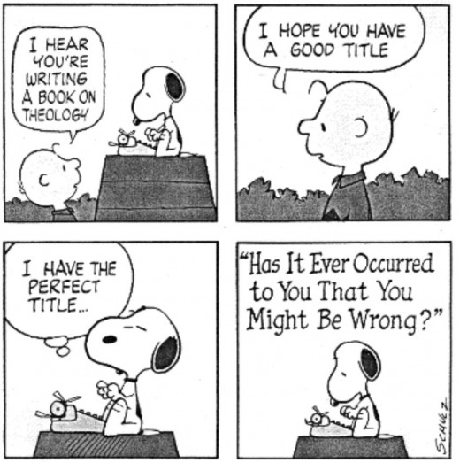
This system of government arose during the second century a.d. and is not found any where in the New Testament.

Slide 7
The federal or representative form of government
This is also known as the Presbyterian system, taken from the Greek word presbuteros.
This word, found sixty-two times in the KJV and is always translated by the English word "elder."
The federal system operates somewhat similarly to that of the U.S. government.
Each local church duly elects ruling elders to represent them.

Slide 8
This group forms the church session (ruling board).
A distinction is made in this session between those ruling elders who govern the church but do not teach, preach, or administer the ordinances, and those elders (Pastors) who do (I Tim. 5:17).
Ruling elders
Administrating elders
Ruling elders are usually elected for a period of time determined by the church body.
There is also a ruling hierarchy within this form of government.

Slide 9
The next high-ranking body in this system is the presbytery, which includes ordained ministers or teaching elders and one ruling elder from each local congregation in a given district.
Although pastors are elected by their own congregations, they must be approved by the local presbytery.
Above the presbytery is the ruling “synod” (from a Greek word meaning "company")
Over the synod is the general assembly, the Supreme Court of its kind.

Slide 10
Argument in support of the federal type of government is the fact that elders were appointed by the apostles (Acts 14:23; Titus 1:5), and were obviously rulers over the churches (Heb. 13:7, 17)

Slide 11
The congregational or democratic form of church government
This type of government is clearly seen in Baptist, Congregational, Evangelical Free, Independent Bible churches, etc.
Followers of this form believe no outside man or group of men should exercise authority over a local assembly.
Therefore, the government should be in the hands of the members themselves.
The pastor is considered to be the head elder or bishop in the church.

Slide 12
Deacons are then chosen to assist him in shepherding the flock.
Pastors and Deacons are elected by the church congregation.
Church is controlled by the majority vote of its members.
In this form of government the Deacon Board has more power and influence over the congregation then the Pastor.
Deacon board only allows what they decided to be important to be brought before the church body and be voted upon.

Slide 13
Arguments in favor of this form of government include the following –
Passages that speak of the responsibilities of the entire church (I Cor. 1:10; Phil. 1:26)
The apparent involvement of the whole church in choosing leaders (Acts 6:3, 5; 15:2, 30; II Cor. 8:19)
The fact that the whole church was involved in exercising discipline (Matt. 18:17; I Cor. 5; II Thess. 3:14)
It is a really stretch of Scripture to basis a congregational form of government on these verses.

Slide 14
The following passage sets forth the clear teachings of Scripture on who should rule, lead, and oversee the local church and its ministry.
Jesus Christ is the Chief Shepherd and the Head of the church.
He is the final authority for the church and we have no option but to obey our head.
In His Word, He has revealed to His church exactly how He wants His church to operate.
The Bible is sufficient to be our guide for all matters of church operation.

Slide 15

5. We do not need to turn to the state or the business world for ideas on how the church should be run.
6. Boards, business meetings, committees, voting, constitutions and by-laws.
7. To receive the full blessing of God the church must follow His expressed will for His church.

Slide 16
(I Peter 5:4) “And when the chief Shepherd shall appear, ye shall receive a crown of glory that fadeth not away.”
(Ephesians 5:23-24) “For the husband is the head of the wife, even as Christ is the head of the church: and he is the saviour of the body. Therefore as the church is subject unto Christ, so let the wives be to their own husbands in every thing.”

Slide 17
Elders, Pastors (Shepherd) and Bishop (Overseer) all refer to the same office. The Following passages use these terms interchangeably for the same office.

Slide 18
(Titus 1:5) “For this cause left I thee in Crete, that thou shouldest set in order the things that are wanting, and ordain elders in every city, as I had appointed thee”
(Titus 1:7) “For a bishop must be blameless, as the steward of God; not selfwilled, not soon angry, not given to wine, no striker, not given to filthy lucre.”
(Acts 20:17) “And from Miletus he sent to Ephesus, and called the elders of the church.”
(Acts 20:28) “Take heed therefore unto yourselves, and to all the flock, over the which the Holy Ghost hath made you overseers, to feed the church of God, which he hath purchased with his own blood.”

Slide 19
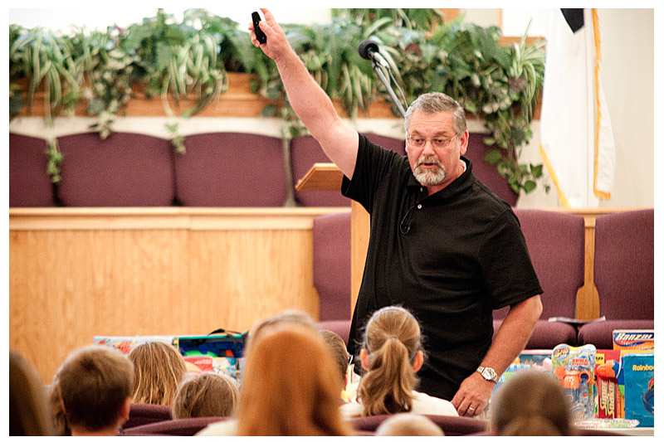
(I Peter 5:1) “The elders which are among you I exhort, who am also an elder, and a witness of the sufferings of Christ, and also a partaker of the glory that shall be revealed.”
(I Peter 5:2) “Feed the flock of God which is among you, taking the oversight thereof, not by constraint, but willingly; not for filthy lucre, but of a ready mind.”

Slide 20
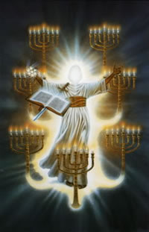
Revelation chapter two and three is proof that God holds the pastor accountable for the church as a whole.
John’s letters to the churches were addressed to the pastors.

Slide 21
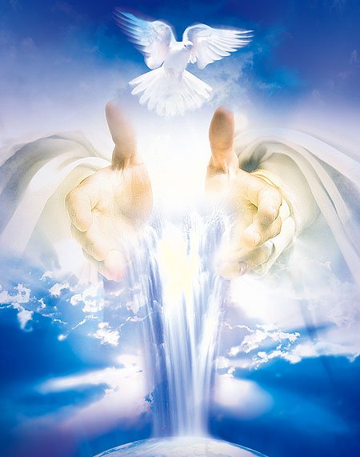

The authority to oversee the church is given to Pastors by God, specifically the Holy Spirit
“Take heed therefore unto yourselves, and to all the flock, over the which the Holy Ghost hath made you overseers, to feed the church of God, which he hath purchased with his own blood.” (Acts 20:28)

Slide 22
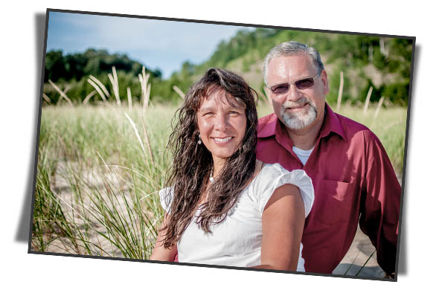
Pastors are over the church by the Lord’s appointment
“And we beseech you, brethren, to know them which labour among you, and are over you in the Lord, and admonish you; And to esteem them very highly in love for their work's sake. And be at peace among yourselves.”
(I Thess. 5:12-13)

Slide 23
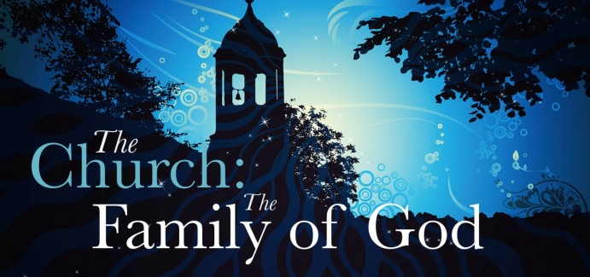
The Apostle Paul likens the operation of the church to the operation of the family.
(I Timothy 3:5)
“For if a man know not how to rule his own house, how shall he take care of the church of God?”

Slide 24
Pastor
“Father”
Pastor
“shepherd, bishop, elder,
overseer, oversight, ruler,
over you in the Lord”
Deacon
(diakonos) literally means
"to run errands, and attendant, a waiter, servant"
Deacon
“Mother”
Deacon
“Mother”
Deacon
“Mother”
Members – “Children”

Slide 25

The pastor is to the church what the husband is to his wife and children. The husband is the final authority in all matters of the home but he loves his wife and children, listens to their advise and then makes the best decision he feels the Lord would have him to make for his family.

Slide 26
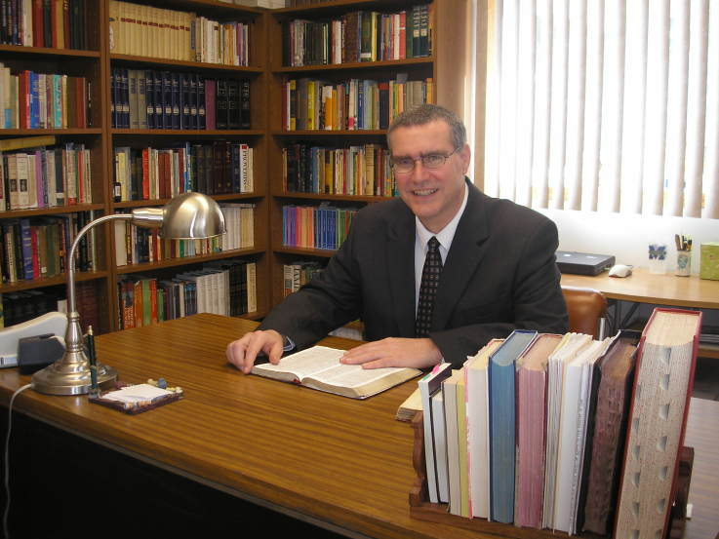
The elder position is a ruling position but the main ministry of the pastor is the ministry of the Word
“Let the elders that rule well be counted worthy of double honour, especially they who labour in the word and doctrine.” (I Timothy 5:17)

Slide 27
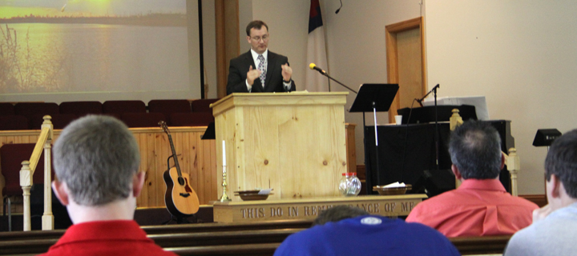
The author of Hebrews acknowledged that pastors have the ruling position over the church. This is clearly not the deacons or the members for he explains that the rulers are the one who have spoken the Word of God unto them.

Slide 28
“Remember them which have the rule over you, who have spoken unto you the word of God: whose faith follow, considering the end of their conversation…Obey them that have the rule over you, and submit yourselves: for they watch for your souls, as they that must give account, that they may do it with joy, and not with grief: for that is unprofitable for you.” (Hebrews 13:7, 17)

Slide 29
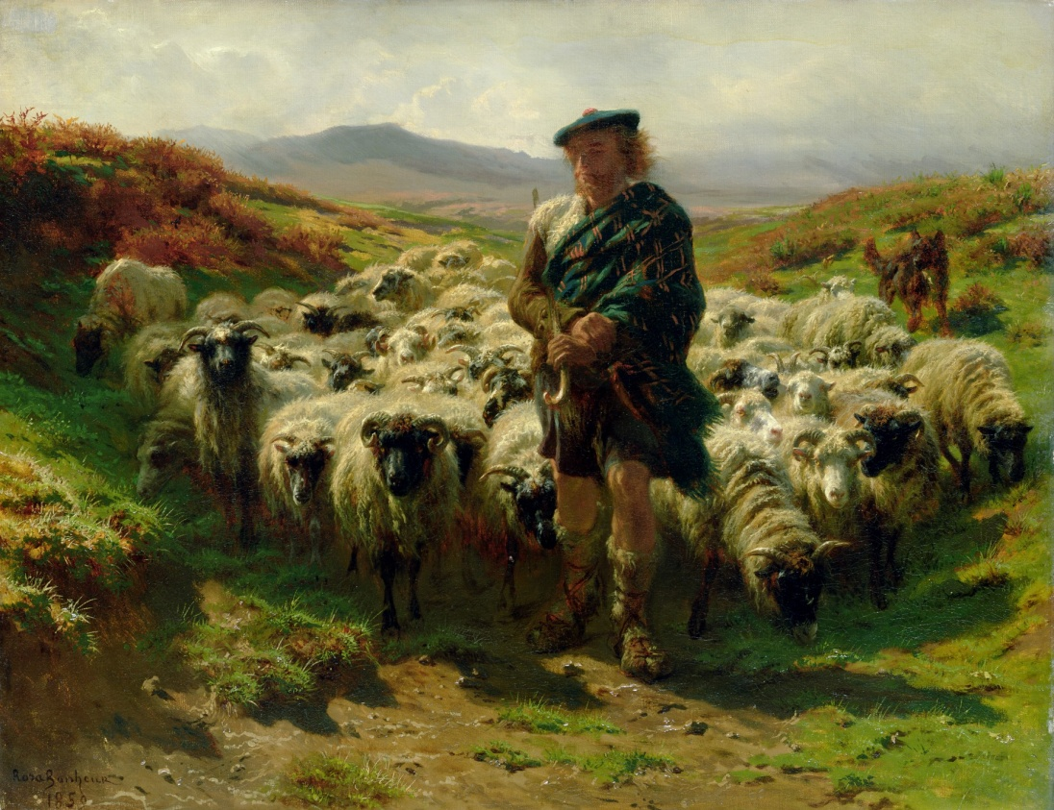
Peter charged the pastors to feed the flock and take the oversight of the church with a willing spirit and a ready mind. To rule in a spirit of servitude and humility as they take the oversight of the church.

Slide 30
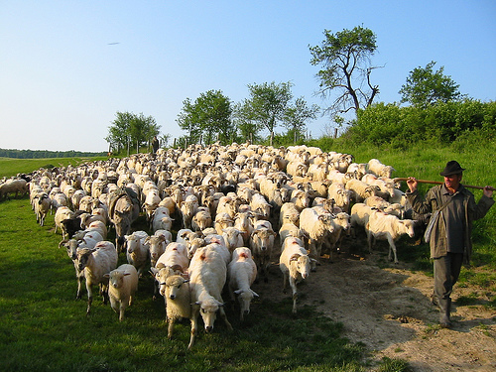
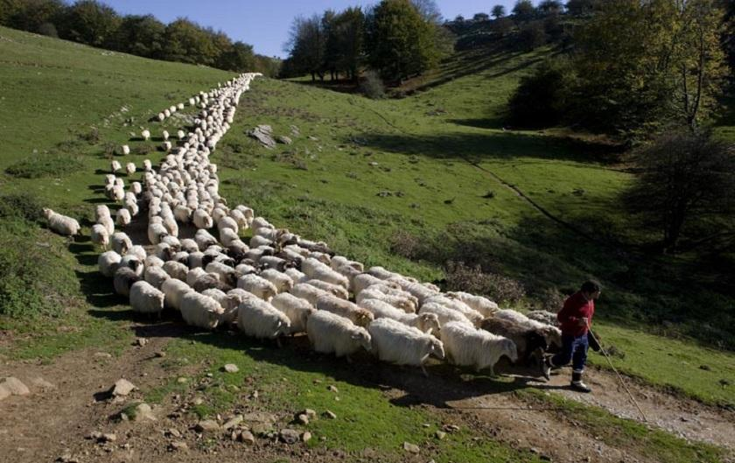
(I Peter 5:2-3)
“Feed the flock of God which is among you, taking the oversight thereof, not by constraint, but willingly; not for filthy lucre, but of a ready mind; Neither as being lords over God's heritage, but being ensamples to the flock.”

Slide 31
Pastors are a gift from God to the church for the perfecting of the members so that they can do the work of the ministry.
“And I will give you pastors according to mine heart, which shall feed you with knowledge and understanding.” (Jer. 3:15)
“And he gave some, apostles; and some, prophets; and some, evangelists; and some, pastors and teachers; For the perfecting of the saints, for the work of the ministry, for the edifying of the body of Christ.” (Eph. 4:11-12)

Slide 32

Pastor

Slide 33
The apostles (where were the first pastors of the church) were the ones who made the final decision as to where the money of the church was spent.

Slide 34
These verses prove that a pastors authority in not just over spiritual matters but over the financial matters of the church also.
“And laid them down at the apostles' feet: and distribution was made unto every man according as he had need.” (Acts 4:35)
“And kept back part of the price, his wife also being privy to it, and brought a certain part, and laid it at the apostles' feet.” (Acts 5:2)

Slide 35
God never ruled His people through boards, committees or majority vote.
God always led by one man. Abraham, Moses, Samuel, David, Kings, Judges, Prophets and the High Priest. Nowhere in the Scripture were the children of God’s ever ruled by majority vote or boards. Men of God (leaders) always sought the counsel from others but the final decision rested in their hands.

Slide 36
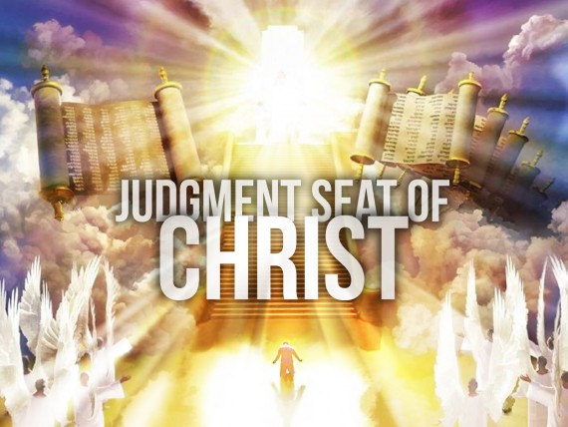
“Obey them that have the rule over you, and submit yourselves: for they watch for your souls, as they that must give account, that they may do it with joy, and not with grief: for that is unprofitable for you.” (Heb. 13:17)

Slide 37
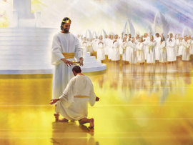
“Feed the flock of God which is among you, taking the oversight thereof, not by constraint, but willingly; not for filthy lucre, but of a ready mind; Neither as being lords over God's heritage, but being ensamples to the flock. And when the chief Shepherd shall appear, ye shall receive a crown of glory.” (I Peter 5:2-4)

