Slide 1
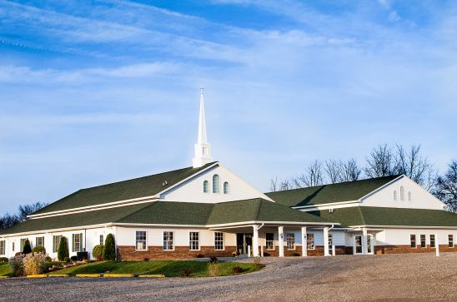
The Doctrine of the Church
The Ministry of the Pastor

Slide 2

The Ministry of the Pastor

Slide 3

The Pastor’s Responsibilities
He is to be an example to all (I Cor. 4:16; 11:1; Phil. 3:17; II Thess. 3:9; I Tim. 4:12; Heb. 13:7; I Pet. 5:3)

Slide 4
I Corinthians 4:16 “Wherefore I beseech you, be ye followers of me.”
I Corinthians 11:1 “Be ye followers of me, even as I also am of Christ.”
Philippians 3:17 “Brethren, be followers together of me, and mark them which walk so as ye have us for an ensample.”
II Thessalonians 3:9 “Not because we have not power, but to make ourselves an ensample unto you to follow us.”
I Timothy 4:12 “Let no man despise thy youth; but be thou an example of the believers, in word, in conversation, in charity, in spirit, in faith, in purity.”

Slide 5

Hebrews 13:7 “Remember them which have the rule over you, who have spoken unto you the word of God: whose faith follow, considering the end of their conversation.”
I Peter 5:3 “Neither as being lords over God's heritage, but being ensamples to the flock.”

Slide 6
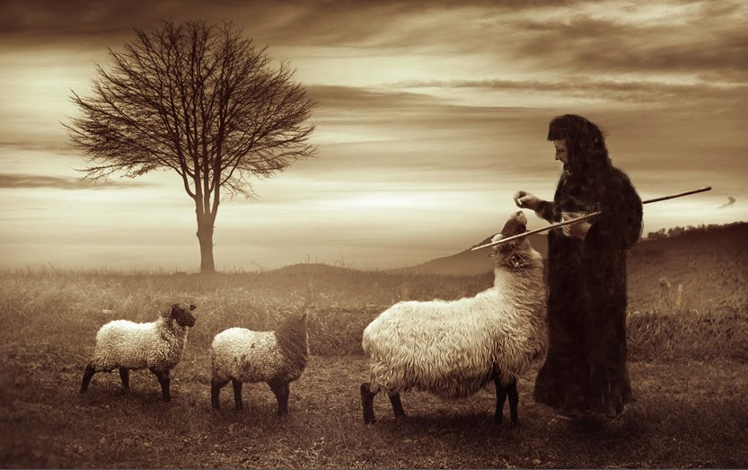

He is to feed and lead his flock (Acts 20:28; I Pet. 5:2)

Slide 7
Acts 20:28
“Take heed therefore unto yourselves, and to all the flock, over the which the Holy Ghost hath made you overseers, to feed the church of God, which he hath purchased with his own blood.”

Slide 8
I Peter 5:2
“Feed the flock of God which is among you, taking the oversight thereof, not by constraint, but willingly; not for filthy lucre, but of a ready mind.”

Slide 9
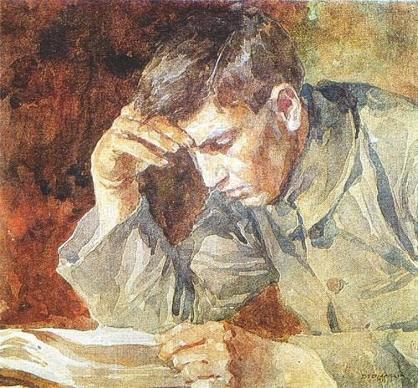
He is to study the Word (II Tim. 2:15)

Slide 10


Slide 11
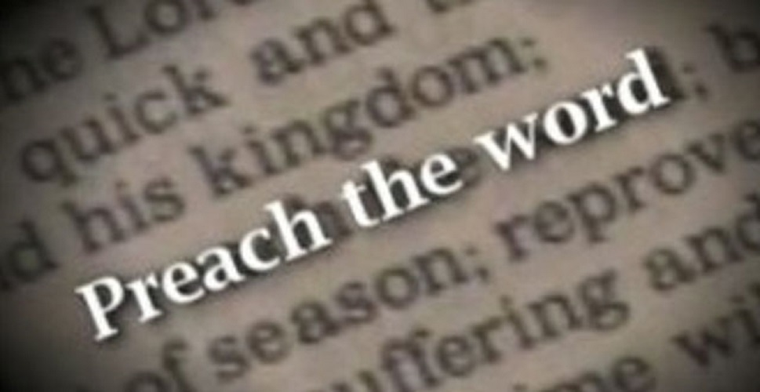
He is to preach the Word (II Tim. 4:2; Acts 6:2-4)

Slide 12
II Timothy 4:2-5
“Preach the word; be instant in season, out of season; reprove, rebuke, exhort with all longsuffering and doctrine. For the time will come when they will not endure sound doctrine; but after their own lusts shall they heap to themselves teachers, having itching ears; And they shall turn away their ears from the truth, and shall be turned unto fables. But watch thou in all things, endure afflictions, do the work of an evangelist, make full proof of thy ministry.”

Slide 13
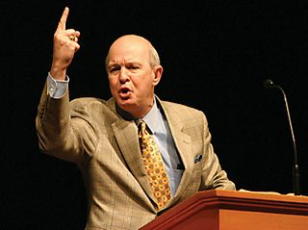
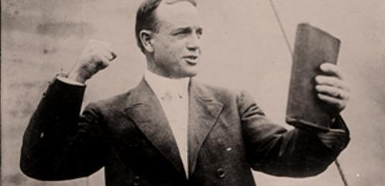
“Make full proof of the ministry”
To carry out fully or completely, to entirely accomplish, convincing or persuasive demonstration, the evidence or argument that compels the mind to accept an assertion as true.

Slide 14
Acts 6:2-4
“Then the twelve called the multitude of the disciples unto them, and said, It is not reason that we should leave the word of God, and serve tables. Wherefore, brethren, look ye out among you seven men of honest report, full of the Holy Ghost and wisdom, whom we may appoint over this business. But we will give ourselves continually to prayer, and to the ministry of the word.”

Slide 15
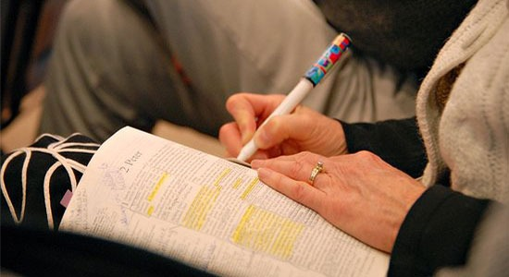
He is to teach the Word (Col. 1:28; Titus 1:9; Matt. 28:20)
Teaching = To provide with knowledge; to give lessons or instruction; to explain how to do something.
Preaching = To tell thoroughly; to cry or proclaim as a herald; to speak forcefully.

Slide 16
Col 1:28 “Whom we preach, warning every man, and teaching every man in all wisdom; that we may present every man perfect in Christ Jesus.”
Titus 1:9 “Holding fast the faithful word as he hath been taught, that he may be able by sound doctrine (teaching) both to exhort and to convince the gainsayers.
Acts 15:35 “Paul also and Barnabas continued in Antioch, teaching and preaching the word of the Lord, with many others also.”

Slide 17

Matt. 28:20
“Teaching them to observe all things whatsoever I have commanded you: and, lo, I am with you alway, even unto the end of the world. Amen.”

Slide 18

He is to reprove, rebuke, exhort and admonish (II Tim. 4:2; I Thess. 5:12; Titus 2:15)

Slide 19
II Tim. 4:2 “Preach the word; be instant in season, out of season; reprove, rebuke, exhort with all longsuffering and doctrine.”
Titus 2:15 “These things speak, and exhort, and rebuke with all authority. Let no man despise thee.”
I Thess. 5:12 “And we beseech you, brethren, to know them which labour among you, and are over you in the Lord, and admonish you.”

Slide 20



He is to warn his flock (Acts 20:31; I Cor. 4:14; I Thess. 5:14; Col. 1:28)

Slide 21
Acts 20:31 “Therefore watch, and remember, that by the space of three years I ceased not to warn every one night and day with tears.”
I Cor. 4:14 “I write not these things to shame you, but as my beloved sons I warn you.”
I Thess. 5:14 “Now we exhort you, brethren, warn them that are unruly, comfort the feebleminded, support the weak, be patient toward all men.”
Col 1:28 “Whom we preach, warning every man, and teaching every man in all wisdom; that we may present every man perfect in Christ Jesus.”

Slide 22
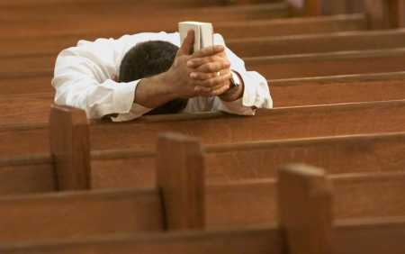
He is to be a man of prayer (Acts. 6:4; I Tim. 2:1)

Slide 23
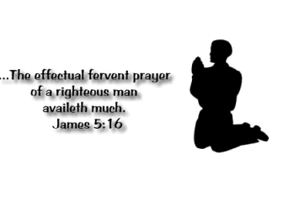
Acts 6:4 “But we will give ourselves continually to prayer, and to the ministry of the word.”
I Tim. 2:1-2 “I exhort therefore, that, first of all, supplications, prayers, intercessions, and giving of thanks, be made for all men. For kings, and for all that are in authority; that we may lead a quiet and peaceable life in all godliness and honesty.”

Slide 24


Slide 25
He is to watch over souls (Acts 20:28-31; Col. 4:17; I Tim. 4:16; 6:11; Heb. 13:17)

Slide 26
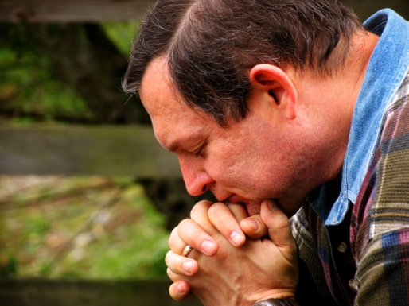
Watch over his own soul -
Acts 20:28 “Take heed therefore unto yourselves, and to all the flock, over the which the Holy Ghost hath made you overseers, to feed the church of God, which he hath purchased with his own blood.”
I Tim. 4:16 “Take heed unto thyself, and unto the doctrine; continue in them: for in doing this thou shalt both save thyself, and them that hear thee.”

Slide 27
I Tim. 6:8-11 “And having food and raiment let us be therewith content. But they that will be rich fall into temptation and a snare, and into many foolish and hurtful lusts, which drown men in destruction and perdition. For the love of money is the root of all evil: which while some coveted after, they have erred from the faith, and pierced themselves through with many sorrows. But thou, O man of God, flee these things; and follow after righteousness, godliness, faith, love, patience, meekness.”

Slide 28

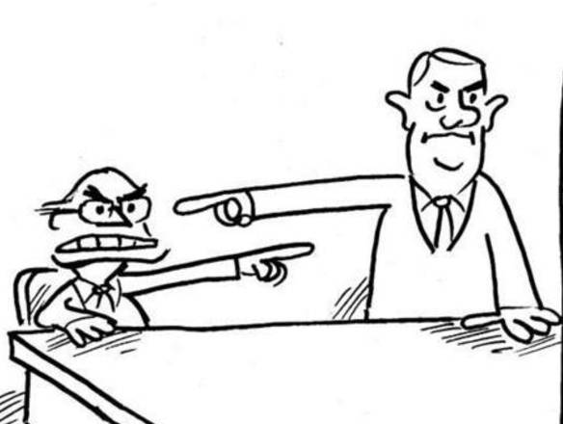
(II Cor. 6:1,3)
“We then, as workers together with him, beseech you also that ye receive not the grace of God in vain….Giving no offence in any thing, that the ministry be not blamed.”

Slide 29
Watch over the souls of church members -
Acts 20:28-31 “Take heed therefore unto yourselves, and to all the flock, over the which the Holy Ghost hath made you overseers, to feed the church of God, which he hath purchased with his own blood. For I know this, that after my departing shall grievous wolves enter in among you, not sparing the flock. Also of your own selves shall men arise, speaking perverse things, to draw away disciples after them. Therefore watch, and remember, that by the space of three years I ceased not to warn every one night and day with tears.”

Slide 30

Hebrews 13:17 “Obey them that have the rule over you, and submit yourselves: for they watch for your souls, as they that must give account, that they may do it with joy, and not with grief: for that is unprofitable for you.”

Slide 31

He is to love his people -
“Seeing ye have purified your souls in obeying the truth through the Spirit unto unfeigned love of the brethren, see that ye love one another with a pure heart fervently.” I Peter 1:22
“We know that we have passed from death unto life, because we love the brethren.” I John 3:14

Slide 32
Paul’s fourfold perspective of pastoral priorities in Acts 20:19-22
“Serving the Lord with all humility of mind, and with many tears, and temptations, which befell me by the lying in wait of the Jews: And how I kept back nothing that was profitable unto you, but have shewed you, and have taught you publickly, and from house to house, Testifying both to the Jews, and also to the Greeks, repentance toward God, and faith toward our Lord Jesus Christ. And now, behold, I go bound in the spirit unto Jerusalem, not knowing the things that shall befall me there.”

Slide 33
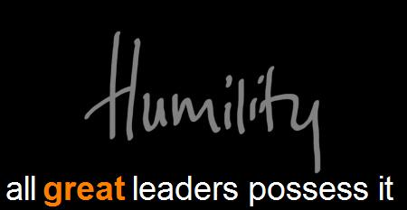
1. A right perspective toward God
“Serving the Lord with all humility of mind, and with many tears, and trials.”

Slide 34

2. A right perspective toward the church
“And how I kept back nothing that was profitable unto you, but have shown you, and have taught you publicly.”

Slide 35
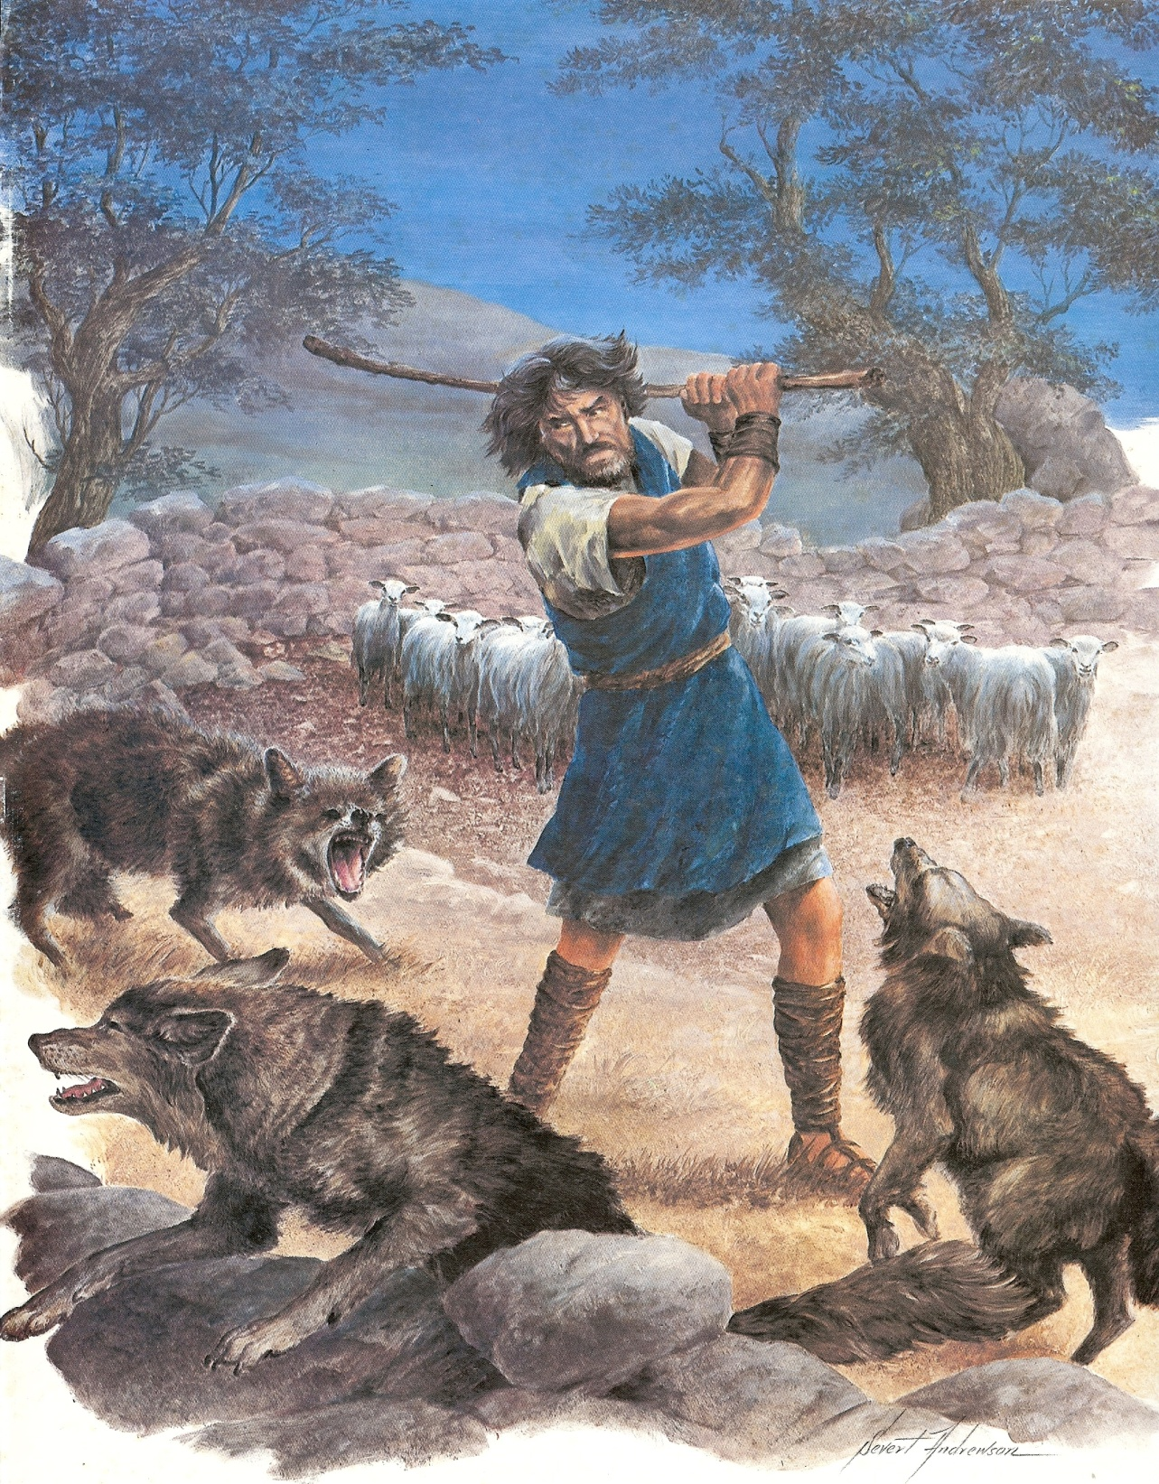

Slide 36
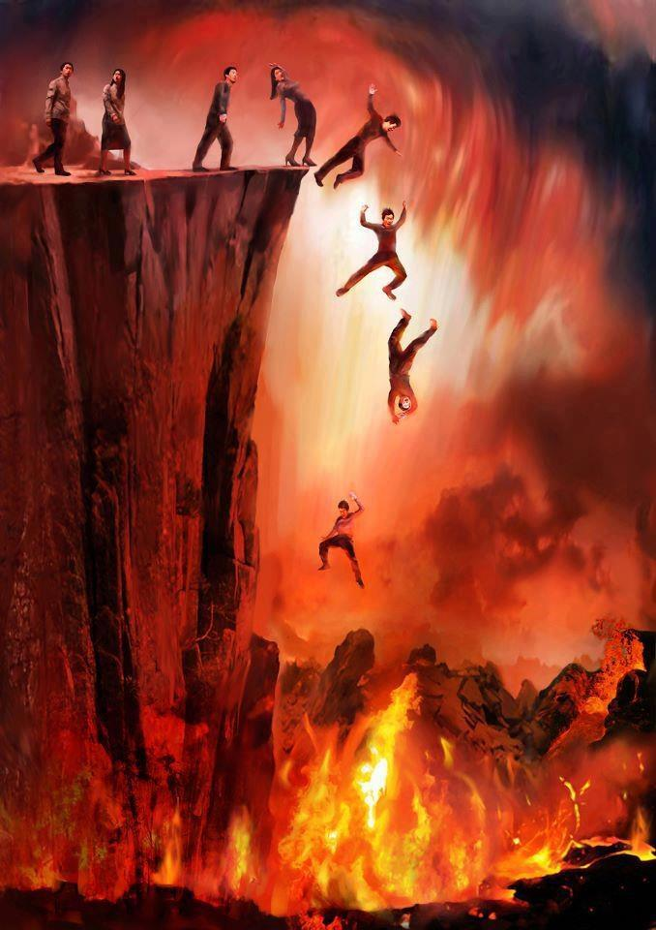
3. A right perspective toward the lost
“And from house to house, testifying both to the Jews and also to the Greeks, repentance toward God, and faith toward our
Lord Jesus Christ.”

Slide 37

4. A right perspective toward himself
“And now, behold, I go bound in the spirit unto Jerusalem, not knowing the things that shall befall me there.”

