Slide 1
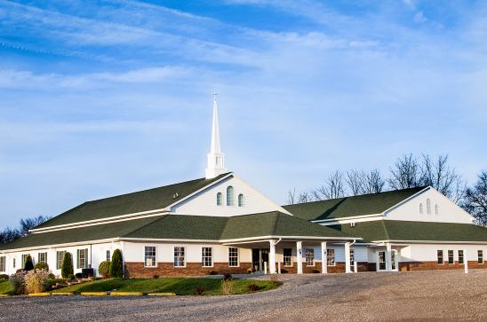
The Doctrine of the Church
The Six Symbols of the Church

Slide 2


Slide 3
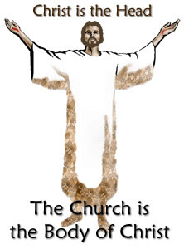
1. The Head of the Body

Slide 4
"For as we have many members in one body, and all members have not the same office: so we, being many, are one body in Christ, and every one members one of another" (Rom. 12:4-5)
"Know ye not that your bodies are the members of Christ?" (1 Cor. 6:15)
"For as the body is one, and hath many members, and all the members of that one body, being many, are one body: so also is Christ. For by one Spirit are we all baptized into one body" (1 Cor. 12:12-13)
"Now ye are the body of Christ, and members in particular" (1 Cor. 12:27)
"There is one body, and one Spirit" (Eph. 4:4)
"For we are members of his body, of his flesh, and of his bone" (Eph. 5:30)
"And he is the head of the body, the church" (Col. 1:18; see also 1 Cor. 10:16-17; Eph. 1:23; 2:16; 4:12, 16; 5:23; Col. 3:15)

Slide 5
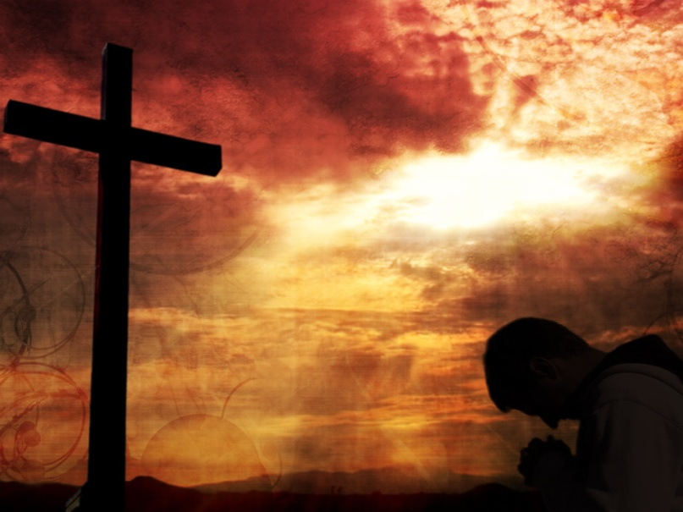

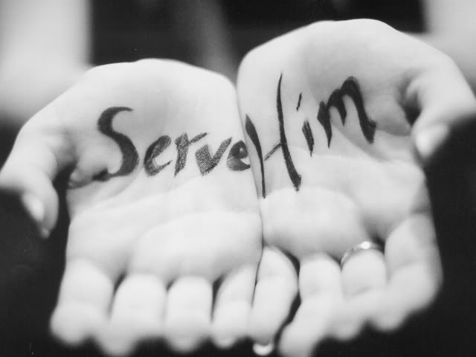

Christ the head / The Church the Body
Be in subjection to the Head – Eph. 5:24
Experience unity with the Head - Eph. 4:3-4
Work in glad service for the Head – Col. 1:18
Take direction from the Head – Eph. 1:22

Slide 6
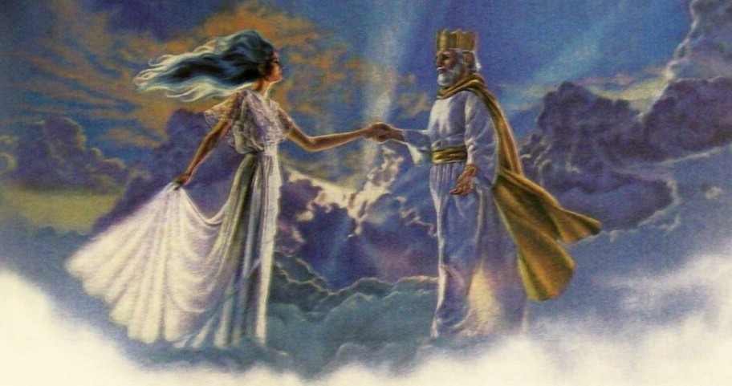
2. The Bridegroom and the Bride

Slide 7
"Husbands, love your wives, even as Christ also loved the church and gave himself for it; that he might sanctify and cleanse it with the washing of water by the word; that he might present it to himself a glorious church, not having spot, or wrinkle, or any such thing; but that it should be holy and without blemish. So ought men to love their wives as their own bodies. He that loveth his wife loveth himself. For no man ever yet hated his own flesh; but nourisheth and cherisheth it, even as the Lord the church: For we are members of his body, of his flesh, and of his bones. For this cause shall a man leave his father and mother, and shall be joined unto his wife, and they two shall be one flesh. This is a great mystery; but I speak concerning Christ and the church" (Eph. 5:25-32)

Slide 8
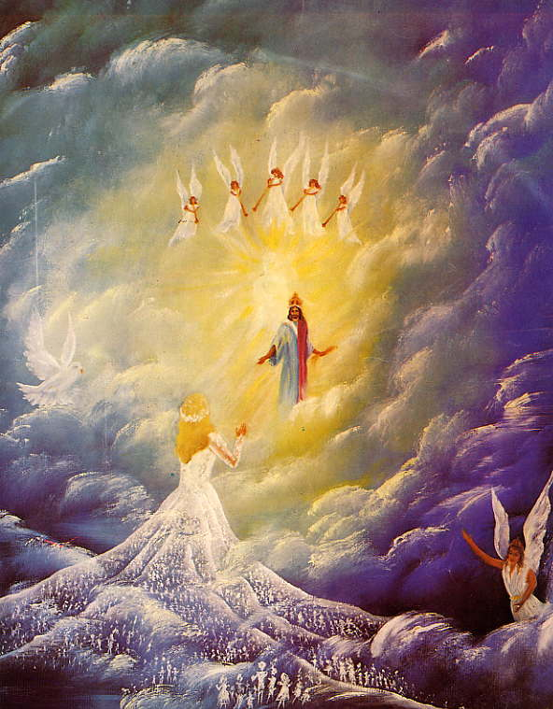
Rapture of the church the Bride
“For this we say unto you by the word of the Lord, that we which are alive and remain unto the coming of the Lord shall not prevent them which are asleep. For the Lord himself shall descend from heaven with a shout, with the voice of the archangel, and with the trump of God:

Slide 9
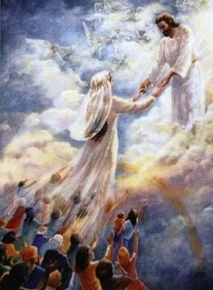
and the dead in Christ shall rise first: Then we which are alive and remain shall be caught up together with them in the clouds, to meet the Lord in the air: and so shall we ever be with the Lord. Wherefore comfort one another with these words.”
(1 Thess. 4:15-18)

Slide 10
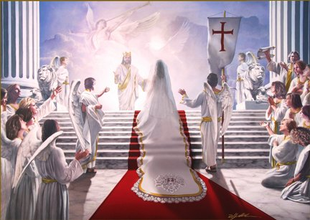
"For I am jealous over you with Godly jealousy: for I have espoused you to one husband, that I may present you as a chaste virgin to Christ" (2 Cor. 11:2)

Slide 11
Marriage supper of the Lamb
(Revelation 19:7-9)
“Let us be glad and rejoice, and give honour to him: for the marriage of the Lamb is come, and his wife hath made herself ready. And to her was granted that she should be arrayed in fine linen, clean and white: for the fine linen is the righteousness of saints. And he saith unto me, Write, Blessed are they which are called unto the marriage supper of the Lamb. And he saith unto me, These are the true sayings of God.”

Slide 12
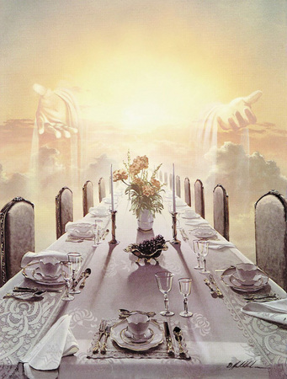
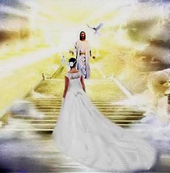

Slide 13
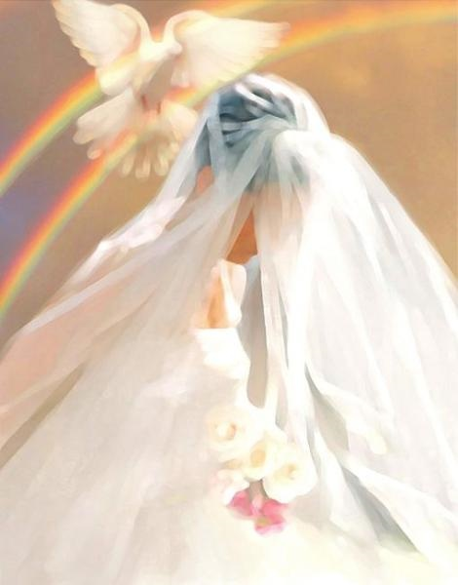
Christ love for His Church
Sacrifice without complaint – (John 10:15; I Peter 2:23)
Forgiveness without reminder – (Psalms 103:12)
Giving without getting – (John 3:16)
Selflessness without resentment – (Luke 23:34)
Unconditional Love – (I Corinthians 13:1-7)

Slide 14
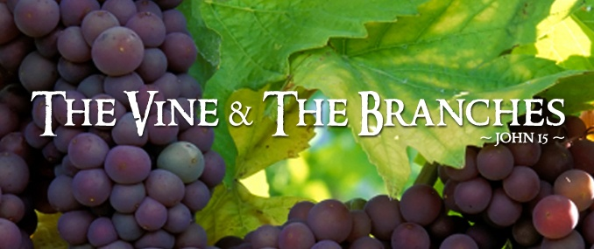
3. The Vine and the Branches

Slide 15
"I am the true vine, and my Father is the husbandman. Every branch in me that beareth not fruit he taketh away; and every branch that beareth fruit, he purgeth it, that it may bring forth more fruit. Now ye are clean through the word which I have spoken unto you. Abide in me, and I in you. As the branch cannot bear fruit of itself, except it abide in the vine; no more can ye, except ye abide in me. I am the vine, ye are the branches: He that abideth in me, and I in him, the same bringeth forth much fruit: for without me ye can do nothing" (John 15:1-5)

Slide 16
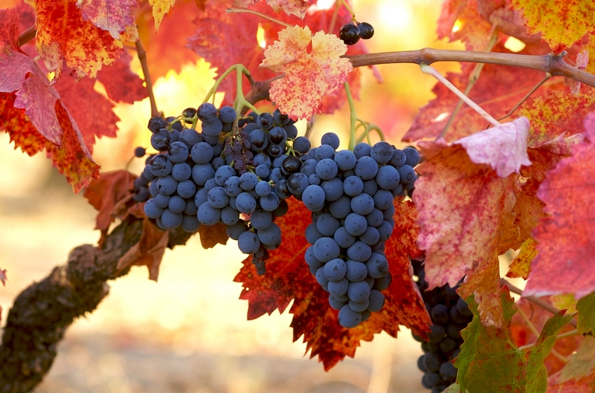
The Secret of Bearing Fruit
(John 15)

Slide 17
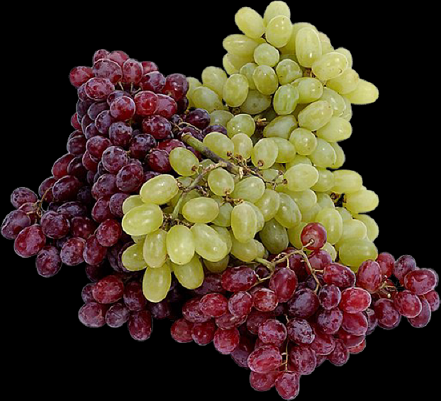
“Ye have not chosen me, but I have chosen you, and ordained you, that ye should go and bring forth fruit, and that your fruit should remain… Herein is my Father glorified, that ye bear much fruit; so shall ye be my disciples.”

Slide 18
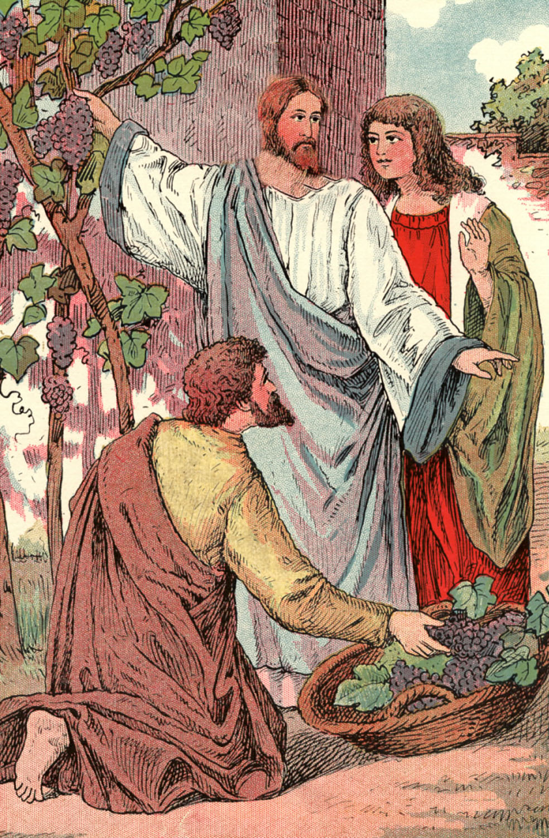
“I am the true vine, and my Father is the husbandman.
Every branch in me that beareth not fruit he taketh away: and every branch that beareth fruit, he purgeth it, that it may bring forth more fruit.”

Slide 19
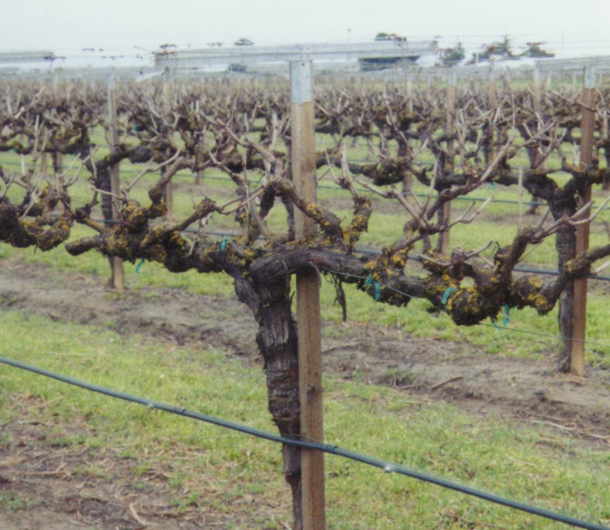

Slide 20
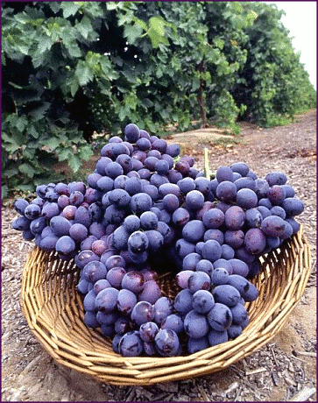

Slide 21
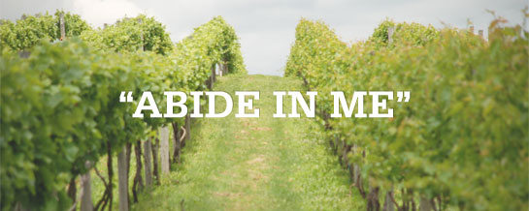
1. The secret of fruit bearing is abiding
“Now ye are clean through the word which I have spoken unto you. Abide in me, and I in you. As the branch cannot bear fruit of itself, except it abide in the vine; no more can ye, except ye abide in me…”

Slide 22
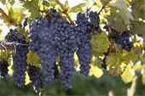
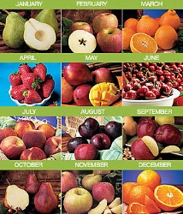
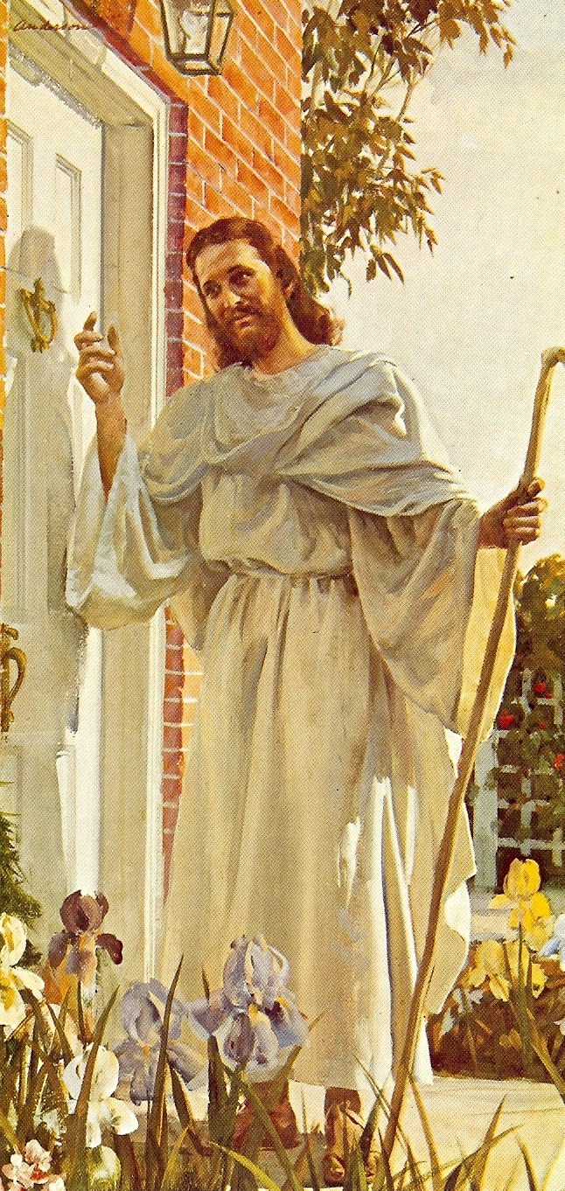

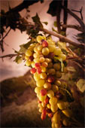
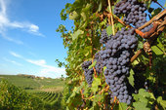
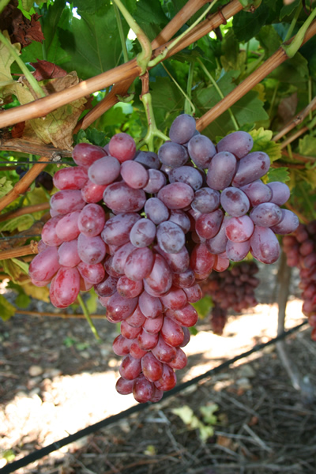
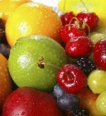
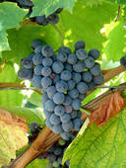
“ I am the vine, ye are the branches: He that abideth in me, and I in him, the same bringeth forth much fruit: for without me ye can do nothing.”

Slide 23
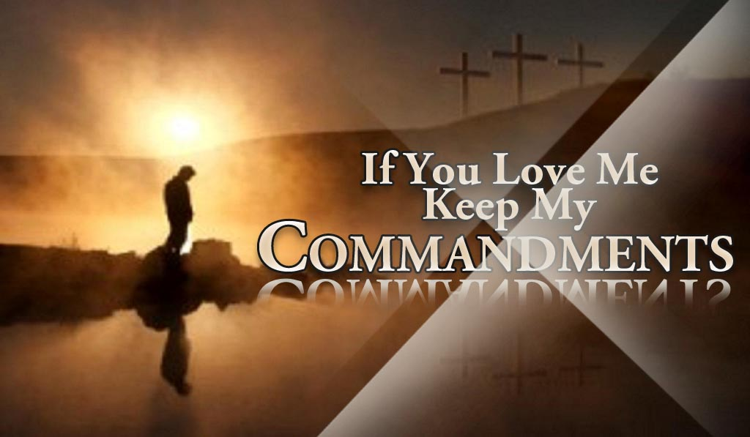
2. The secret of abiding is obeying
“If ye keep my commandments, ye shall abide in my love; even as I have kept my Father's commandments, and abide in his love…”

Slide 24
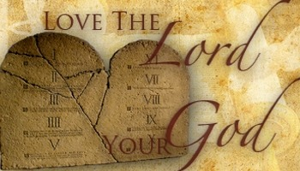
3. The secret of obeying is loving
“Herein is my Father glorified, that ye bear much fruit; so shall ye be my disciples. As the Father hath loved me, so have I loved you: continue ye in my love…”

Slide 25

4. The secret of loving is knowing
“Ye are my friends, if ye do whatsoever I command you. Henceforth I call you not servants; for the servant knoweth not what his lord doeth: but I have called you friends…”

Slide 26

“These things have I spoken unto you, that my joy might remain in you, and that your joy might be full…”

Slide 27
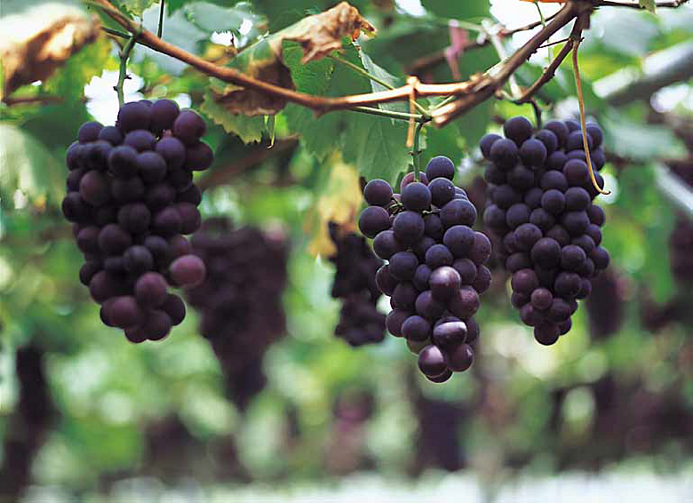
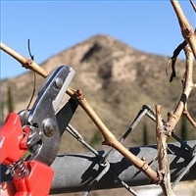
“Every branch that beareth fruit, he purgeth it, that it may bring forth more fruit…”

Slide 28
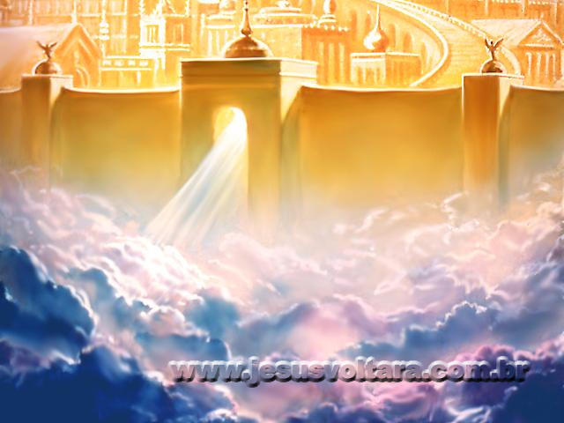
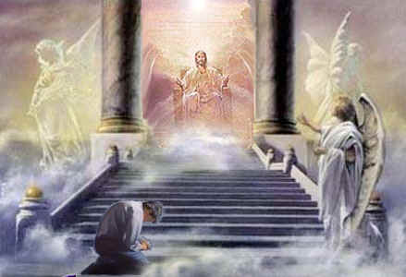
“And now, little children, abide in him; that, when he shall appear, we may have confidence, and not be ashamed before him at his coming…”

Slide 29
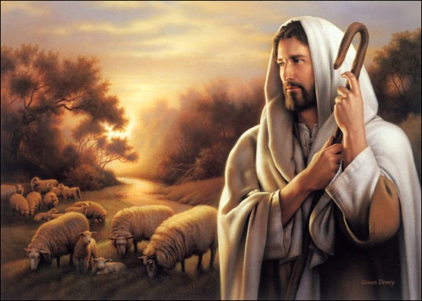
4. The Shepherd and the Sheep

Slide 30
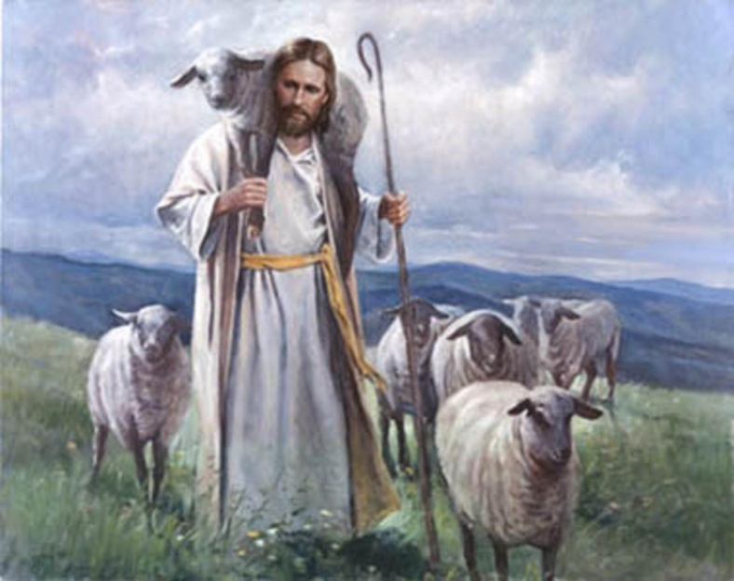
"I am the good shepherd; the good shepherd giveth his life for the sheep" (John 10:11)
"Now the God of peace, that brought again from the dead our Lord Jesus, that great shepherd of the sheep, through the blood of the everlasting covenant" (Heb. 13:20)
"And when the chief Shepherd shall appear, ye shall receive a crown of glory that fadeth not away" (I Pet. 5:4)

Slide 31
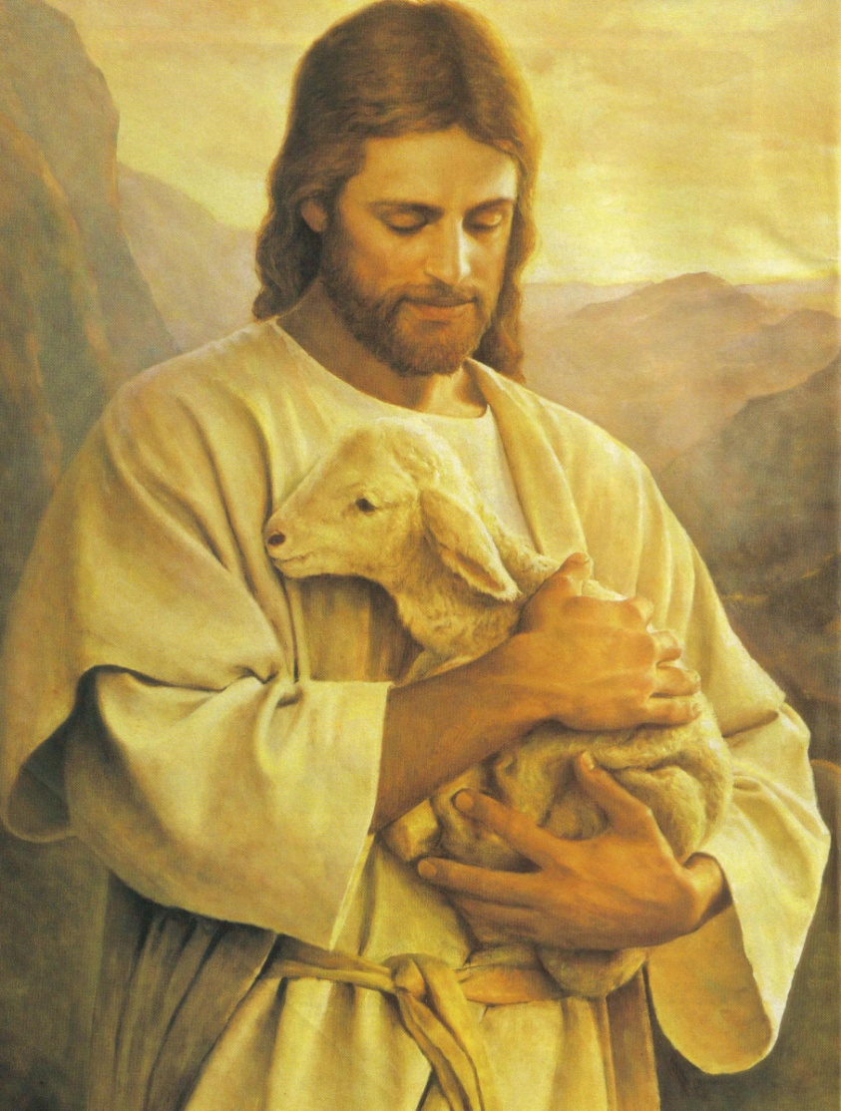
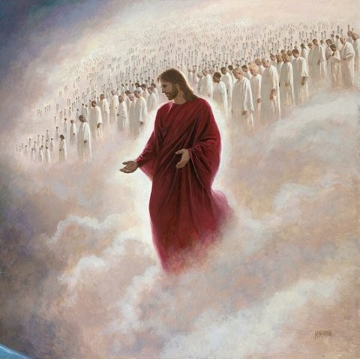
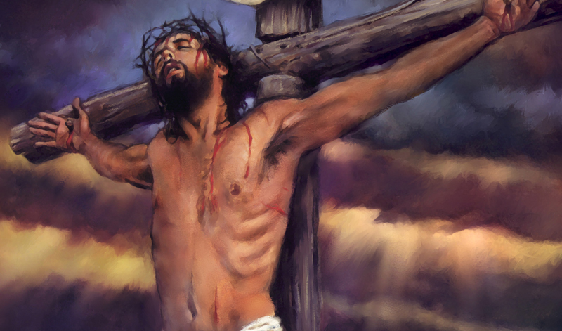
The Great Shepherd – “Cars and provides for His sheep”
The Good Shepherd – “Gave His life for the Sheep.
The Chief Shepherd – “Will one day return for His sheep”

Slide 32
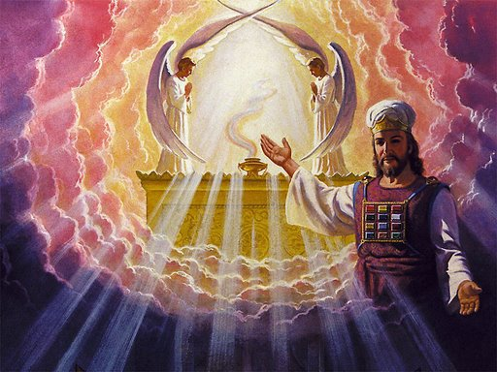
5. The High Priest and a Kingdom of Priests

Slide 33
The Church as Priest unto God
"But ye are a chosen generation, a royal priesthood, an holy nation, a peculiar people; that ye should show forth the praises of him who hath called you out of darkness into his marvelous light" (I Pet. 2:9)
"And hath made us kings and priests unto God and his father" (Rev. 1:6)
"And hast made us unto our God kings and priests: and we shall reign on the earth" (Rev. 5:10)
"But they shall be priests of God and of Christ, and shall reign with him a thousand years" (Rev. 20:6)

Slide 34
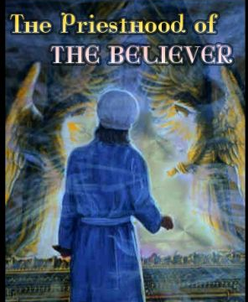

Slide 35
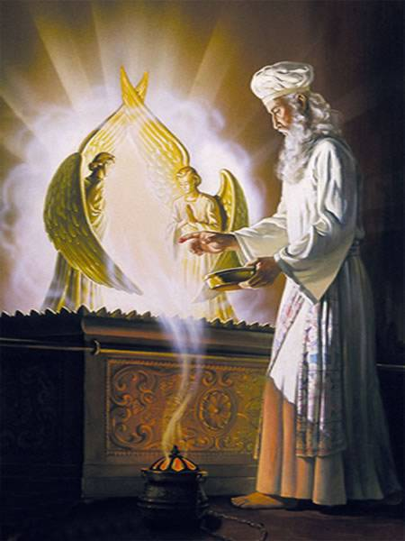
The Old Testament priest was to offer up an animal sacrifice. The New Testament priest is to offer up sacrifices also, but of a different kind. He is to offer up:
The sacrifice of his body as a living offering (Rom. 12:1)
The sacrifice of praise (I Pet. 2:5, 9; Heb. 13:15)
The sacrifice of doing good (Heb. 13:16)
The sacrifice of substance (Heb. 13:16)

Slide 36
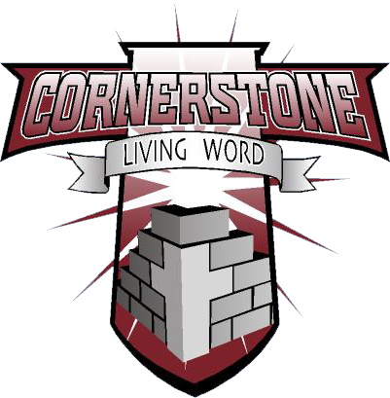
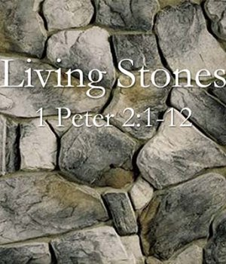
6. The Cornerstone and the Living Stones

Slide 37
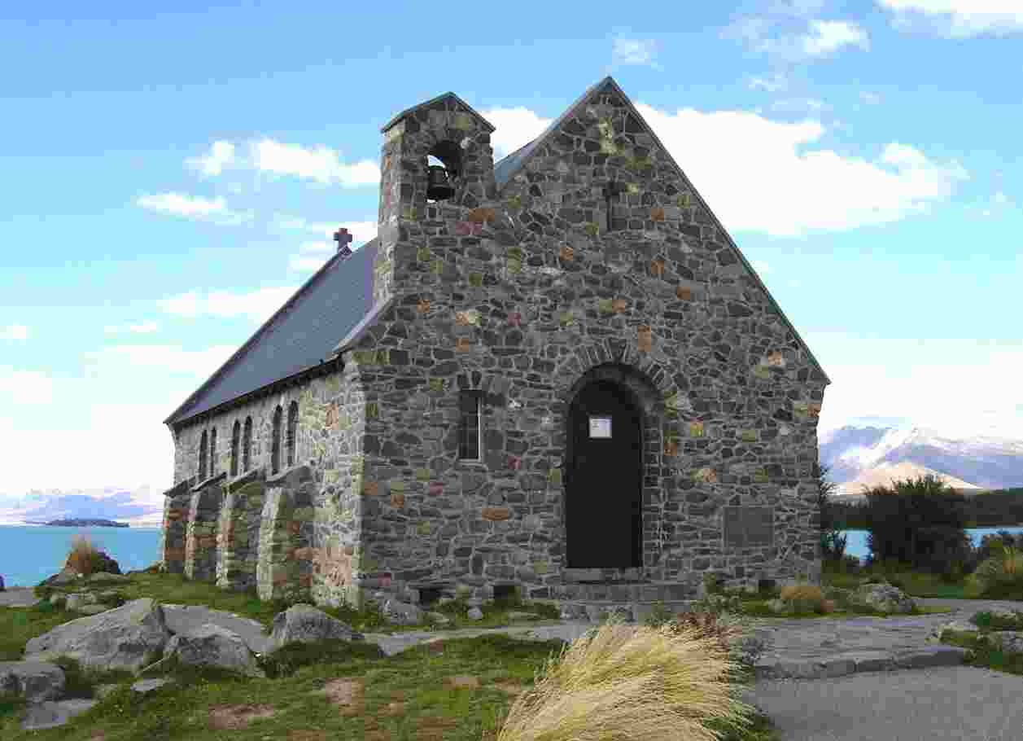
"To whom coming, as unto a living stone, disallowed indeed of men, but chosen of God, and precious, ye also, as lively stones, are built up a spiritual house, an holy priesthood, to offer up spiritual sacrifices, acceptable to God by Jesus Christ" (I Pet. 2:4-5)

Slide 38
"Now therefore ye are no more strangers and foreigners, but fellow-citizens with the saints, and of the household of God; and are built upon the foundation of the apostles and prophets, Jesus Christ himself being the chief corner stone; in whom all the building fitly framed together groweth unto an holy temple in the Lord: In whom ye also are builded together for an habitation of God through the Spirit”
(Eph. 2:19-22)

Slide 39


Slide 40
I Cor. 3:16 “Know ye not that ye are the temple of God, and that the Spirit of God dwelleth in you?”
Temple (Naos), referring to the holy place and the Holy of Holies
Lev. 20:7 “Sanctify yourselves therefore, and be ye holy: for I am the LORD your God.”
I Pet. 1:15 “But as he which hath called you is holy, so be ye holy in all manner of conversation.”
I Pet. 1:16 “Because it is written, Be ye holy; for I am holy.”

Slide 41
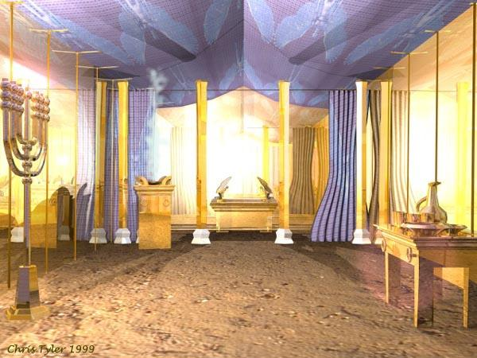
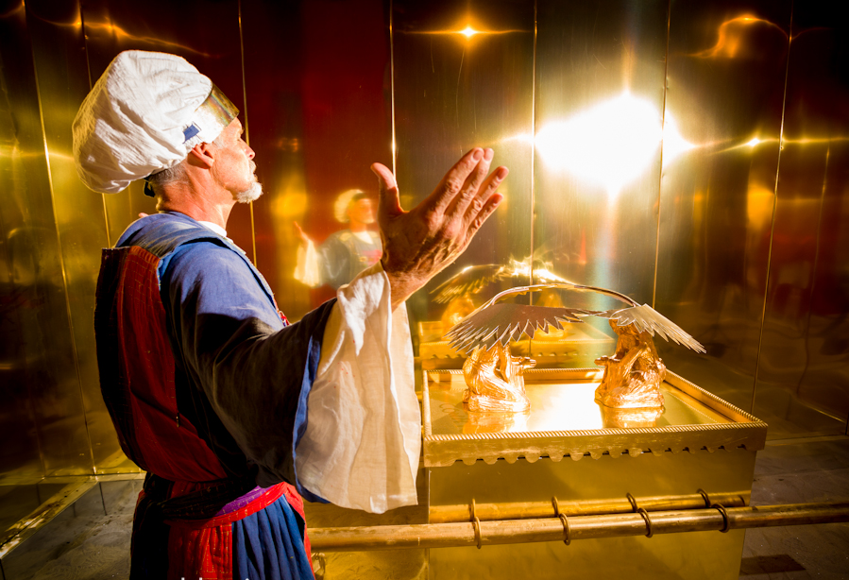

Slide 42
Symbols of the Church
The Head of the Body
The Bridegroom and the Bride
The Vine and the Branches
The Shepherd and the Sheep
The High Priest and the Kingdom of Priest
The Cornerstone and the Living Stones

