Slide 1
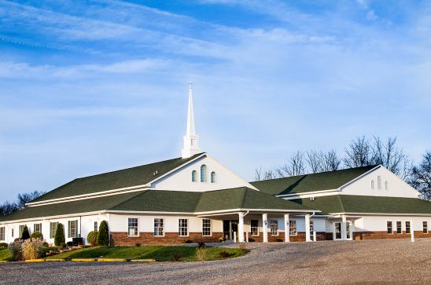
The Doctrine of the Church
How to build the Church God’s Way

Slide 2

God’s methods vs.
Our methods of
Building the church of Jesus Christ

Slide 3
“I will build my church; and the gates of hell shall not prevail against it…” Matthew 16:18
“Except the Lord build the house, they labor in vain that build it…” Psalm 127:1
“Therefore whosoever heareth these sayings of mine, and doeth them, I will liken him unto a wise man, which built his house upon a rock…and every one that heareth these sayings of mine, and doeth them not, shall be likened unto a foolish man, which build his house upon the sand…” Matthew 7:24, 26

Slide 4
“As a wise masterbuilder, I have laid the foundation, and another buildeth thereon. But let every man take heed how he buildeth thereupon. For other foundation can no man lay than that is laid, which is Jesus Christ…” I Cor. 3:10
“Now therefore ye are no more strangers and foreigners, but fellowcitizens with the saints, and of the household of God; And are built upon the foundation of the apostles and prophets, Jesus Christ himself being the chief corner stone; In whom all the building fitly framed together groweth unto an holy temple in the Lord. In whom ye are also builded together for an habitation of God through the Spirit…” Eph. 2:19-21

Slide 5
We build our Church / God builds His Church – Isa. 55:8-9; Matt. 16:18
We add members to our Church / God adds Believers to His Church – Acts 2:47; I John 2:19
We borrow for our Church / God pays for His Church – Matt. 6:24; Phil. 4:19
We make sinners comfortable in our Church / God makes sinners uncomfortable in His Church – Acts 5:13; II Tim. 4:2
We bring the world into our Church / God sends His Church into the World – John 17

Slide 6
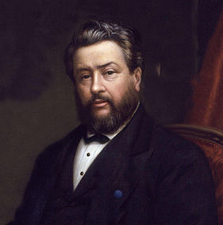
Charles Spurgeon – “The devil hath seldom done a cleverer thing than hinting to the church that part of its mission is to provide entertainment to the people, with the view of wining them to Christ…Providing amusement for the people is nowhere spoken of in the Scriptures as a function of the Church…Entertainment ministries will, in the long term promote worldliness…”
1834-1892

Slide 7
We chose our pastors in our Church / God gives pastors to His Church – Eph. 4:11-12; I Cor. 12:11, 18
We appoint Church leaders with man’s credentials in our Church / God appoints men with His credentials in His Church – Jer. 3:15; Titus 1:5-9
We rule our Church by majority vote / God rules His Church through the pastoral leadership - Heb. 13:7, 17; I Tim. 5:17; I Thess. 5:12-14
We play the worlds music to reach the lost in our Church / God wants the music in His Church to exalt Him and edify believers – Ps. 149:1; II Cor. 6:14-7:1; Eph. 5:18-1

Slide 8
We entertain our youth in our Church / God challenges youth in His Church – I Tim. 4:12; I John 2:14; Titus 2:6
We call for the doctors first in our Church / God wants us to call for the Elders first in His Church – Mark 5:26; James 5:14-16
We major on feasting and fellowship in our Church / God urges fasting and prayer in His Church - Mark 9:29; Luke 5:34-35
We focus on quick results in our Church / God focuses on lasting fruit in His Church– John 15:1-17; I Cor. 15:58

Slide 9
We measure a churches spiritual maturity by the number of people attending, amount of ministry the church is involved in and how much money the church collects.
God measures the spiritual maturity of a church by -
> The yieldedness of each member to the Lord - (Eph. 6:6)
> The holiness of the church body - (Rom. 12:1-2)
> A loving spirit within the fellowship - (I Cor. 13:1-8)
> The ability of the church to teach and apply Biblical principles (obedience) - (Heb. 5:11-14)
> And the fulfilling of the Great Commission - (Matt. 28:19-20)

Slide 10
