Slide 1

The Revelation of Jesus Christ
A study of the book
of Revelation

Slide 2
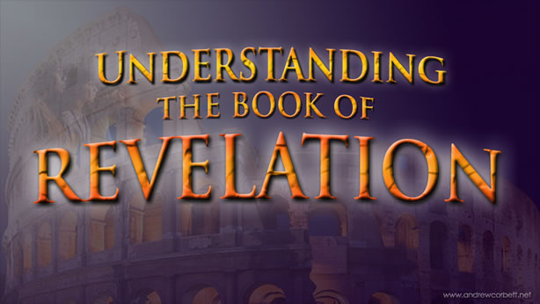

Slide 3

Revelation 1:1-19
“The Revelation of Jesus Christ”

Slide 4
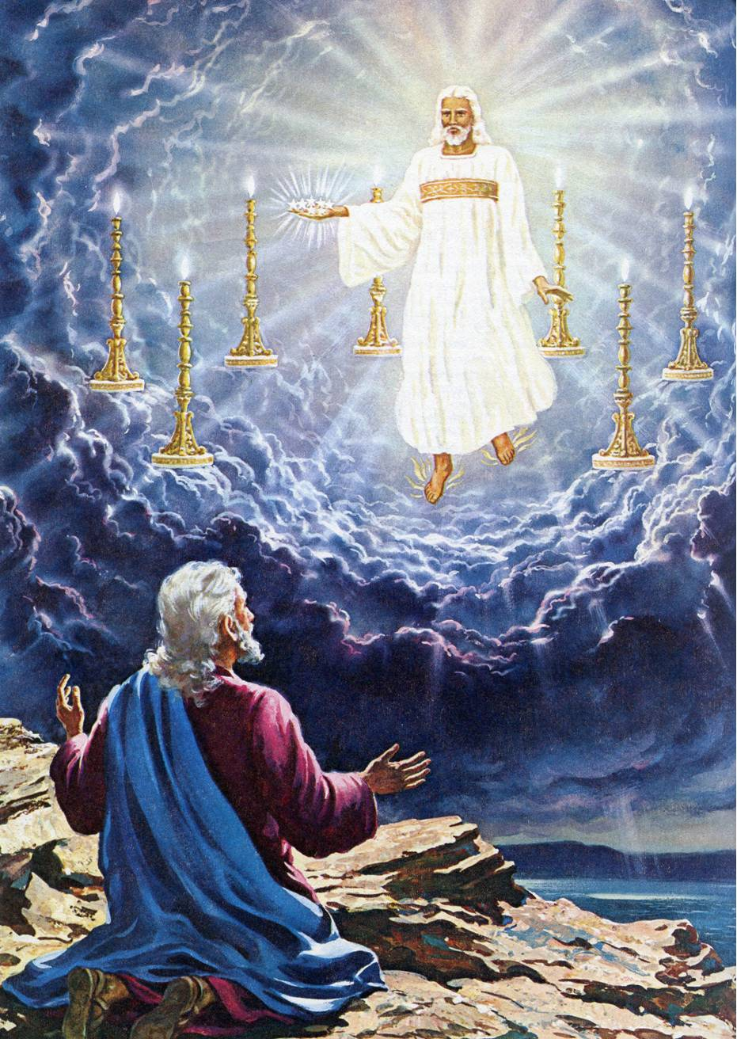
“The Revelation of Jesus Christ, which God gave unto him, to shew unto his servants things which must shortly come to pass…”

Slide 5
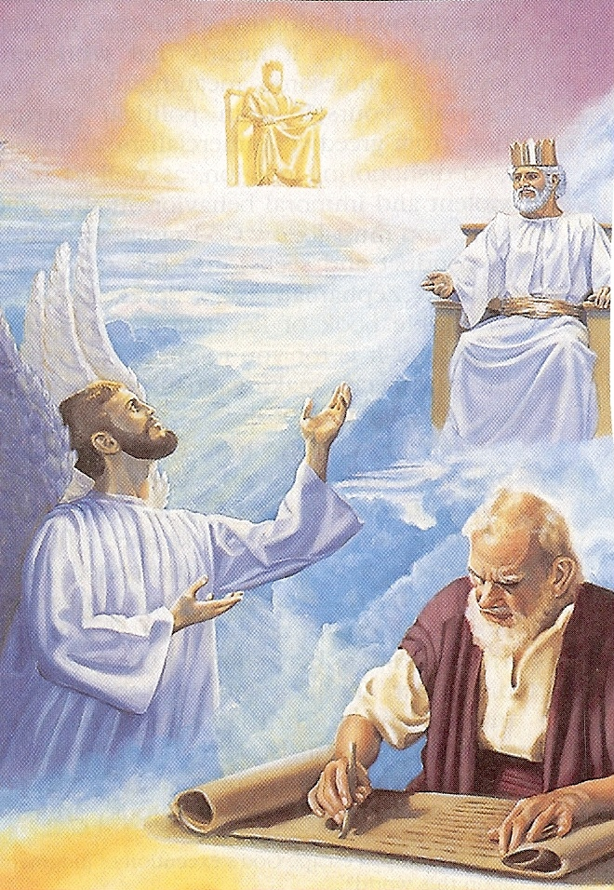
“…and he sent and signified (to make known by signs, speech, or action) it by his angel unto his servant John.”

Slide 6
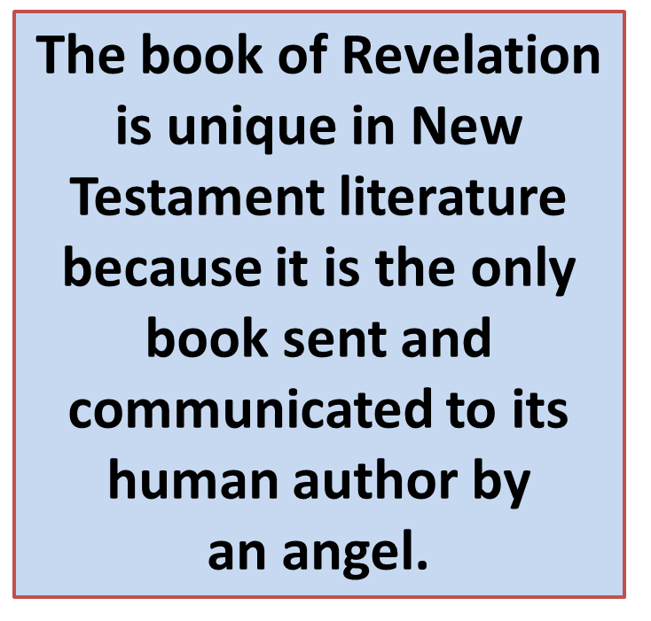

Slide 7
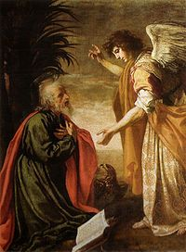
“I Jesus have sent mine angel to testify unto you these things in the churches.” (Rev. 22:16)

Slide 8
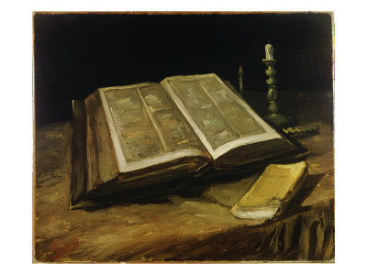
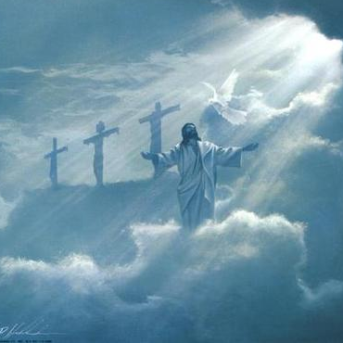
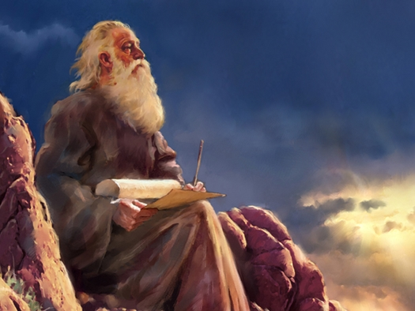
“Who bare record of the Word of God, and the testimony of Jesus Christ, and of all things that he saw.”

Slide 9
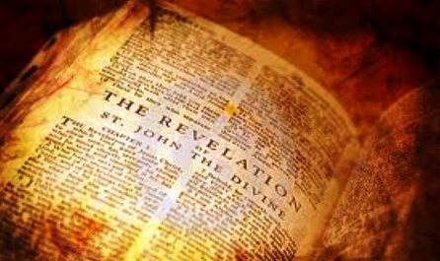
“Blessed is he that readeth, and they that hear the words of this prophecy, and keep those things which are written therein: for the time is at hand.”

Slide 10
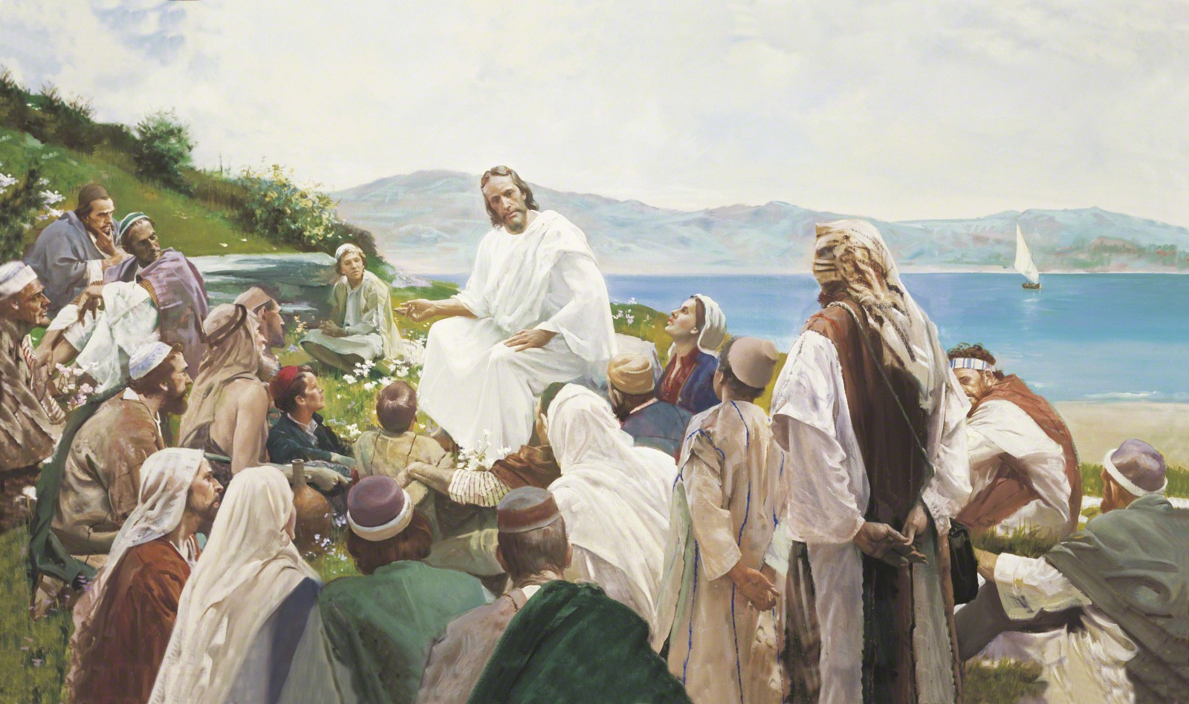
“Blessed are they that hear the Word of God, and keep it.” (Luke 11:28)

Slide 11
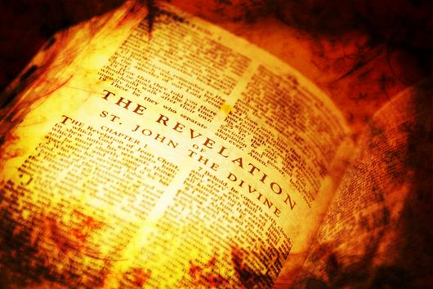
The Blessings of the
Book of Revelation
The blessing of obedience – 1:3; 22:7, 14
The blessing of eternal life – 14:13
The blessing of purity in life – 16:15
The blessing of being called to the marriage supper of the Lamb – 19:9
The blessing of the resurrection – 20:6

Slide 12
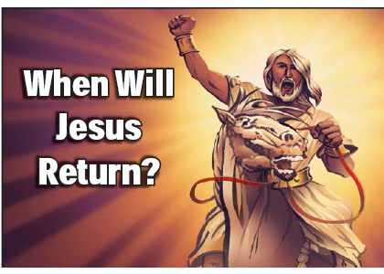

Slide 13
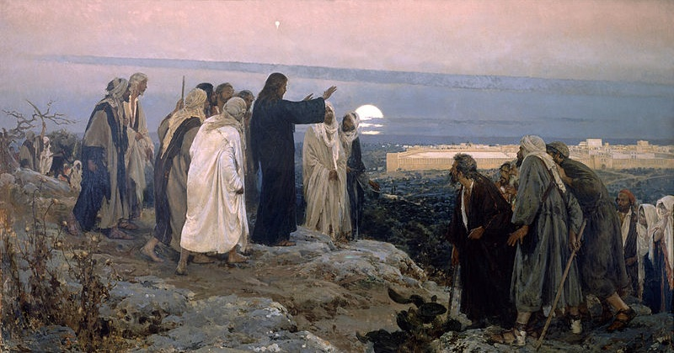
Signs of Christ Coming
“And as he sat upon the mount of Olives, the disciples came unto him privately, saying, Tell us, when shall these things be? and what shall be the sign of thy coming, and of the end of the world?” (Matthew 24:3)

Slide 14
The Signs of the Times
Daniel chapter 7-12
Matthew chapter 24
Mark chapter 13
Luke chapter 21
Epistles of Paul
Revelation

Slide 15

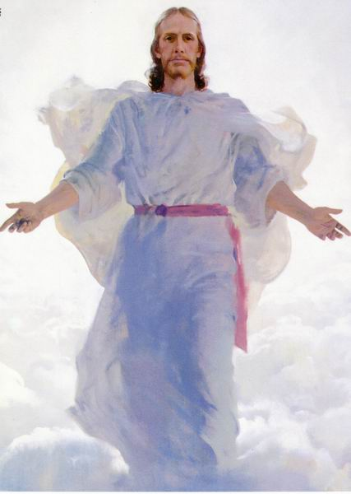
Increase of false religion
False religious leaders
False prophets (teachers)
False Christ
Many Anti-Christ’s
Hardness to the gospel
Breakup of the traditional family
Betrayal of friends and family members
Domestic violence will be ramped
Lawlessness will increase

Slide 16
Spiritual apathy / Lukewarm
Church will have a form of Godliness but no power
Christians will be unfaithful to the Lord and His Church
Many unbelievers will be within the Church
Church we be contemporary, full of compromise and worldliness
Great falling away from the fundamental truths of Scripture
Increase of sin and wickedness

Slide 17
Increase of occult activity and involvement
Spiritual blindness
Speed and ease of travel
Acceleration of knowledge
Increase in scientific knowledge
Increase in medical knowledge
Communication breakthroughs
Increase in technical knowledge
Computer age/Internet
One world economy

Slide 18
One world currency
Cashless society
One world money market
Movement towards a one world church Ecumenicalism will increase
Mocking of Biblical truth
Men will be arrogant and prideful
Increase of diseases
Climate change / Natural disasters
Famines / Pestilences

Slide 19
Powerful earthquakes
Hurricanes
Tsunamis
Expansion of Governmental control over society
Increase of immorality
Breakdown of moral values
The acceptance of Sodomy (homosexuality)
Men will live for the fulfillment fleshly desires
Rebellion towards authority

Slide 20
Greed / Covetousness
Lack of self-control
Increase of war
Terrorism through out the world
Perilous time
Men will be…
Unthankful
Unholy
Liars
Selfish
Despise those that do good

Slide 21
Men will call evil good and good evil
Lovers of pleasure more then lovers of God
Increase of scoffers and mockers
Increase in the enemies of the cross of Christ
Evil men and seducers will wax worse and worse
Men will glory in things that they ought to be ashamed of
Ability to mark people for identification purposes
Preparations for the rebuilding of the Jewish temple
Worldwide preaching of the Gospel

Slide 22
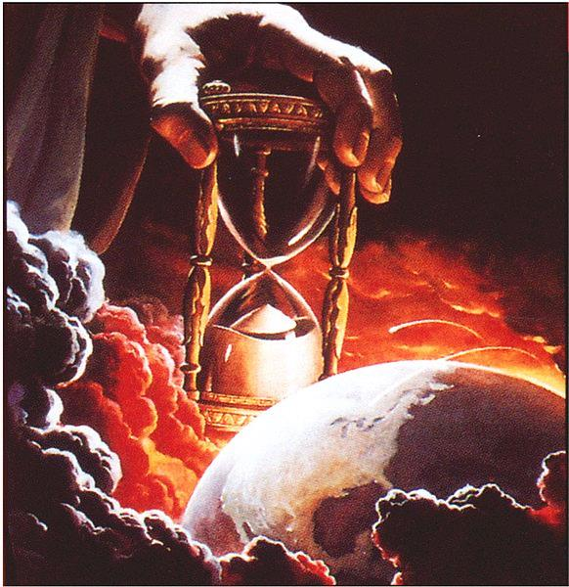
“The time is at hand…”
Nothing else has to occur before the Rapture and the Tribulation period.

Slide 23
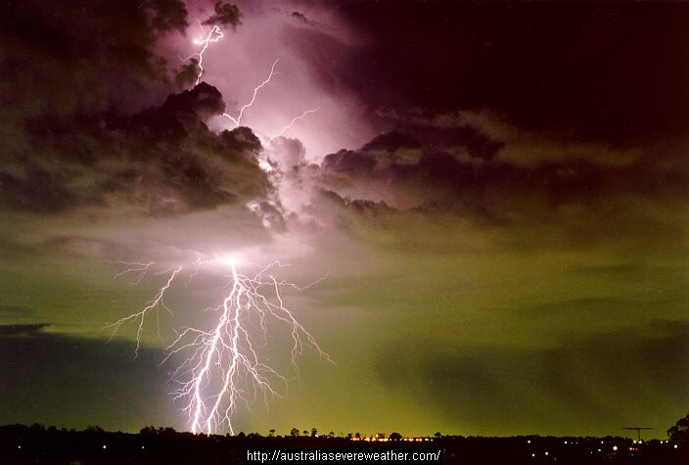
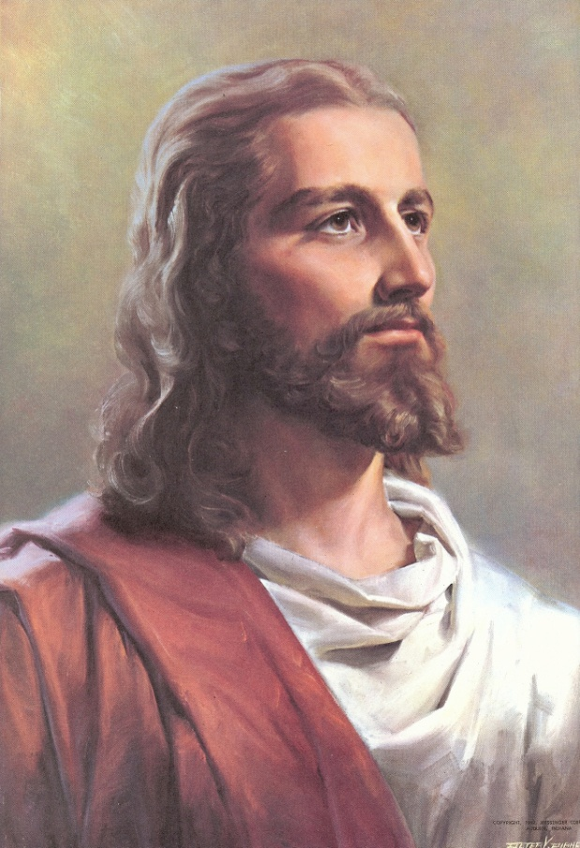
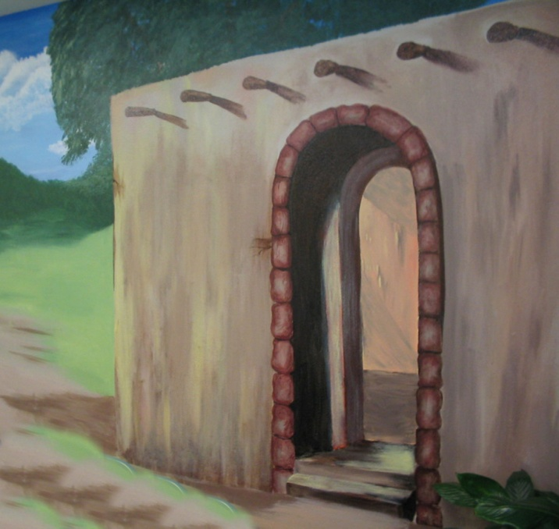
“So likewise ye, when ye shall see all these things, know that it is near, even at the door.”
( Mt. 24:33)

Slide 24
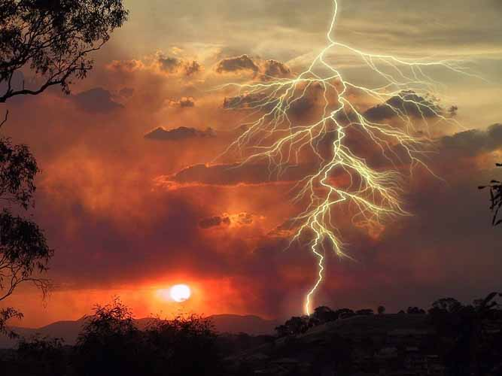
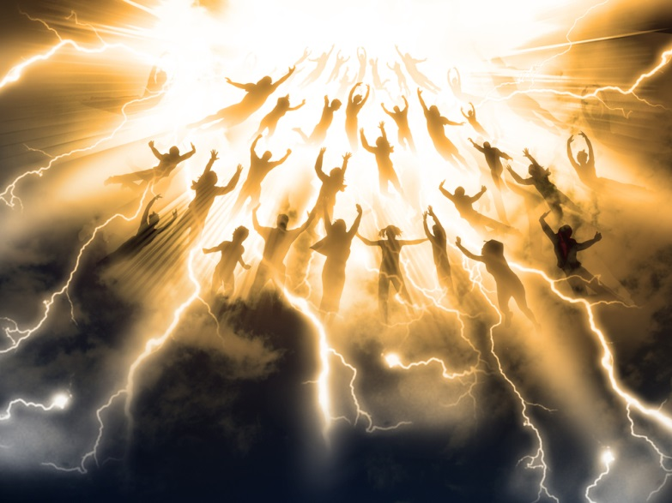

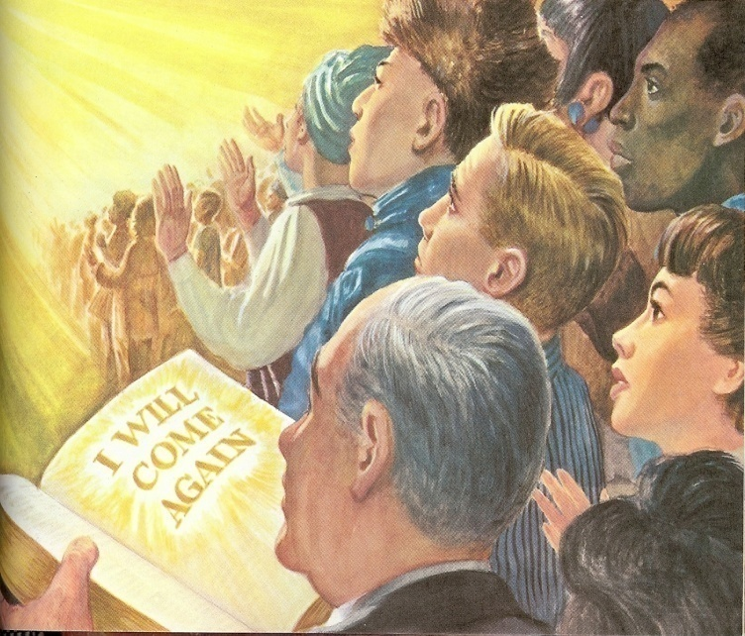
“When these things begin to come to pass, then look up… for your redemption draweth nigh.”
(Luke 21:28)

Slide 25
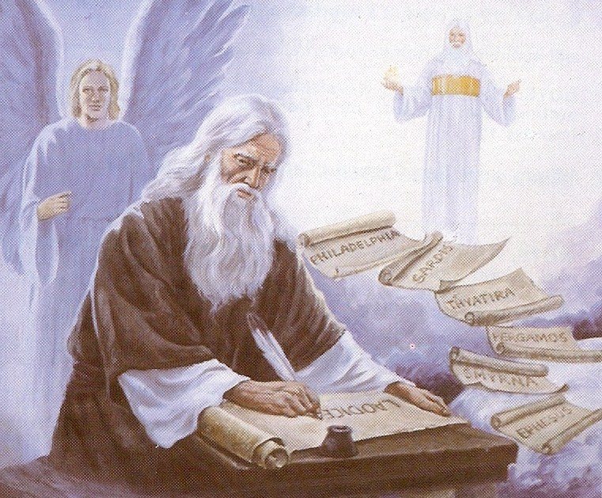
“John to the seven churches which are in Asia…”

Slide 26
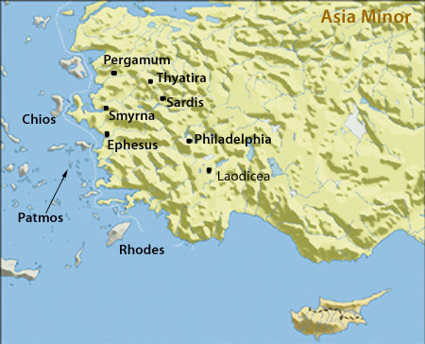

Slide 27
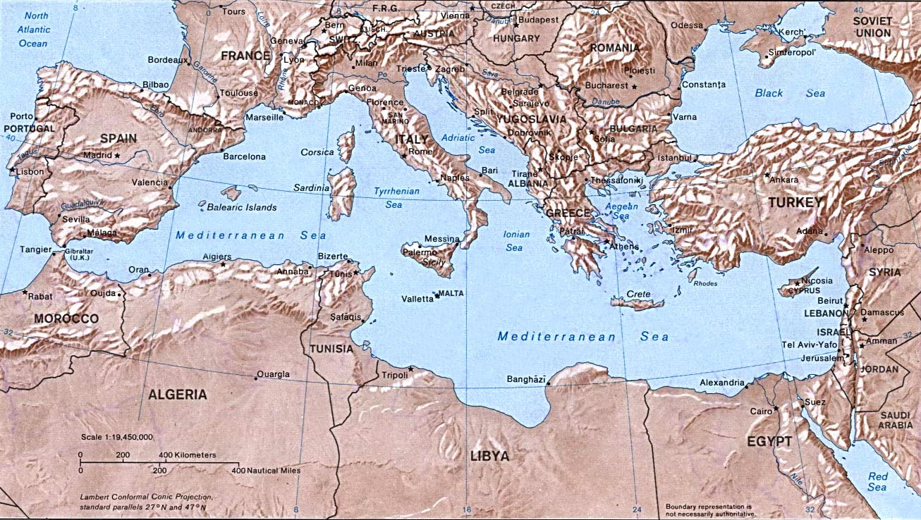
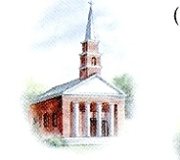




“…Grace be unto you, and peace…”

Slide 28
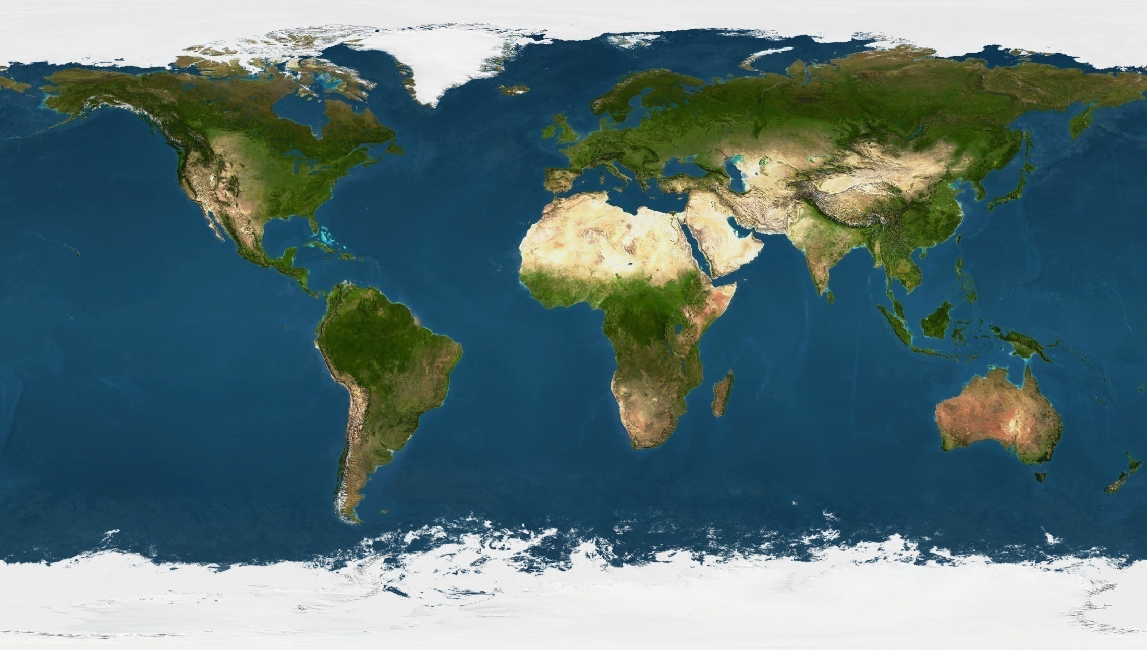
Matt. 24:14 “And this gospel of the kingdom shall be preached in all the world for a witness unto all nations; and then shall the end come.”

Slide 29


Slide 30

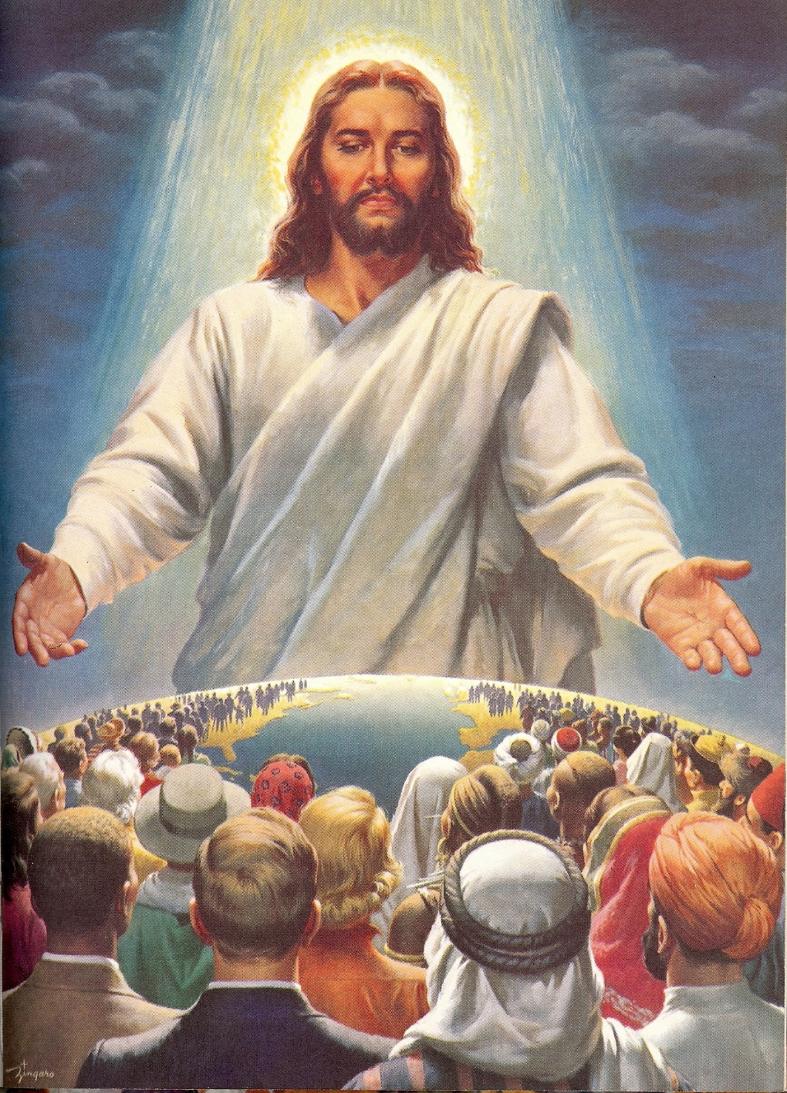

Slide 31
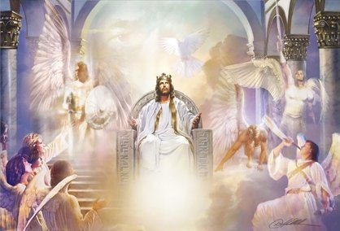
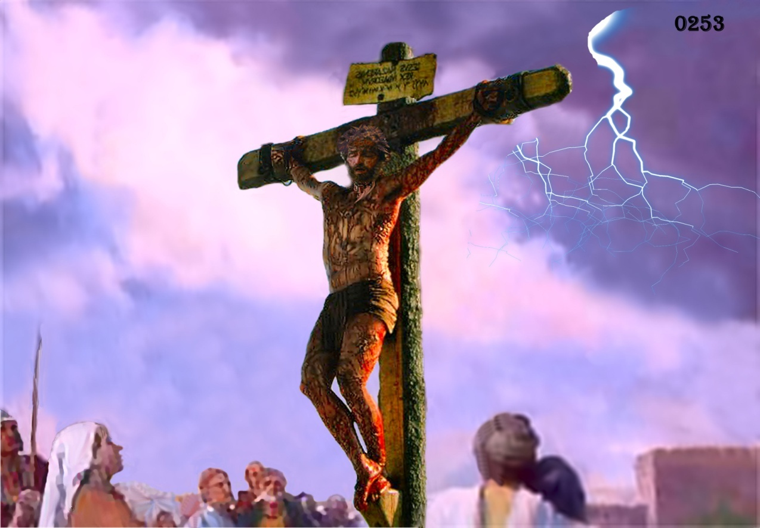
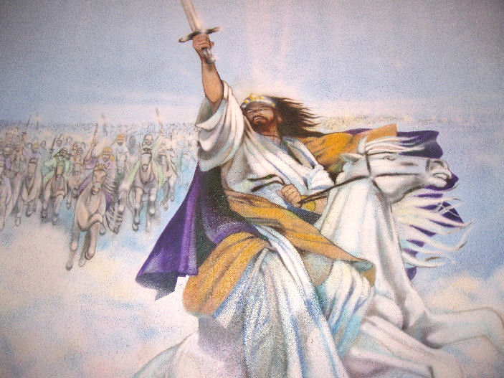
“…from him which is, and which was, and which is to come…”

Slide 32
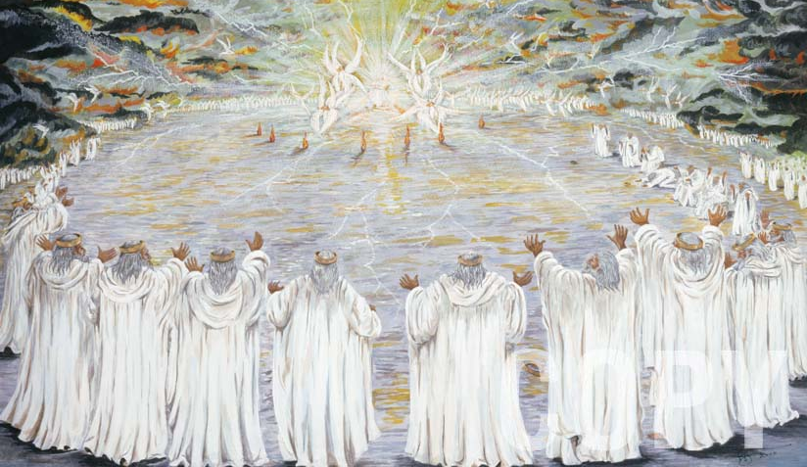
“…and from the seven Spirits which are before his throne.”

Slide 33
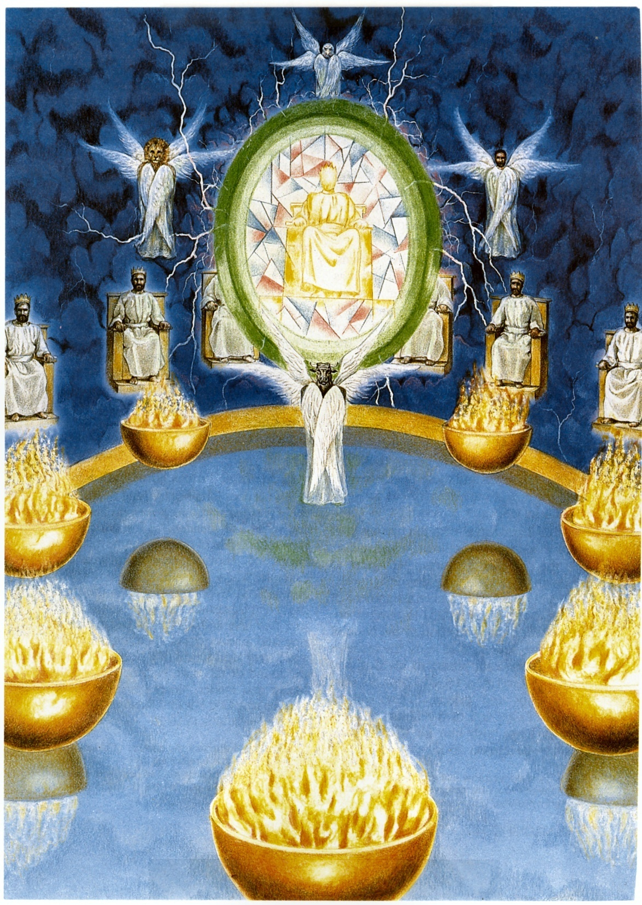
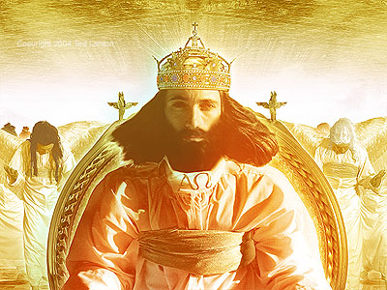

The Seven Spirits of God
(Revelation 4:1-11;
Isaiah 11:2)
Spirit of the Lord
Spirit of wisdom
Spirit of understanding
Spirit of counsel
Spirit of might (power)
Spirit of knowledge
Spirit of the fear of the Lord

Slide 34
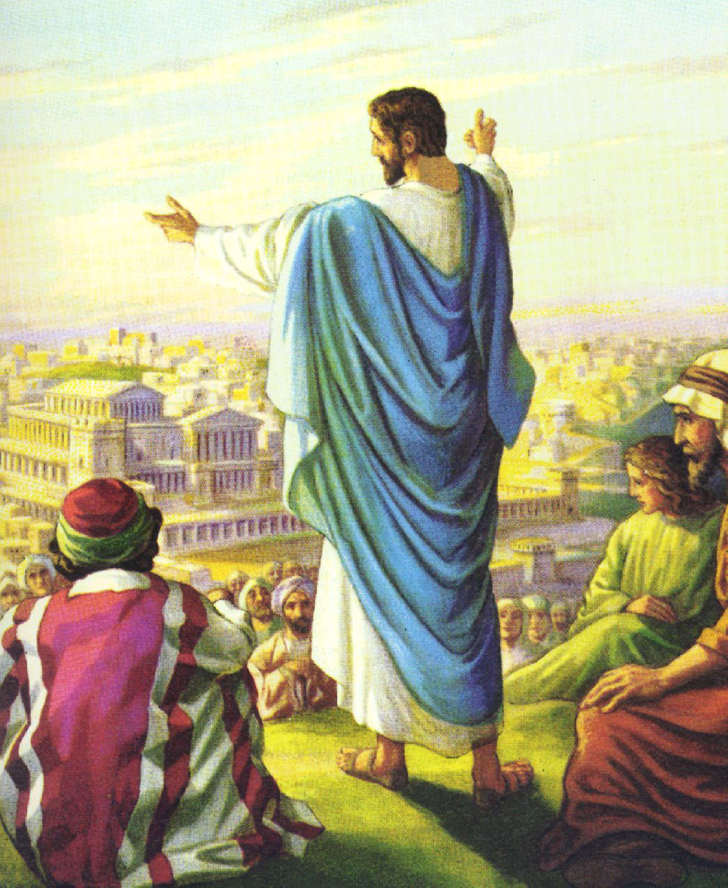
“And from Jesus Christ, who is the faithful witness …”

Slide 35
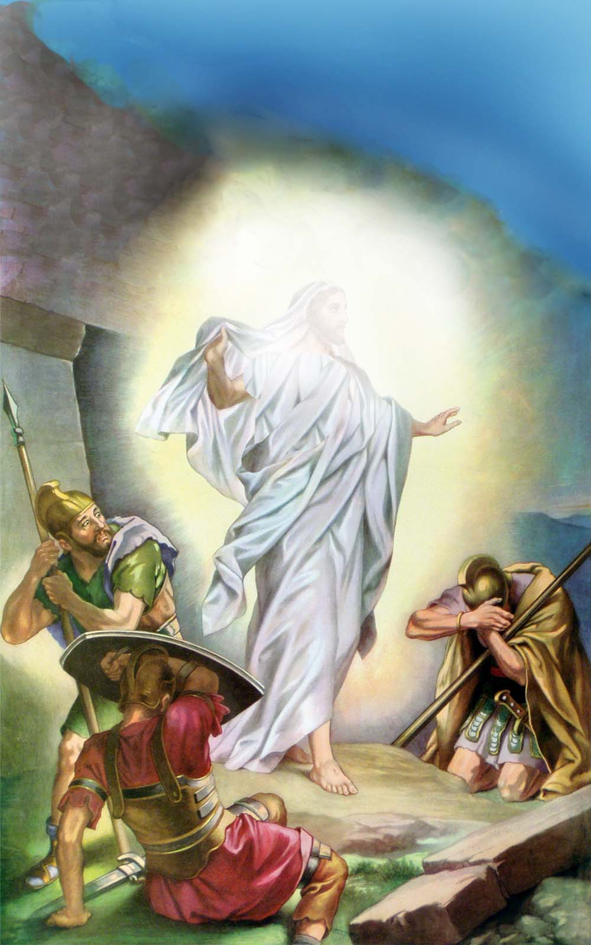
“…and the first begotten (born) of the dead…”
(see I Cor. 15:1-26)

Slide 36
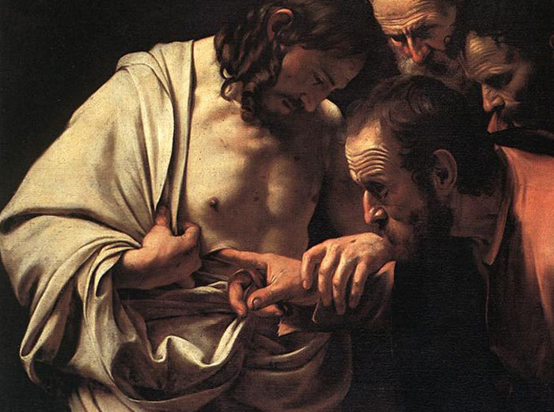

Slide 37
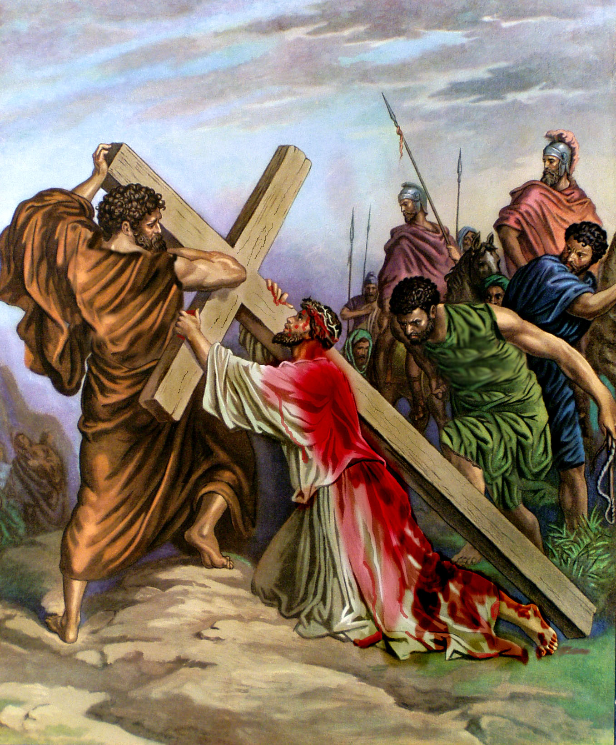
“Unto him that loved us, and washed us from our sins in his own blood.”

Slide 38
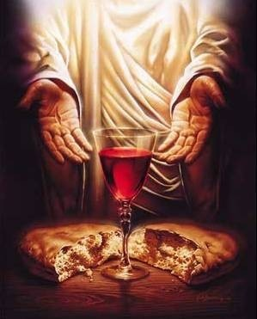
“The blood of Jesus Christ his Son cleanseth us from all sin.”
(I John 1:7)

Slide 39
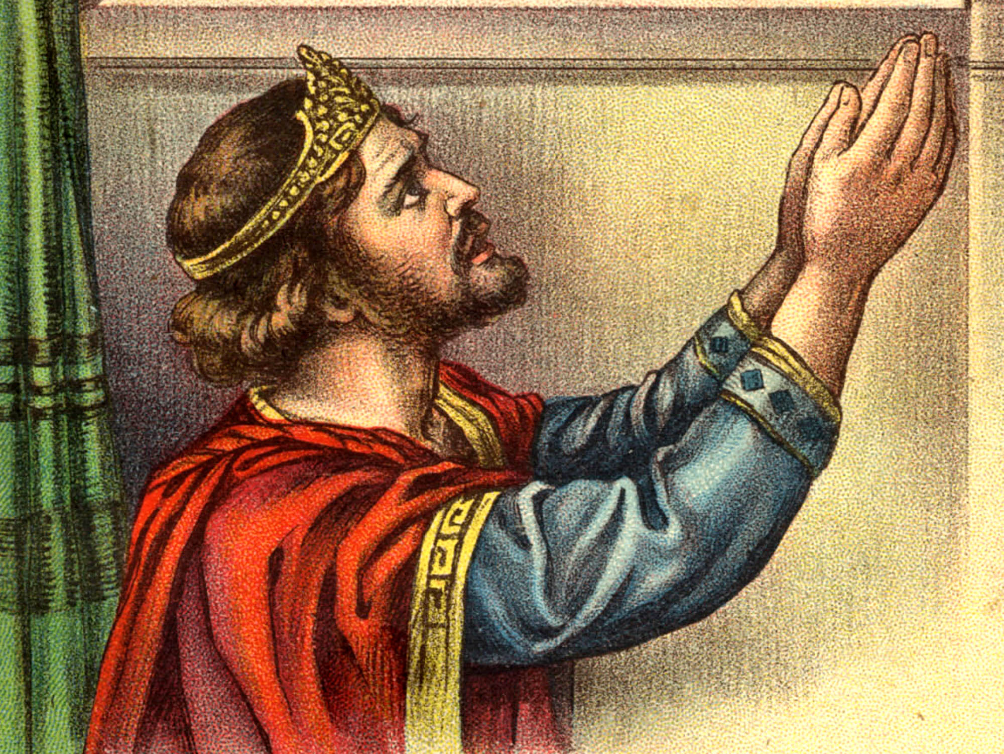
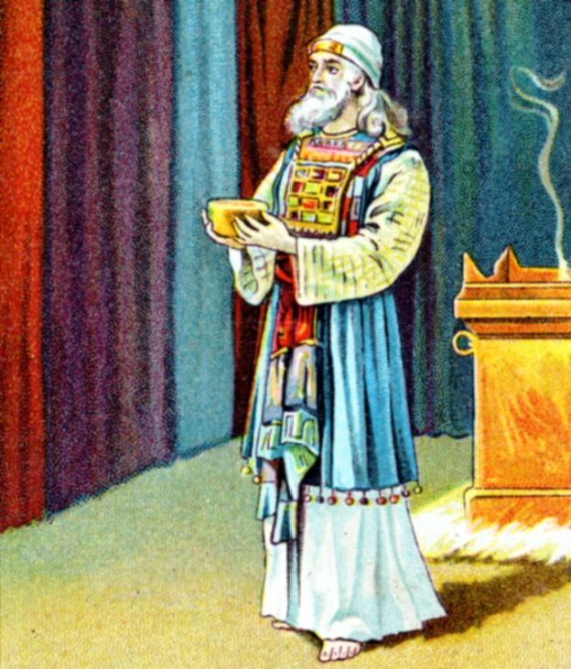
“And hath made us kings and priests unto God and his Father.”

Slide 40
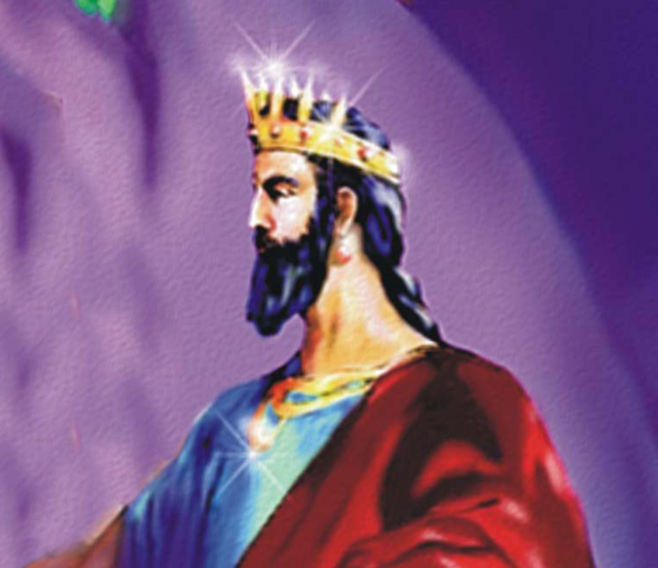
“Do ye not know that the saint shall judge the world?...And I saw thrones, and they sat upon them, and judgment was given unto them…and they lived and reigned with Christ a thousand years.”

Slide 41
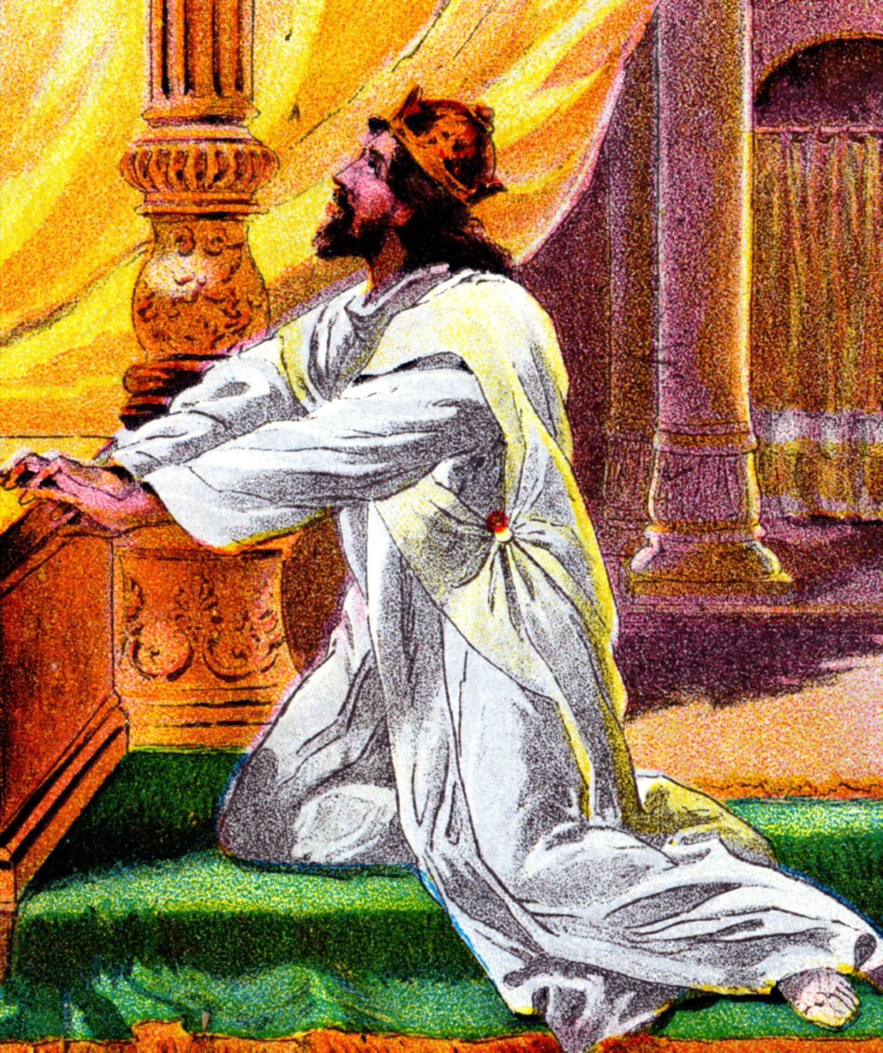
“It is an abomination to kings to commit wickedness: for the throne is established by righteousness…It is not for kings to drink wine; nor for princes strong drink: Lest they drink and forget the law, and pervert judgment.”

Slide 42
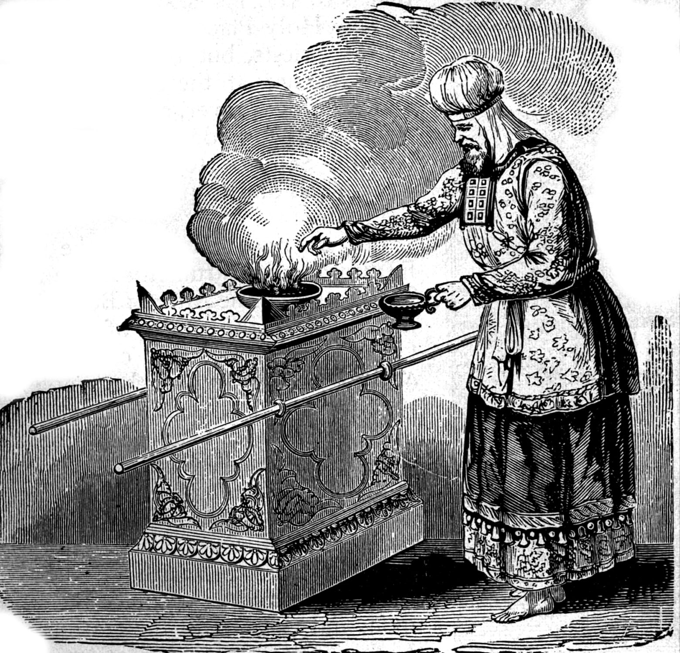
“But ye are a chosen generation, a royal priesthood, a holy nation, a peculiar people; that ye should show forth the praises of him who hath called you out of darkness into his marvelous light. Which in time past were not a people, but are now the people of God.”

Slide 43
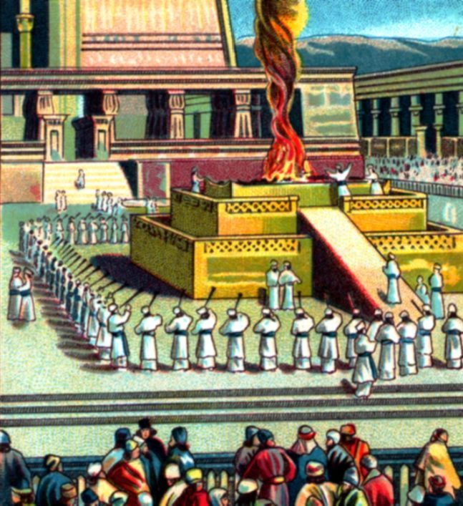
Present your bodies a living sacrifice – Romans 12:1-2
“By Him let us offer the sacrifice of praise to God continually, that is, the fruit of our lips giving thanks to His name.”
“Having received the things that were sent form you, an odour of a sweet smell, a sacrifice acceptable, well pleasing to God.”

Slide 44
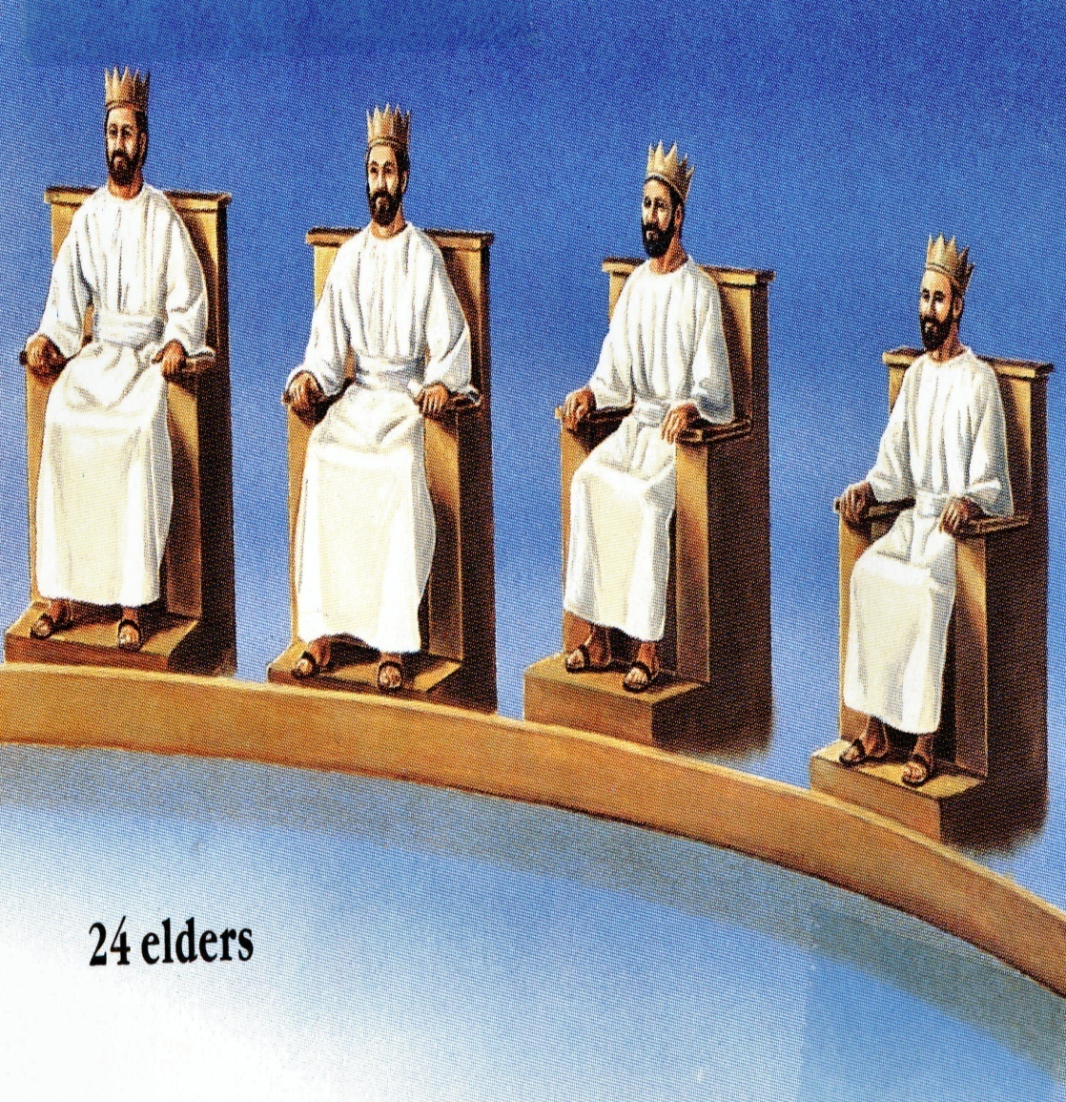
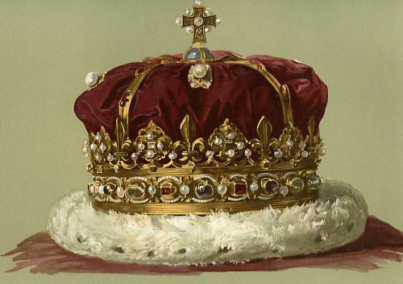
“And hath raised us up together, and made us sit together in heavenly places in Christ Jesus. That in the ages to come He might show the exceeding riches of His grace in His kindness toward us through Jesus Christ.”
“For by grace are ye saved through faith…”

Slide 45
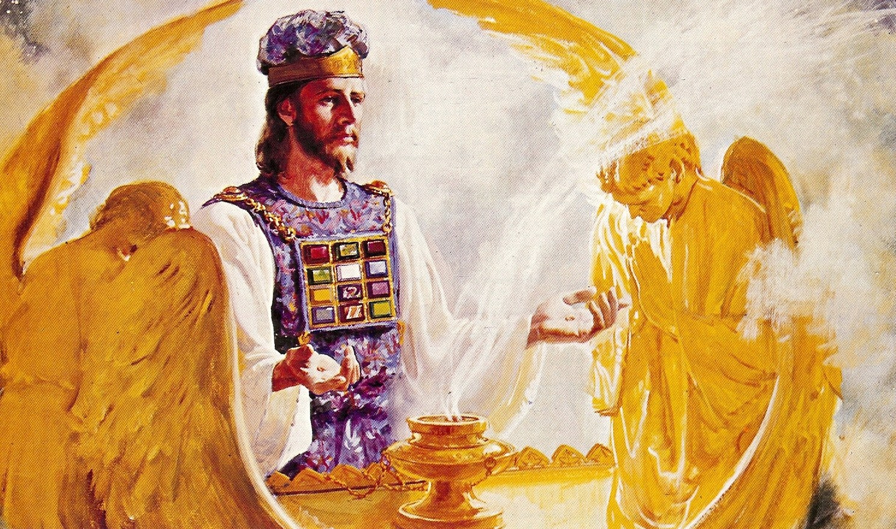
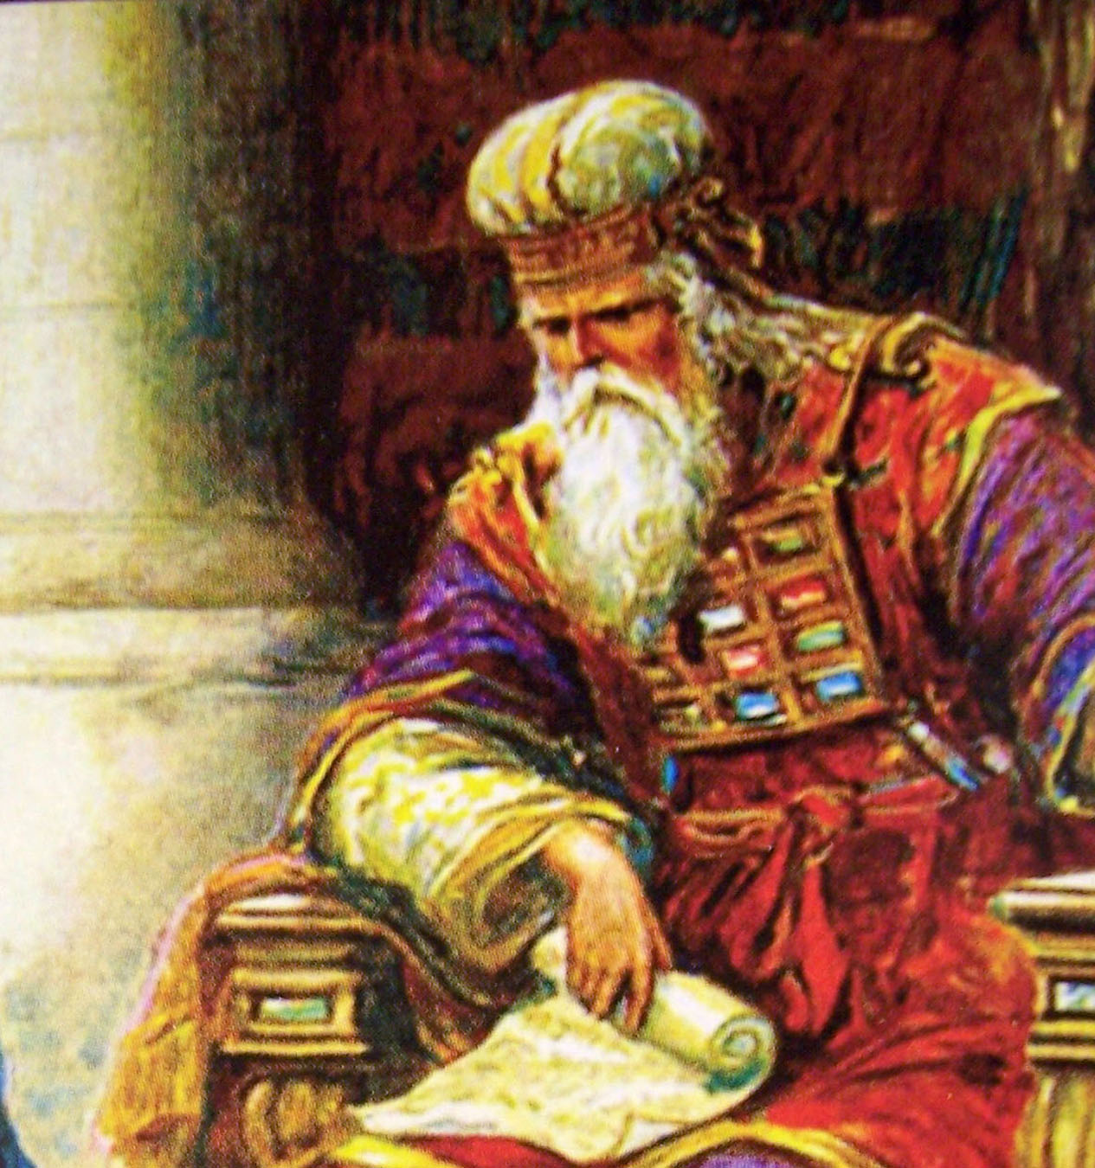
Jesus Christ our Great High Priest
“Seeing then that we have a great high priest, that is passed into the heavens, Jesus the Son of God, let us hold fast our profession. For we have not a high priest which cannot be touched with the feelings of our infirmities; but was in all points tempted like as we are, ye without sin. Let us therefore come boldly unto the throne of grace...”

Slide 46
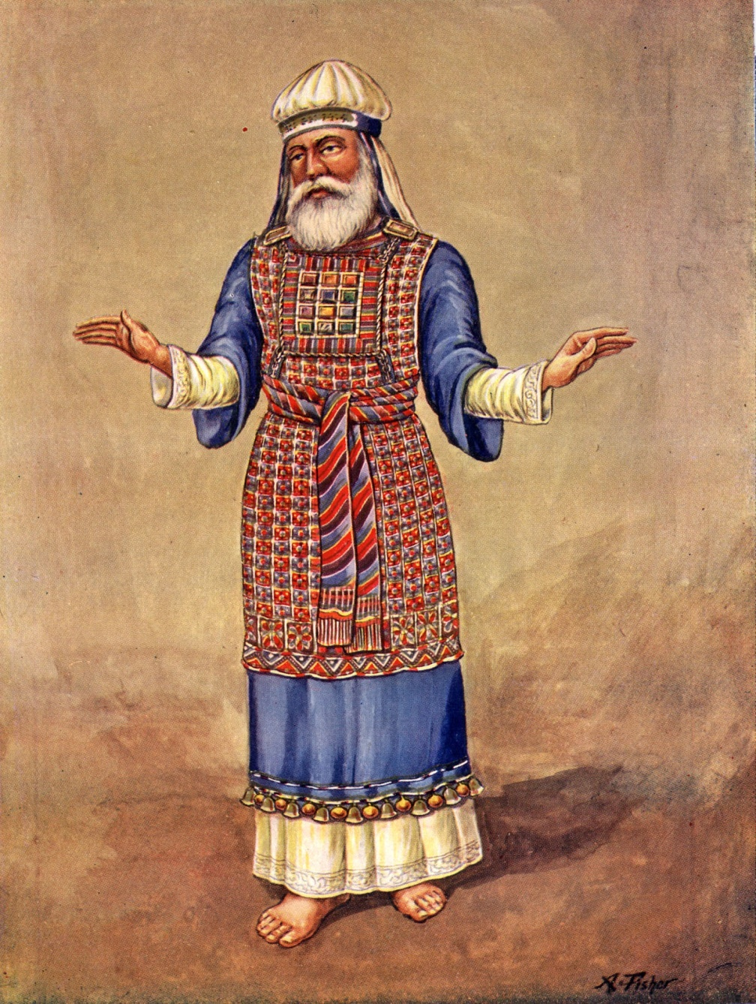
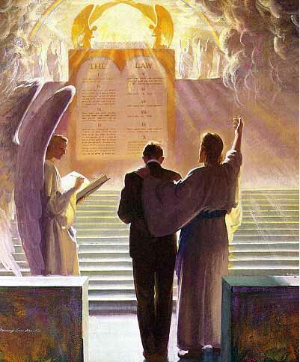
“For there is one God, and one mediator between God and men, the man Christ Jesus… but now hath he obtained a more excellent ministry, by how much also he is the mediator of a better covenant…the new covenant, and to the blood of sprinkling, that speaketh better things…”

Slide 47


Slide 48

“Wherefore He is able also to save them to the uttermost that come unto God by Him, seeing He ever liveth to make intercession for them. For such a high priest become us, who is holy, harmless, undefiled, separate from sinners, and made higher then the heavens.”

Slide 49

“Who needeth not daily, as those high priest, to offer up sacrifices, first for his own sins, and then for the people’s: for this He did once, when He offered up himself.”
(Hebrews 7:25-27)

Slide 50









Slide 51

“For I came not to judge the world, but to save the world.”
(John 12:47)

Slide 52

“God hath appointed a day, in the which He will judge the world in righteousness by that man whom He hath ordained; whereof He hath given assurance unto all men, in that He hath raised Him from the dead.” (Acts 17:31)

Slide 53


Slide 54


Slide 55


“Behold, he cometh with clouds; and every eye shall see him.”

Slide 56

“King of king
and
Lord of lords.”

Slide 57

“All kindred's of the earth shall wail because of Him.”

Slide 58



“Behold, the Lion of the tribe of Juda.”
“Behold the Lamb of God, which taketh away the sin of the world.”

Slide 59

“And I saw another angel fly in the midst of heaven, having the everlasting gospel to preach unto them that dwell on the earth, and to every nation,
and kindred, and tongue, and people, Saying with a loud voice, Fear God, and give glory to Him; for the hour of His judgment is come: worship Him that made heaven, and earth, and the sea, and the fountains of waters…If any man worship the beast and his image, and receive his mark…the same shall drink of the wine of the wrath of God; which is poured out without mixture into the cup of His indignation;

Slide 60
and he shall be tormented with fire and brimstone in the presence of the holy angels, and in the presence of the Lamb. And the smoke of their torment ascendeth up for ever and ever: and they have no rest day nor night…Yet they repented not of the works of their hands, that they should not worship devils, and idols of gold, and silver, and stone, and of wood: which neither can see, nor hear, nor walk…They blasphemed the name of God, which hath power over these plagues: and they repented not to give Him glory…”
(Revelation 14:6, 9-11, 9:20, 16:9)

Slide 61








“Fear God, and give glory to him; for the hour of his judgment is come.”

Slide 62
“I am Alpha and Omega, the beginning and the ending, saith the Lord…”

Slide 63


Slide 64


Slide 65

“which is…”

Slide 66

“…and which was…”

Slide 67

“…and which is to come…”

Slide 68

“The Almighty God”

Slide 69


“I John, who also am your brother and companion…”
In tribulation (persecution) – “Many are the afflictions of he righteousness.”
In the kingdom – “Blessed are they persecuted for righteousness sake: for theirs is the kingdom of heaven.”
In patience (perseverance) of Jesus Christ – “Praying always with all prayer and supplication in the Spirit, and watching thereunto with all perseverance…”

Slide 70




Slide 71




“…was in the isle that is called Patmos, for the word of God, and for the testimony of Jesus Christ.”

Slide 72


“I was in the Spirit on the Lord's day, and heard behind me a great voice, as of a trumpet.”

Slide 73
“Saying, I am Alpha and Omega, the first and the last...”

Slide 74
“…and, What thou seest, write in a book, and send it unto the seven churches.”

Slide 75

“And I turned to see the voice that spake with me. And being turned, I saw seven golden candlesticks.”

Slide 76

“And in the midst of the seven candlesticks one like unto the Son of man, clothed with a garment down to the foot, and girt about the paps with a golden girdle.”

Slide 77

“His head and his hairs were
white like wool, as white as snow…”

Slide 78


“…his eyes were as a flame of fire.”

Slide 79

“And his feet like unto fine brass, as if they burned in a furnace.”

Slide 80


“…his voice as the sound of many waters.”

Slide 81

“And he had in his right hand seven stars.”

Slide 82

“…and out of his mouth went a sharp two edged sword.”

Slide 83

“…and his countenance was as the sun shineth in his strength.”

Slide 84
“And when I saw him, I fell at his feet as dead.”

Slide 85

“And he laid his right hand upon me, saying unto me, Fear not; I am the first and the last.”

Slide 86

“I am He that liveth, and, was dead; and behold, I am alive forevermore.”

Slide 87



Slide 88


Slide 89





Slide 90



“I will build my church; and the gates of hell shall not prevail against it. And I will give unto thee the keys of the kingdom of heaven.”
(Matthew 16:18-19)

Slide 91
Gospel
(Romans 10:9-10)

Slide 92

“So then faith cometh by hearing, and hearing by the word of God.”
(Rom. 10:17)

Slide 93

“But as it is written, Eye hath not seen, nor ear heard, neither have entered into the heart of man, the things which God hath prepared for them that love him.” (I Cor. 2:9)

Slide 94

“Write the things…”
(Revelation 1:19)
“The things which thou hast seen” –
(Revelation 1:1-20)
“The things which are” –
(Revelation 2:1-3:22)
“The things which shall be hereafter.” – (Revelation 4:1-22:21)

Slide 95

“The mystery of the seven stars which thou sawest in my right hand, and the seven golden candlesticks. The seven stars are the angels of the seven churches: and the seven candlesticks which thou sawest are the seven churches.”

Slide 96


