Slide 1
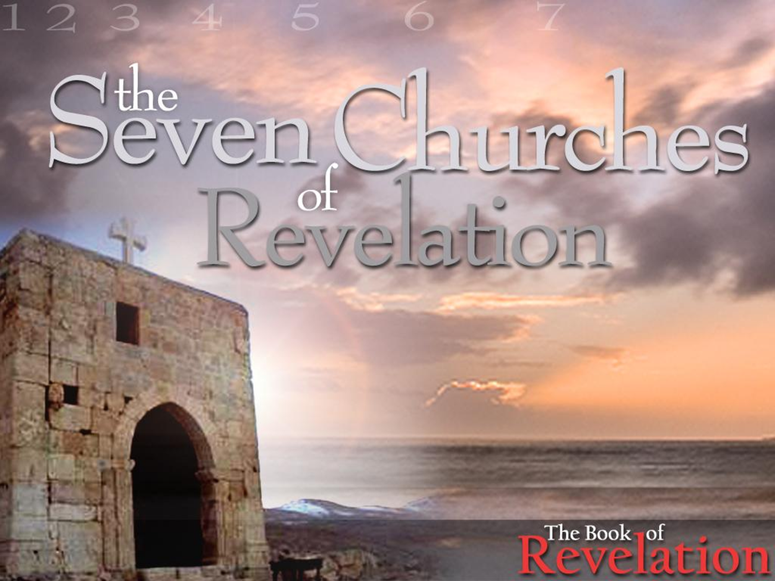

The Revelation of Jesus Christ
A study of the book
of Revelation

Slide 2

Revelation 2:1-7
The Church at Ephesus

Slide 3
Revelation 2:8-11
“The Church at Smyrna”

Slide 4
Revelation 2:12-17
“The Church at Pergamos”

Slide 5
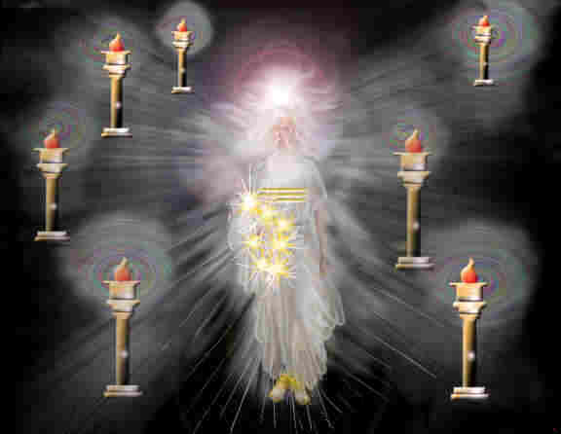
Signs of Christ’s Return
(Church age)
Ephesus – Fundamental - A.D. 30-100
Smyrna – Persecuted – A.D. 100-312
Pergamos – Worldly – A.D. 312-606
Thyatira – Pagan – A.D. 606-1520 (Dark Ages)
Sardis – Spiritually Dead – A.D. 1520-1750
Philadelphia – Revival – A.D. 1750-1900
Laodicea – Apathy – A.D. 1900-Rapture

Slide 6
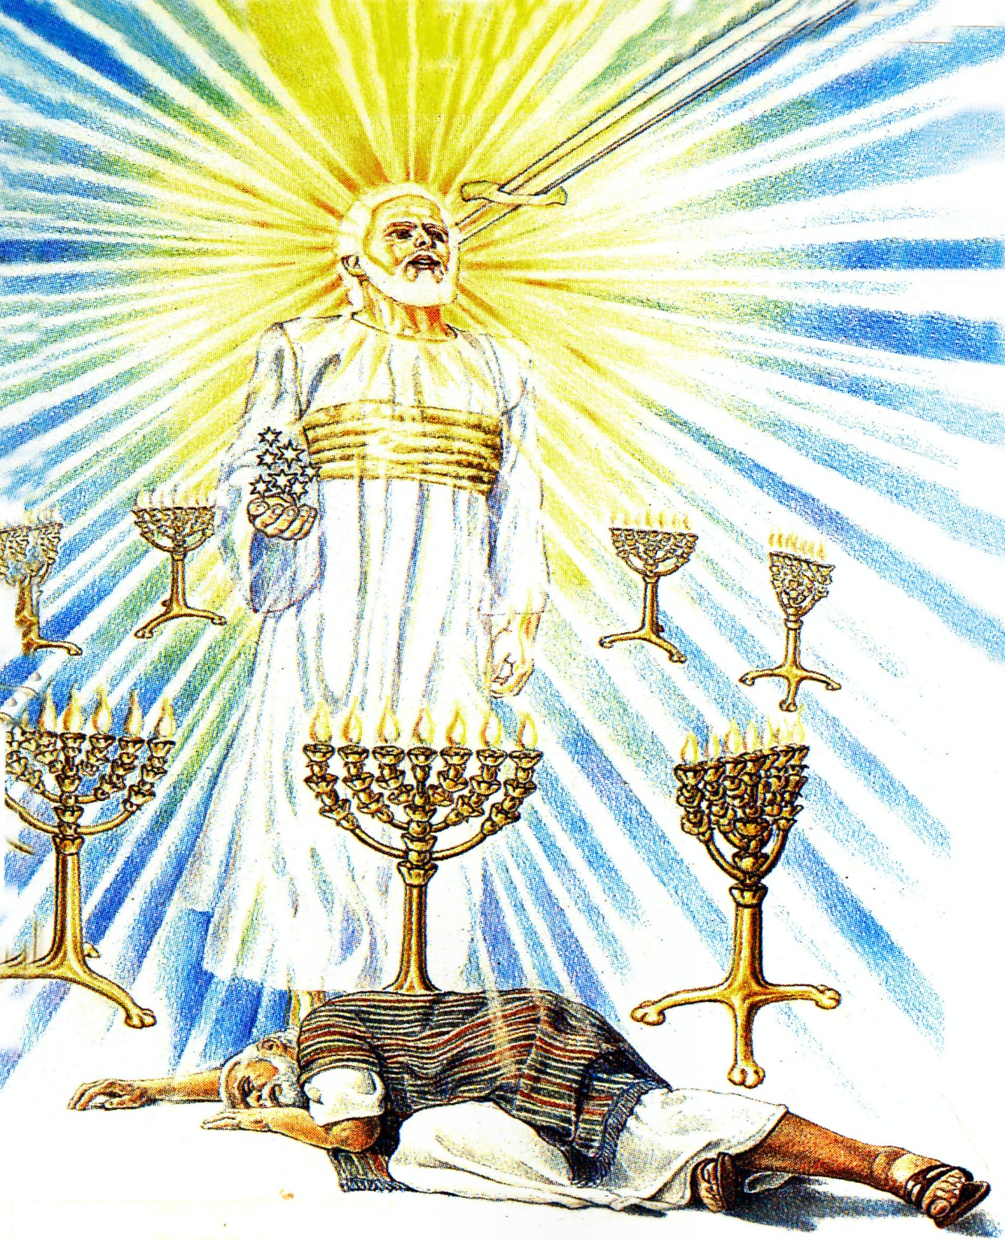
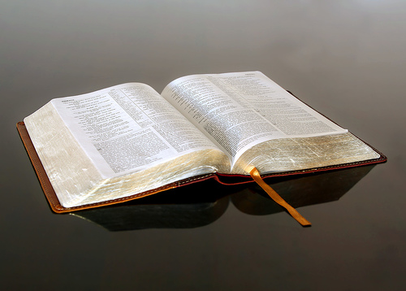
“And to the angel of the church in Pergamos write; These things saith he which hath the sharp sword with two edges.”

Slide 7
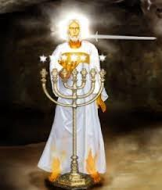

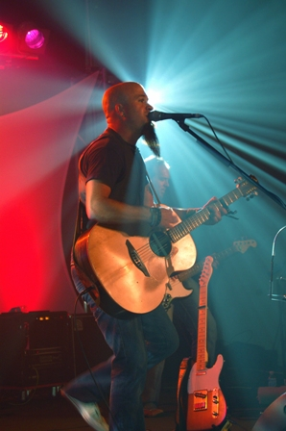
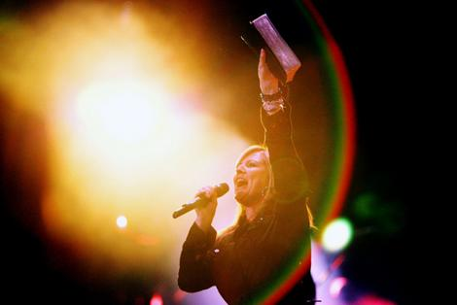
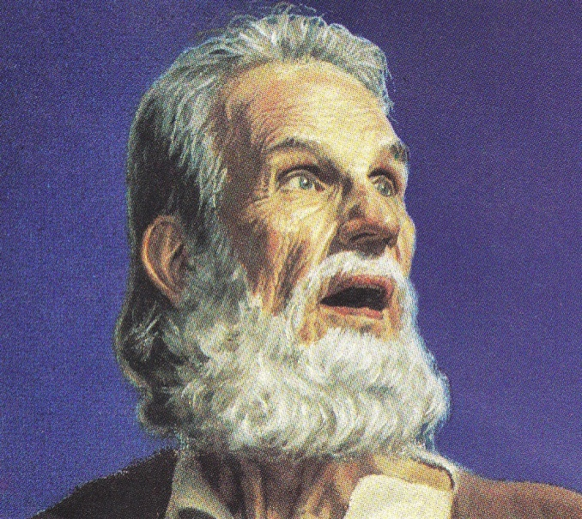
Pergamos
“The worldly church”

Slide 8
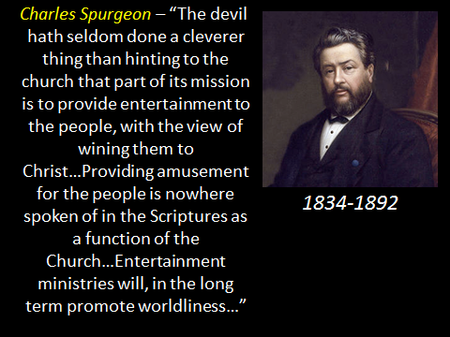
How does a church become Worldly?

Slide 9
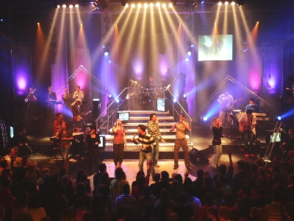
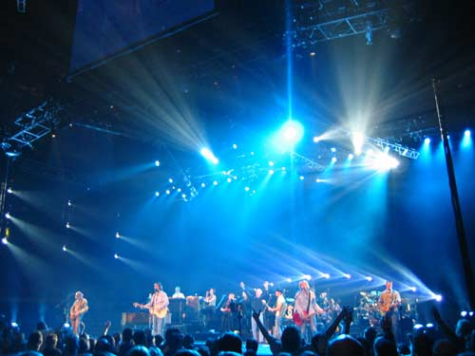
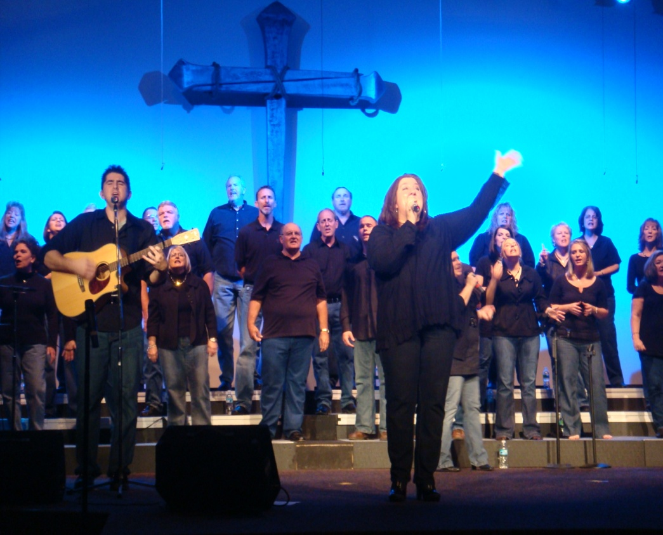
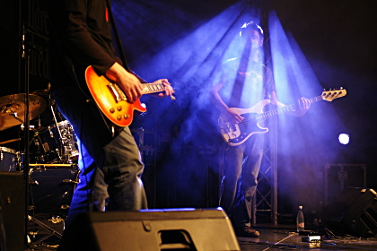
The church and its members begin to participate in worldly functions and activities.
The church and its members allowed worldly activities to take place in the church and in the homes of its members.
The church begins to accept people into membership who have not truly repented and turned from the world to Christ.
The church and its members allowed false teaching and preaching in the church.

Slide 10
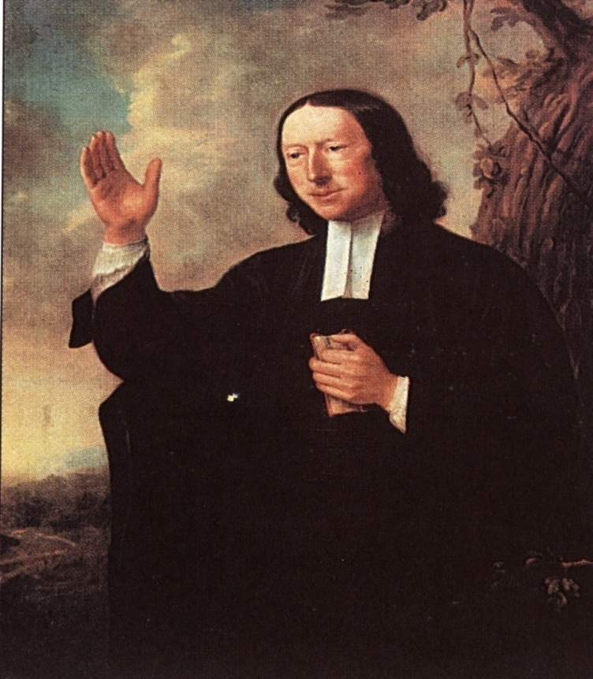
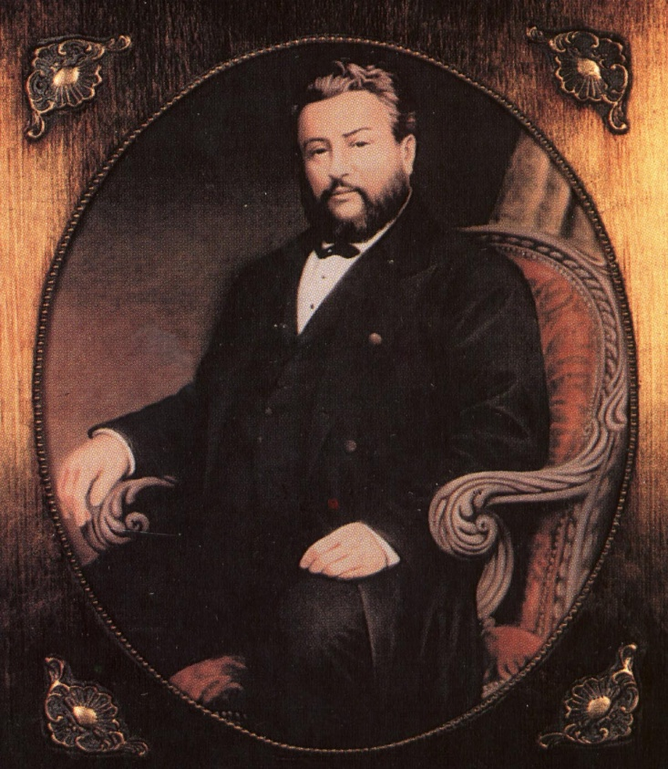
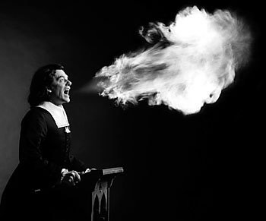
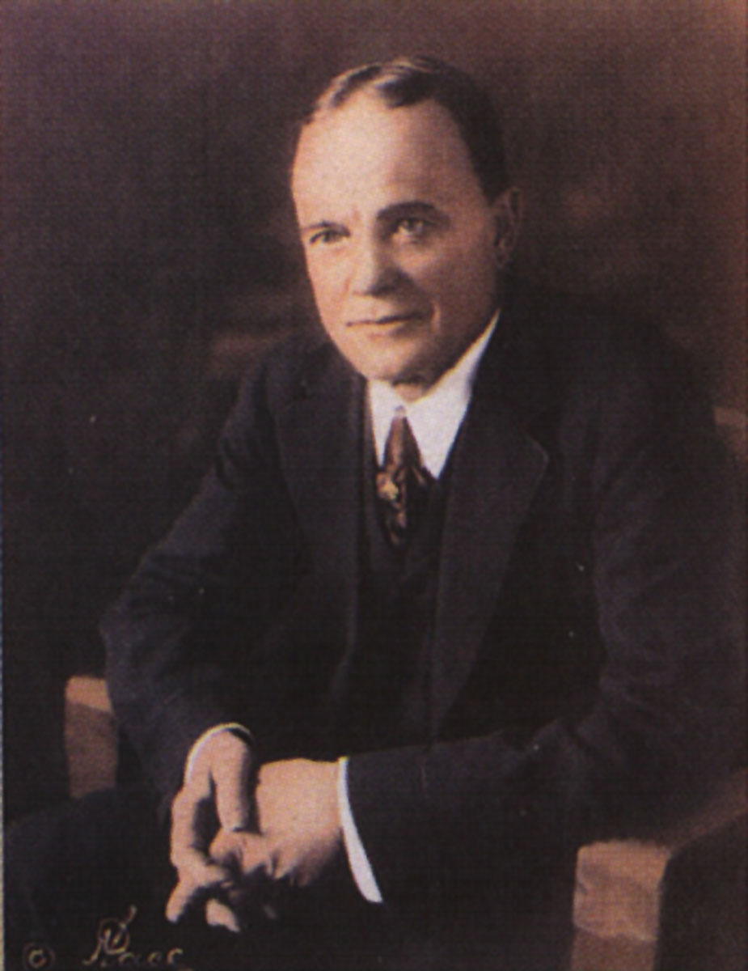
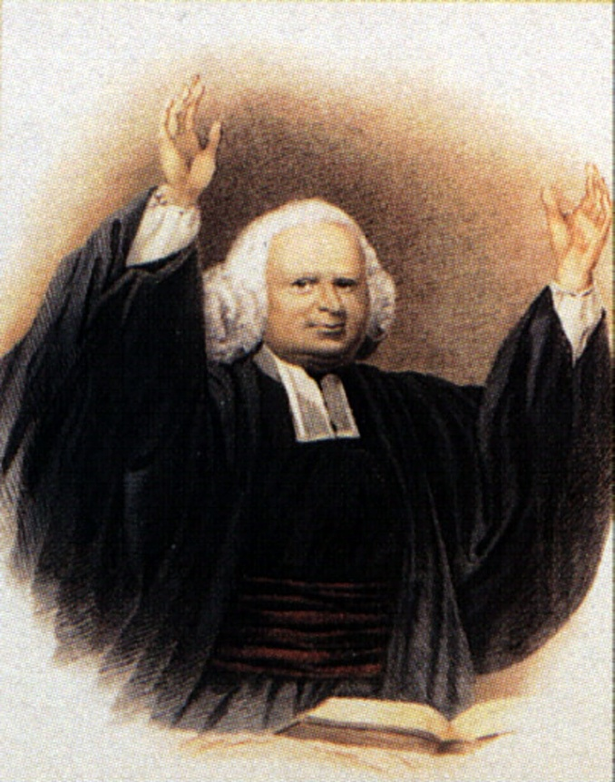
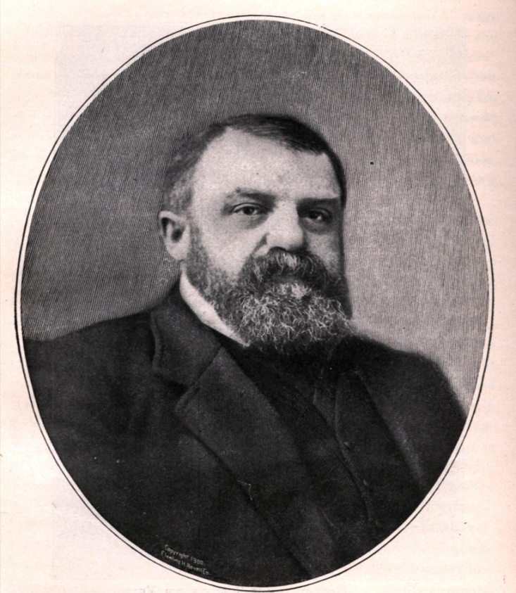

Slide 11
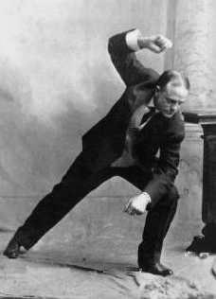
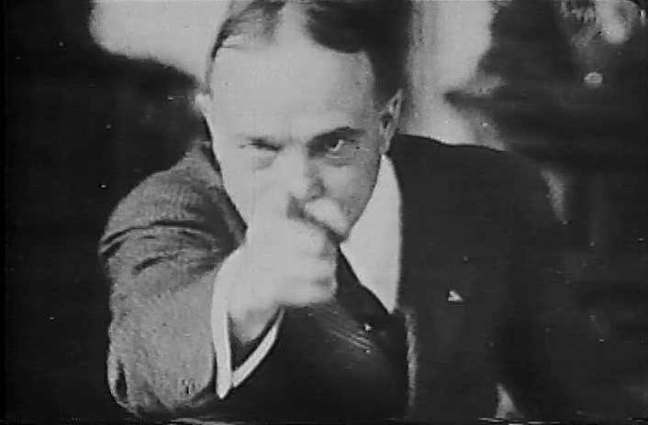
Preached from 1910-1935
Billy Sunday - Wikipedia
William Ashley "Billy" Sunday was an American athlete who, after being a popular outfielder in baseball's National League during the 1880s, became the most celebrated and influential American during the first two decades of the 20th century.

Slide 12
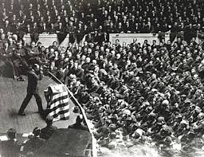
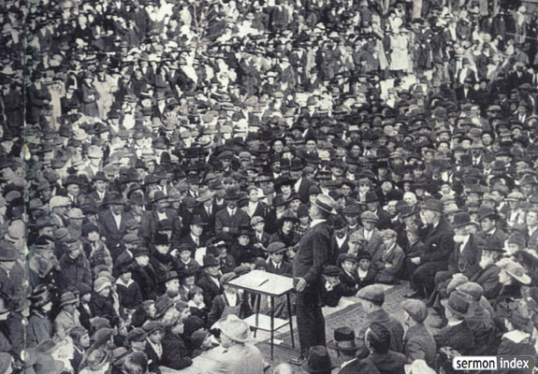
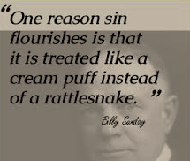
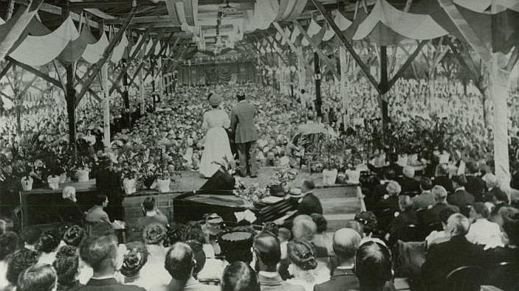
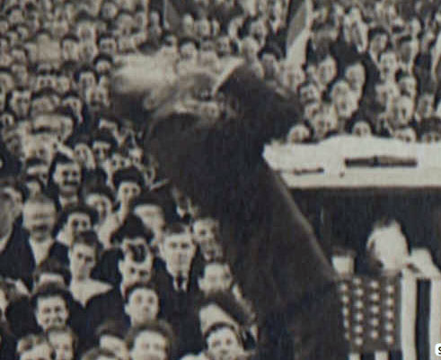

Slide 13

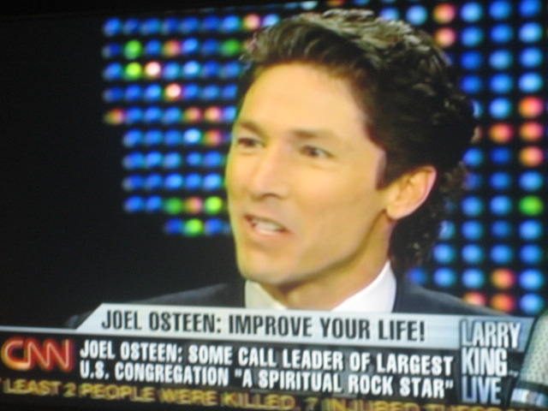
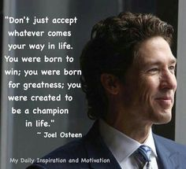


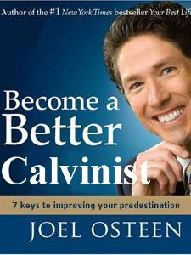

Slide 14
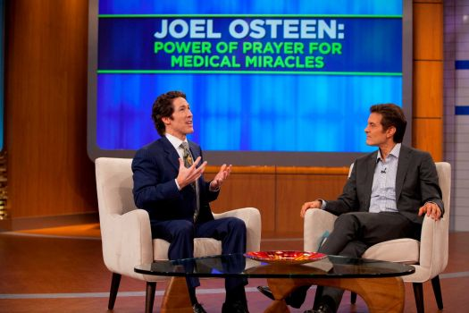
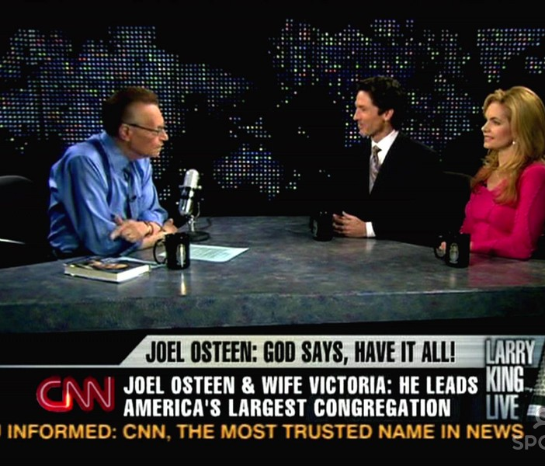
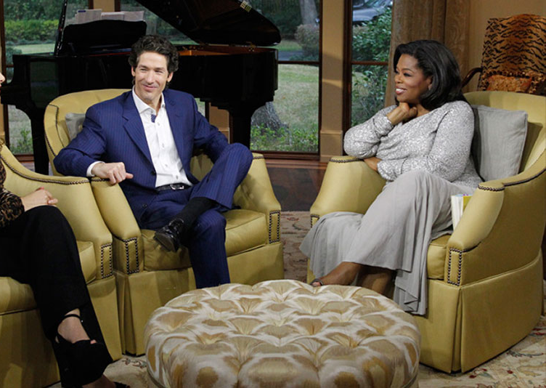


Slide 15
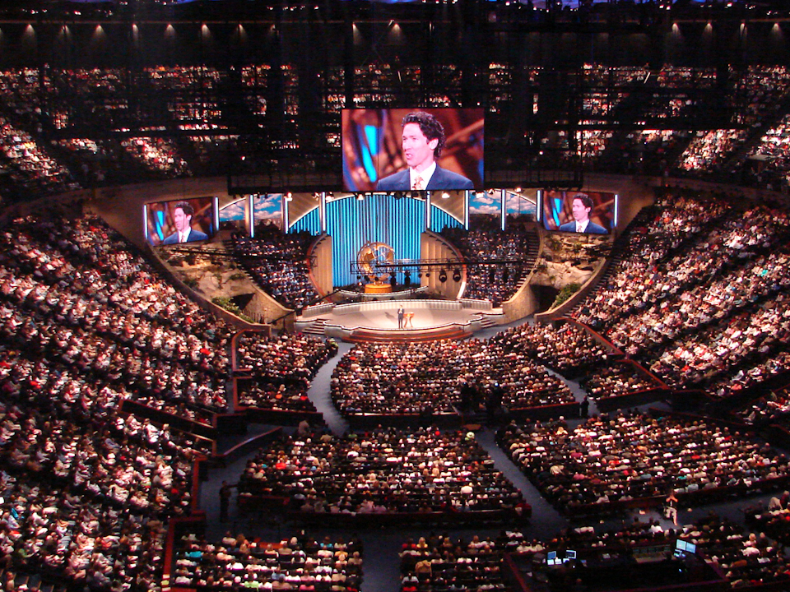

Slide 16
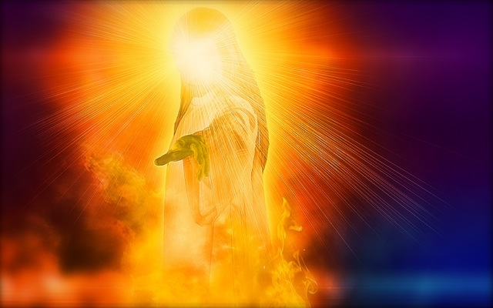
“I know thy works…”
“Every man's work shall be made manifest: for the day shall declare it, because it shall be revealed by fire; and the fire shall try every man's work of what sort it is. If any man's work abide which he hath built thereupon, he shall receive a reward.”
(I Cor. 3:13-14 )

Slide 17
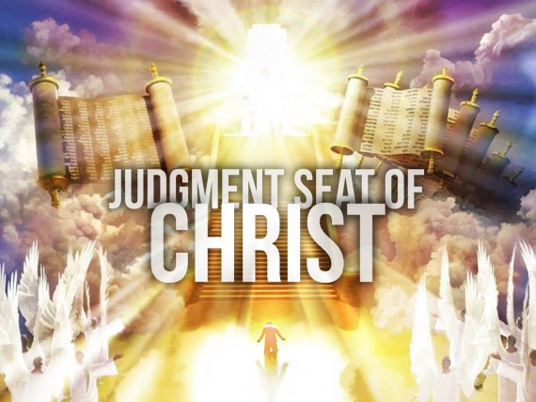

Slide 18
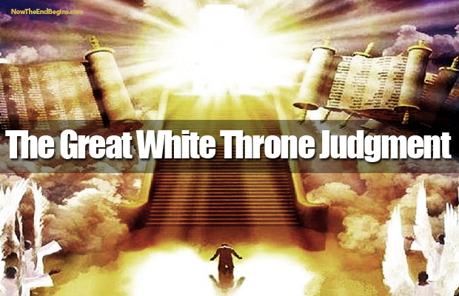
“And the dead were judged out of those things which were written in the books, according to their works.”

Slide 19
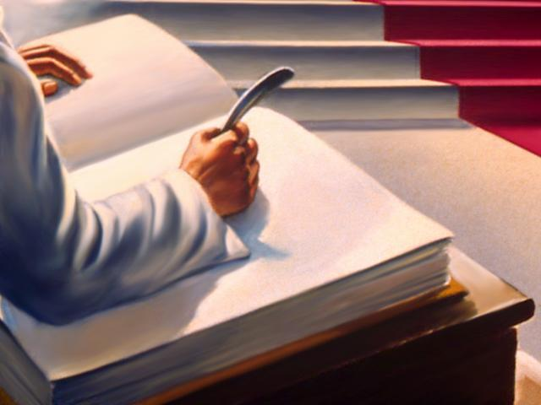
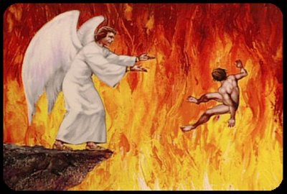
“…and whosoever was not found written in the book of life was cast into the lake of fire.”

Slide 20
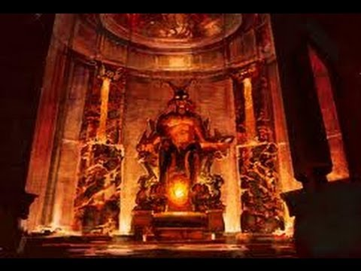
“…and where thou dwellest, even where Satan's seat is.”

Slide 21
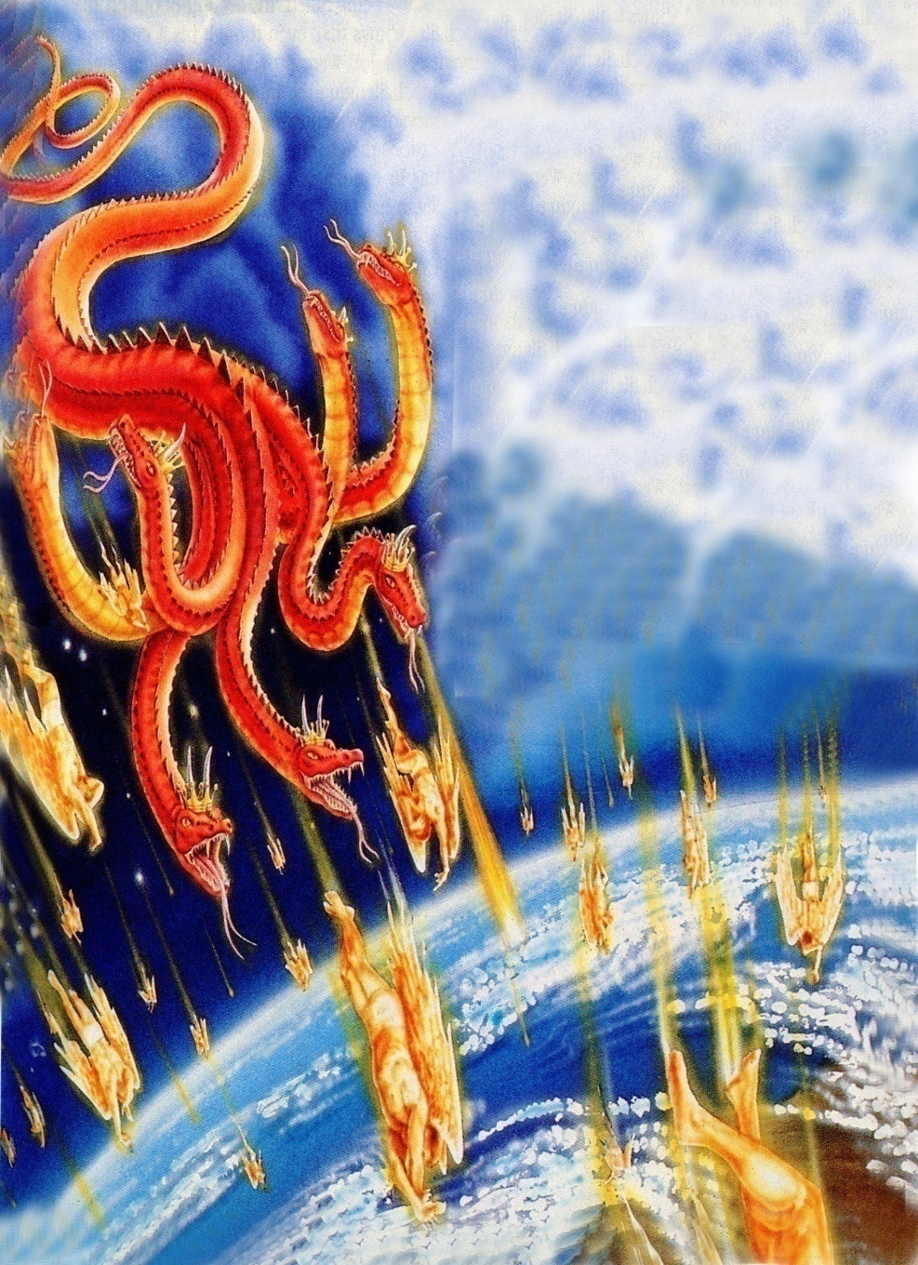
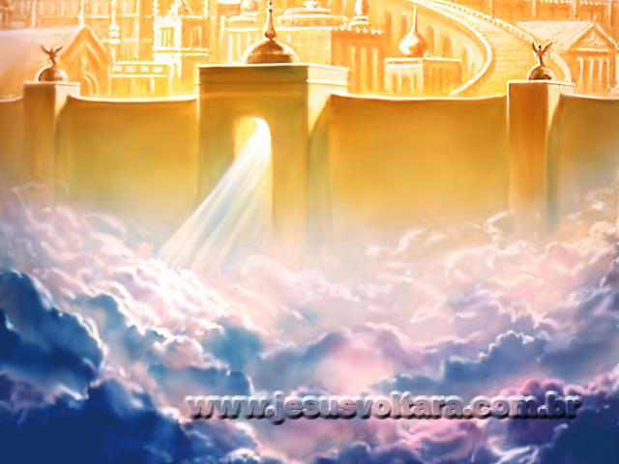
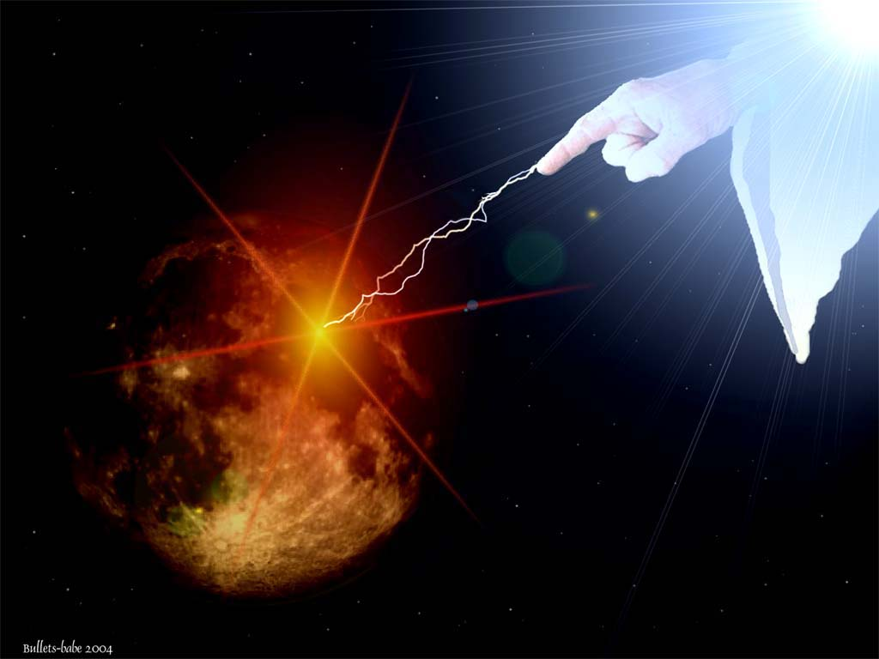
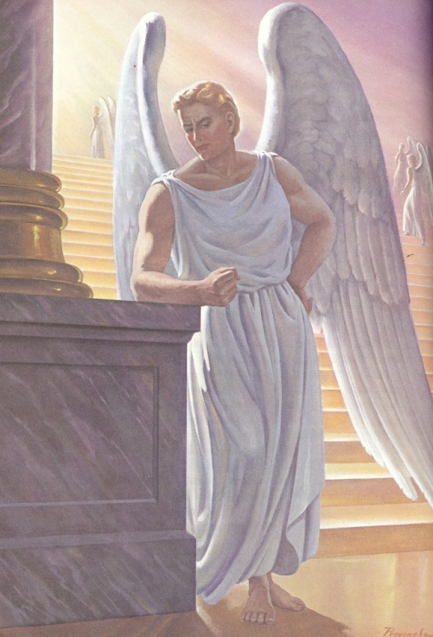
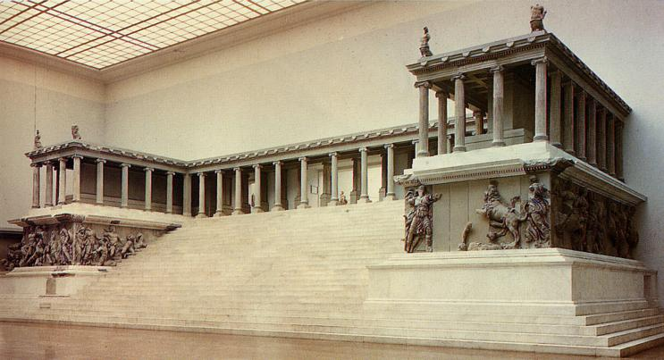
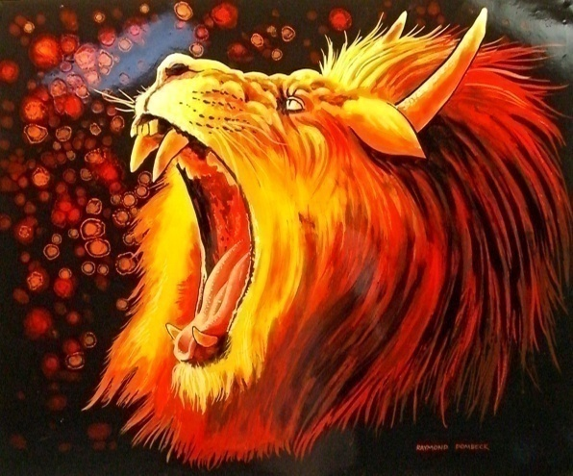

Slide 22
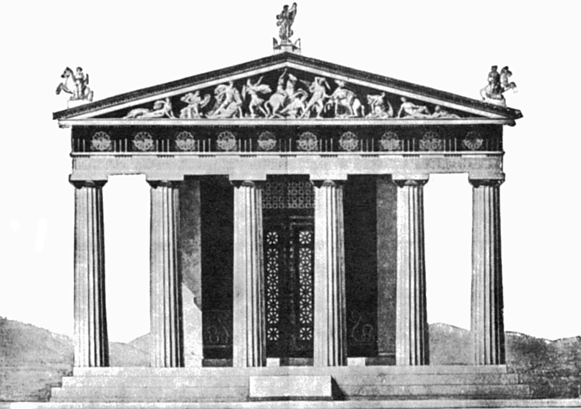
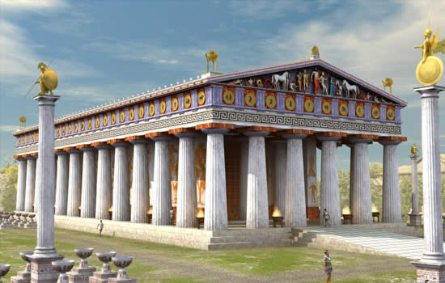
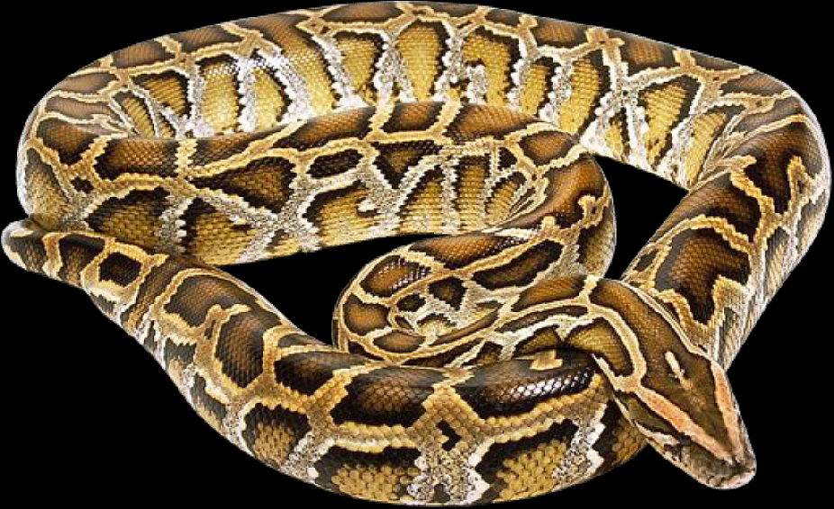
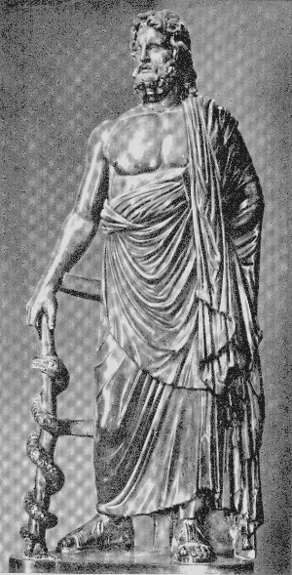
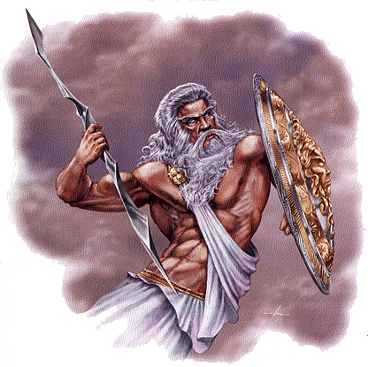
Pagan temples
Zeus – symbol of a serpent

Slide 23


Slide 24



“For we wrestle not against flesh and blood, but against principalities, against powers, against the rulers of the darkness of this world, against spiritual wickedness {wicked spirits} in high places.”
( Eph 6:12)

Slide 25


“Thou holdest fast my name...”

Slide 26

“…and hast not denied my faith. Even in those days wherein Antipas was my faithful martyr, who was slain among you, where Satan dwelleth.”

Slide 27


Antipas a Faithful Martyr

Slide 28


“I have a few things against thee…”

Slide 29
“Thou hast there them that hold the doctrine of Balaam, who taught Balac to cast a stumblingblock before the children of Israel, to eat things sacrificed unto idols, and to commit fornication.”

Slide 30

Doctrine of Balaam
The Mixture of Religion and Worldliness

Slide 31

“I will promote thee thee unto very great honor, and I will do whatsoever thou sayest unto me: come therefore, I pray thee, curse me this people.”

Slide 32







Slide 33


Slide 34
“Behold, these caused the children of Israel, through the counsel of Balaam, to commit trespass against the Lord, and there was a plague among the congregation of the Lord.”
(Num. 31:16)

Slide 35

“Be not unequally yoked together with unbelievers…”

Slide 36
“Balac to cast a stumblingblock before the children of Israel, to eat things sacrificed unto idols, and to commit fornication.”

Slide 37


Slide 38
“Balac to cast a stumblingblock before the children of Israel, to eat things sacrificed unto idols, and to commit fornication.”

Slide 39





Slide 40


“No man put a stumbling block or an occasion to fall in his brother’s way…”

Slide 41

“So hast thou also them that hold the doctrine of the Nicolaitans, which thing I hate.”

Slide 42

Doctrine of the Nicolaitans
Christ did away with the Old Testament Law and instituted the Christian Law of Liberty.
Believers are eternally secure, thus how they live their lives is not important.
It is only the soul that is important to God. What you do with your body is not.

Slide 43

Followers of Nicolas taught –
Christians can live however they want.
Christians are “under grace”
- They can live a sinful life-style
because they are forgiven of their
sin.
- They can enjoy the pleasures of sin
without consequence.

Slide 44

“The law of the harvest”
(Gal. 6:7-9)

Slide 45
We reap what we sow – “…that shall he also reap…”
Note: We reap exactly what we have sown in our lives. If we do good, we shall reap good; if we do evil, we shall reap evil.
We reap in proportion to what we sow – “he which soweth sparingly shall reap also sparingly; and he which soweth bountifully shall reap also bountifully…”
We always reap more then what we sow – “…be not deceived; God is not mocked…”
We always reap in a different season then when we sow – “…in due season we shall reap…”

Slide 46

Sow a thought
Reap a action
Sow a action
Reap a habit
Sow a habit
Reap a character
Sow a character
Reap a destiny

Slide 47

The Doctrine of Paul
“God Forbid Doctrine”
“Shall we continue in sin that Grace may abound, God forbid.”
“Know ye not that your bodies are the members of Christ? Shall I then take the members of Christ, and make them the members of a harlot? God forbid…Ye are bought with a price, therefore glorify God in your body and in your spirit, which are God’s.”

Slide 48
“Do we make void the Law through faith? God forbid: yea, we establish the Law.”
“What then? Shall we sin, because we are not under the Law, but under grace? God forbid.”
“What shall we say then? Is the law sin? God forbid. Nay, I had not known sin, but by the Law.”
“What shall we say then? Is there unrighteousness with God?
God forbid.”

Slide 49
“For the grace of God that bringeth salvation hath appeared to all men. Teaching us that, denying ungodliness and worldly lust, we should live soberly, righteously, and godly, in this present world. Looking for that blessed hope, and the glorious appearing of our great God and our Savior Jesus Christ; Who gave Himself for us, the He might redeem us from all iniquity, and purify unto Himself a peculiar people, zealous of good works.”

Slide 50
Romans 3:8
“And not rather, (as we be slanderously reported, and as some affirm that we say,) Let us do evil, that good may come? whose damnation is just.”

Slide 51


Slide 52

“Repent; or else I will come unto thee quickly, and will fight against them with the sword of my mouth. He that hath an ear, let him hear what the Spirit saith unto the churches.”

Slide 53



Slide 54


“I will give to eat of the hidden manna…”

Slide 55

“Then Jesus saith unto them…Moses gave you not that bread from heaven; but my Father giveth you the true bread from heaven…And Jesus said unto them, I am the bread of life: he that cometh to me shall never hunger; and he that believeth on me shall never thirst…This is that bread which came down from heaven: not as your fathers did eat manna, and are dead: he that eateth of this bread shall live for ever.”
(John 6:32, 35, 58)

Slide 56


“And in the stone a new name.”

Slide 57

During the time of John’s writing of the book of the Revelation a white stone given to a person at the close of a trial meant he was acquitted of his crimes.

Slide 58
(Isaiah 62:2) “And thou shalt be called by a new name, which the mouth of the LORD shall name.”
(Revelation 3:12) “Him that overcometh… I will write upon him my new name.”

Slide 59


