Slide 1


Slide 2

Revelation 1:1-19
The Vision of the
Glorified Christ

Slide 3
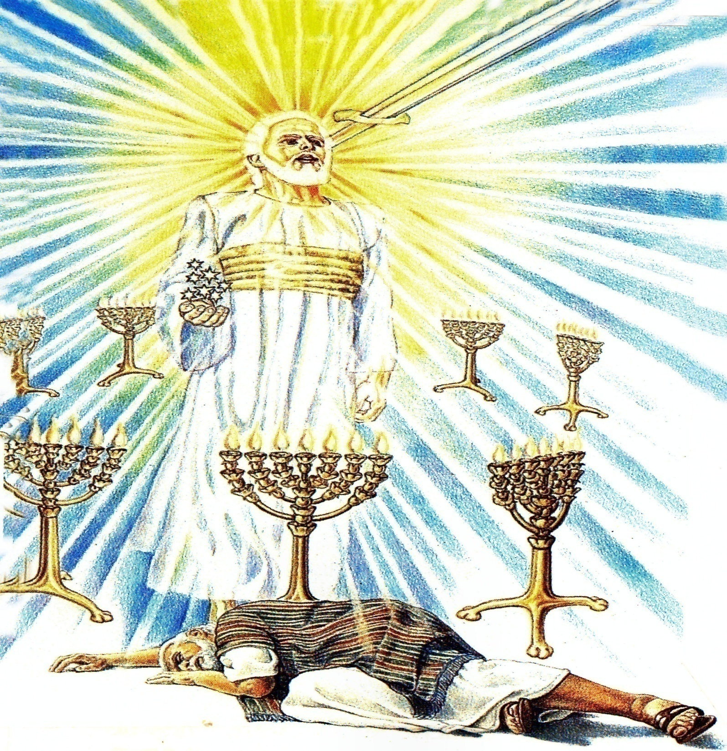

Slide 4
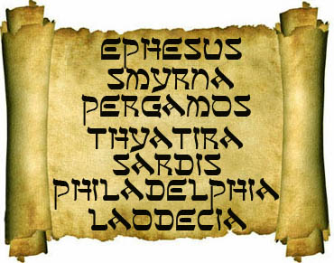
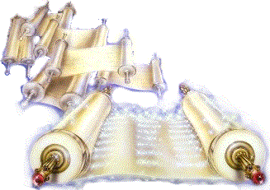
“What thou seest, write in a book, and send it unto the seven churches which are in Asia; unto Ephesus, and unto Smyrna, and unto Pergamos, and unto Thyatira, and unto Sardis, and unto Philadelphia, and unto Laodicea.”

Slide 5
Revelation 2:1-7
The Church at Ephesus

Slide 6


Slide 7
Revelation 2:8-11
“The Church at Smyrna”

Slide 8


Slide 9
Revelation 2:12-17
“The Church at Pergamos”

Slide 10


Slide 11
Revelation 2:18-29
“The Church at Thyatira”

Slide 12
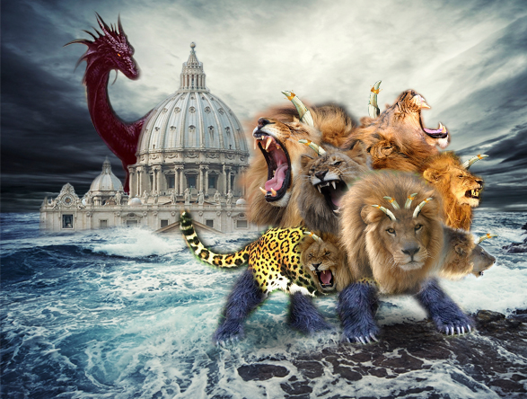
The Church that
Became Pagan

Slide 13
Revelation 3:1-6
“The Church at Sardis”

Slide 14
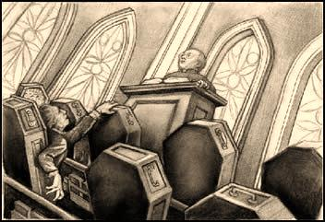
The Spiritually Dead Church
“…thou hast a name that thou livest, and art dead.”

Slide 15
Revelation 3:7-13
“The Church at Philadelphia”

Slide 16


Slide 17
Revelation 3:14-22
“The Church at Laodicea”

Slide 18
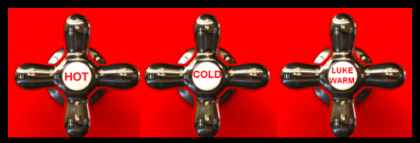

Slide 19
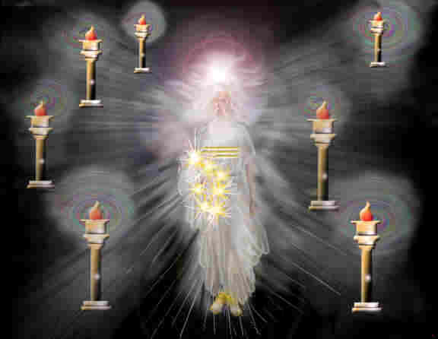
Signs of Christ’s Return
(Church age)
Ephesus – Fundamental - A.D. 30-100
Smyrna – Persecuted – A.D. 100-312
Pergamos – Worldly – A.D. 312-606
Thyatira – Pagan – A.D. 606-1520
(Dark Ages)
Sardis – Spiritually Dead – A.D. 1520-1750
Philadelphia – Revival – A.D. 1750-1900
Laodicea – Apathy – A.D. 1900-Rapture

Slide 20
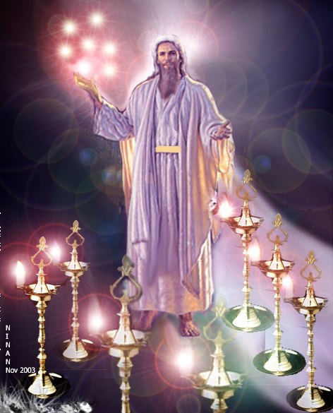
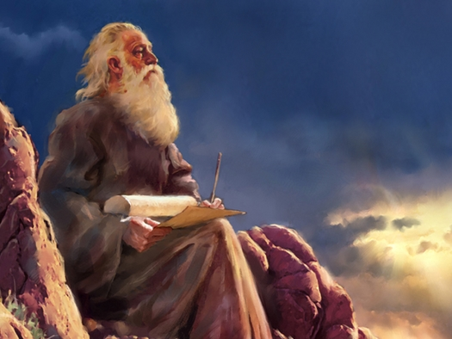
“And unto the angel of the church of the Laodiceans write…”

Slide 21
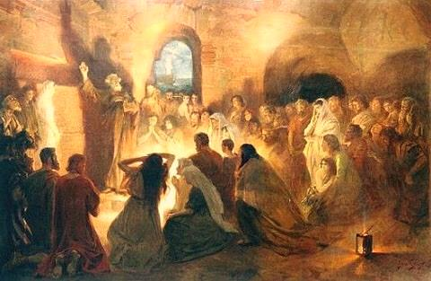
“…the angel…”
“…the church…”

Slide 22
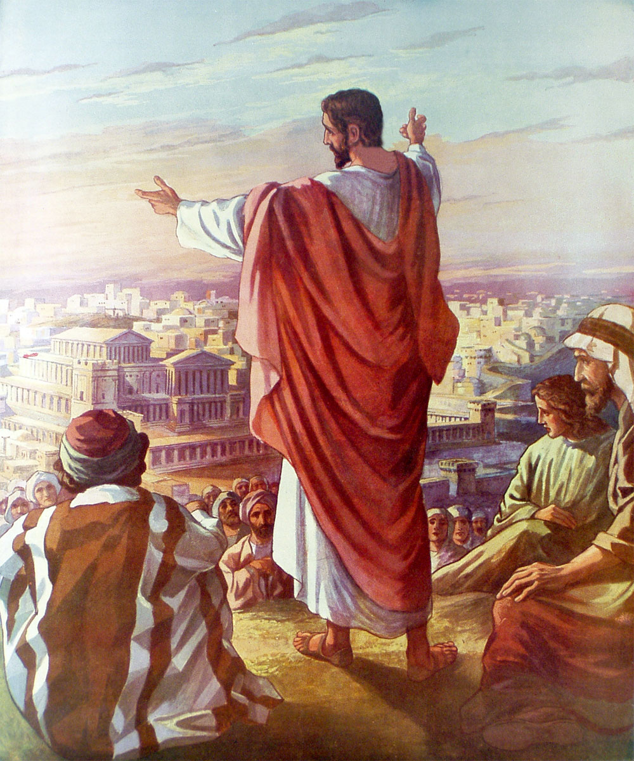
“These things saith the…”
Amen
Faithful and true witness
The beginning of the creation of God

Slide 23
Amen
We use this word to close prayer
We also use this word to declare the truthfulness of a statement
Amen is also translated in the KJV = “Verily”
When used in the beginning of a sentence it means “This is true!”
When used at the end of a sentence it means “So be it!”

Slide 24
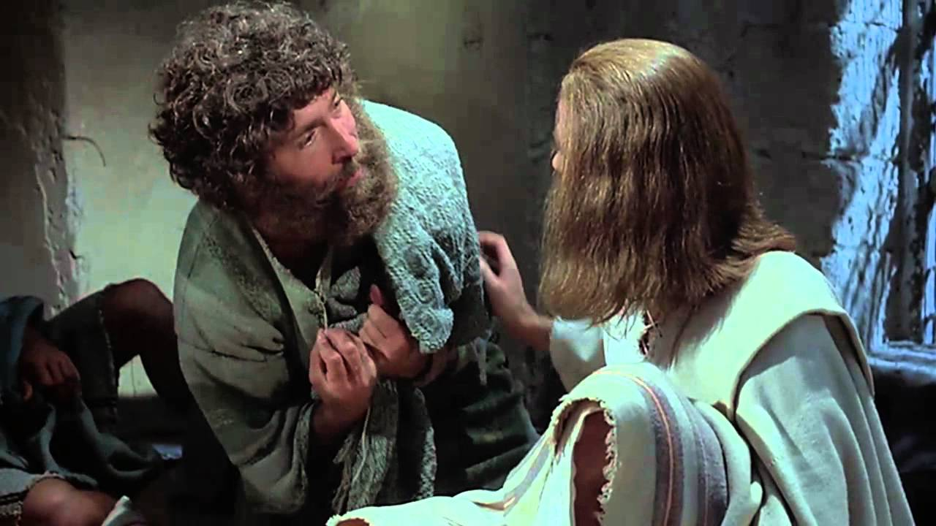
“Jesus saith unto him, I am the way, the truth, and the life: no man cometh unto the Father, but by me.”

Slide 25
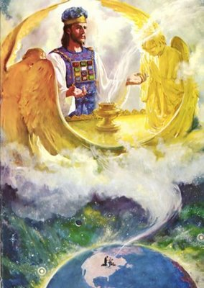
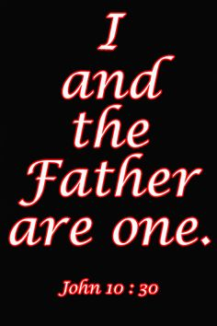
Faithful and True Witness
Christ is the faithful witness.
Christ witnesses to man about God – John 1:1-4, 14, 14:7-11
Christ witnesses to God about man – I John 2:1-2; Hebrews 7:25; I Timothy 2:5

Slide 26
The Beginning of the
Creation of God
Creator of all things – John 1:3
Sustainer of all things – Hebrews 1:1-3
Christ was not the first of God’s creation, He was the creator of all God’s creation – Colossians 1:16
Beginning (Greek) = “Cause of origin”
“Christ is the cause or origin of the creation of God.” (I Corinthians 8:6)

Slide 27
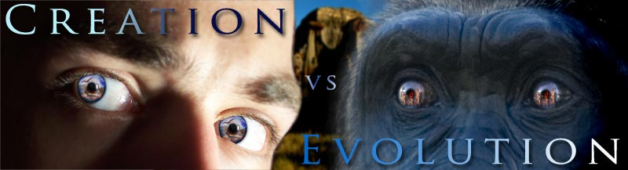
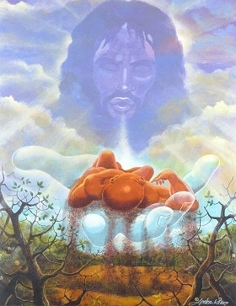
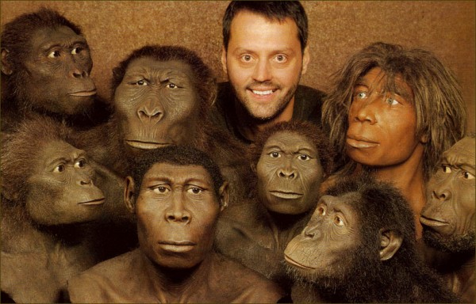

Slide 28

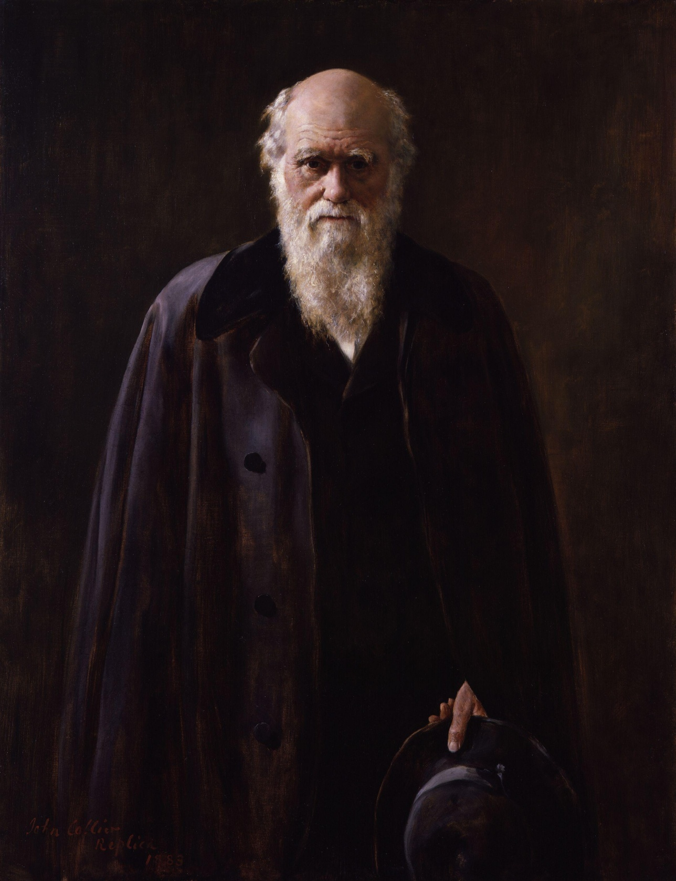
“Professing themselves to be wise, they became fools…”

Slide 29
Col. 2:8
“Beware lest any man spoil you through philosophy and vain deceit, after the tradition of men, after the rudiments of the world, and not after Christ.”

Slide 30
Rom. 1:21-24
“Because that, when they knew God, they glorified him not as God, neither were thankful; but became vain in their imaginations, and their foolish heart was darkened. Professing themselves to be wise, they became fools, And changed the glory of the uncorruptible God into an image made like to corruptible man, and to birds, and fourfooted beasts, and creeping things. Wherefore God also gave them up to uncleanness through the lusts of their own hearts, to dishonour their own bodies between themselves.”

Slide 31
Psalm 53:1
“The fool hath said in his heart, There is no God. Corrupt are they, and have done abominable iniquity: there is none that doeth good.”

Slide 32
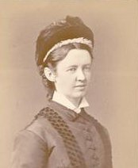
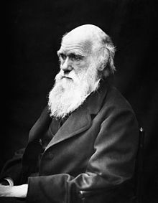
Elizabeth Cotton
THE LADY HOPE "STORY"

Slide 33
It was one of those glorious autumn afternoons, that we sometimes enjoy in England, when I was asked to go in and sit with the well known professor, Charles Darwin. He was almost bedridden for some months before he died. I used to feel when I saw him that his fine presence would make a grand picture for our Royal Academy; but never did I think so more strongly than on this particular occasion. He was sitting up in bed, wearing a soft embroidered dressing gown, of rather a rich purple shade. Propped up by pillows, he was gazing out on a far-stretching scene of woods and cornfields, which glowed in the light of one of those marvelous sunsets. His noble forehead and fine features seem to be lit up with pleasure as I entered the room.

Slide 34
He waved his hand toward the window as he pointed out the scene beyond, while in the other hand he held an open Bible, which he was always studying.
"What are you reading now?" I asked as I seated myself beside his bedside. "Hebrews!" he answered - "still Hebrews. 'The Royal Book' I call it. Isn't it grand?"
Then, placing his finger on certain passages, he commented on them.
I made some allusions to the strong opinions expressed by many persons on the history of the Creation, its grandeur, and then their treatment of the earlier chapters of the Book of Genesis.

Slide 35
He seemed greatly distressed, his fingers twitched nervously, and a look of agony came over his face as he said:
"I was a young man with unformed ideas. I threw out queries, suggestions, wondering all the time over everything, and to my astonishment, the ideas took like wildfire. People made a religion of them."

Slide 36
Then he paused, and after a few more sentences on "the holiness of God" and the "grandeur of this book," looking at the Bible which he was holding tenderly all the time, he suddenly said: "I have a summer house in the garden which holds about thirty people. It is over there," pointing through the open window. "I want you very much to speak there. I know you read the Bible in the villages. To-morrow afternoon I should like the servants on the place, some tenants and a few of the neighbors; to gather there. Will you speak to them?"

Slide 37
"What shall I speak about?" I asked.
"Christ Jesus!" he replied in a clear, emphatic voice, adding in a lower tone, "and his salvation. Is not that the best theme? And then I want you to sing some hymns with them. You lead on your small instrument, do you not?" The wonderful look of brightness and animation on his face as he said this I shall never forget, for he added: "If you take the meeting at three o'clock this window will be open, and you will know that I am joining in with the singing."
How I wished I could have made a picture of the fine old man and his beautiful surroundings on that memorable day!

Slide 38
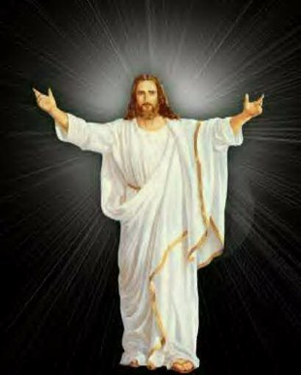

“I know thy works…”

Slide 39


“I would thou wert cold or hot…”

Slide 40
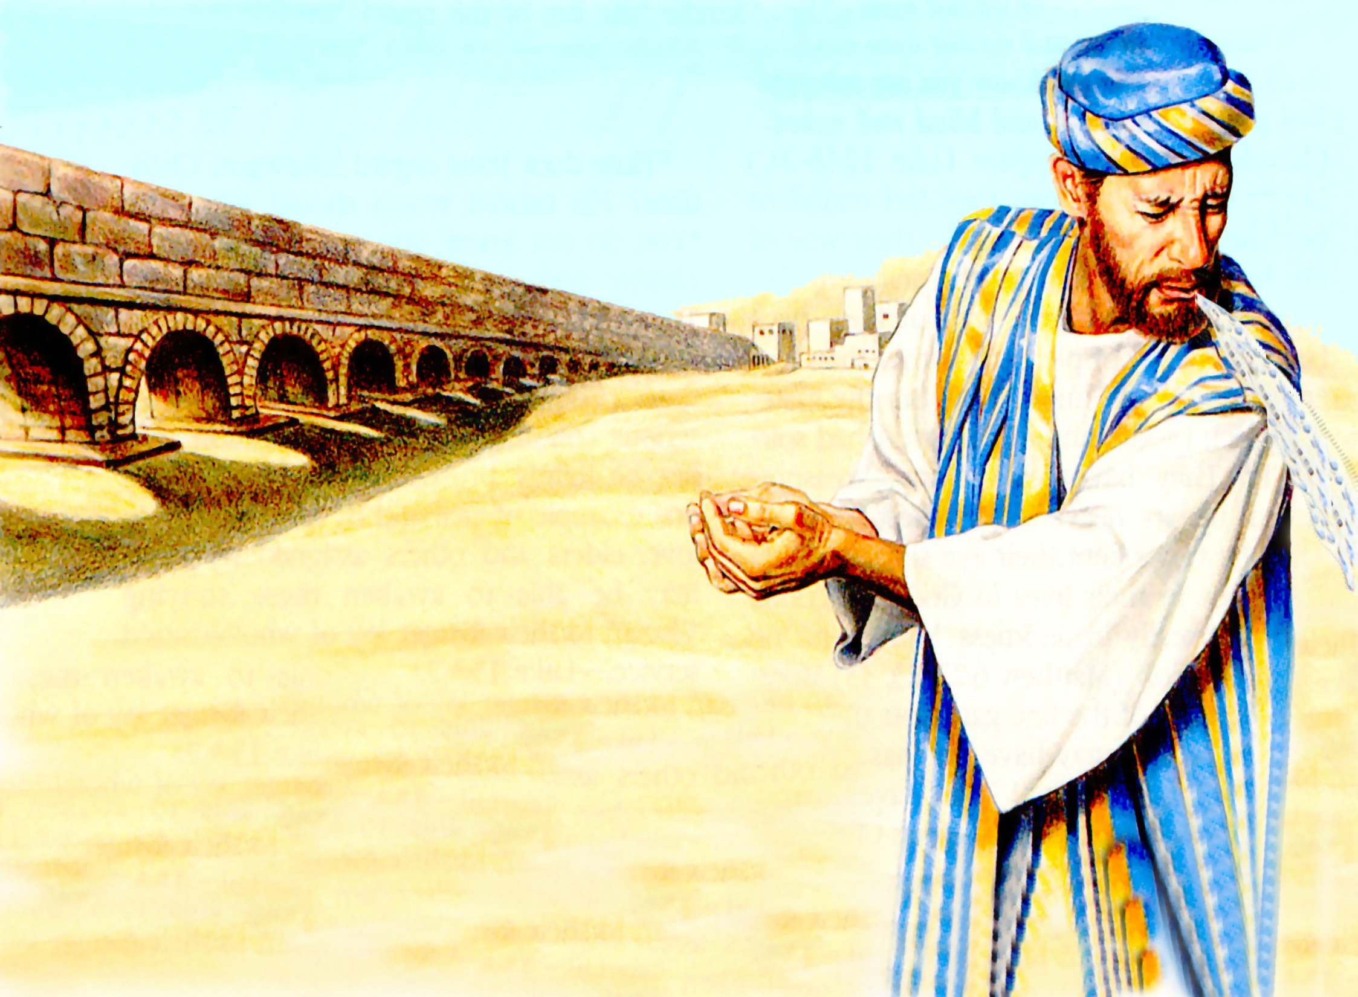
“I will spew thee out of my mouth…”

Slide 41
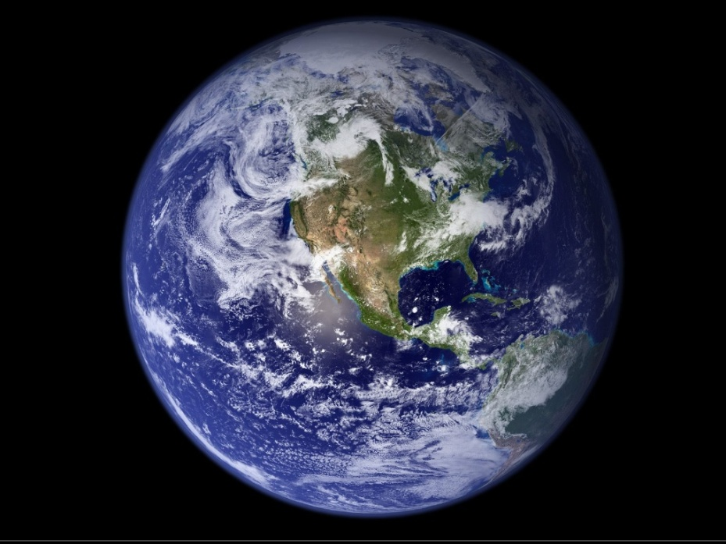

Wealthy and prosperous
Center of trade
Financial banking center
Clothing manufacturing center
Location of a medical school renown for making eye salve
Public bath houses
Huge Stadium
Shopping center

Slide 42
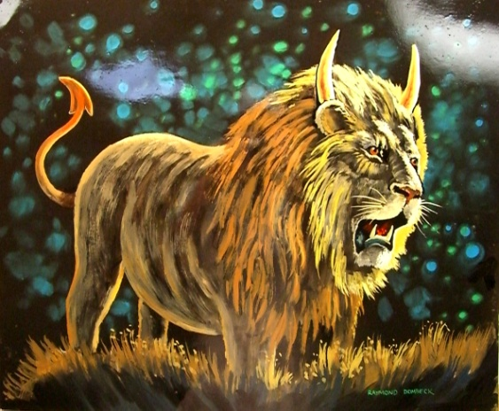
“The church did not maintain its standard of separation. The world came into the church destroying its testimony and ministry.”
(I John 2:15-17)

Slide 43
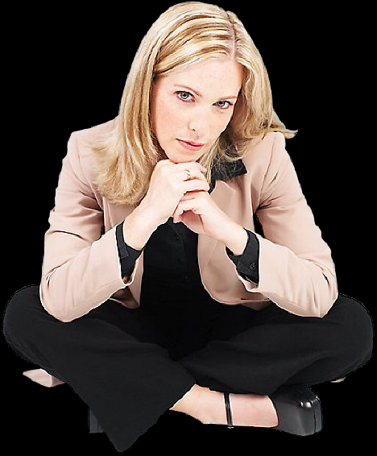
Attitude
Indifferent
Complacent
Lethargic
Self-satisfied
Neutral
Apathetic

Slide 44
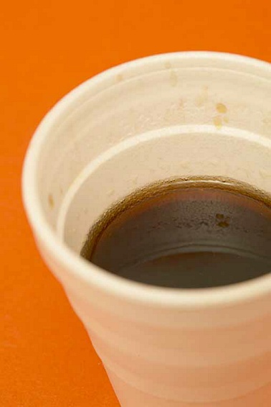
Lukewarm
“Half Hearted Commitment”
To Christ – Luke 9:23
Proclaiming Christ – Matthew 28:19-20
Teaching the Word – II Timothy 4:1-4
Missions and evangelism – Acts 1:8
Self-denial and sacrifice – Matthew 19:21
To church – Hebrews 10:25
Supporting the church – II Corinthians 9:7
Searching Scriptures – John 5:39
Prayer – Luke 18:1-12
Spiritual growth – I Peter 2:1-2

Slide 45
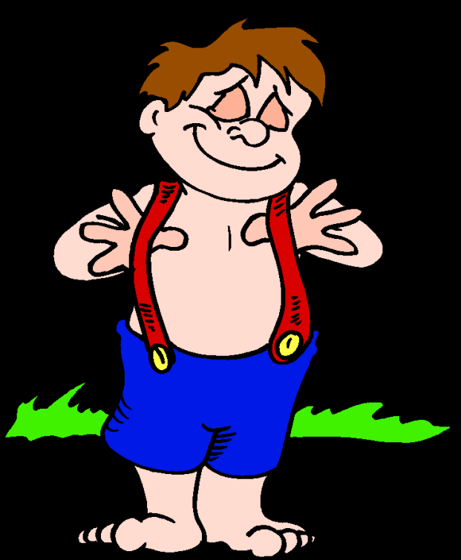
Lukewarm
“Deception”
We have need of nothing – Galatians 6:3; II Corinthians 10:12
They did not realize their true spiritual condition before God:

Slide 46

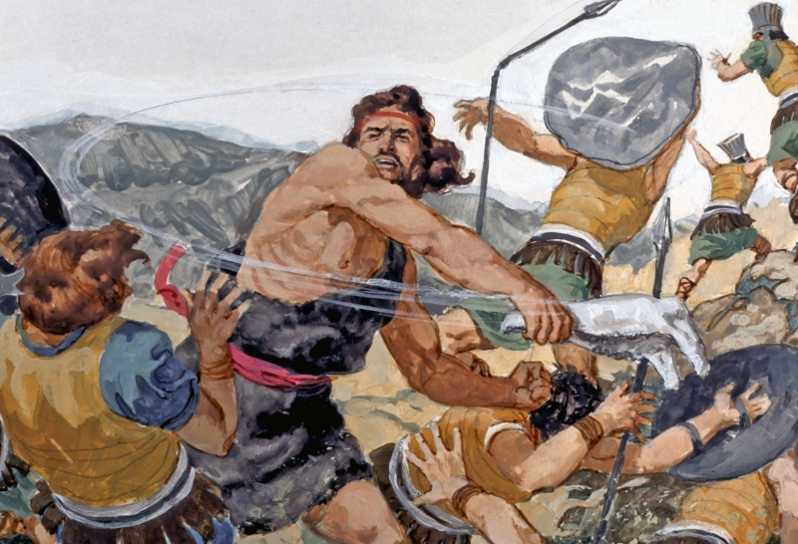
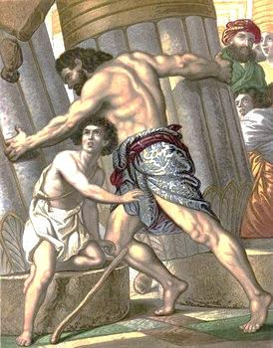

Slide 47
(Judges 14:5-6)
“Then went Samson down, and his father and his mother, to Timnath, and came to the vineyards of Timnath: and, behold, a young lion roared against him. And the Spirit of the LORD came mightily upon him, and he rent him as he would have rent a kid, and he had nothing in his hand: but he told not his father or his mother what he had done.”

Slide 48
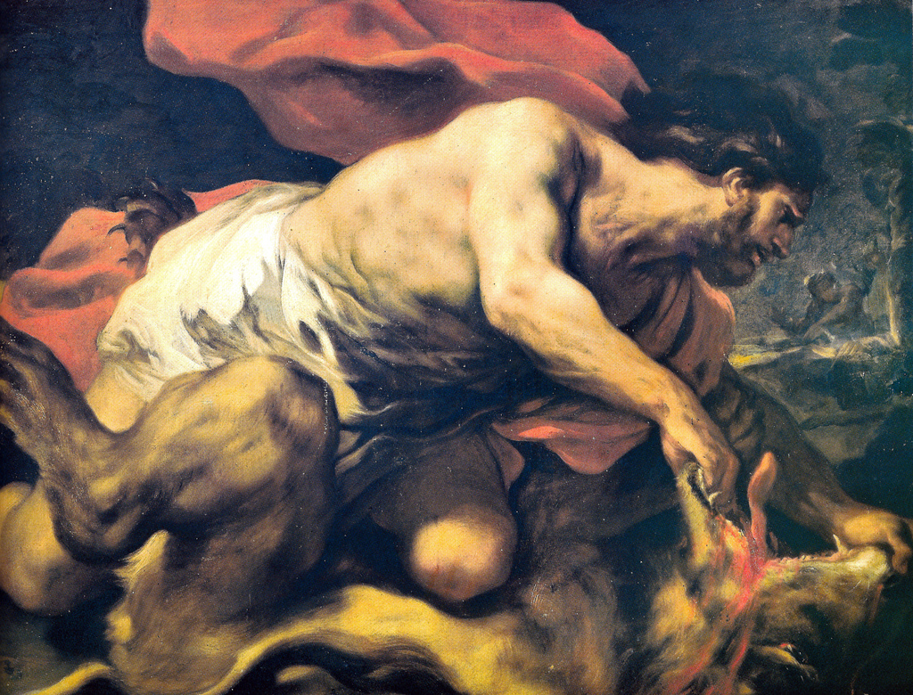

Slide 49
(Judges 15:4-5)
“And Samson went and caught three hundred foxes, and took firebrands, and turned tail to tail, and put a firebrand in the midst between two tails. And when he had set the brands on fire, he let them go into the standing corn of the Philistines, and burnt up both the shocks, and also the standing corn, with the vineyards and olives.”

Slide 50
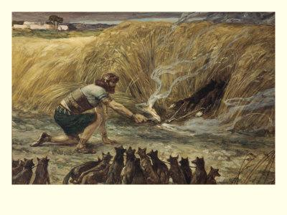

Slide 51
(Judges 15:15)
“And he found a new jawbone of an ass, and put forth his hand, and took it, and slew a thousand men therewith.”

Slide 52
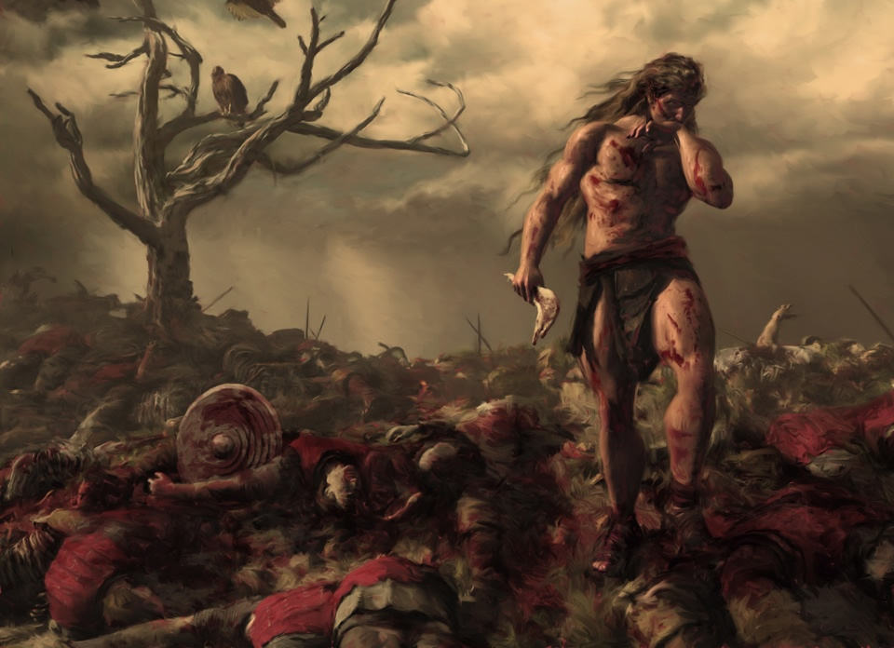

Slide 53
(Judges 16:3)
“And Samson lay till midnight, and arose at midnight, and took the doors of the gate of the city, and the two posts, and went away with them, bar and all, and put them upon his shoulders, and carried them up to the top of an hill that is before Hebron.” (38 miles uphill)

Slide 54
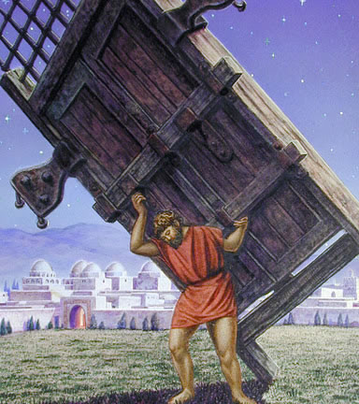

Slide 55
(Judges 16:20)
“And she said, The Philistines be upon thee, Samson. And he awoke out of his sleep, and said, I will go out as at other times before, and shake myself. And he wist not that the LORD was departed from him.”

Slide 56
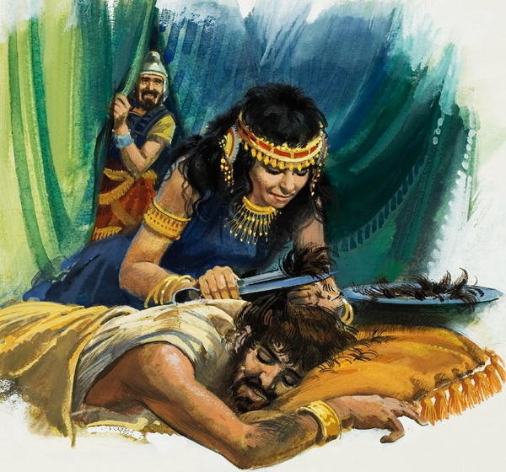

Slide 57
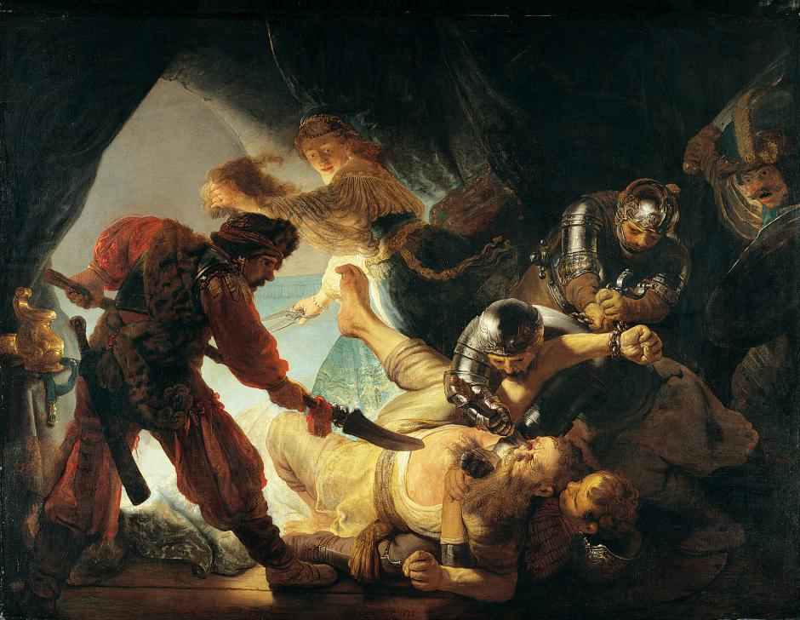

Slide 58
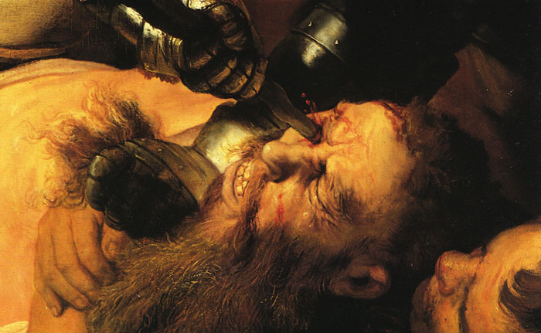

Slide 59
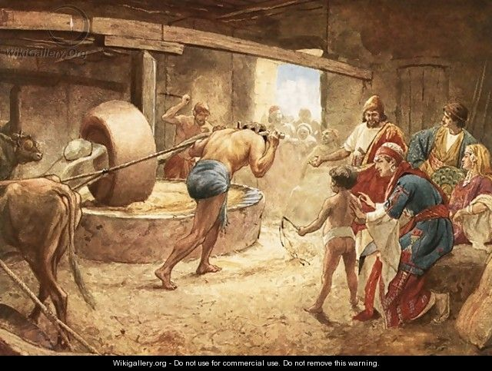

Slide 60
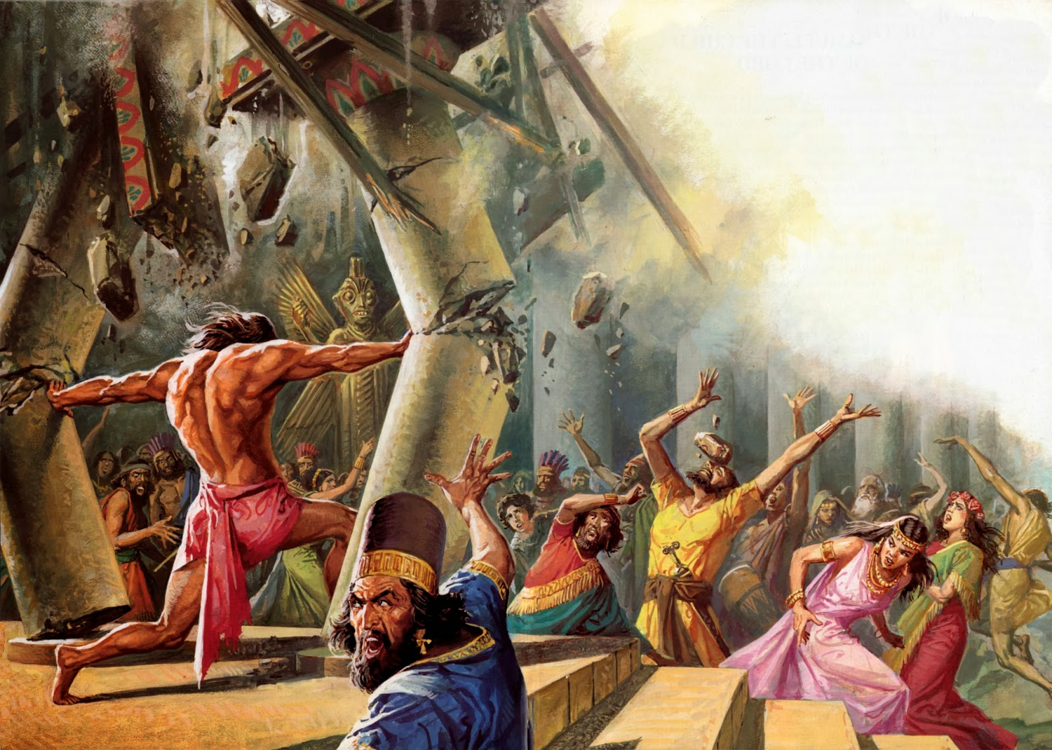
(Judges 16:28)
“And Samson called unto the LORD, and said, O Lord GOD, remember me, I pray thee, and strengthen me, I pray thee, only this once.”

Slide 61
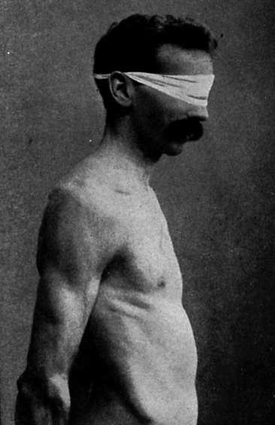
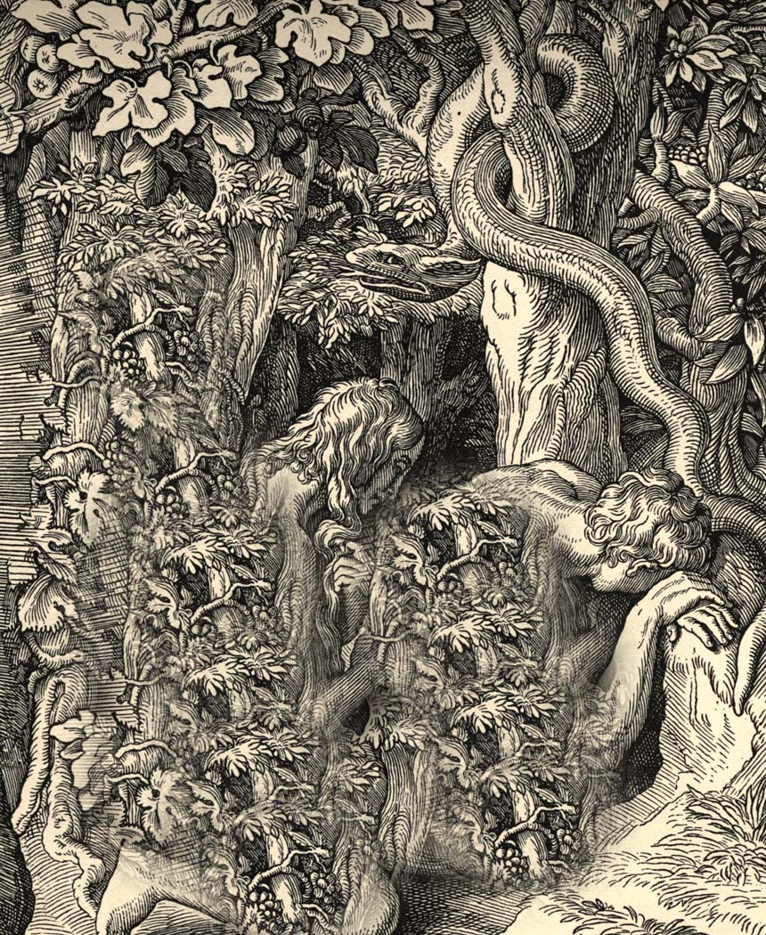
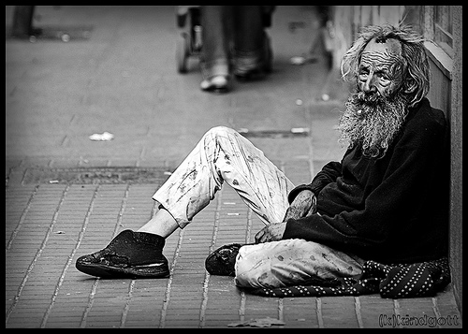
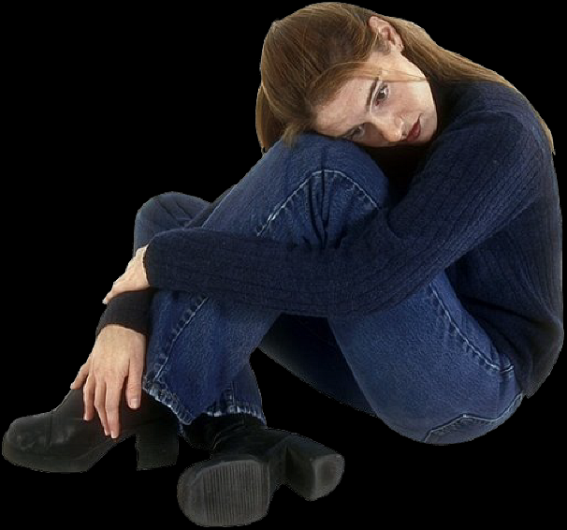
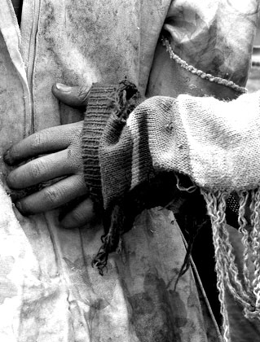
Lukewarm
“True Spiritual Condition”
Wretched – Romans 7: 14-24
Miserable – Isaiah 64:6
Poor – Spiritual poverty
Blind – II Corinthians 4:4
Naked – Matthew 22:11-13; Revelation 16:15

Slide 62
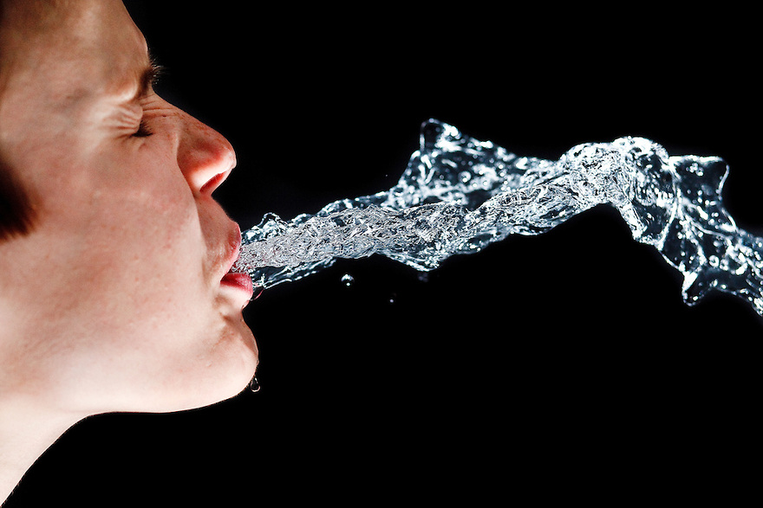
“…because thou art lukewarm, and neither cold nor hot, I will spue thee out of my mouth.”

Slide 63
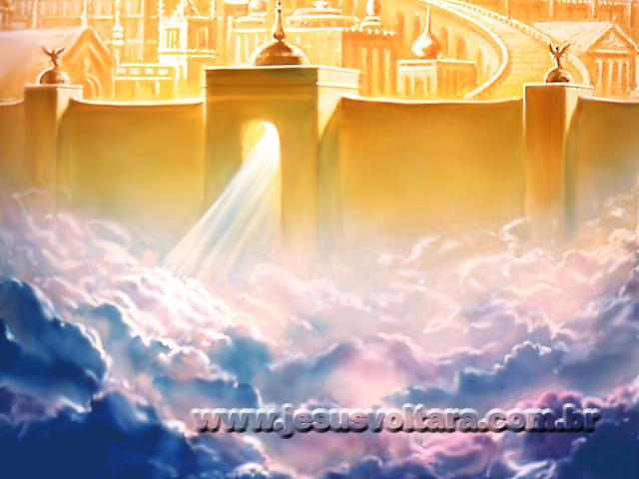
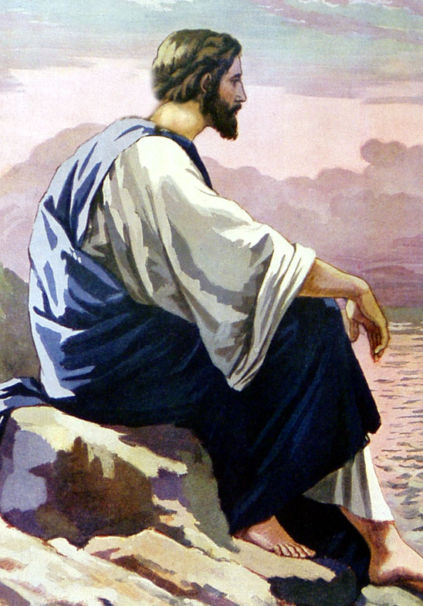
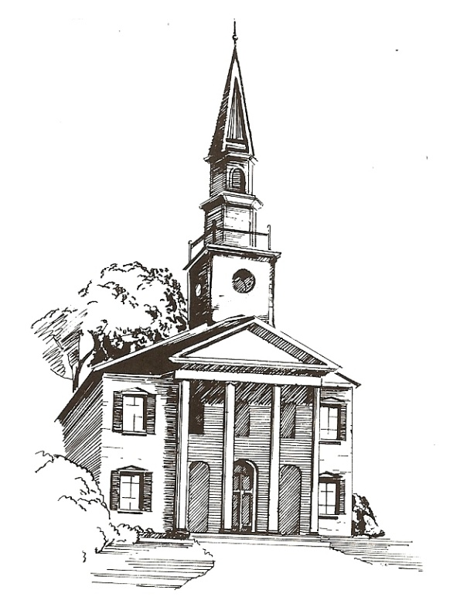
“I counsel thee…”

Slide 64
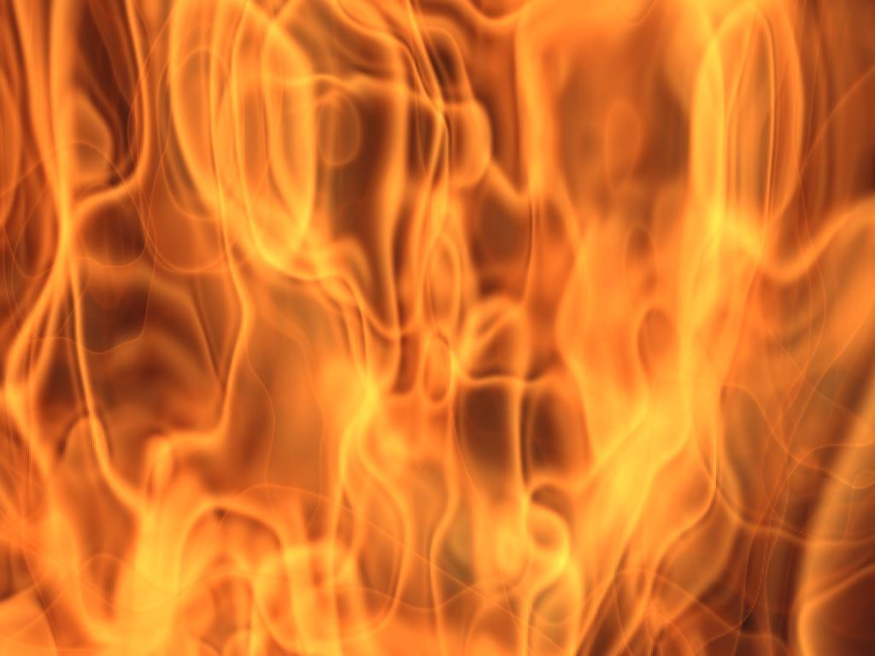
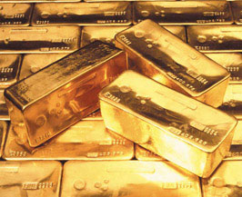
“Buy of me Gold tried in the fire, that thou mayest be rich…”

Slide 65
I Timothy 6:17-19; Hebrews 11:26; Matthew 19:21; Ephesians 1:3-2:10
Center of banking
Manufacturing center
Extremely wealthy
They had worldly wealth (gold)
They needed spiritual wealth (gold) – “True spiritual riches…”

Slide 66
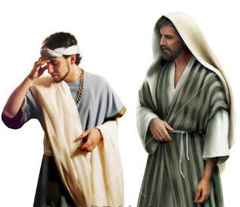
(Matthew 19:21)
“Jesus said unto him, If thou wilt be perfect, go and sell that thou hast, and give to the poor, and thou shalt have treasure in heaven: and come and follow me.”

Slide 67


Slide 68
“…and white raiment, that thou mayest be clothed, and that the shame of they nakedness do not appear…”

Slide 69

“Let us be glad and rejoice, and give honour to him: for the marriage of the Lamb is come, and his wife hath made herself ready. And to her was granted that she should be arrayed in fine linen, clean and white: for the fine linen is the righteousness of saints.” (Revelation 19:7-8)

Slide 70



“…anoint thine eyes with eyesalve, that thou mayest see…”

Slide 71

“As many as I love, I rebuke and chasten: be zealous therefore, and repent.”

Slide 72

“Behold, I stand at the door, and knock…”

Slide 73

“…if any man hear my voice, and open the door, I will come in to him, and will sup with him, and he with me.”

Slide 74

“To him that overcometh will I grant to sit with me in my throne, even as I also overcame, and am set down with my Father in his throne.”

Slide 75

“He that hath an ear, let him hear what the Spirit saith unto the churches.”

