Slide 1




Slide 2




Slide 3










Slide 4

The Powerful Role of Music in Society
Music and society have always been closely related. Music reflects and creates social conditions including the factors that either facilitate or impede social change. Today’s society is all based on what you watch on T.V., those you hang around, how you were raised, and the music you listen to. Music is perhaps one of the most powerful forces we encounter. Music can both establish and destroy morality.
Cary Schmidt
Pastor, Emmanuel Baptist Church

Slide 5


Slide 6

(Ezekiel 28:12-15)
“Thou sealest up the sum, full of wisdom, and perfect in beauty. Thou hast been in Eden the garden of God; every precious stone was thy covering, the sardius, topaz, and the diamond, the beryl, the onyx, and the jasper, the sapphire, the emerald, and the carbuncle, and gold: the workmanship of thy tabrets and of thy pipes was prepared in thee in the day that thou wast created. Thou art the anointed cherub that covereth; and I have set thee so…Thou wast perfect in thy ways from the day that thou wast created, till iniquity was found in thee.”

Slide 7
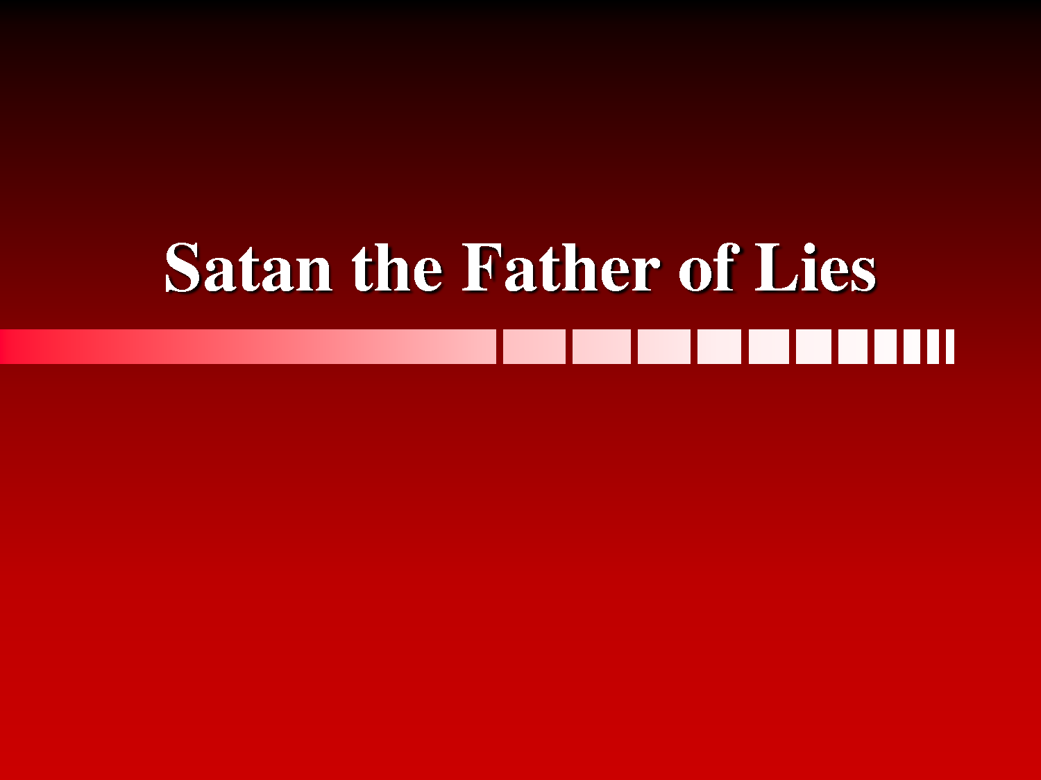


Slide 8

“But strong meat (Word of God) belongeth to them that are of full age, even those who by reason of use have their senses exercised to discern both good and evil.”
Heb 5:14

Slide 9

Biblical Principles for
Discerning Godly Music

Slide 10

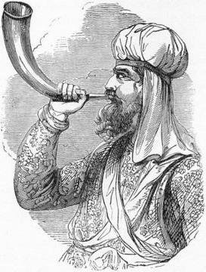
“Set ye up a standard in the land, blow the trumpet among the nations.” (Jer. 51:27)

Slide 11
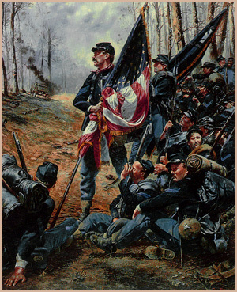


Slide 12

“So shall they fear the name of the LORD from the west, and his glory from the rising of the sun. When the enemy shall come in like a flood, the Spirit of the LORD shall lift up a standard against him.” (Isaiah 59:19)

Slide 13


God’s Word Commands The Believer “Approve things that are excellent.”
(Philippians 1:10)

Slide 14



Because of how music affects our minds and bodies it must come under scrutiny of Scripture
(I Peter 2:11)
Music is intimately connected
with worship, and is therefore
shapes our view
of God
(Psalm 99:9)

Slide 15
“[Prove] what is acceptable unto the Lord. And have no fellowship with the unfruitful works of darkness, but rather reprove them. . .Wherefore be ye not unwise, but understanding what the will of the Lord is. . .Speaking to yourselves in psalms and hymns and spiritual songs, singing and making melody in your heart to the Lord.” (Ephesians 5:10-19)

Slide 16


MUSIC IS NOT AMORAL
Music is a form of communication.
Whenever two notes are put together, they become communication and are subject to God’s Judgment - Matthew 12:36
God does not judge amoral things, but judges according to whether something is “good or bad. . .” - II Corinthians 5:10

Slide 17


God promises that if we allow the Word of God to dwell within us richly - Colossians 3:14-16
Our senses will be exercised to discern between good and evil - Hebrews 5:14

Slide 18
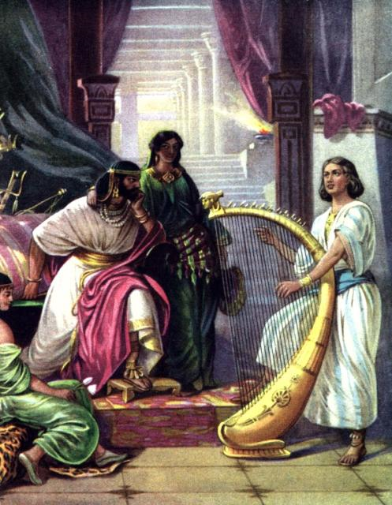

PUTTING MUSIC
TO THE TEST OF SCRIPTURE
Does it glorify God? I Corinthians 10:31
Does it provide an atmosphere of spiritual uplift and inspiration? I Samuel 16:23

Slide 19
Does it contain words that are worthwhile in meaning or are contrary to what is decent and Scripturally right? - Ephesians 4:21-24, 29
“If so be that ye have heard him, and have been taught by him, as the truth is in Jesus: That ye put off concerning the former conversation the old man, which is corrupt according to the deceitful lusts; And be renewed in the spirit of your mind; And that ye put on the new man, which after God is created in righteousness and true holiness. Let no corrupt communication proceed out of your mouth, but that which is good to the use of edifying, that it may minister grace unto the hearers.”

Slide 20
“Either make the tree good, and his fruit good; or else make the tree corrupt, and his fruit corrupt: for the tree is known by his fruit. O generation of vipers, how can ye, being evil, speak good things? for out of the abundance of the heart the mouth speaketh. A good man out of the good treasure of the heart bringeth forth good things: and an evil man out of the evil treasure bringeth forth evil things. But I say unto you, That every idle word that men shall speak, they shall give account thereof in the day of judgment. For by thy words thou shalt be justified, and by thy words thou shalt be condemned.”

Slide 21

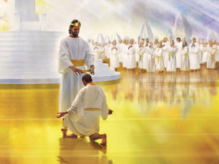

Slide 22

Does rhythm, background beat, breathy sliding pitches, or syncopation appeal to my lower impulses and excite my flesh?
(Romans 12:1-2; 13:14)

Slide 23
Does the music move your hips or your heart?

Slide 24
“For they that are after the flesh do mind the things of the flesh; but they that are after the Spirit the things of the Spirit. For to be carnally minded is death; but to be spiritually minded is life and peace. Because the carnal mind is enmity against God: for it is not subject to the law of God, neither indeed can be.” (Rom. 8:5-7)
“For the flesh lusteth against the Spirit, and the Spirit against the flesh: and these are contrary the one to the other: so that ye cannot do the things that ye would. Now the works of the flesh are manifest, which are these; Adultery, fornication, uncleanness, lasciviousness.” (Gal. 5:17, 19)

Slide 25

Does the presentation of the music have a carnal style?
(I Corinthians 3:1-3; 5:6)

Slide 26



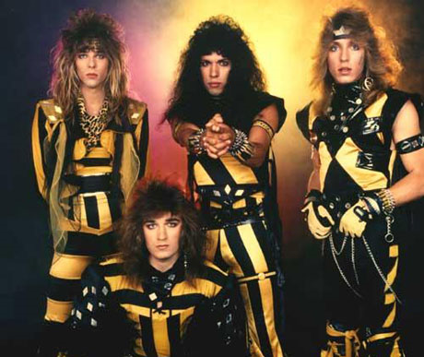



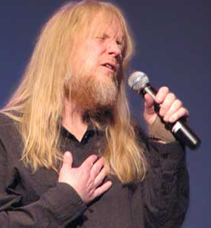
Are the musicians who sing the music examples to be followed?
( Philippians 3:15-20)

Slide 27

Is there any appearance of evil in the music?
(I Thessalonians 5:21-22)

Slide 28

Is there any sensuality or rebellion sensed in the music
(James 3:15-17)

Slide 29
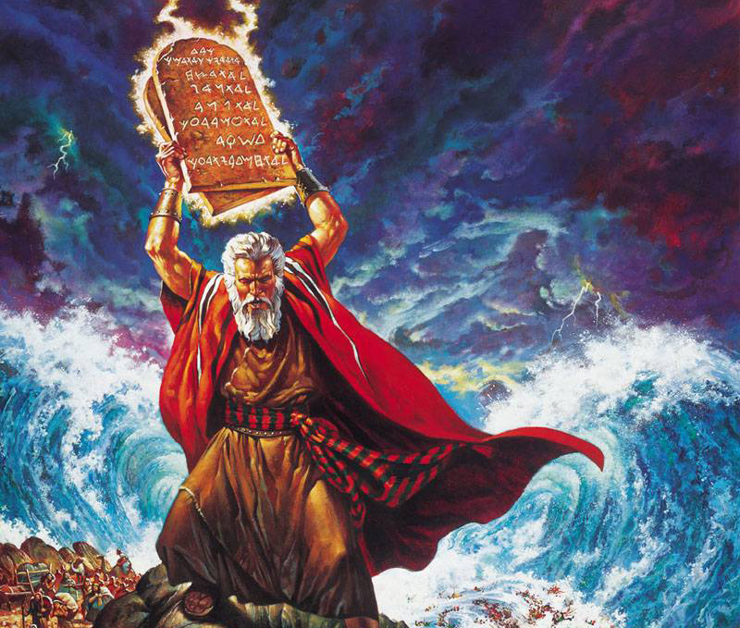
It is not the voice of them that shout for mastery, neither is it the voice of them that cry for being overcome: but the noise of them that sing do I hear.” (Exodus 32:17-18)
“AND WHEN JOSHUA HEARD THE NOISE OF THE PEOPLE AS THEY SHOUTED HE SAID UNTO MOSES, THERE IS A NOISE OF WAR IN THE CAMP. AND HE SAID,

Slide 30

Does it have a clear understandable Scriptural message?
(I Corinthians 14:7-9)

Slide 31
“And even things without life giving sound, whether pipe or harp, except they give a distinction in the sounds, how shall it be known what is piped or harped? For if the trumpet give an uncertain sound, who shall prepare himself to the battle? So likewise ye, except ye utter by the tongue words easy to be understood, how shall it be known what is spoken? for ye shall speak into the air.”

Slide 32

Does the music violate the Biblical principle of not mixing light with darkness or the clean with the unclean?
(II Corinthians 6:14-7:1)

Slide 33
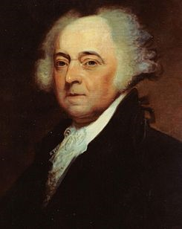
Godly music adheres to God’s standard of separation - I John 2:15-16
John Adams Stated
While President
“The church is the moral compass of society. But in order to remain a true and faithful compass, the church must remain separate and independent of the influences of that society.”

Slide 34
Godly music does not imitate the world’s music - James 4:4
NOTE: The strongest evidences of admiration is imitation. The Christian who says he loves God but listens to carnal music is guilty of violating God’s command of separation - Hebrews 13:13-16
Godly music is not appealing to the world - John 15:18-19
NOTE: The function of music is to edify Christians and to praise God, not appeal to the world - Ephesians 5:19; Colossians 3:16

Slide 35


Godly music is called a “new song” - Psalms 33:1-3; 40:3; 96:1-2; 98:1-2; 144:9-10; 149:1-4
If the believer is going to “put off the old man and put on the new man” it is important that he put off the worlds music and put on Godly music.
God ordained preaching, not music, to win the lost - I Corinthians 1:18-21

Slide 36


Does the rhythm of the music bring me under its power (is it addictive?)
(I Corinthians 6:12)

Slide 37
Is the melody [that which is designed to carry the message] supported by the harmony and rhythm?
Godly music will always have a Biblical balance:
The melody will be the dominant, the harmony will be secondary, and the rhythm will be supportive - (Ephesians 5:19)

Slide 38
Godly Music
Carnal Music
Rhythm
Harmony
Melody
Rhythm
Harmony
Melody

Slide 39

Variety in Biblical Music
“Let the word of Christ dwell in you richly in all wisdom; teaching and admonishing one another in psalms and hymns and spiritual songs, singing with grace in your hearts to the Lord.” (Col. 3:16)
Psalms – Word of God put to music
Hymns – Songs with great doctrinal truths
Spiritual songs – Songs expressing personal testimony

Slide 40

Does the music offend
Spiritual (mature) Christians?
(Romans 14:21)

Slide 41

Does the music have the potential of causing others to stumble?
(I Corinthians 8:1-13)

Slide 42

Is there any doubt in your mind concerning the music?
(Romans 14:23)

Slide 43
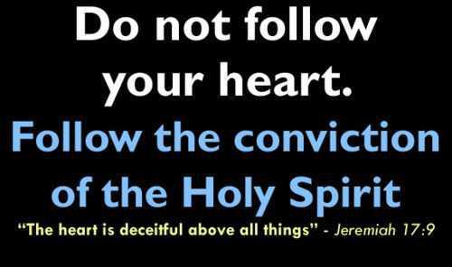
Is there any conviction of the Holy Spirit concerning your music?

Slide 44






Slide 45


Slide 46




Evil / Sin

Slide 47


Applying Biblical Principle
There may be a fine line between what is good and acceptable music and what is not.
To avoid being drawn across the line it would be wise to stay away from the line.

Slide 48



Slide 49

Satan will seek to get an advantage in our lives and churches however he can – II Cor. 2:11
To stop this from happening in the area of music, avoid any music that may be questionable - II Cor. 2:11

Slide 50

Right
Good
Bad
Wrong

Slide 51

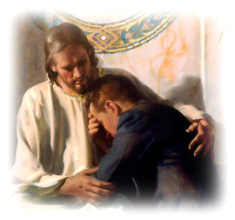

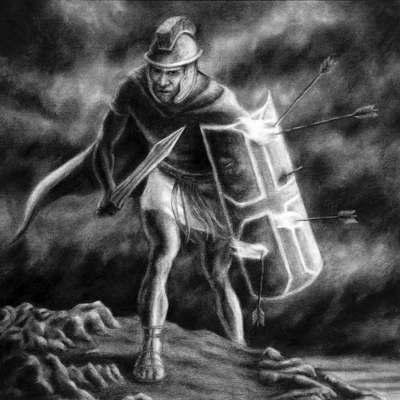
Repent of listening to carnal music - Rev. 3:19
Remove the music from your life – Acts 19:19
Replace it with good godly music – II Tim. 2:22
Resist the temptation to go back to your old music – James 4:7

Slide 52


“Whatsoever ye do, do all to the glory of God.”

