Slide 1


Do you want to go to Heaven?

Slide 2

What the Bible says about Heaven
552 times the word “Heaven”
is found in the Bible

Slide 3
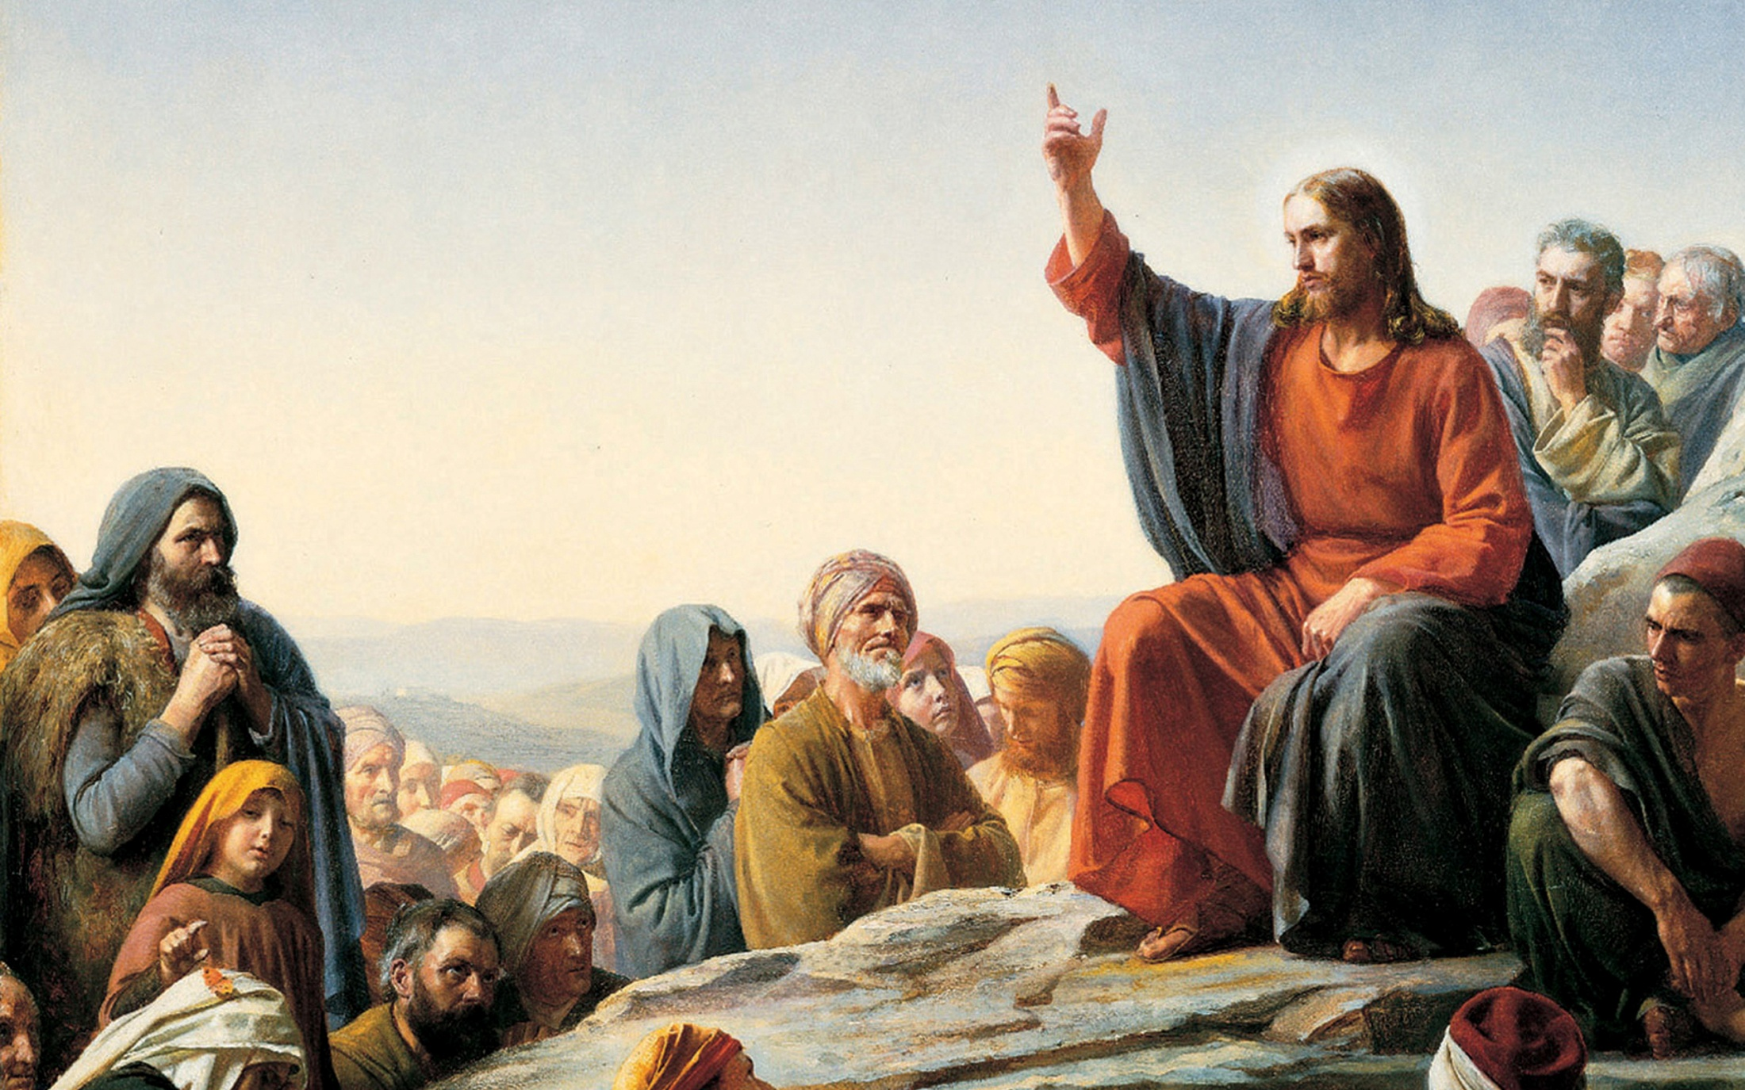

Slide 4
“Repent ye: for the kingdom of heaven is at hand.”
“Blessed are the poor in spirit: for theirs is the kingdom of heaven.”
“Blessed are they which are persecuted for righteousness' sake: for theirs is the kingdom of heaven.”
“For I say unto you, That except your righteousness shall exceed the righteousness of the scribes and Pharisees, ye shall in no case enter into the kingdom of heaven.”

Slide 5
“But lay up for yourselves treasures in heaven, where neither moth nor rust doth corrupt, and where thieves do not break through nor steal.”
“Verily I say unto you, Except ye be converted, and become as little children, ye shall not enter into the kingdom of heaven.”
“In my Father's house are many mansions: if it were not so, I would have told you. I go to prepare a place for you.”

Slide 6


Slide 7
“For our conversation (citizenship) is in heaven; from whence also we look for the Saviour, the Lord Jesus Christ.”
“For in this we groan, earnestly desiring to be clothed upon with our house which is from heaven.”
“But though we, or an angel from heaven, preach any other gospel unto you than that which we have preached unto you, let him be accursed.”

Slide 8
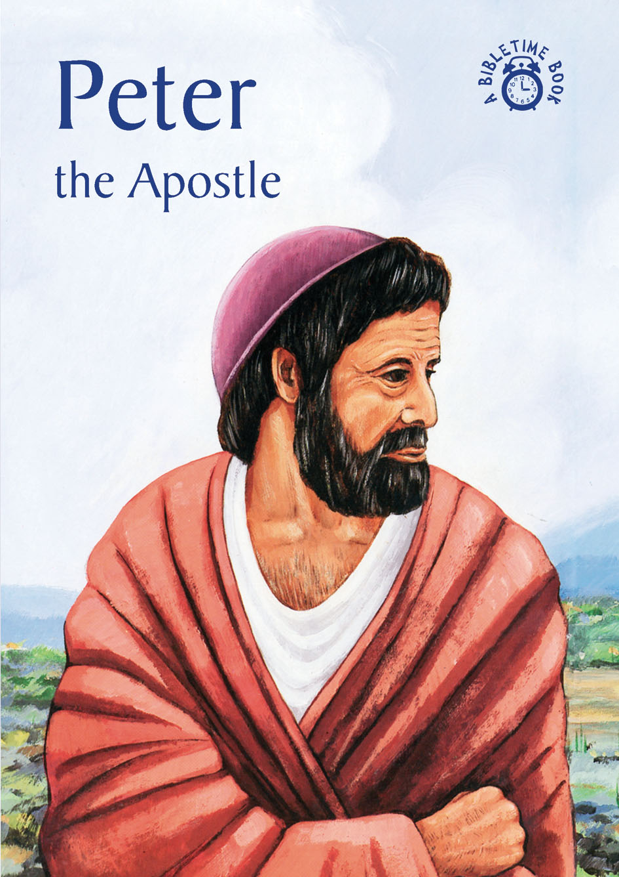

Slide 9
“Blessed be the God and Father of our Lord Jesus Christ, which according to his abundant mercy hath begotten us again unto a lively hope by the resurrection of Jesus Christ from the dead, To an inheritance incorruptible, and undefiled, and that fadeth not away, reserved
in heaven for you.”

Slide 10
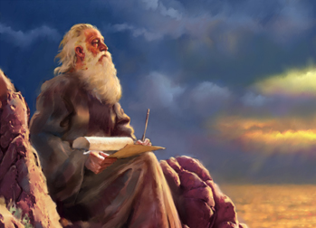
Apostle John
(Speaks 54 times of Heaven in the book of the Revelation)

Slide 11
“And I heard a great voice out of heaven saying, Behold, the tabernacle of God is with men, and he will dwell with them, and they shall be his people, and God himself shall be with them, and be their God.”

Slide 12
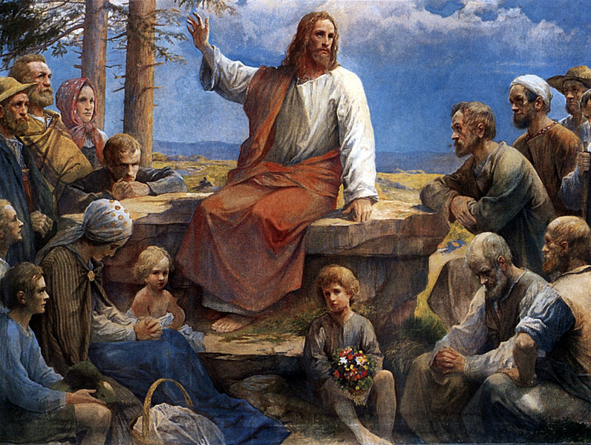
“Not every one that saith unto me, Lord, Lord, shall enter into the kingdom of heaven.”

Slide 13

How can a person go to Heaven?

Slide 14
“Jesus saith unto him, I am the way, the truth, and the life: no man cometh unto the Father, but by me.” John 14:6

Slide 15
“Neither is there salvation in any other: for there is none other name under heaven given among
men, whereby we
Must be saved.”
Acts 4:12

Slide 16
“And there shall in no wise enter into it (Heaven) any thing that defileth, neither whatsoever worketh abomination, or maketh a lie: but they which are written in the Lamb's book of life.”
Rev. 21:27

Slide 17
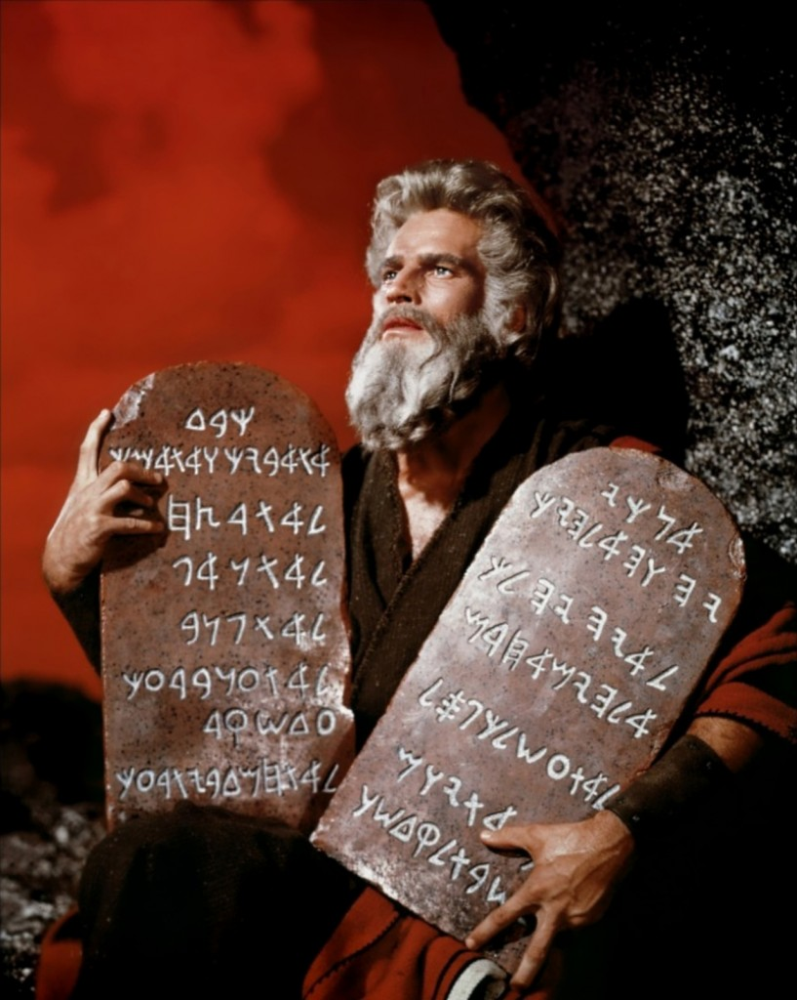
“Whosoever committeth sin transgresseth also the law: for sin is the transgression of the law.”
I John 3:4

Slide 18


Slide 19
“As it is written, There is none righteous, no, not one: There is none that understandeth, there is none that seeketh after God.
They are all gone out of the way, they are together become unprofitable; there is none that doeth good, no, not one.”
Rom. 3:10-12

Slide 20
Sin

Slide 21
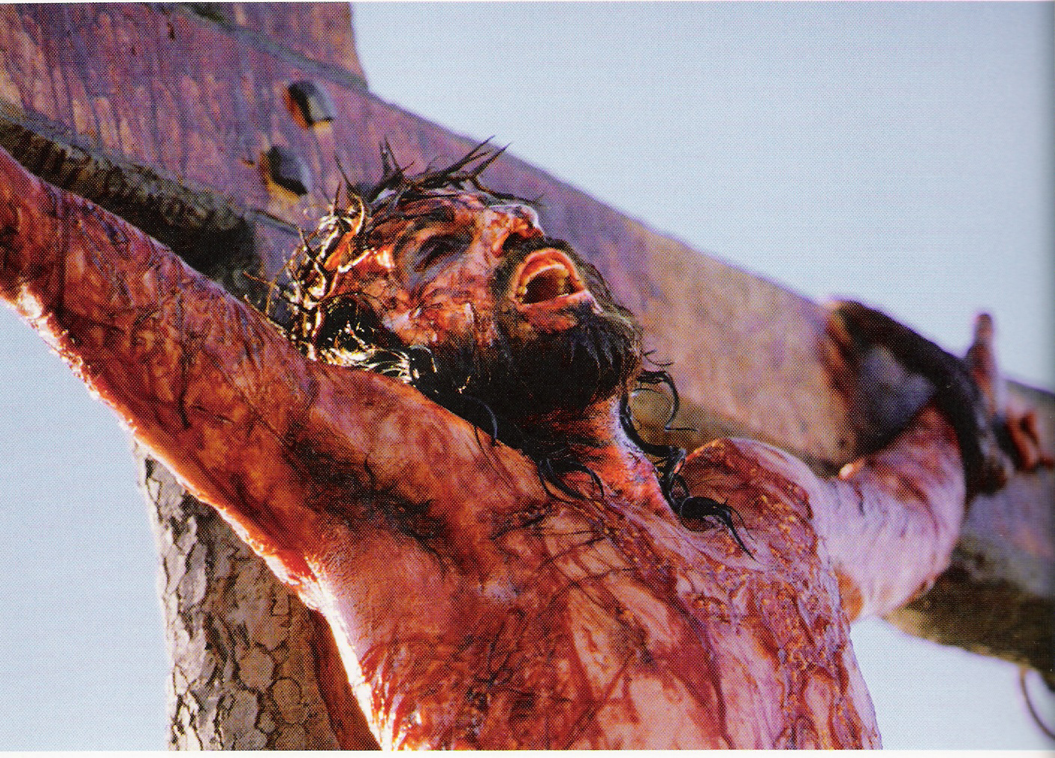

Slide 22
“For he hath made him to be sin for us, who knew no sin; that we might be made the righteousness of God in him.”
II Cor. 5:21

Slide 23


Slide 24


Slide 25

“The blood of Jesus Christ his Son cleanseth us from all sin.” I John 1:7

Slide 26



Slide 27
Sin

Slide 28
“And whosoever was not found written in the book of life was cast into the lake of fire.”
Rev. 20:15

Slide 29


Slide 30


Slide 31

Do you want to go to Heaven?

Slide 32

“That if thou shalt confess with thy mouth the Lord Jesus, and shalt believe in thine heart that God hath raised him from the dead, thou
shalt be saved.” Rom. 10:9

Slide 33
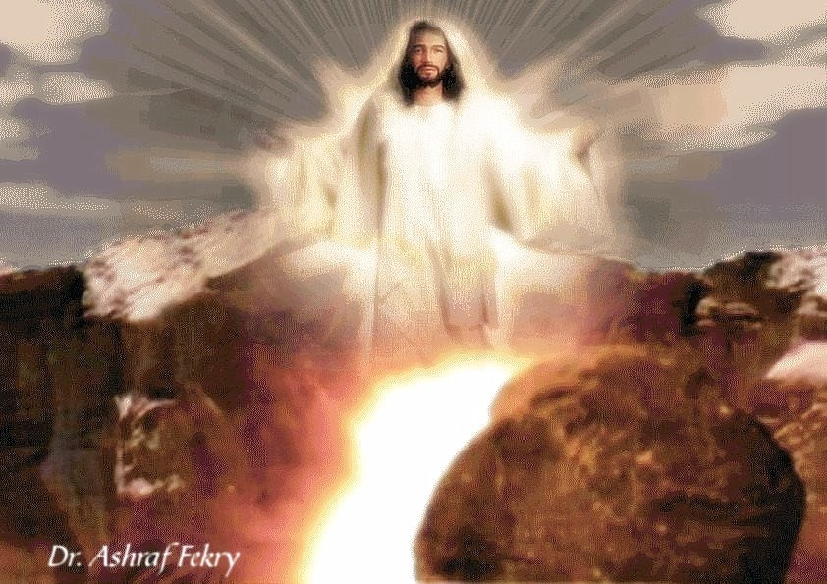
“Him that cometh to me I will in no wise cast out.” John 6:37

