Slide 1
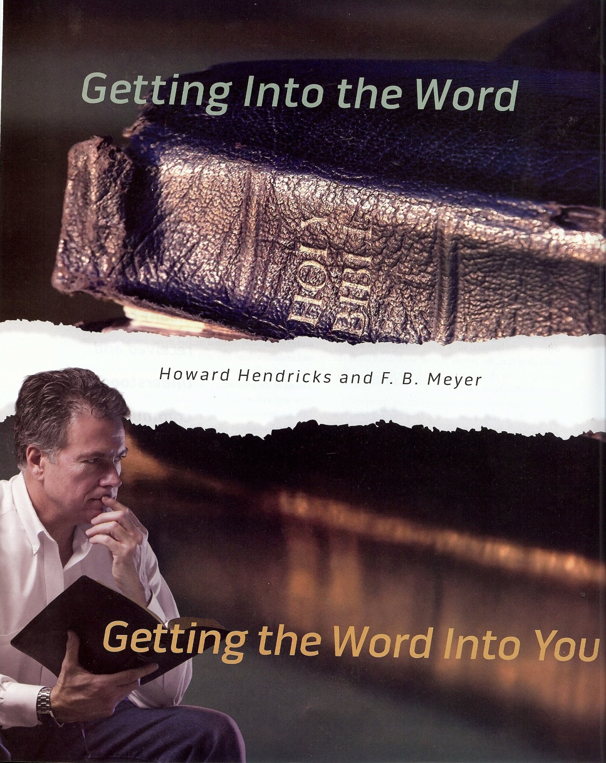
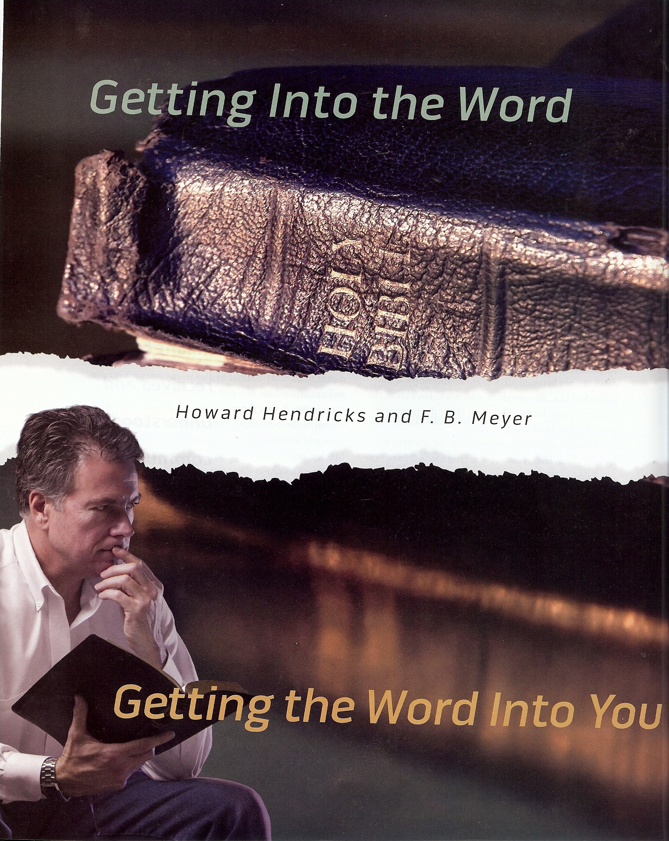

Slide 2
One of the greatest problems facing the church today is that we have Christians who are under the teaching of the Word of God but they are not in it for themselves - “Study to shew thyself approved unto God, a workman that needeth not to be ashamed, rightly dividing the word of truth.” II Timothy 2:15
Being under the teaching of the Word of God should stimulate us to get into the Word ourselves. It should not be a substitute – (see Psalms 119)

Slide 3
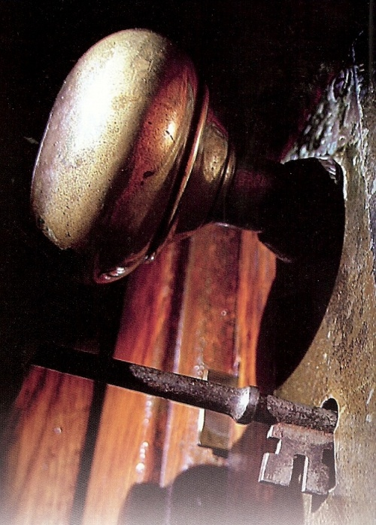

Why Should I Study the
Bible for Myself?
Commandment – Matthew 4:4
Growth – I Peter 2:2
Maturity – Hebrews 5:13-14
Guidance – II Timothy 3:16-17
Cleansing from sin – John 15:3; Ephesians 5:26
Victory over sin – Psalm 119:9
Wisdom – Psalms 1
Blessing – Revelation 1:3
Love for the Lord – I John 2:5

Slide 4
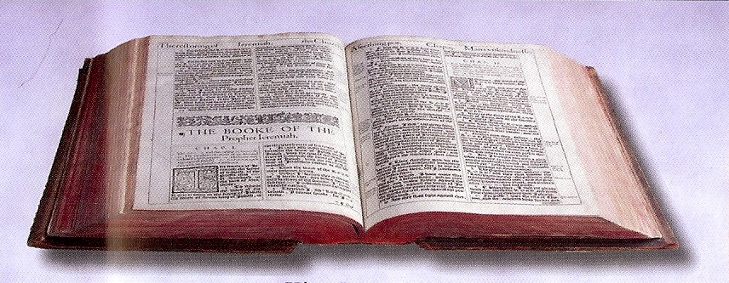
Getting into the Word for Yourself
“Some simple suggestions”
Make time for Bible study – Ephesians 5:16
Ask for understanding – Psalms 119:18
Develop your own personal plan –
Read the Bible through in a year
Study a book of the Bible
Study passages
Study the life of Christ or other Bible characters
Study subjects or topics
Invest in a good Bible computer program – (Power Bible CD)

Slide 5
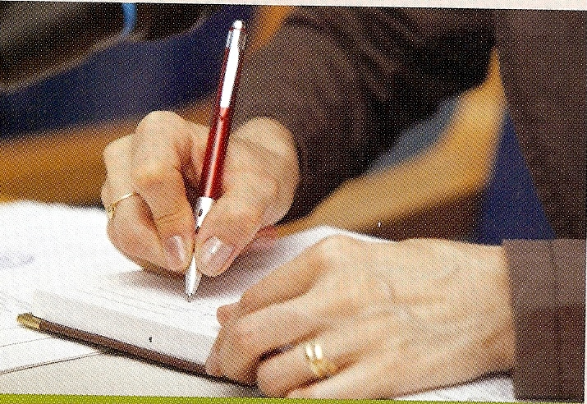
Read with pen in hand (Jot down the following) –
What you have learned
How God has spoken to you
How God has encouraged you
How God has convicted you of sin
Repentance
Underline special passages
Write down cross references
Journal your spiritual life
Write down dates

Slide 6
Turn Bible reading into prayer – Psalms
If you are reading about holiness turn that into a personal prayer for holiness.
If you are reading about the glory of God take time to worship and praise Him for His power and great glory.
If you are reading about the consequences of sin ask God to produce within you a “Fear of the Lord.”
If you are reading about the good character of a Bible personality ask the Lord to develop that character in you.

Slide 7
Example
(Psalms 15:4)
“He that sweareth to his own hurt, and changeth not.”
“Lord, I recall some promises I have made that, although painful, I need to keep. Forgive me, Lord, for breaking my commitment to _________.
Help me today to make that right, and to become the type of righteous person this psalm addresses.”

Slide 8
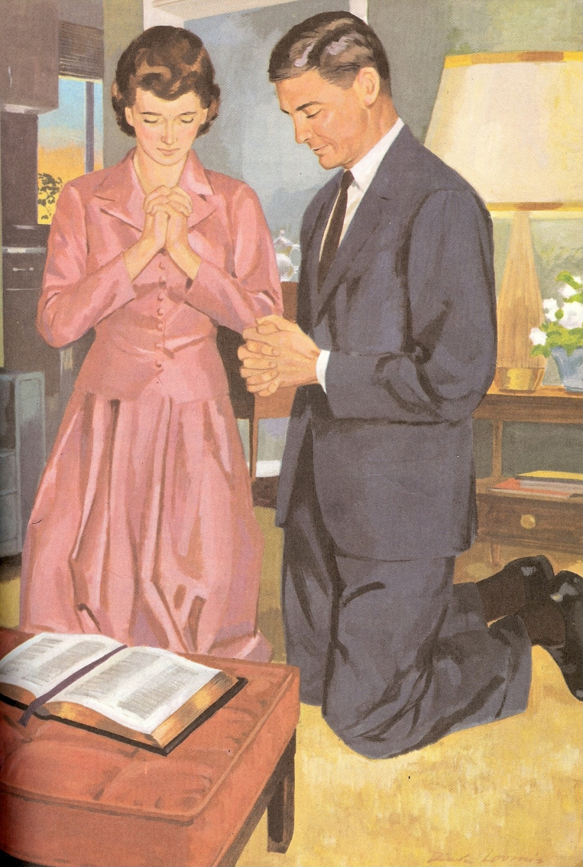
“Lord, I also want to pray for ___________, who is considering divorce and claims to be a Christian. Please bless him and lead him in the way of righteousness. Please give him courage to stay with his wife and give me an opportunity to talk with him and encourage him.”

Slide 9
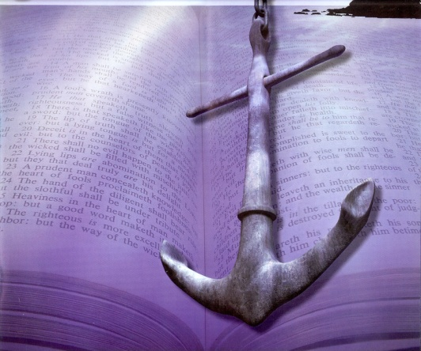
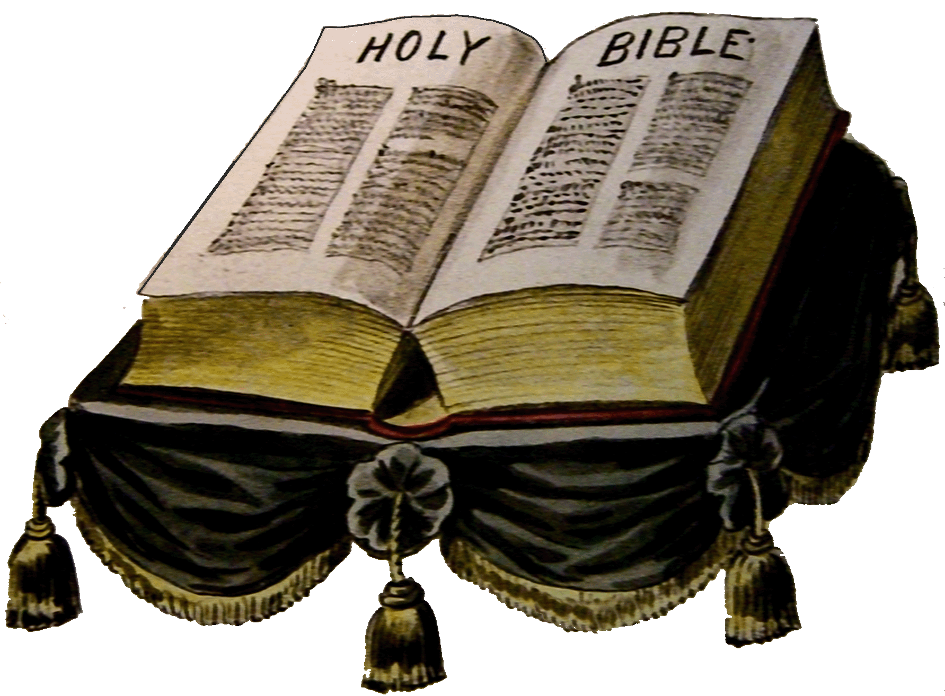
Put into practice what you have learned
“This book of the law shall not depart out of thy mouth; but thou shalt meditate therein day and night, that thou mayest observe to do according to all that is written therein: for then thou shalt make thy way prosperous, and then thou shalt have good success.”
(Joshua 1:8)

Slide 10
