Slide 1
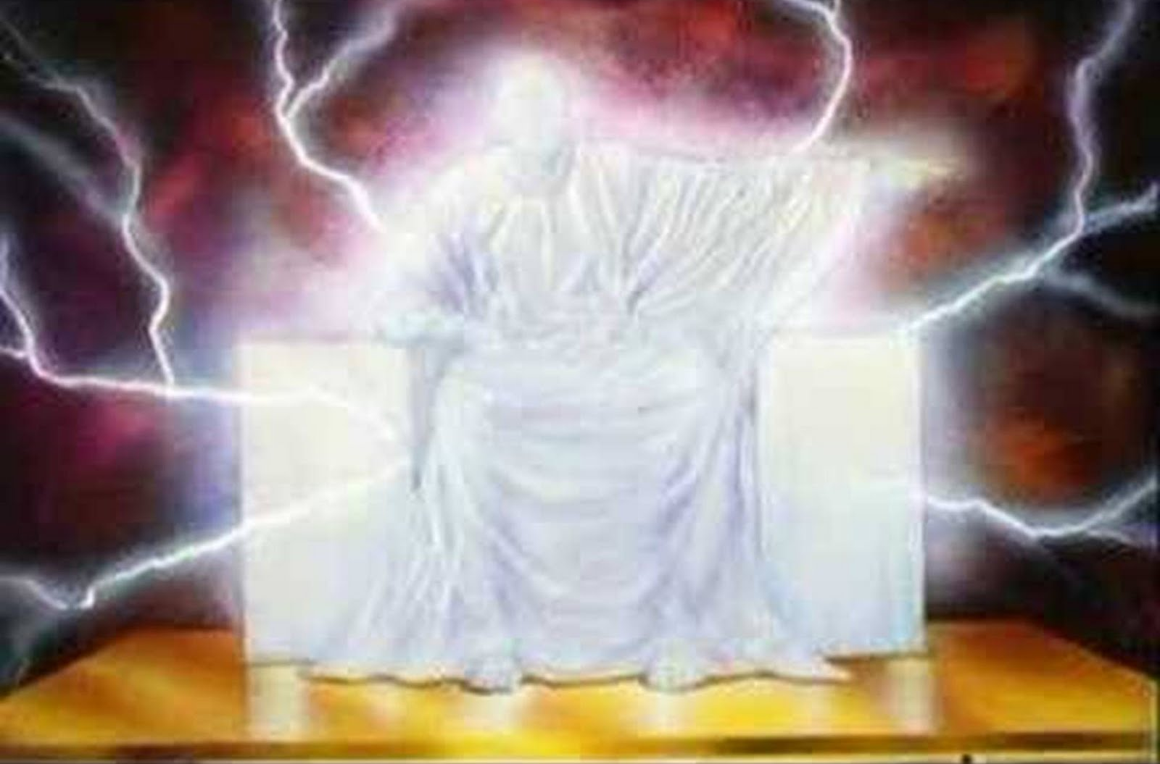
The Great White Throne
(Revelation 20:11-15)

Slide 2
“And as it is appointed unto men once to die, but after this the judgment”
(Heb 9:27)

Slide 3
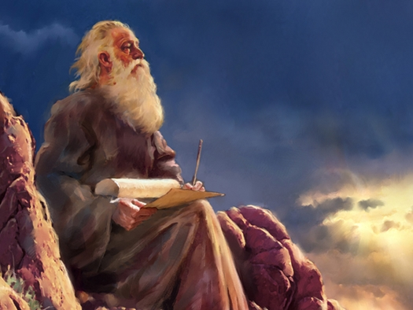
“And I saw the dead, small and
great, stand before God”

Slide 4
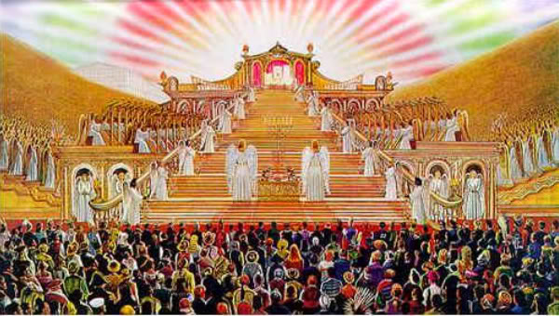

Slide 5
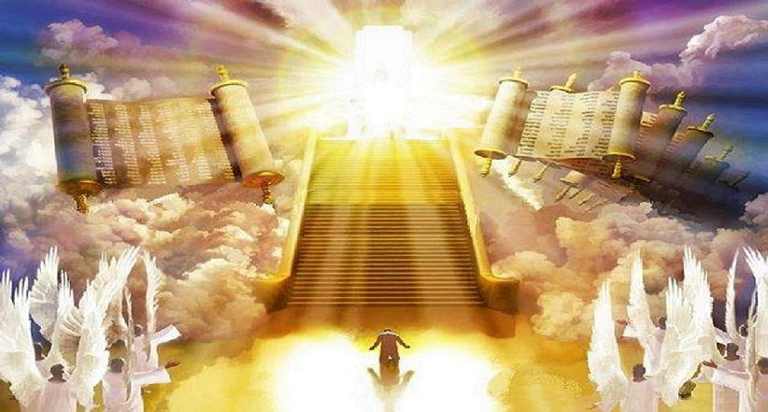
“And the books were opened…”

Slide 6
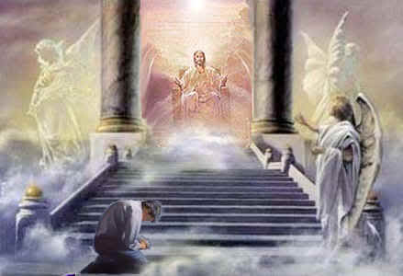
“And the dead were judged out of those things which were written in the books.”

Slide 7
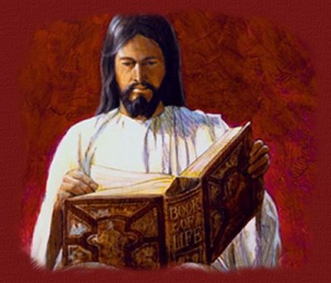
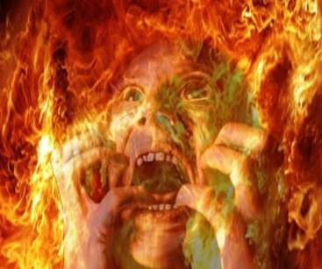
“And whosoever was not found written in the book of life was cast into the lake of fire.” Rev. 20:15

Slide 8
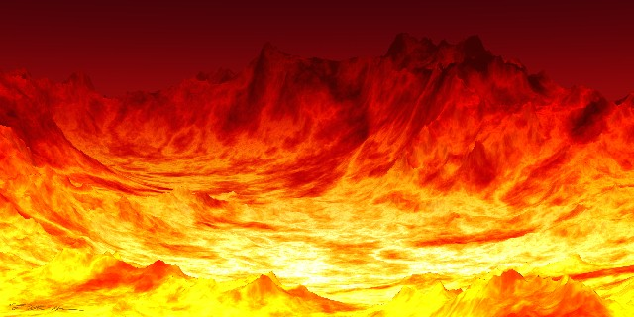
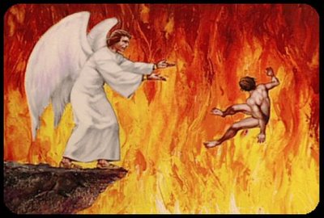

Slide 9
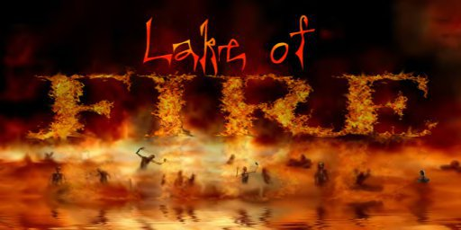

Slide 10
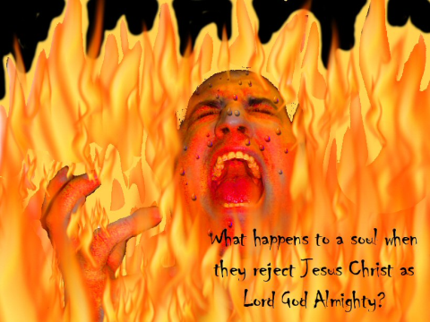

Slide 11
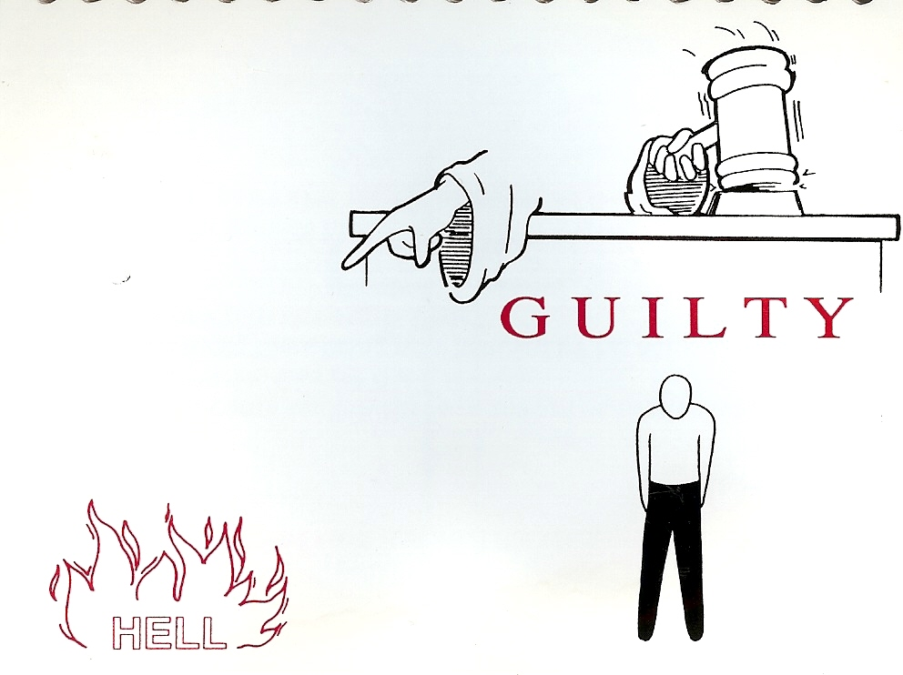
“For whosoever shall keep the whole law, and yet offend in one point, he is guilty of all.”
James 2:10

Slide 12
I John 3:4 “Whosoever committeth sin transgresseth also the law: for sin is the transgression of the law.”
Romans 3:19 “Now we know that what things soever the law saith, it saith to them who are under the law: that every mouth may be stopped, and all the world may become guilty before God.”

Slide 13
“But your iniquities (sins) have separated between you and your God, and your sins have hid his face from you.” (Isa. 59:2)

Slide 14
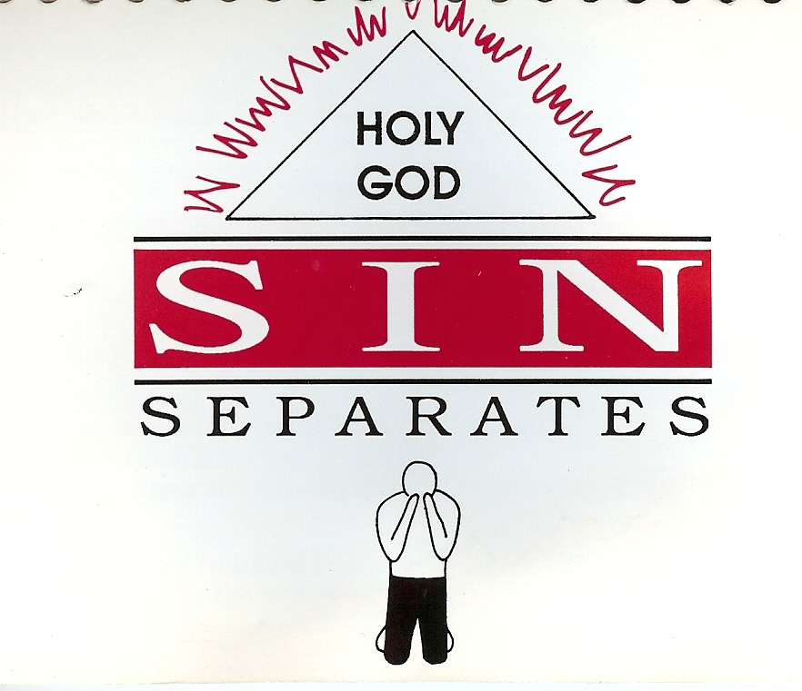

Slide 15
“As it is written, There is none righteous, no, not one: There is none that understandeth, there is none that seeketh after God.
They are all gone out of the way, they are together become unprofitable; there is none that doeth good, no, not one.”
(Romans 3:10-12)

Slide 16
“And there shall in no wise enter into it (Heaven) any thing that defileth, neither whatsoever worketh abomination, or maketh a lie: but they which are written in the Lamb's book of life.”
(Revelation 21:27)

Slide 17
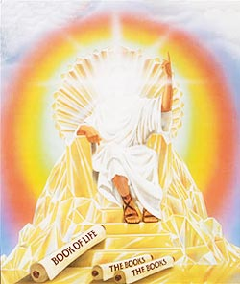

Slide 18
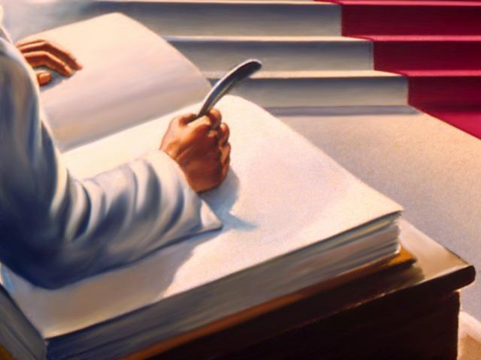
Your name

Slide 19
“For God so loved the world, that he gave his only begotten Son, that whosoever believeth in him should not perish, but have everlasting life.” (John 3:16)

Slide 20
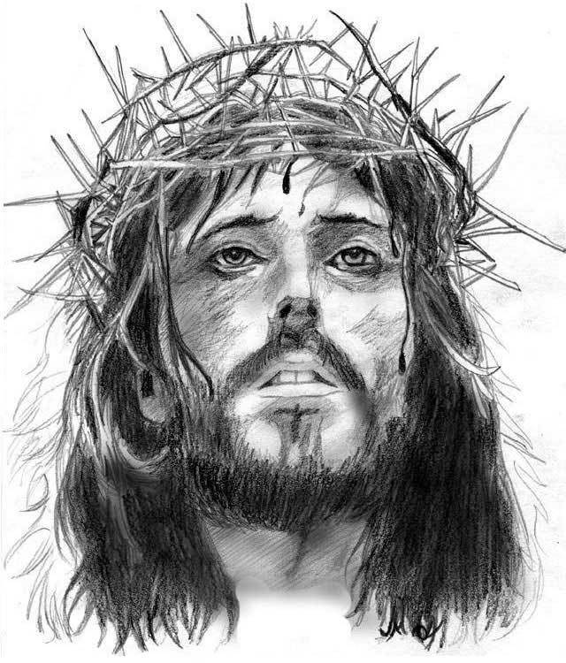
“Jesus saith unto him, I am the way, the truth, and the life: no man cometh unto the Father, but by me.” John 14:6
“Neither is there salvation in any other: for there is none other name under heaven given among men, whereby we must be saved.”
(Acts 4:12)

Slide 21
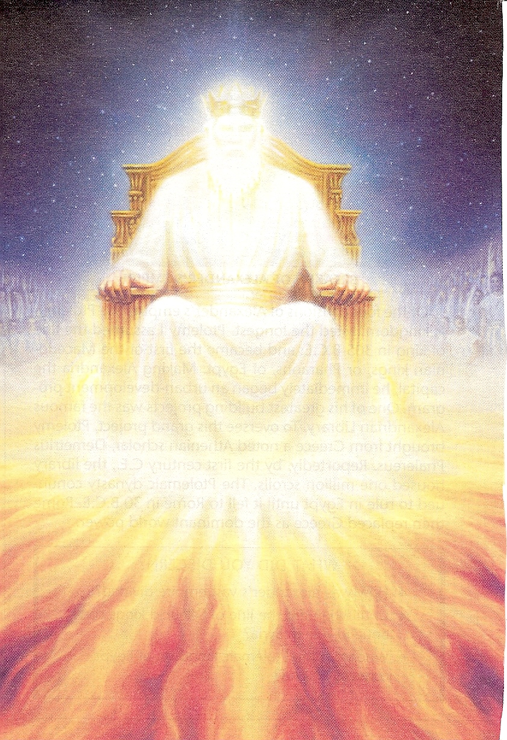
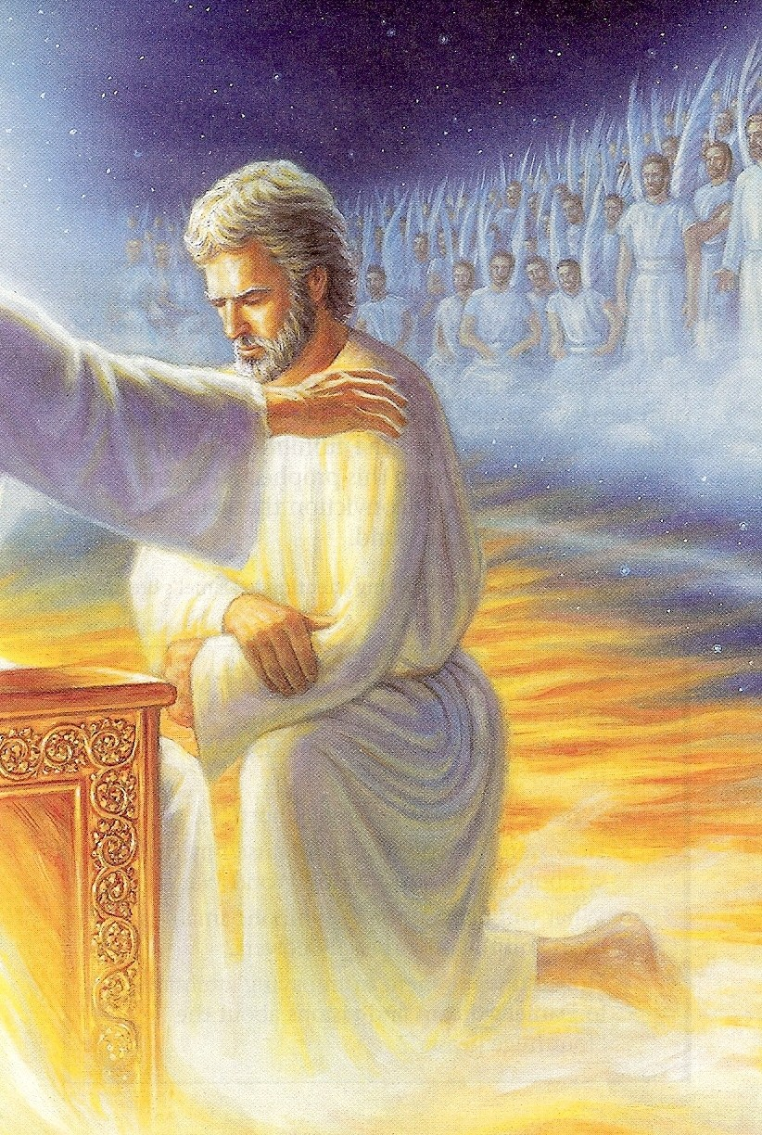
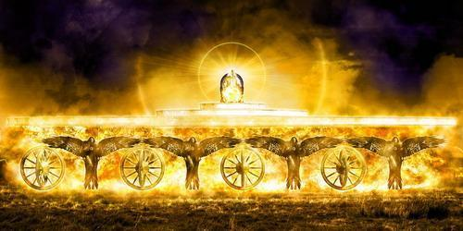
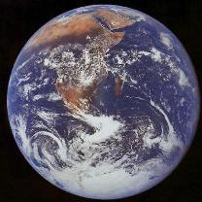

Slide 22
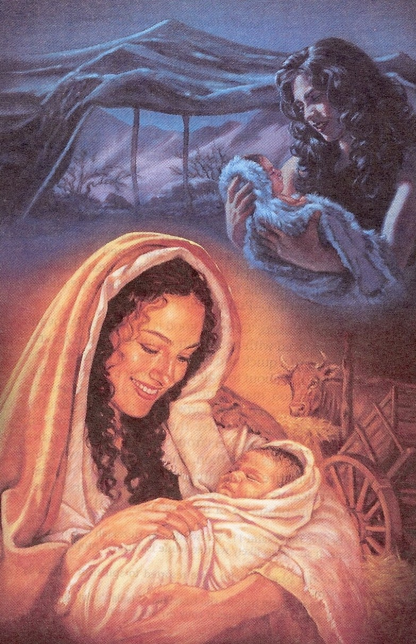

Slide 23
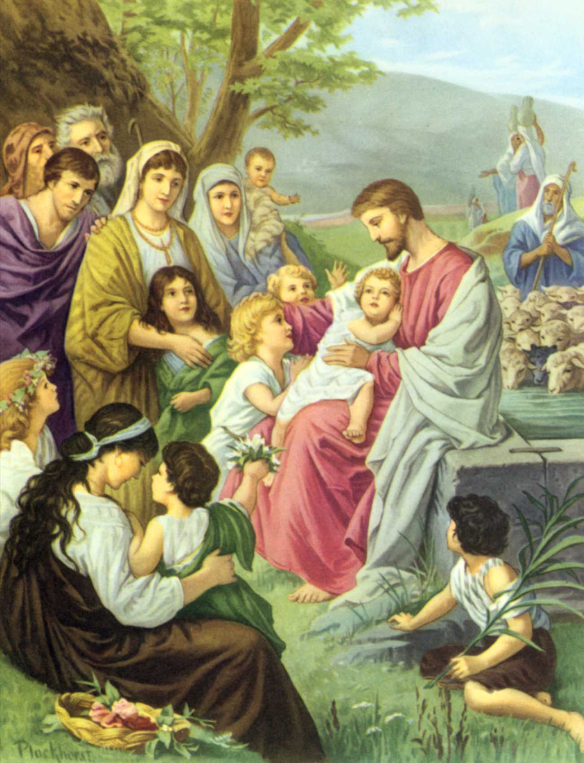

Slide 24
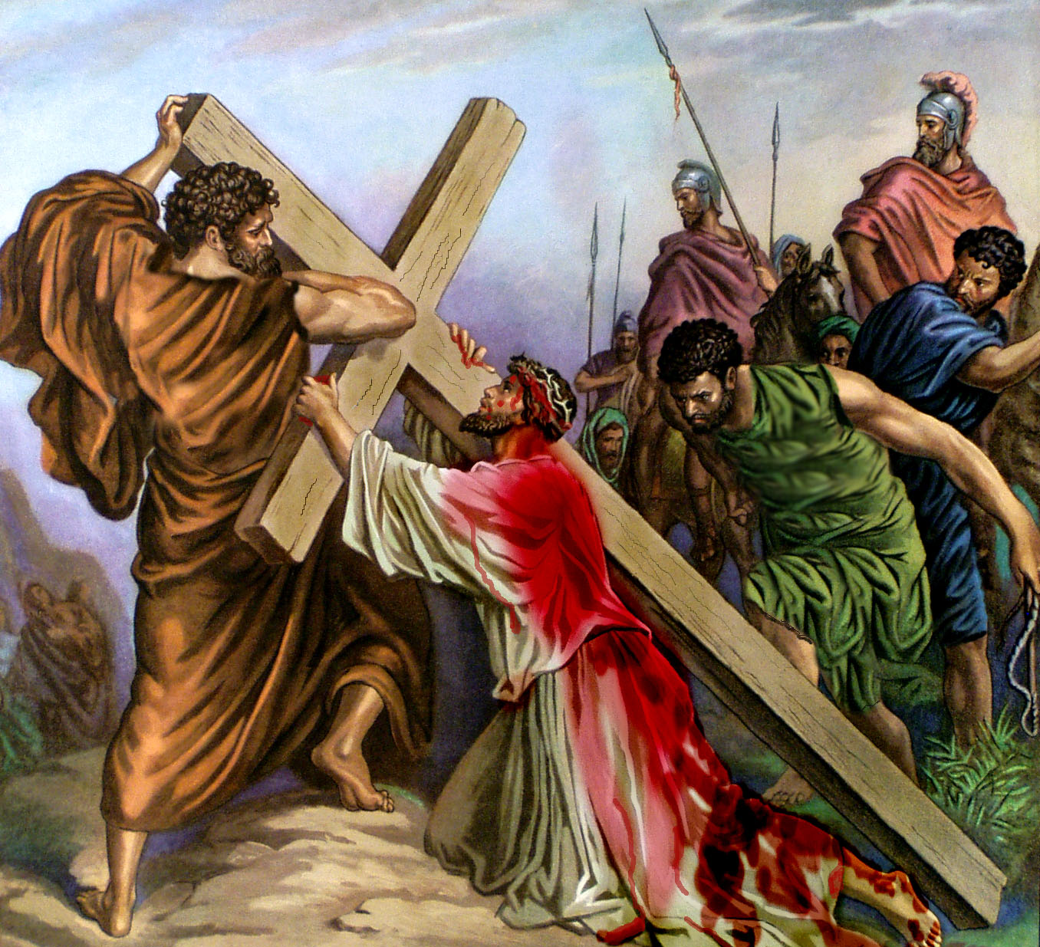

Slide 25
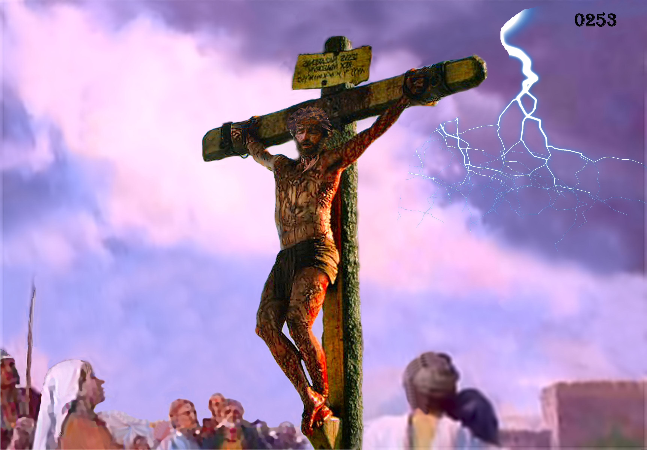

Slide 26
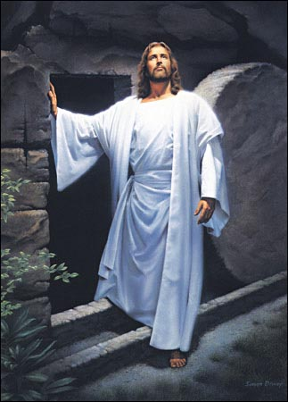

Slide 27
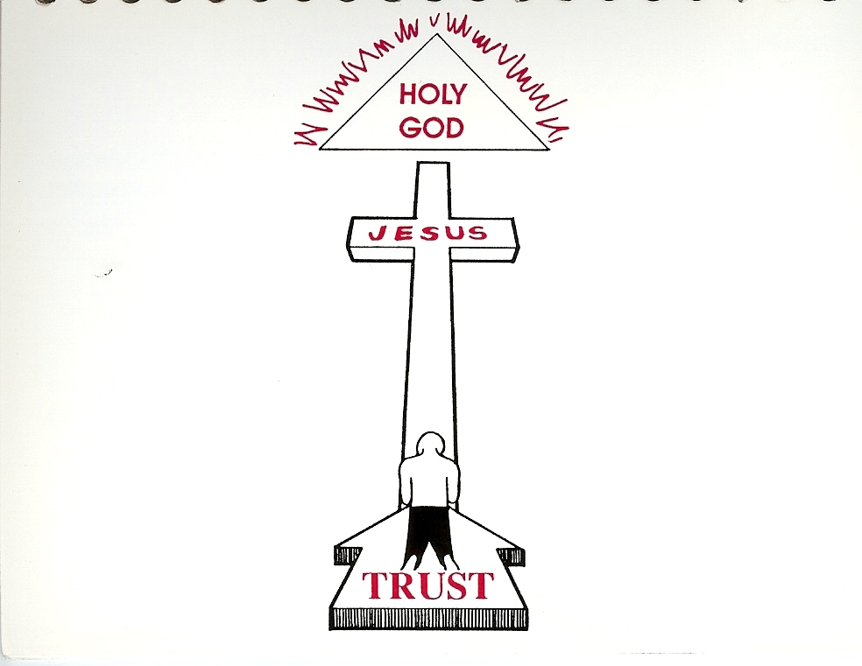
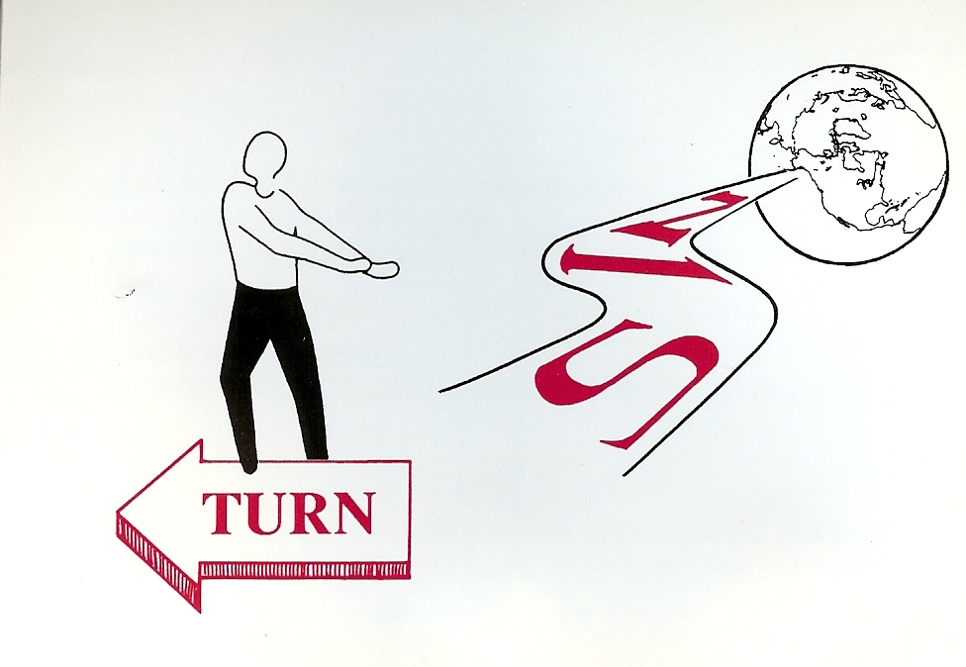
“Being justified by faith, we have peace with God through our Lord Jesus Christ.” (Rom. 5:1)

Slide 28
“Except ye repent, ye shall all likewise perish” (Luke 13:3)

Slide 29
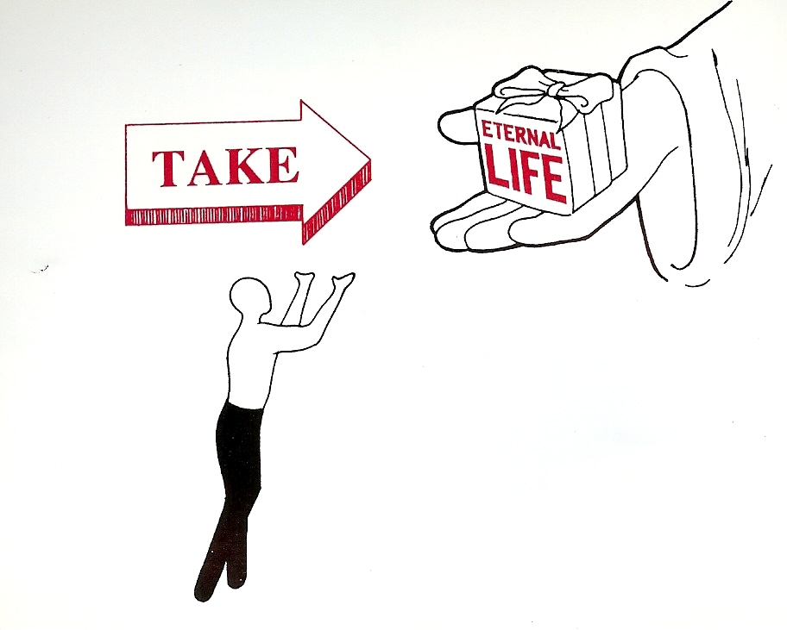
“But as many as received him, to them gave he power to become the sons of God, even to them that believe on his name.” (John 1:12)

Slide 30
“For by grace are ye saved through faith; and that not of yourselves: it is the gift of God: Not of works, lest any man should boast.”
(Ephesians 2:8-9)

Slide 31
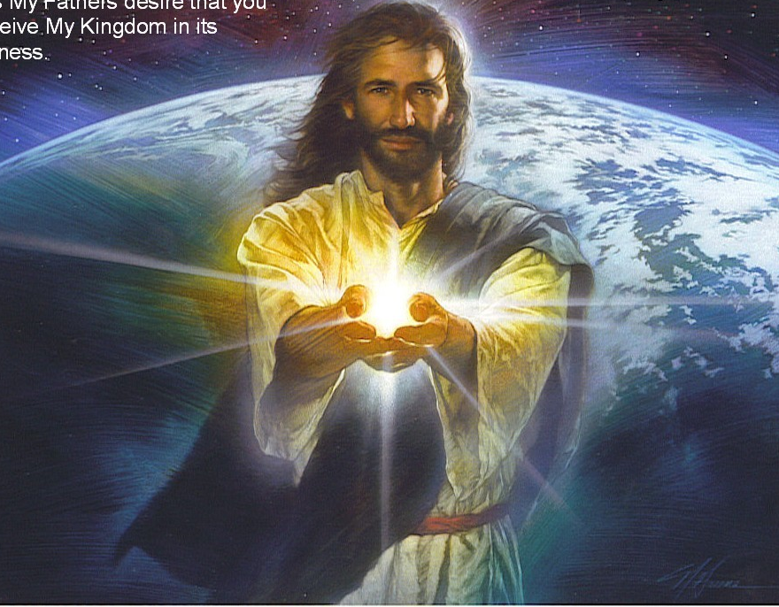
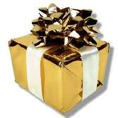

Slide 32
“How shall we escape, if we neglect so great salvation?”
(Heb. 2:3)

Slide 33
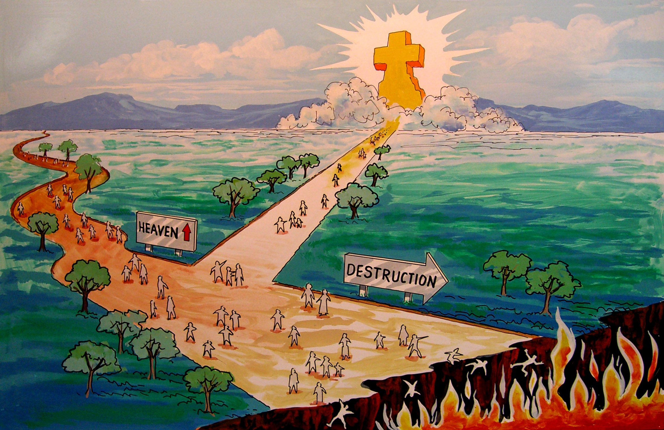
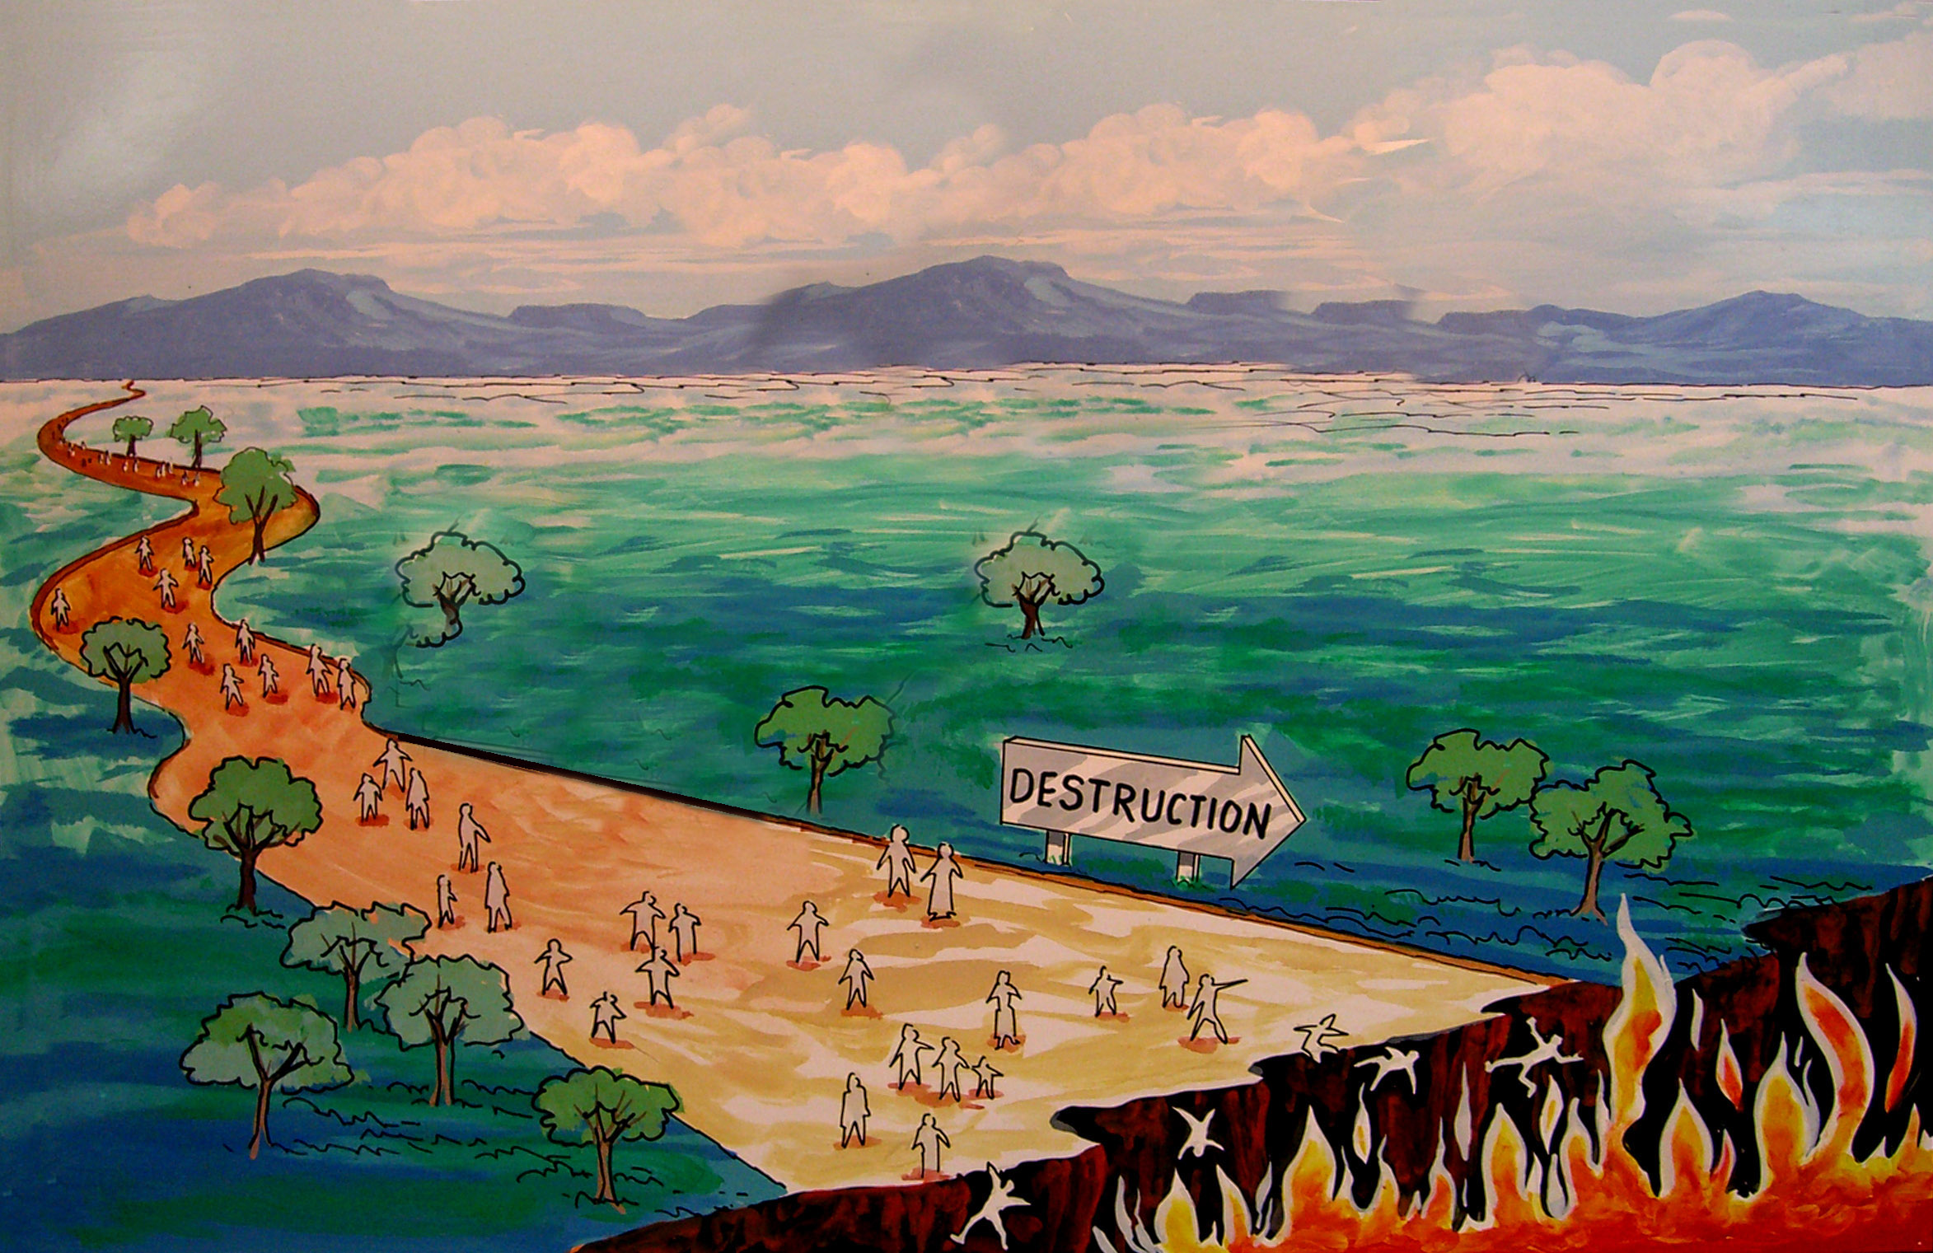

Slide 34
“For God hath not appointed us to wrath, but to obtain salvation by our Lord Jesus Christ.”
(I Thess. 5:9)

Slide 35
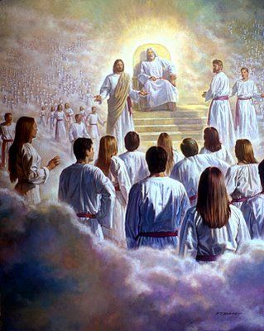
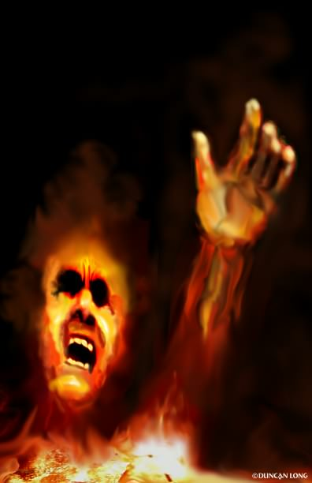
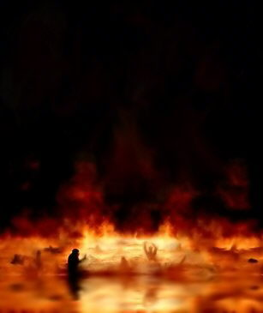

Slide 36
“The Lord is not slack concerning his promise, as some men count slackness; but is longsuffering to us-ward, not willing that any should perish, but that all should come
to repentance.”
(II Pet. 3:9)

Slide 37
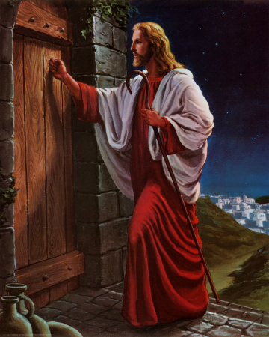

Slide 38
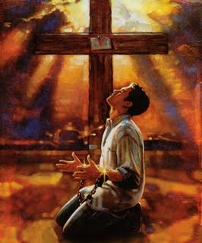

Slide 39
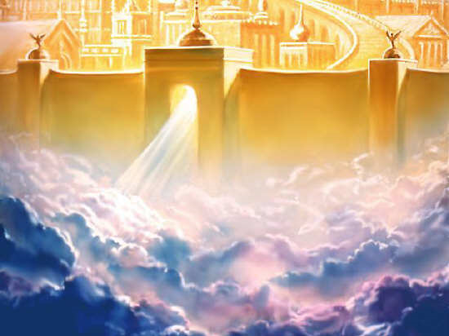
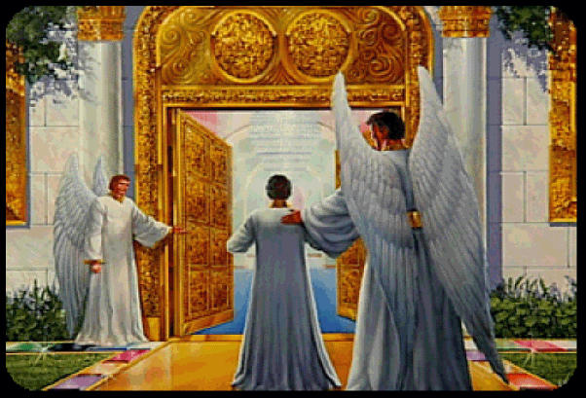

Slide 40
The Great White Throne
(Revelation 20:11-15)

Slide 41
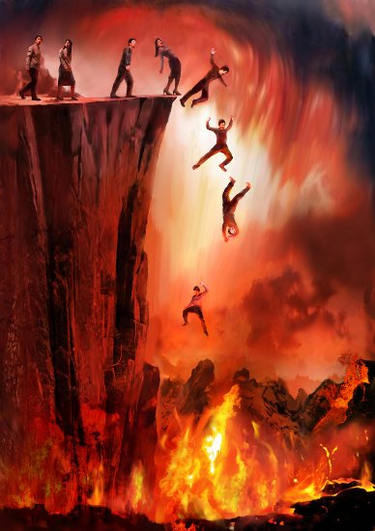

Slide 42


