Slide 1

The Revelation of Jesus Christ
A study of the book
of Revelation

Slide 2

Revelation 6:1-17
“The Seven Seal Judgments”

Slide 3
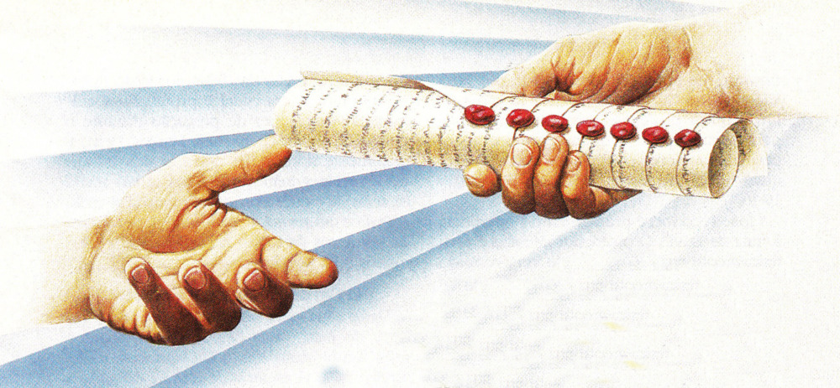
“And I saw in the right hand of him that sat on the throne a book written within and on the backside, sealed with seven seals.” (Rev. 5:1)

Slide 4
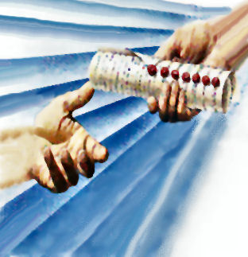
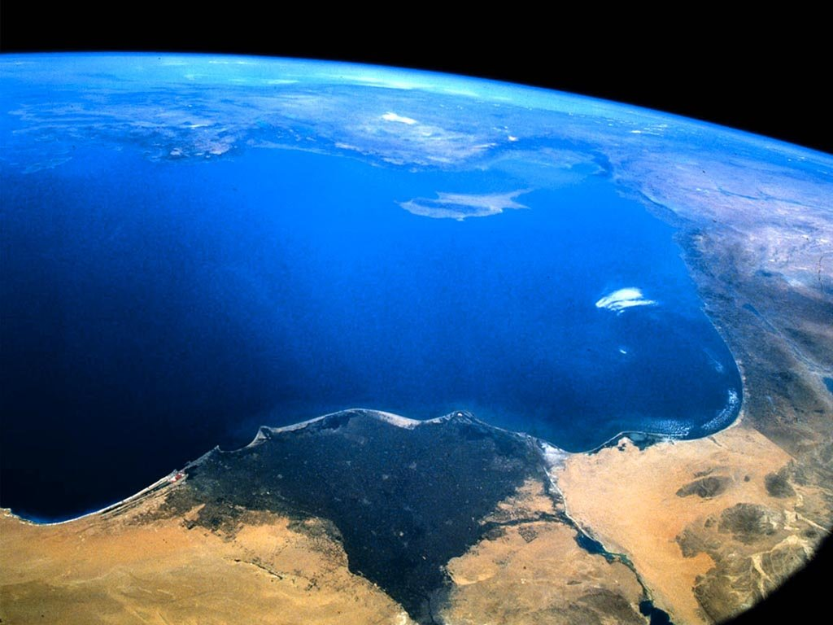
The seven sealed book is the
title deed to the earth
“The earth is the Lord’s, and the fullness thereof…” (Psalms 24:1)
“Thou hast created all things, and for thy pleasure they are and were created.”
(Revelation 4:11)

Slide 5
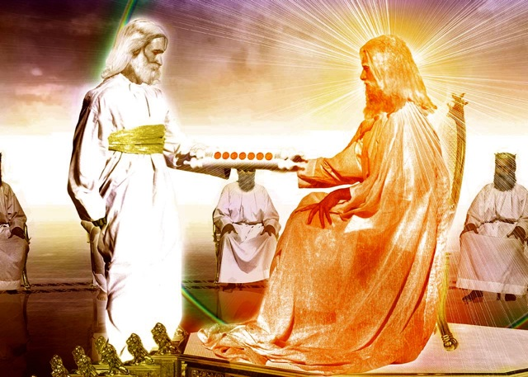
“And he came and took the book out of the right hand of Him that sat upon the throne...”

Slide 6
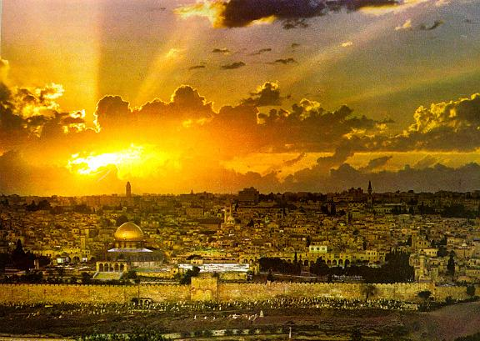
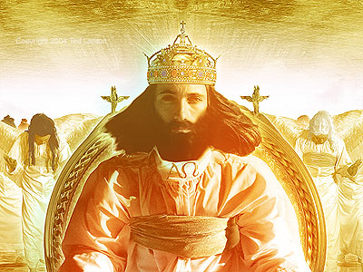
“The kingdoms of this world are become the kingdoms of our Lord, and of His Christ; and He shall reign for ever and ever.” (Revelation 11:5)

Slide 7
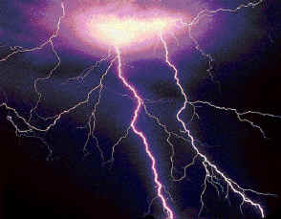
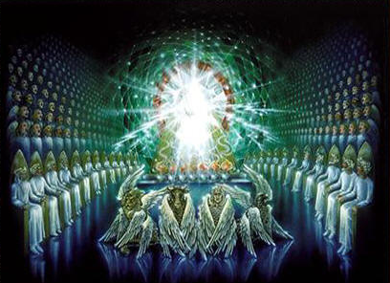
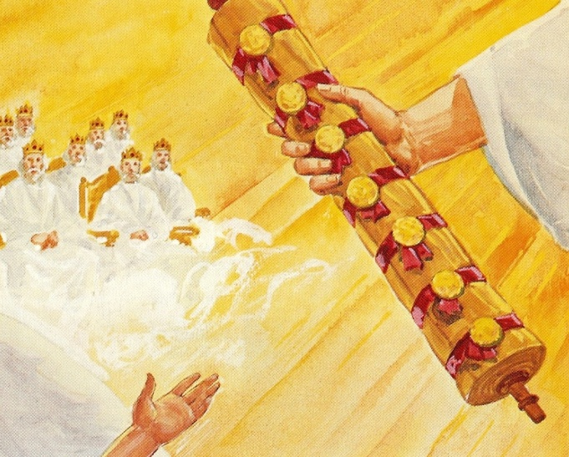
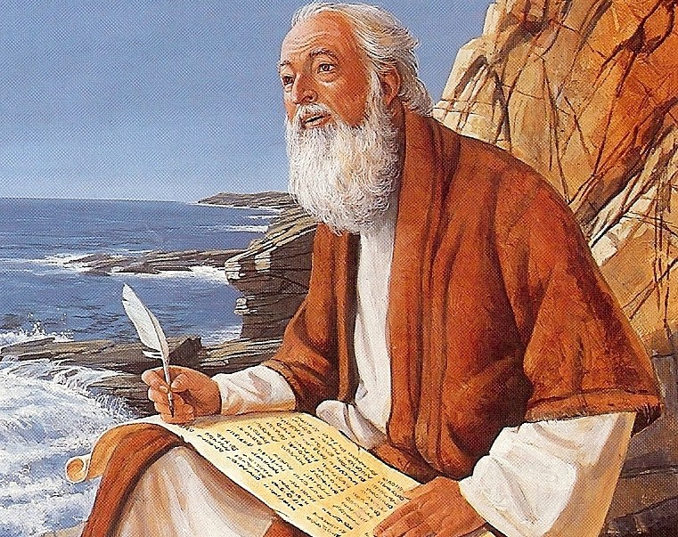
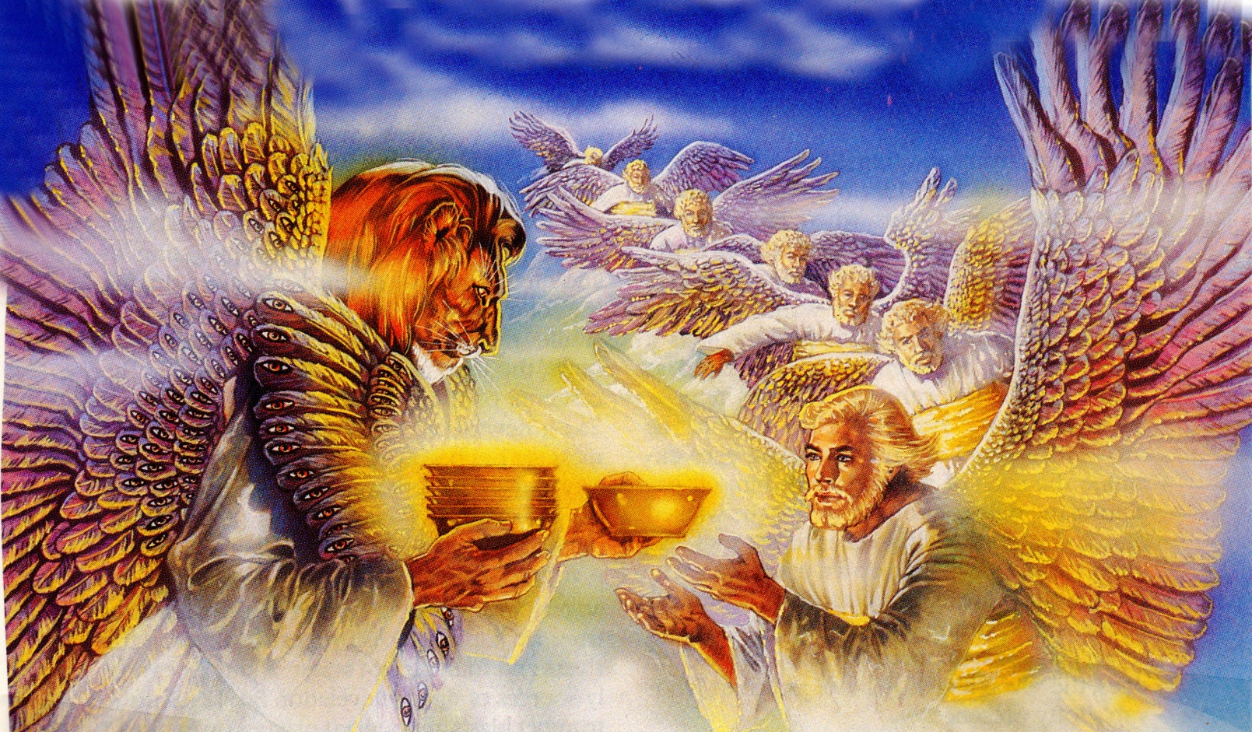
“And I saw when the Lamb opened one of the seals, and I heard, as it were the noise of thunder, one of the four beasts saying Come and see.”

Slide 8
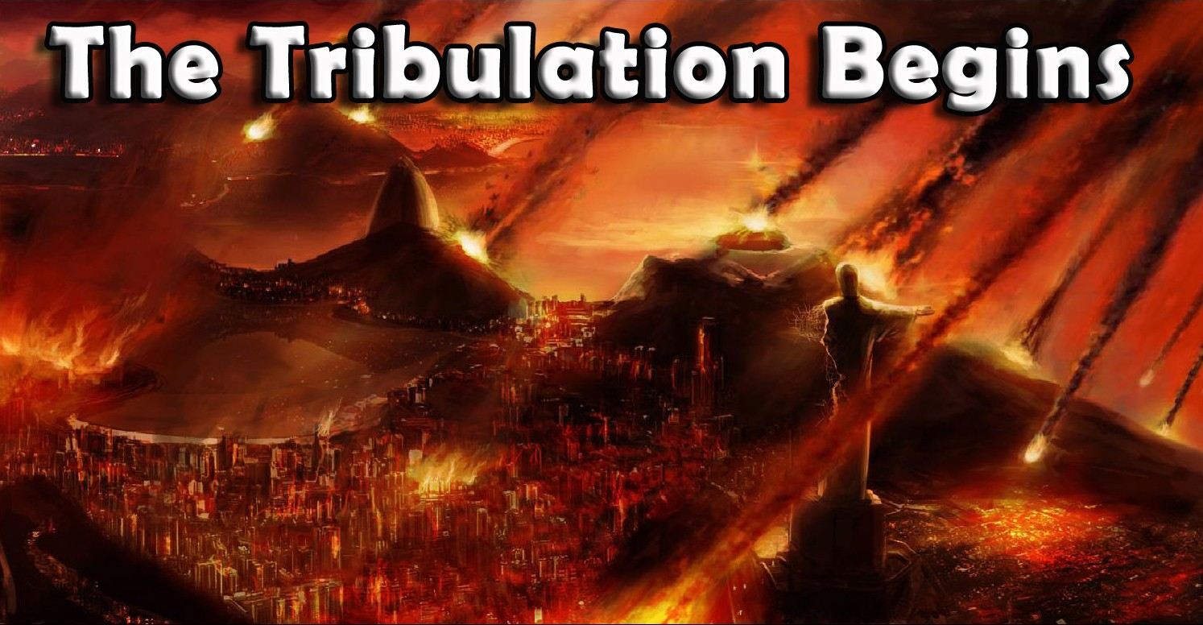
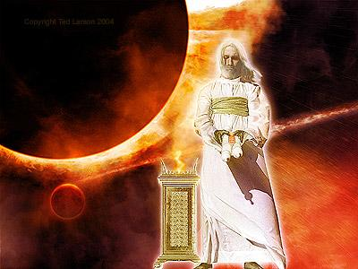

Slide 9
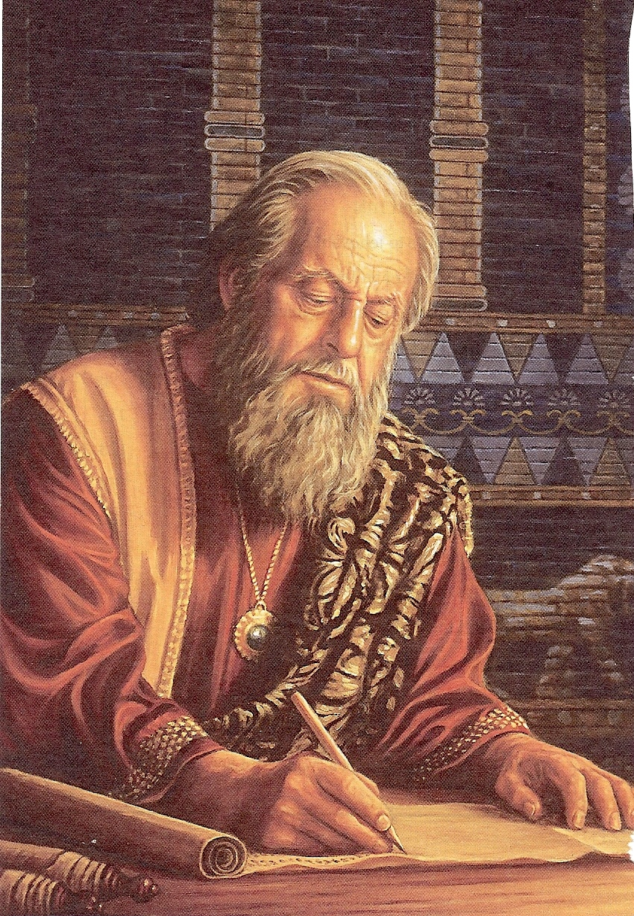
“And the end thereof shall be with a flood (judgment) and unto the end of the war desolations are determined.” (Daniel 9:26)

Slide 10
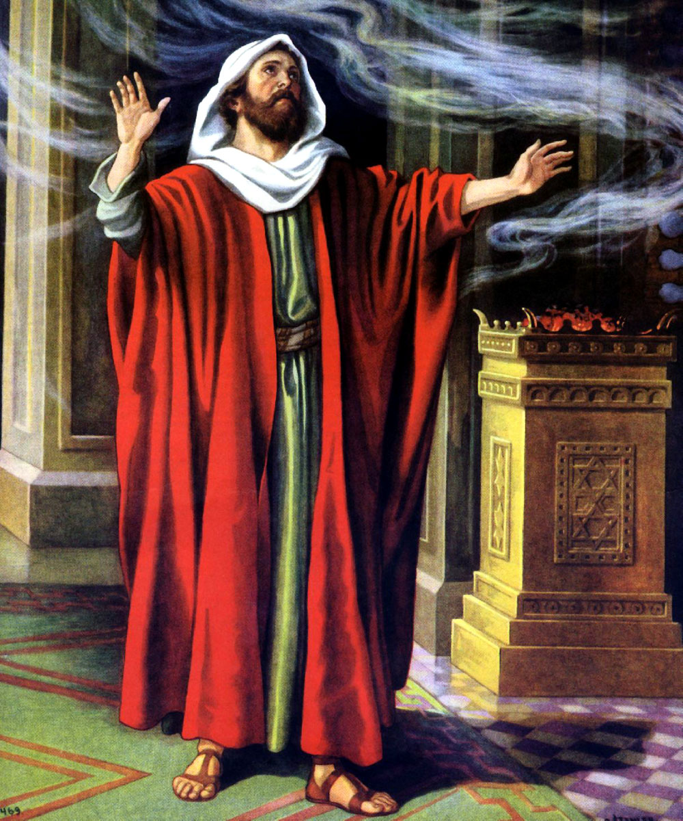
“Alas! for that day is great, so that none is like it: it is even the time of Jacob’s trouble; but we shall be saved out of it.” (Jeremiah 30:7)

Slide 11
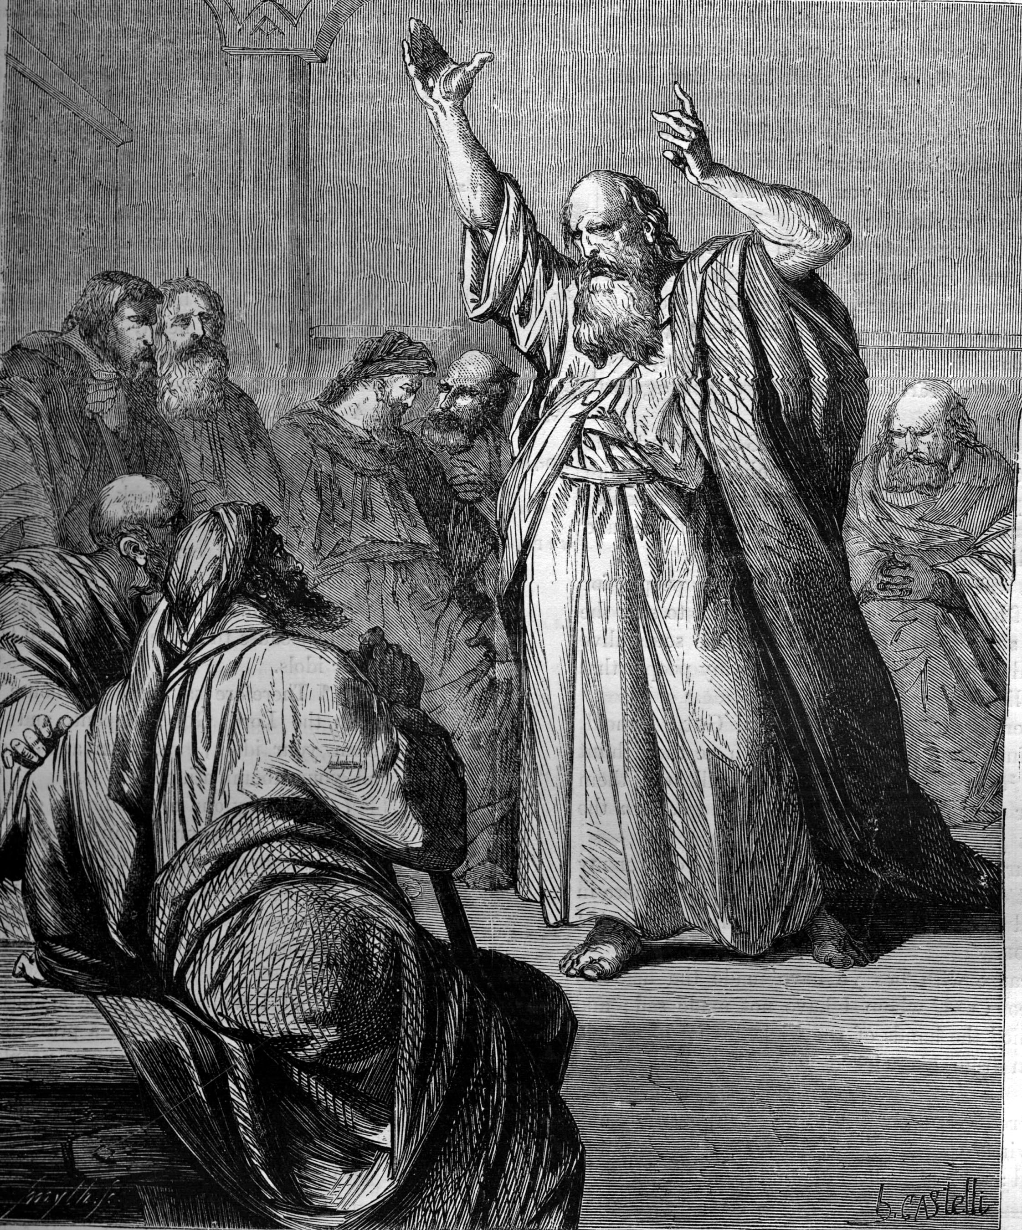
“The day of vengeance of our God.” (Isaiah 61:2)

Slide 12
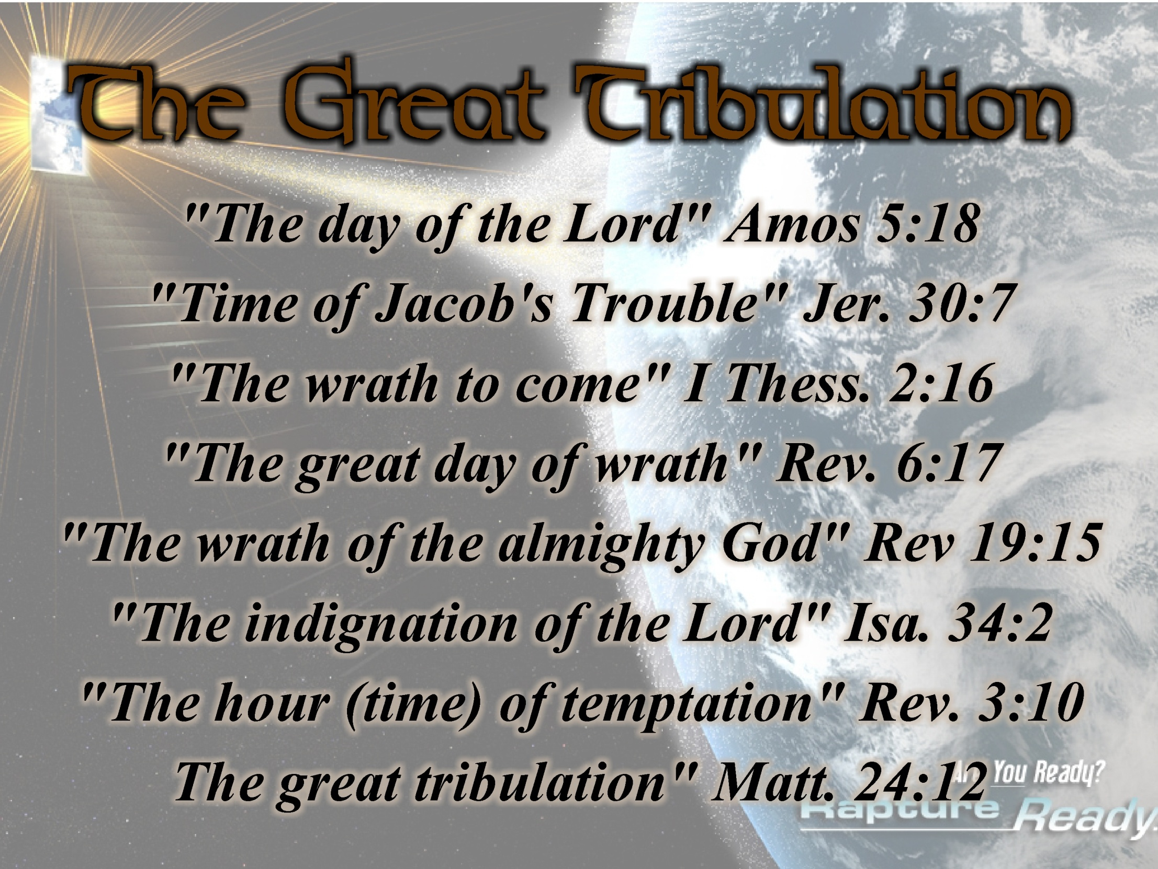

Slide 13
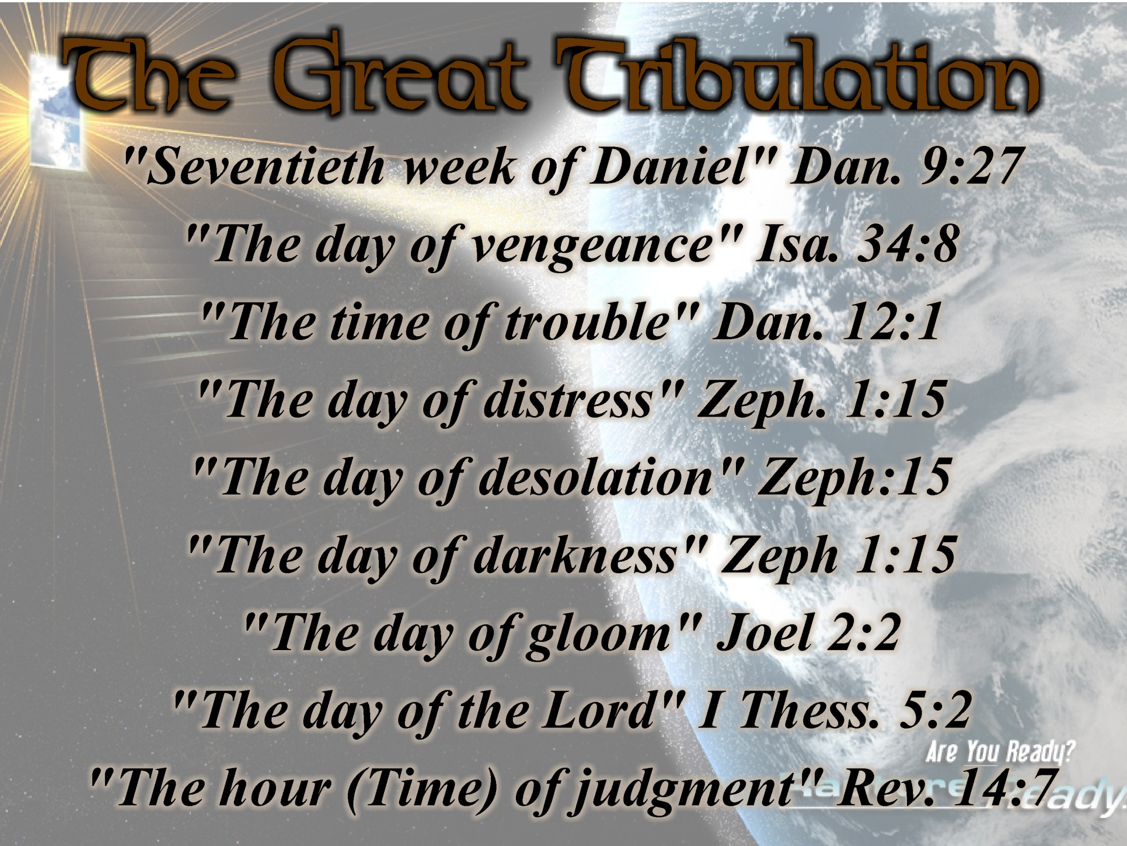

Slide 14
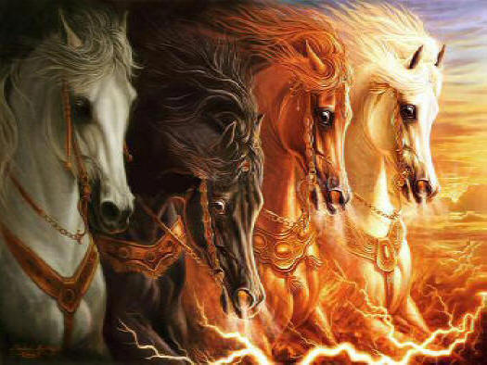

Slide 15
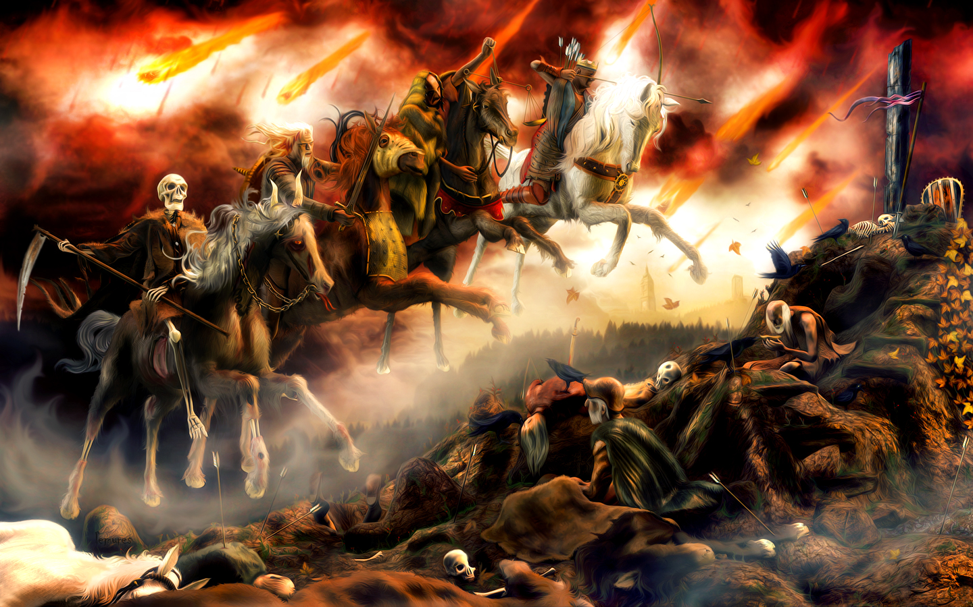

Slide 16
Rev. 6:2

Slide 17
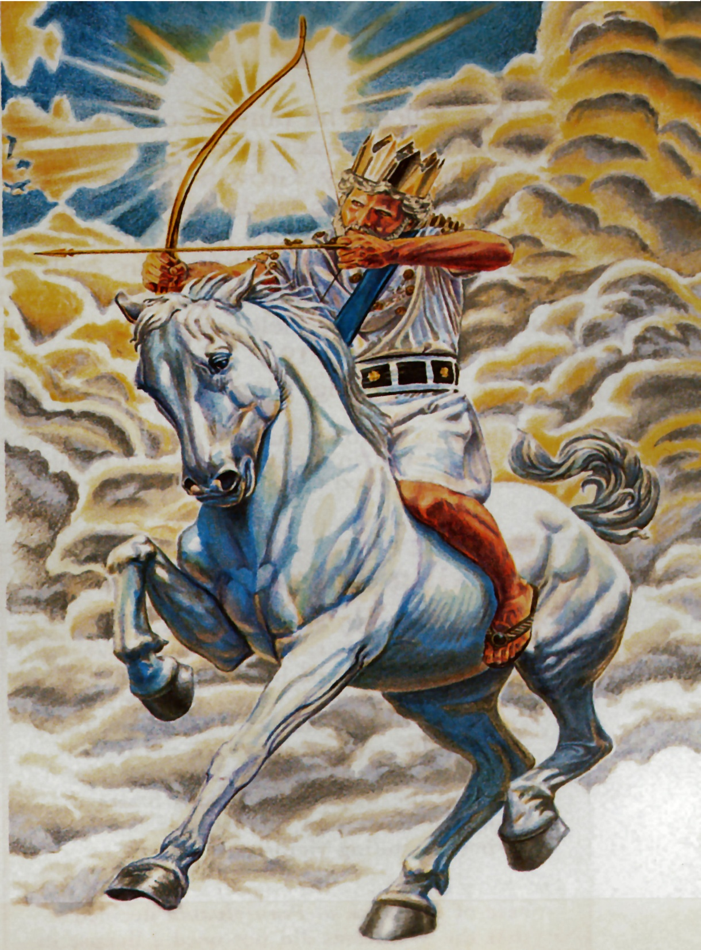
“And I saw, and behold a white horse: and he that sat on him had a bow; and a crown was given unto him: and he went forth conquering, and to conquer.”

Slide 18
The Anti-Christ
“His character”
(Daniel 8:23-26, 11:36-45)
King (great political leader)
Willful king (forceful dictator)
King of fierce countenance
Highly intelligent
Great in power (authority)
Skillful in battle
Prosperous (wealthy)
Practices (does whatever he wants)

Slide 19
Successful economic policies.
Prideful king – “shall exalt himself, and magnify himself above every god…”
Blasphemous king.
Greedy king.
Honors the god of force.
Warfare is high on his priority list.
Spends vast amounts of money on his war machine.
Appoints political leaders and divides the land for personal gain.

Slide 20
Does not regard the God of his fathers.
Does not regard any god.
Acknowledges a strange god (Satan)
No desire for women.
Anti-Christ and the 10 Nation Federation will be attacked by Kings of the south (Egypt and African armies) and the Kings of the north (Russia and other Arab countries)
Anti-Christ will defeat these countries – “He shall enter into the countries, and shall overflow and passover…”

Slide 21
Anti-Christ will exercise the “Abomination of Desolation” and force men to take his mark.
Anti-Christ continues to conquer towards the south – Egypt, Libya, and Ethiopia (Northeastern Africa)
Anti-Christ will increase in wealth and strength.
Anti-Christ goes forth to fight invading armies from the east and north.
China and allies from the east attack and are defeated by the Anti-Christ and the ten nation federation.

Slide 22
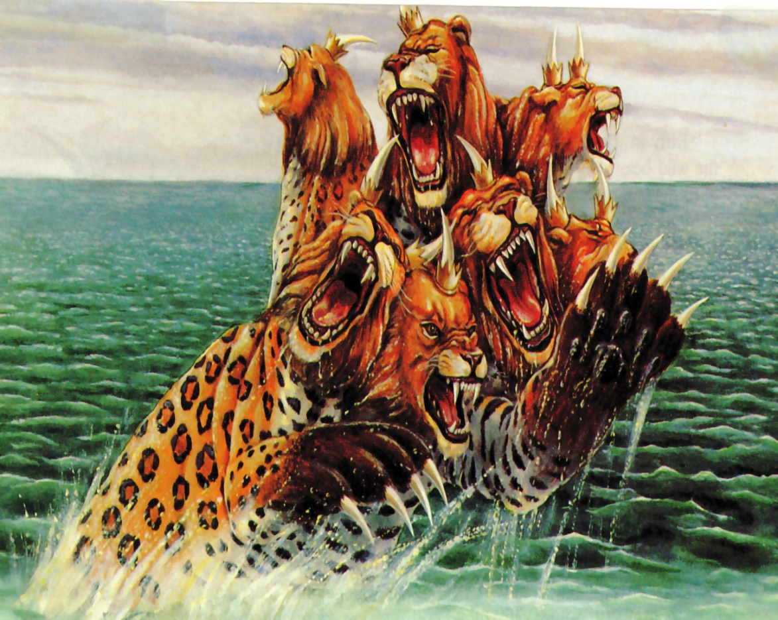
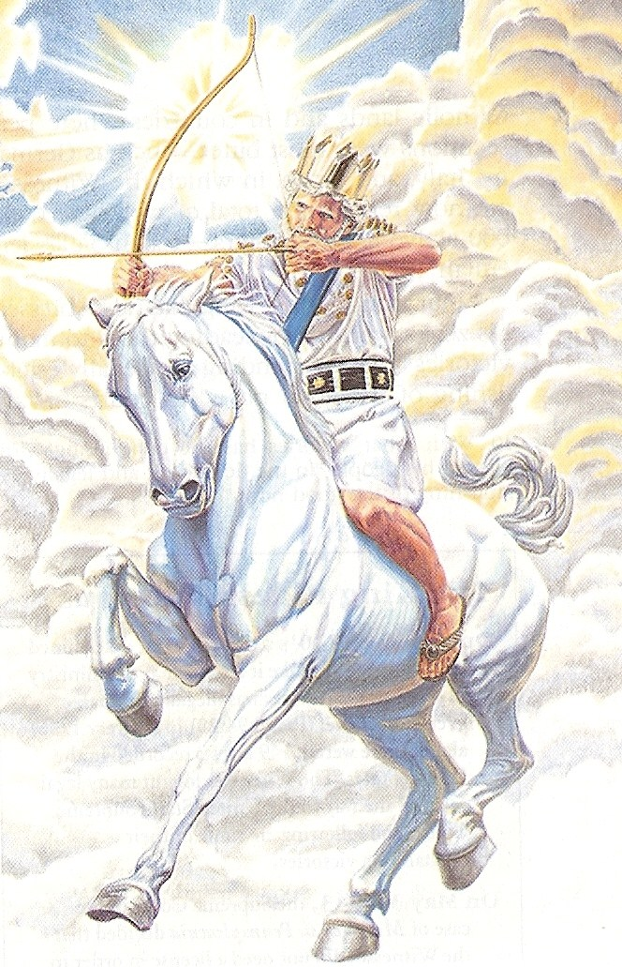
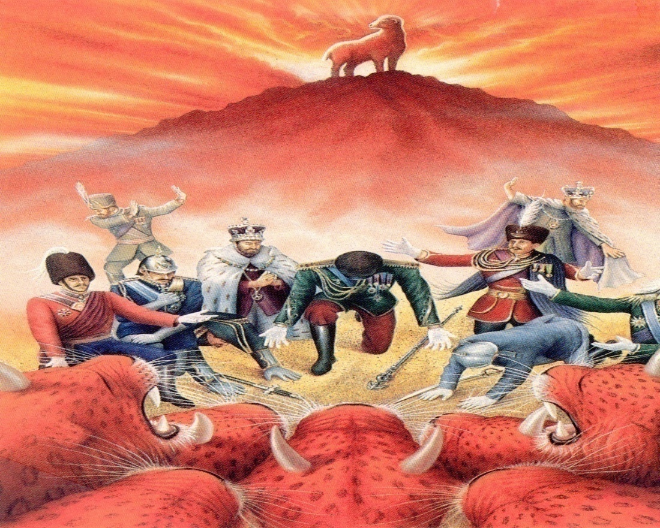
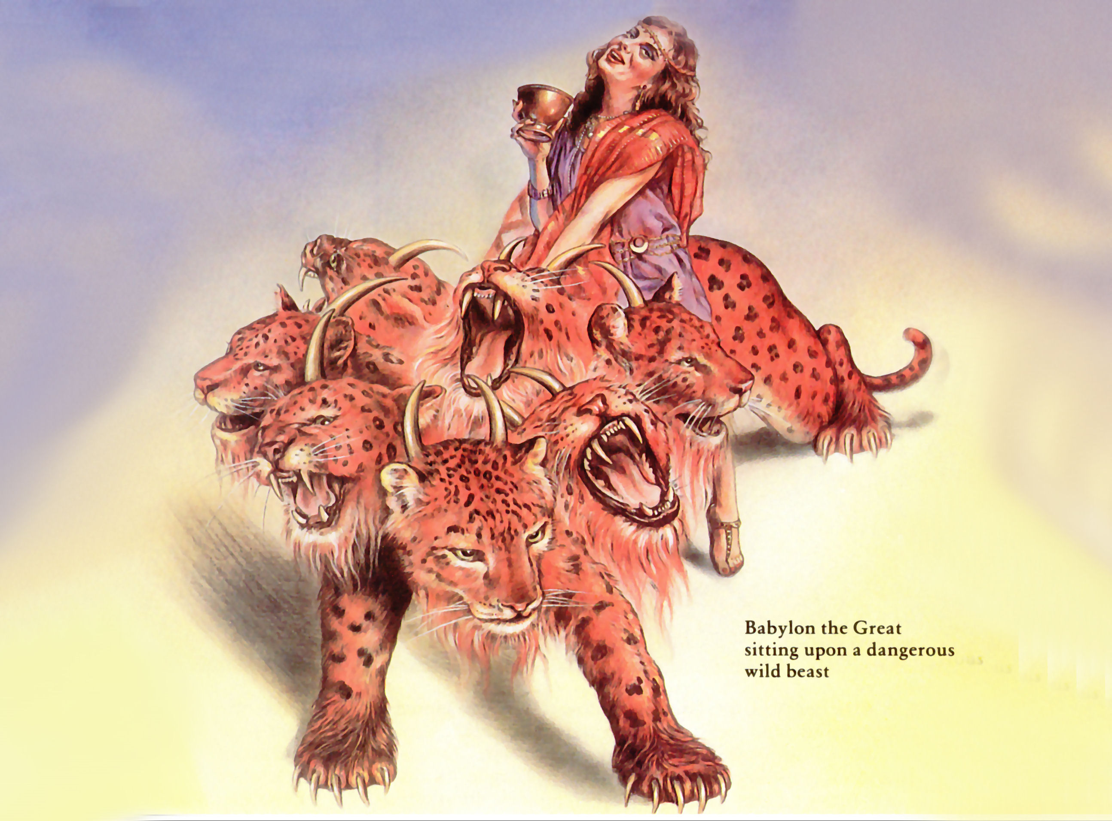

Slide 23
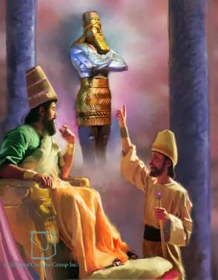
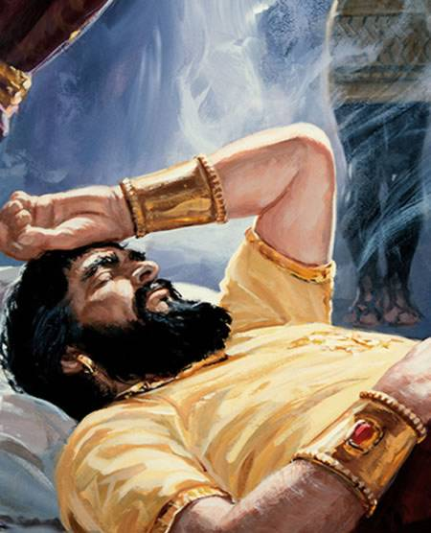

Slide 24
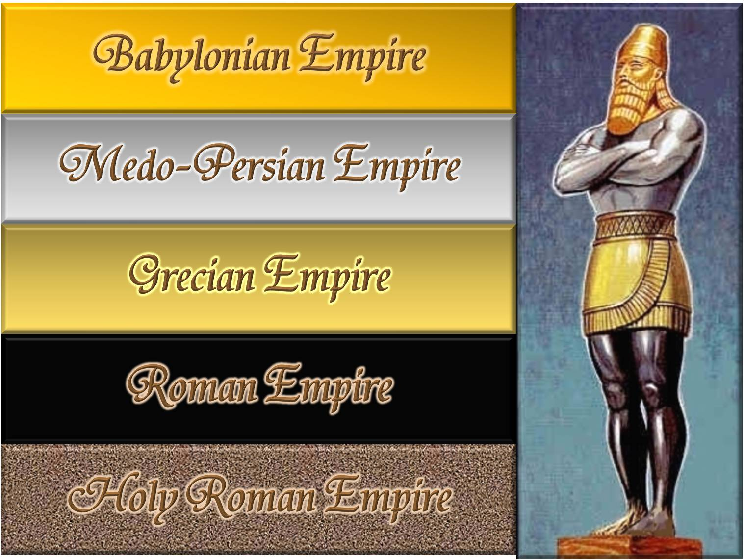

Slide 25
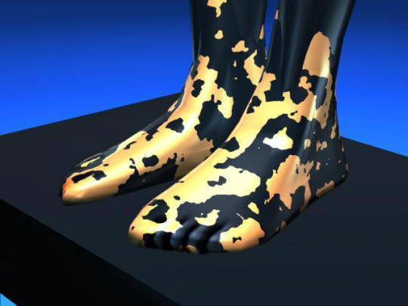
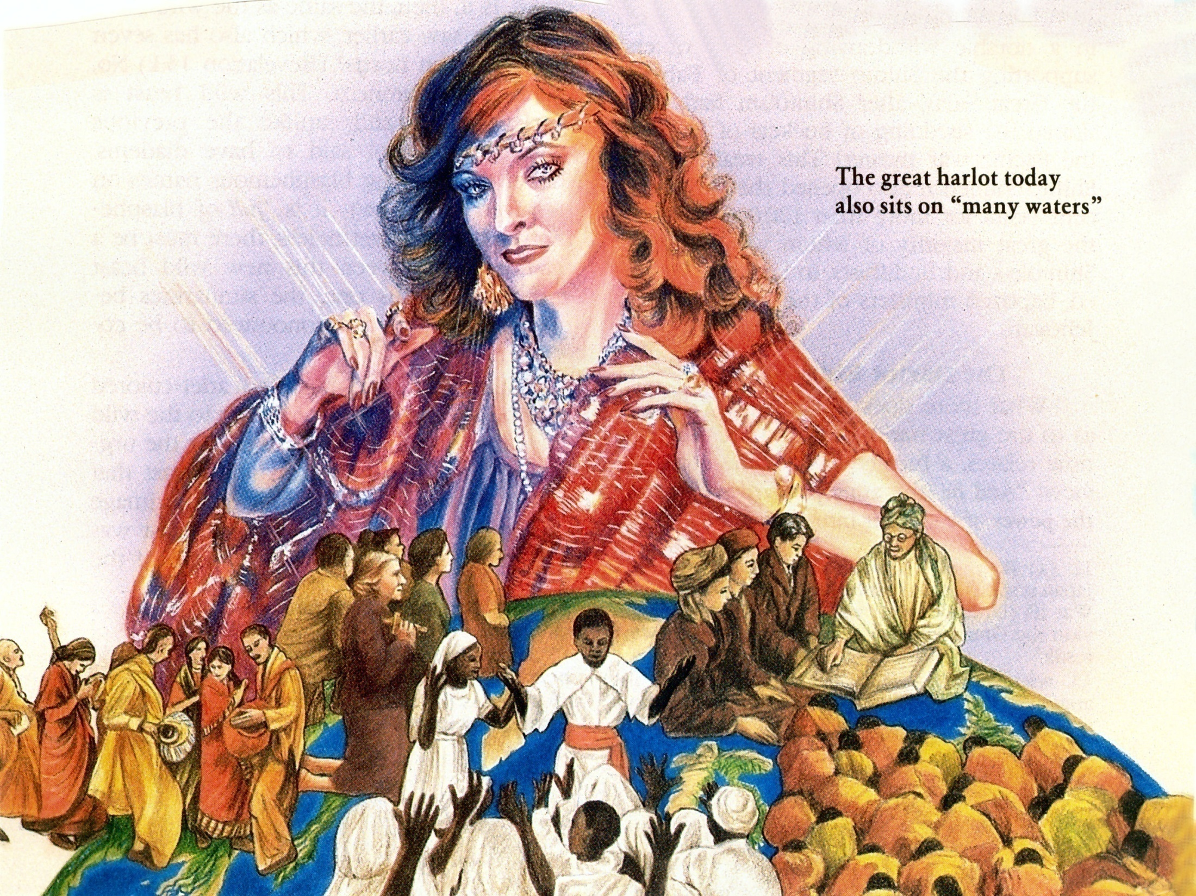
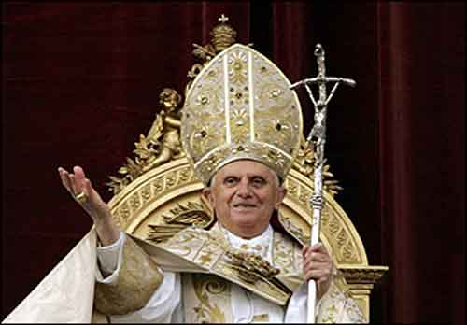
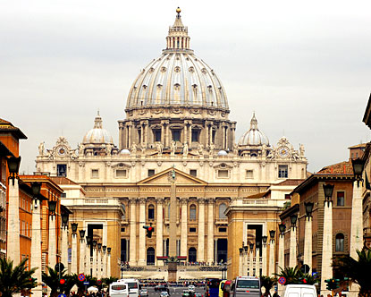

Slide 26
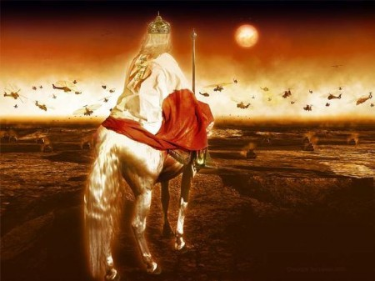
One world government – Revelation 17:13
One world economy – Revelation 13:17
One world money market – Revelation 18:3, 15
One world church – Revelation 17:1-9

Slide 27
Daniel 7:26-27 “But the judgment shall sit, and they shall take away his dominion, to consume and to destroy it unto the end. And the kingdom and dominion, and greatness of the kingdom under the whole heaven, shall be given to the people of the saints of the most High, whose kingdom is an everlasting kingdom, and all dominions shall serve and obey Him.”
Daniel 8:25 “…but he shall be broken without hand…” (no one to help him)
Daniel 11:36 “He shall prosper till the indignation be accomplished; for that is determined shall be done…”

Slide 28
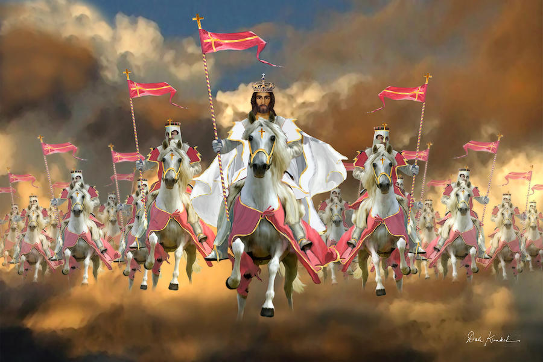

Slide 30
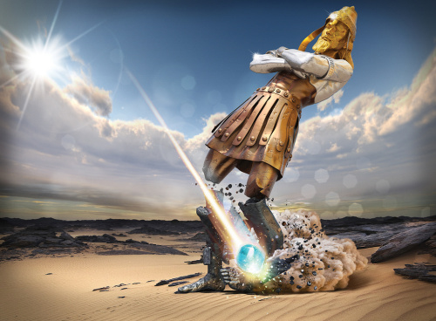

Slide 31
6:3-4

Slide 32
“And when he had opened the second seal, I heard the second beast say, Come and see. And there went out another horse that was red: and power was given to him that sat thereon to take peace from the earth, and that they should kill one another: and there was given unto him a great sword.”

Slide 33
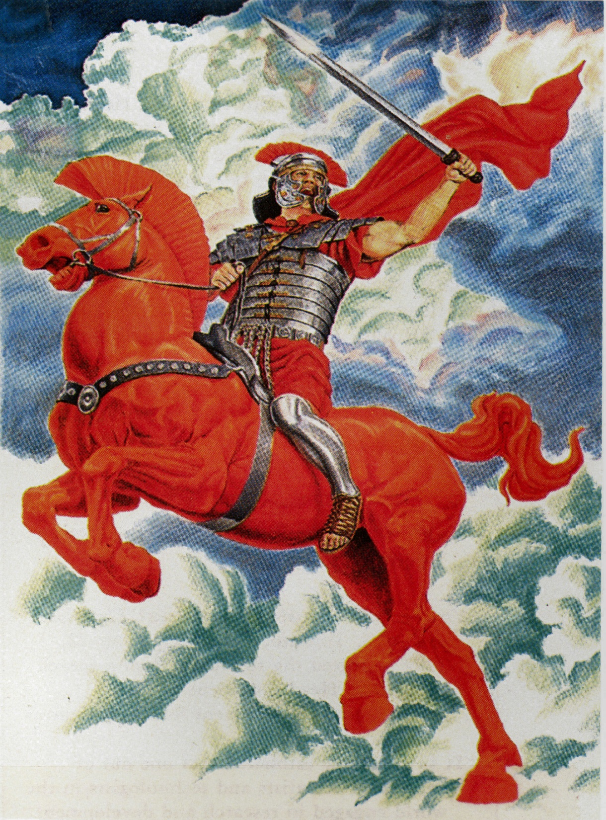

Slide 34

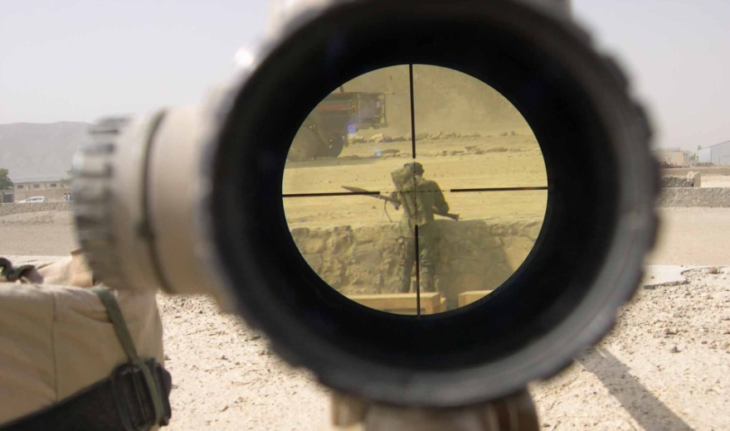
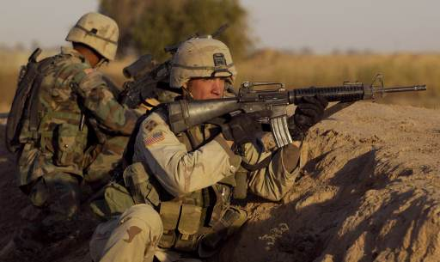

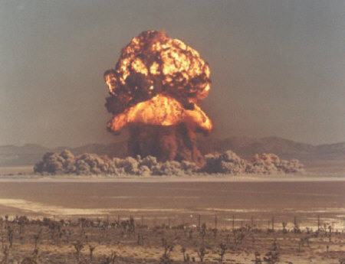
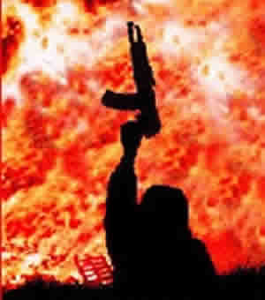
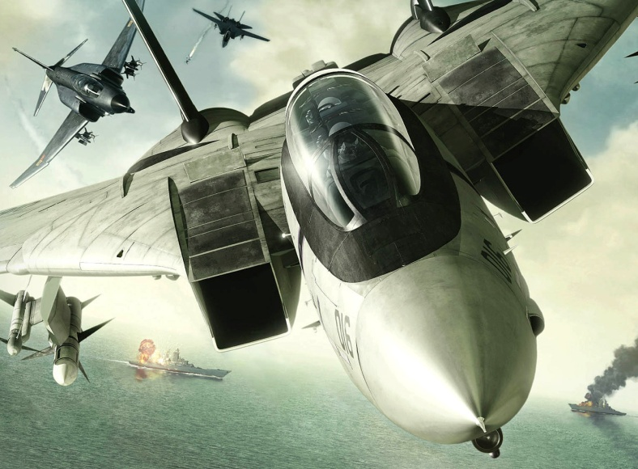
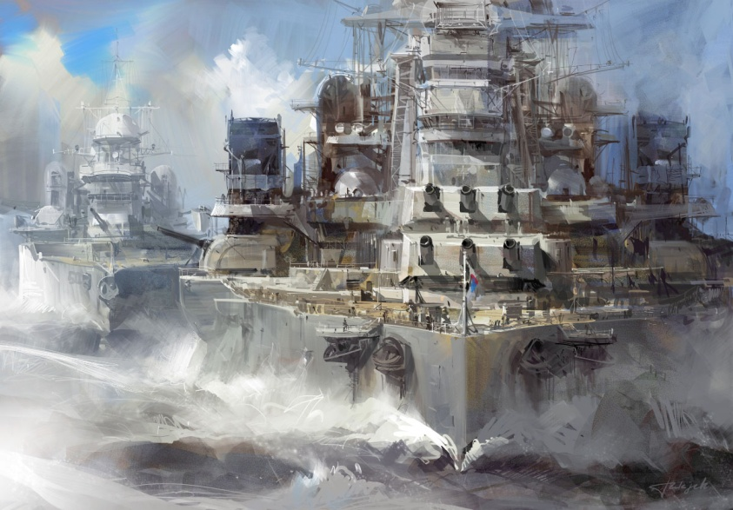
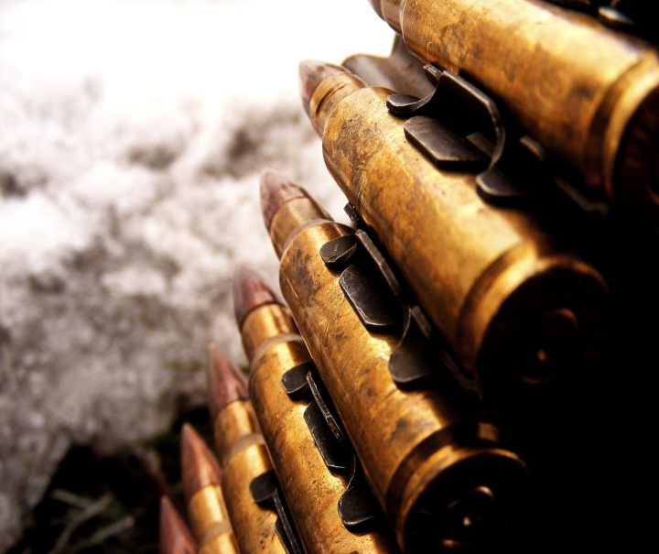
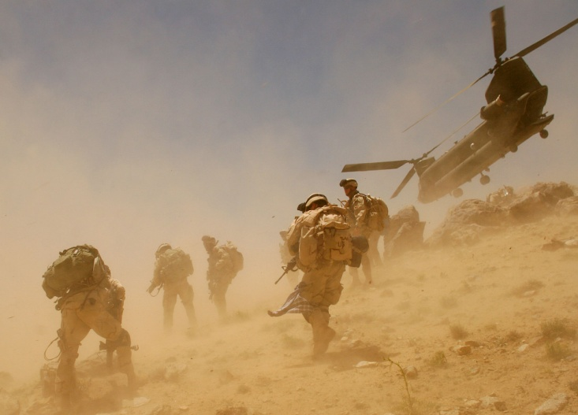

Slide 35
6:5-6

Slide 36
“And when he had opened the third seal, I heard the third beast say, Come and see. And I beheld, and lo a black horse; and he that sat on him had a pair of balances in his hand. And I heard a voice in the midst of the four beasts say, A measure of wheat for a penny, and three measures of barley for a penny; and see thou hurt not the oil and the wine.”

Slide 37
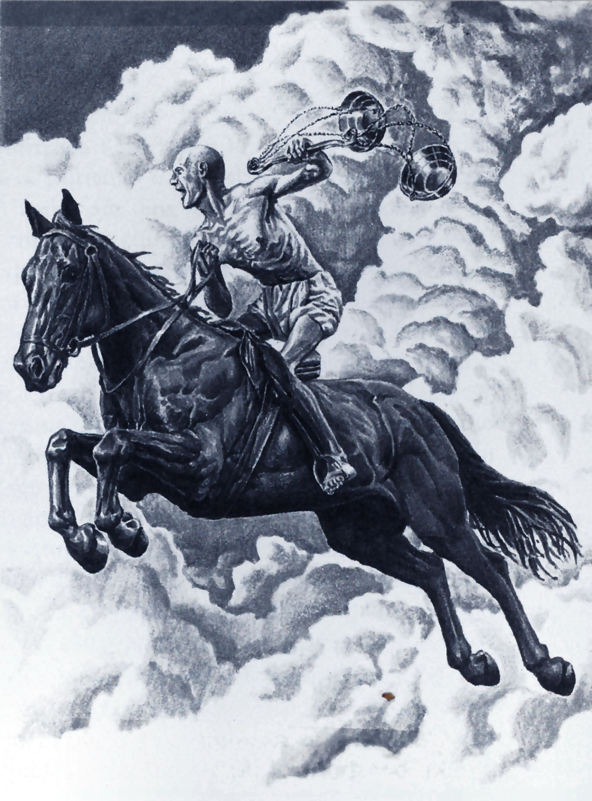

Slide 38
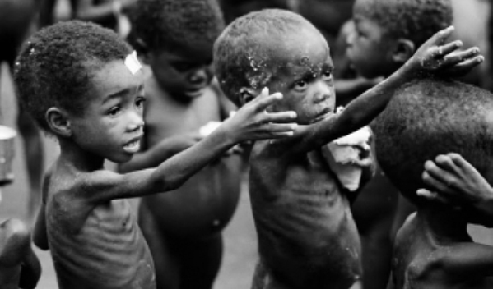
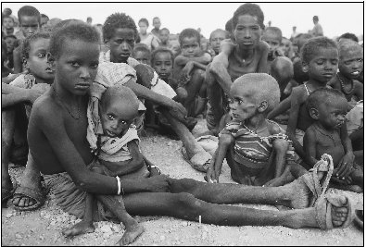
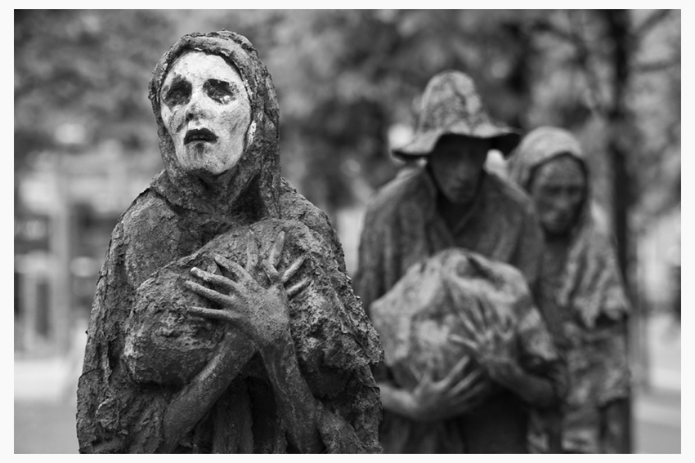
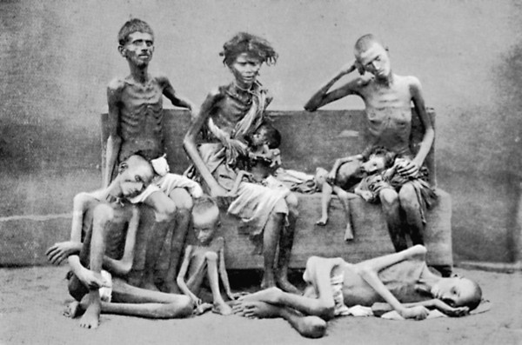

Slide 39
6:7-8

Slide 40
“And when he had opened the fourth seal, I heard the voice of the fourth beast say, Come and see. And I looked, and behold a pale horse: and his name that sat on him was Death, and Hell followed with him. And power was given unto them over the fourth part of the earth, to kill with sword, and with hunger, and with death, and with the beasts of the earth.”

Slide 41
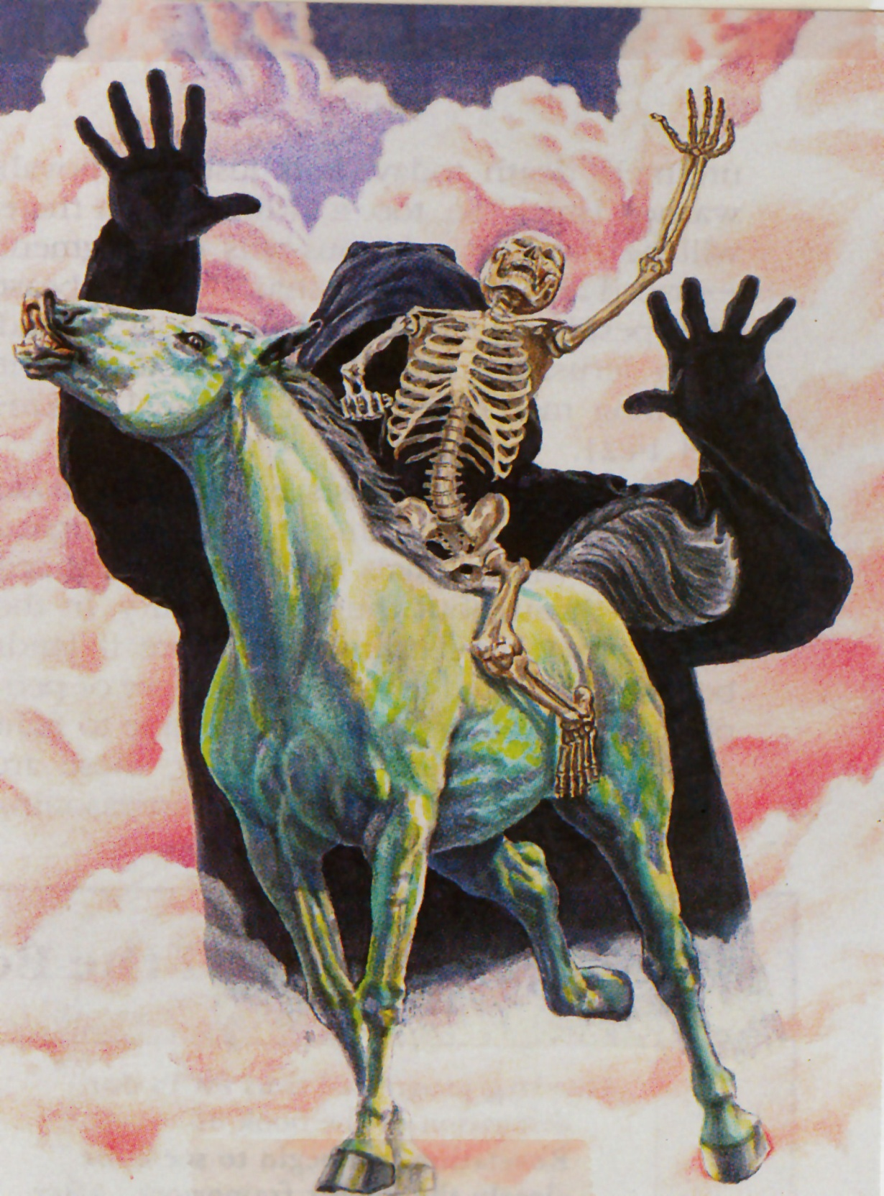

Slide 42






Slide 43




Killed by war
Killed by hunger
Killed by death
Killed by the beast of the earth

Slide 44


World’s present population 7 billion
¼ of the world’s population = 1.75 billion

Slide 45


Slide 46
6:9-11

Slide 47
“And when he had opened the fifth seal, I saw under the altar the souls of them that were slain for the word of God, and for the testimony which they held: And they cried with a loud voice, saying, How long, O Lord, holy and true, dost thou not judge and avenge our blood on them that dwell on the earth? And white robes were given unto every one of them; and it was said unto them, that they should rest yet for a little season, until their fellowservants also and their brethren, that should be killed as they were, should be fulfilled.”

Slide 48


Revelation 7:9-17

Slide 49


Revelation 12:10-17

Slide 50






Revelation 13:1-8

Slide 51





Revelation 13:11-18

Slide 52




Revelation 17:1-6

Slide 53








Slide 54
6:12-17

Slide 55
“And I beheld when he had opened the sixth seal, and, lo, there was a great earthquake; and the sun became black as sackcloth of hair, and the moon became as blood; And the stars of heaven fell unto the earth, even as a fig tree casteth her untimely figs, when she is shaken of a mighty wind. And the heaven departed as a scroll when it is rolled together; and every mountain and island were moved out of their places.

Slide 56
And the kings of the earth, and the great men, and the rich men, and the chief captains, and the mighty men, and every bondman, and every free man, hid themselves in the dens and in the rocks of the mountains; And said to the mountains and rocks, Fall on us, and hide us from the face of him that sitteth on the throne, and from the wrath of the Lamb: For the great day of his wrath is come; and who shall be able to stand?”

Slide 57




Slide 58




Slide 59





Slide 60

“The sun be darkened, and the moon shall not give her light, and the stars shall fall from heaven, and the powers of the heavens shall be shaken. And then shall appear the sign of the son of man in heaven: and then shall all the tribes of the earth mourn, and they shall see the Son of Man coming in the clouds of heaven with power and great glory.”
(Matthew 24:29-30)

Slide 61


Slide 62


“Hide us from the face of Him that sitteth on the throne, and from the wrath of the Lamb. For the great day of His wrath is come; and who shall be able to stand.”

