Slide 1
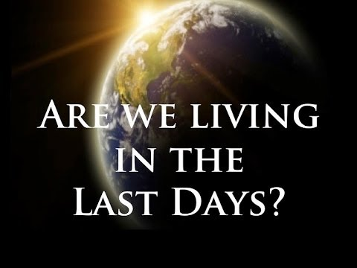
(2 Timothy 3:1)
“This know also, that in the last days perilous (dangerous) times shall come.”

Slide 2

(1 Chronicles 12:32)
“And of the children of Issachar, which were men that had understanding of the times, to know what Israel ought to do.”

Slide 3



Slide 4
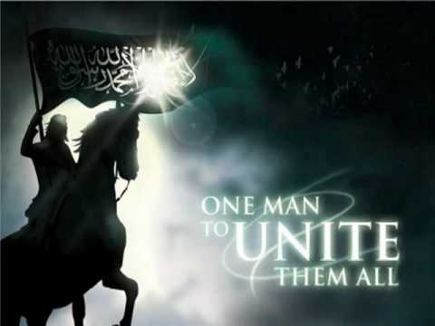

Slide 5
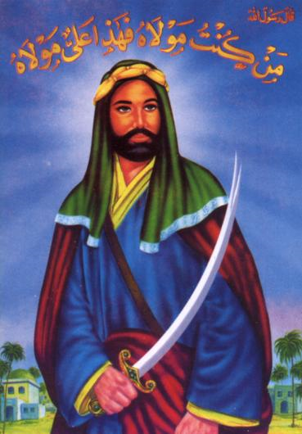
The Prophet Muhammad said:
The world will not come to an end until the Arabs are ruled by a man from my family whose name is the same as mine and whose father’s name is the same as my father’s.

Slide 6
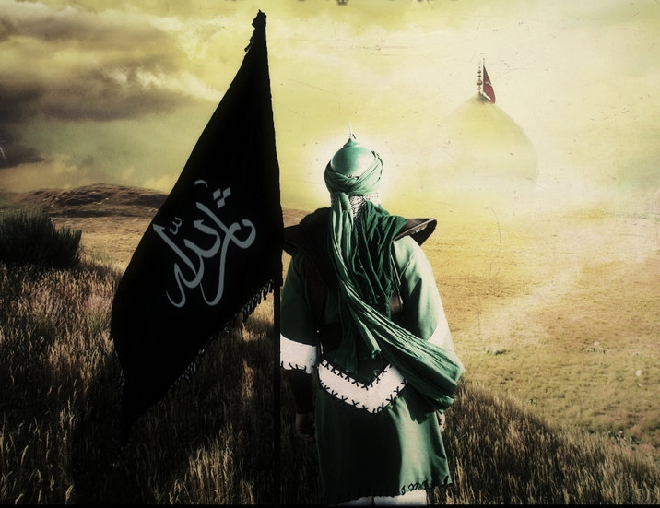
Muhammad Al-Mahdi Means = “Rightly-guided; Under the Guidance of Allah; or Redeemer”

Slide 7
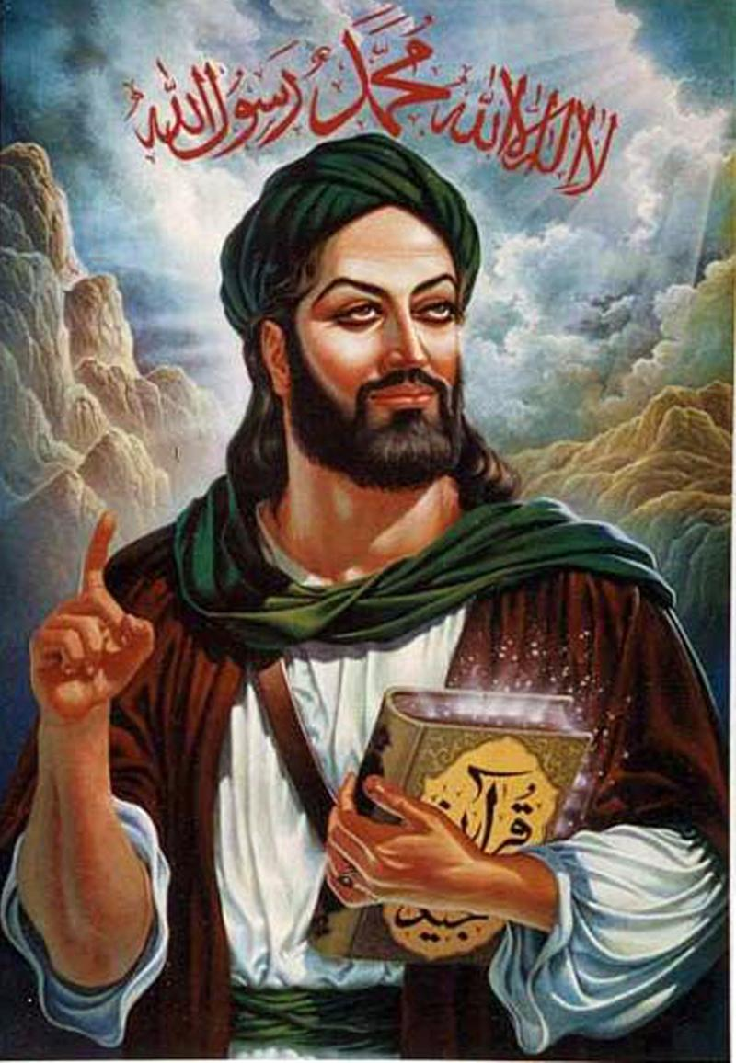
The belief in Al-Mahdi - as the embodiment of the Messiah or the Savior who will appear at the end of time - is a belief in the fulfillment of God’s promise made to Muhammad. It is a belief common to all Muslims based on the accepted sayings of the Prophet Muhammad.

Slide 8
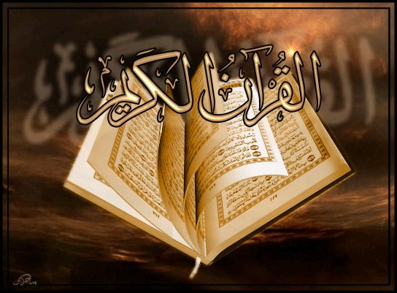

Slide 9
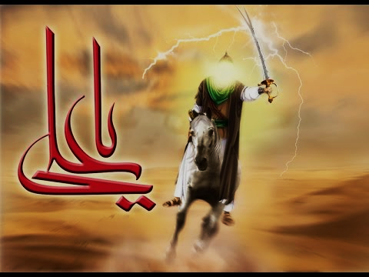
The Mahdi is the prophesied redeemer of Islam who will stay on Earth for seven years before the Day of Judgment and will rid the world of wrongdoing, injustice and tyranny.
He will fill the world with justice and fairness at a time when the world will be filled with oppression, which is war and calamities.

Slide 10
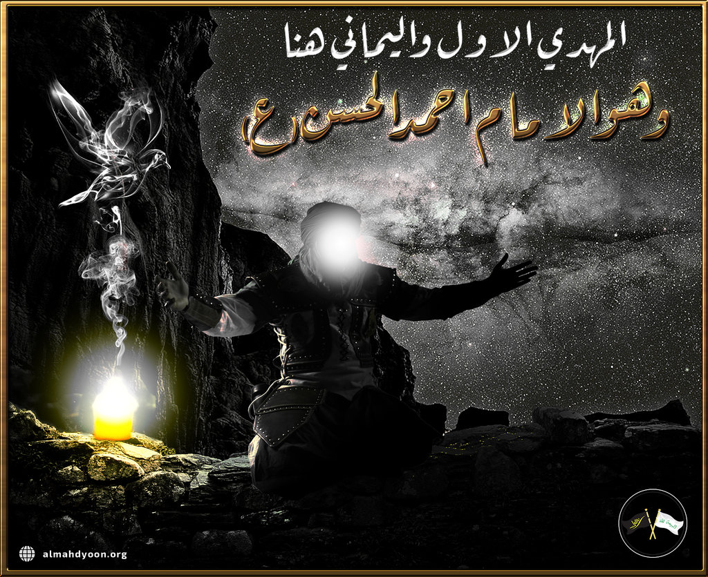
The Mahdi will be the 12th Imam
Each Imam was the son of the previous Imam. The twelfth and final Imam is Muhammad al-Mahdi, who is believed by Muslims to be currently alive, and hidden from view until he returns to bring justice to the world.

Slide 11
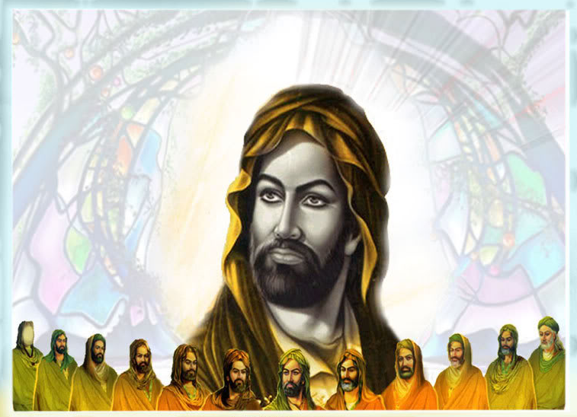
The Twelve Imams are the spiritual and political successors to the prophet Muhammad

Slide 12
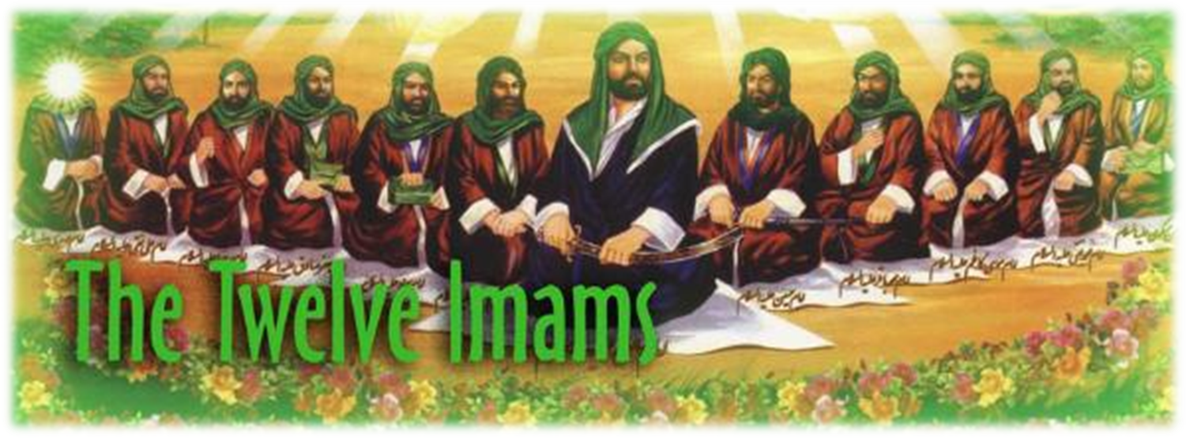
1. Ali Al Murtaza
2. Imam Hassan
3. Imam Hussain
4. Imam Zain Ul Aabideen
5. Imam Mohammad Baqar
6. Imam Jaffar Sadiq
7. Imam Moosa Kazim
8. Imam Ali Ibne Moosa Raza
9. Imam Mohammad Taqqi
10. Imam Ali Naqqi
11. Imam Hassan Askari
12. Imam Mahdi

Slide 13
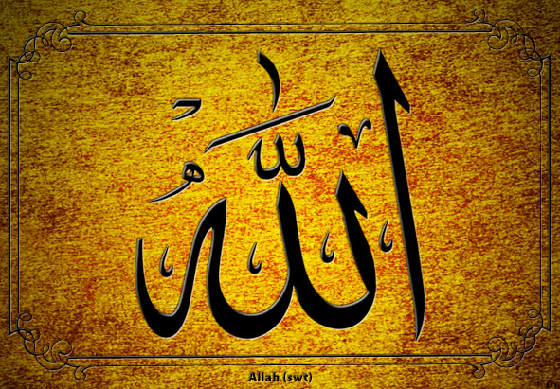
Only Allah can appoint an Imam and no man has the power to do so. The 12th Imam is said to have divine status as did each of the Imam’s before him. The 12th Imam is also called the Hidden Imam and the Mahdi.

Slide 14
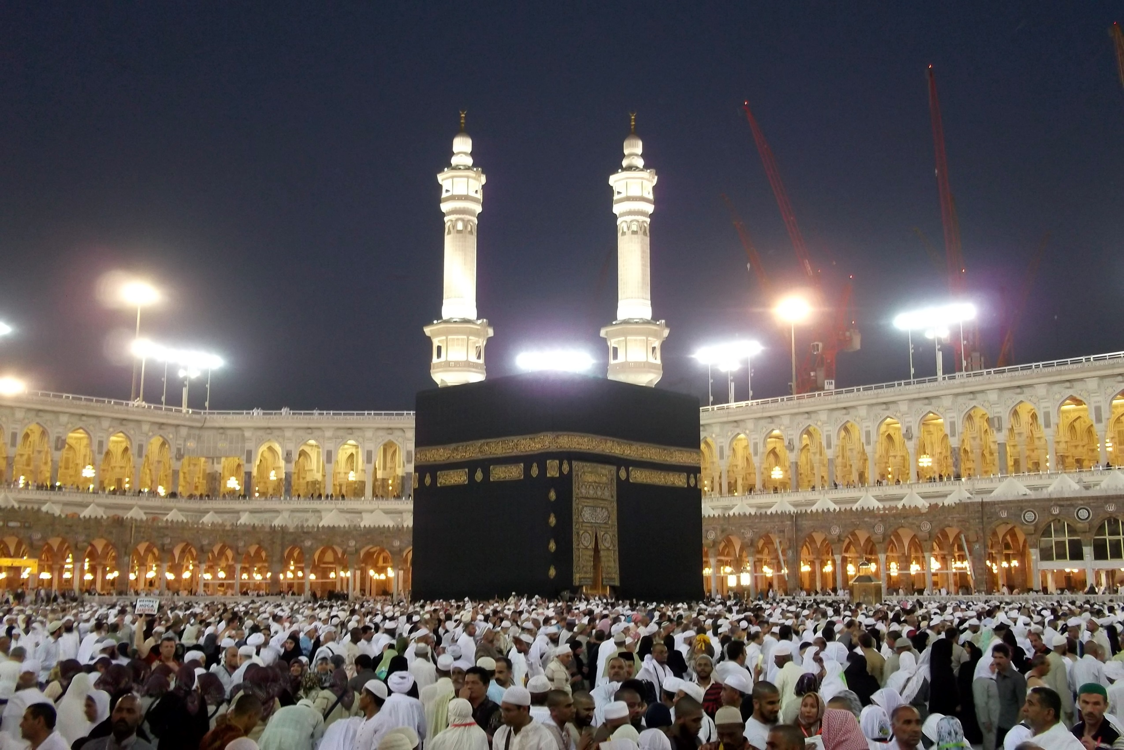
He will be a direct descendant of Muhammad
Will have a broad forehead and pointed nose
Will return just before the end of the world
His appearance will be preceded by a number of prophetic events during 3 years of horrendous world chaos, tyranny and oppression
Will appear in Makkah, thousands will pledge allegiance to him
Will rule over the Arabs and the world for 7 years
Will eradicate all tyranny and oppression bringing harmony and world peace
Will lead prayers in Makkah with Jesus Christ by his side following him

Slide 15
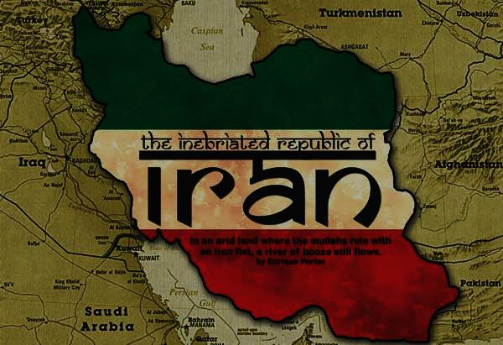
Remarkably, the 12th Imam theory plays heavily into the world’s current concerns with Iran. The Muslim President of Iran, Hassan Rouhani, is deeply committed to the Islamic Messiah, al Mahdi. Rouhani believes he is yet to come.
He claims that he is to personally prepare the world for the coming Mahdi. In order to save the world, it must be in a state of terror and chaos. He claims the he has been “directed by Allah to pave the way for the glorious appearance of the Mahdi”

Slide 16
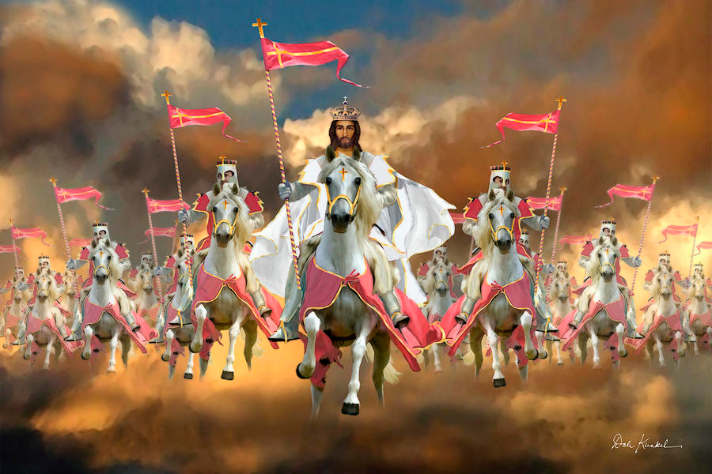
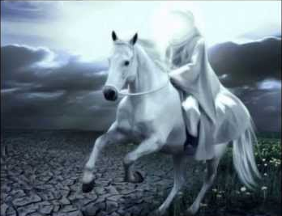
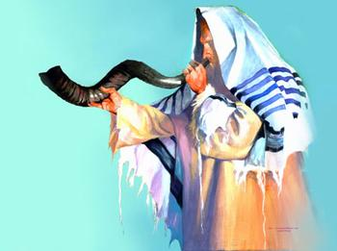
While Christians look for Jesus’ 2nd coming, the Jews await the Messiah and Muslims await the 12th Imam.

Slide 17
Islam’s teaching about the Mahdi
The Mahdi is Islam’s primary messiah figure.
He will be a descendant of Muhammad and will bear Muhammad’s name.
He will be a very devout Muslim.
He will be an unparalleled spiritual, political and military world leader.
He will emerge after Arabs throw off the reins of their rulers and take possession of their land. This will be a period of great turmoil and suffering.

Slide 18

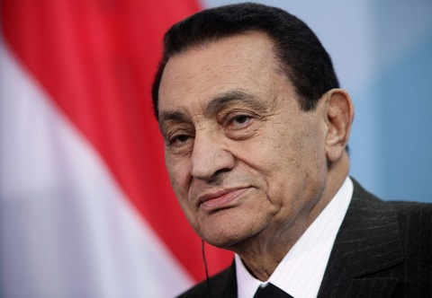
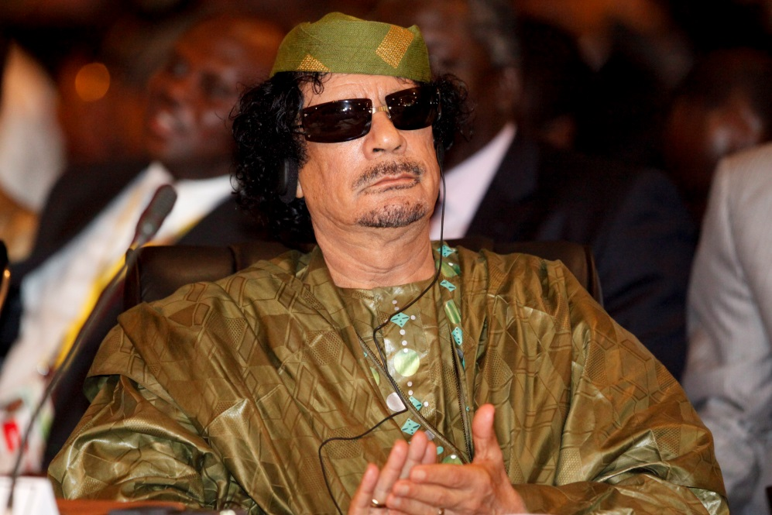
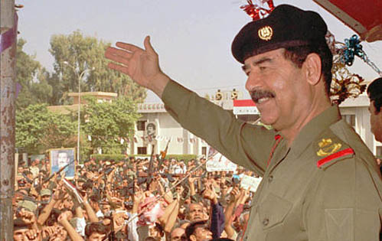

Slide 19
He will establish justice and righteousness throughout the world and eradicate tyranny and oppression.
He will lead a world revolution and establish a new world order.
He will lead military action against all who oppose him.
He will invade many countries.
He will make a seven year peace treaty with the Jewish nation.
He will discover some previously undiscovered biblical manuscripts that he will use to argue with the Jews and cause some Jews to convert to Islam.

Slide 20
He will rule for seven years.
He will conquer Israel for Islam and lead the “faithful Muslims” in a final slaughter/battle against Jews.
He will also re-discover the Ark of the Covenant from the Sea of Galilee, which he will bring to Jerusalem.
He will establish an Islamic world headquarters from Jerusalem.
He will unite all religions under Islam.
He will posses and distribute enormous amounts of wealth.

Slide 21
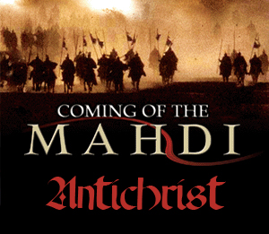
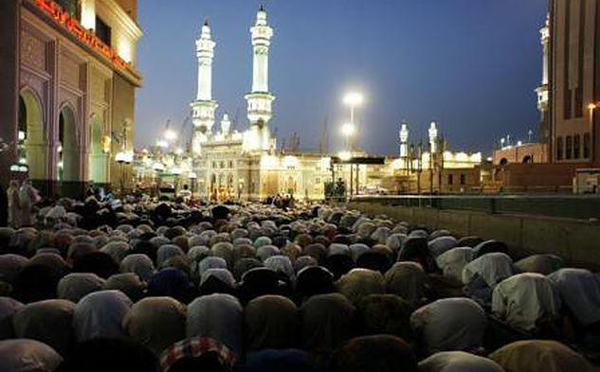
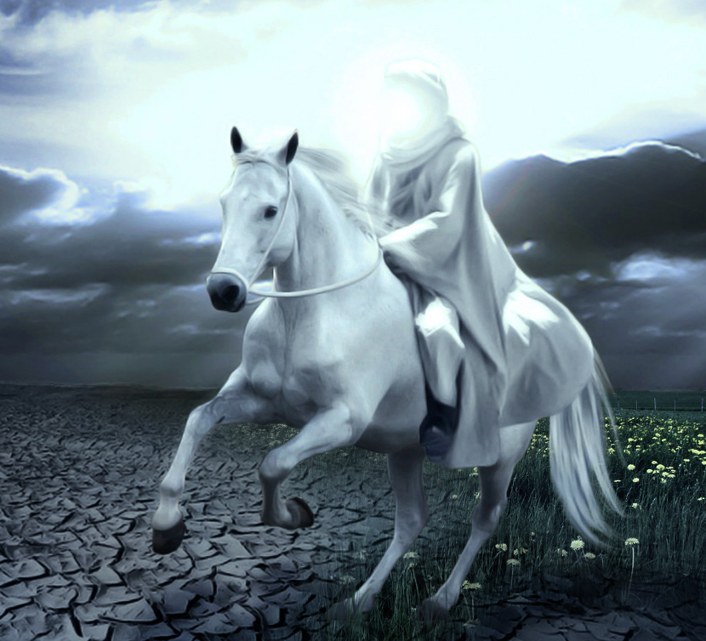
He will be loved by all the people of the earth.
He will appear riding a white horse.

Slide 22
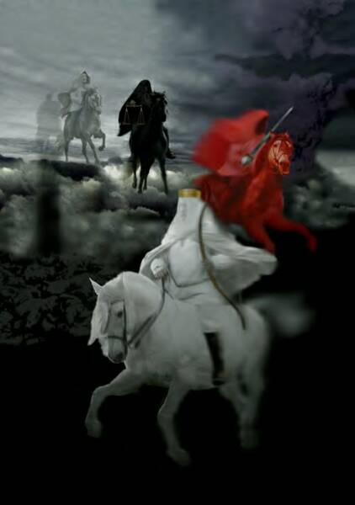
“And I saw, and behold a white horse: and he that sat on him had a bow; and a crown was given unto him: and he went forth conquering, and to conquer.”
(Revelation 6:2)

Slide 23

“Little children, it is the last time: and as ye have heard that antichrist shall come, even now are there many antichrists; whereby we know that it is the last time.” (I John 2:18)

Slide 24
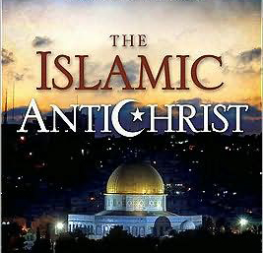

Slide 25
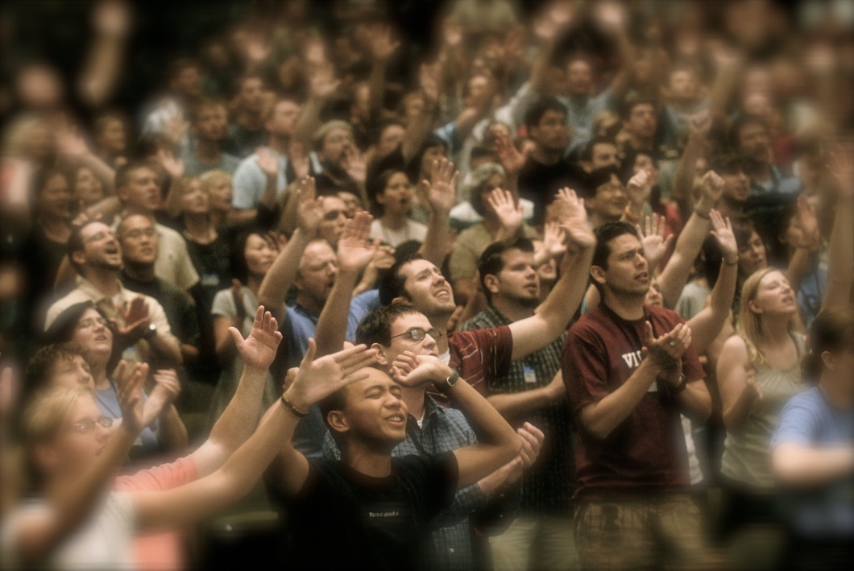
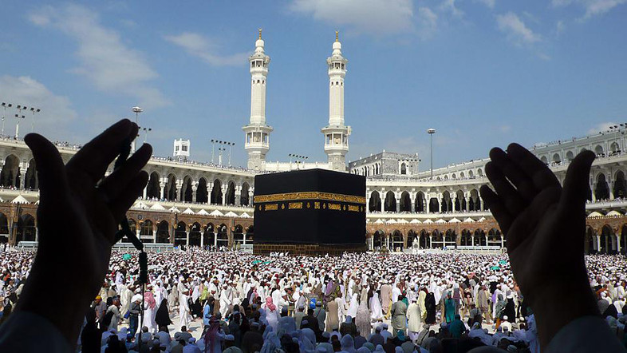
Similarities between the Anti-Christ and the Mahdi
The antichrist will be a leader who has the ability to speak boldly - Daniel 7:7-8; Rev. 13:5
The Mahdi will be a leader who has the ability to speak boldly -“He will be so powerful that if he…shouts among the mountains, hard rocks will turn into powder…”

Slide 26
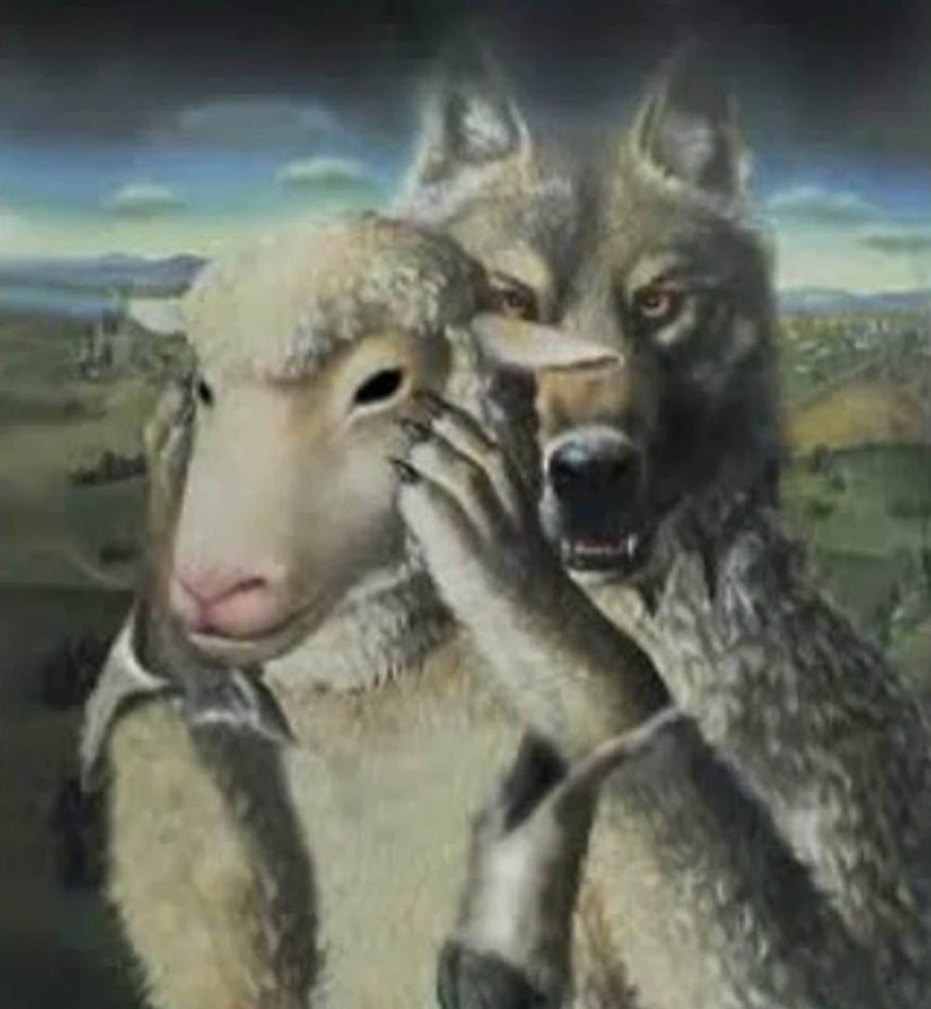
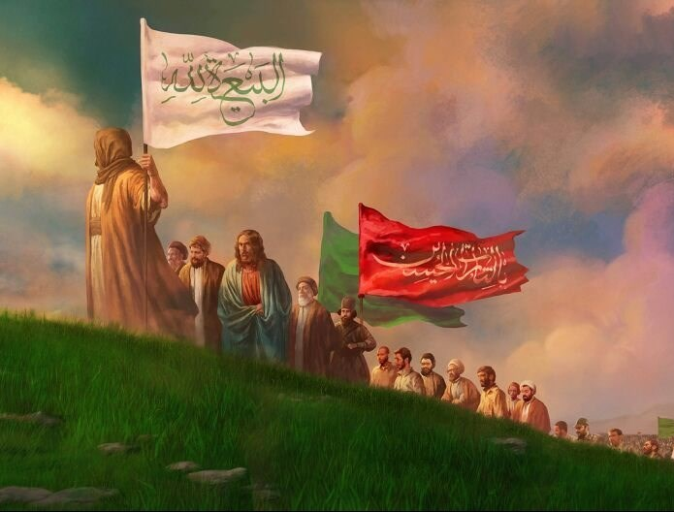
The Antichrist will be accompanied by the false prophet who will lead people into serving him – Rev. 19:20
The ‘Muslim Jesus’ (not to be confused with the Christian Jesus) will return to help the Mahdi to be accepted by the world - “The Hour will not be established until the son of Mary descends amongst you as a just ruler. Money will be in abundance so that nobody will accept it (as charitable gifts).”

Slide 27
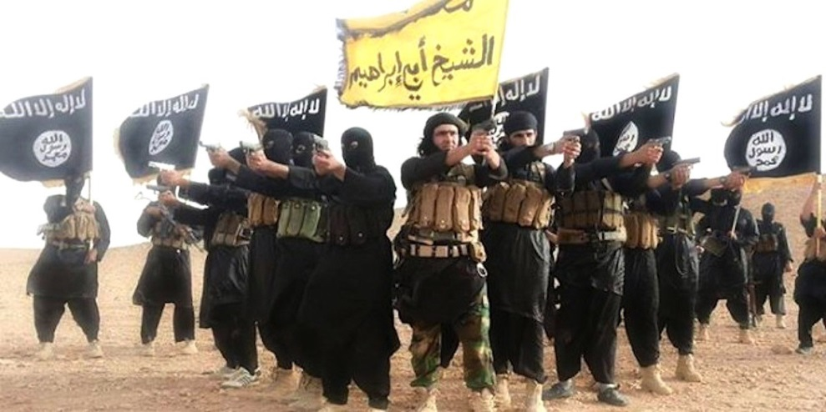
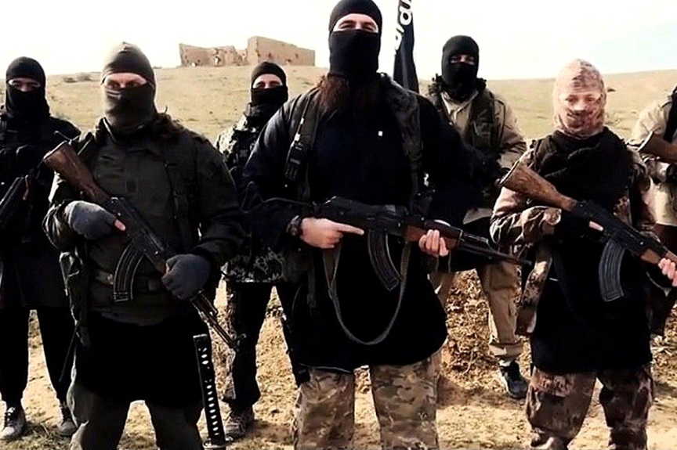
The Antichrist will have a powerful army that will do damage to the earth. Ultimately causing all to follow him – Rev. 13:4-8
The Mahdi will also have a powerful army that will do damage on the earth. Ultimately causing all to follow him - “Mahdi will receive a pledge of allegiance as a caliphate for Muslims. He will lead Muslims in many battles of jihad…If you see him, go and give him your allegiance.”
Caliphate = A successor to the Islamic prophet Muhammad and a leader of the entire Muslim community.

Slide 28
Caliphate
A caliphate (Arabic: خِلافة‎ khilāfa) is a form of Islamic government led by a caliph - a person considered a political and religious successor to the Islamic prophet, Muhammad, and a leader of the entire Muslim community.

Slide 29
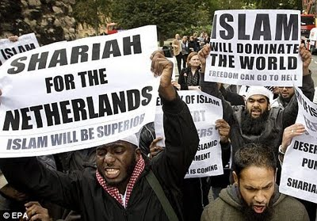
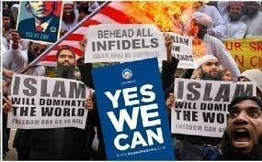
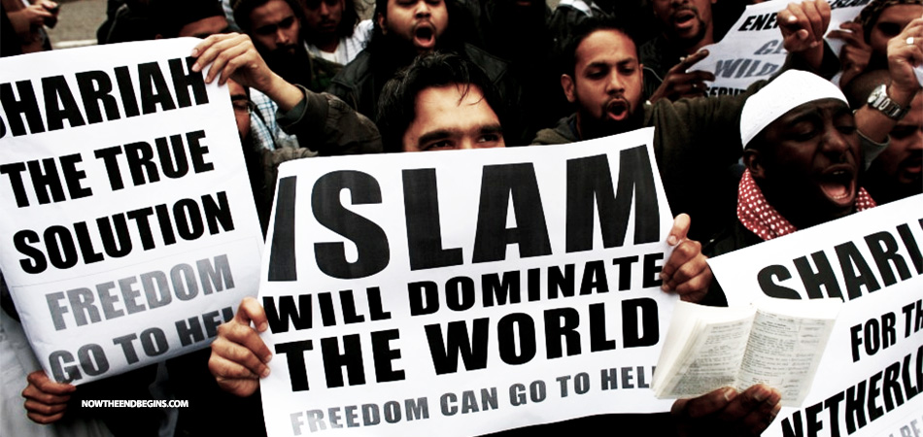
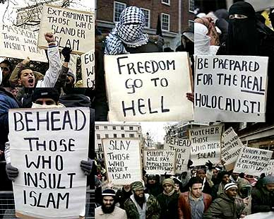
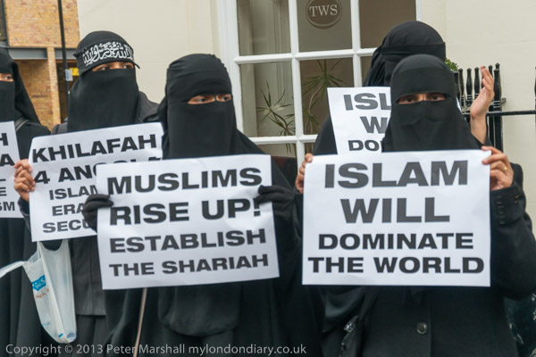

Slide 30
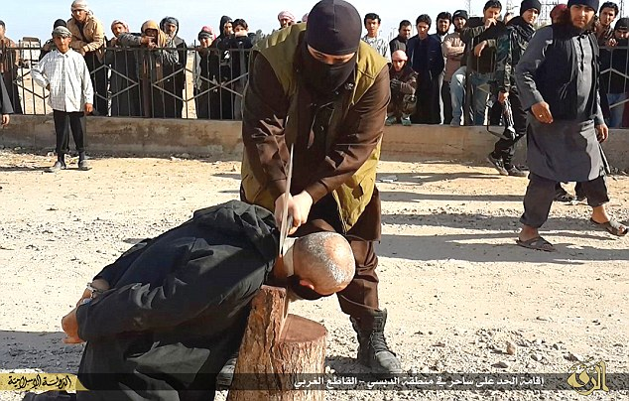
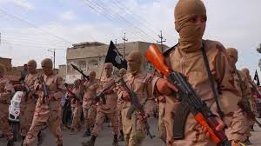
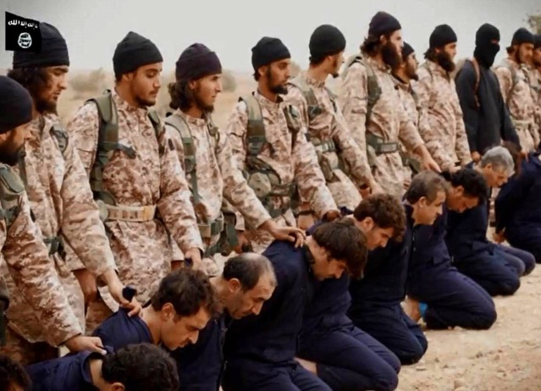
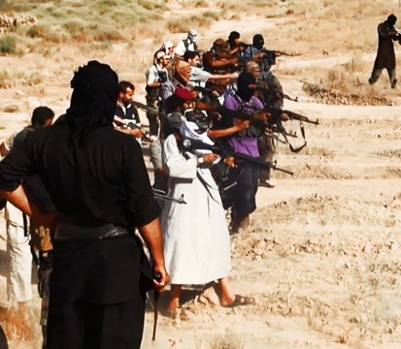
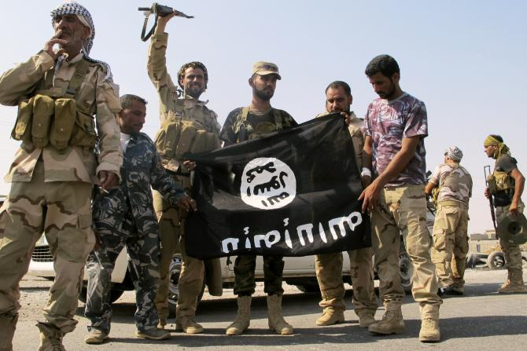
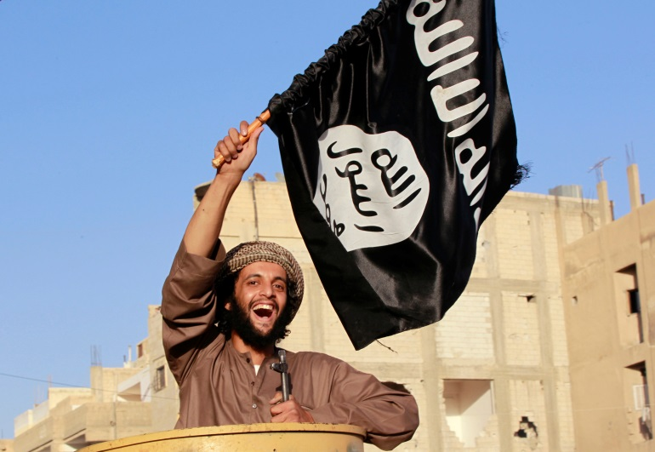
(Genesis 16:12)
“And he will be a wild man; his hand will be against every man, and every man's hand against him.”

Slide 31
The Antichrist will be a world leader and rule for seven years – Dan. 9:27
The Mahdi will be a world leader and rule for seven years - “The Mahdi will fill the earth with equity and justice as it was filled with oppression and tyranny, and he will rule for seven years…Fight against the forces of evil, lead a world revolution and set up a new world order.”

Slide 32
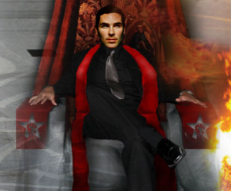
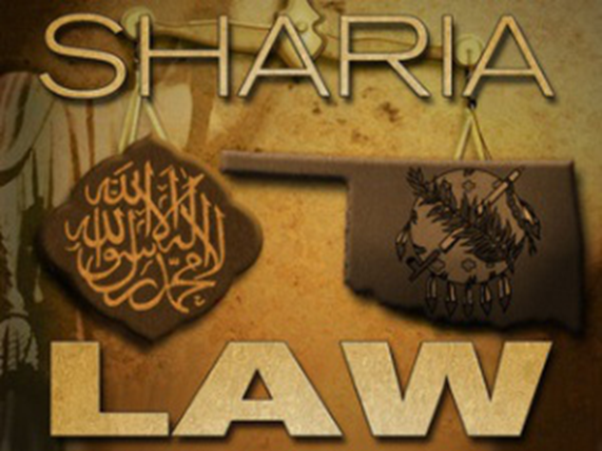
The Antichrist will change times and laws – Dan. 7:25
The Mahdi will adopt the Islamic calendar thus changing the times. In addition he will promote Sharia law changing the laws - “He…will govern the people by the Law of their prophet and establish Islam on the earth.”

Slide 33
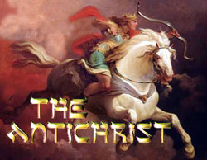
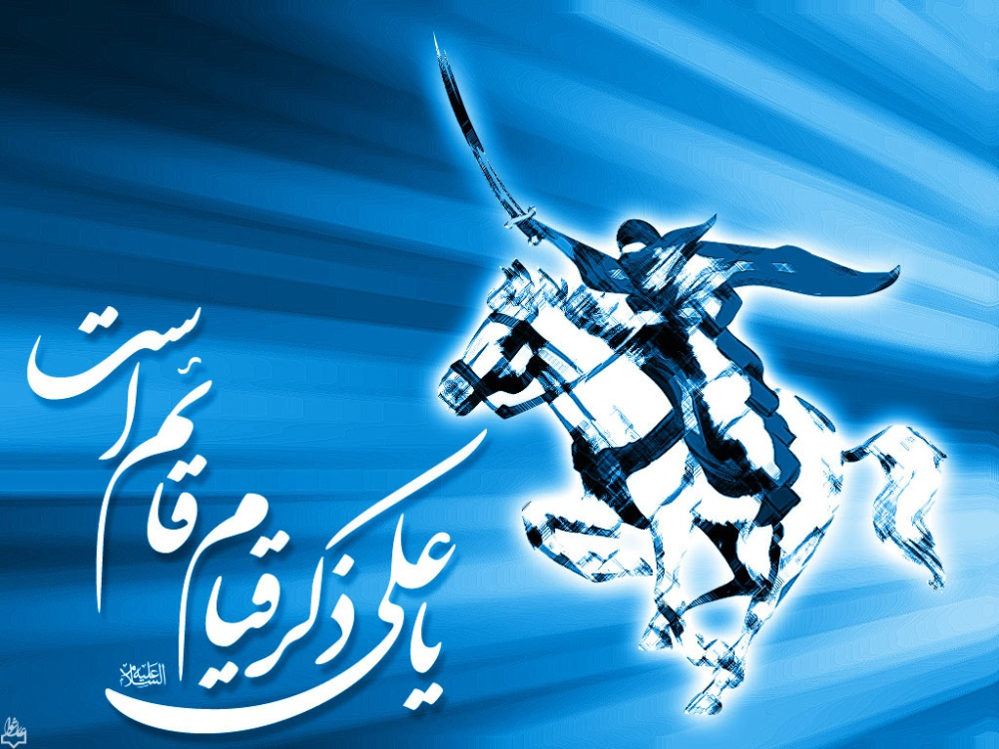
The Antichrist comes riding on a white horse – Rev. 6:2
The Mahdi comes riding on a white horse - “It is clear that this man is the Mahdi who will ride the white horse and judge by the Qur’an.”

Slide 34

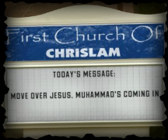
The Antichrist and false prophet will promote a one world religion – Rev. 13:15
The Mahdi will make Islam the only acceptable religion - “He will govern the people by the Law of their prophet and establish Islam on the earth.”

Slide 35
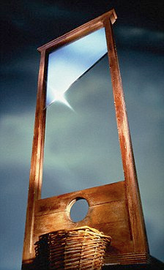
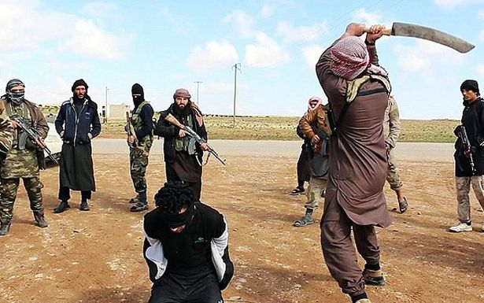
The Antichrist will execute infidels through beheadings - Rev. 20:4
The Mahdi will execute infidels, anyone who does not believe in Islam, through beheading - “I will instill terror into the hearts of the unbelievers: smite ye above their necks and smite all their finger-tips off…Therefore, when ye meet the Unbelievers, strike off their heads.”

Slide 36
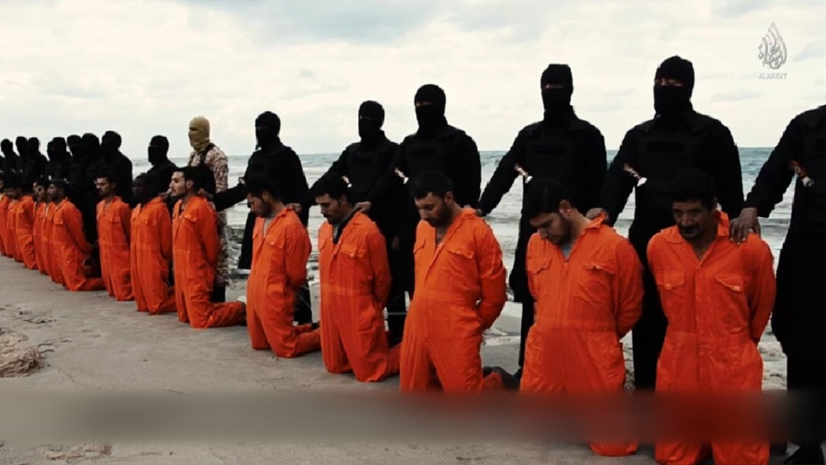
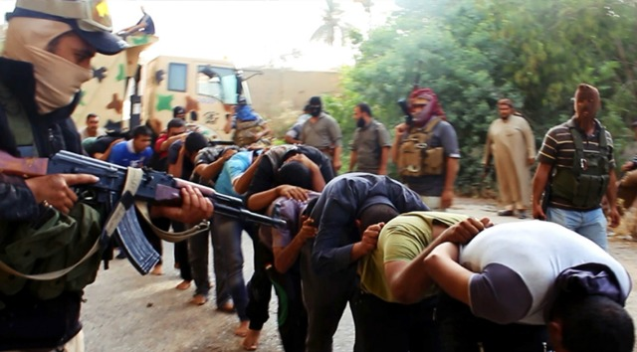
The Antichrist will kill Jews and Christians. He will kill anyone opposing him – Rev. 12:4, 13:7
The Mahdi will kill anyone who opposes Islam. He will kill the Jews and Christians - “Muslims take neither Jews nor the Christians for your friends. They are friends with one another. Whoever of you seeks their friendship shall become one of their numbers. Allah does not guide wrongdoing. Slay the idolaters wherever you find them. Arrest them, besiege them, and lie in ambush for them.”

Slide 37



The Antichrist will attack and conquer Jerusalem – Zech. 14:2
The Mahdi will conquer Jerusalem - “Jerusalem will be the location of the rightly guided caliphate and the center of Islamic rule, which will be headed by Imam al-Mahdi.”
“And I saw, and behold a white horse: and he that sat on him had a bow; and a crown was given unto him: and he went forth conquering, and to conquer.” (Revelation 6:2)

Slide 38

The Antichrist performs many signs, wonders, and miracles – II Thess. 2:9; Rev. 12:13-14
The Mahdi performs many signs, wonders, and miracles - “In the last days the Mahdi will appear. Allah will give him power over the wind and the rain and the earth will bring forth its foliage. He will give away wealth profusely, flocks will be in abundance, and the community will be large and honored.”

Slide 39


The Antichrist will make people receive a mark on the hand or forehead to pledge allegiance to him – Rev. 13:16-17
Followers of the Mahdi will mark themselves with headbands on the foreheads – “Muslims will receive the name of God, the Most Gracious and Merciful (in the name of Allah) upon their foreheads.”

Slide 40

Iran is now asserting that Armageddon is at hand and that the Islamic regime’s followers, indeed all of Islam, must prepare for a monumental change in the world.
Officials of the Islamic regime last year held their annual conference on the Mahdism Doctrine to prepare for the coming of the last Islamic messiah, the 12th Imam, Mahdi.
Read more at http: www.wnd.com

Slide 41


Slide 42


Slide 43


Slide 45


Slide 46








Slide 47


“And when the dragon saw that he was cast unto the earth, he persecuted the woman which brought forth the man child.”
(Rev. 12:13)

Slide 48

(Revelation 17:6)
“And I saw the woman drunken with the blood of the saints, and with the blood of the martyrs of Jesus.”

Slide 49






Slide 50

During his hour-long speech, a smiling Pope Francis was quoted telling the Vatican’s guests that the Koran, and the spiritual teachings contained therein, are just as valid as the Holy Bible.

Slide 51
“Jesus Christ, Jehovah, Allah. These are all names employed to describe an entity that is distinctly the same across the world. For centuries, blood has been needlessly shed because of the desire to segregate our faiths. This, however, should be the very concept which unites us as people, as nations, and as a world bound by faith. Together, we can bring about an unprecedented age of peace, all we need to achieve such a state is respect each others beliefs, for we are all children of God regardless of the name we choose to address him by.”

Slide 52


Slide 53


One world government
Revelation 17:13

Slide 54

One world economy
Revelation 13:17

Slide 55

One world money market
Revelation 18:3, 15

Slide 56

One world church
Revelation 17:1-9

Slide 57


Slide 58
(Matthew 24:23-25)
“Then if any man shall say unto you, Lo, here is Christ, or there; believe it not. For there shall arise false Christ’s, and false prophets, and shall shew great signs and wonders; insomuch that, if it were possible, they shall deceive the very elect. Behold, I have told you before.”

Slide 59
(Matthew 24:6, 33)
“And ye shall hear of wars and rumours of wars: see that ye be not troubled: for all these things must come to pass…So likewise ye, when ye shall see all these things, know that it is near, even at the door.”

Slide 60


Which one are you going to Believe?
Bible
Quran

