Slide 1

The Revelation of Jesus Christ
A study of the book
of Revelation

Slide 2

Revelation 9:1-21
“The Seven Trumpets”
(Continued)

Slide 3
Revelation 8:1-11:19
“The Seven Trumpets”

Slide 4
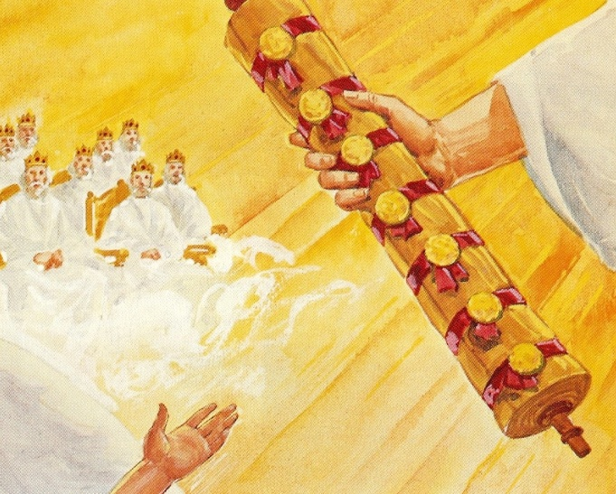
Seven Seal Judgments
(Revelation 8:1-5)

Slide 5
“And when he had opened the seventh seal, there was silence in heaven about the space of half an hour. And I saw the seven angels which stood before God; and to them were given seven trumpets.”

Slide 6
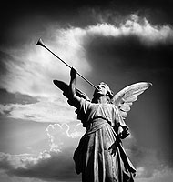
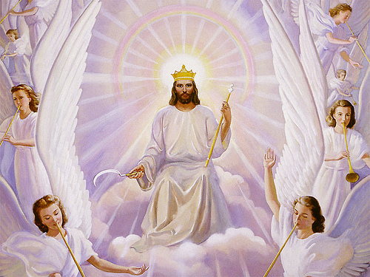

Slide 7
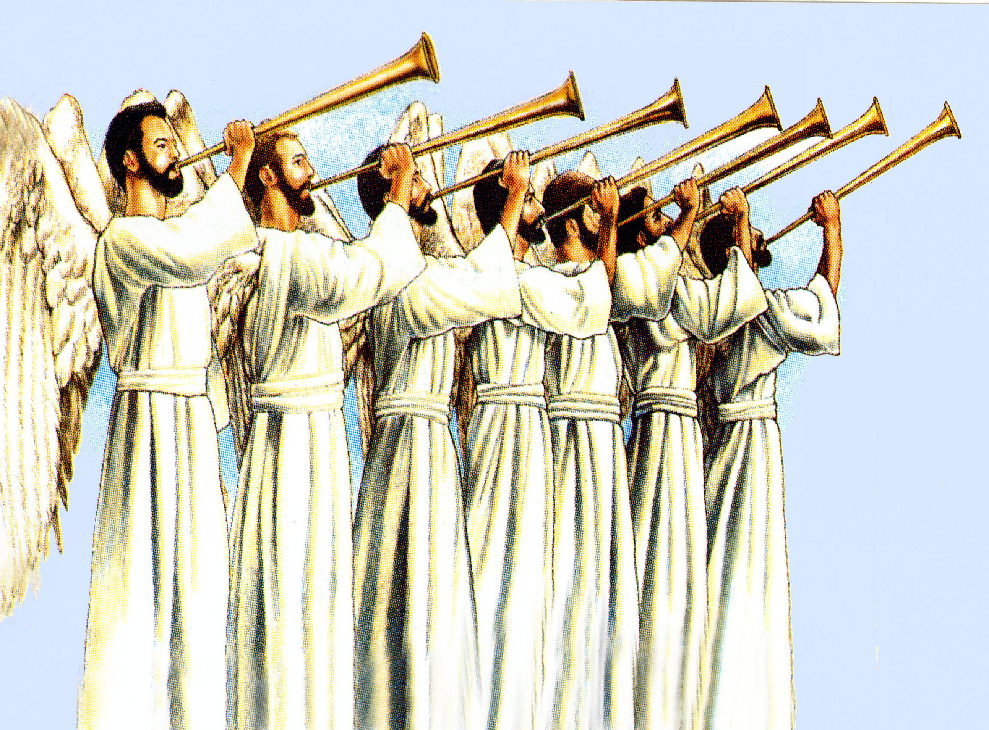
“And the seven angels which had the seven trumpets prepared themselves to sound.”

Slide 8
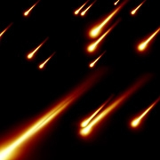
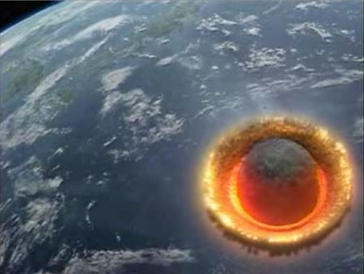
“The first angel sounded, and there followed hail and fire mingled with blood, and they were cast upon the earth: and the third part of trees was burnt up, and all green grass was burnt up.”

Slide 9
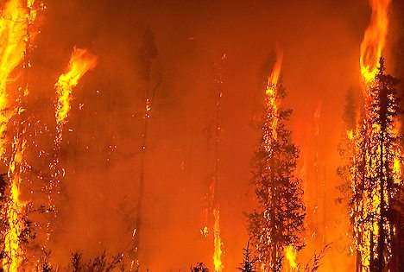
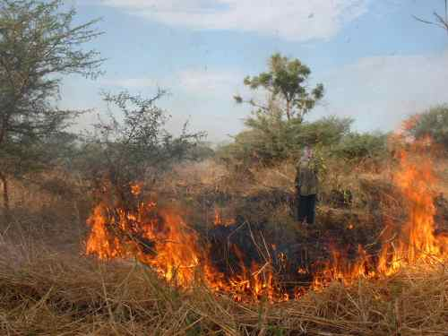
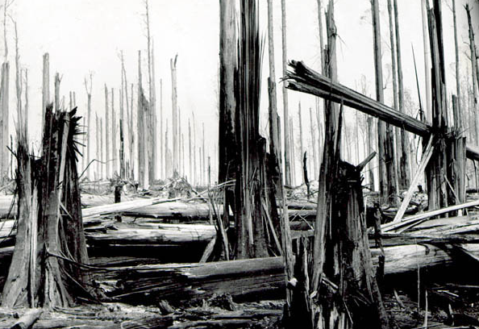
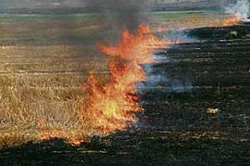
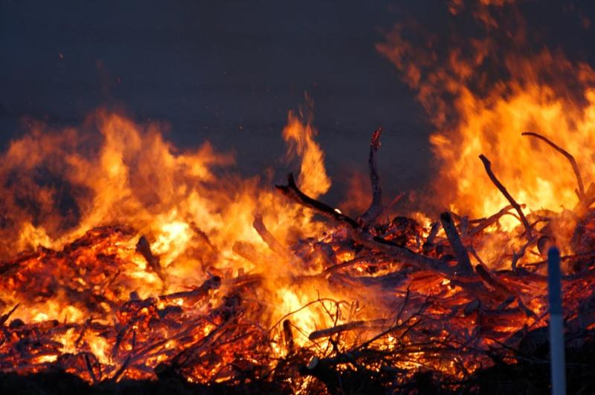

Slide 10
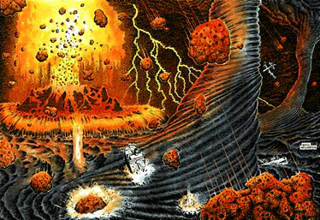
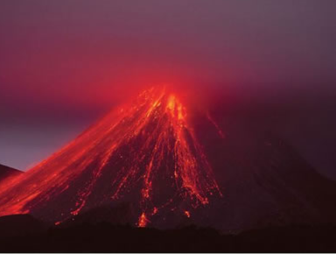
“And the second angel sounded, and as it were a great mountain burning with fire was cast into the sea.”

Slide 11
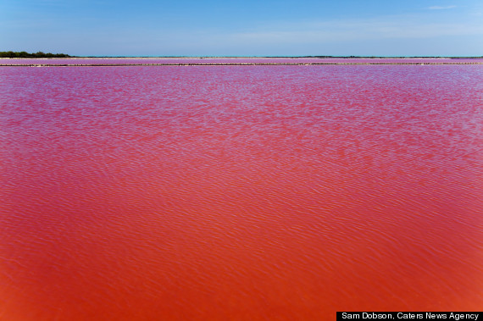
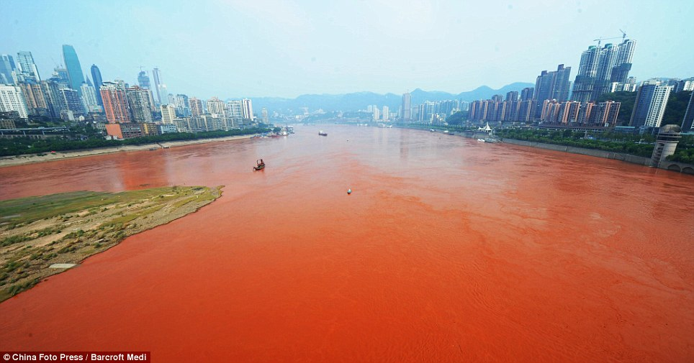
“And the third part of the sea became blood…”

Slide 12
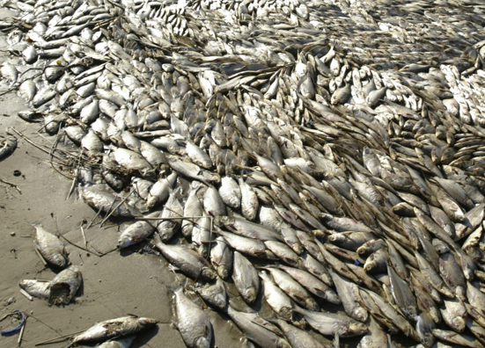
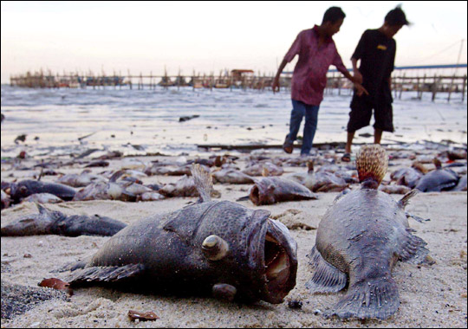
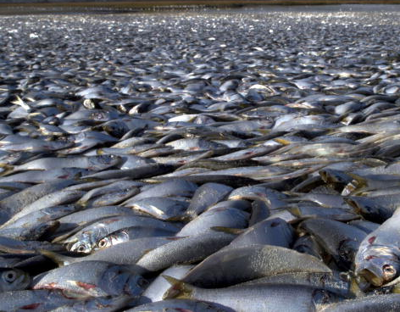
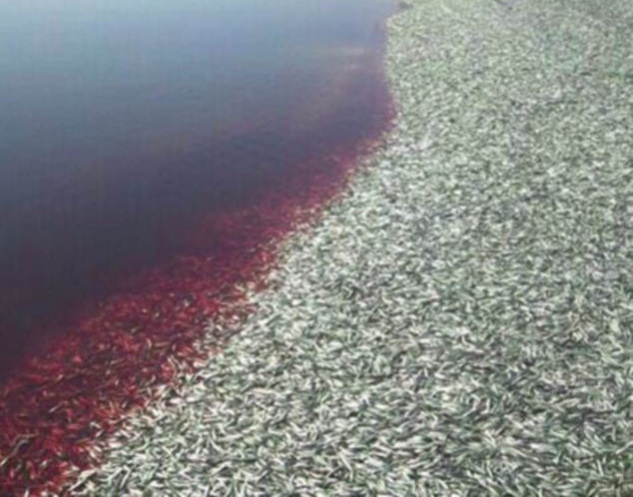
“And the third part of the creatures which were in the sea, and had life, died…”

Slide 13
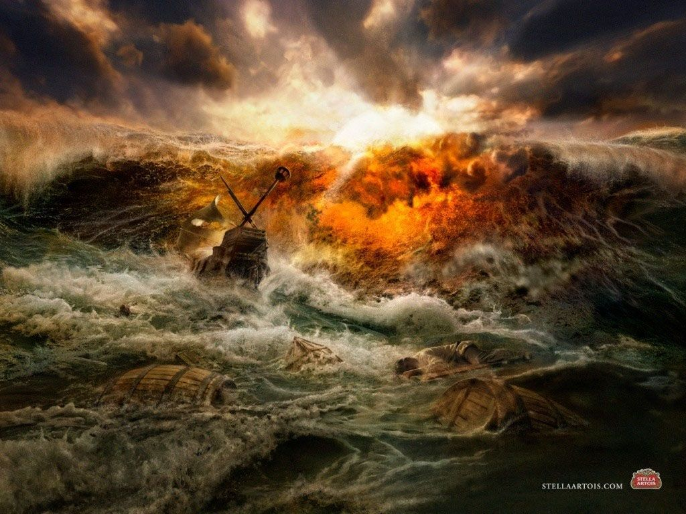
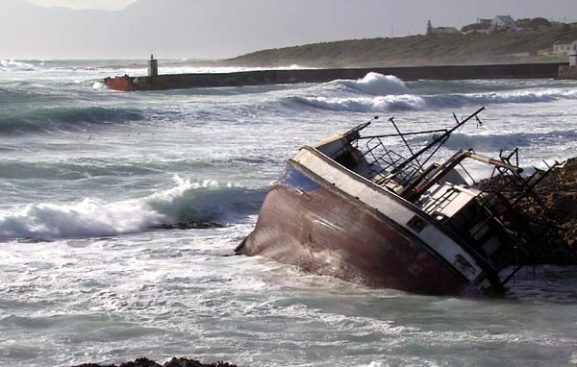
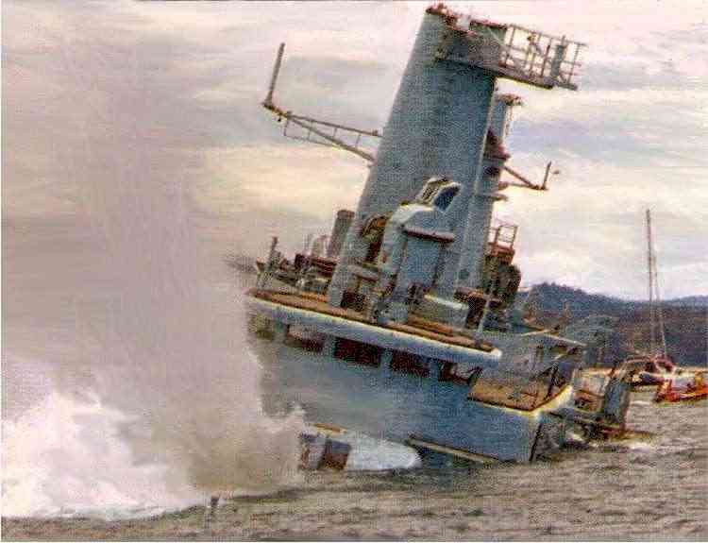
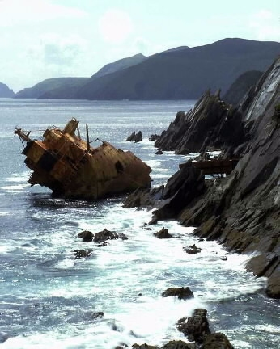
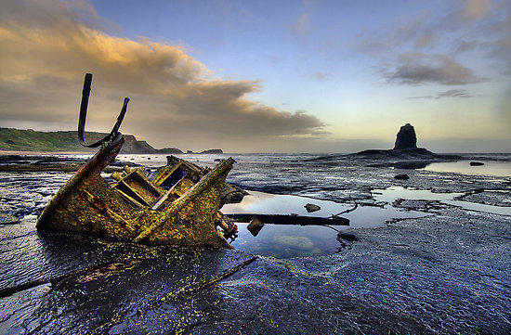
“And the third part of the ships were destroyed.”

Slide 14

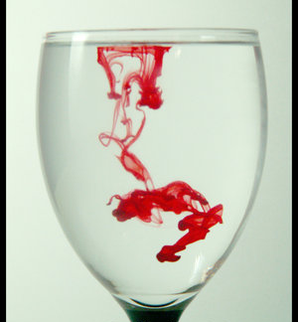
“The same shall drink of the wine of the wrath of God, which is poured out without mixture into the cup of His indignation.” (Revelation 14:10)

Slide 15
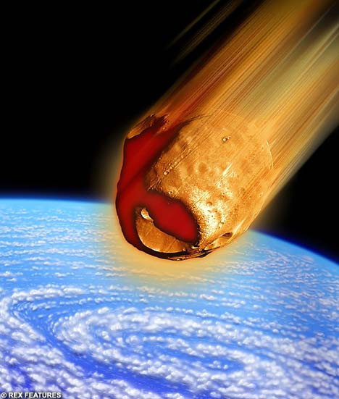
“And the third angel sounded, and there fell a great star from heaven, burning as it were a lamp, and it fell upon the third part of the rivers, and upon the fountains of waters.”

Slide 16
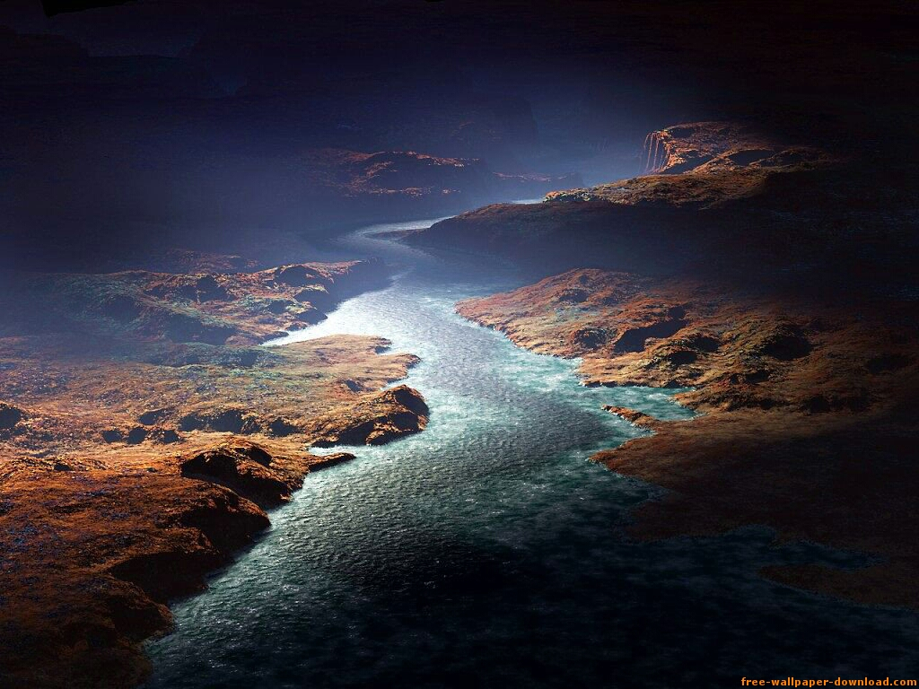
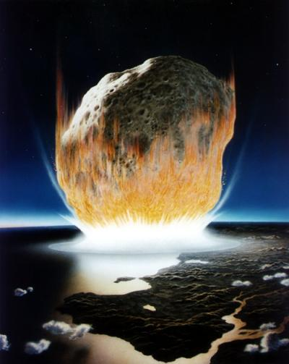
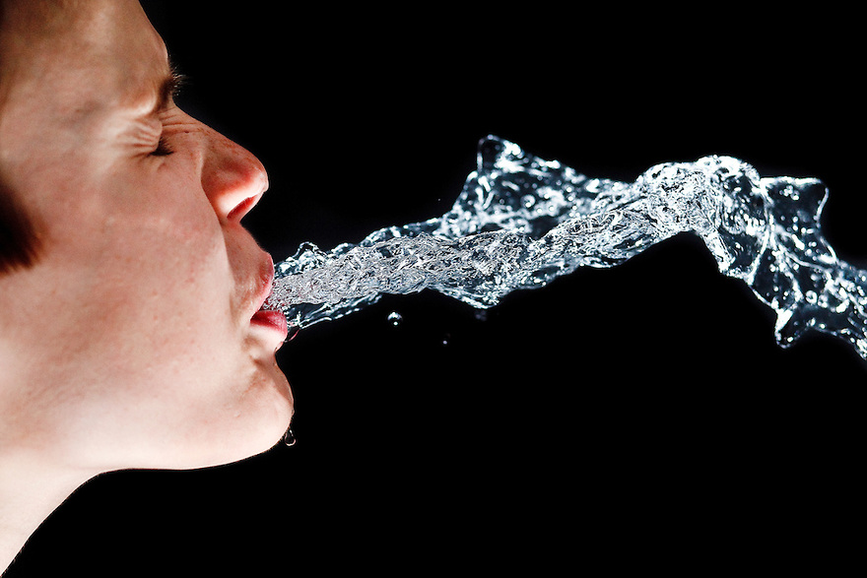
Wormwood

Slide 17
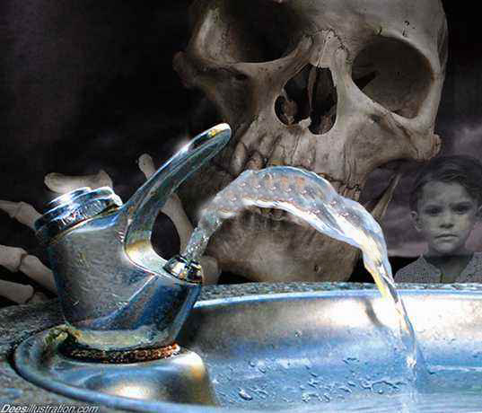
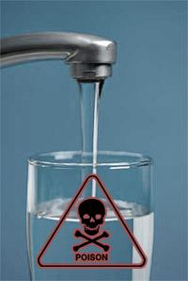
“And the name of the star is called Wormwood: and the third part of the waters became wormwood.”

Slide 18
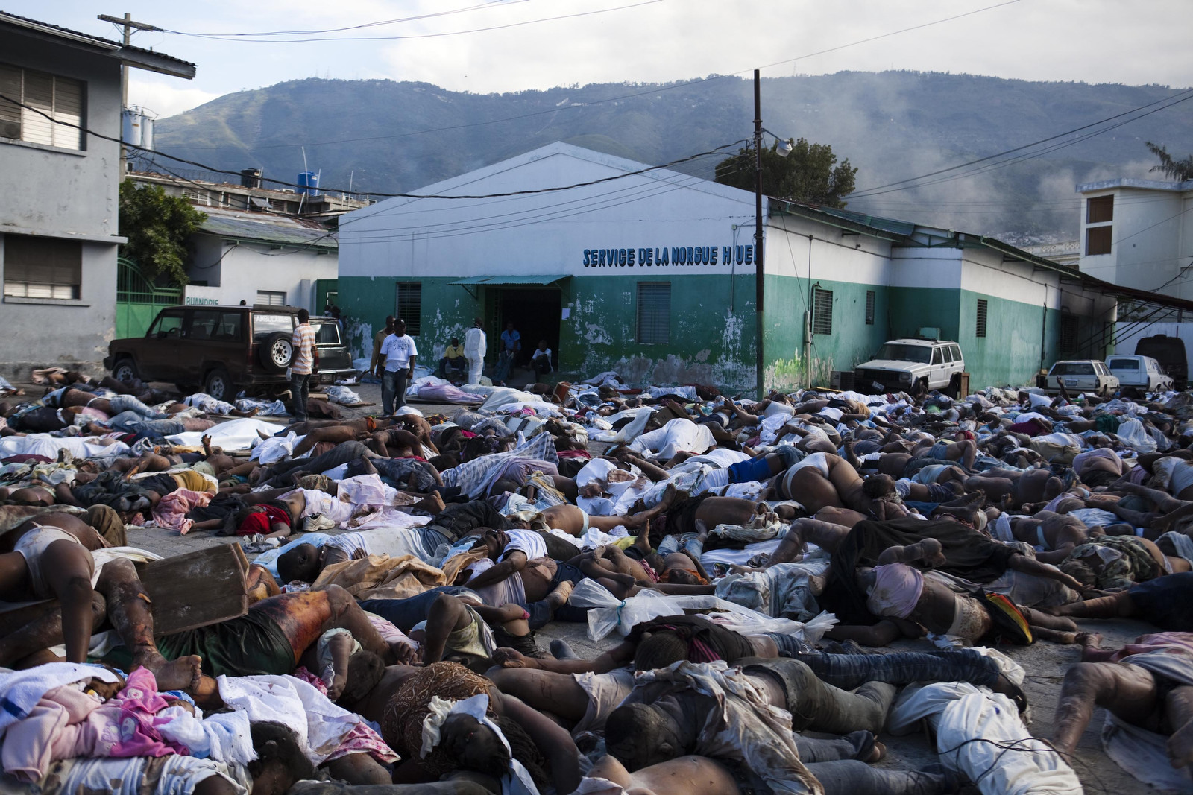
“And many men died of the waters, because they were made bitter.”

Slide 19
“And the fourth angel sounded, and the third part of the sun was smitten, and the third part of the moon, and the third part of the stars; so as the third part of them was darkened, and the day shone not for a third part of it, and the night likewise.”

Slide 20
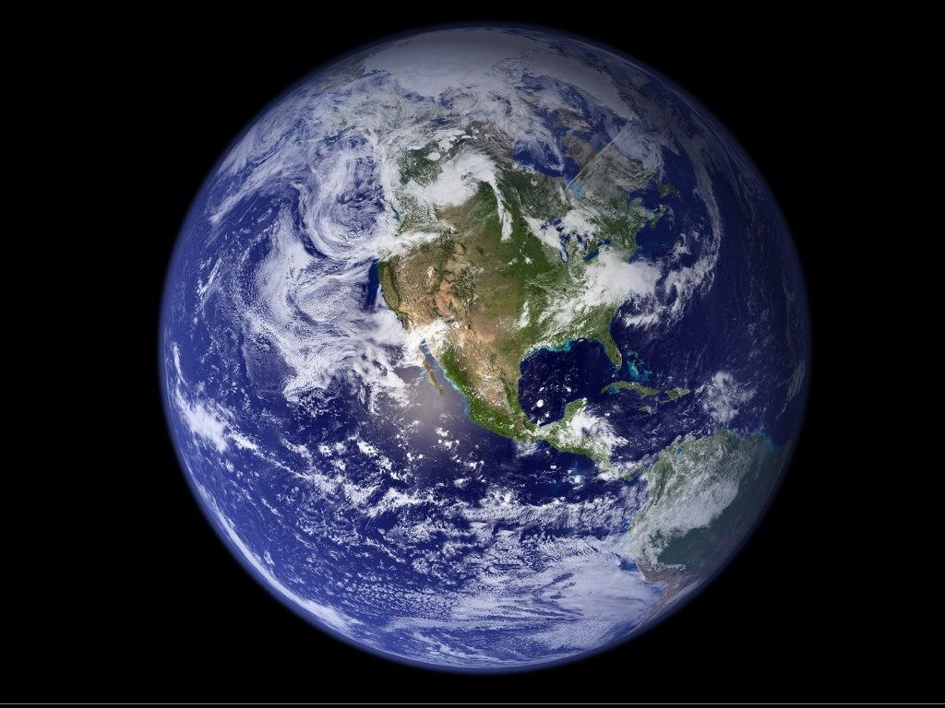
The light coming from the sun, moon, and stars is reduced by a third.

Slide 21
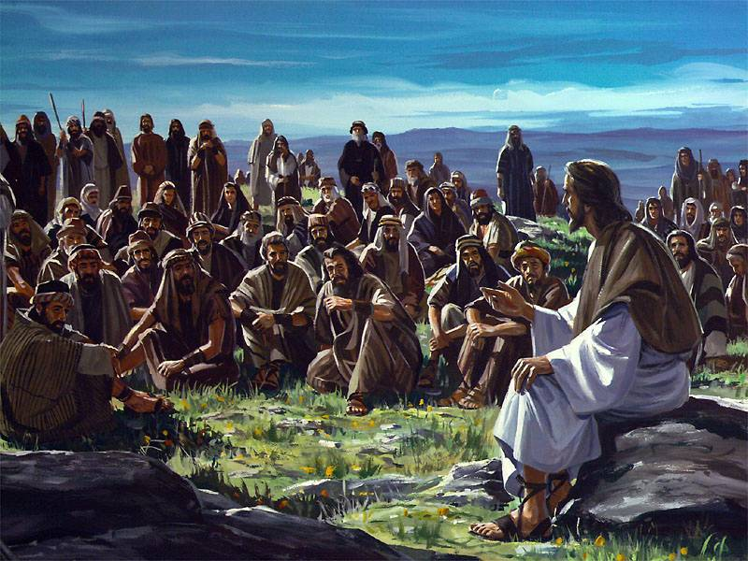
“And there shall be signs in the sun, and in the moon, and in the stars; and upon the earth distress of nations, with perplexity; the sea and the waves roaring. Men’s hearts failing them for fear, and for looking after those things which are coming on the earth: for the powers of heaven shall be.” (Luke 21:25-27)

Slide 22
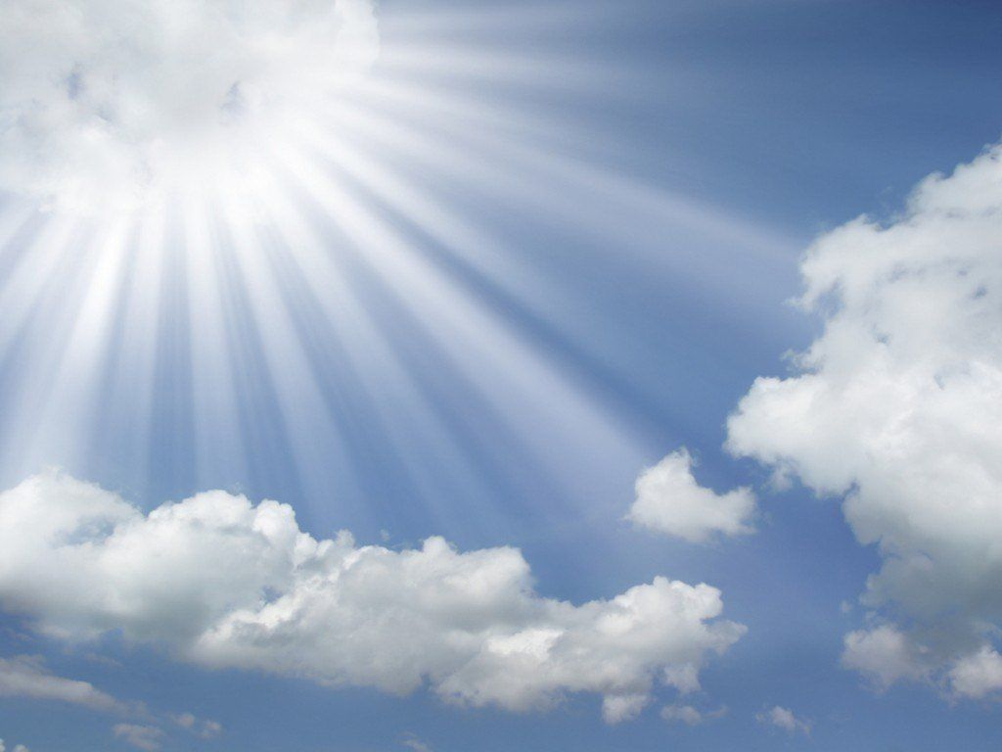
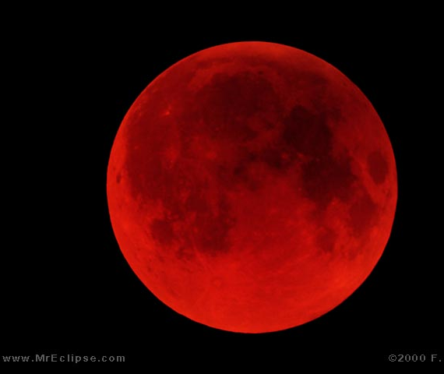
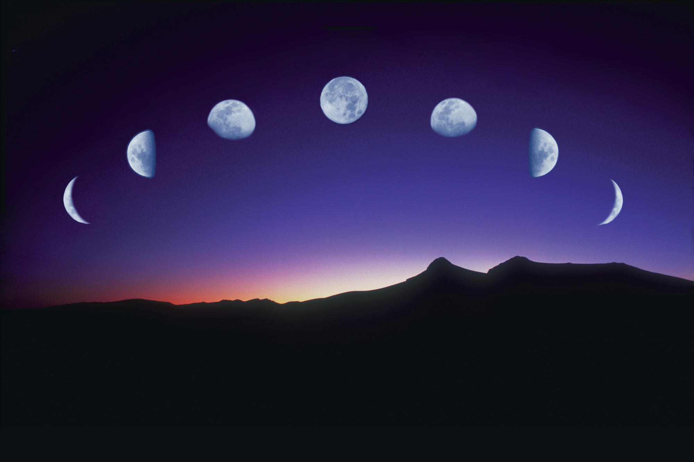
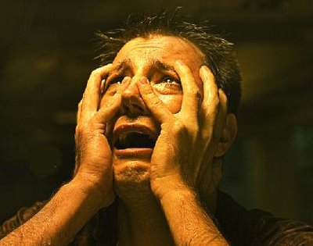
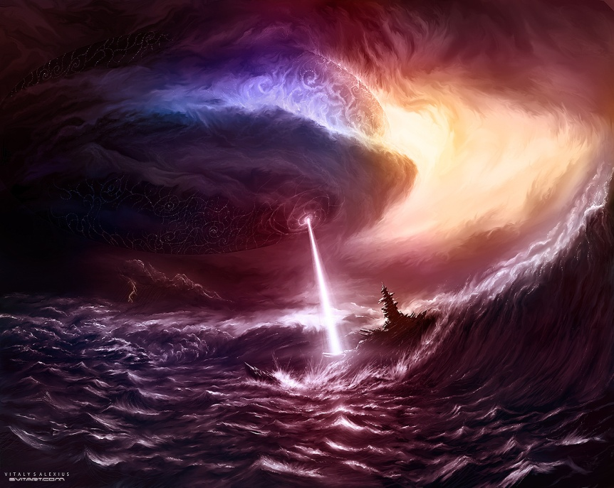
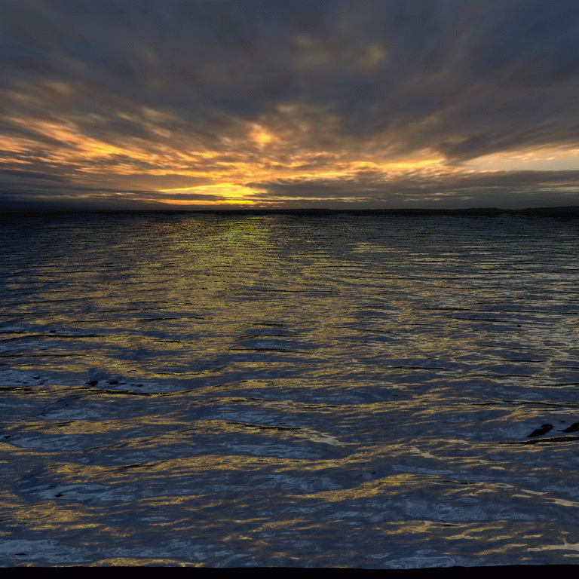
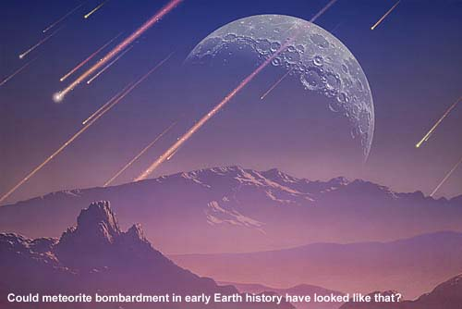
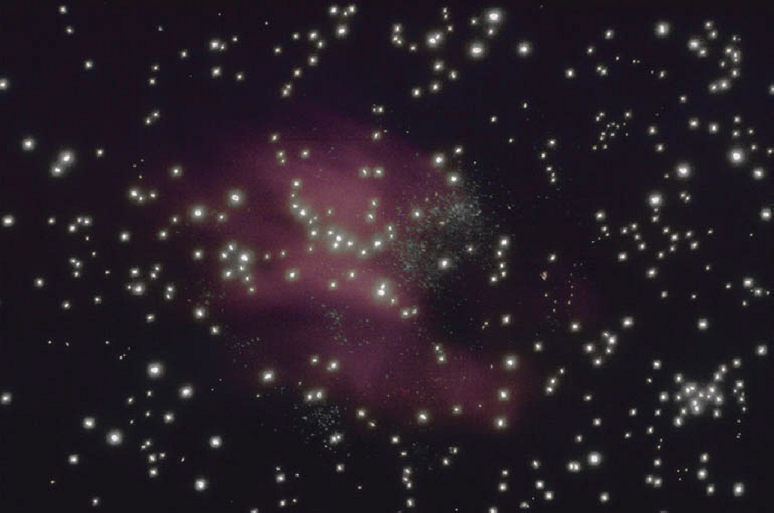

Slide 23
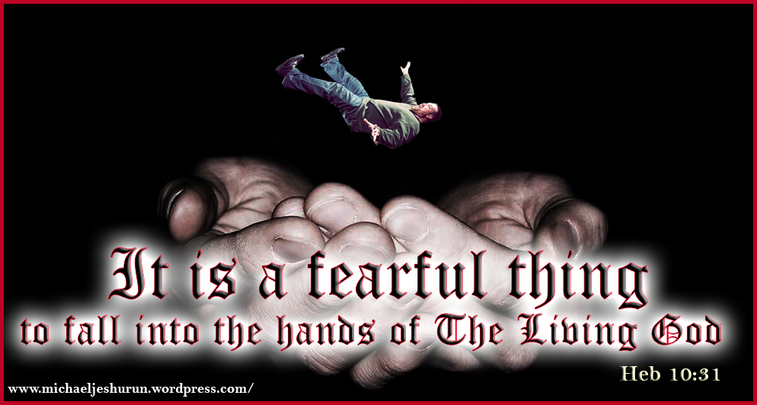

Slide 24
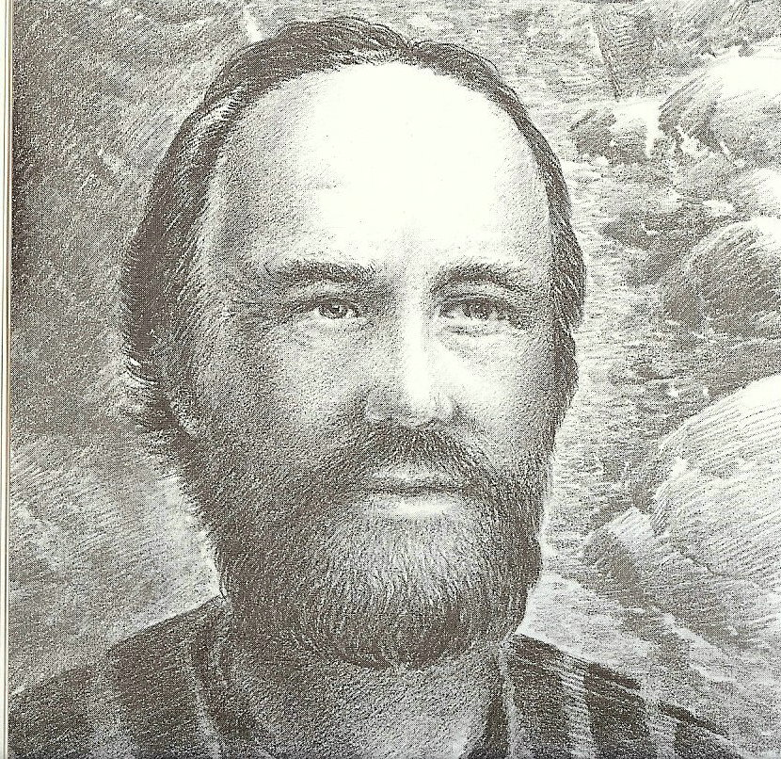
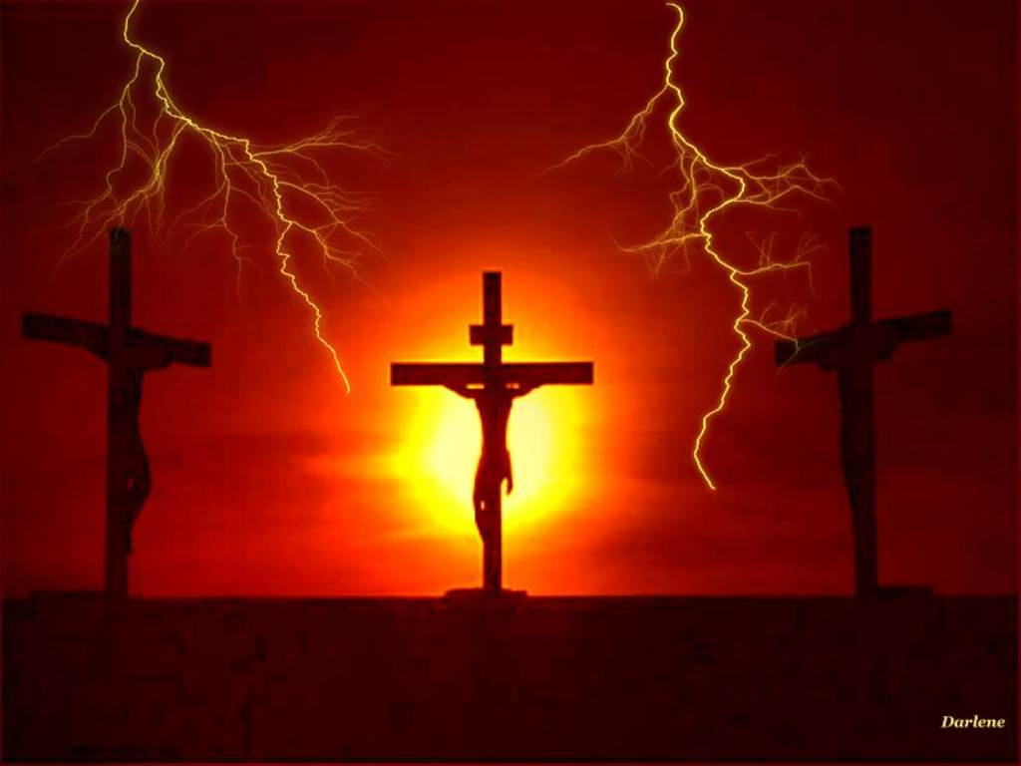
“For God hath not appointed us to wrath, but to obtain salvation by our Lord Jesus Christ.”
(I Thessalonians 5:9)

Slide 25
Revelation 8:13-9:1-21
“The Seven Trumpets”
(Continued)

Slide 26
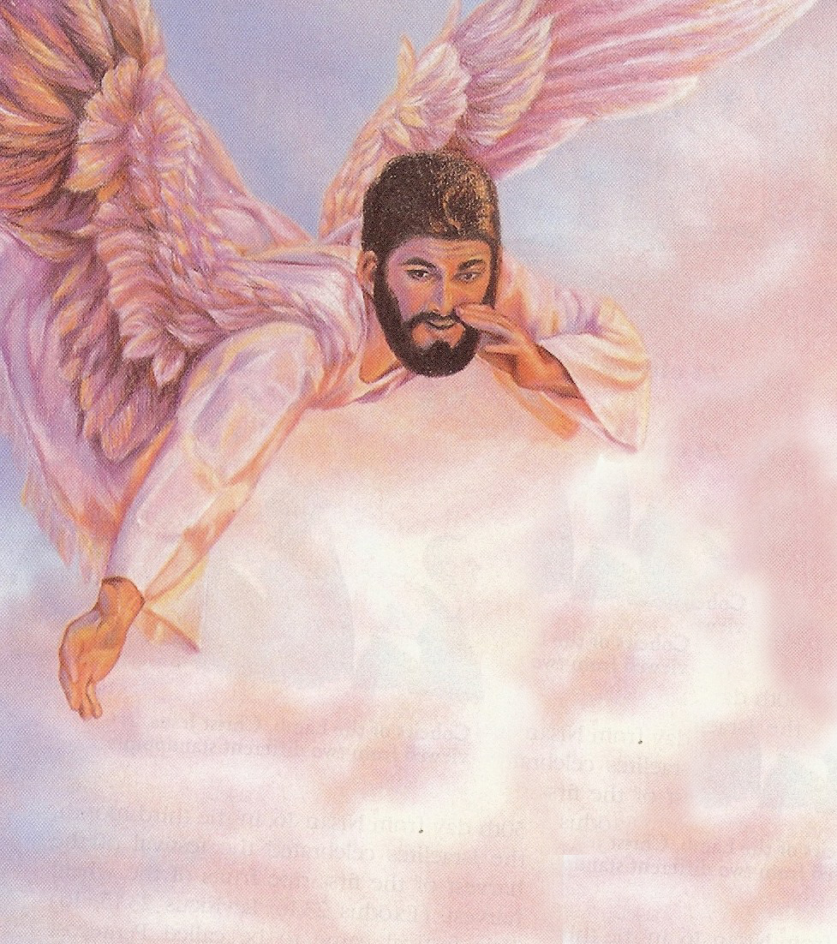
“And I beheld, and heard an angel flying through the midst of heaven, saying with a loud voice.”

Slide 27
“Woe, woe, woe, to the inhabiters of the earth by reason of the other voices of the trumpet of the three angels, which are yet to sound!”

Slide 28
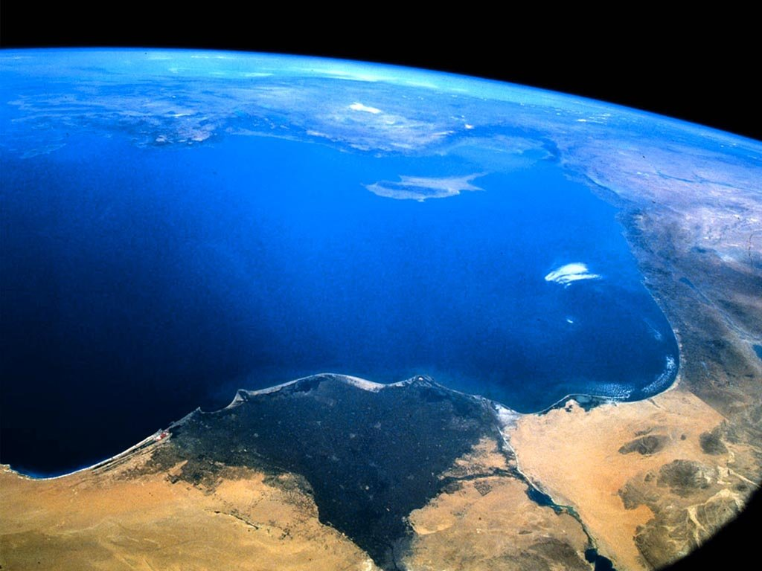
Revelation 9:1-11:19

Slide 29
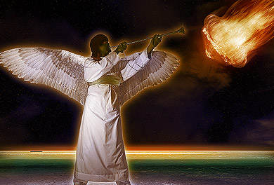
“And the fifth angel sounded, and I saw a star fall from heaven unto the earth: and to him was given the key of the bottomless pit.”

Slide 30
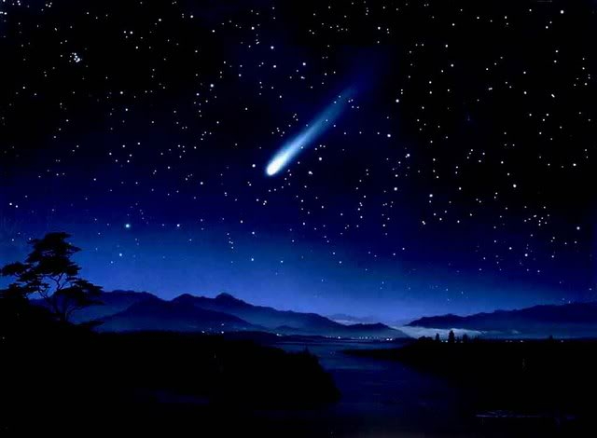
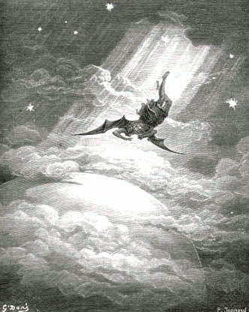

Jesus – “I beheld Satan as lightning fall from heaven.” (Luke 10:18)
Isaiah – “How art thou fallen from heaven, O Lucifer, son of the morning.” (Isaiah 14:12)

Slide 31


“And he opened the bottomless pit; and there arose a smoke out of the pit, as the smoke of a great furnace; and the sun and the air were darkened by reason of the smoke of the pit. And there came out of the smoke locusts upon the earth: and unto them was given power, as the scorpions of the earth have power.”

Slide 32
The Bottomless Pit
“The Abyss”
The place where demons dreaded to go – Luke 8:31
The place where angels which kept not their first estate, but left their own habitation are reserved in everlasting chains under darkness waiting the day of judgment – Jude 6
The location of the “pit” is in the “lower parts of the earth” – Ephesians 4:9

Slide 33


“For if God spared not the angels that sinned, but cast them down to hell (tartarus), and delivered them into chains of darkness, to be reserved unto judgment.”
(II Peter 2:4)

Slide 34


“And they shall be gathered together, as prisoners are gathered in the pit, and shall be shut up in the prison…” (Isa. 24:22)

Slide 35


“Cast him down to hell with them that descend into the pit.”
(Ezek. 31:16)

Slide 36




“For a fire is kindled in mine anger, and shall burn unto the lowest hell…They shall be burnt with hunger, and devoured with burning heat, and with bitter destruction: I will also send the teeth of beasts upon them, with the poison of serpents…” (Deut. 32)

Slide 37


After Christ’s death He descended into the lower parts of the earth and preached unto the spirits in prison
(I Peter 3:19)

Slide 38
Apollyon = Destroyer

Slide 39
“And the shapes of the locusts were like unto horses prepared unto battle; and on their heads were as it were crowns like gold, and their faces were as the faces of men. And they had hair as the hair of women, and their teeth were as the teeth of lions. And they had breastplates, as it were breastplates of iron; and the sound of their wings was as the sound of chariots of many horses running to battle.”

Slide 40

Horses prepared for battle – Ready to attack
Crowns of gold – Authority and power
Faces of men – Intelligence
Hair as the hair of women – Seduce and ensnare
Teeth as a lion – Fierce, cruel and devouring
Breastplates as of iron – Indestructible
Wings that sound like many chariots rushing to battle – Terrifying
Tails like a scorpion – Sting of extreme pain

Slide 41
“And there came out of the smoke locusts upon the earth: and unto them was given power, as the scorpions of the earth have power. And it was commanded them that they should not hurt the grass of the earth, neither any green thing, neither any tree; but only those men which have not the seal of God in their foreheads. And to them it was given that they should not kill them, but that they should be tormented five months: and their torment was as the torment of a scorpion, when he striketh a man.”

Slide 42




Slide 43
“And they had tails like unto scorpions, and there were stings in their tails: and their power was to hurt men five months. And they had a king over them, which is the angel of the bottomless pit, whose name in the Hebrew tongue is Abaddon, but in the Greek tongue hath his name Apollyon. One woe is past; and, behold, there come two woes more hereafter.”

Slide 44



Slide 45






Slide 46
“One woe is past; and, behold, there come two woes more hereafter.”

Slide 47

“And the sixth angel sounded, and I heard a voice from the four horns of the golden altar which is before God, Saying to the sixth angel which had the trumpet.”

Slide 48
“Loose the four angels which are bound in the great river Euphrates.”

Slide 49



Slide 50
Time of their judgment
(1 hour, 1 day, 1 month, 1 year)
The purpose of their judgment is to kill 1/3 of the population of the earth.

Slide 51

200 Million
“And the number of the army of the horsemen were two hundred thousand thousand: and I heard the number of them.”

Slide 52

“And thus I saw the horses in the vision, and them that sat on them, having breastplates of fire, and of jacinth, and brimstone: and the heads of the horses were as the heads of lions; and out of their mouths issued fire and smoke and brimstone.”
Breastplates – Protected and indestructible
Heads like lions – Furious and devouring
Mouth that spits fire – Full of wrath and furry
Tails like serpents – Poisonous strikes and deadly wounds
“Their power is in their mouth and in their tails...”

Slide 53
“By these three was the third part of men killed, by the fire, and by the smoke, and by the brimstone, which issued out of their mouths. For their power is in their mouth, and in their tails: for their tails were like unto serpents, and had heads, and with them they do hurt.”

Slide 54


Slide 55


Slide 56


Slide 57

Prepared for an hour, and a day, and a month, and a year = 397 days and 1 hour
Kill 1/3 part of men
The 6th trumpet, combined with the 4th seal (6:8) has now reduced the population of the earth to over ½ of its pre-tribulation level.

Slide 58








Slide 59
“And the rest of the men which were not killed by these plagues yet repented not of the works of their hands, that they should not worship devils, and idols of gold, and silver, and brass, and stone, and of wood: which neither can see, nor hear, nor walk: Neither repented they of their murders, nor of their sorceries, nor of their fornication, nor of their thefts.”

Slide 60








Slide 61





Slide 62

“Knowing the time; that now it is high time to awake out of sleep: for now is our salvation nearer than when we believed. The night is far spent, the day is at hand: let us therefore cast off the works of darkness, and let us put on the armor of light.
Notes:
Ting a

Slide 63



Let us walk honestly, as in the day; not in rioting and drunkenness, not in chambering and wantonness, not in strife and envying. But put ye on the Lord Jesus Christ, and make not provision for the flesh, to fulfill the lusts thereof.”
(Romans 13:11-14)

Slide 64




“Whereas ye know not what shall be on the morrow. For what is your life? It is even a vapor, that appeareth for a little time, and then vanisheth away.” (James 4:14)

Slide 65

“Therefore be ye also ready: for in such an hour as ye think not the Son
of man cometh.”
(Matthew 24:44)

Slide 66

“And every man that hath this hope in him purifieth himself, even as he is pure.”
(I John 3:3)

Slide 67


