Slide 1

The Revelation of Jesus Christ
A study of the book
of Revelation

Slide 2

Revelation 17:1-19:10
“The Apostate Church”
“The Great Whore”
(Part 1)

Slide 3
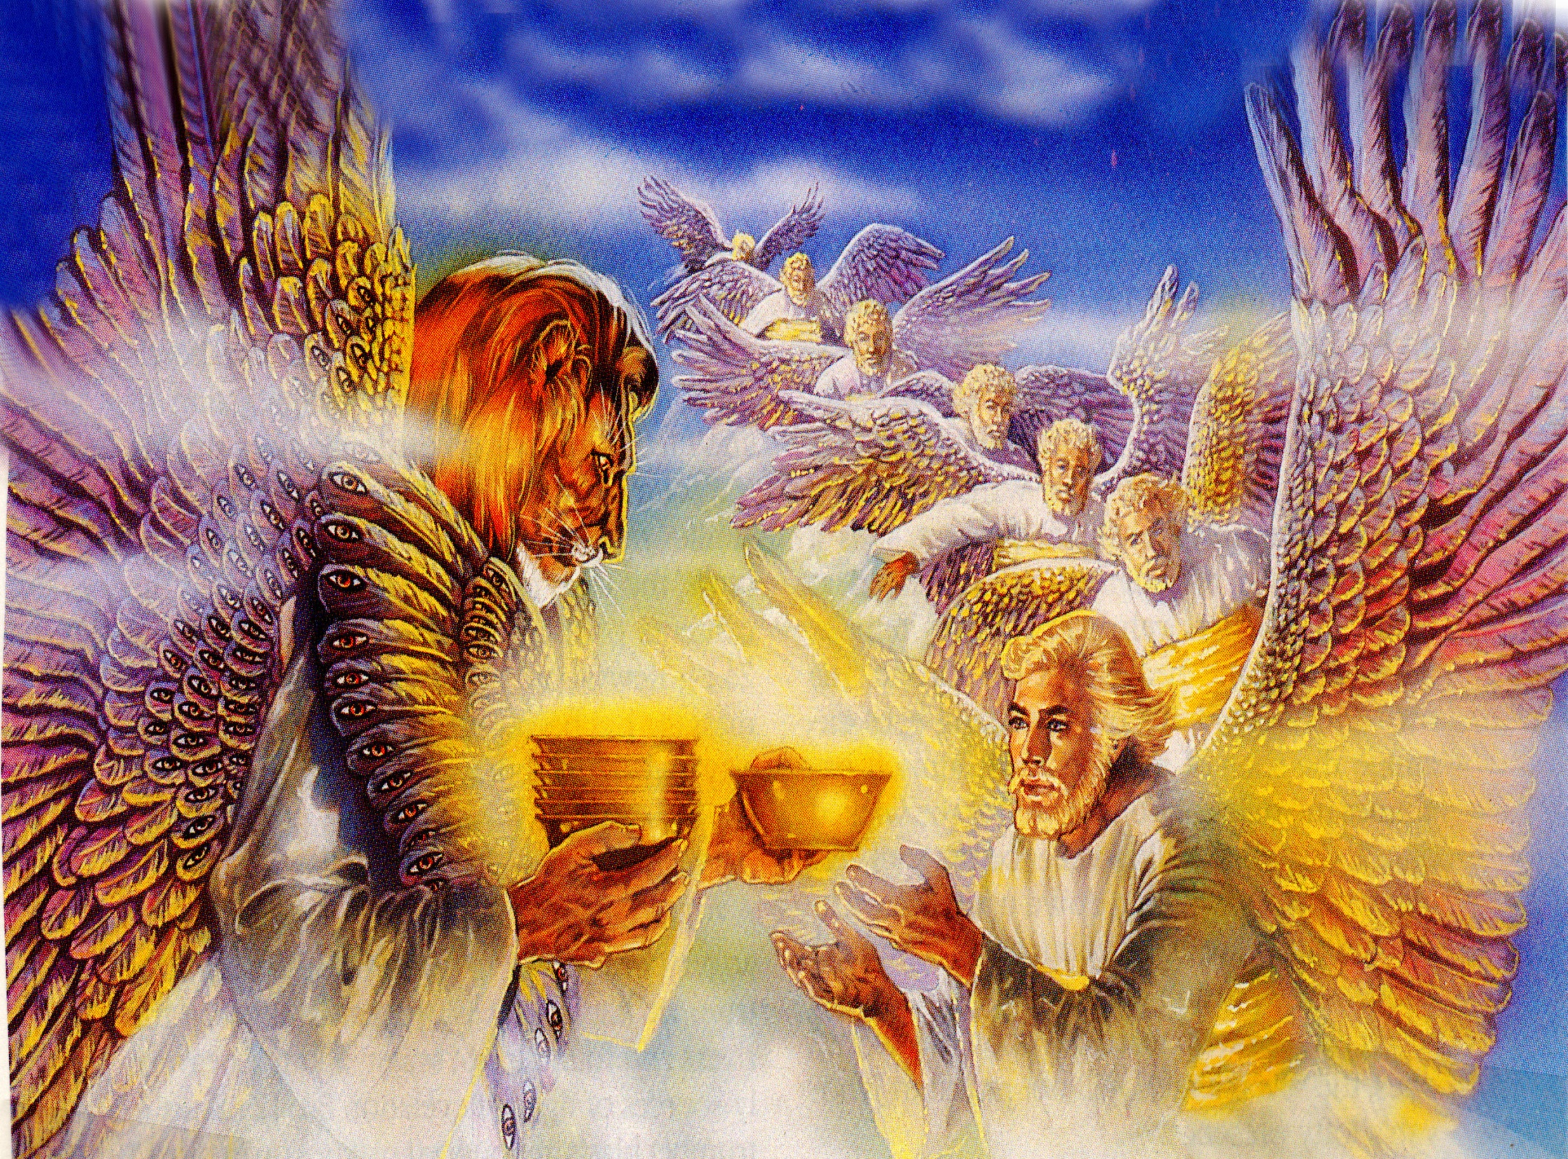
“And there came one of the seven angels (seraphim’s Rev. 4:6-9) which had the seven vials, and talked with me, saying unto me, Come hither; I will shew unto thee the judgment of the great whore that sitteth upon many waters.”

Slide 4
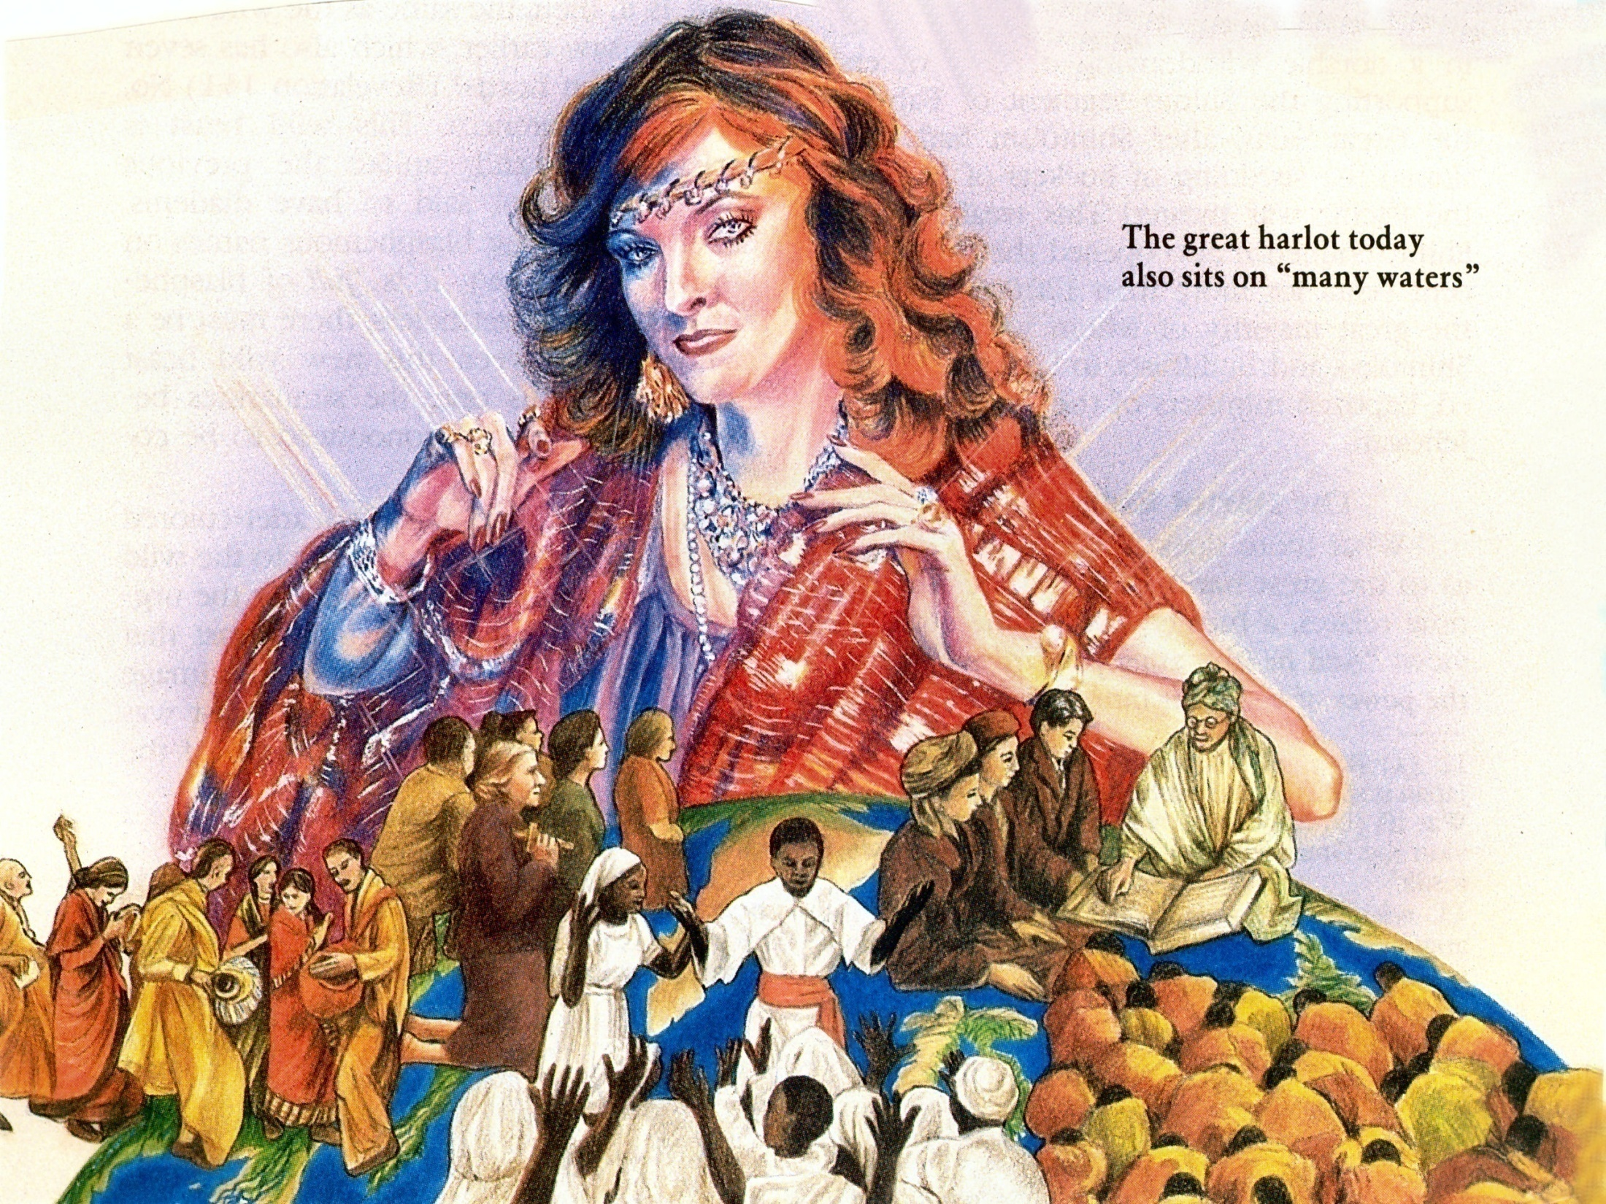
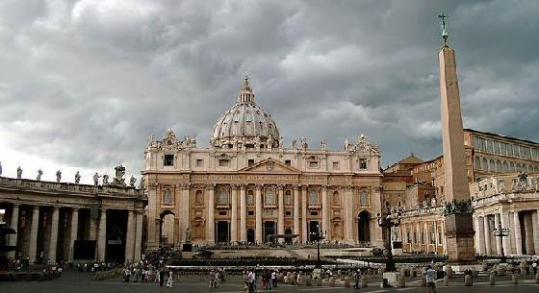
“And he said unto me, the waters which thou sawest, where the whore sitteth, are peoples, and multitudes, and nations and tongues.” (Revelation 17:15)
Catholic = Universal

Slide 5
“With whom the kings of the earth have committed fornication…”

Slide 6
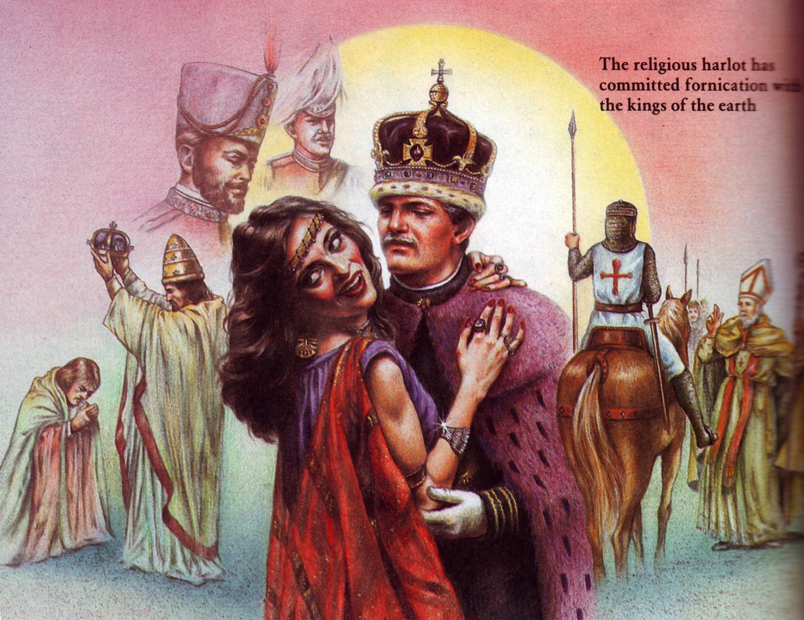
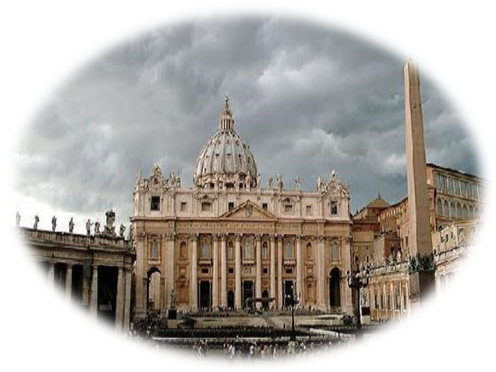

Slide 7
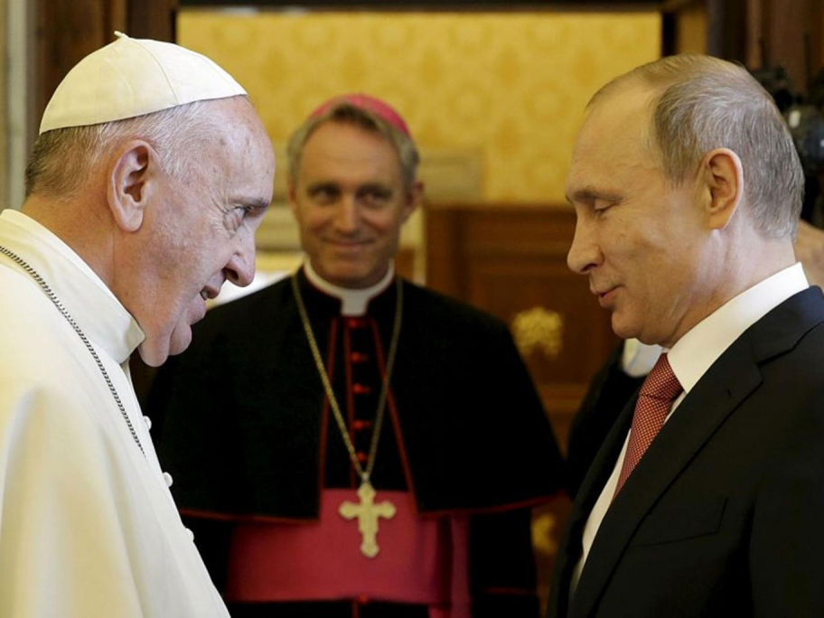
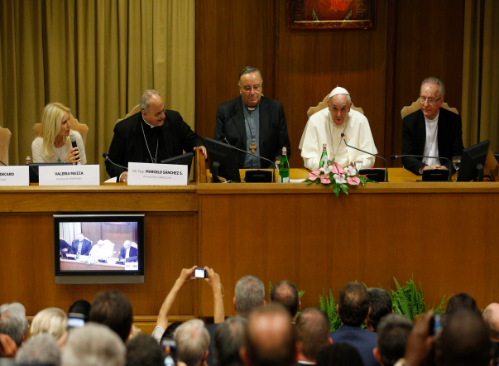
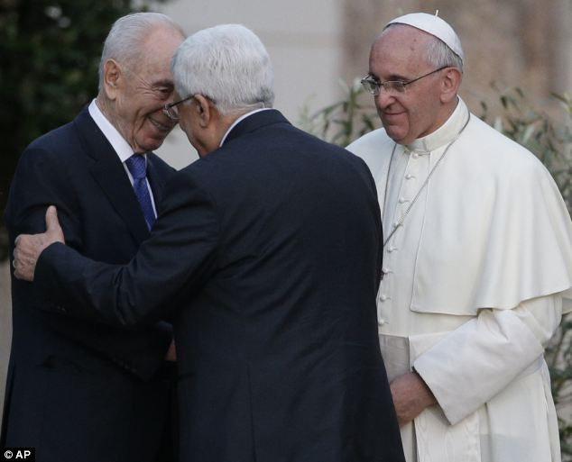
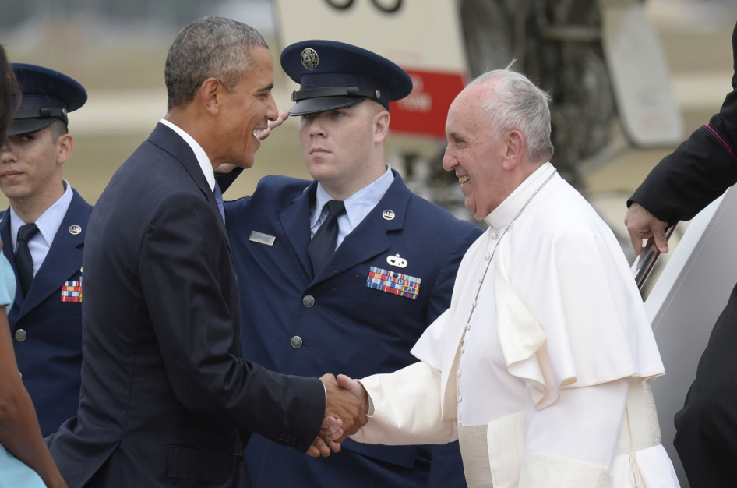
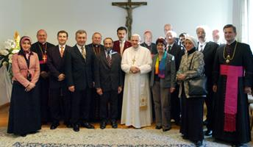
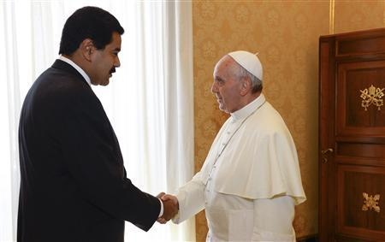
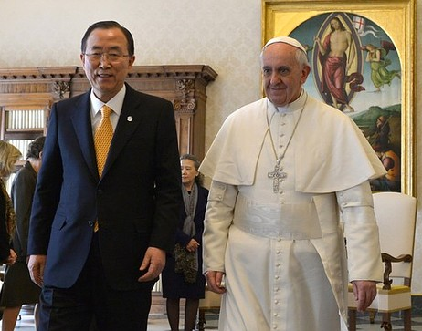
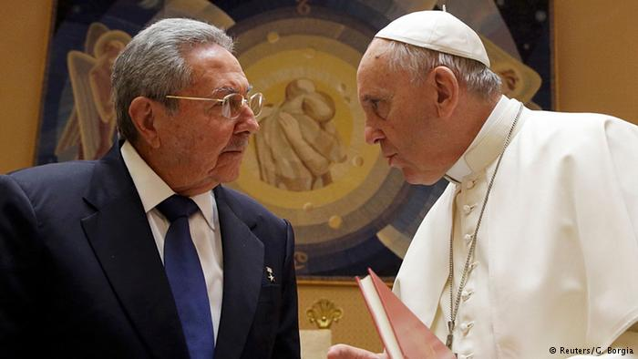
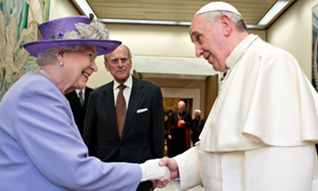
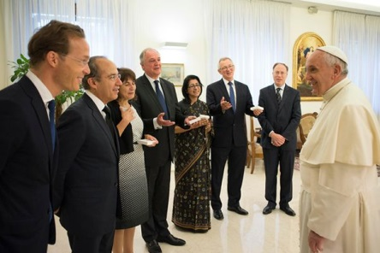

Slide 8
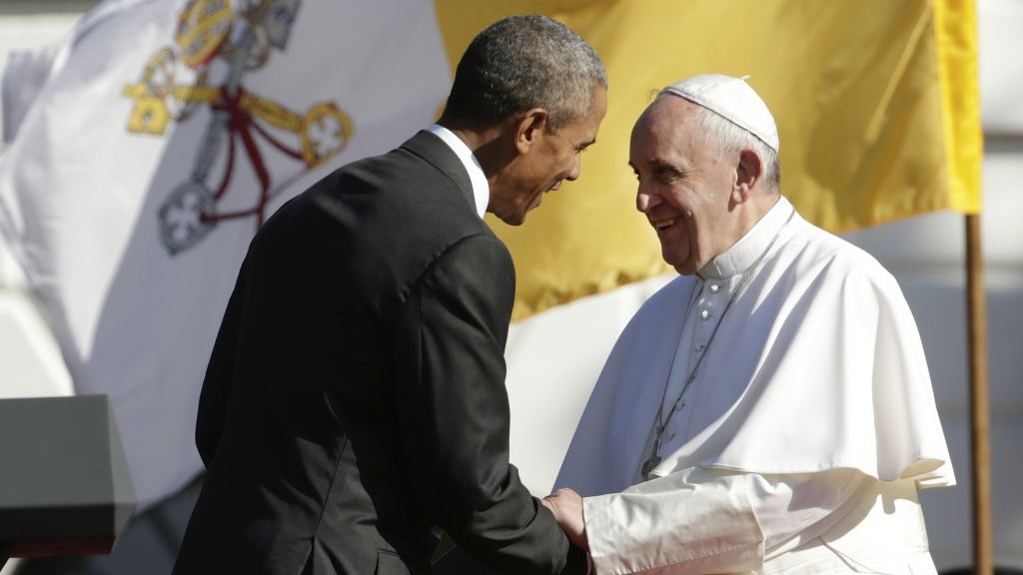

Slide 9
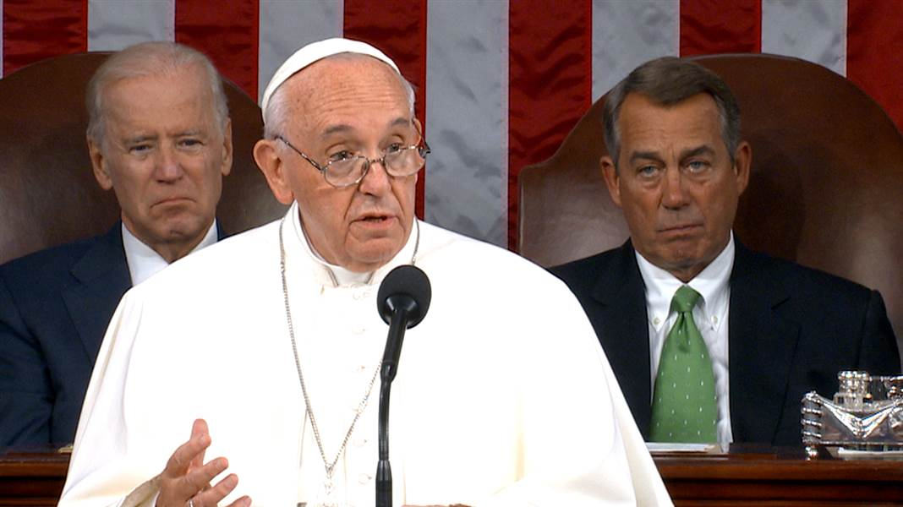

Slide 10
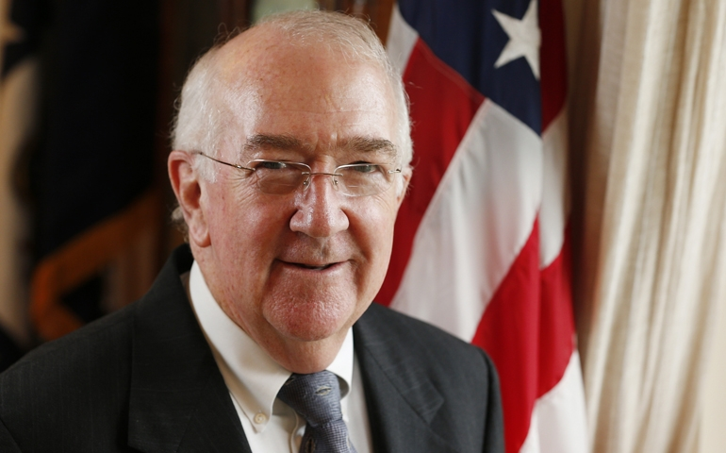
U.S. Ambassador to the Holy See. Ambassador Ken Hackett was nominated by President Barack Obama on June 14, 2013 to serve as the U.S. Ambassador to the Holy See.

Slide 11
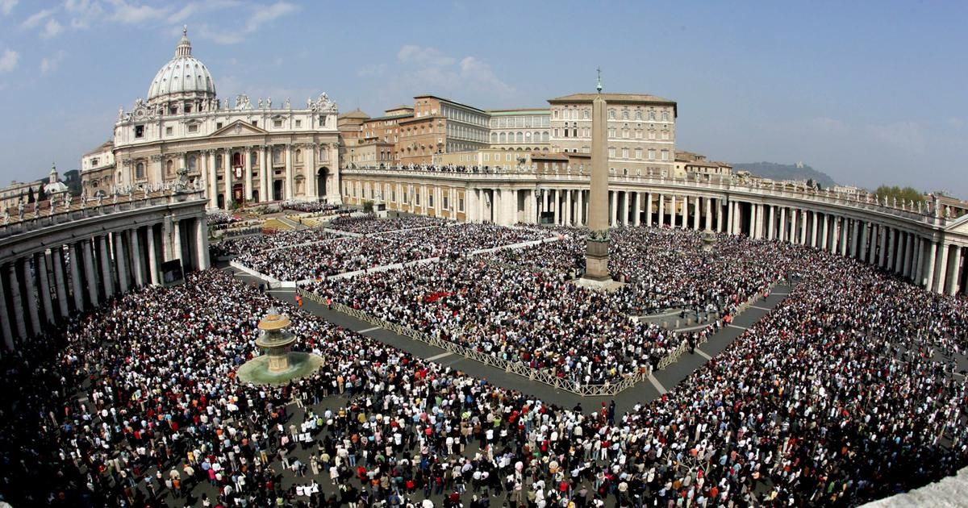
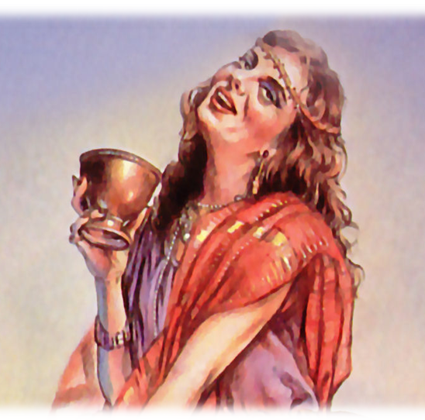
“…and the inhabitants of the earth have been made drunk with the wine of her fornication.”

Slide 12
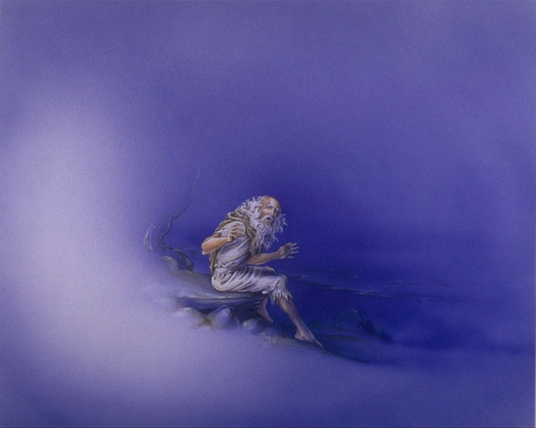
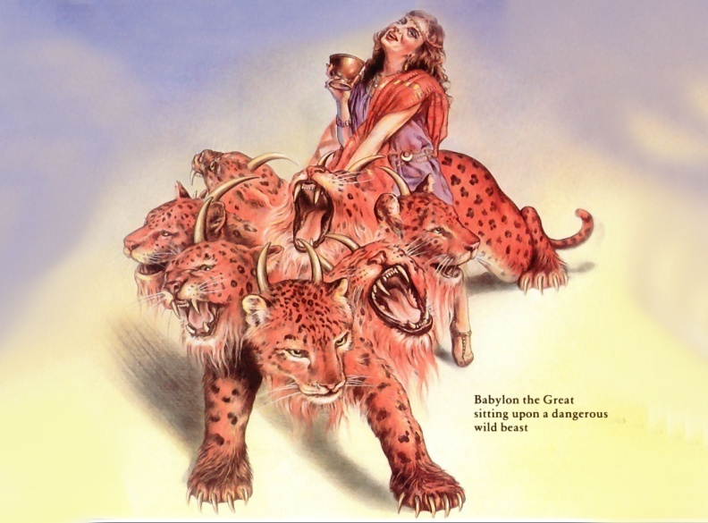
“So he carried me away in the spirit into the wilderness: and I saw a woman sit upon a scarlet coloured beast, full of names of blasphemy, having seven heads
and ten horns.”

Slide 13

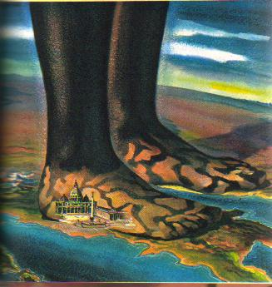
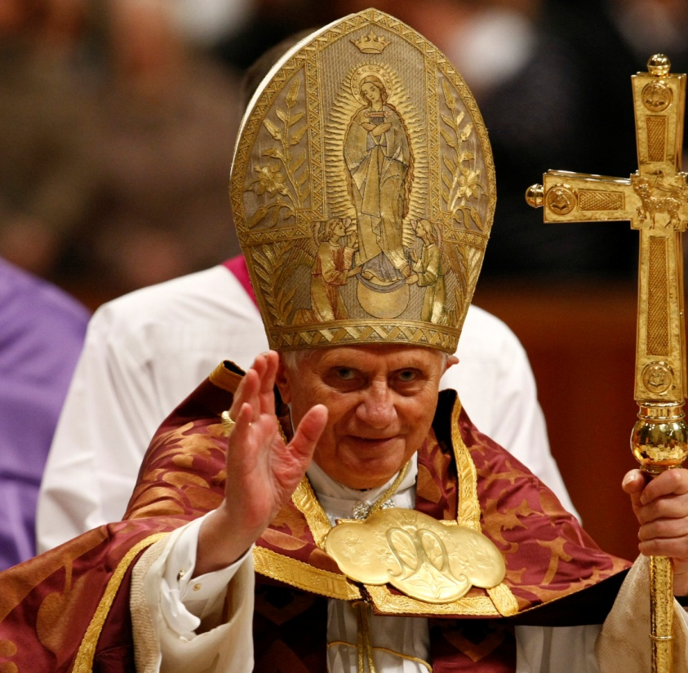
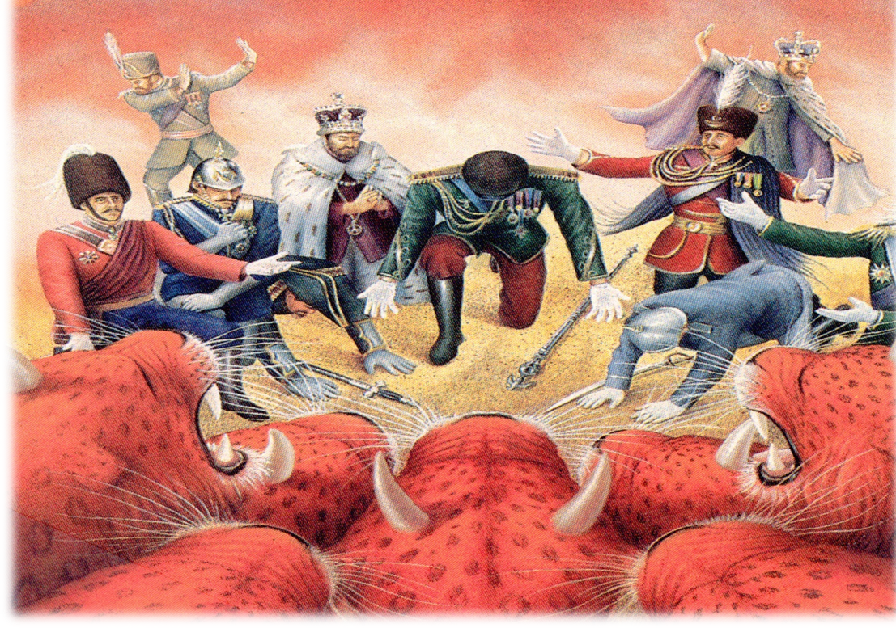
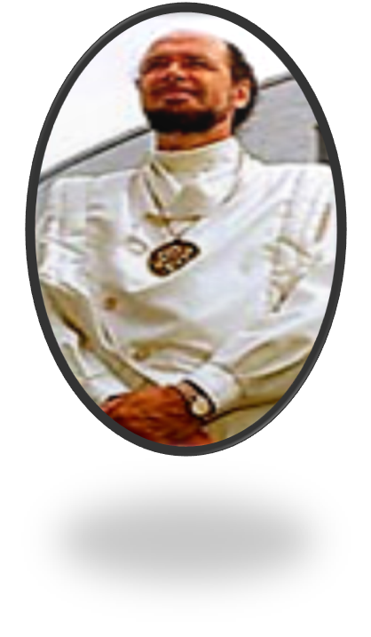
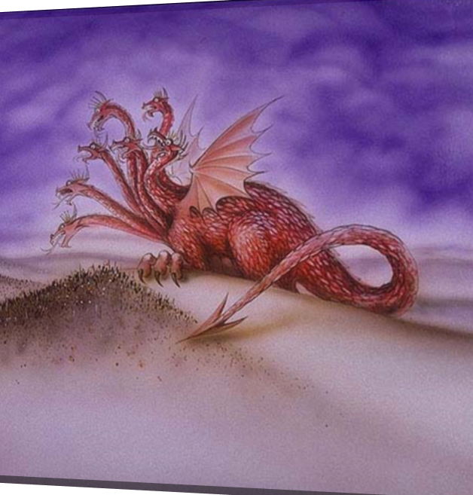

Slide 14
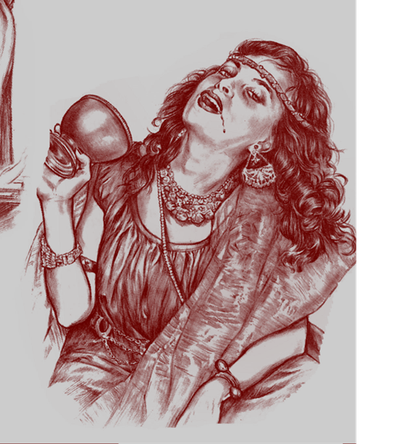
“And I saw the woman drunken with the blood of the saints, and with the blood of the martyrs of Jesus: and when I saw her, I wondered with great admiration.”

Slide 15
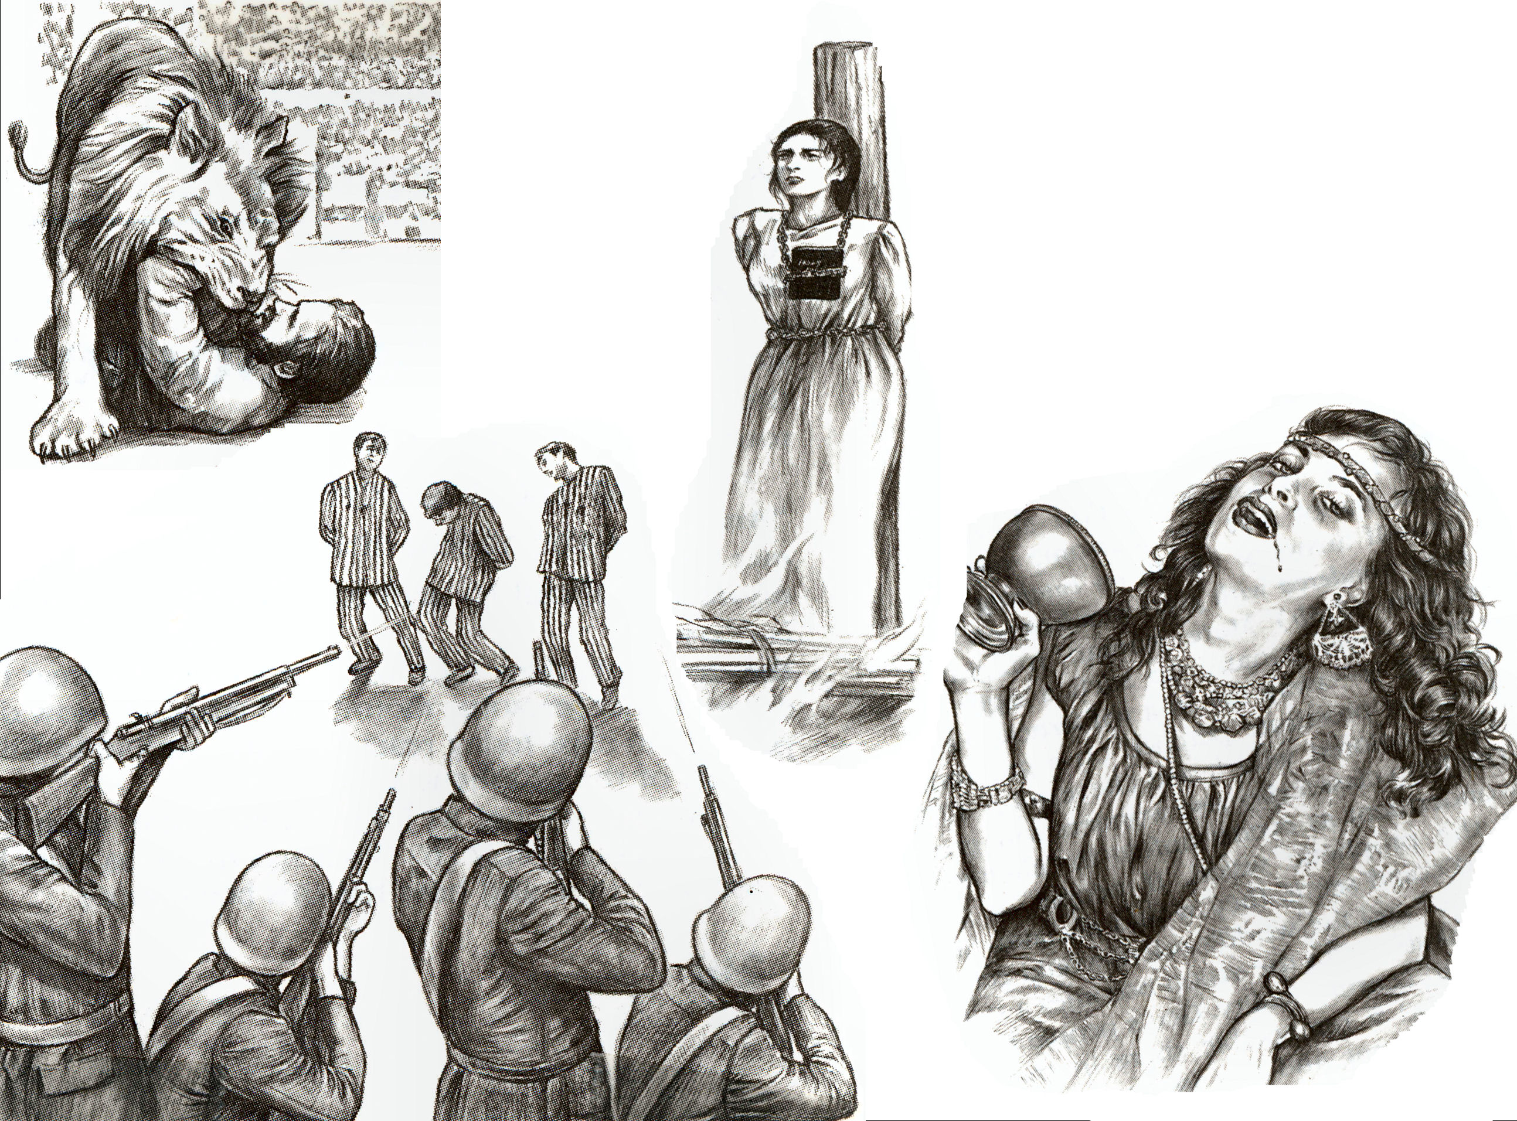

Slide 16
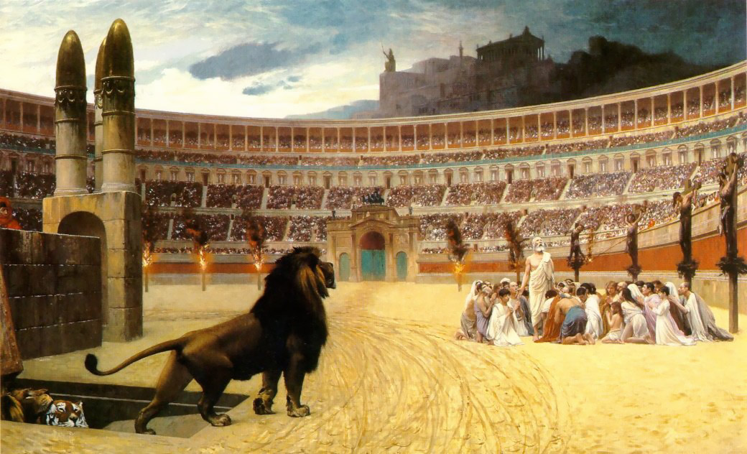
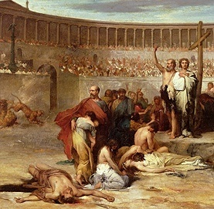
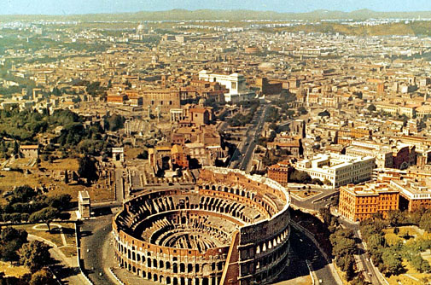
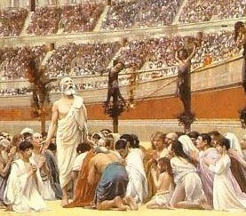

Slide 17
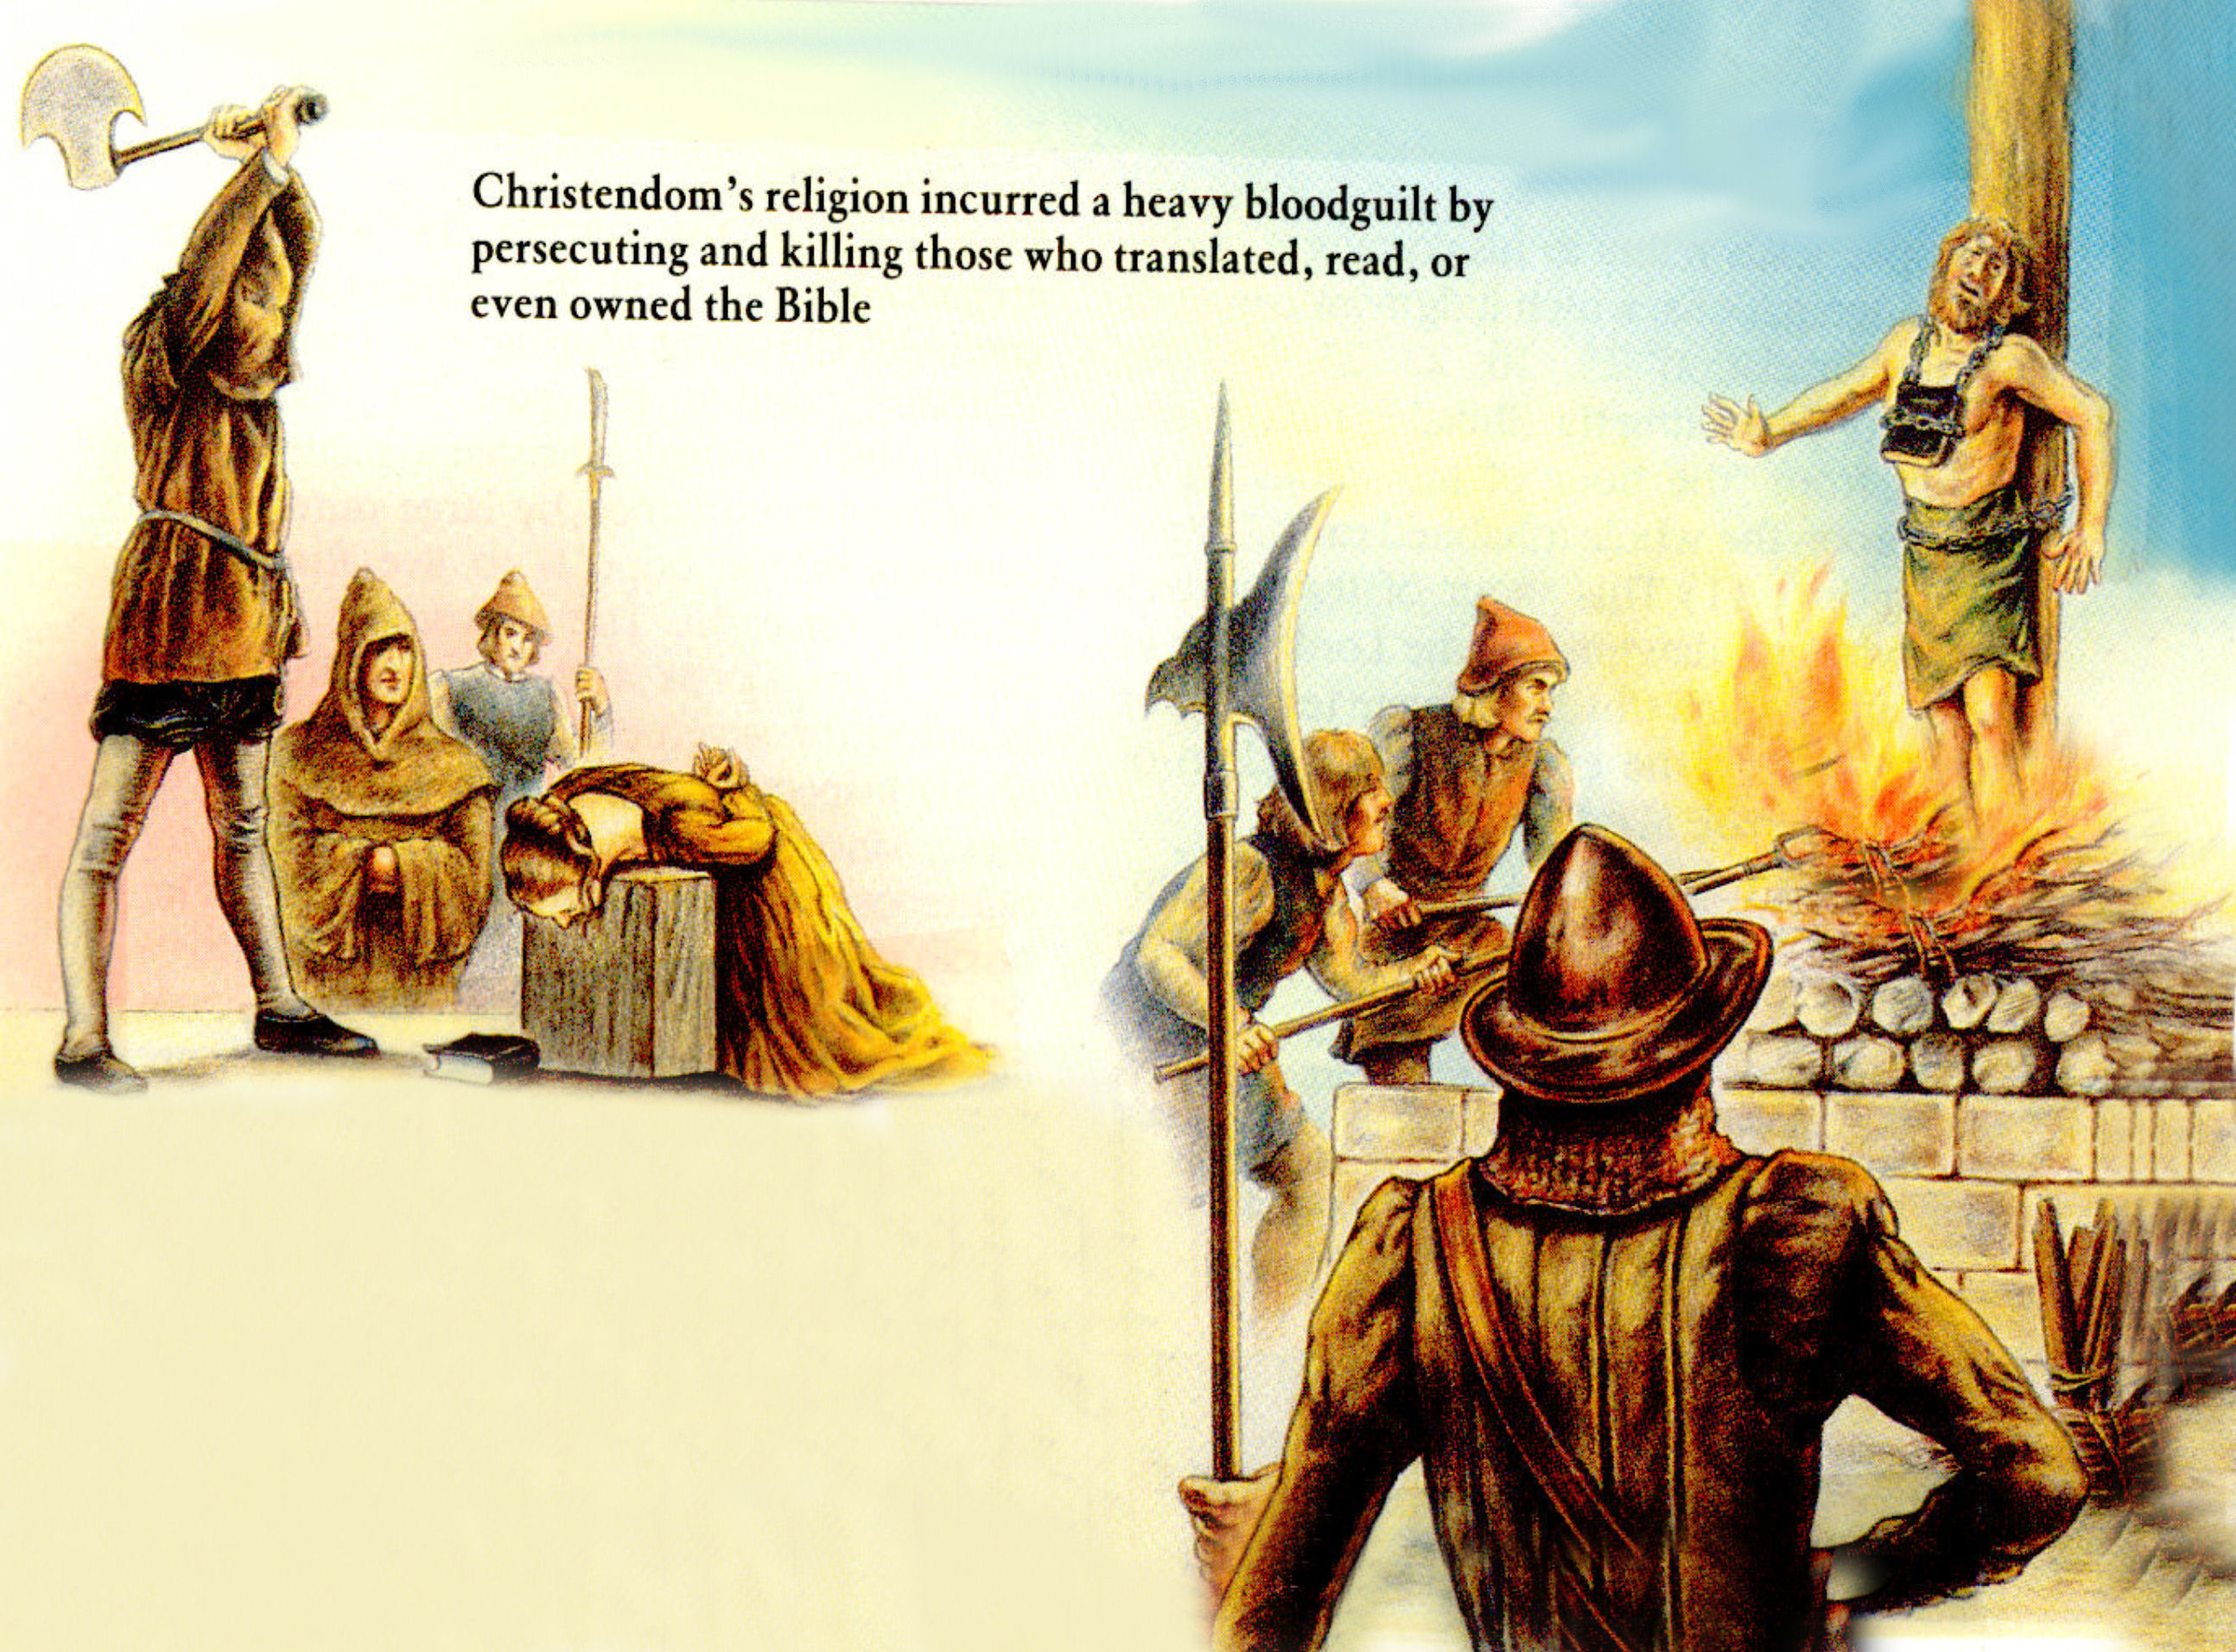
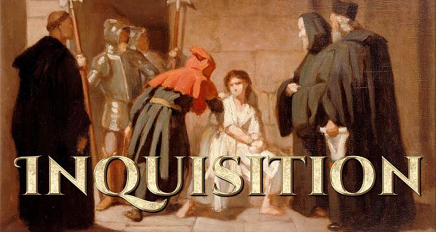

Slide 18
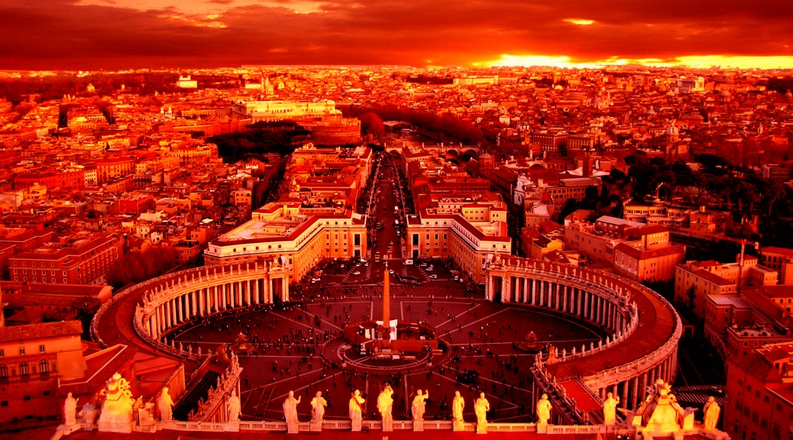
“And the woman was arrayed in purple and scarlet colour, and decked with gold and precious stones and pearls; having a golden cup in her hand full of abominations and filthiness of her fornication.”

Slide 19
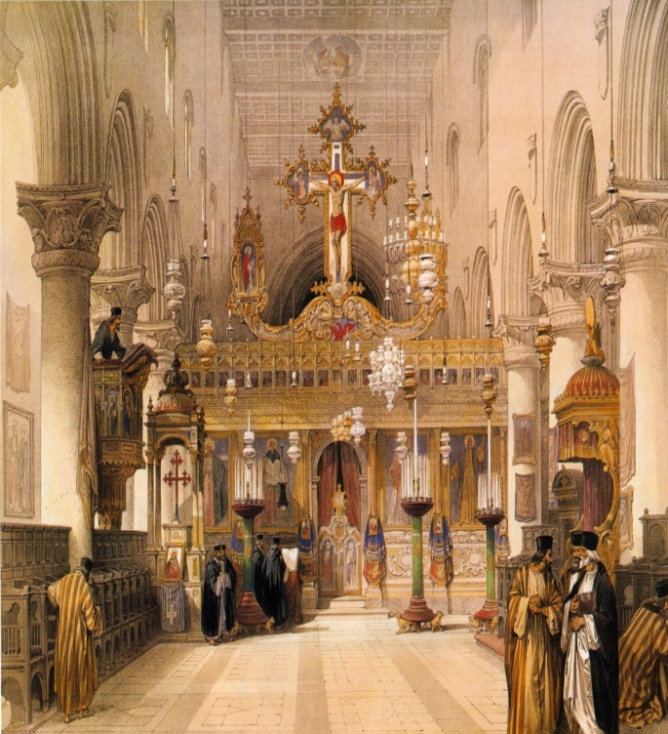
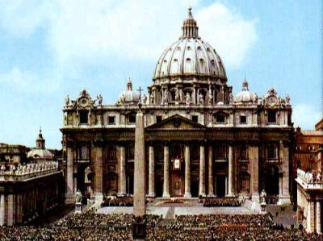
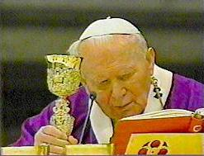
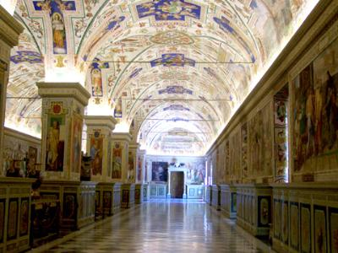
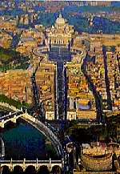
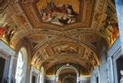

Slide 20
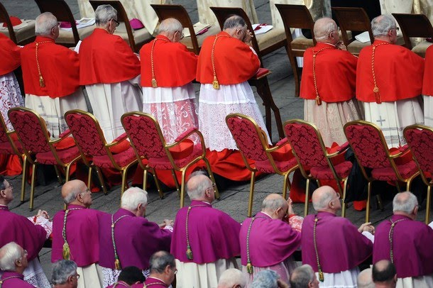
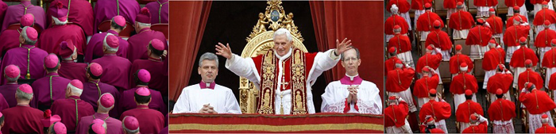
“And the woman was arrayed in purple and scarlet colour.”

Slide 21
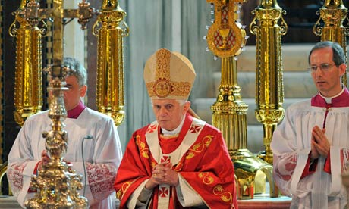
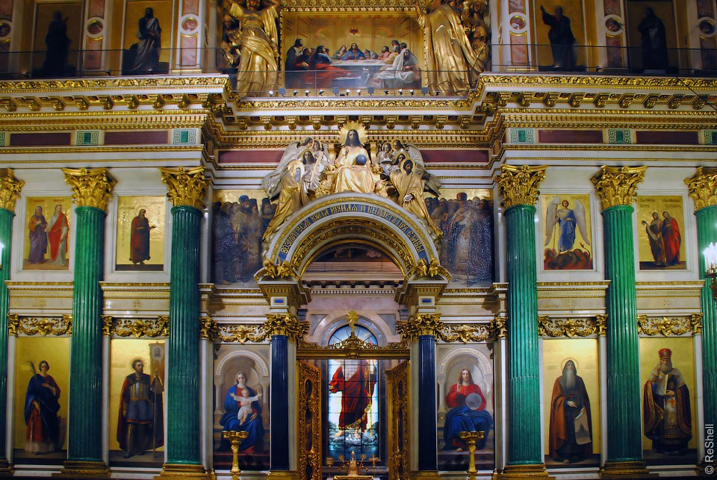
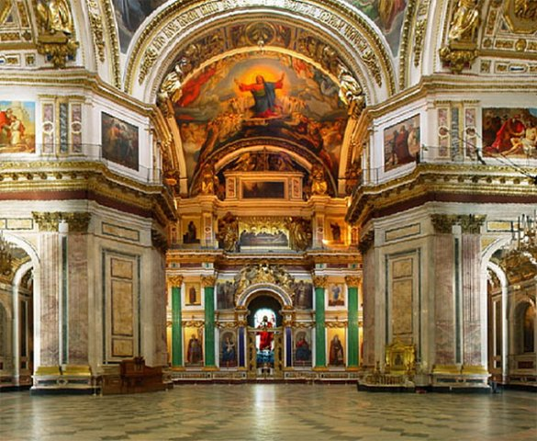
“And decked with gold and precious stones and pearls.”

Slide 22
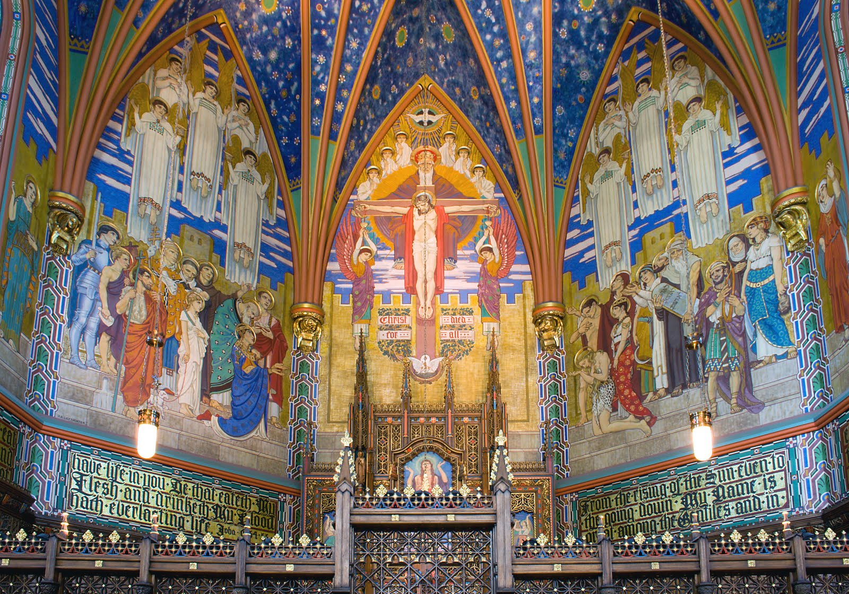

Slide 23
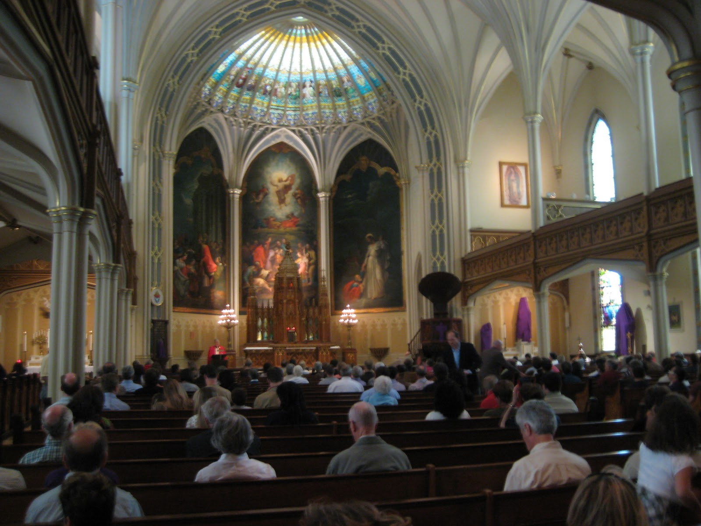

Slide 24
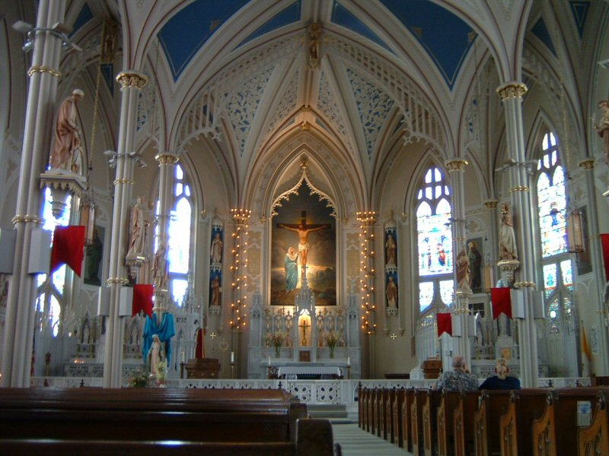

Slide 25

“…having a golden cup in her hand full of abominations and filthiness of her fornication.”

Slide 26








Slide 27


“Mystery, Babylon the Great”
.

Slide 28


Slide 29



Nimrod And The Tower Of Babel

Slide 30

Nimrod and the Tower of Babel
(Genesis 10-11)
Nimrod was the great grandson of Noah, the grandson of Ham, the son of Cush
Powerful leader – “Mighty in the earth…”
Mighty hunter
Builder – “From that land (Babylon) he went to Assyria and built Nineveh…”
Visionary – “Desired to expand his empire.” (Genesis 10:10-11)

Slide 31
The whole earth had one language
The people lived together as a whole civilization (communal living leads to sinful behavior)
Under the leadership of Nimrod the people built a city and tower – Fame, power, unity, security, one great world empire
A tower was built for religious worship – One world religion
The tower represented – A stairway to heaven (built by their own effort, works, man-made)
Symbol of false religion

Slide 32



Slide 33


Semiramis – Queen of Heaven Semiramis - Mother of God

Slide 34


Slide 35
When Shem came into power, he made a terrible example of the black apostate. Shem had Nimrod's body cut to pieces, and had the pieces sent out over the world as a grim warning to those who would defy the GOD of Heaven. Nimrod's death was one of the most violent ever suffered by man. After Nimrod's death (c. 2167 BC), Semiramis promoted the belief that he was a god. Semiramis bore a son, Horus. She declared that she had been visited by the spirit of Nimrod, who left her pregnant with the boy. Horus, she maintained, was Nimrod reincarnated.

Slide 36






“Worship of a Mother/Child goddess”

Slide 37







Cross as a religious symbol in worship

Slide 38

Unmarried Priesthood

Slide 39


The use of prayer beads

Slide 40



Worship of the dead

Slide 41



Infallible Priesthood

Slide 42







The Worship of a
High Priest

Slide 43






Images used in worship
(Idols)

Slide 44






Use of pagan symbols in worship

Slide 45







Slide 46


Slide 47


Obelisk in front of Saint Peter's Basilica

Slide 48




Spiritism
Praying to the dead

Slide 49









Torture of Heretics
“Drunk with the blood of the saints.”
Torture of Heretics

Slide 50


“And the angel said unto me, Wherefore didst thou marvel? I will tell thee the mystery of the woman, and of the beast that carrieth her, which hath the seven heads and ten horns.”

Slide 51


Slide 52

Revelation 17:9
“And here is the mind which hath wisdom. The seven heads are the seven mountains (Rome is the only city in the world that is designated as “The lofty city of seven hills)
…on which the woman (harlot = false apostate church = Roman Catholic Church)
…sitteth (reigns as queen).” – Revelation 17: 18-19

Slide 53


Revelation 17:9

Slide 54

“Seven mountains, on which the woman (whore / false church) sitteth…”
Mountain (Greek – oros) = To rise or lift above itself above the plain, a hill.

Slide 55


Slide 56

Next Session
“The Destruction of the Great Whore”

Slide 57
The Revelation of Jesus Christ
A study of the book
of Revelation

Slide 58
Revelation 17:1-19:10
“The Apostate Church”
“The Great Whore”
(Part 2)

Slide 59

MYSTERY, BABYLON THE GREAT, THE MOTHER OF HARLOTS AND ABOMINATIONS OF THE EARTH

Slide 60
(Revelation 17:15)
“And he saith unto me, The waters which thou sawest, where the whore sitteth, are peoples, and multitudes, and nations, and tongues.”

Slide 61





Revelation 17:15

Slide 62

Revelation 17:16-18

Slide 63

“And the ten horns which thou sawest upon the beast, these shall hate the whore, and shall make her desolate and naked, and shall eat her flesh, and burn her with fire. For God hath put in their hearts to fulfill his will, and to agree, and give their kingdom unto the beast, until the words of God shall be fulfilled. And the woman which thou sawest is that great city, which reigneth over the kings of the earth.”

Slide 64

“And the ten horns which thou sawest upon the beast, these shall hate the whore, and shall make her desolate and naked…”

Slide 65


“…and burn her with fire. For God hath put in their hearts to fulfill his will.”

Slide 66

“For God hath put in their hearts to fulfill his will.”

Slide 67

(Revelation 18:1)
“And after these things I saw another angel come down from heaven, having great power; and the earth was lightened with his glory.”

Slide 68


“I saw an angel having great power… and he cried mightily with a strong voice, saying…”

Slide 69


“Babylon the great is fallen…”

Slide 70






“…the habitation of devils, and every foul spirit…”

Slide 71


“For all nations have drunk of the wine of the wrath of her fornication.”

Slide 72








“The kings of the earth have committed fornication with her…”

Slide 74












“The merchants of the earth are waxed rich through the abundance of her delicacies…”

Slide 75


The Vatican bank sees its future, and it's all about managing money

Slide 76


“Come out of her, my people, that ye be not partakers of her sins…”

Slide 77

“And I heard another voice from heaven saying, come out of her my people…” (Revelation 18:4)
“Mark them which cause divisions and offenses contrary to the doctrine which ye have learned; and avoid them.”
“Be not ye therefore partakers with them.”
“Come out from among them and be ye separate saith the Lord.”
“Have no fellowship with the unfruitful works of darkness.”

Slide 78


“Her sins have reached unto heaven…”

Slide 79



Revelation 18:6-9

Slide 80


“Reward her even as she rewarded you, and double unto her double according to her works: in the cup which she hath filled fill to her double.”

Slide 81

“How much she hath glorified herself, and lived deliciously, so much torment and sorrow give her: for she saith in her heart, I sit a queen, and am no widow, and shall see no sorrow.”

Slide 82

“Therefore shall her plagues come in one day, death, and mourning, and famine; and she shall be utterly burned with fire: for strong is the Lord God who judgeth her.”

Slide 83

“And the kings of the earth, who have committed fornication and lived deliciously with her, shall bewail her, and lament for her, when they shall see the smoke of her burning.”

Slide 84





“Standing afar off for the fear of her torment, saying, Alas, alas, that great city Babylon, that mighty city! for in one hour is thy judgment come. And the merchants of the earth shall weep and mourn over her; for no man buyeth their merchandise any more: And the merchants of the earth shall weep and mourn over her…”

Slide 85
“And saying, Alas, alas, that great city, that was clothed in fine linen, and purple, and scarlet, and decked with gold, and precious stones, and pearls! For in one hour so great riches is come to nought. And every shipmaster, and all the company in ships, and sailors, and as many as trade by sea, stood afar off,

Slide 86


“And cried when they saw the smoke of her burning, saying, What city is like unto this great city! And they cast dust on their heads, and cried, weeping and wailing, saying, Alas, alas, that great city, wherein were made rich all that had ships in the sea by reason of her costliness! for in one hour is she made desolate.”

Slide 87

“Rejoice over her, thou heaven, and ye holy apostles and prophets; for God hath avenged you on her.”
Heaven rejoices over the judgment of the whore

Slide 88

“And a mighty angel took up a stone like a great millstone, and cast it into the sea, saying, Thus with violence shall that great city Babylon be thrown down, and shall be found no more at all.”

Slide 89





“And the voice of harpers, and musicians, and of pipers, and trumpeters, shall be heard no more at all in thee.”

Slide 90








“No craftsman, of whatsoever craft he be, shall be found any more in thee…”

Slide 91


Slide 92


Slide 93





Slide 94





Slide 95



“The light of a candle shall shine no more at all in thee…”

Slide 96



“The voice of the bridegroom and of the bride shall be heard no more at all in thee…”

Slide 97


“For by thy sorceries were all nations deceived.”

Slide 98


“In her was found the blood of the prophets, and of saints, and of all that were slain upon the earth.”

Slide 99






Slide 100

(Revelation 19:1-3)
“And after these things I heard a great voice of much people in heaven, saying, Alleluia; Salvation, and glory, and honour, and power, unto the Lord our God.”

Slide 101


“True and righteousness are thy judgments: for he hath judged the great whore, which did corrupt the earth…”

Slide 102


“And her smoke rose up forever and ever…”

Slide 103


(Revelation 19:4)
“And the four and twenty elders and the four beasts fell down and worshipped God that sat on the throne, saying, Amen; Alleluia.”

Slide 104

“Praise our God, all ye His servants…”

Slide 105


“And I heard as it were the voice of a great multitude, and as the voice of many waters…saying, Alleluia: for the Lord God omnipotent reigneth. Let us rejoice and be glad…”
(Revelation 19:6-7)

Slide 106

“And I heard as it were the voice of a great multitude…as the voice of mighty thunderings, saying, Alleluia: for the Lord God omnipotent reigneth. Let us rejoice and be glad…”
(Revelation 19:6-7)

Slide 107

“And to her was granted that she should be arrayed in fine linen, clean and white: for the fine linen is the righteousness of saints.”

Slide 108


Slide 109


“And he saith unto me, Write, Blessed are they which are called unto the marriage supper of the Lamb. And he saith unto me, These are the true sayings of God.”

Slide 110


Slide 111

“Whosoever will my come…”

Slide 112

“And I fell at his feet to worship him.”

Slide 113

“And he said unto me, See thou do it not: I am thy fellowservant, and of thy brethren that have the testimony of Jesus: worship God: for the testimony of Jesus is the spirit of prophecy.”

