Slide 1

The Revelation of Jesus Christ
A study of the book
of Revelation

Slide 2

Revelation 17:1-19:10
“The Apostate Church”
“The Great Whore”
(Part 2)

Slide 3


Slide 4
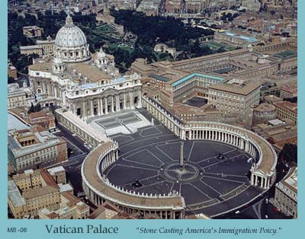
The Apostate Church
“The identity of the great whore”
Revelation 17:1-19:10

Slide 5
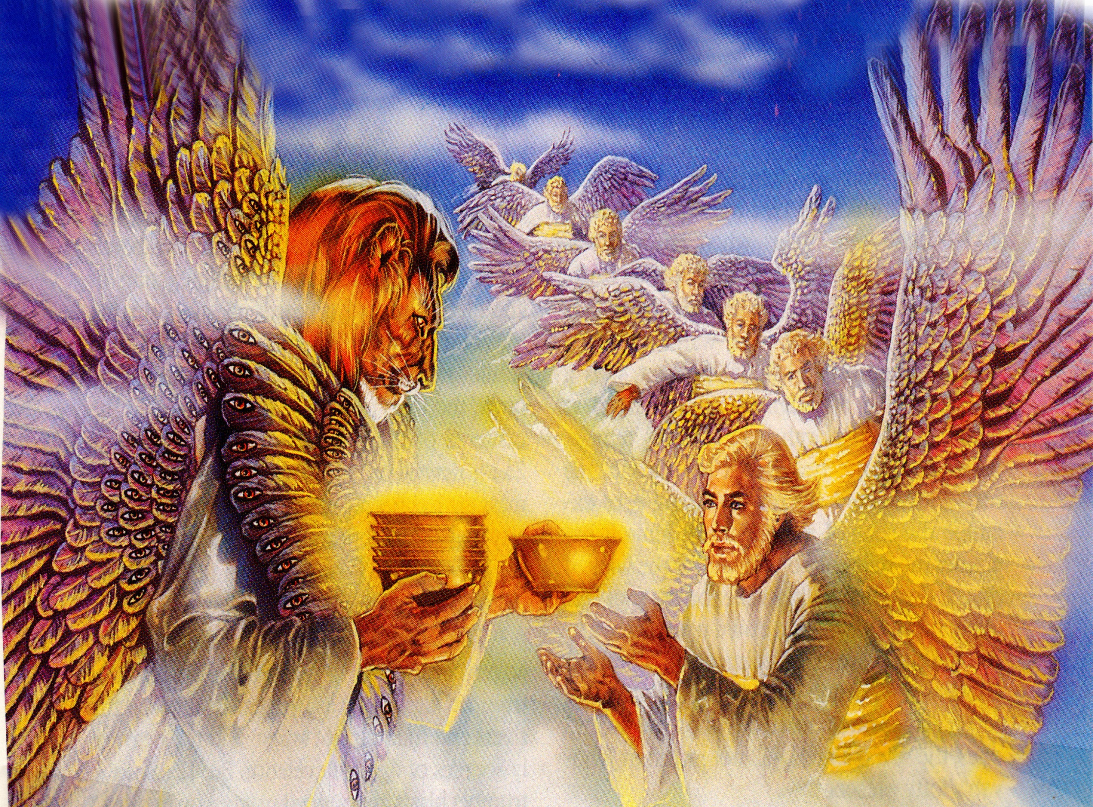
“And there came one of the seven angels (seraphim’s Rev. 4:6-9) which had the seven vials, and talked with me, saying unto me, Come hither; I will shew unto thee the judgment of the great whore that sitteth upon many waters.”

Slide 6
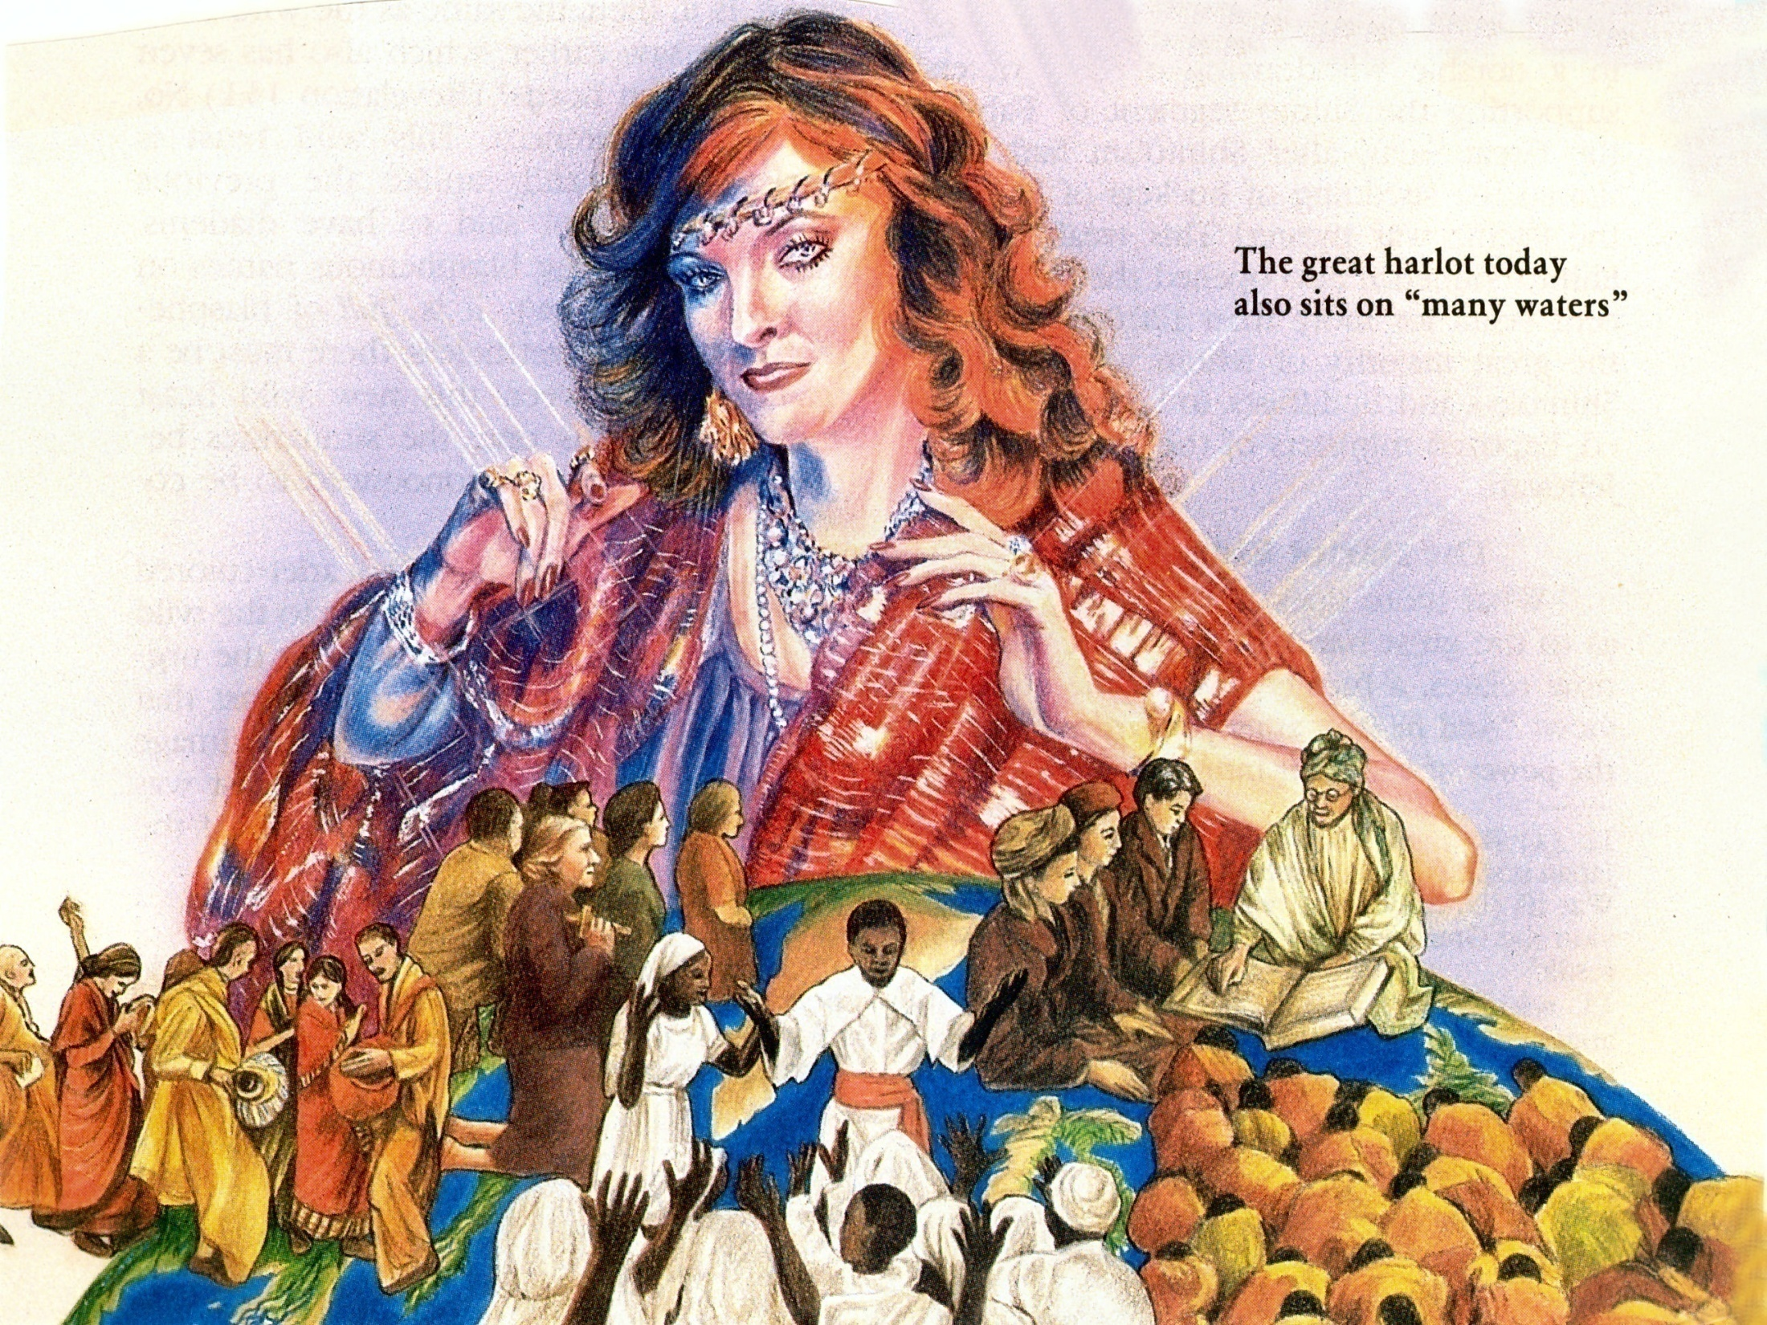
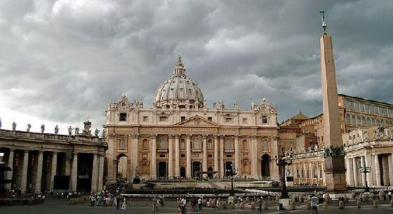
“And he said unto me, the waters which thou sawest, where the whore sitteth, are peoples, and multitudes, and nations and tongues.” (Revelation 17:15)
Catholic = Universal

Slide 7
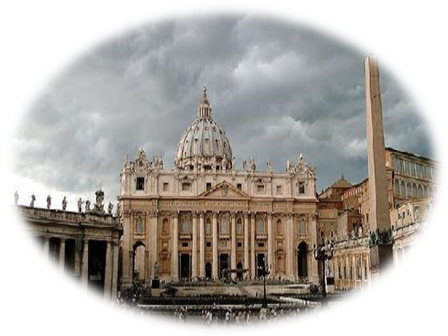
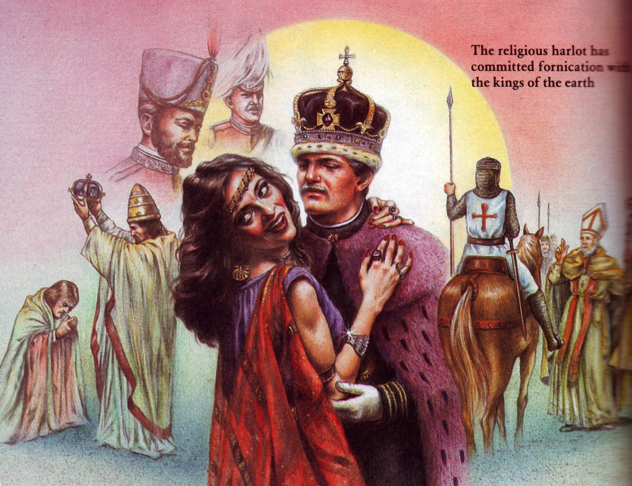
“With whom the kings of the earth have committed fornication…”

Slide 8
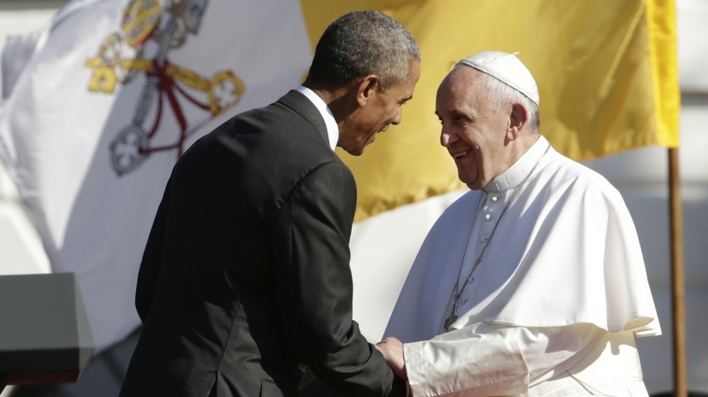

Slide 9
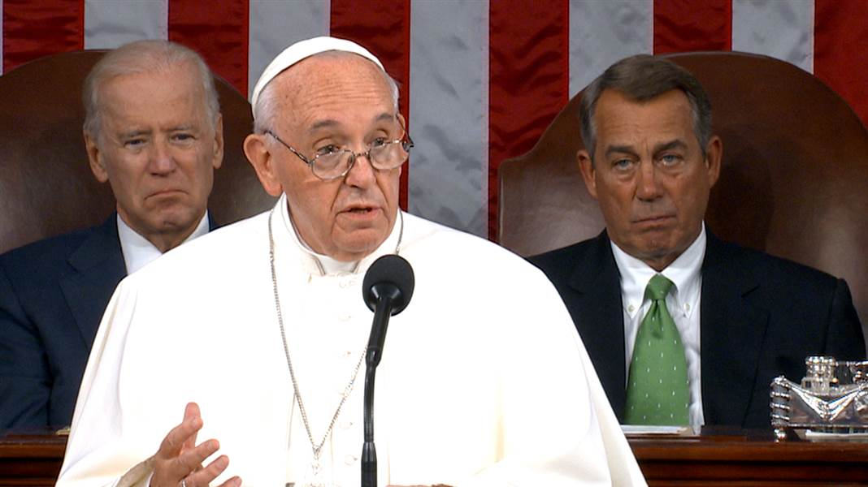

Slide 10
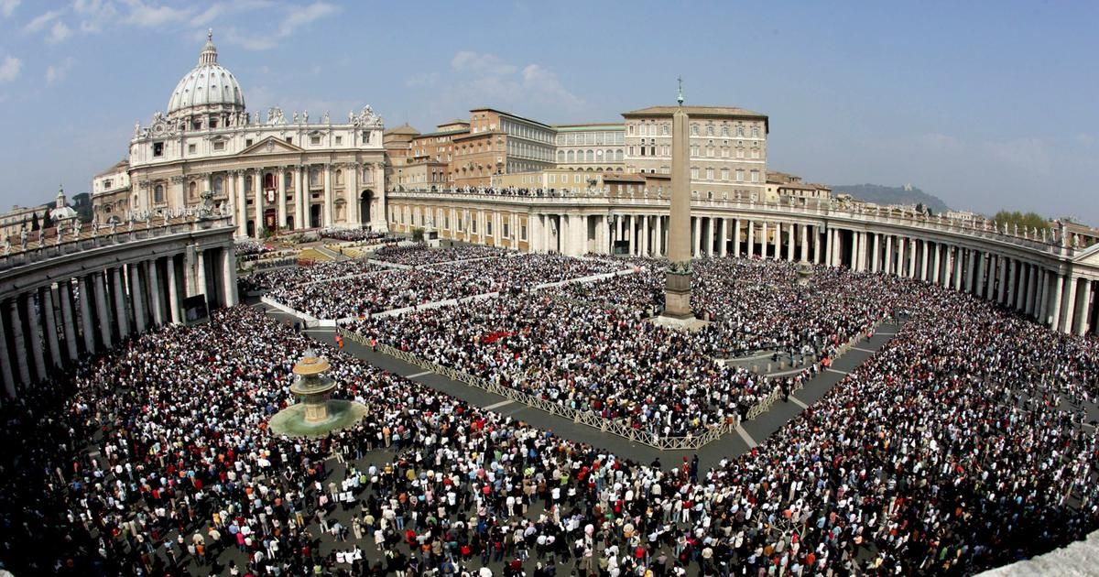
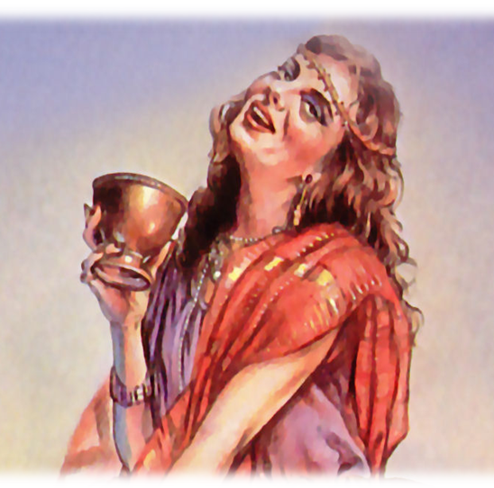
“…and the inhabitants of the earth have been made drunk with the wine of her fornication.”

Slide 11
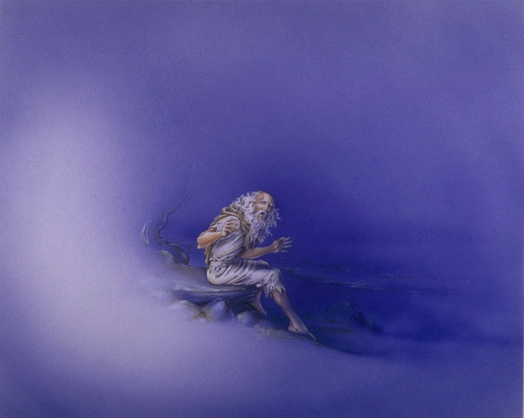
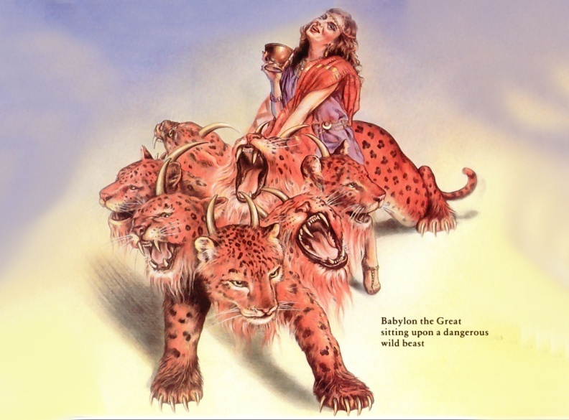
“So he carried me away in the spirit into the wilderness: and I saw a woman sit upon a scarlet coloured beast, full of names of blasphemy, having seven heads
and ten horns.”

Slide 12

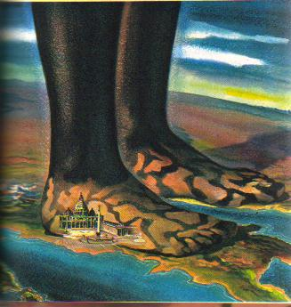
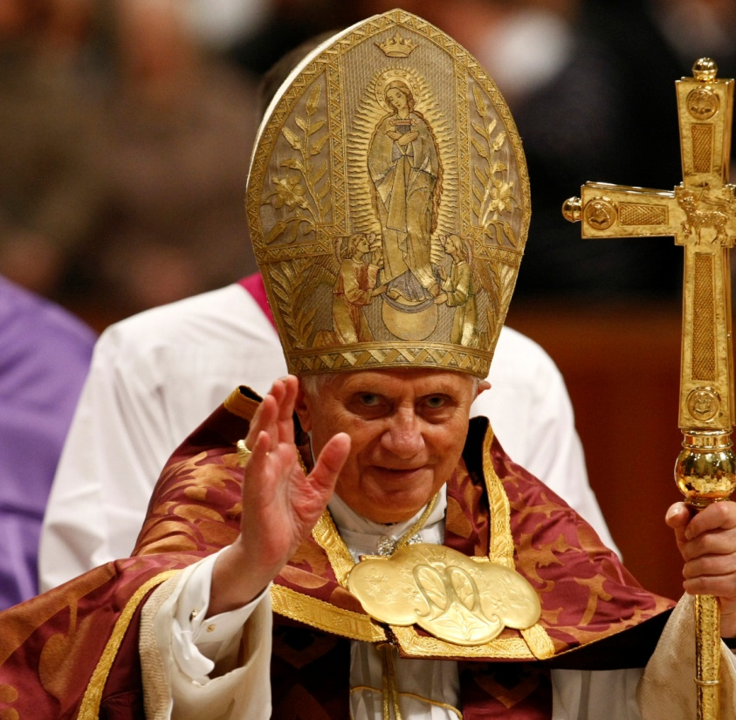
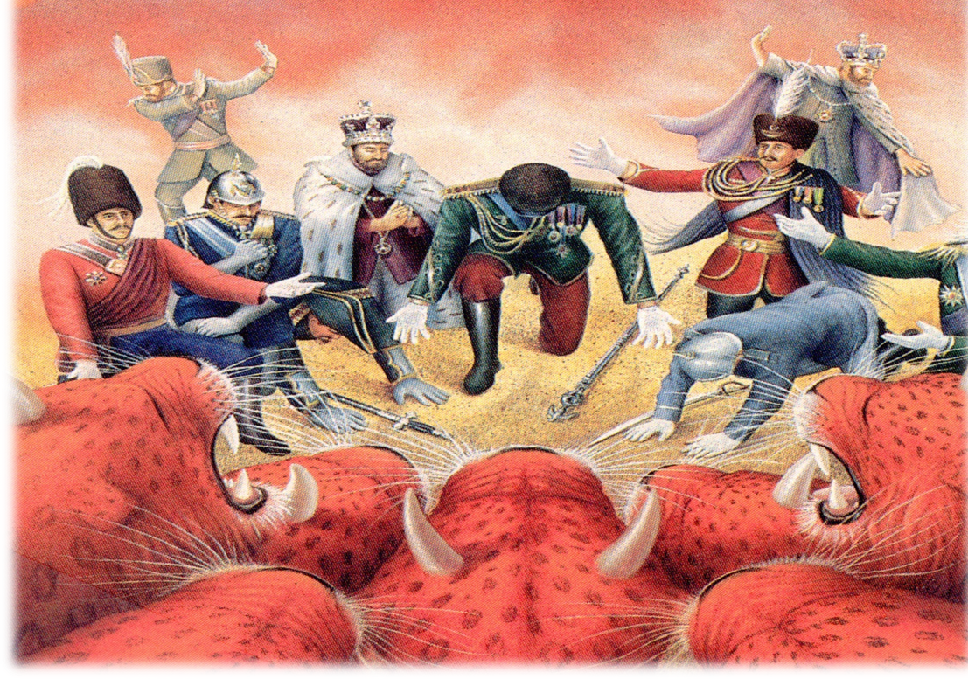
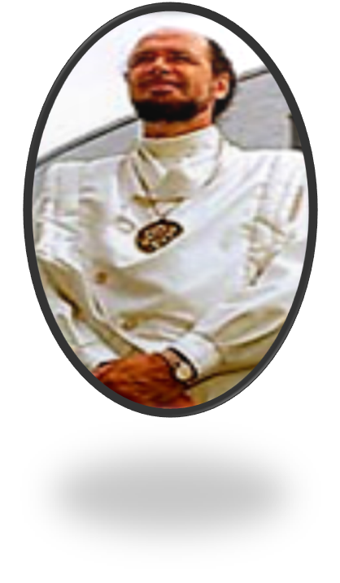
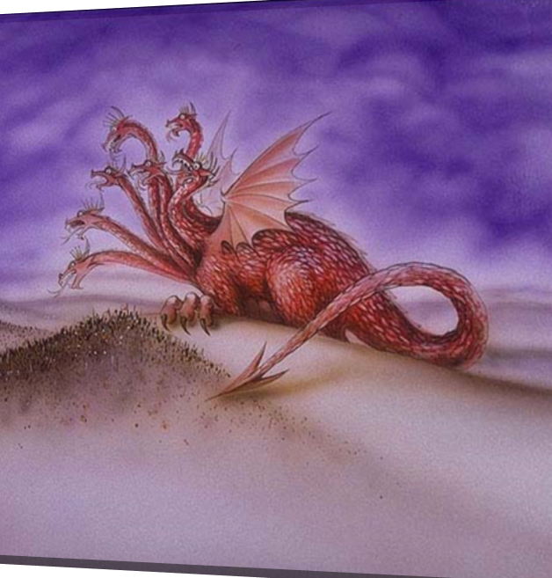

Slide 13
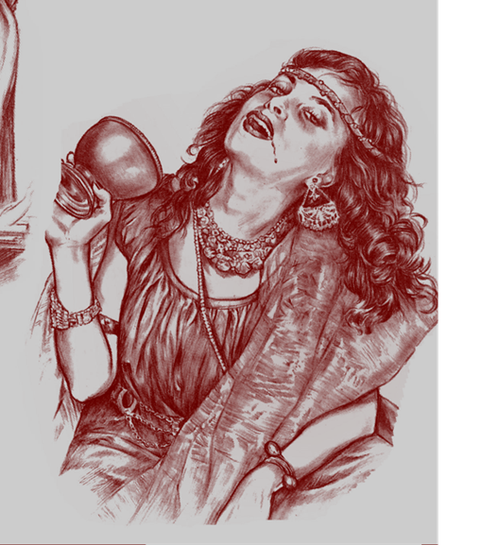
“And I saw the woman drunken with the blood of the saints, and with the blood of the martyrs of Jesus: and when I saw her, I wondered with great admiration.”

Slide 14
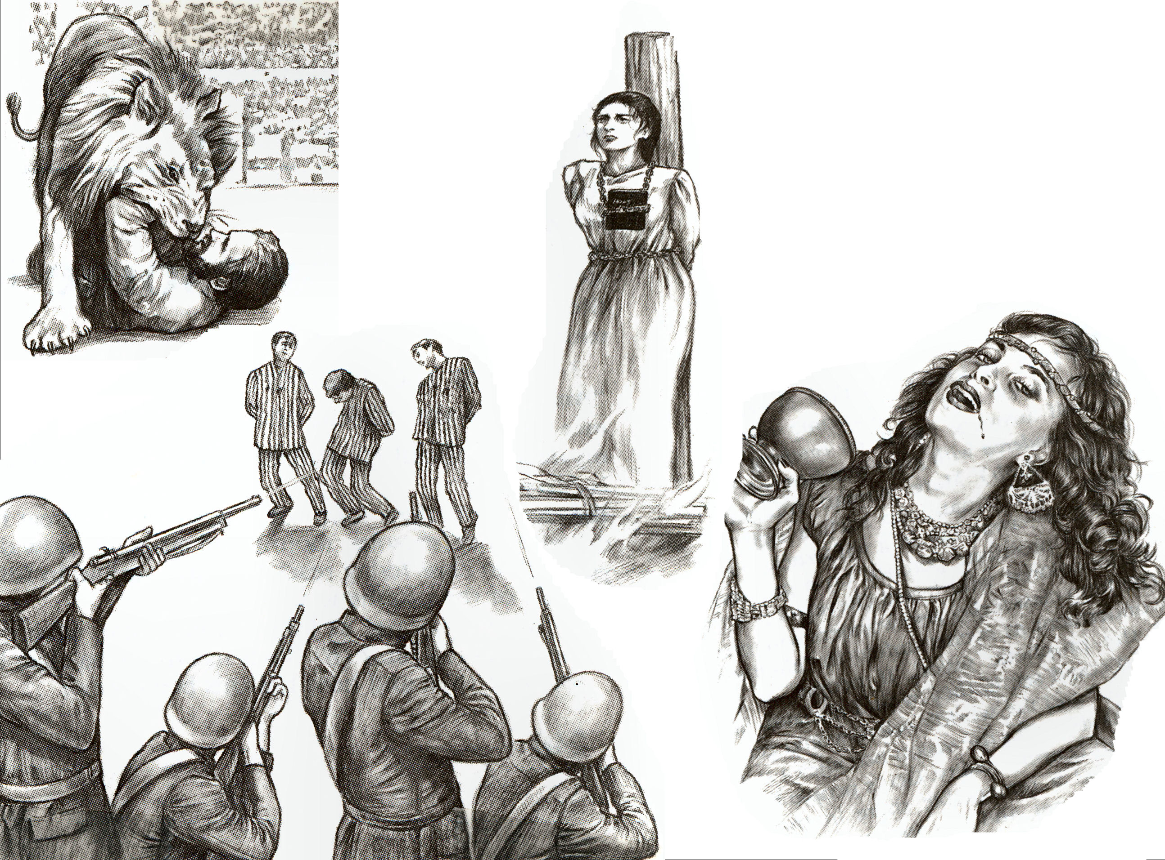

Slide 15
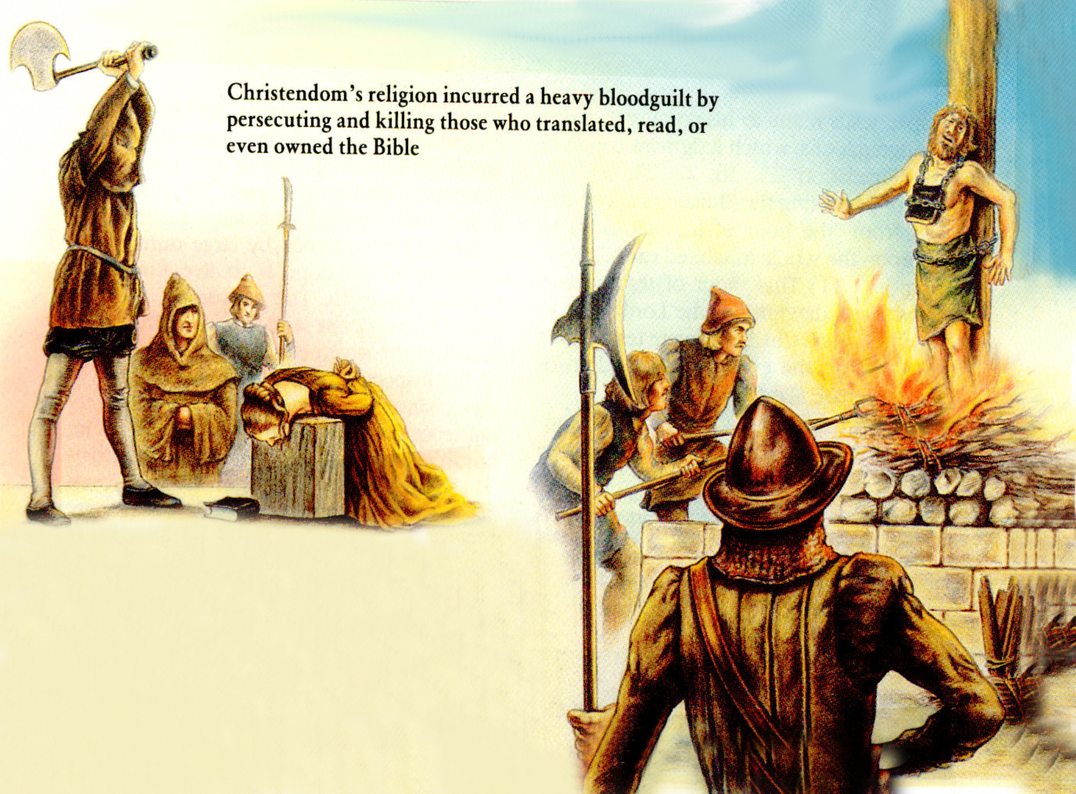
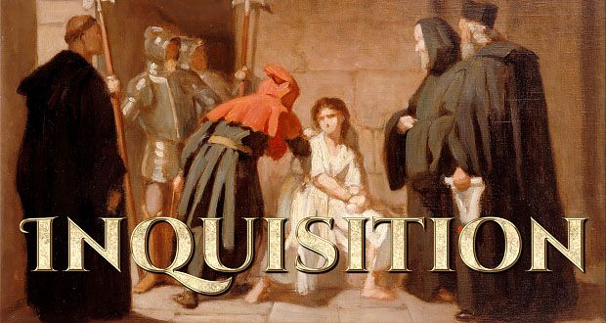


Slide 16
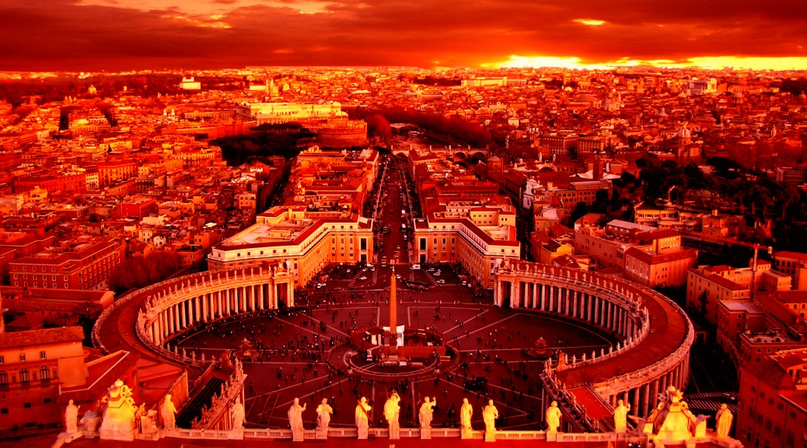
“And the woman was arrayed in purple and scarlet colour, and decked with gold and precious stones and pearls; having a golden cup in her hand full of abominations and filthiness of her fornication.”

Slide 17
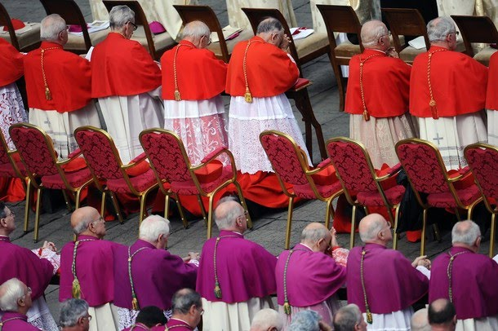
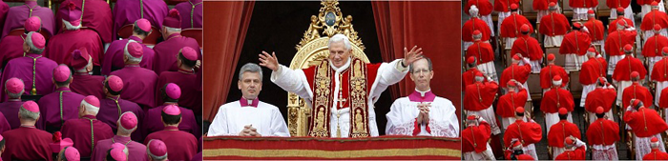
“And the woman was arrayed in purple and scarlet colour.”

Slide 18
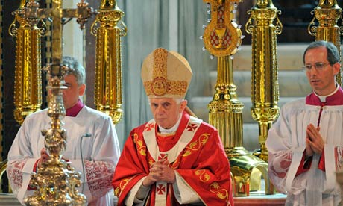
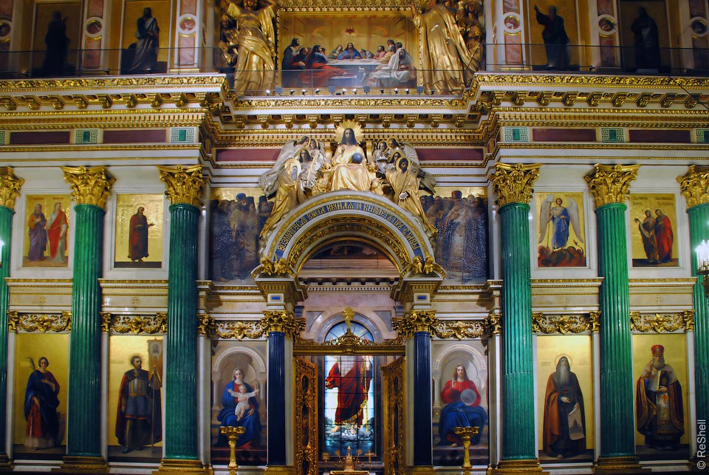
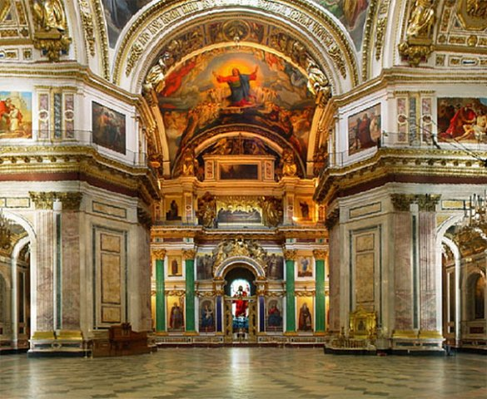
“And decked with gold and precious stones and pearls.”

Slide 19
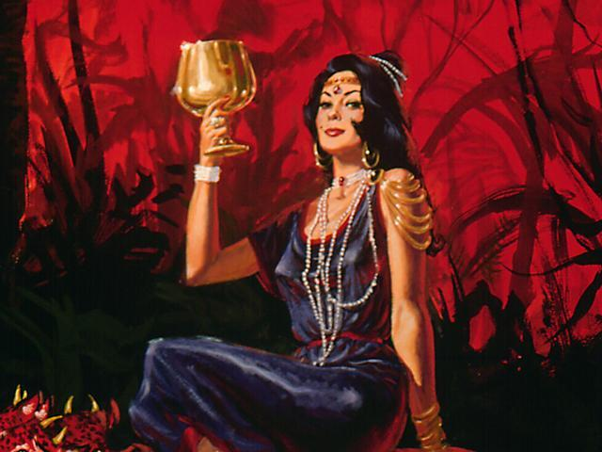
“…having a golden cup in her hand full of abominations and filthiness of her fornication.”

Slide 20
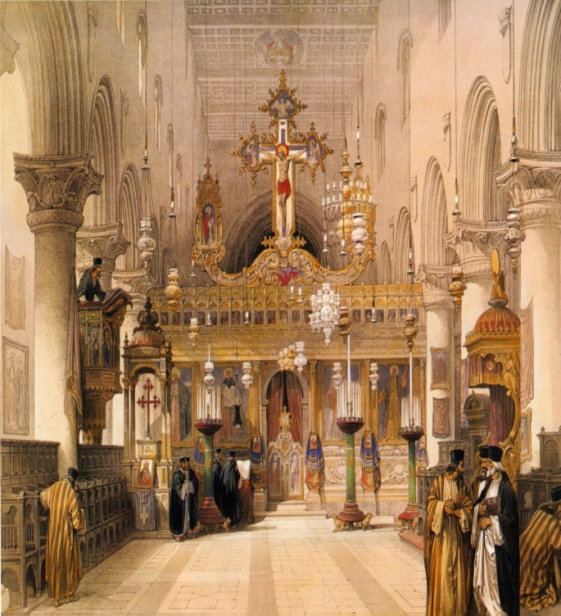
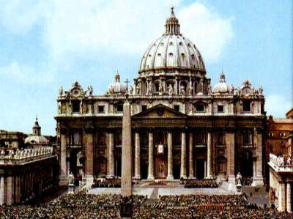
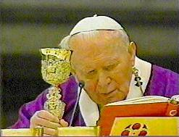
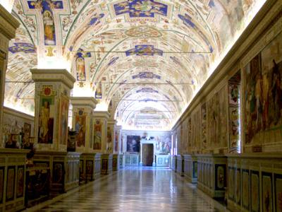
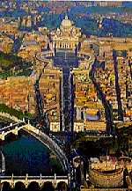
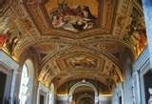

Slide 21
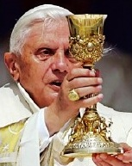
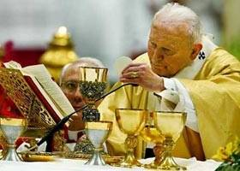
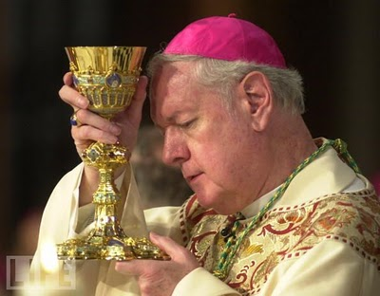
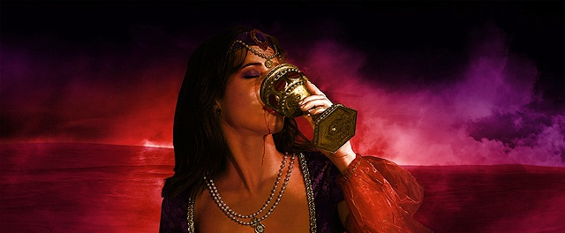
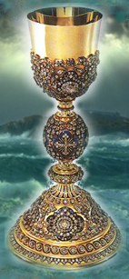
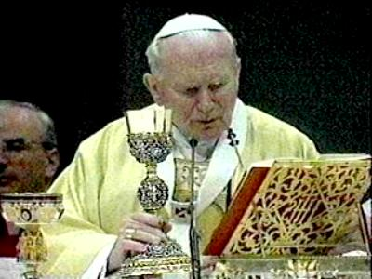
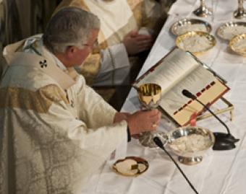

Slide 22
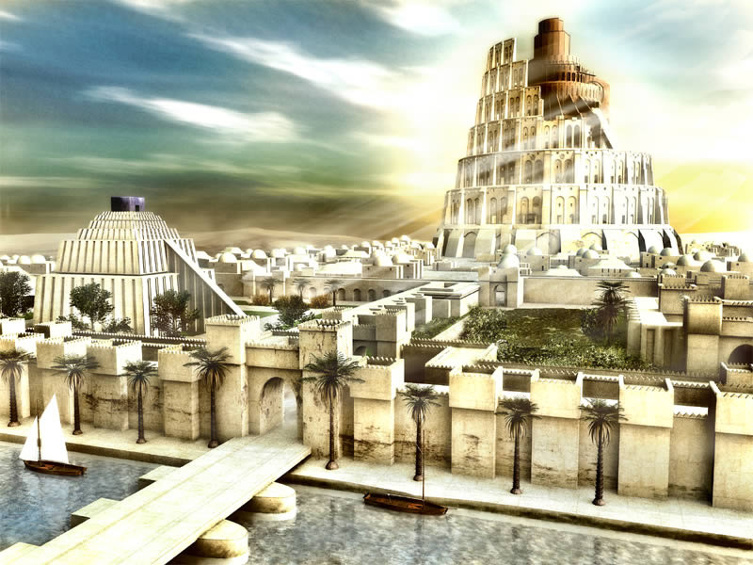
“Mystery, Babylon the Great”
.

Slide 23
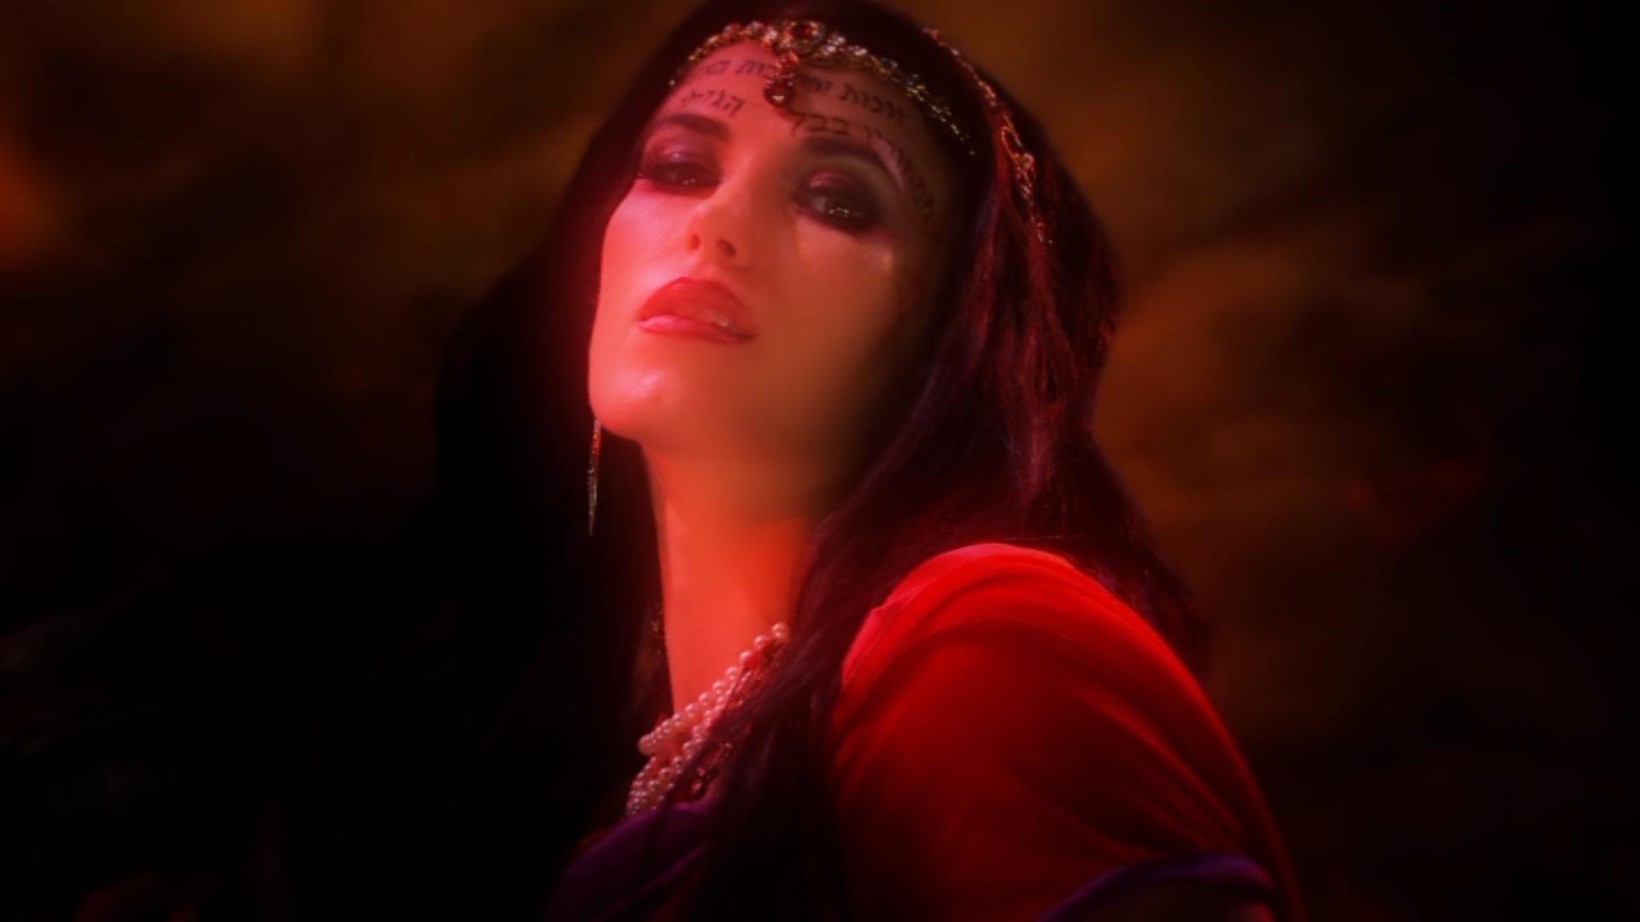
“And upon her forehead was a name written, Mystery, Babylon the Great, the Mother of Harlots and Abominations of the Earth.”

Slide 24
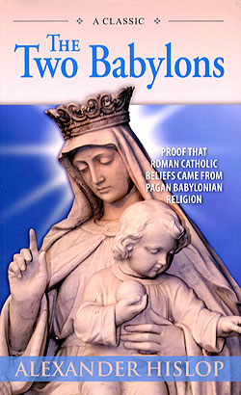

Slide 25
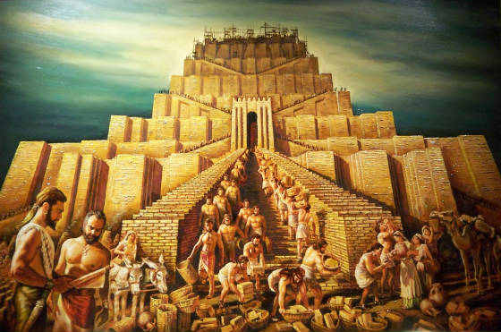
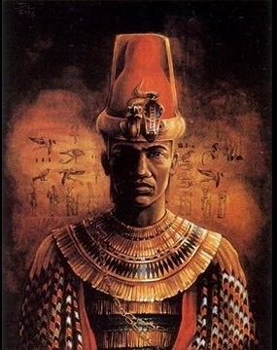

Nimrod And The Tower Of Babel

Slide 26
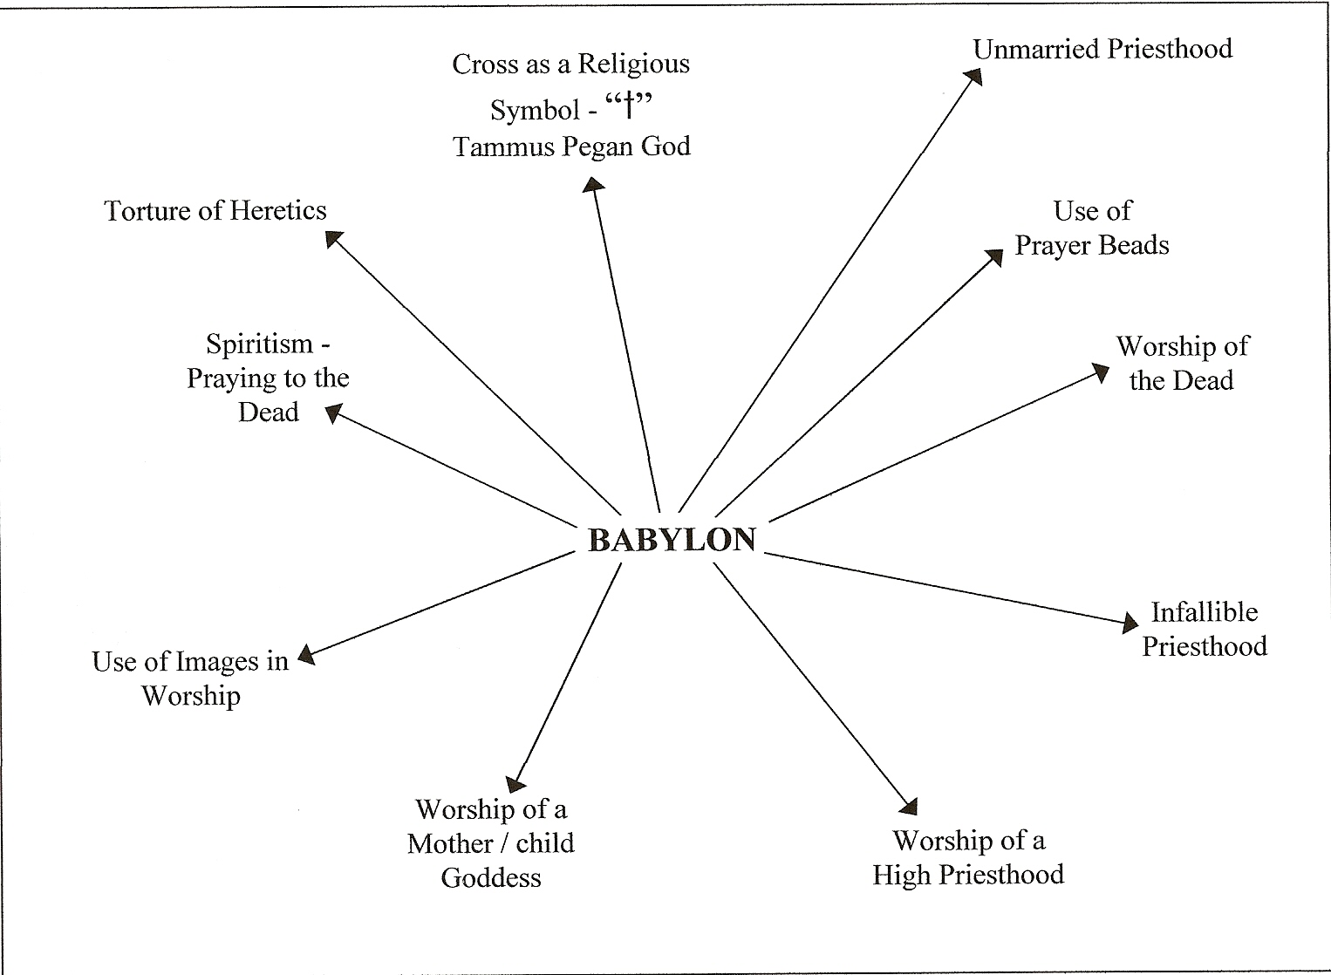
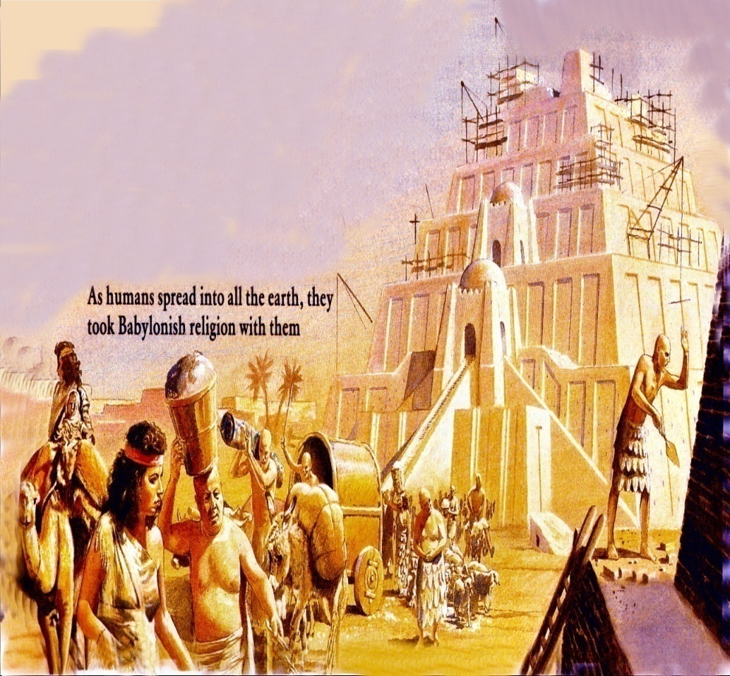

Slide 27
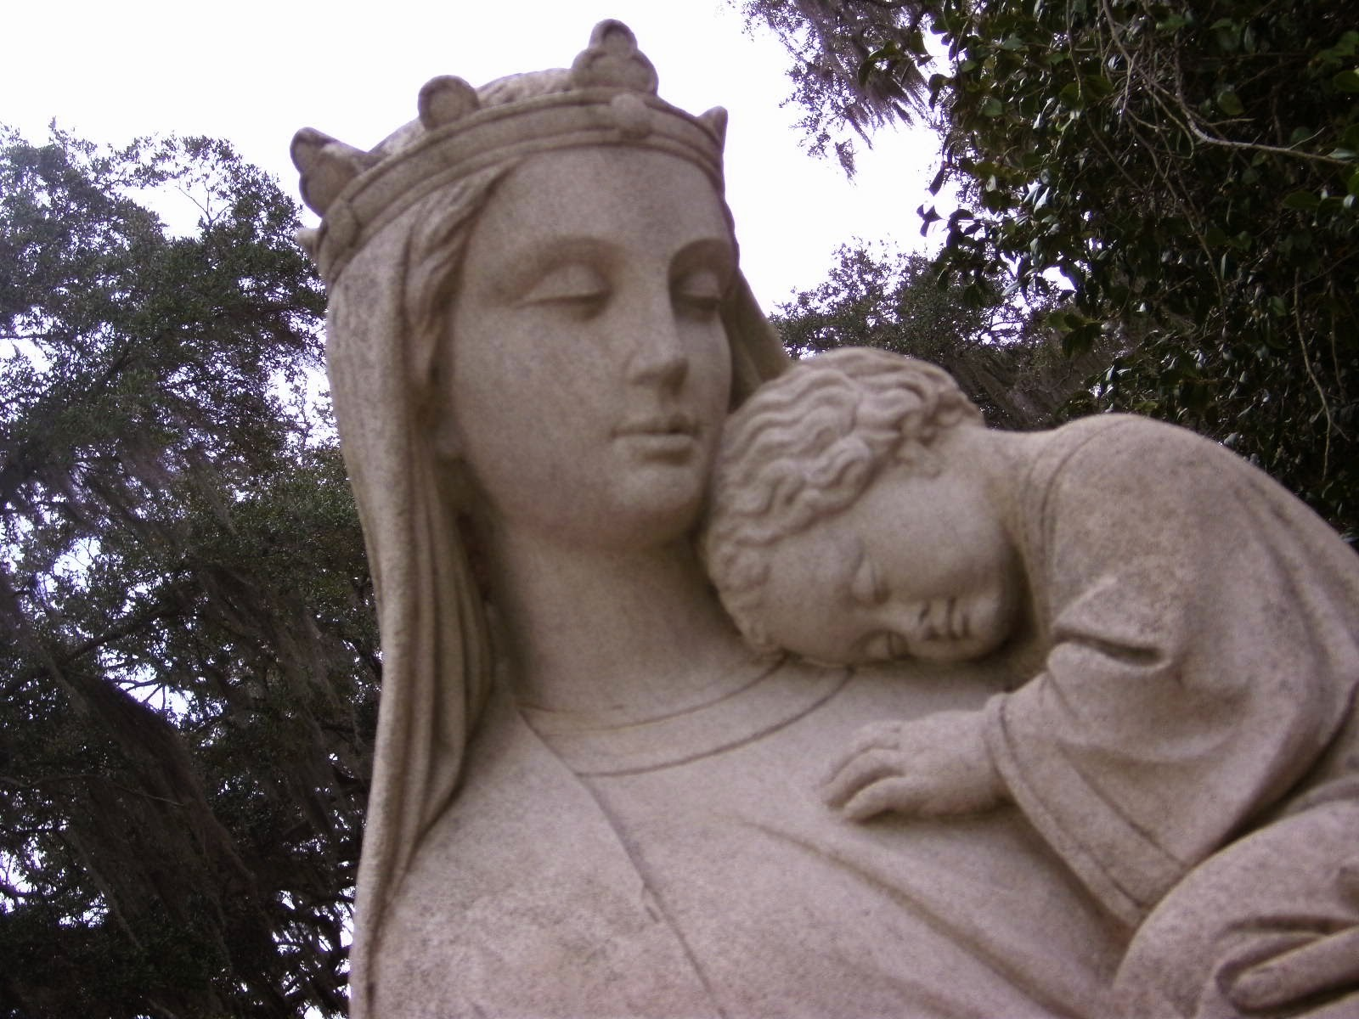
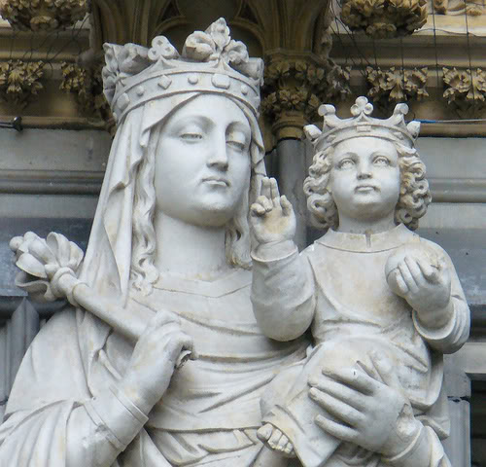
Semiramis – Queen of Heaven Semiramis - Mother of God

Slide 28






“Worship of a Mother/Child goddess”

Slide 29







Cross as a religious symbol in worship

Slide 30

Unmarried Priesthood

Slide 31


The use of prayer beads

Slide 32



Worship of the dead

Slide 33



Infallible Priesthood

Slide 34







The Worship of a
High Priest

Slide 35






Images used in worship
(Idols)

Slide 36






Use of pagan symbols in worship

Slide 37




Spiritism
Praying to the dead

Slide 38









Torture of Heretics
“Drunk with the blood of the saints.”
Torture of Heretics

Slide 39


Slide 40


Obelisk in front of Saint Peter's Basilica

Slide 41

MYSTERY, BABYLON THE GREAT, THE MOTHER OF HARLOTS AND ABOMINATIONS OF THE EARTH

Slide 42

“And here is the mind which hath wisdom. The seven heads are seven mountains, on which the woman sitteth.”

Slide 43


Slide 44


Revelation 17:9

Slide 45

“And there came one of the seven angels which had the seven vials, and talked with me, saying unto me, Come hither; I will shew unto thee the judgment of the great whore that sitteth upon many waters.” (Revelation 17:1)

Slide 46


Revelation 17:15

Slide 47

Revelation 17:16-18

Slide 48

“And the ten horns which thou sawest upon the beast, these shall hate the whore, and shall make her desolate and naked, and shall eat her flesh, and burn her with fire. For God hath put in their hearts to fulfill his will, and to agree, and give their kingdom unto the beast, until the words of God shall be fulfilled. And the woman which thou sawest is that great city, which reigneth over the kings of the earth.”

Slide 49

“And the ten horns which thou sawest upon the beast, these shall hate the whore, and shall make her desolate and naked…”

Slide 50


“…and burn her with fire. For God hath put in their hearts to fulfill his will.”

Slide 51

“For God hath put in their hearts to fulfill his will.”

Slide 52

(Revelation 18:1)
“And after these things I saw another angel come down from heaven, having great power; and the earth was lightened with his glory.”

Slide 53


“I saw an angel having great power… and he cried mightily with a strong voice, saying…”

Slide 54


“Babylon the great is fallen…”

Slide 55






“…the habitation of devils, and every foul spirit…”

Slide 56


“For all nations have drunk of the wine of the wrath of her fornication.”

Slide 57








“The kings of the earth have committed fornication with her…”

Slide 58











Slide 59












“The merchants of the earth are waxed rich through the abundance of her delicacies…”

Slide 60


The Vatican bank sees its future, and it's all about managing money

Slide 61


“Come out of her, my people, that ye be not partakers of her sins…”

Slide 62


“Her sins have reached unto heaven…”

Slide 63

“And I heard another voice from heaven saying, come out of her my people…” (Revelation 18:4)
“Mark them which cause divisions and offenses contrary to the doctrine which ye have learned; and avoid them.”
“Be not ye therefore partakers with them.”
“Come out from among them and be ye separate saith the Lord.”
“Have no fellowship with the unfruitful works of darkness.”

Slide 64


Revelation 18:6-9

Slide 65


“Reward her even as she rewarded you, and double unto her double according to her works: in the cup which she hath filled fill to her double.”

Slide 66

“How much she hath glorified herself, and lived deliciously, so much torment and sorrow give her: for she saith in her heart, I sit a queen, and am no widow, and shall see no sorrow.”

Slide 67

“Therefore shall her plagues come in one day, death, and mourning, and famine; and she shall be utterly burned with fire: for strong is the Lord God who judgeth her.”

Slide 68

“And the kings of the earth, who have committed fornication and lived deliciously with her, shall bewail her, and lament for her, when they shall see the smoke of her burning.”

Slide 69





“Standing afar off for the fear of her torment, saying, Alas, alas, that great city Babylon, that mighty city! for in one hour is thy judgment come. And the merchants of the earth shall weep and mourn over her; for no man buyeth their merchandise any more: And the merchants of the earth shall weep and mourn over her…”

Slide 70
“And saying, Alas, alas, that great city, that was clothed in fine linen, and purple, and scarlet, and decked with gold, and precious stones, and pearls! For in one hour so great riches is come to nought. And every shipmaster, and all the company in ships, and sailors, and as many as trade by sea, stood afar off,

Slide 71
“And cried when they saw the smoke of her burning, saying, What city is like unto this great city! And they cast dust on their heads, and cried, weeping and wailing, saying, Alas, alas, that great city, wherein were made rich all that had ships in the sea by reason of her costliness! for in one hour is she made desolate.”

Slide 72

“Rejoice over her, thou heaven, and ye holy apostles and prophets; for God hath avenged you on her.”
Heaven rejoices over the judgment of the whore

Slide 73

“And a mighty angel took up a stone like a great millstone, and cast it into the sea, saying, Thus with violence shall that great city Babylon be thrown down, and shall be found no more at all.”

Slide 74





“And the voice of harpers, and musicians, and of pipers, and trumpeters, shall be heard no more at all in thee.”

Slide 75








“No craftsman, of whatsoever craft he be, shall be found any more in thee…”

Slide 76


Slide 77


Slide 78





Slide 79





Slide 80



“The light of a candle shall shine no more at all in thee…”

Slide 81



“The voice of the bridegroom and of the bride shall be heard no more at all in thee…”

Slide 82


“For by thy sorceries were all nations deceived.”

Slide 83


“In her was found the blood of the prophets, and of saints, and of all that were slain upon the earth.”

Slide 84






Slide 85

(Revelation 19:1-3)
“And after these things I heard a great voice of much people in heaven, saying, Alleluia; Salvation, and glory, and honour, and power, unto the Lord our God.”

Slide 86


“True and righteousness are thy judgments: for he hath judged the great whore, which did corrupt the earth…”

Slide 87


“And her smoke rose up forever and ever…”

Slide 88


(Revelation 19:4)
“And the four and twenty elders and the four beasts fell down and worshipped God that sat on the throne, saying, Amen; Alleluia.”

Slide 89

“Praise our God, all ye His servants…”

Slide 90


“And I heard as it were the voice of a great multitude, and as the voice of many waters…saying, Alleluia: for the Lord God omnipotent reigneth. Let us rejoice and be glad…”
(Revelation 19:6-7)

Slide 91

“And I heard as it were the voice of a great multitude…as the voice of mighty thunderings, saying, Alleluia: for the Lord God omnipotent reigneth. Let us rejoice and be glad…”
(Revelation 19:6-7)

Slide 92

“And to her was granted that she should be arrayed in fine linen, clean and white: for the fine linen is the righteousness of saints.”

Slide 93


Slide 94


“And he saith unto me, Write, Blessed are they which are called unto the marriage supper of the Lamb. And he saith unto me, These are the true sayings of God.”

Slide 95


Slide 96

“Whosoever will my come…”

Slide 97

“And I fell at his feet to worship him.”

Slide 98

“And he said unto me, See thou do it not: I am thy fellowservant, and of thy brethren that have the testimony of Jesus: worship God: for the testimony of Jesus is the spirit of prophecy.”

