Slide 1
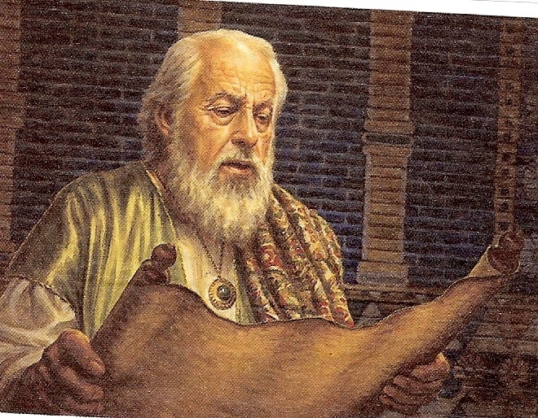
The Seventy Weeks of Daniel
Daniel 9:24-27

Slide 2
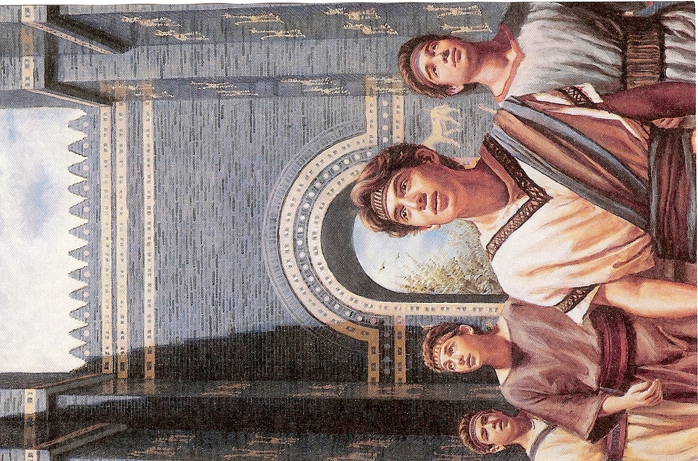

Slide 3
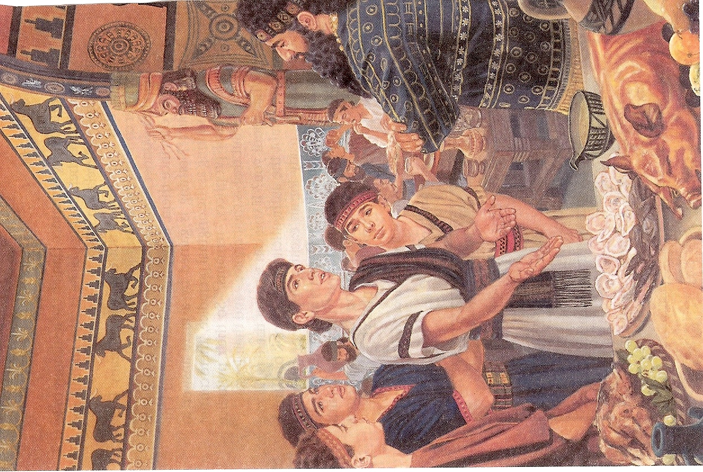

Slide 4
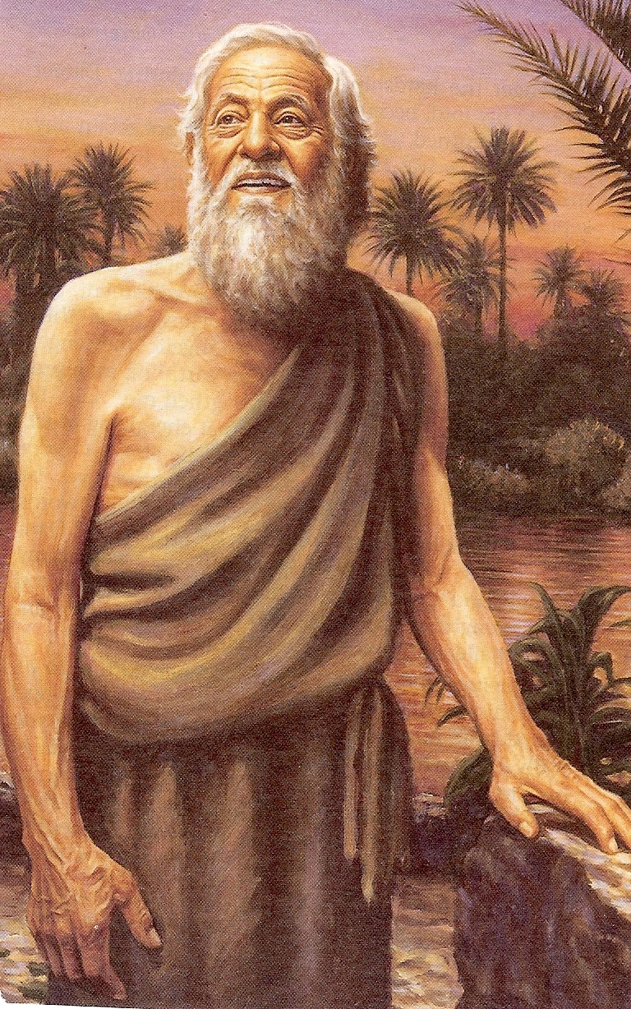

Slide 5
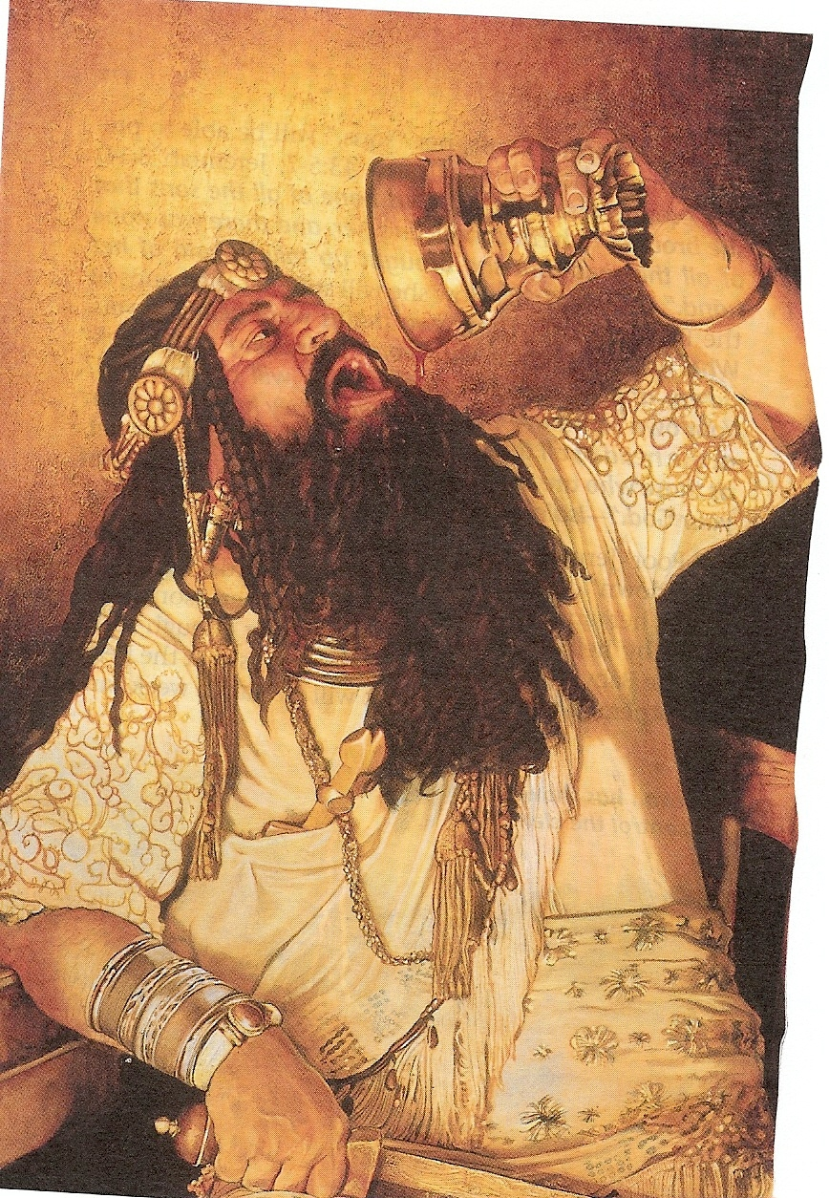

Slide 6
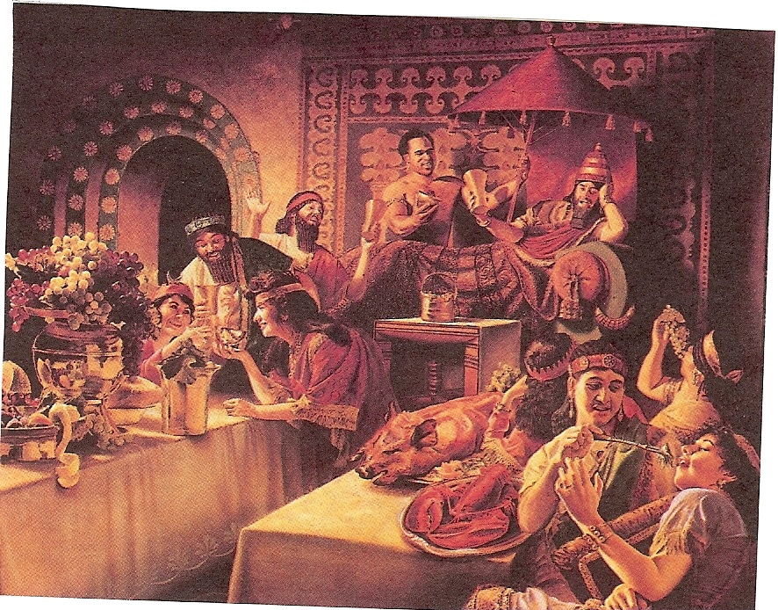

Slide 7
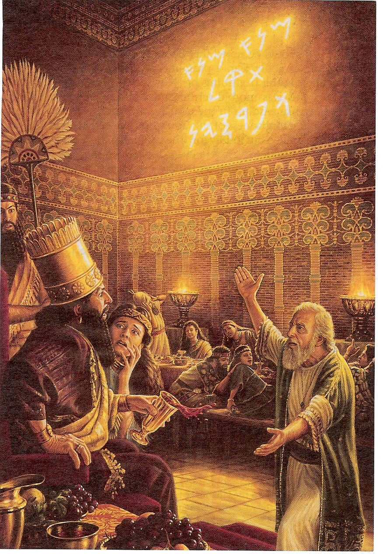

Slide 8
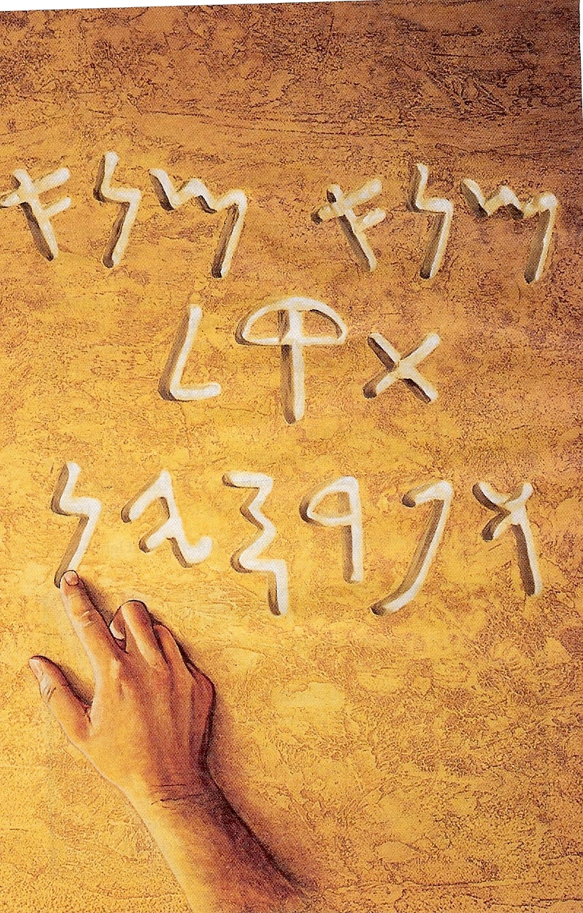

Slide 9
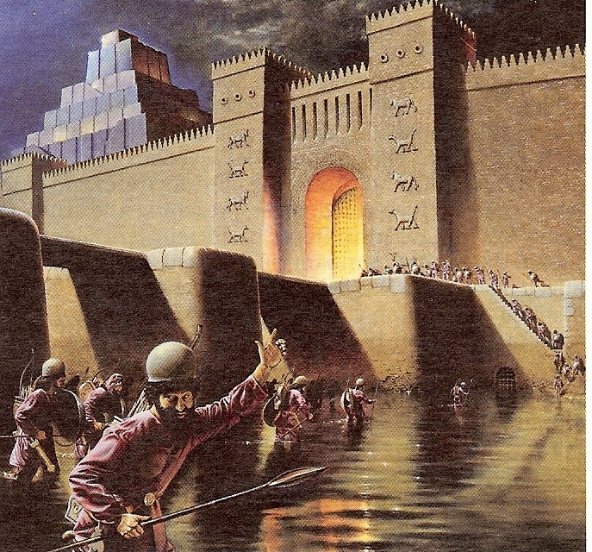

Slide 10
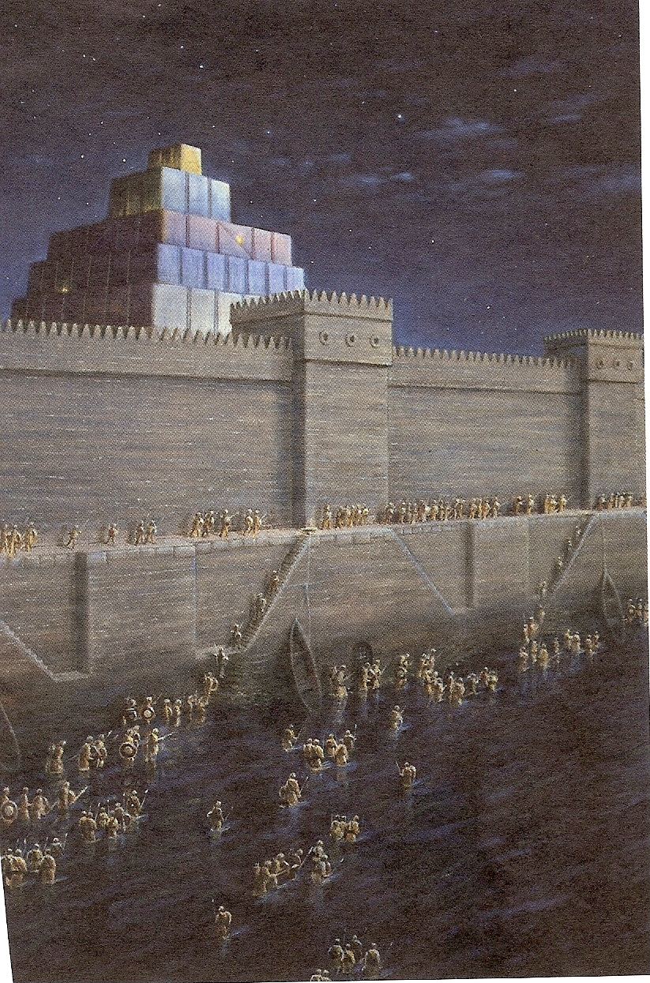

Slide 11
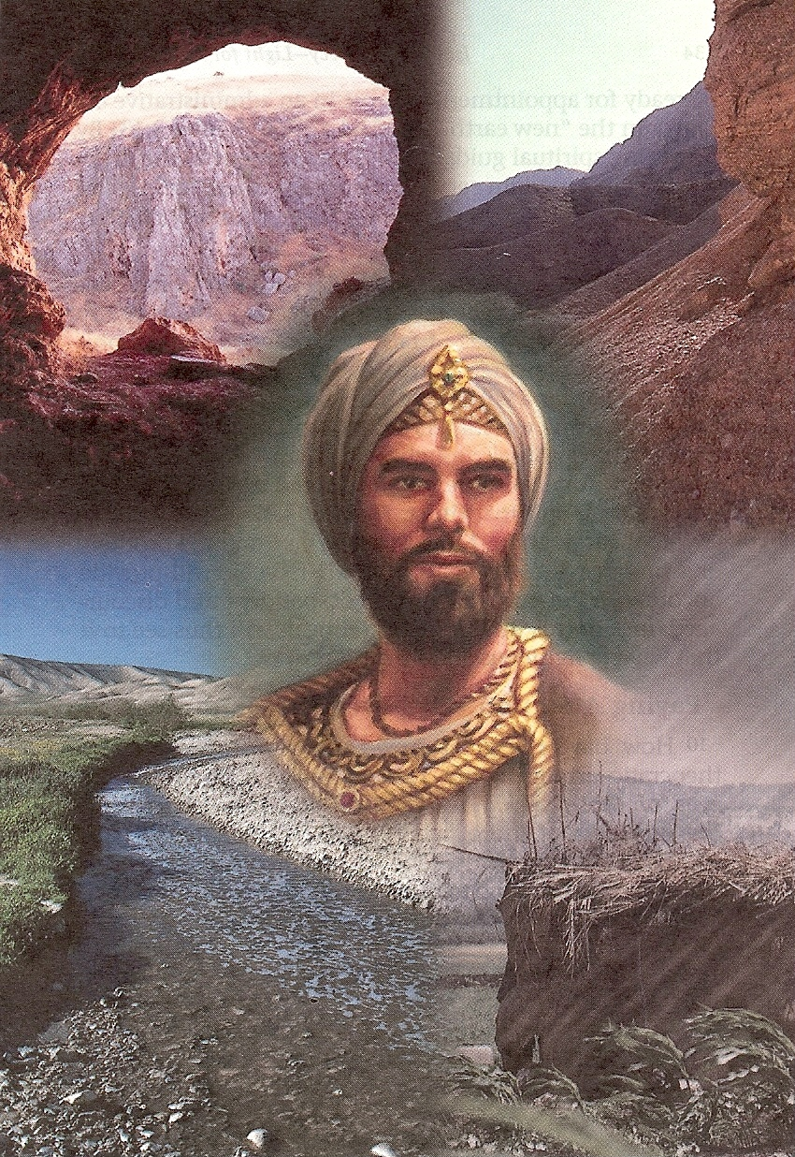

Slide 12
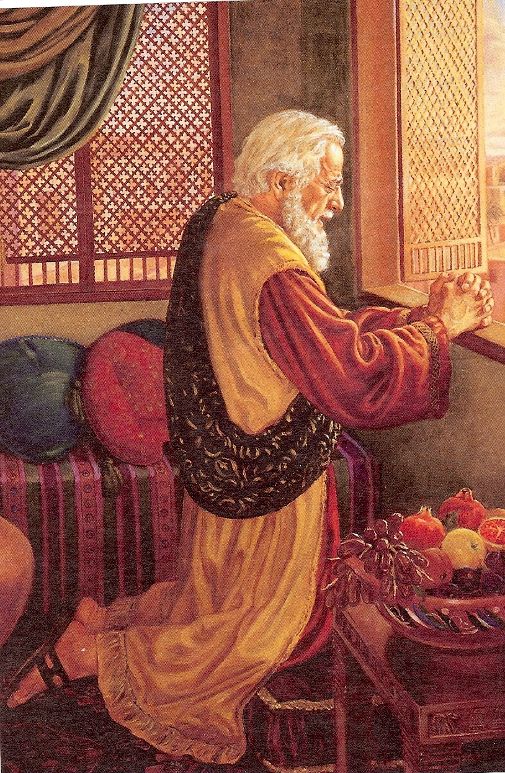

Slide 13
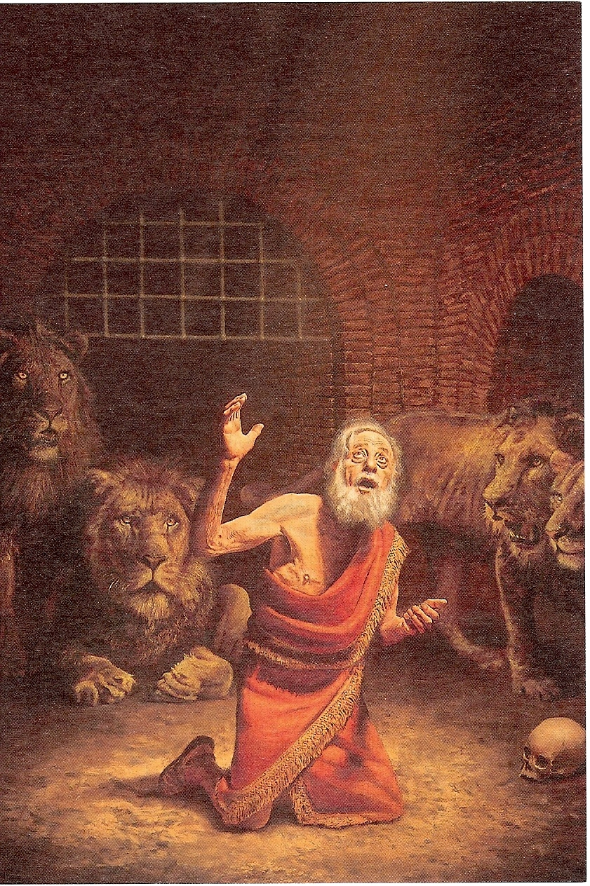

Slide 14
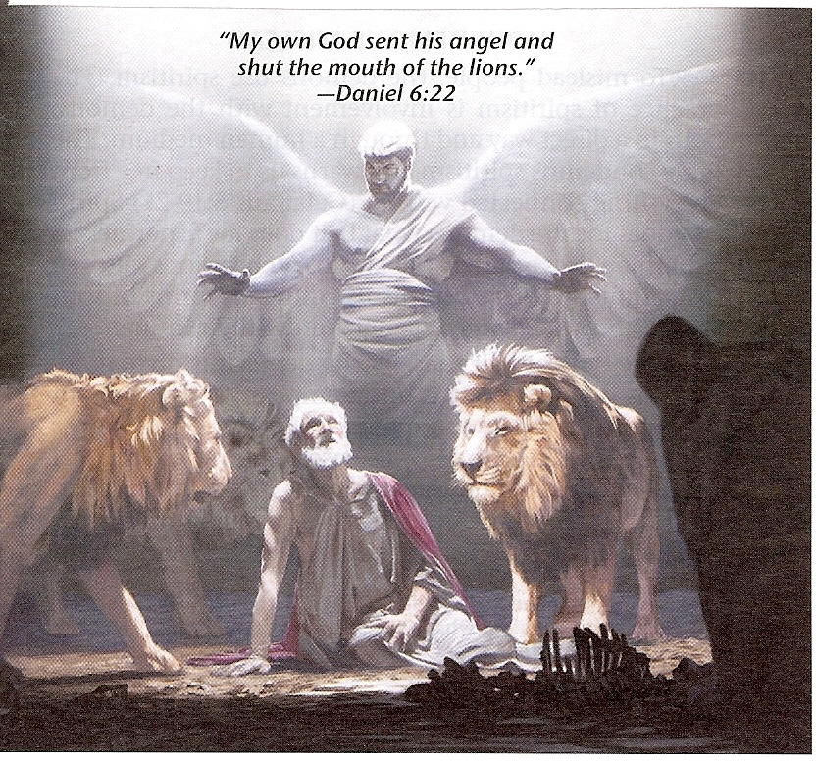

Slide 15
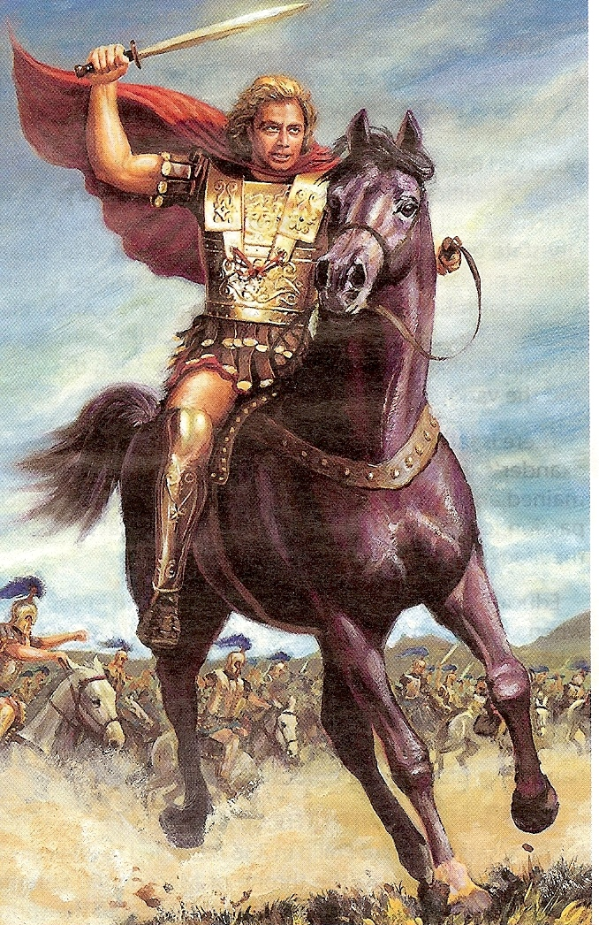

Slide 16
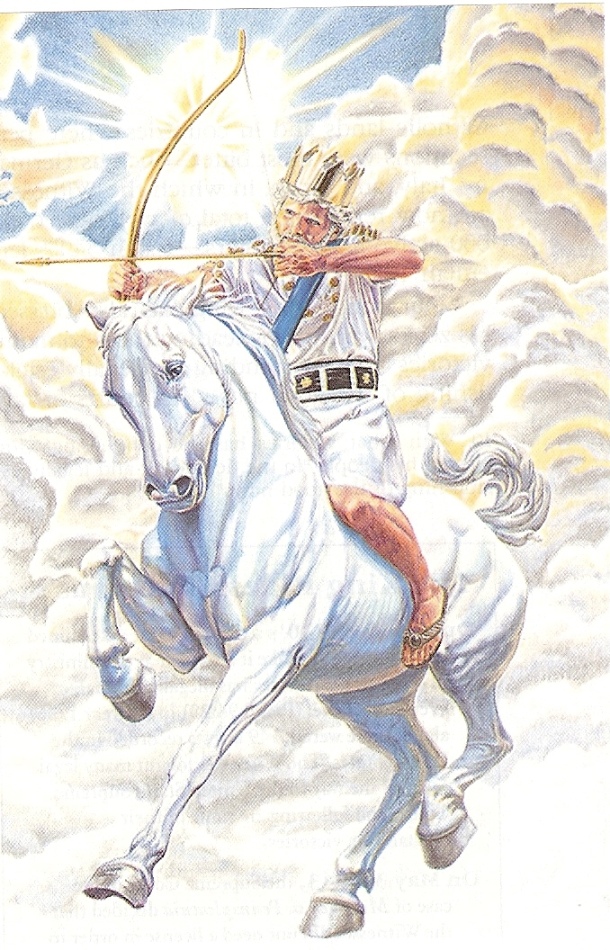

Slide 17
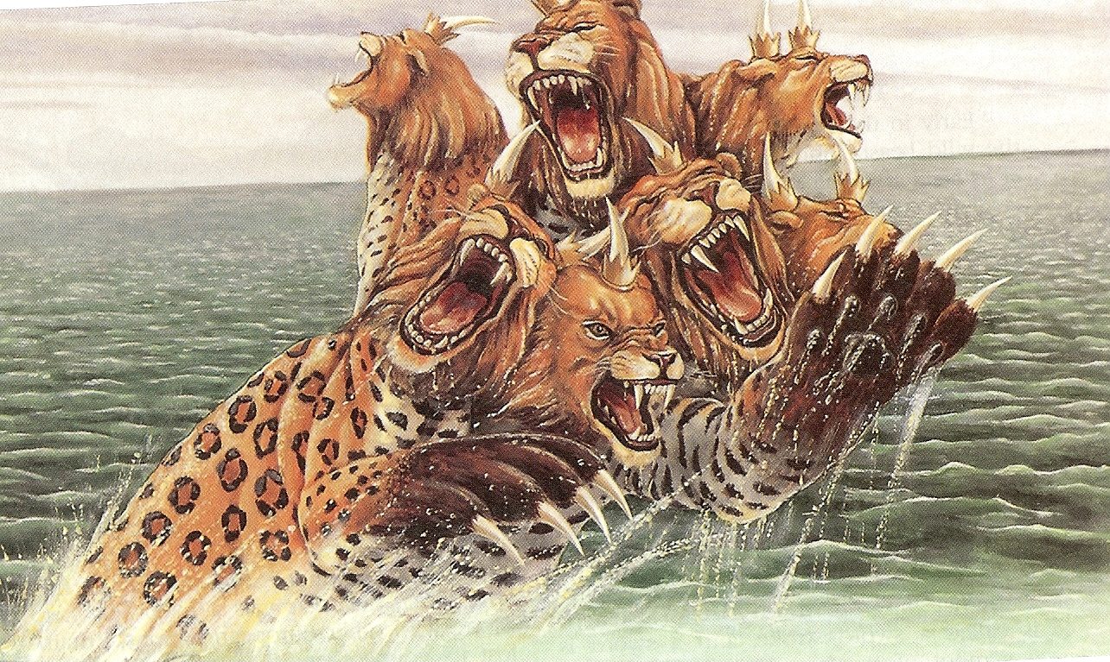

Slide 18


Slide 19
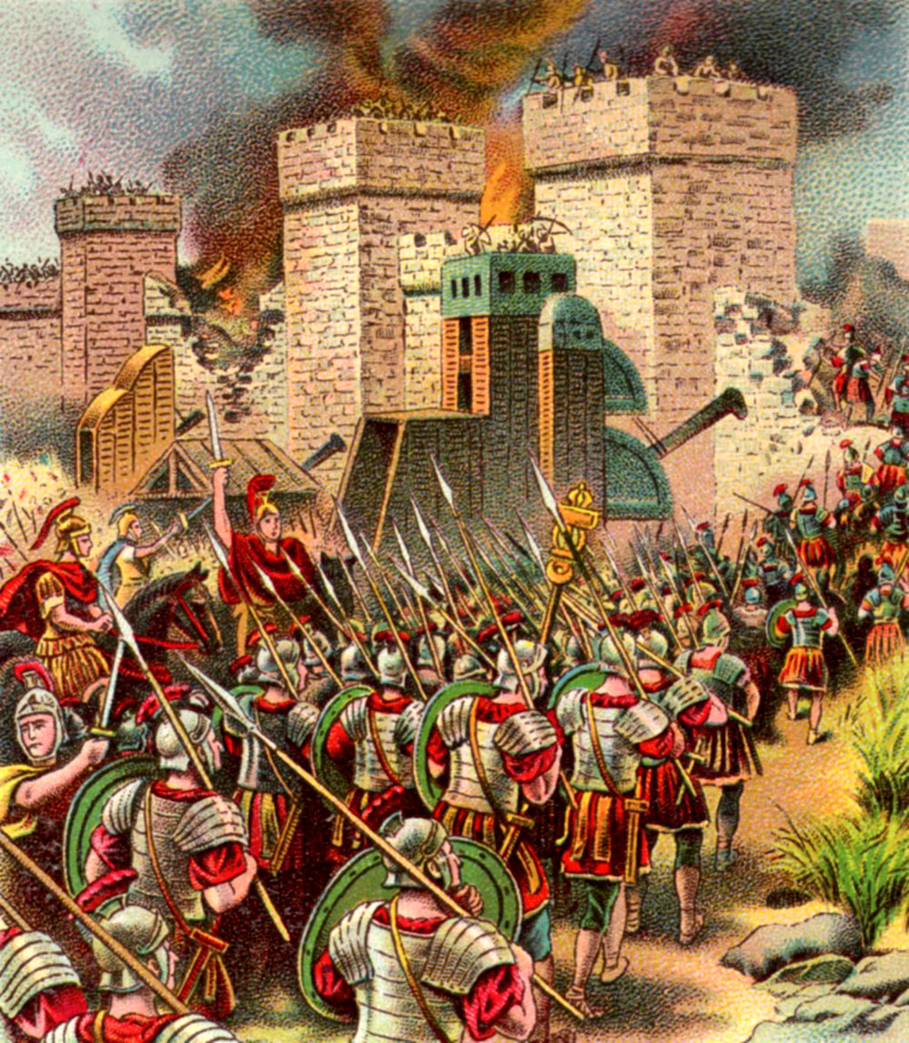

Slide 20

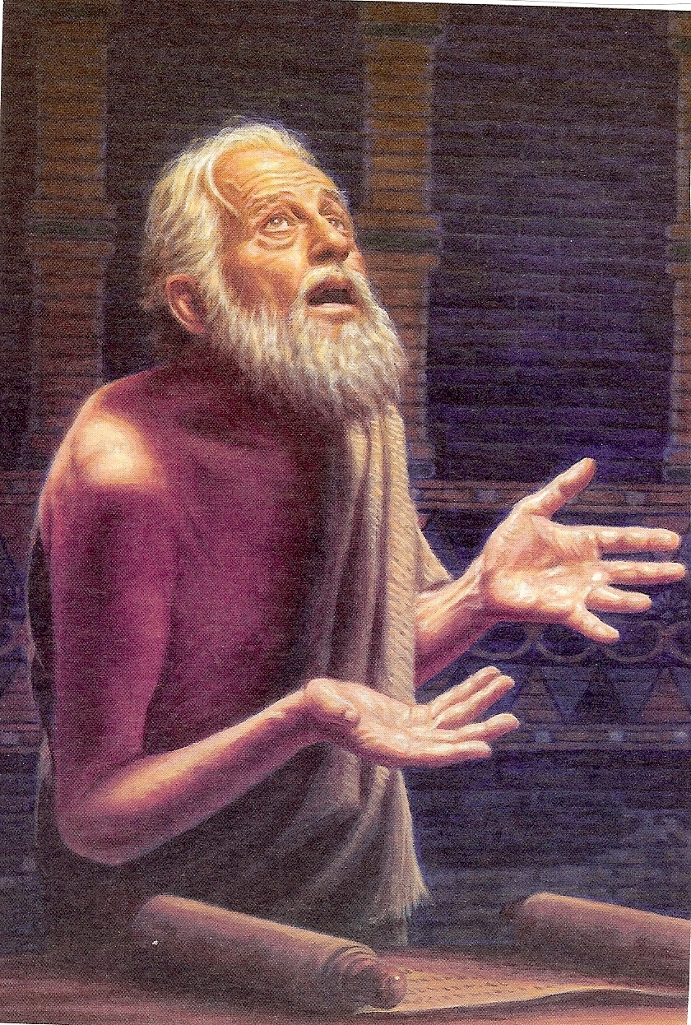

Slide 21
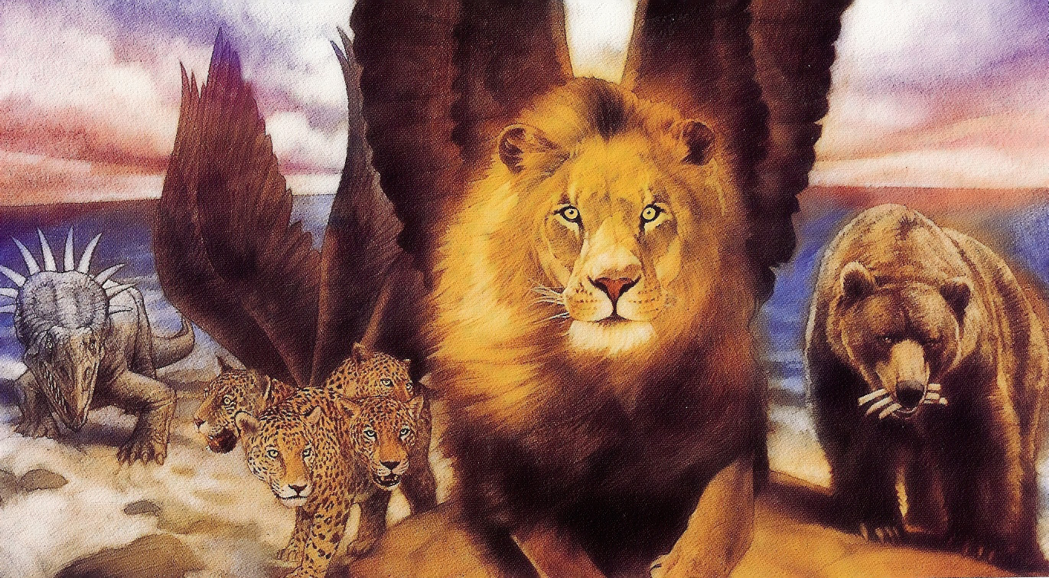

Slide 22
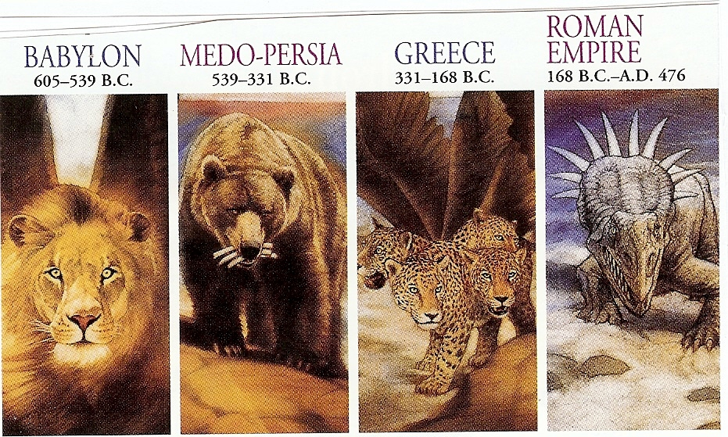

Slide 23
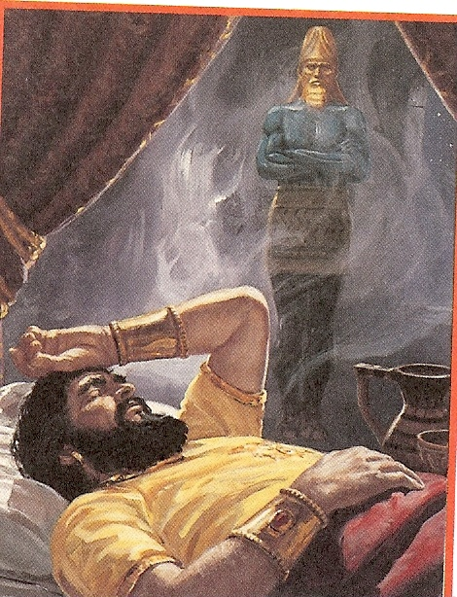

Slide 24
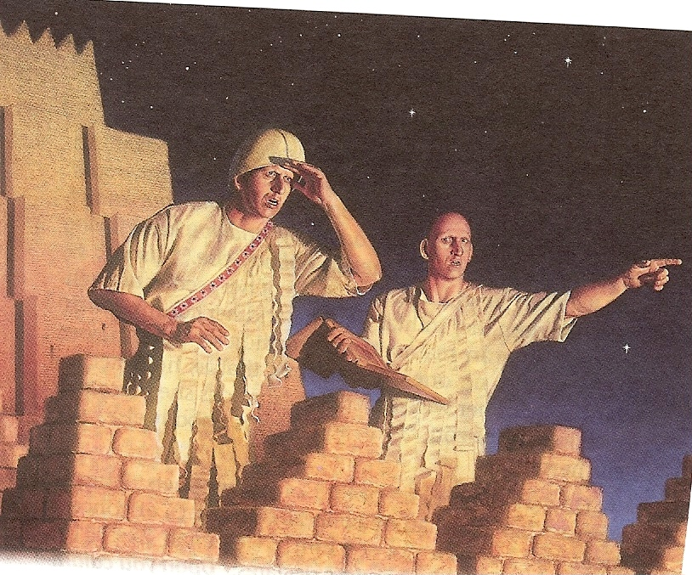

Slide 25
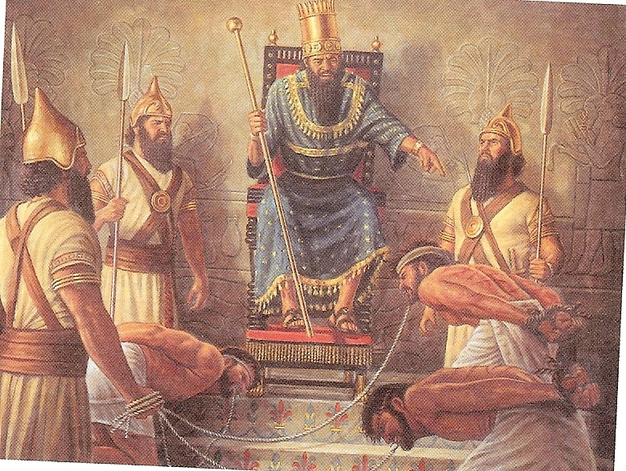

Slide 26

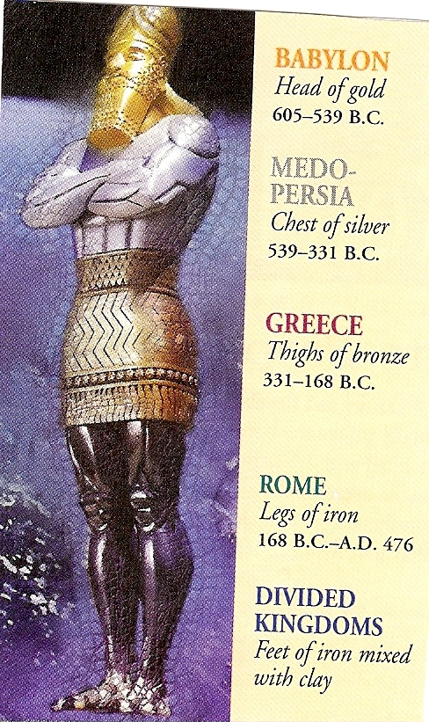

Slide 27
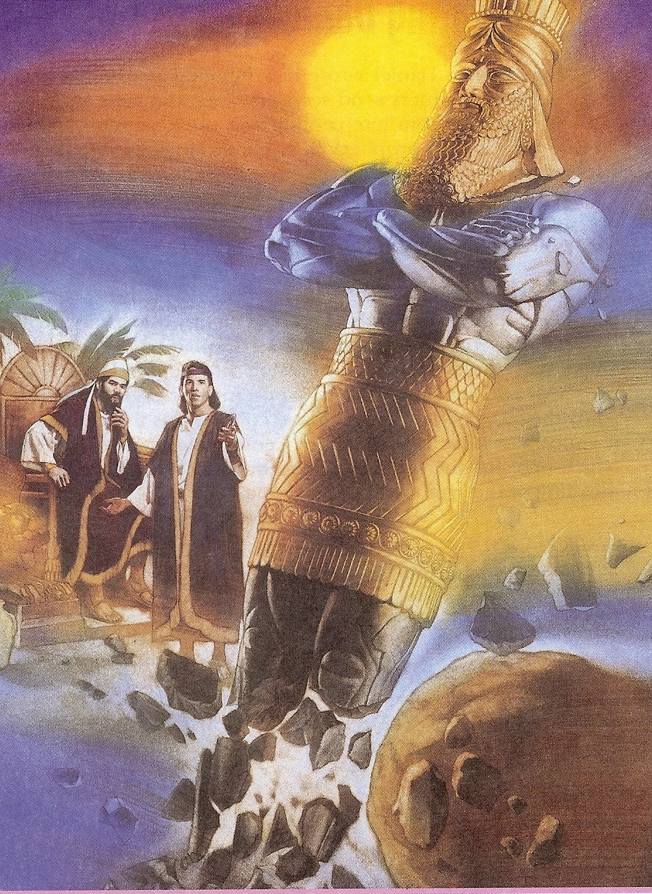

Slide 28
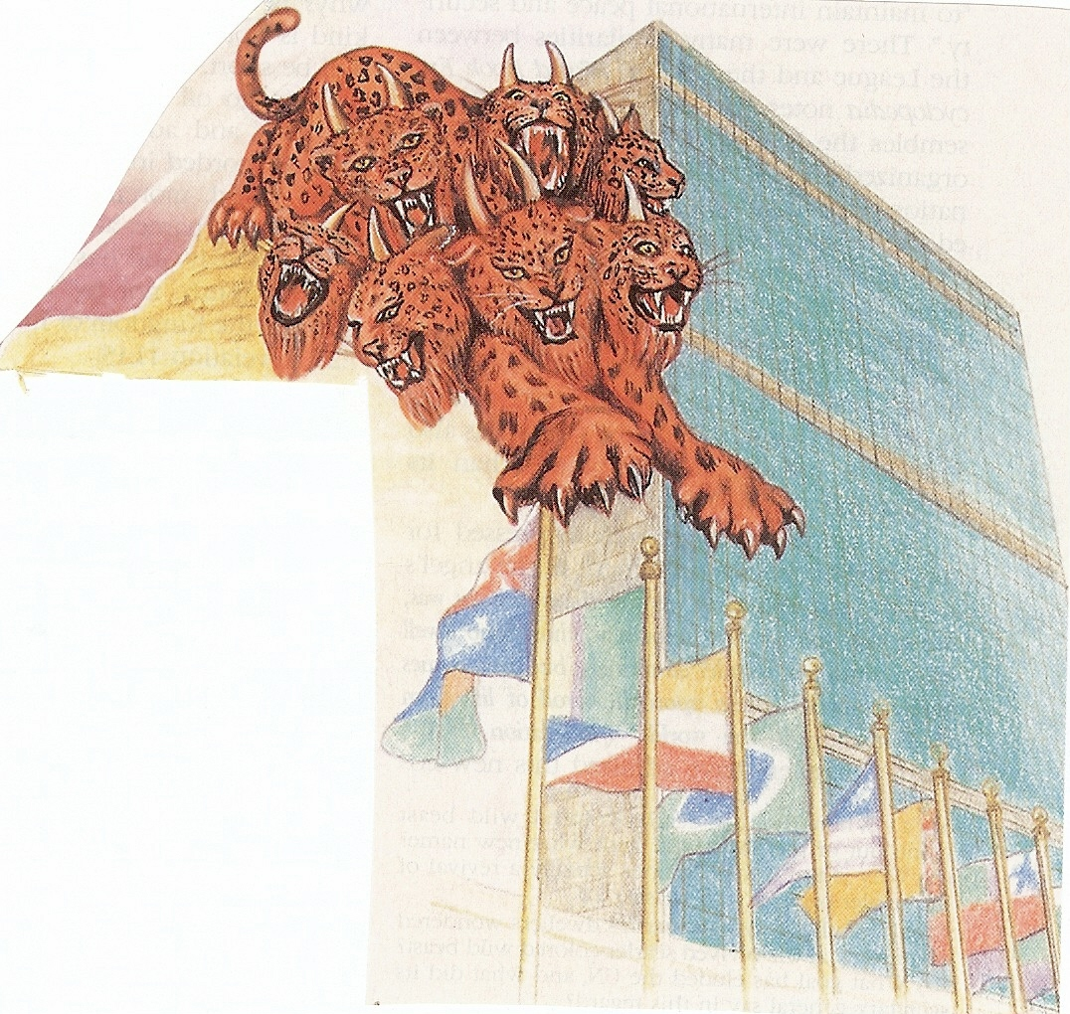
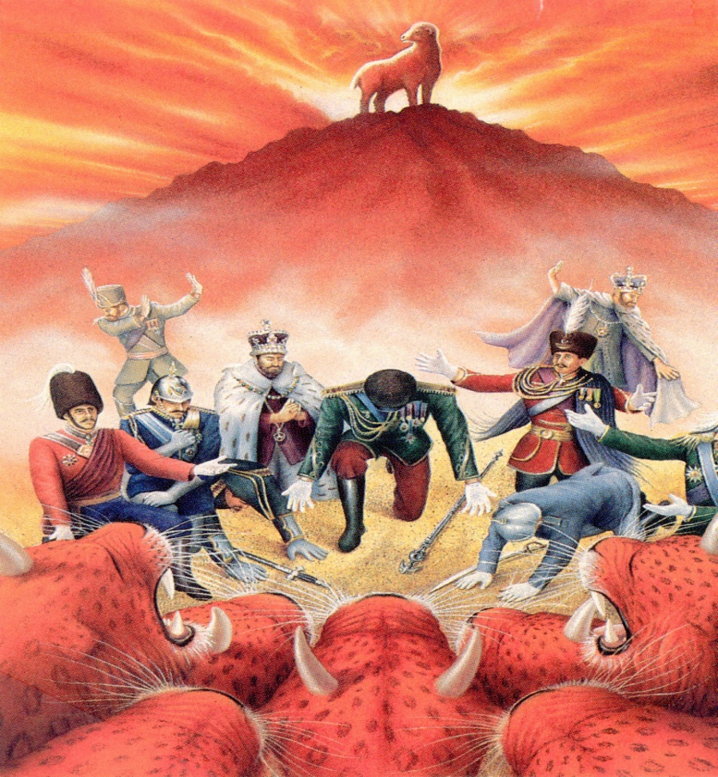

Slide 29
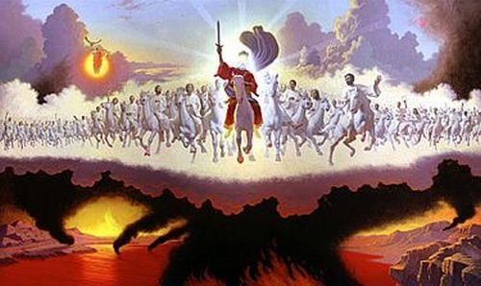

Slide 30
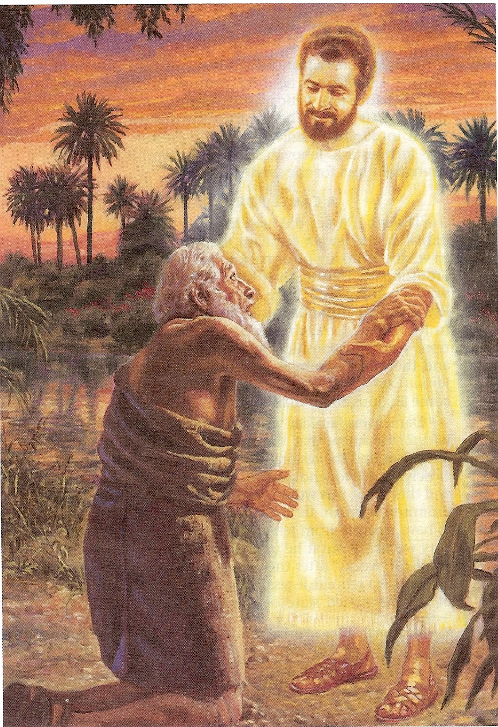

Slide 31
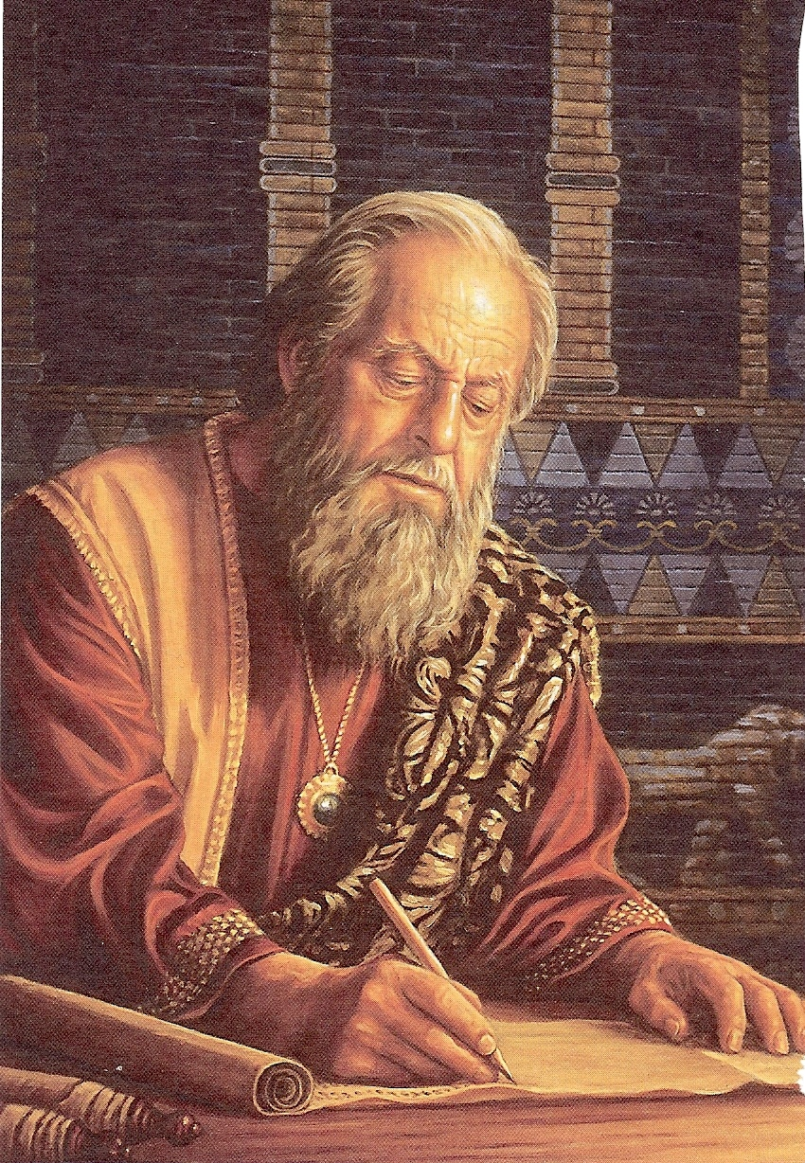

Slide 32
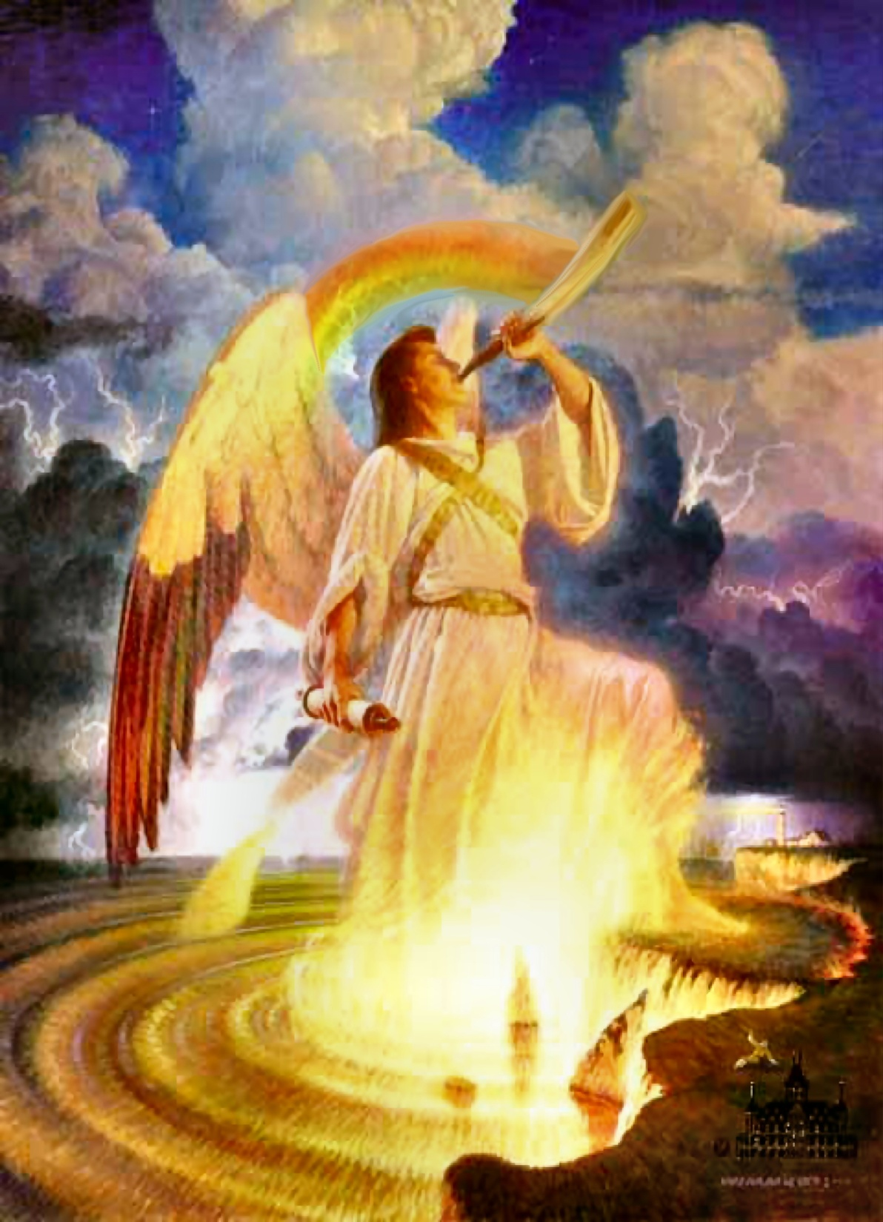

Gives the interpretation of prophetic chronology

Slide 33
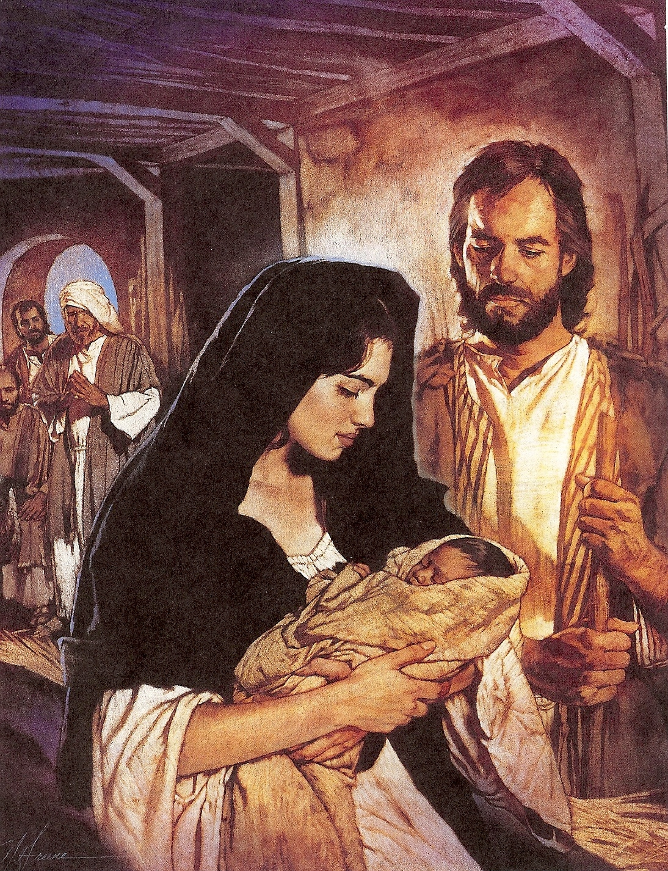
Reveals the time and purpose of Christ’s first coming

Slide 34
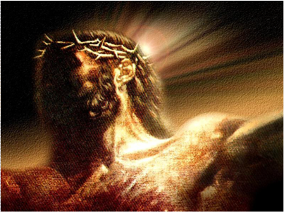
Foretells the rejection of Christ in His first coming

Slide 35
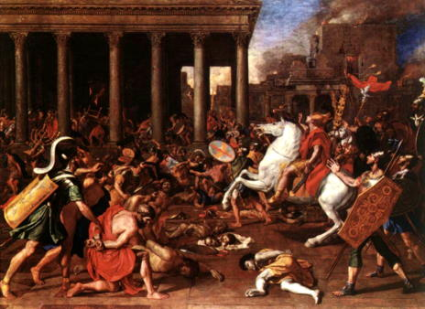
Prophesies the destruction of Jerusalem
Prophesies the destruction of Jerusalem
Put in picture of Jerusalem being destroyed

Slide 36

Predicts the length of the Tribulation period

Slide 37
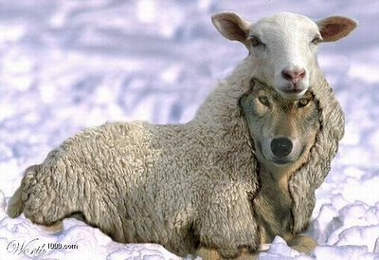
Unveils the rise of the Anti-Christ and the peace covenant
“For many shall come in my name, saying, I am Christ and shall deceive many.” (Matt. 24:5)

Slide 38

The six-fold purpose of the seventy weeks

Slide 39

To finishing Israel’s transgression
(Apostasy)
“And so all Israel shall be saved: as it is written, There shall come out of Zion the deliverer, and shall turn away ungodliness from Jacob. For this is my covenant unto them.” (Rom. 11:26)

Slide 40
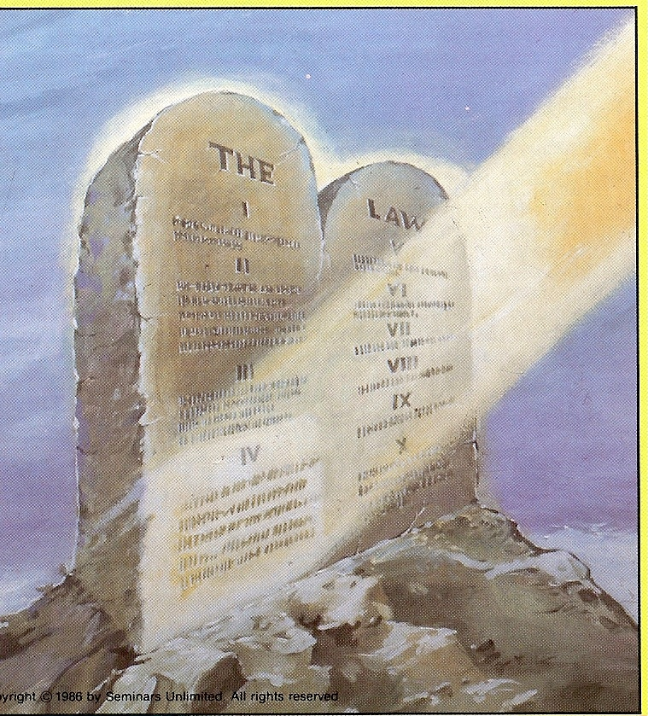
To make an end of sin

Slide 41
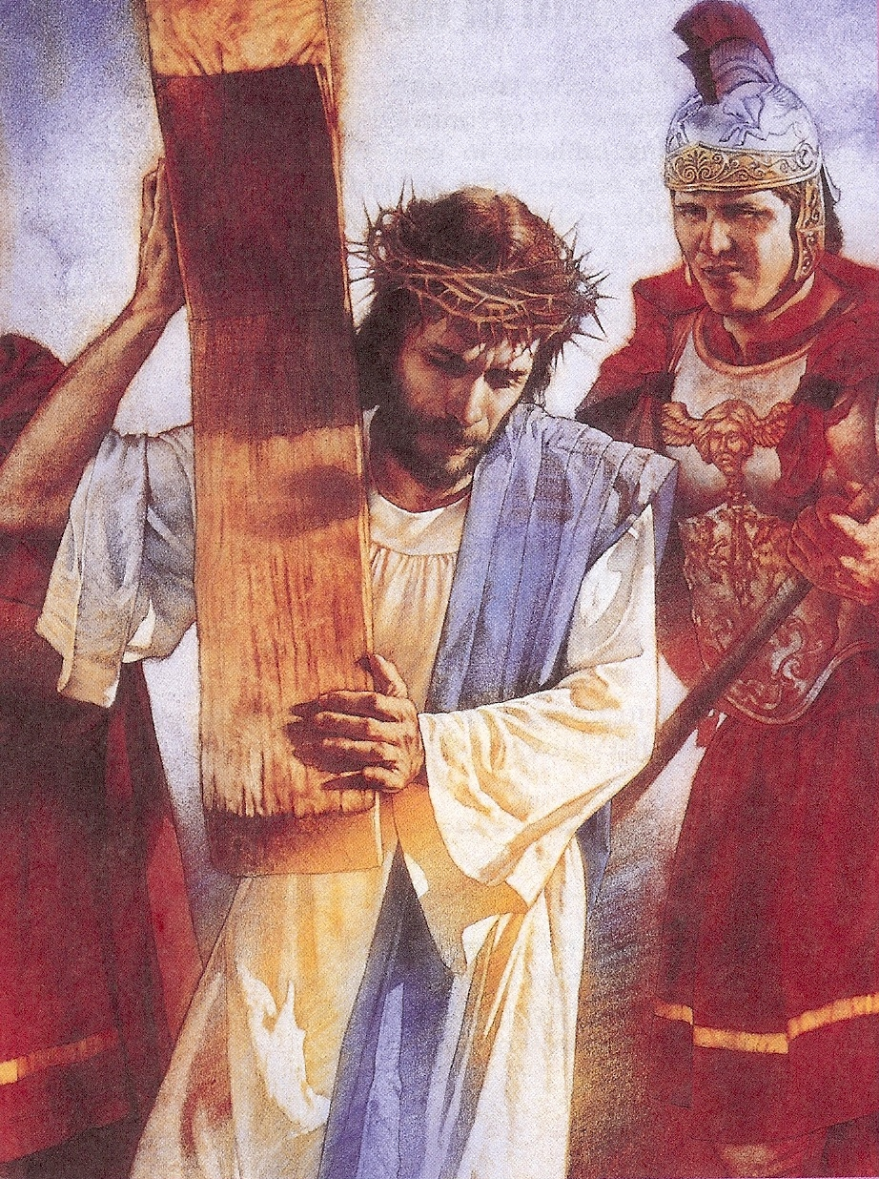
“For He hath made Him to be sin for us, who knew no sin; that we might be made the righteousness of God in him.” ( II Cor. 5:21)

Slide 42
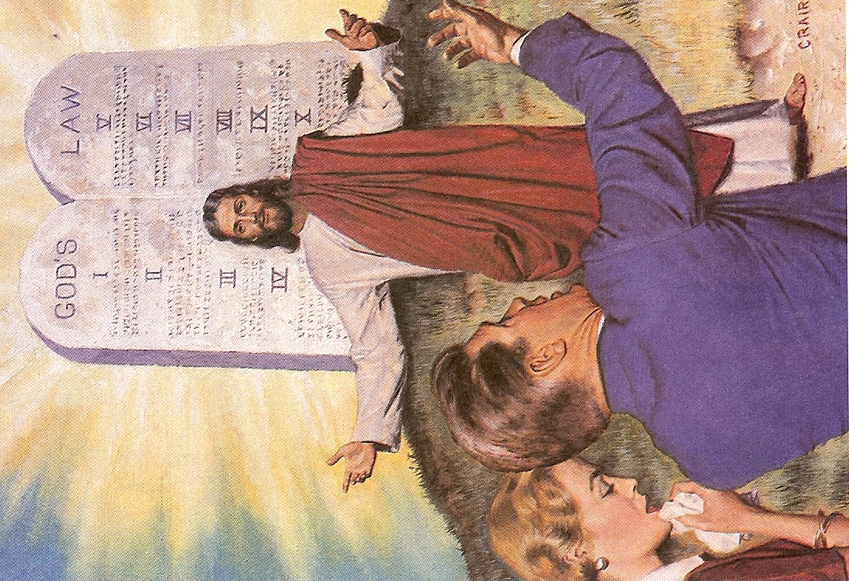

Slide 43

To make reconciliation for iniquity

Slide 44
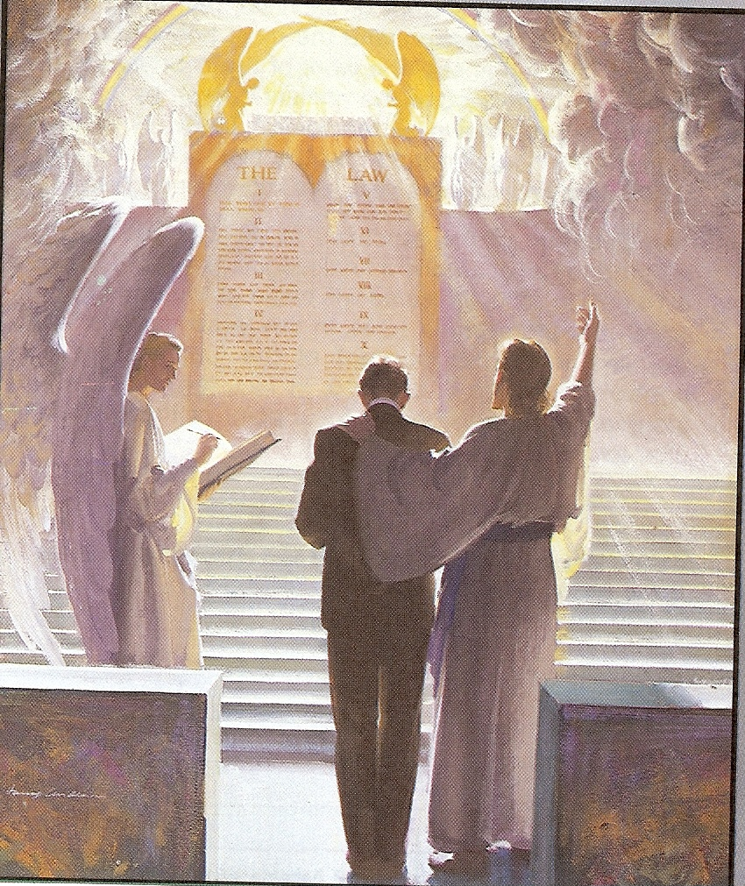
“There is therefore now no condemnation to them which are in Christ Jesus.”
(Romans 8:1)

Slide 45


Bring in everlasting righteousness

Slide 46
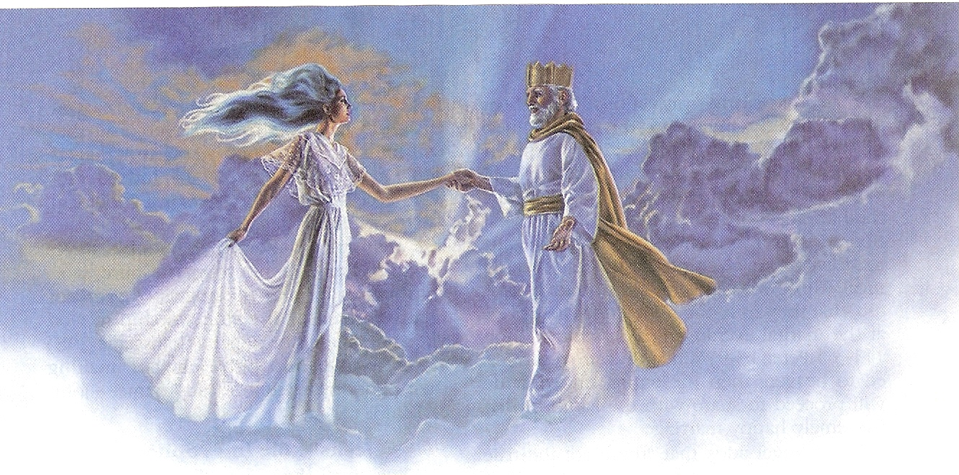

Slide 47
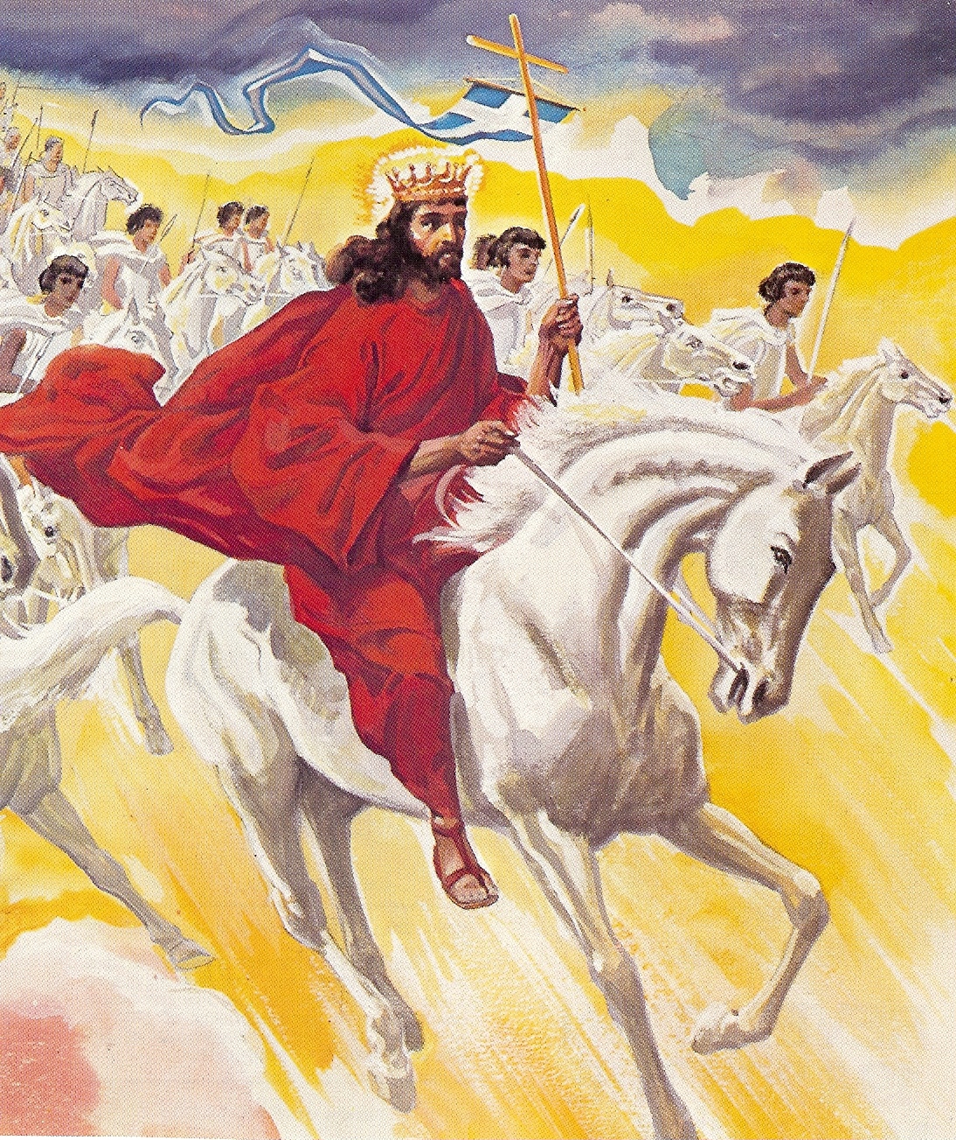

Slide 48
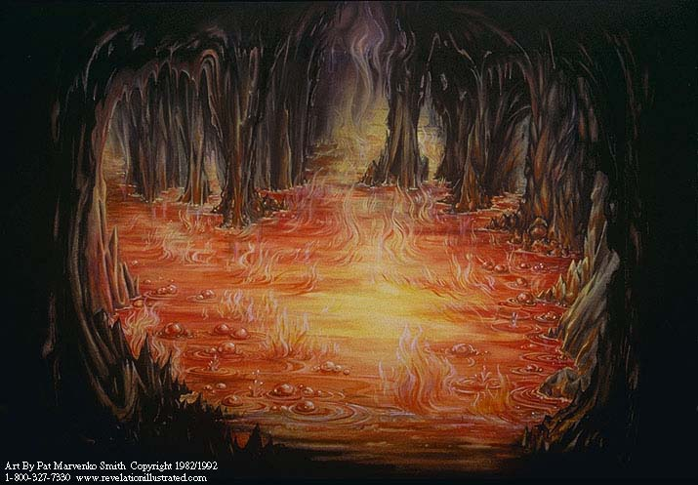
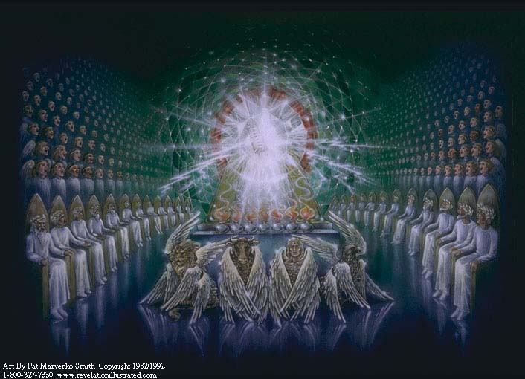
“And death and hell were cast into the Lake of Fire” (Rev. 20:14)

Slide 49


Slide 50


Slide 51

To seal up the vision and prophecy
“Shut up the words, and seal the book, even to the time of the end.”
(Daniel 12:4)

Slide 52
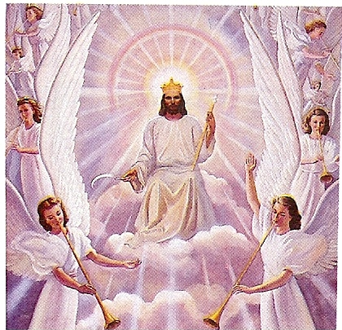
To anoint the most Holy one
“And of his kingdom there shall be no end.” (Luke 1:33)

Slide 53
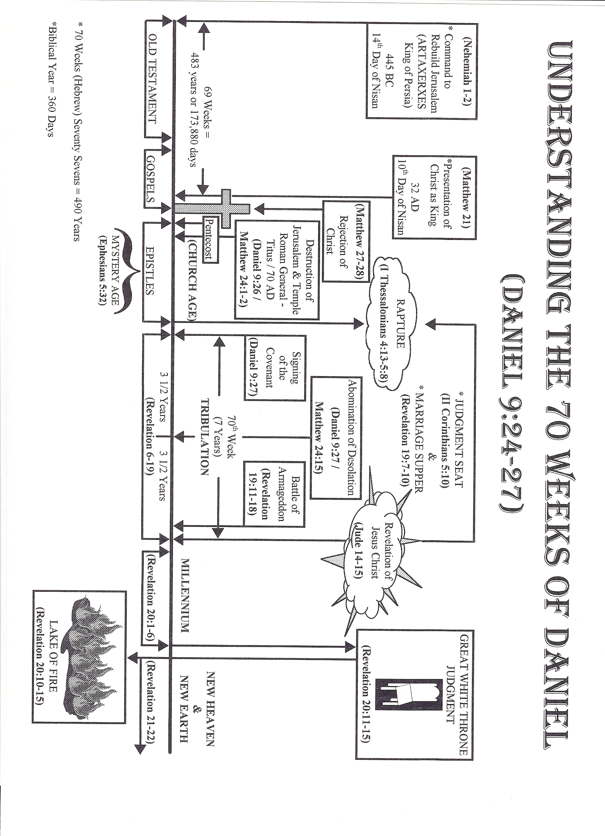

Slide 54
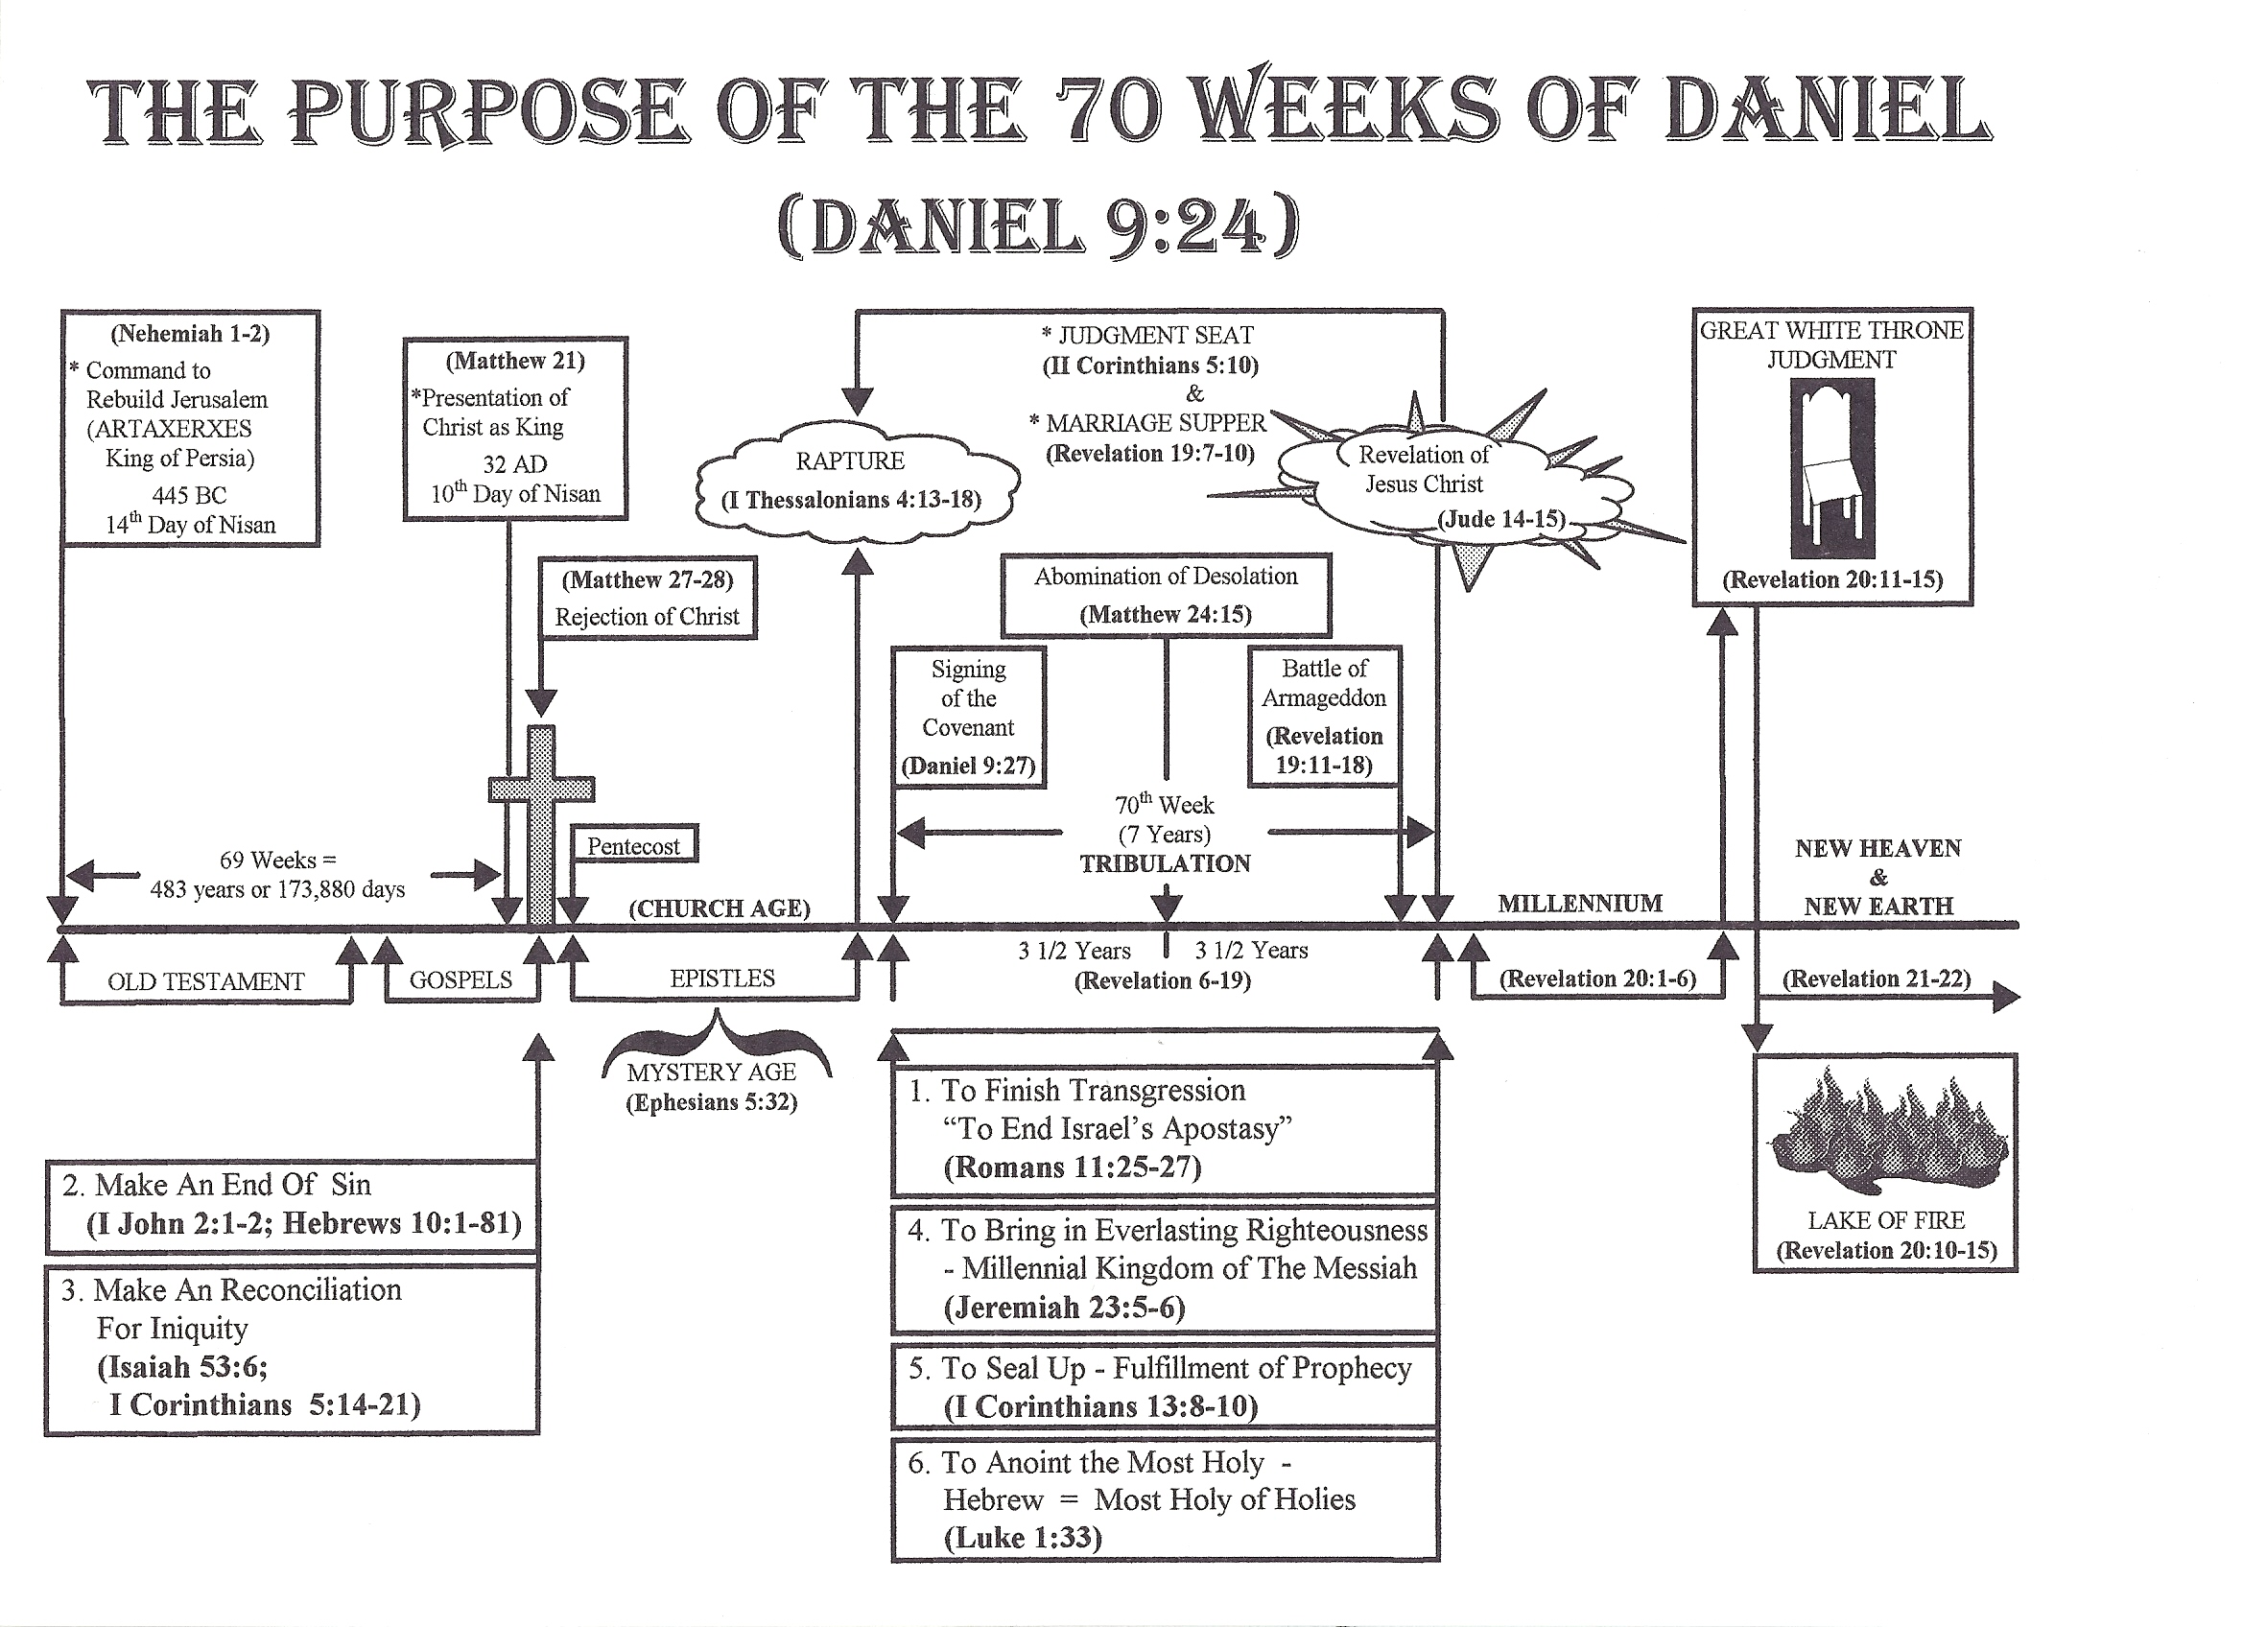

Slide 55
DANIEL’S VISION OF THE
SEVENTY WEEKS
(Daniel 9:24-27)
THE CONTEXT OF DANIEL’S VISION - Daniel 9:1-13
Before we consider Daniel’s vision of the seventy weeks it is important for us to consider the context in which the vision took place.
The time of the vision - Daniel 9:1-2
a. Daniel’s vision took place in the first year of the reign of Darius the Mede who was king over the realm of the Chaldeans (Babylonian Empire).
b. The date of Daniel’s vision was 538 BC.
c. Daniel’s vision of the seventy weeks took place in the same year he was cast into the den of lions - Daniel 6:10-28

Slide 56
Daniel tries to understand the vision of the “King of Fierce Countenance” (Anti-christ) - Daniel 8:23-27
a. Daniel was sick for several days - Daniel 8:27
b. Daniel seeks an understanding of his vision through the Word of God -
Daniel 9:1-2
NOTE: Approximately 13 years had elapsed between Daniel’s vision in chapter
8 and His vision in chapter 9:24-27
1) Daniel was reading the Word of God in order to gain an understanding of his vision - “. . . I Daniel understood by the books the number of years. . .”
2) Daniel discovers a prophecy of Jeremiah concerning seventy years of Babylonian captivity - Jeremiah 25:11; 29:4-10
a) The reason for the seventy year captivity - II Chronicles 36:21
b) The seventy years of captivity began in 605 BC - Daniel 1:1-2
c) Sixty eight years of the seventy years had already past.
d) Isaiah prophesied that Cyrus King of Persia would end the seventy year captivity with an edict allowing Israel to return to their land -
Isaiah 44:28

Slide 57
3) Daniel is perplexed over the vision concerning the restoration of Israel to their homeland of Palestine - Daniel 7:1-8:27
a) According to Jeremiah and Isaiah the captivity of Israel was almost over and should climax in about two years.
b) Daniel however had just seen four world empires that would arise before Israel would be restored in their homeland as a nation
NOTE: At this time only Babylon had risen and fallen - Daniel 5:30
c) Daniel seeks and understanding of his vision through prayer,
supplications, and fasting - Daniel 9:3-19

Slide 58
Daniel’s vision – (Daniel 7:1-8:14)
Lion – Babylon
Bear – Medo-Persian
Leopard – Greece
Dreadful beast – Rome
Nebuchadnezzar’s vision - (Daniel 2:1-45)
Head of gold – Babylon
Breast and arms of silver – Medo-Persian
Belly and thighs of brass – Greece
Legs of Iron – Rome
(Restoration of Israel)
Feet of clay and iron – Ten nation Federation over which the Anti-Christ will rule during the Tribulation – Rev. 13:1-12
NOTE: At this time only Babylon had risen and fallen - Daniel 5:30
c) Daniel seeks and understanding of his vision through prayer,
supplications, and fasting - Daniel 9:3-19

Slide 59
3. God interrupts Daniel’s prayer in order to give him an understanding of his vision - Daniel 9:20-23
NOTE: What Daniel was about to discover was that the seventy years of captivity in Babylon was only a type of a longer dispersion that would last seven times as long as the seventy years (490 years) -
Daniel 9:24 “Seventy weeks (seventy sevens) are determined upon thy people (Israel). . .”
THE CONTEXT OF DANIEL’S VISION - Daniel 9:24-27
The angel Gabriel reveals to Daniel that a period of seven times as long as the one mentioned by Jeremiah, which he has just been studying, is yet to pass before God’s plan for Israel will be consummated.

Slide 60
Daniel’s vision of the seventy weeks is one of the most important revelations in all of Scripture -
a. It gives the interpretation of prophetic chronology.
b. It reveals the time and purpose of Christ’ first coming.
c. It foretells the rejection of Christ in his first coming.
d. It prophesies the destruction of Jerusalem (70 AD).
e. It predicts the length of the Tribulation period (7 years).
f. It unveils the rise of the Anti-Christ, the signing of the peace covenant, and the abomination of desolation.

Slide 61
The six fold purpose of the seventy weeks - Daniel 9:24
NOTE: It is extremely important to keep in mind that this vision of Daniel has to do only with Daniel’s people, the Jews, and that the events will take place in the Holy City of Jerusalem (the Church is not in view in Daniel’s vision).
a. To finish the transgression (end Israel’s apostasy –
Romans 11:25-27
b. To make an end of sin - Romans 11:26-27; Hebrews 10:1-18
c. To make reconciliation for iniquity -
Isaiah 53:6; II Corinthians 5:121
d. To bring in everlasting righteousness -
Psalms 2; Jeremiah 31:33-34;Luke 1:33
e. To seal up the vision and prophecy - I Corinthians 13:8-10

Slide 62
NOTE: Vision (knowledge) and prophecy will be no more. Because God will be present with his people in the person of His Son the Lord Jesus Christ there will be no need of visions or prophecy when Christ rules in his Millennial Kingdom.
NOTE: Jesus is the Word of God (Logos - John 1:1, 14) and as the personal revelation of God, the Word of God will go forth from His throne.
f. To anoint the Most Holy (Jesus Christ – King of kings) - Ezekiel 41-42
NOTE: This anointing takes place when Jesus returns in His second-
coming and establishes his earthy kingdom - Revelation 19-20
[ ] THE CONTEXTUAL INTERPRETATION OF DANIEL’S VISION -
Daniel 9:24-27
1. The Seventy Weeks - Daniel 9:24
a. The word “week” is used because we have no word in the English language that is the exact equivalent of the Hebrew which signifies seven.
      The translators of the King James Version used “week” instead of “sevens”.
      “Seventy sevens are determined upon thy people. . .”
      It is as we read the context that we discover that Daniel is speaking of
years, not days or months - Daniel 9:2

Slide 63
1. The Seventy Weeks - Daniel 9:24
  a. The word “week” is used because we have no word in the English language that is the exact equivalent of the Hebrew which signifies seven.
The translators of the King James Version used “week” instead of “sevens”.
“Seventy sevens are determined upon thy people. . .”
b. It is as we read the context that we discover that Daniel is speaking of
years, not days or months - Daniel 9:2
NOTE: 70 x 7 = 490 years
2. The beginning of the Seventy Weeks (490 years) - Daniel 9:25
a. The seventy weeks begin with the order of King Artaxerxes to rebuild Jerusalem.
Note: This decree was given to Nehemiah the beloved cup bearer of
Artaxerxes King of Persia - Nehemiah 1-2

Slide 64
NOTE: Because of Nehemiah’s prayer and personal testimony
Artaxerxes granted Nehemiah’s request to return to Jerusalem
and rebuild the city.
b. The date of King Artaxerxes’ command to rebuild Jerusalem was the 14th day of Nisan in the year 445 BC.
3. The revealing of Israel’s Messiah - Daniel 9:25
a. After seven weeks and threescore and two weeks the Messiah Prince will come.
b. Seven weeks (49 years) plus threescore and two weeks (62 weeks or 434 years) - 49 years + 434 years = 483 years

Slide 65
The rejection of Israel’s Messiah - Daniel 9:26
a. After threescore and two weeks (434 years) plus the seven weeks (49
years) - Daniel 9:25, Messiah will be cut off - Calvary (rejection of
Jesus as Messiah)
* Threescore and two weeks plus seven weeks equal 483 years or
173,880 days
* Command to rebuild the temple 445 BC - 14th day of Nisan
* The entry of Christ into Jerusalem - 32 AD on the 10th day of Nisan
- Matthew 21
* Taking into consideration that a Biblical year was 360 days, Jesus
presented himself as Israel’s Messiah 483 years after Artaxerxes gave
the command to rebuild Jerusalem or 173,880 days.
Perfect Fulfillment!!!

Slide 66
b. “. . .Messiah would be cut off, but not for himself. . .” - Romans 5:1-11
II Corinthians 5:14-21; I Peter 2:21-24
“. . . God commendeth his love toward us, in that, while we were yet
sinners Christ died for us.” Romans 5:8
5. The destruction of Israel and the temple - Daniel 9:26 - “. . . the prince
that shall come shall destroy the city. . .”
NOTE: This happened in 70 AD by the Roman General Titus in order to
crush the rebellion of the Jewish zealots - Jesus spoke of this
happening - Matthew 24:1-2

Slide 67
The Rise of the Anti-Christ and the Final week (70th) - Daniel 9:27
  The signing of the Covenant will be the beginning of the last seven years in Israel’s history.
  From the end of the 69 weeks (483 years) we have been living in the Church age.
  That age will end with the Rapture of the Church – (II Thessalonians 4-5)
  After the rapture Anti-Christ will reveal himself - (II Thessalonians 2)
  He will confirm a covenant with Israel and many other nations
  (Peace Agreement) -
  The temple will be rebuilt and there will be 3 1/2 years of peace –
  (I Thessalonians 5:1-4).

Slide 68
    a. Middle of the Week - (3 1/2 years) middle of the Tribulation Anti-Christ will exercise the abomination of desolations - Matthew 24:15; II Thessalonians 2:4-5
* Daniel 7:25 - Time (year) times (two years) and half of times (1/2
years) = 3 1/2 years
* Revelation 12:6 - 1260 days
* Revelation 11:2; 13:5-6 - 42 months
b. At the end of the 70 weeks (490 years) Jesus Christ will return in Power and Great Glory (Matthew 24:15-31, to establish His Kingdom on earth (Revelation 19-20).

