Slide 1
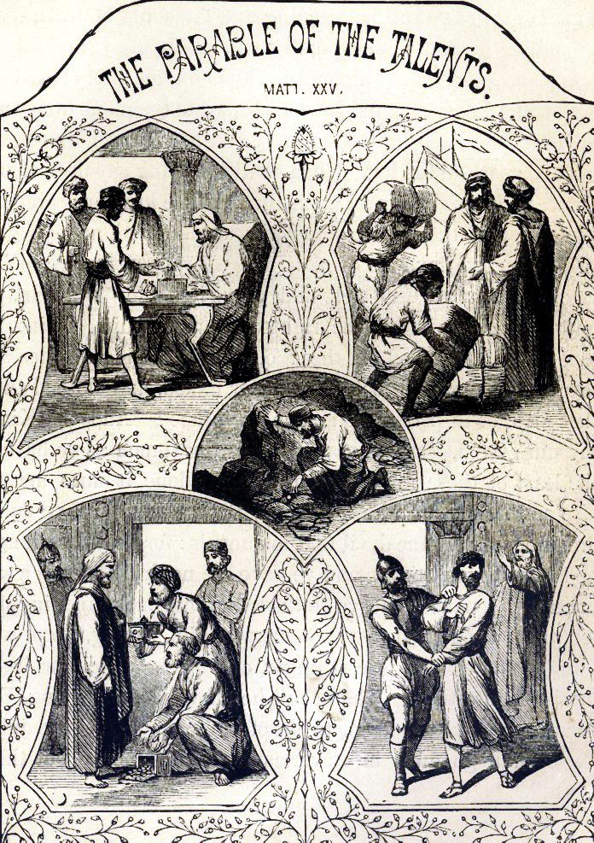
Prophetic Parable
“The parable of the talents”
(Matthew 25:14-31)

Slide 2
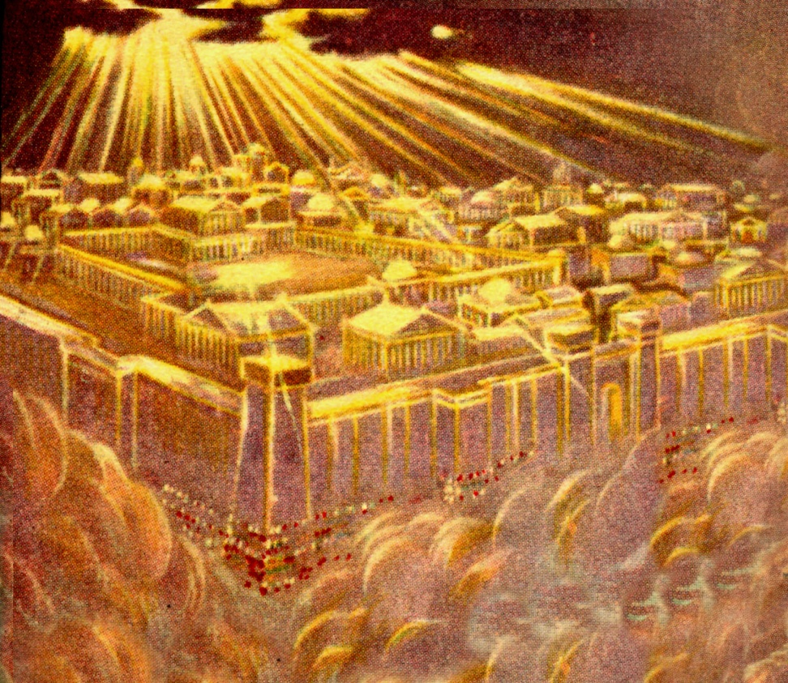
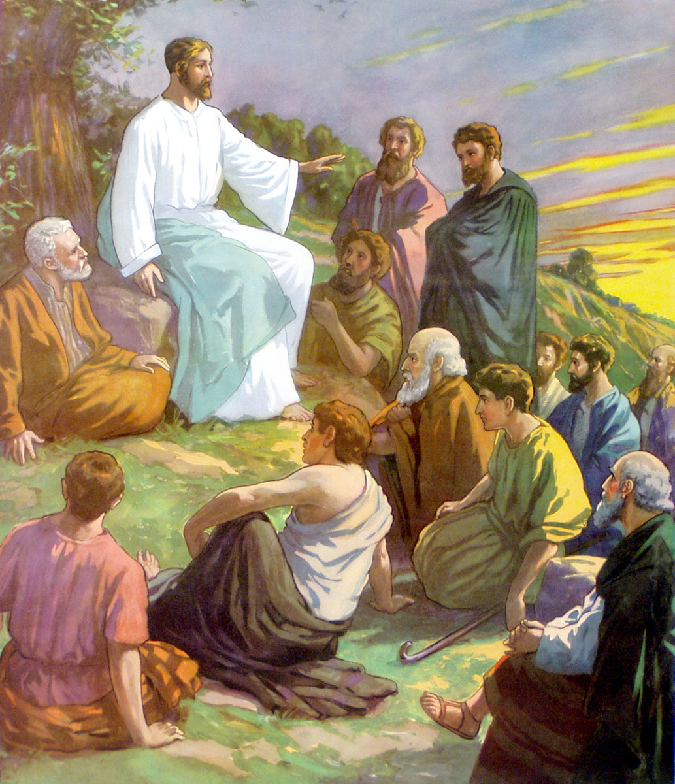
“For the kingdom of heaven is as a man traveling into a far country.”
(Matthew 24:45-51)
(Luke 19:11-27)

Slide 3
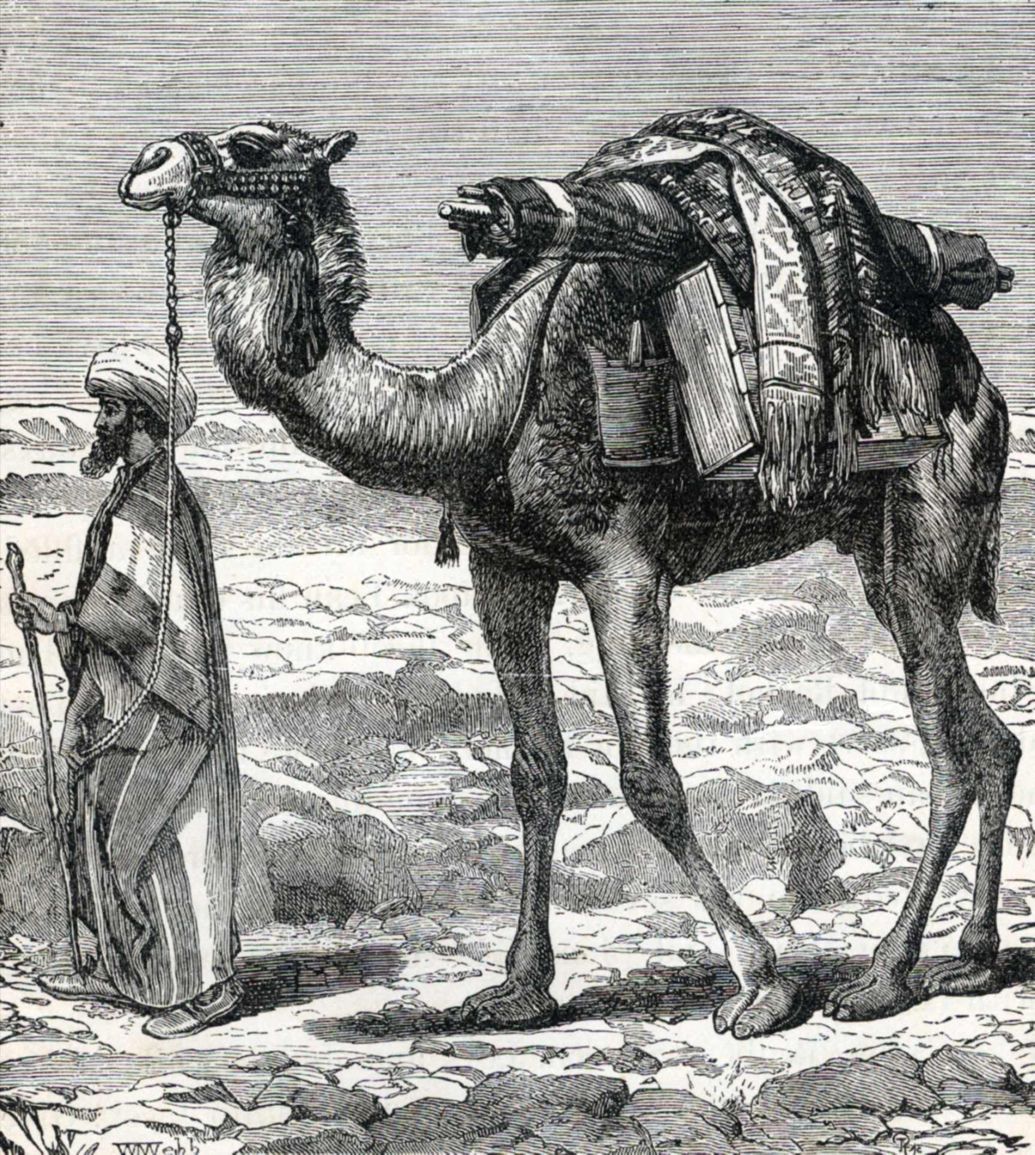

Slide 4
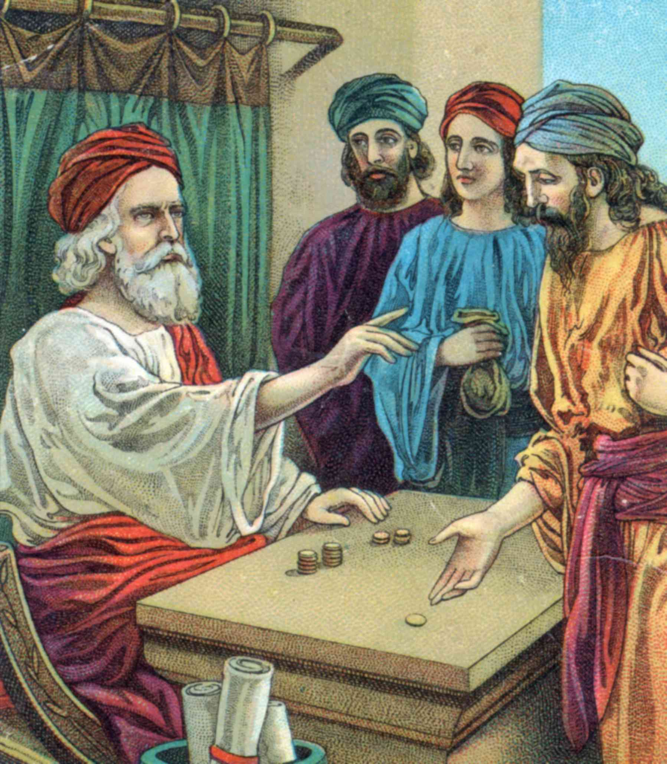
“Called his own servants, and delivered unto them his goods…to every man according to his several (own) ability…”

Slide 5

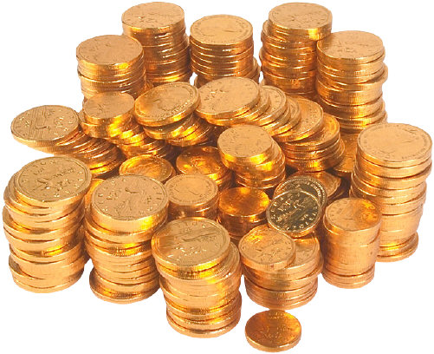

Slide 8
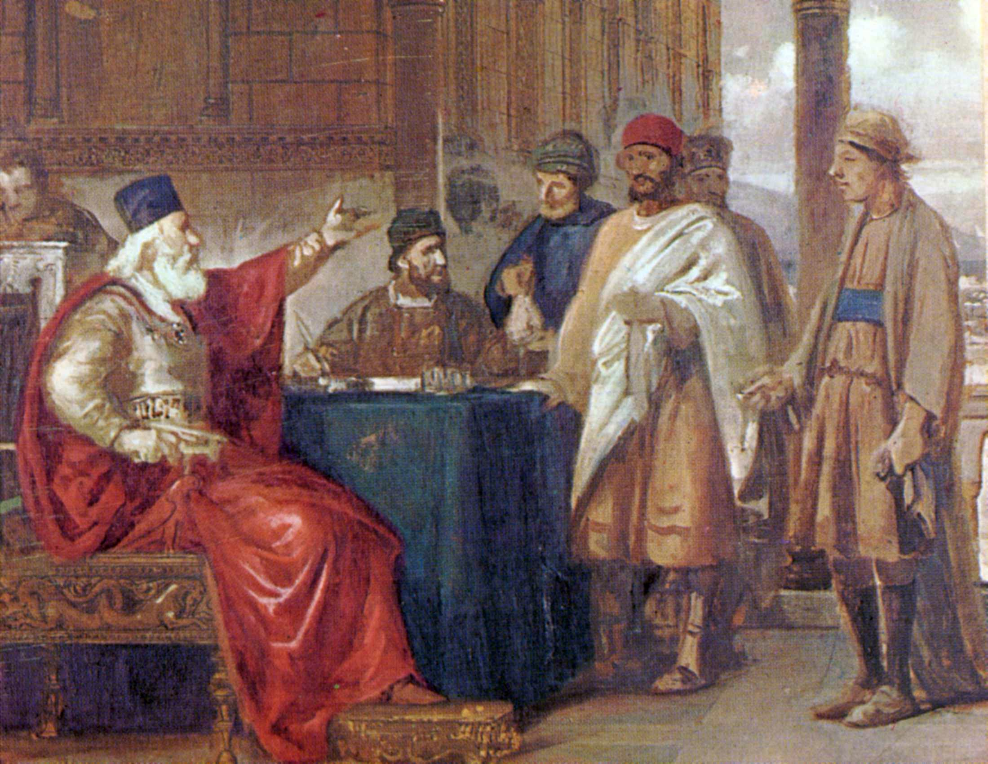
“Occupy till I come…”

Slide 9

“A certain nobleman went into a far country to receive for himself a kingdom, and to return…and he called unto him his servants (stewards) and said unto them, occupy
(busy yourself in trade and investing) till I come.”
(Luke 19:12-13)

Slide 10
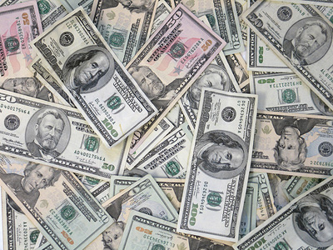
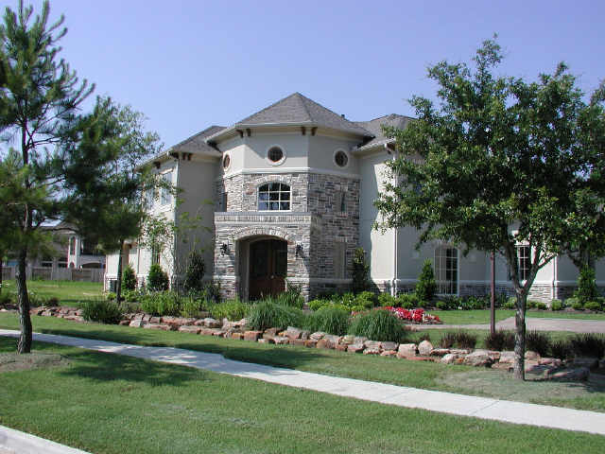
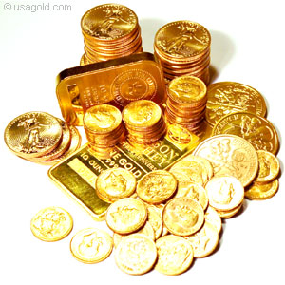
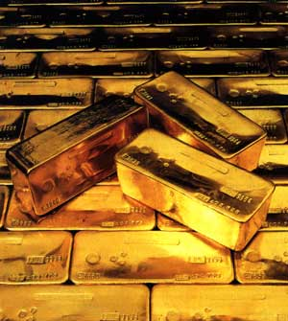
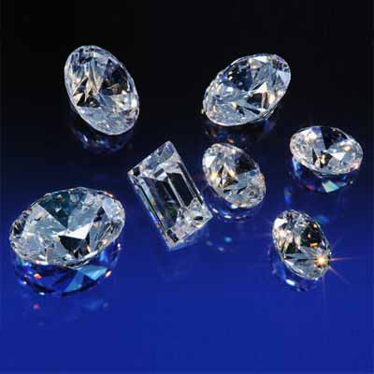
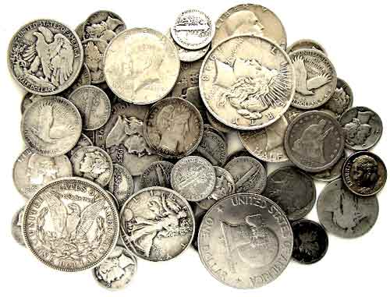
“And he that had received the five talents went and traded with the same, and made them other five talents.”

Slide 11

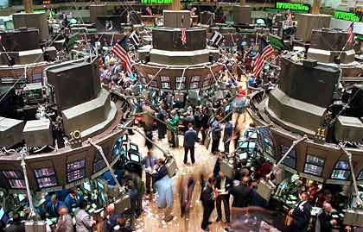

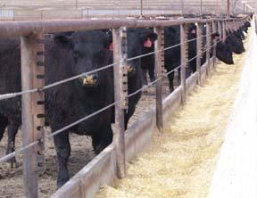
“He that received two, he also gained another two.”

Slide 12
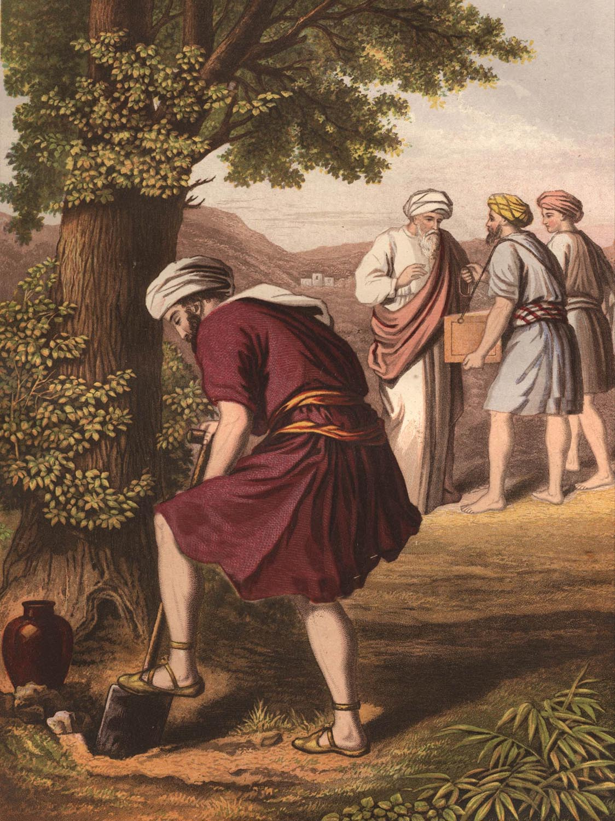
“He that had received one went and digged in the earth, and hid his lord’s money.”

Slide 13
Excuse – “I knew thee that thou
art a hard (demanding)
man…and I was afraid.”
Truth – “Thou wicked and slothful servant.”

Slide 14

Our Talents
Life
Abilities
Gifts
Talents
Possessions
Money
Investments
Resources
Spiritual gifts

Slide 15
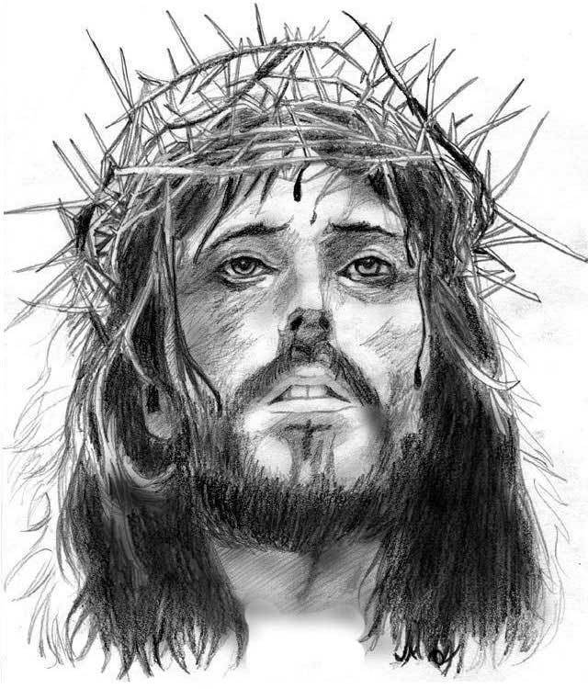
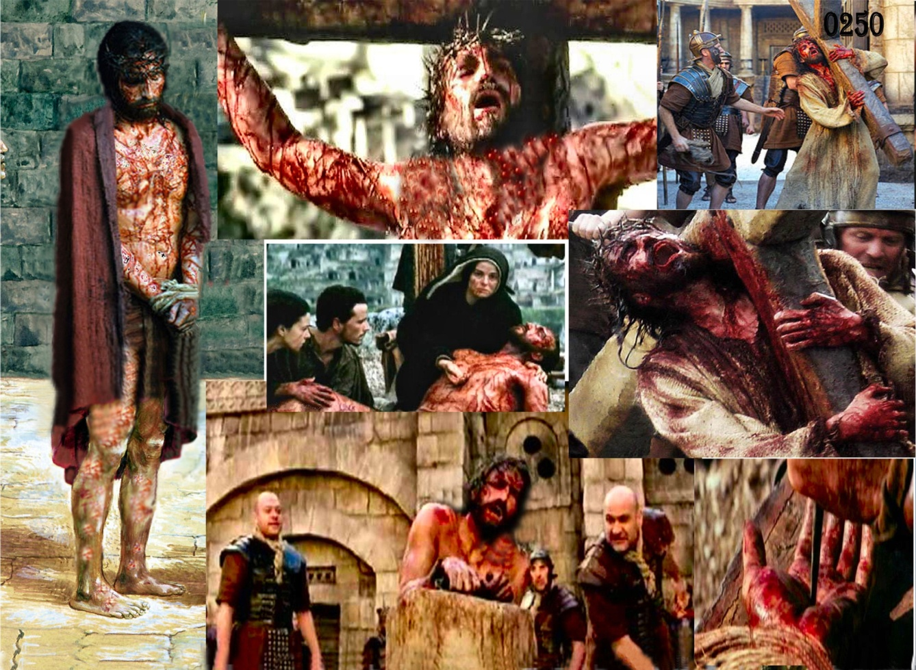
“For ye are bought with a price; Therefore glorify God in you body, and in your spirit, which are God’s…Ye are bought with a price; be not ye the servants of men.”

Slide 16


“As every man hath received the gift, even so minister the same one to another, as good stewards of the manifold grace of God.”

Slide 17

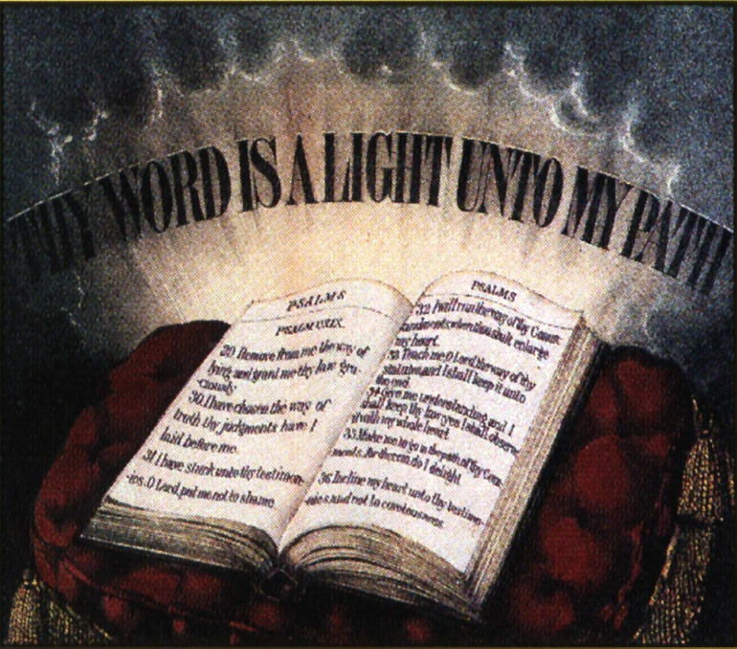
“Now concerning spiritual gifts, brethren, I would not have you ignorant.”
(I Corinthians 12:1)

Slide 18

“…to every man according to his several (own) ability…”
“There are diversities (different kinds) of gifts, but the same Spirit…But the manifestation of the Spirit is given to every man to profit withal…to one is given___________, to another is given ____________, but all these worketh that one and the selfsame Spirit dividing to every man severally (individually) as he will.”
(I Corinthians 12:4-11)

Slide 19
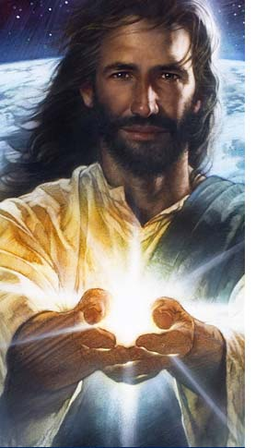

“And He (Christ) gave gifts unto men…for the perfecting of the saints, for the work of the ministry, for the edifying of the body of Christ.”
(Ephesians 4:8-13)

Slide 20

Seven Motivational Gifts
(Romans 12:3-8)
Prophet
Server
Teacher
Exhorter
Giver
Organizer
Mercy

Slide 21
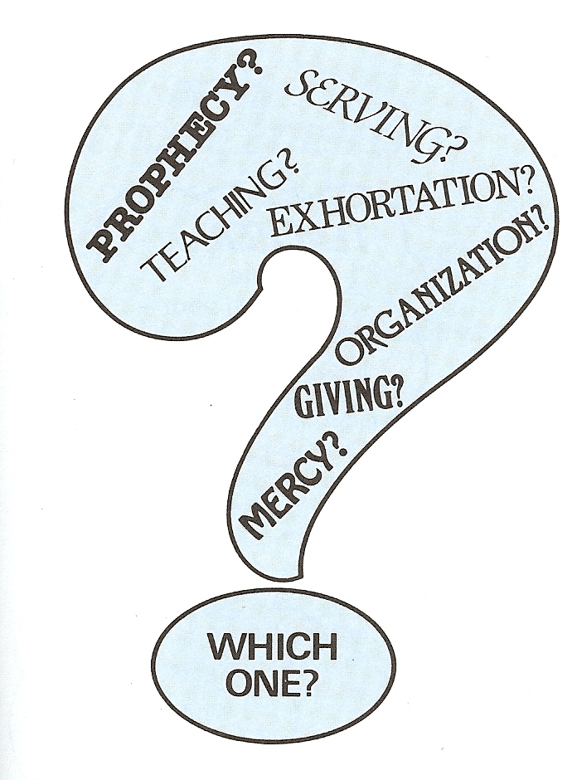

Slide 22
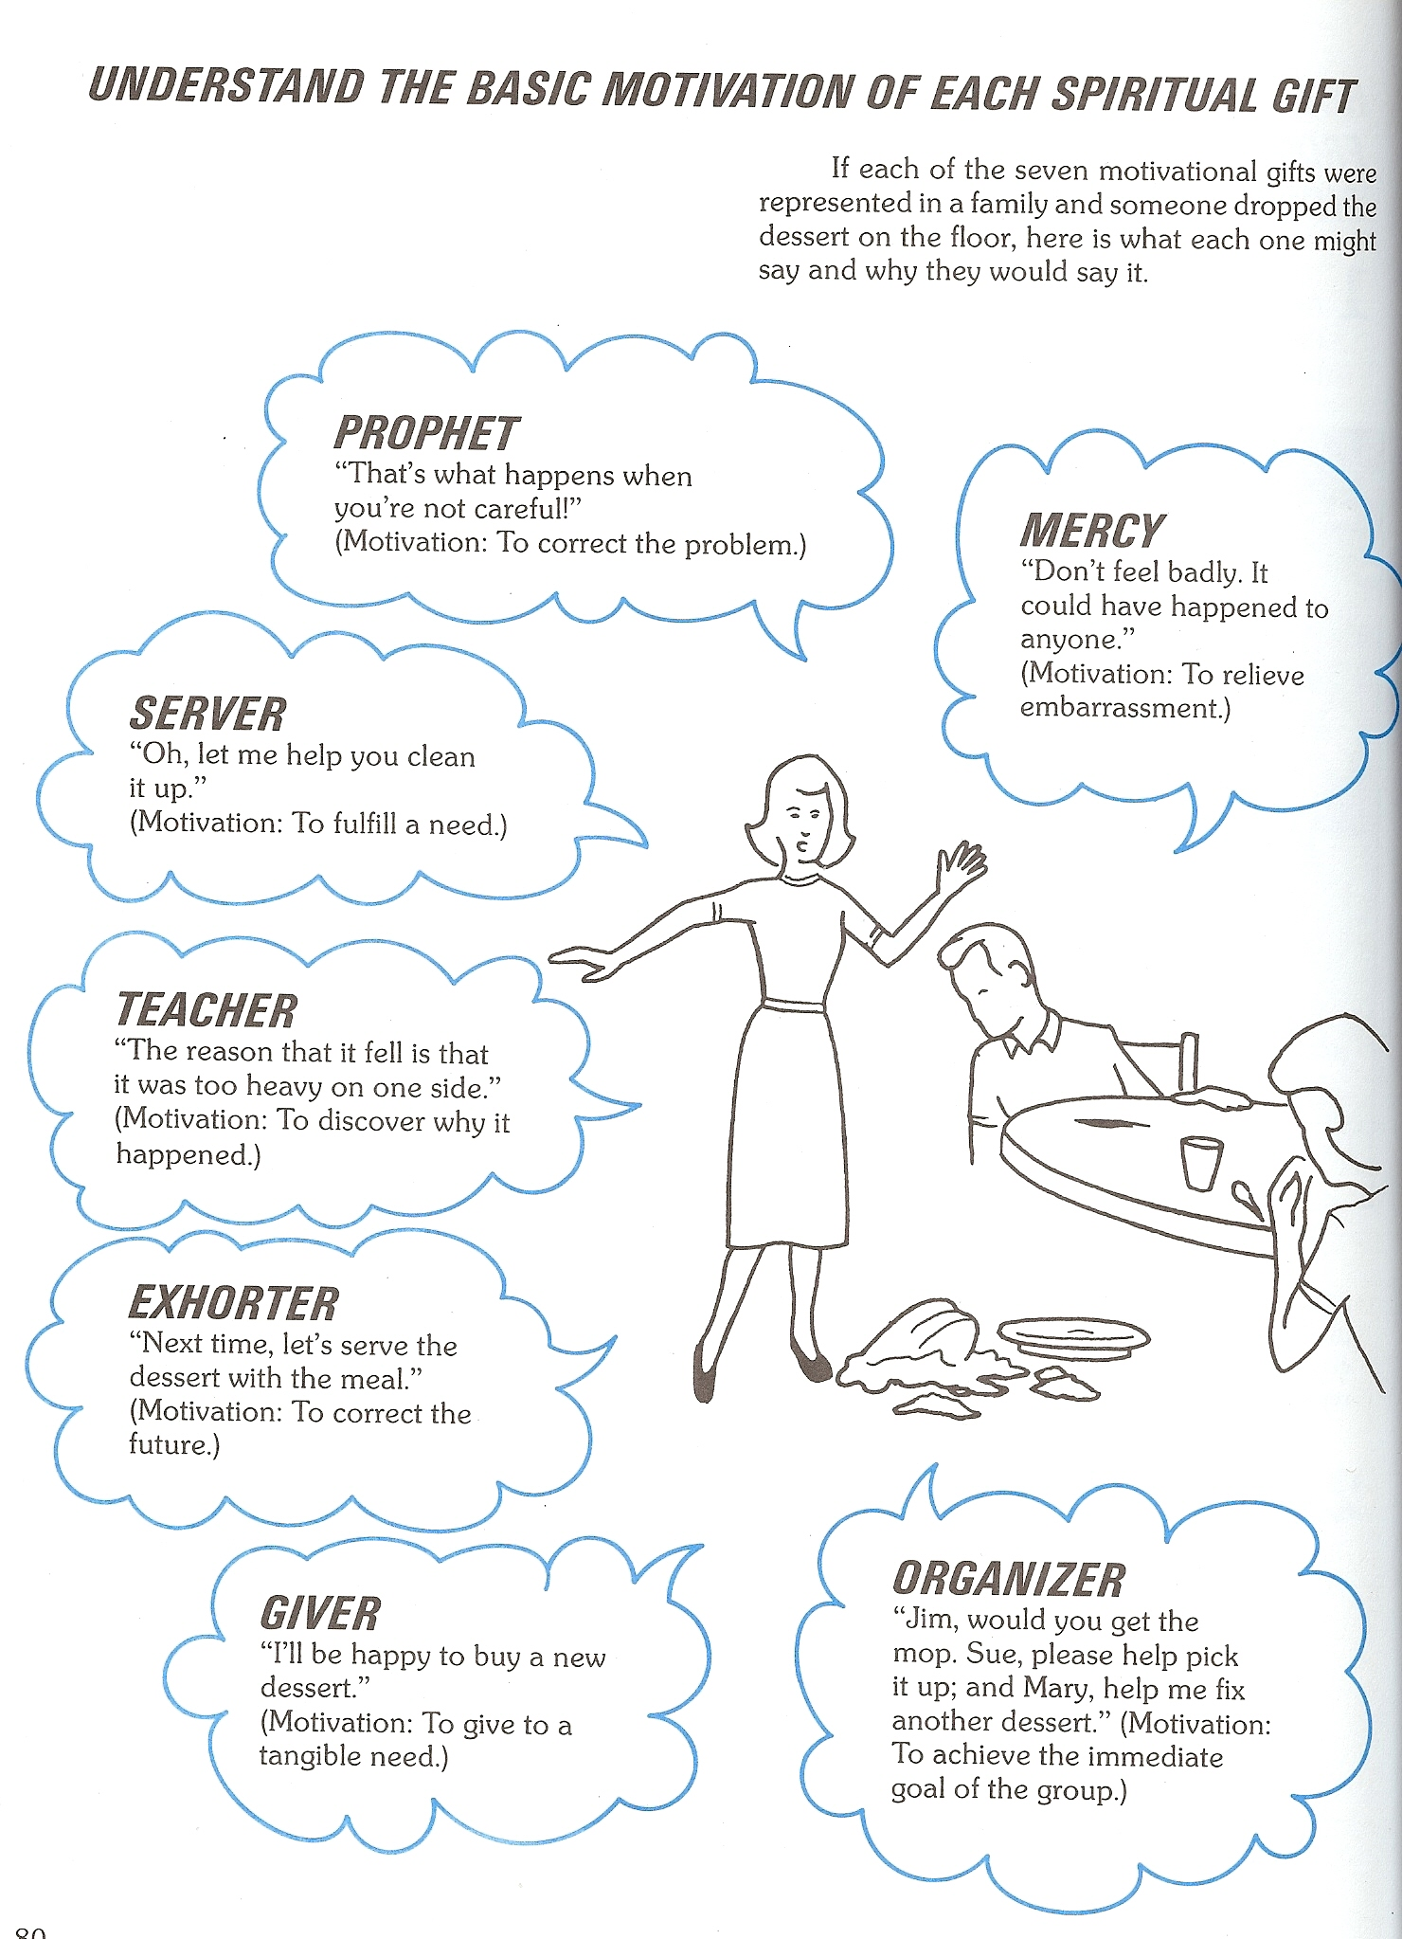

Slide 23
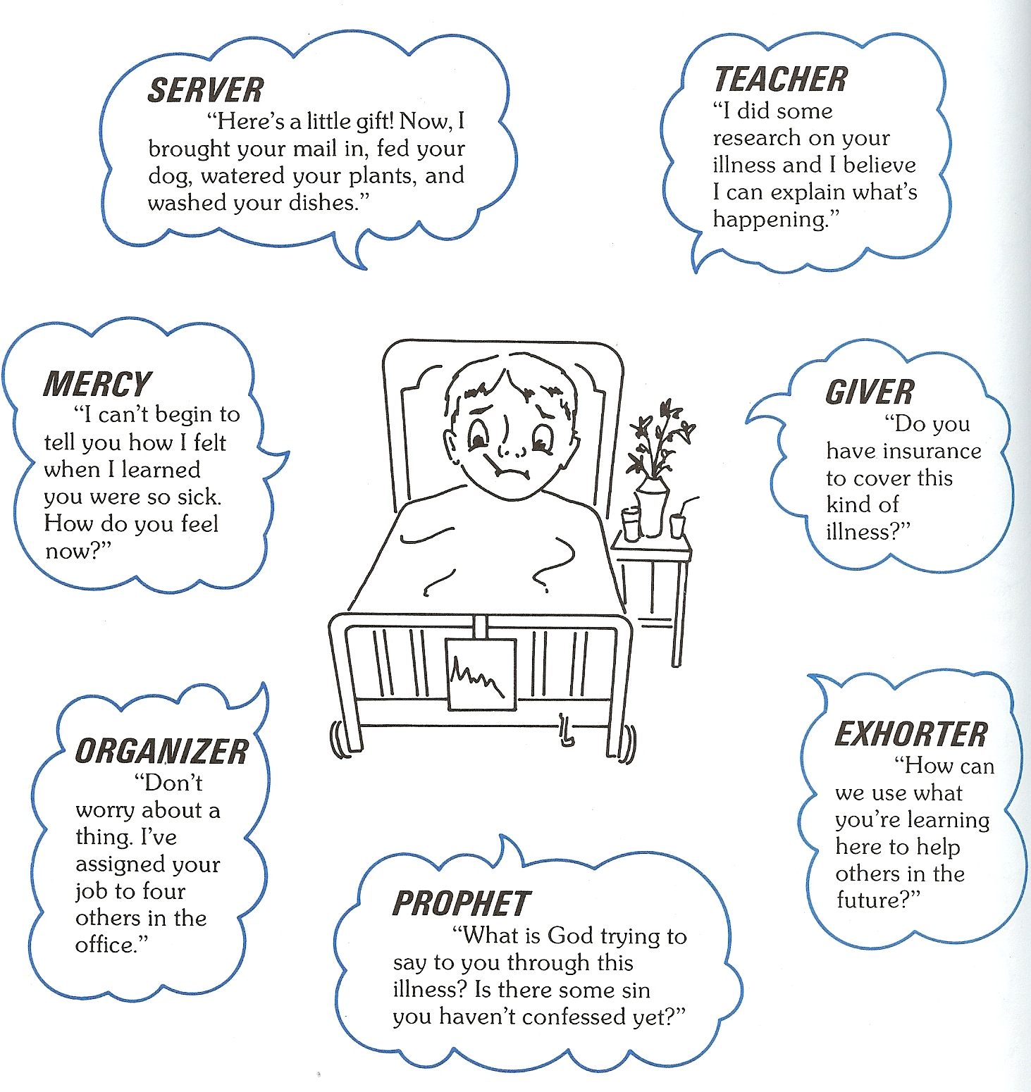

Slide 24
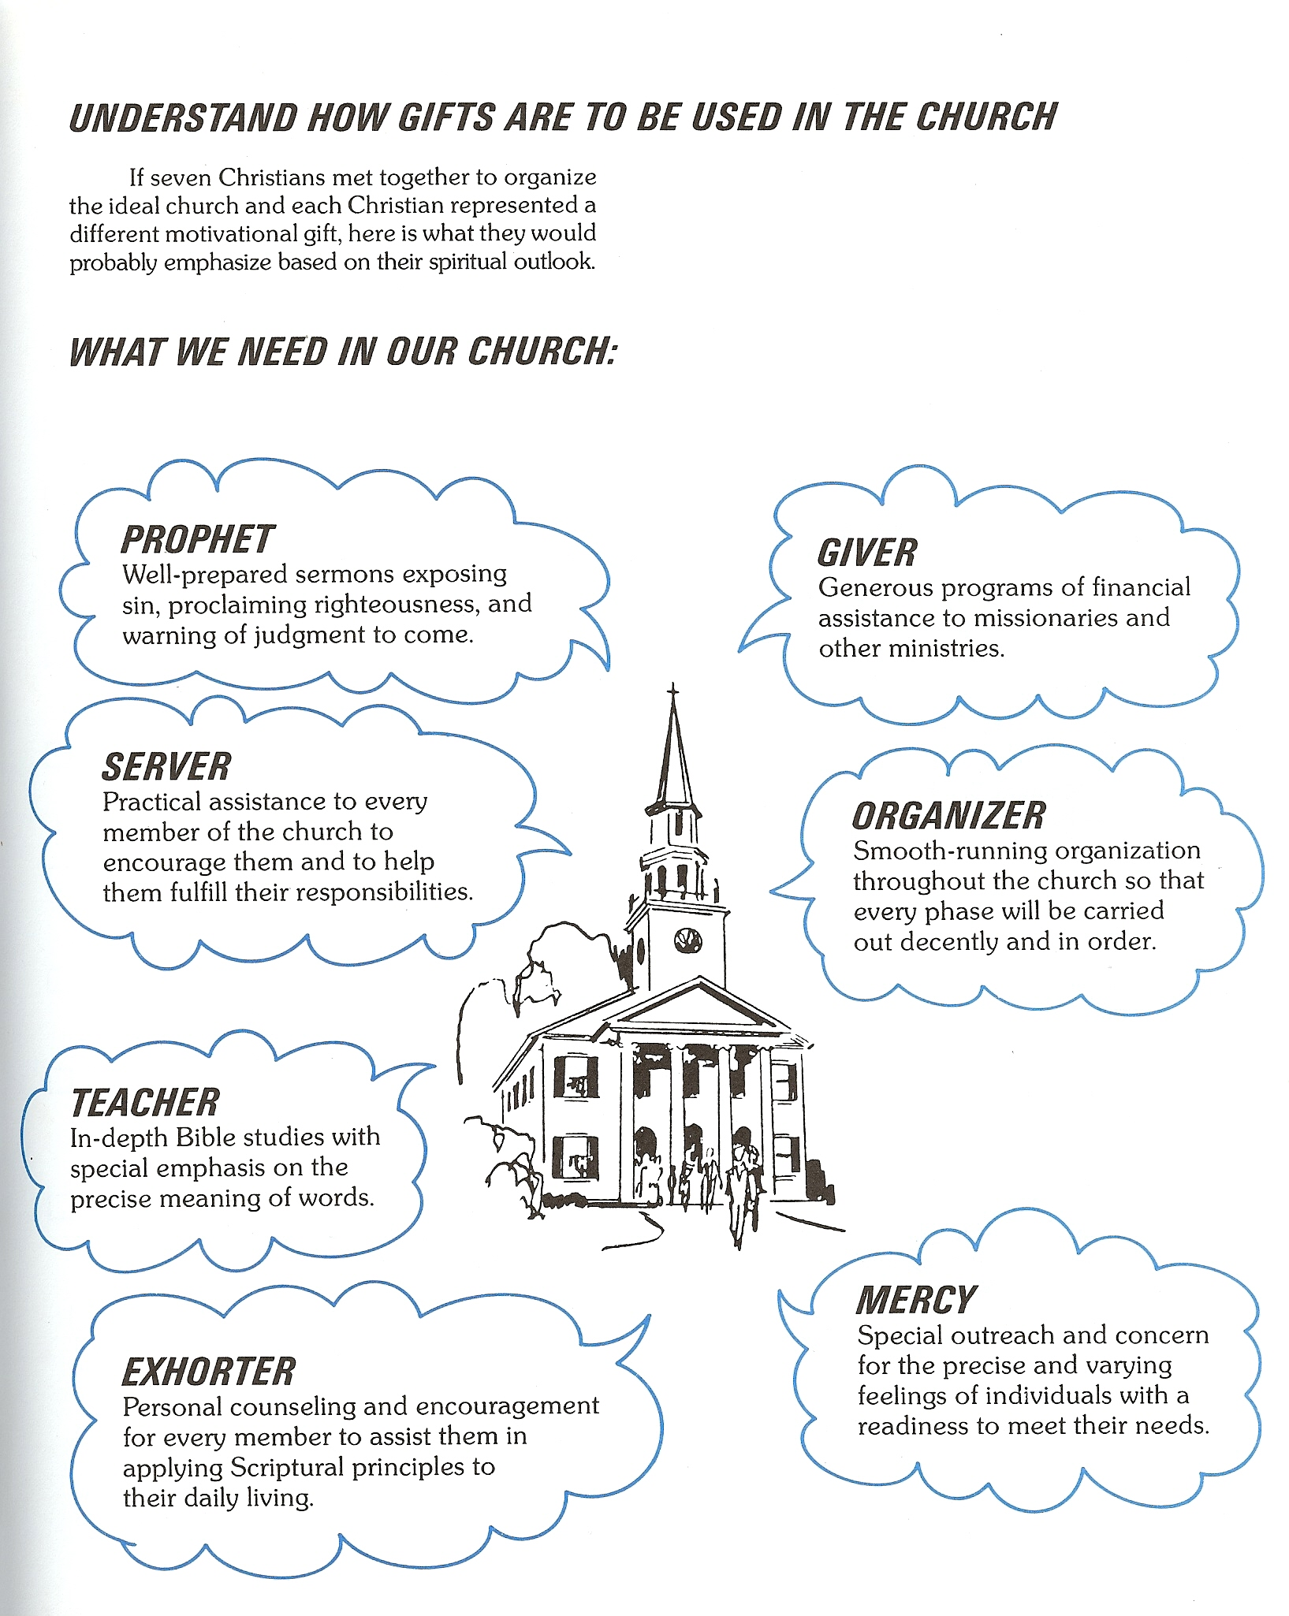

Slide 25
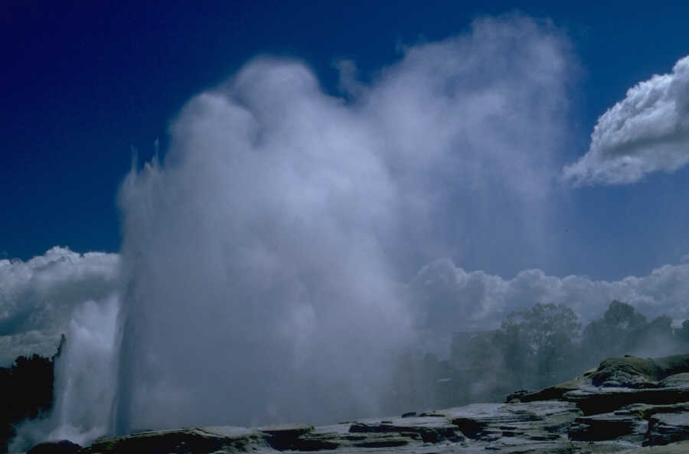
“Who then is that faithful and wise steward, whom his lord shall make ruler over his household, to give them their portion of meat in due season?”

Slide 26
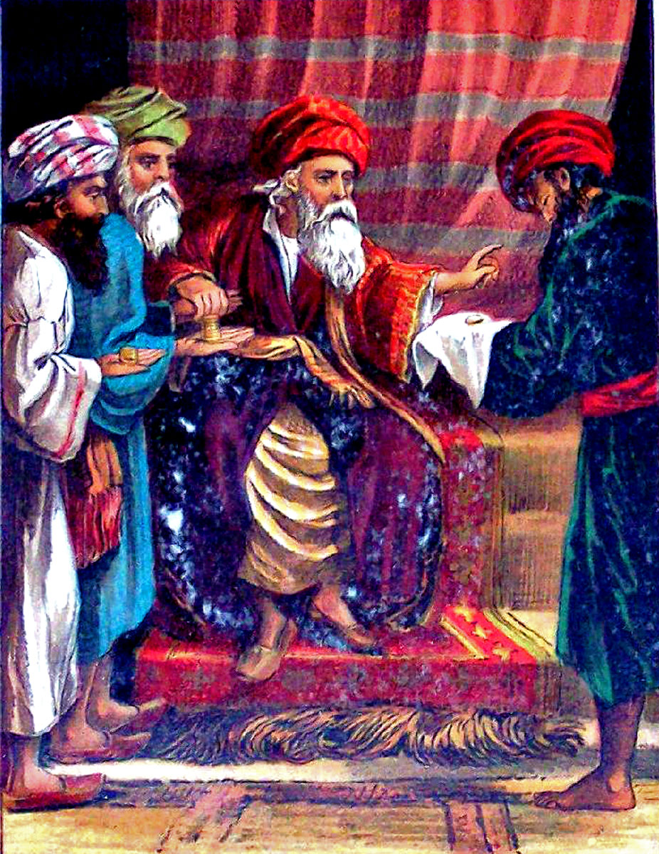
“Moreover it is required in stewards, that a man be found faithful.”

Slide 27
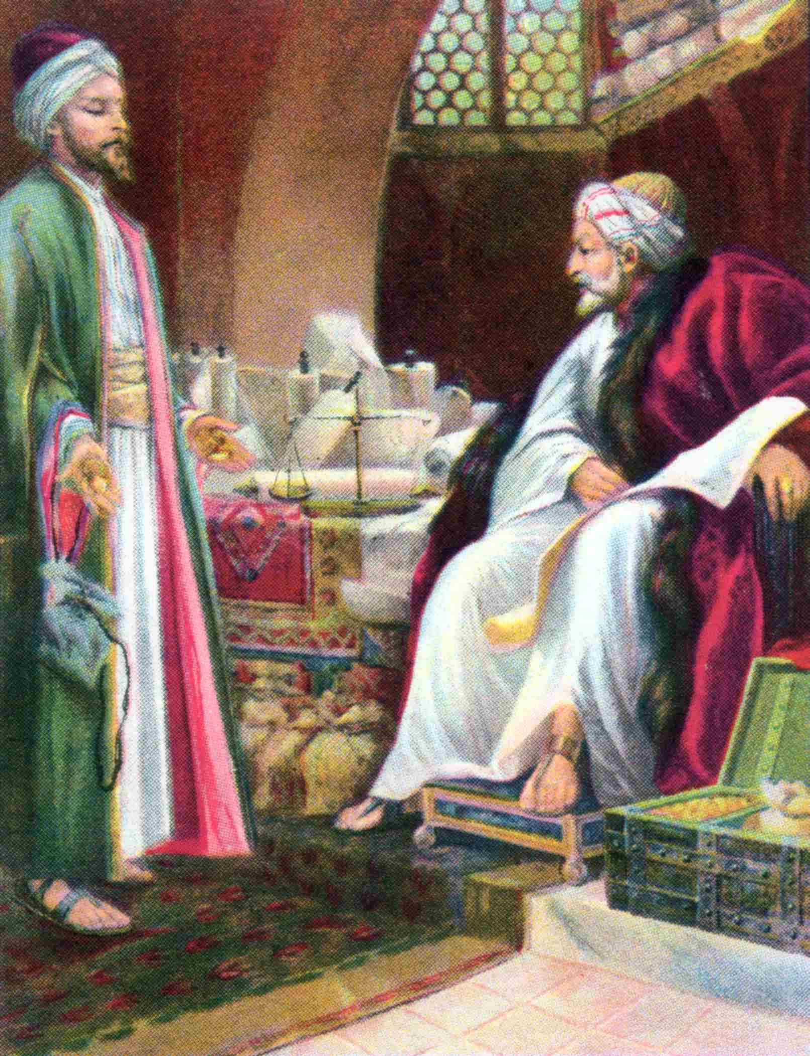
“Well done, thou good and faithful servant: thou hast been faithful over a few things, I will make thee ruler over many things: enter thou into the joy of the Lord.”

Slide 28
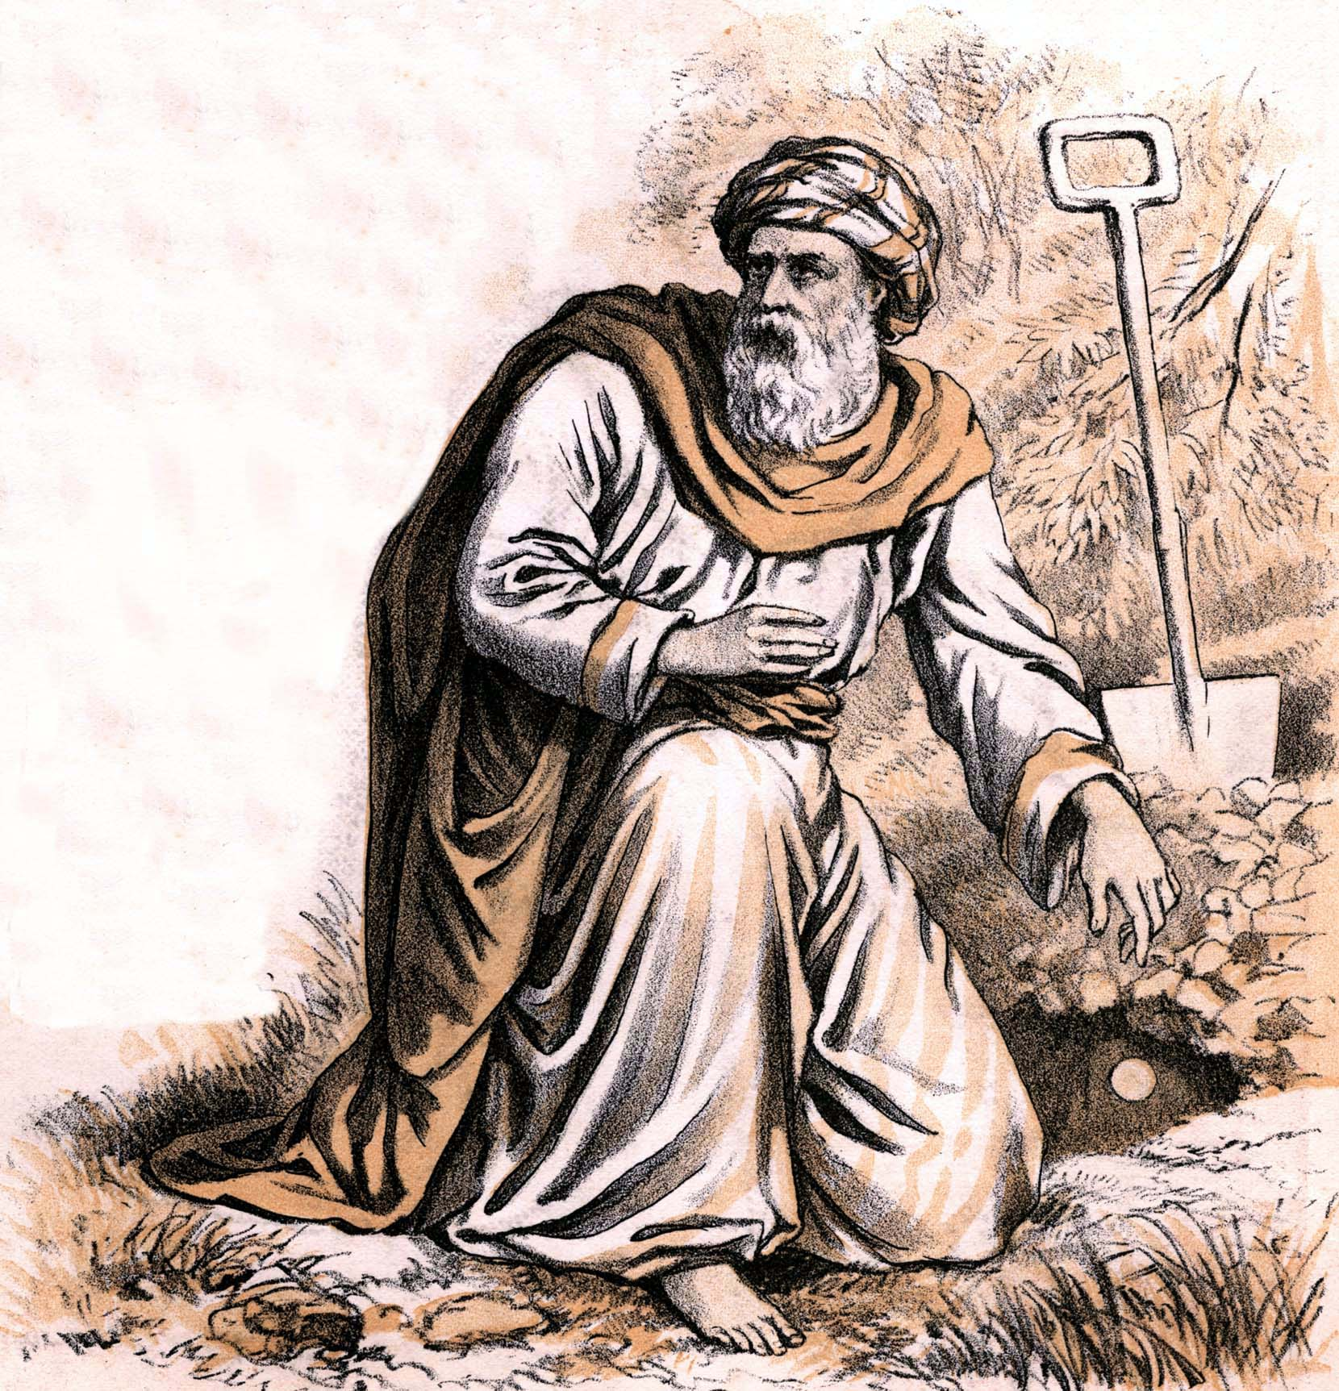
“We will not have this man to reign over us…Out of thine own mouth will I judge thee, thou wicked servant.”
(Luke 19:14,22)

Slide 29
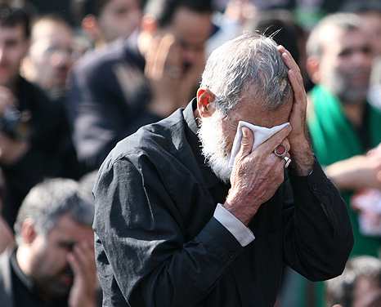
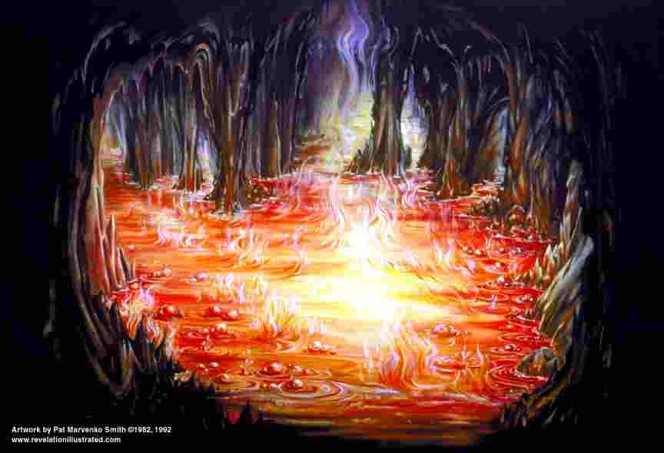
“Cast ye the unprofitable servant into outer darkness: there shall be weeping and gnashing of teeth.”

Slide 30
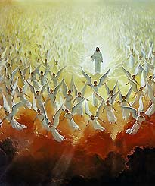
“The Son of Man shall come in His glory, and all the holy angels with Him, then shall He sit upon the throne of His glory.”

Slide 31
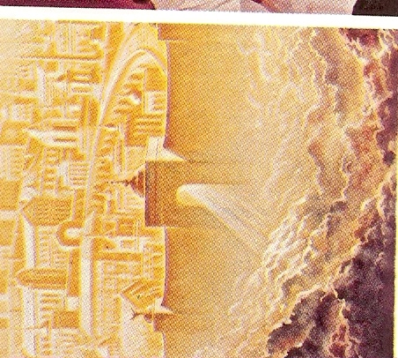
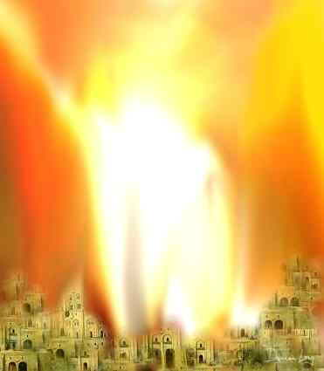
“For we must all stand before the Judgment Seat of Christ; that every one may receive the things done in his body, according to that he hath done, whether it be good or bad…Every man’s work shall be made manifest: for the day shall declare it, because it shall be revealed by fire; and the fire shall try every man’s work of what sort it is.”

