Slide 1
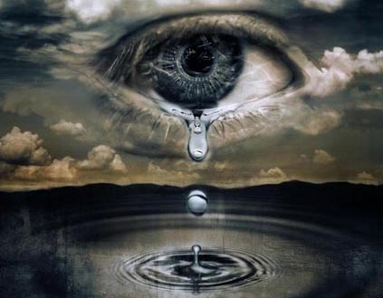
“Wherefore let them that suffer according to the will of God commit the keeping of their souls to him in well doing, as unto a faithful Creator.” (1 Peter 4:19)

Slide 2
Reasons why God’s children suffer
1. Sometimes God’s people suffer because of Satan's attack -
Jesus said to Peter "And the Lord said, Simon, Simon, behold, Satan hath desired to have you, that he may sift you as wheat."
Paul said - "...once and again, Satan hindered us."
The word of God call's Satan our "Enemy"
That is why we must "Put on the whole armor of God..."

Slide 3
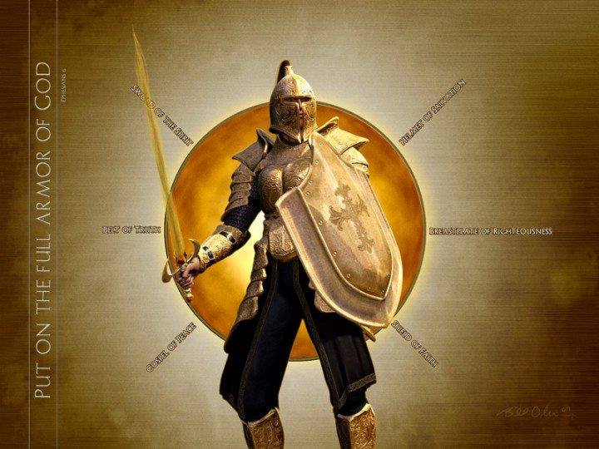

Slide 4
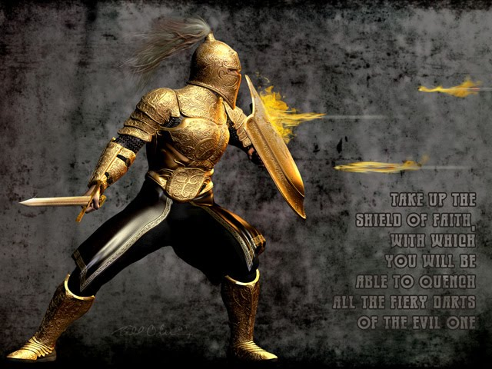
“…taking the shield of faith, wherewith ye shall be able to quench all the fiery darts of the wicked.”

Slide 5
2. Sometimes God’s people suffer because other people are against God - "If the world hate you, ye know that it hated me before it hated you.“
3. Sometimes God’s people suffer simply because we live in a fallen and sinful world thus we suffer the consequences of the fall – Genesis 3
God does not always rescue his people from such troubles, although sometimes he does - "The rain falls on the just and unjust alike...Man is born to trouble..."
Such suffering and trouble are opportunities for us as Christians to trust God and draw closer to him - (Psalms)

Slide 6

Suffering will make you
"bitter or better/ weaker or stronger"

Slide 7
4. Sometimes God’s people suffer because of their own sinful behavior and foolish decisions - "We reap what we sow”
We Refuse to Follow God’s Instructions (Numbers 20:1-29)
We Make Bad Decisions (Genesis 16:1-6)
We Don’t Judge Ourselves (I Corinthians 11:31)
We Refuse Correction (Hebrews 12:5-11)
Our Past Sins Come Back to Haunt us (Proverbs 28:13)
We Are Hearers of the Word But Not Doers (James 1:22-25)

Slide 8
We Don’t Resist the Devil (James 4:7)
We Are Easily Enticed and Commit Sin (Proverbs 1:19-33)
We Lack Discipline and Self Control (II Peter 1:5-10)
We Put Our Trust in the Arm of the Flesh (Zechariah 4:6)
We Didn’t Obey the Voice of the Holy Spirit (Hebrews 3:7-19)
We Are Under a Generational Curse (Deuteronomy 5:6-9)

Slide 9
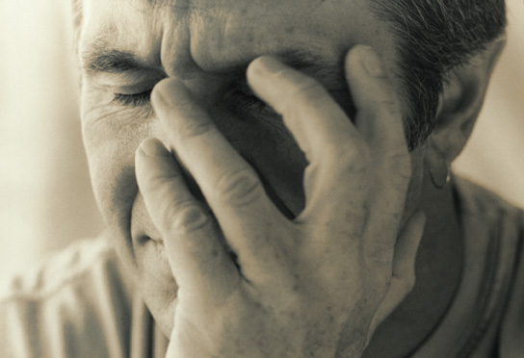
“As many as I love, I rebuke and chasten: be zealous therefore, and repent.” Rev. 3:19

Slide 10
5. Sometimes God allows his people to suffer because He is working in our lives – Romans 8:28
God teaches us valuable lessons through suffering that in no other way could be learned - (2 Corinthians 12:7-10)
> Infirmities- sickness
> Reproaches - insult, injury, bodily harm
> Necessities - unavoidable trials
> Persecutions - opposition and rejection (friends, family, world)
> Distress - calamity, anguish

Slide 11
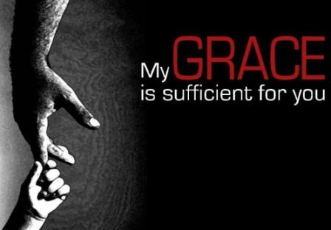
“Therefore I take pleasure in infirmities, in reproaches, in necessities, in persecutions, in distresses for Christ's sake: for when I am weak, then am I strong.”

Slide 12
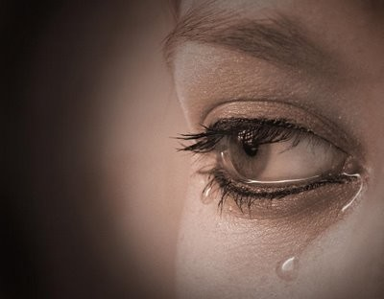
Suffering is a vital and important part of God's plan (will) for His people.
    “Wherefore let them that suffer according to the will of God commit the keeping of their souls to him in well doing, as unto a faithful Creator.”
    (1 Peter 4:19)

Slide 13
I Peter
1 Peter 2:19 For this is thankworthy, if a man for conscience toward God endure grief, suffering wrongfully.
1 Peter 2:20 For what glory is it, if, when ye be buffeted for your faults, ye shall take it patiently? but if, when ye do well, and suffer for it, ye take it patiently, this is acceptable with God.
1 Peter 2:21 For even hereunto were ye called: because Christ also suffered for us, leaving us an example, that ye should follow his steps:

Slide 14
1 Peter 2:22 Who did no sin, neither was guile found in his mouth:
1 Peter 2:23 Who, when he was reviled, reviled not again; when he suffered, he threatened not; but committed himself to him that judgeth righteously:
1 Peter 3:14 But and if ye suffer for righteousness' sake, happy are ye: and be not afraid of their terror, neither be troubled.
1 Peter 3:16 Having a good conscience; that, whereas they speak evil of you, as of evildoers, they may be ashamed that falsely accuse your good conversation in Christ.

Slide 15
1 Peter 3:17 For it is better, if the will of God be so, that ye suffer for well doing, than for evil doing.
1 Peter 4:1 Forasmuch then as Christ hath suffered for us in the flesh, arm yourselves likewise with the same mind.
1 Peter 4:4 Wherein they think it strange that ye run not with them to the same excess of riot, speaking evil of you:
1 Peter 4:12 Beloved, think it not strange concerning the fiery trial which is to try you, as though some strange thing happened unto you:

Slide 16
1 Peter 4:13 But rejoice, inasmuch as ye are partakers of Christ's sufferings; that, when his glory shall be revealed, ye may be glad also with exceeding joy.
1 Peter 4:14 If ye be reproached for the name of Christ, happy are ye; for the spirit of glory and of God resteth upon you: on their part he is evil spoken of, but on your part he is glorified.
1 Peter 4:16 Yet if any man suffer as a Christian, let him not be ashamed; but let him glorify God on this behalf.

Slide 17
1 Peter 5:7 Casting all your care upon him; for he careth for you.
1 Peter 5:8 Be sober, be vigilant; because your adversary the devil, as a roaring lion, walketh about, seeking whom he may devour:
1 Peter 5:9 Whom resist stedfast in the faith, knowing that the same afflictions are accomplished in your brethren that are in the world.
1 Peter 5:10 But the God of all grace, who hath called us unto his eternal glory by Christ Jesus, after that ye have suffered a while, make you perfect, stablish, strengthen, settle you.
1 Peter 5:11 To him be glory and dominion forever and ever. Amen.

Slide 18
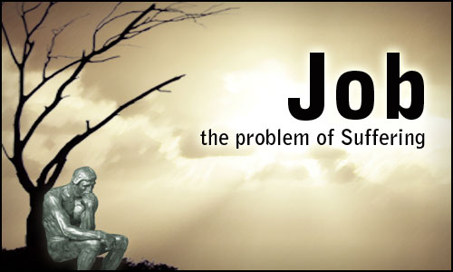
The unbelievable sufferings of Job were by the will of God, for his ultimate good and for God's glory.

Slide 19
"What? shall we receive good at the hand of God, and shall we not receive evil (bad)? In all this Job sinned not, nor charged God foolishly."

Slide 20

“In all this…”
What does all this include?

Slide 21
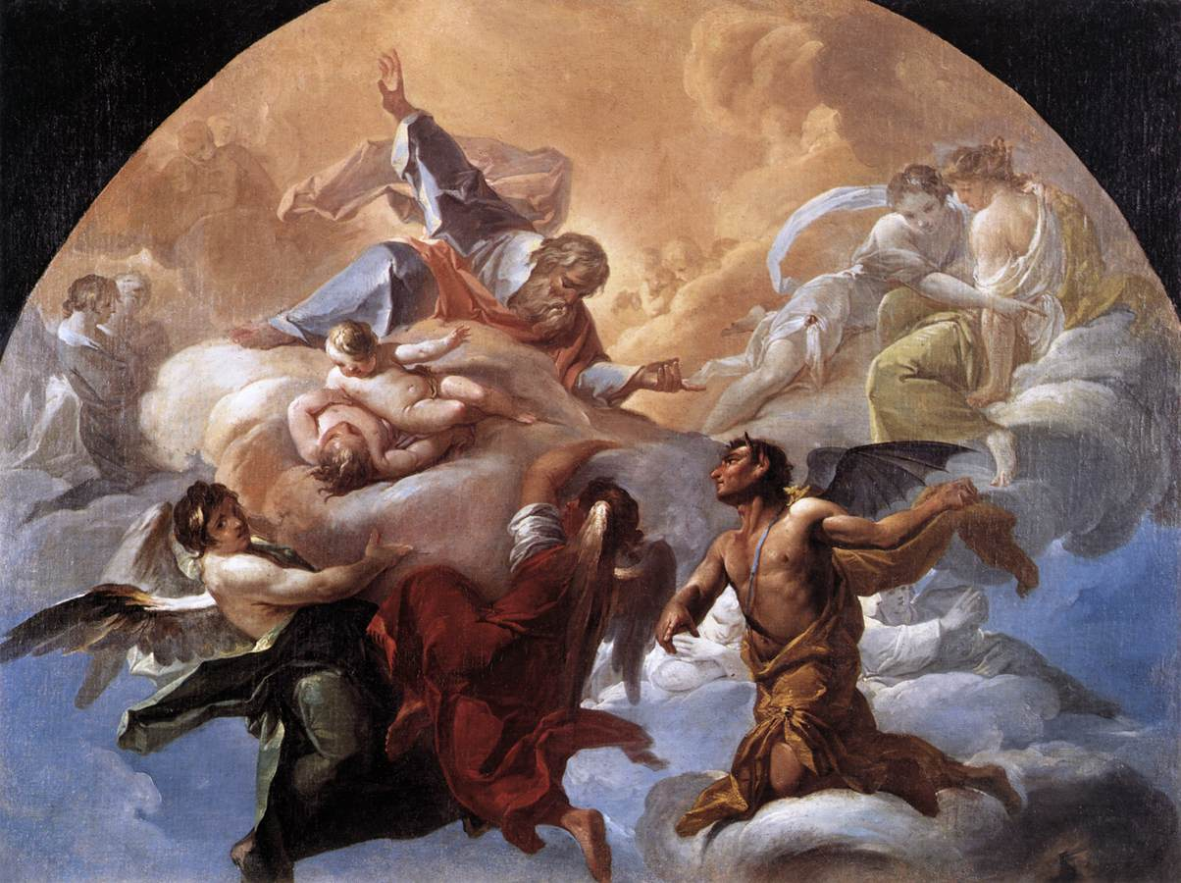
Satan attacked Job in seven areas of life
(Job 1-2)

Slide 22
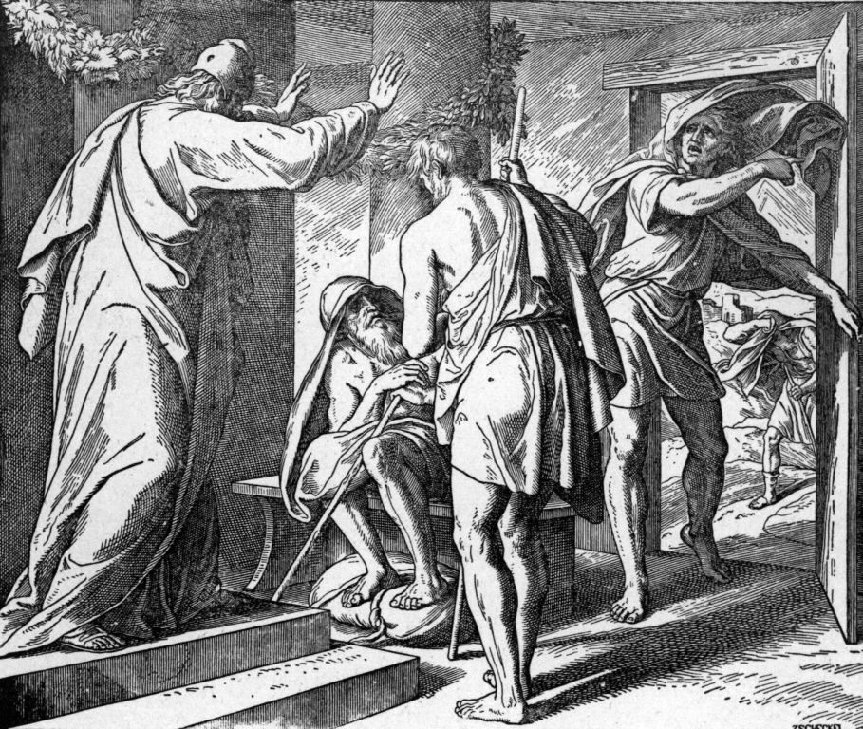
Attacked his job (Ox, servants)
Job 1:14, 17

Slide 23
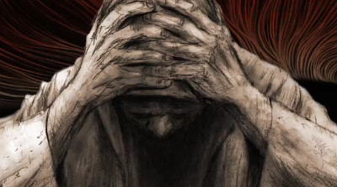
Attacked his wealth (sheep)
Job 1:16

Slide 24
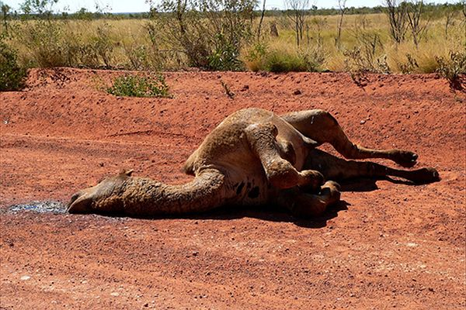
Attacked his transportation (camels) Job 1:3

Slide 25
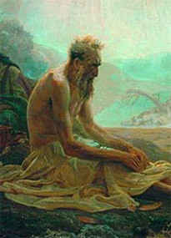
Attacked his family
Job 1:18-19

Slide 26
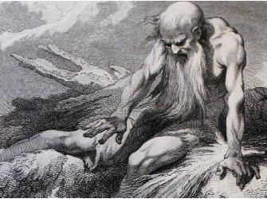
Attacked his health
Job 2:7

Slide 27
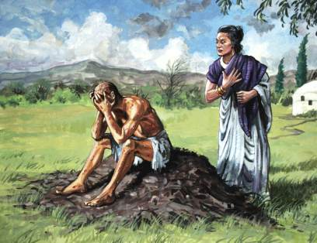
Attacked his marriage
Job 2:8-9

Slide 28
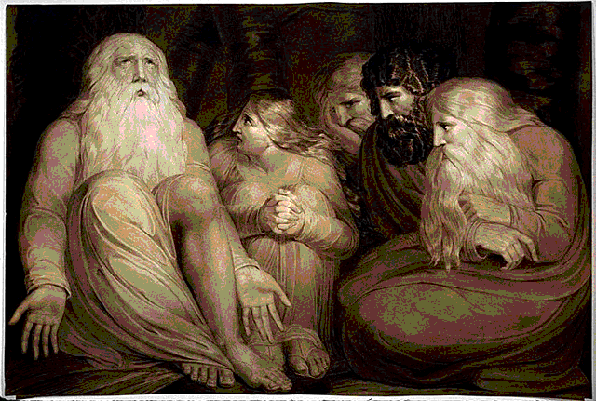
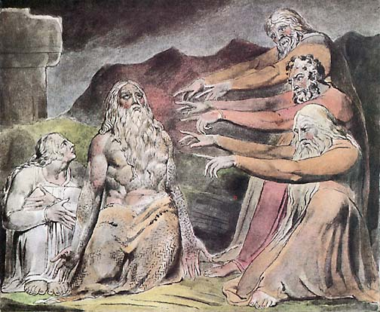
Attacked his friendships
Job 5:11

Slide 29

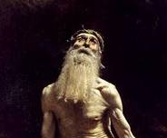
“But he knoweth the way that I take: when he hath tried me, I shall come forth as gold.” Job 23:10

Slide 30
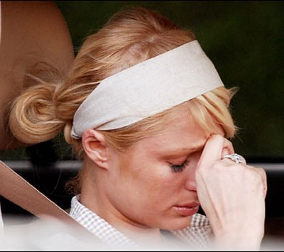
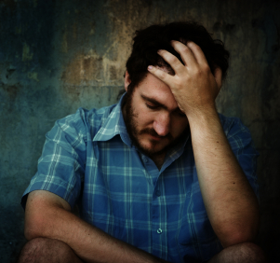
Twenty reasons God allows suffering to come into our lives

Slide 31
1) Suffering is God’s way of getting our attention - Psalms 25:1-2; Matthew 11:28
Note: Suffering is sometimes used as discipline for God's people, and as such comes from God's love, and causes us to grow in Christ: Heb 12:5-11
2) Suffering is God’s call for self-examination - Proverbs 28:13; I Corinthians 11:28-32
Note: Fellowship with God is restored, when we confess and repent of sin: 1 John 1:7-9; Prov. 28:13
Note: Suffering is used by God to teach us the importance of obedience: Heb 5:8; Phil 2:8

Slide 32
3) Suffering is God’s way of freeing us from a carnal view of life by causing us to refocus on things that are really important (right priorities in life) - Philippians 3:7-8; Colossians 3:2
Note: Reevaluating our priorities is a huge benefit of suffering: Exodus 20:9; Psalms 127:2; Haggai 1:3-8
4) Suffering is God’s way of revealing our faults - I Peter 2:18-20 "suffering for our faults"
5) Suffering is God’s way of increasing our patience - James 1:2-4
6) Suffering is God’s way of giving us new insights from Scripture - Romans 5:3-4

Slide 33
7) Suffering is God’s way of conquering our pride - Proverbs 16:18; 29:23; Luke 14:11
Note: Humility is needed in each of our lives. The Pride of life runs deeply in all of us: "...be clothed with humility: for God resisteth the proud, and giveth grace to the humble...But he giveth more grace. Wherefore he saith, God resisteth the proud, but giveth grace unto the humble."
8) Suffering is God’s method of purifying our faith - James 1:2-3; I Peter 1:6-7
9) Suffering is our motivation to cry out to God - Psalms 3:4; 9:12; 34:17; 56:9-10; 66:18

Slide 34
10) Suffering is God’s way of increasing our hatred for evil - Galatians 6:7-8; Hebrews 11:25
11) Suffering is God’s way of motivating us to pray - I Timothy 2:1-2
12) Suffering is God’s way of sifting our friendships - Proverbs 17:17
13) Suffering is God’s call to identify with Christ - Philippians 3:10
14) Suffering is our preparation for comforting others - II Corinthians 1:3-5; 4:8-10, 12, 16

Slide 35
15) Suffering is evidence that we are engaged in spiritual warfare - Ephesians 6:10-18
16) Suffering is a reminder of our weakness and his strength - II Corinthians 12:7-10
17) Suffering helps us grow in faith -1 Peter 1:6-8
18) Suffering provides opportunities to witness for Christ - 1 Pet 2:12, Phil 1:12-18
19) Suffering is God’s means of testing the genuineness of our salvation - Matthew 7:24-27
20) Suffering is our opportunity to glorify God - I Peter 2:12-25

Slide 36
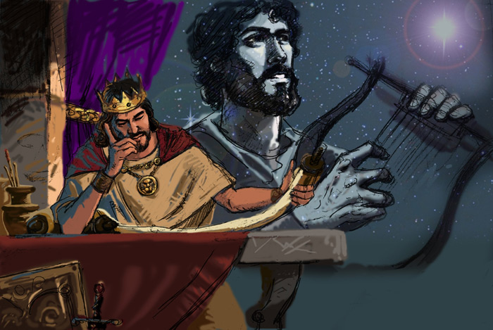
The Psalmist said
"It is good for me that I have been afflicted; that I might learn thy statutes.” Psalm 119:71

Slide 37
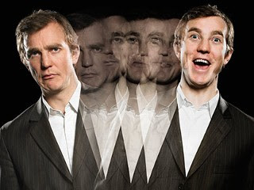
Developing a Biblical view of suffering will change your perspective on life.

Slide 38
Seven things you need to do when suffering comes into your life
First, check your self to see if you are being disciplined - "judge ourselves, that we be not judged".
Second, realize that you are not out of the will of God because you are experiencing suffering - 1 Peter 4:19
Third, seek God - Ask Him to reveal his plan and purpose in the suffering your are experiencing - 1 John 5:14

Slide 39
4. Forth, in everything give thanks: for this is the will of God in Christ Jesus concerning you - 1 Thess. 5:18
5. Fifth, remember that God, who has called you to suffer for a while, (according to His will) will in due course of time, make you perfect (mature), established, strengthened, and settled - 1 Pet 5:6-11
6. Sixth, focus on the truth that there will be no suffering for God's people in eternity - I Peter 4:12-19

Slide 40
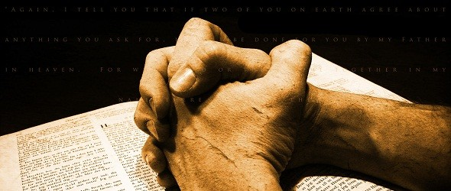
7. Seventh, continue doing good by committing your soul (Mind, Will, Emotion) to the keeping of God because He is a faithful creator – 1 Cor. 10:13 "There hath no temptation taken you but such as is common to man: but God is faithful, who will not suffer you to be tempted above that ye are able; but will with the temptation also make a way to escape, that ye may be able to bear it."

Slide 41
“Wherefore let them that suffer according to the will of God commit the keeping of their souls to him in well doing, as unto a faithful Creator.” (1 Peter 4:19)

