Slide 1
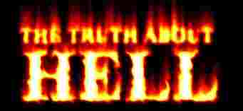

Slide 2
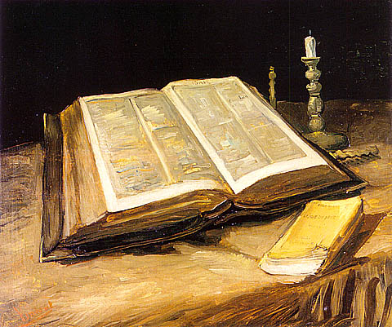
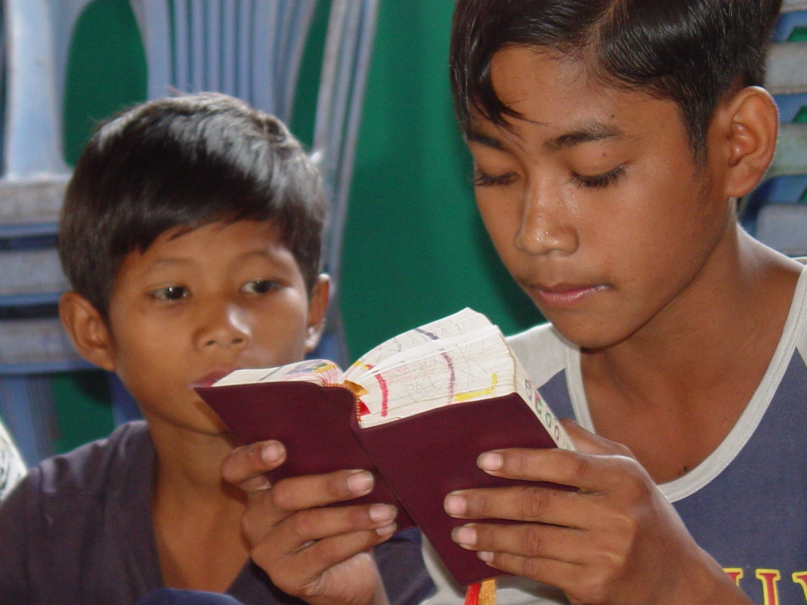
5 references to the “Lake of Fire.”
Over 150 references to Hell in the Word of God.
There are 53 references to “Hell” in the Bible.

Slide 3
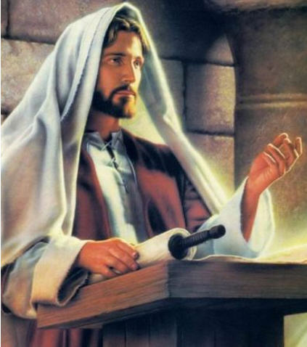
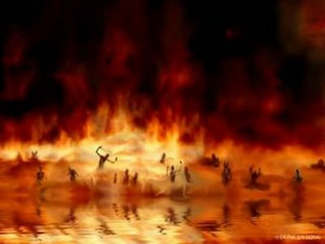
Fire - Matt 7:19, 13:40, 25:41
Everlasting fire - Matt 18:8, 25:41
Hell fire - Matt 5:22, 18:9, Mark 9:47
Damnation - Matt 23:14, Mark 12:40
Eternal damnation - Mark 3:29

Slide 4
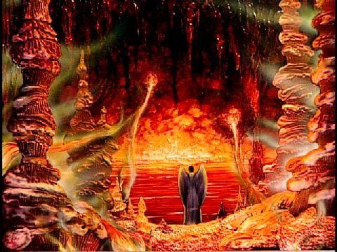
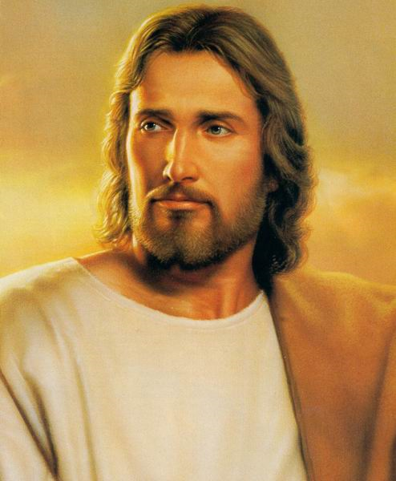
Damnation of hell - Matt 23:33
Resurrection of damnation - John 5:29
Furnace of fire - Matt 13:42, 50
The fire that never shall be quenched - Mark 9:43, 45
The fire is not quenched - Mark 9:44, 46, 48

Slide 5
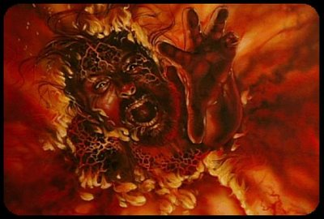
Matthew 13:42 "And shall cast them into a FURNACE OF FIRE: there shall be wailing and gnashing of teeth.“
Matthew 25:41 "Depart from me, ye cursed, into EVERLASTING FIRE. . .“

Slide 6
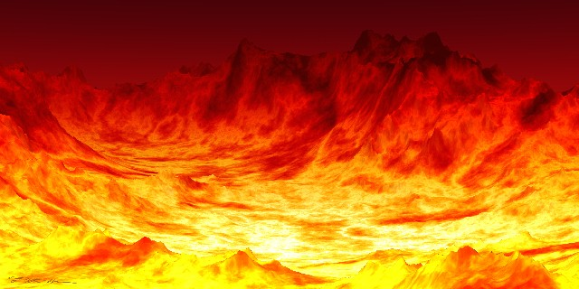
Where their worm dieth not - Mark 9:44, 46, 48
Wailing and gnashing of teeth - Matt 13:42, 50
Weeping and gnashing of teeth - Matt 8:12, 22:13, 25:30

Slide 7
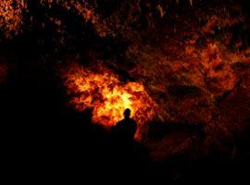
Torments - Luke 16:23
Place of torment - Luke 16:28
Tormented in this flame - Luke 16:24
Everlasting punishment - Matt 25:46
Outer darkness - Matt 8:12, 22:13

Slide 8
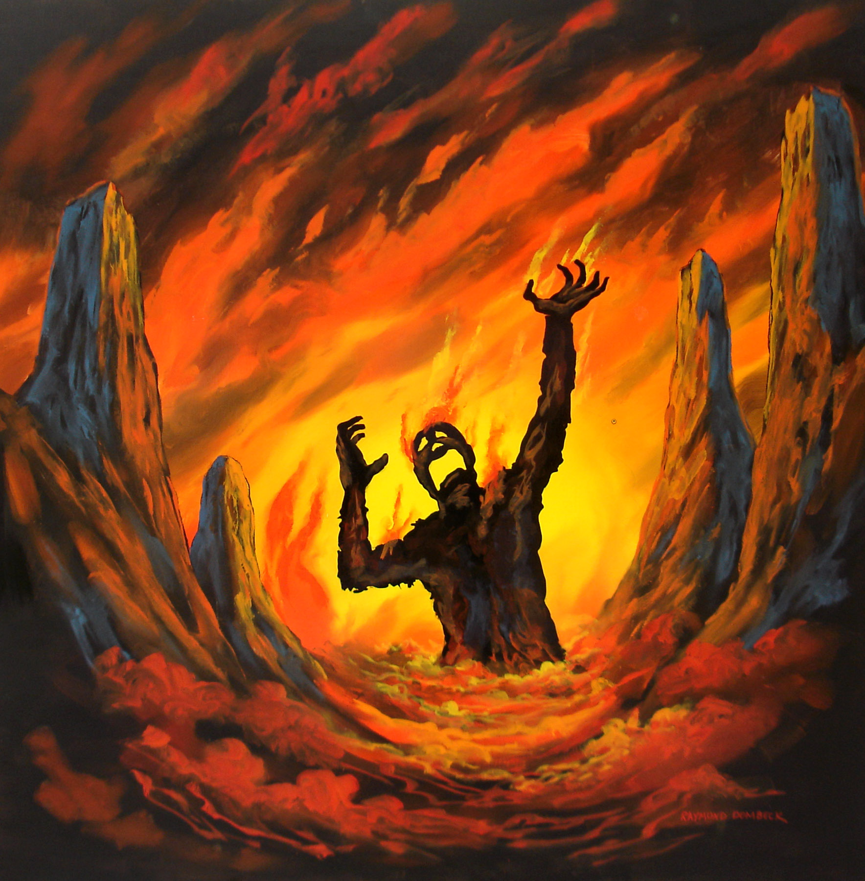
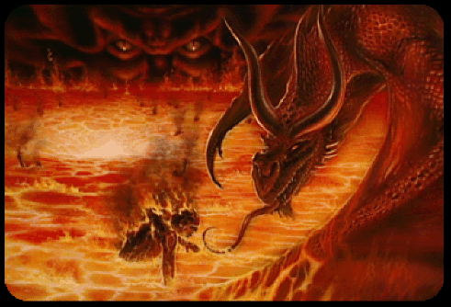
“Then shall he say also unto them on the left hand, Depart from me, ye cursed, into everlasting fire, prepared for the devil and his angels.” Matt. 25:41

Slide 9
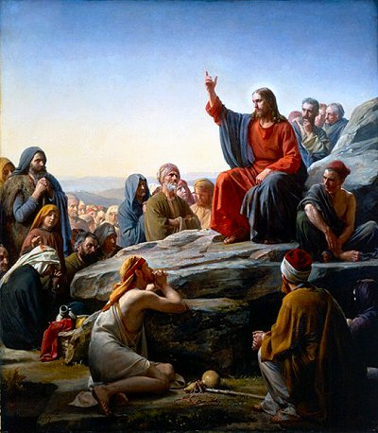
(Luke 16:19-31)

Slide 10
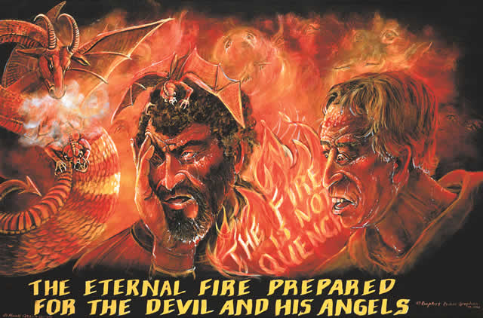
(Luke 16:23-24, 28)
"And in hell he lift up his eyes, being in TORMENTS. . .”
“I am TORMENTED in this FLAME. . .”
“PLACE OF TORMENT."

Slide 11
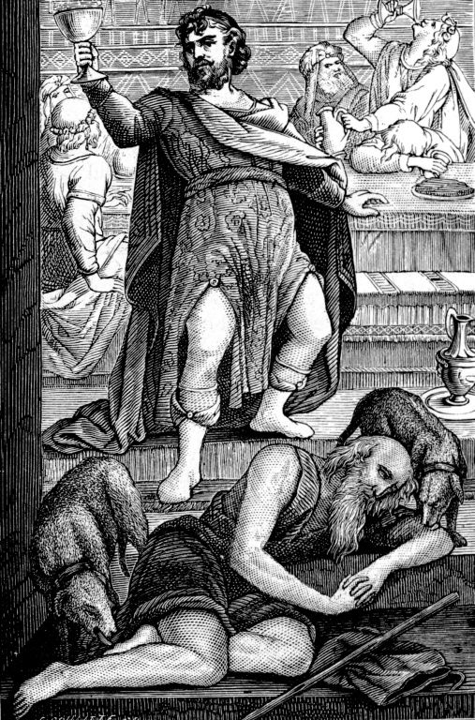

Slide 12
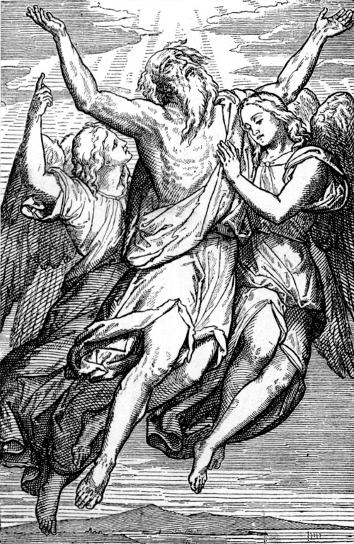

Slide 13
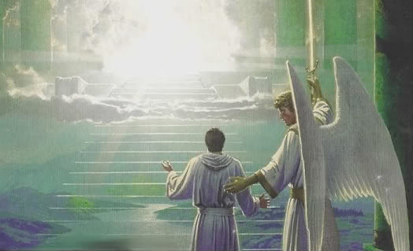

Slide 14
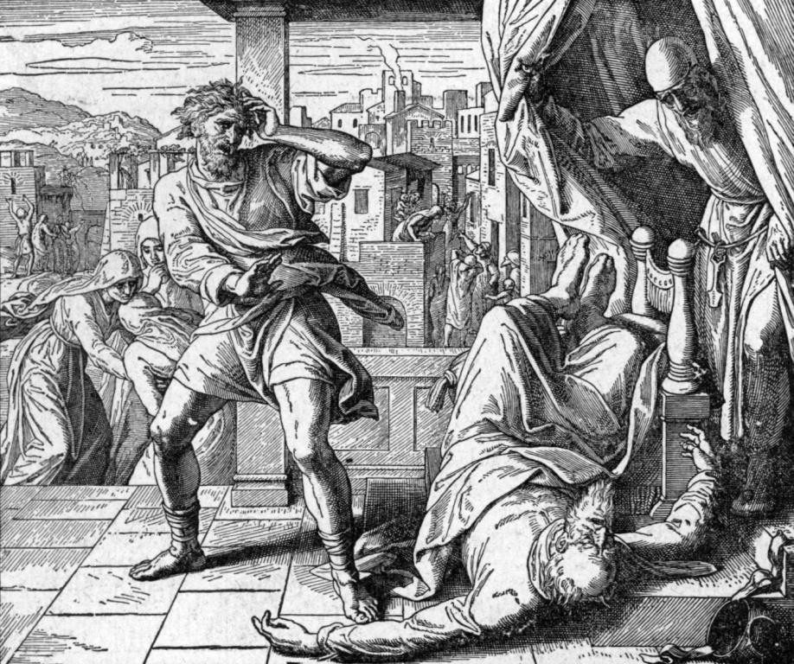

Slide 15
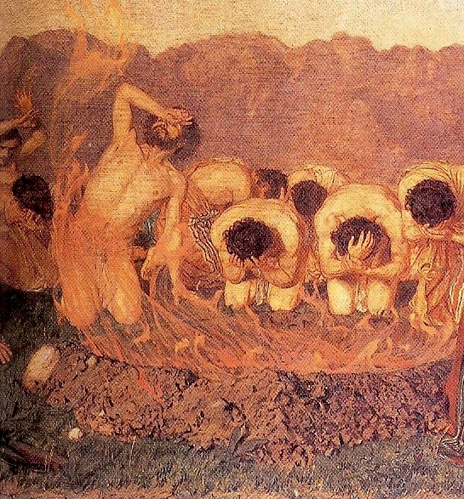

Slide 16
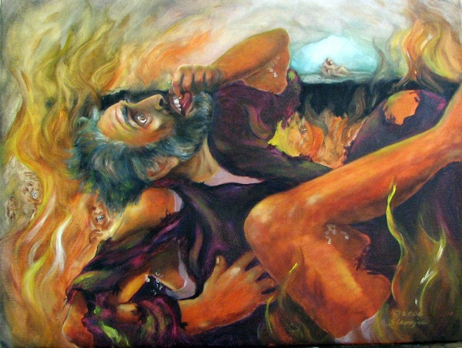
“And in hell he lift up his eyes, being in torments…”

Slide 17
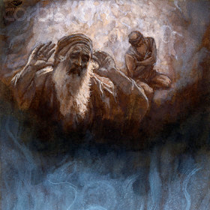
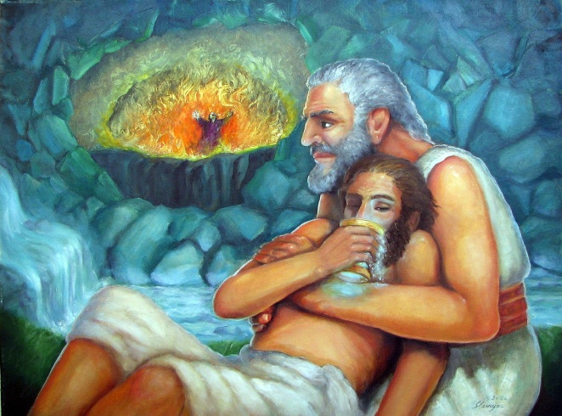

Slide 18
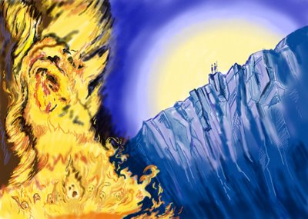

Slide 19
“And if thy hand offend thee, cut it off: it is better for thee to enter into life maimed, than having two hands to go into hell, into the fire that never shall be quenched…And if thy foot offend thee, cut it off: it is better for thee to enter halt into life, than having two feet to be cast into hell, into the fire that never shall be quenched…And if thine eye offend thee, pluck it out: it is better for thee to enter into the kingdom of God with one eye, than having two eyes to be cast into hell fire.”

Slide 20
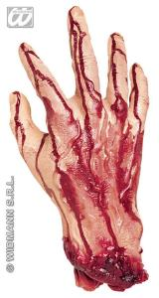
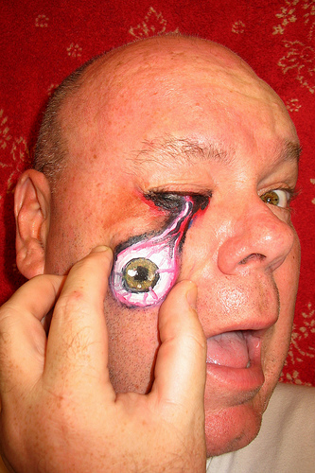
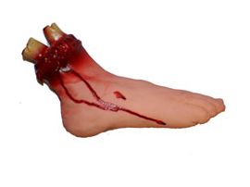
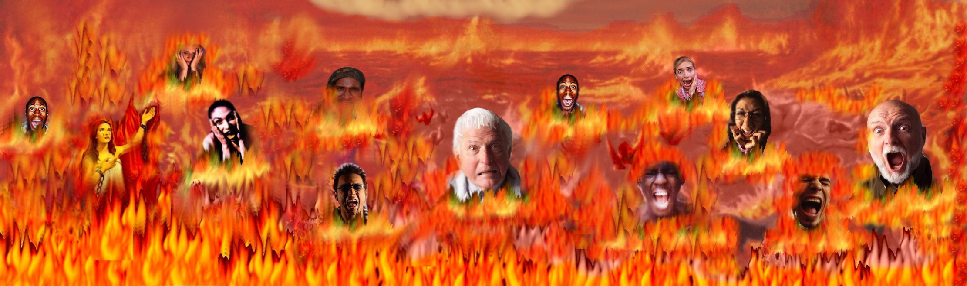

Slide 21
“Lowest hell…deeper than hell…let them go down quick into hell…hell is beneath…brought down into hell…debase thyself even unto hell…dig into hell…the belly of hell…lower parts of the earth…”

Slide 22
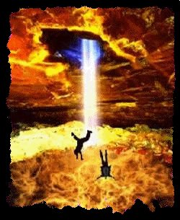
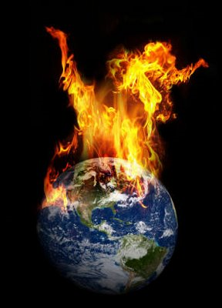
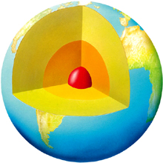
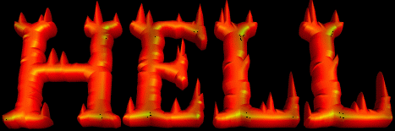

Slide 23
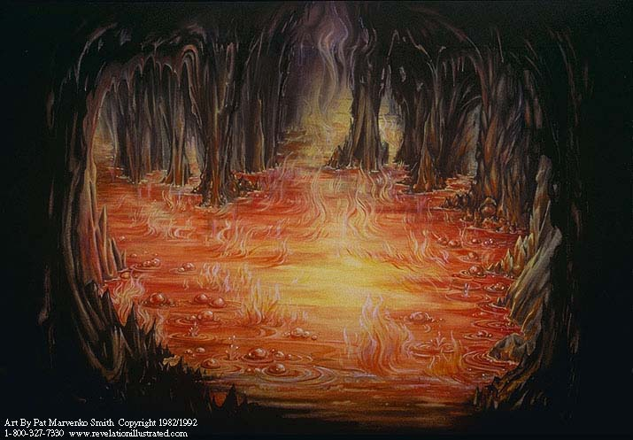
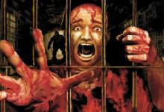
“And they shall be gathered together, as prisoners are gathered in the pit, and shall be shut up in the prison…” (Isa. 24:22)

Slide 24
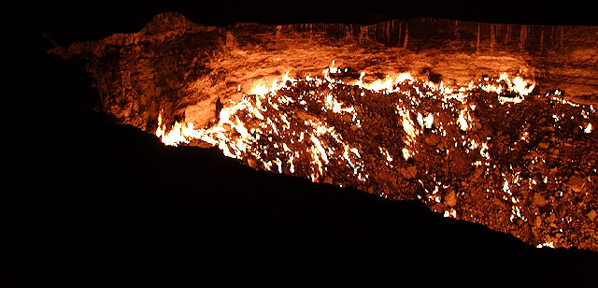
“Cast him down to hell with them that descend into the pit.”
(Ezek. 31:16)

Slide 25
“The same shall drink of the wine of the wrath of God, which is poured out without mixture into the cup of his indignation; and he shall be tormented with fire and brimstone.”
(Revelation 14:10)

Slide 26
“For God hath not appointed us to wrath, but to obtain salvation by our Lord Jesus Christ…”
(I Thess. 5:9)

Slide 27
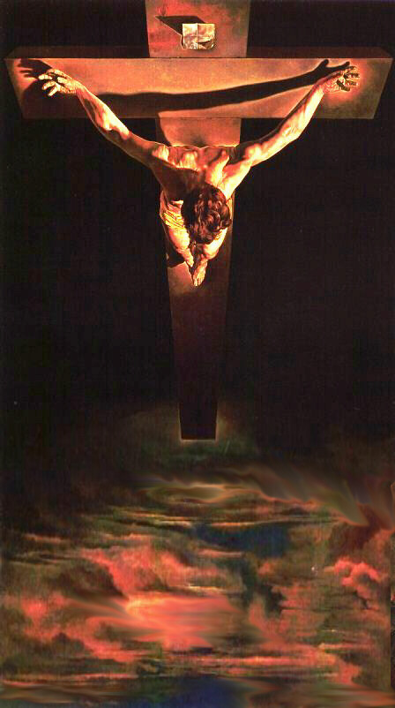
“Much more then, being now justified by his blood, we shall be saved from wrath through him.”
“In whom we have redemption through his blood, the forgiveness of sins, according to the riches of his grace.”
“Without shedding of blood is no remission.”
“The blood of Jesus Christ his Son cleanseth us from all sin.”

Slide 28
“For by grace are ye saved through faith; and that not of yourselves: it is the gift of God: Not of works, lest any man should boast.”
(Ephesians 2:8-9)

Slide 29
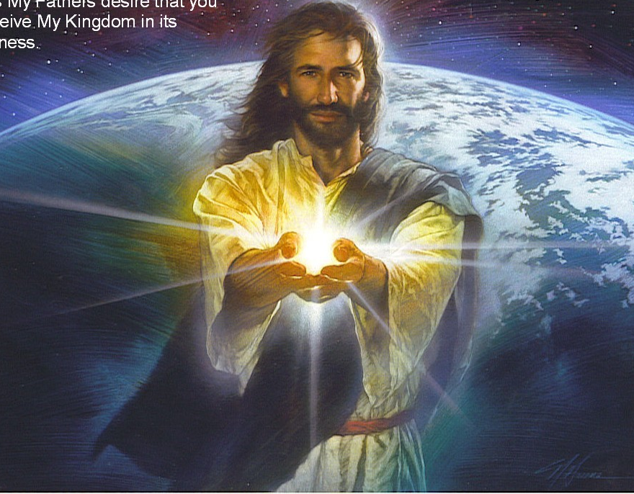


Slide 30
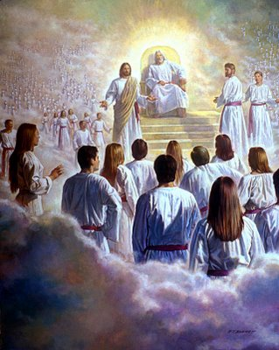
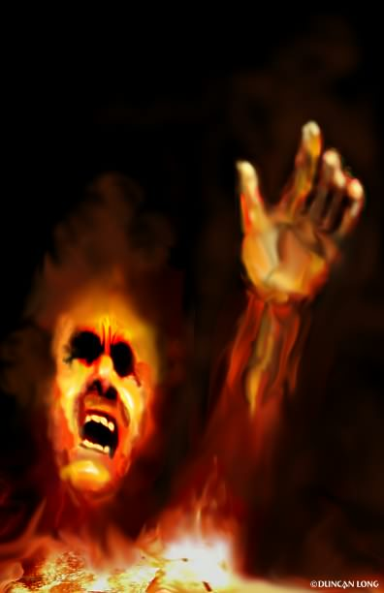
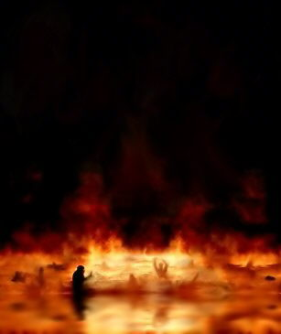

Slide 31
“The Lord is not slack concerning his promise, as some men count slackness; but is longsuffering to us-ward, not willing that any should perish, but that all should come
to repentance.”
(II Pet. 3:9)

Slide 32
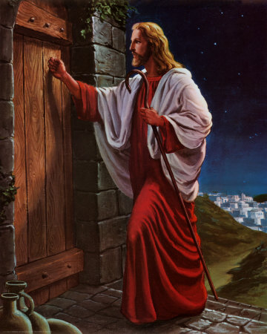

Slide 33
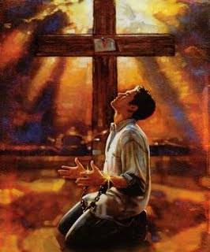

Slide 34
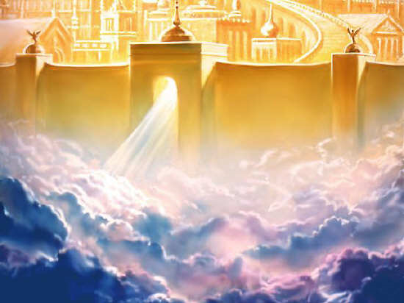
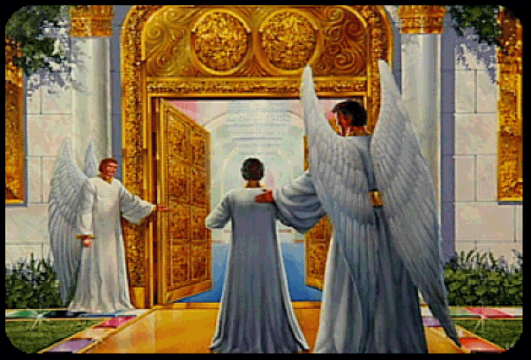

Slide 35
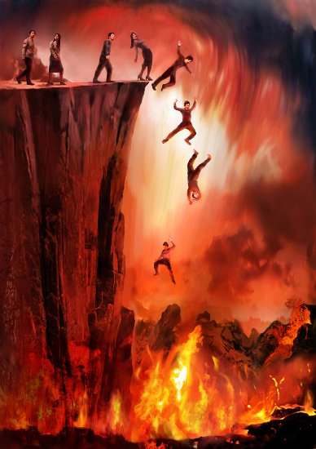

Slide 36


