Slide 1
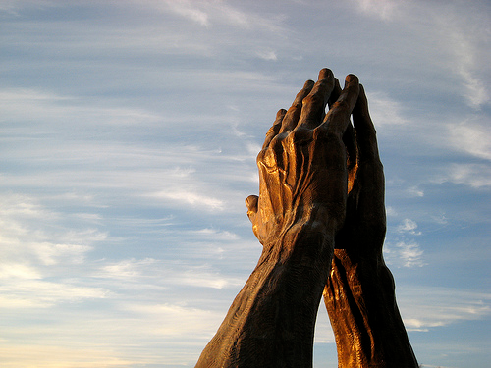
What hinders our prayers from being answered?
“The effectual fervent prayer of a righteous man availeth much…” James 5: 16

Slide 2
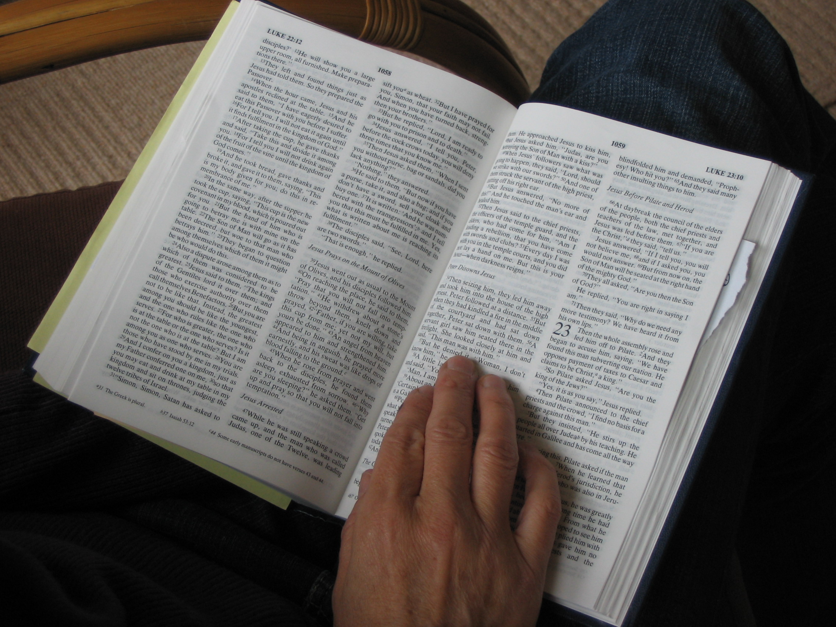
“Evening, and morning, and at noon, will I pray, and cry aloud: and he shall hear my voice.”
Psalm 55:17

Slide 3
God commands us to pray - Matt 26:41, Mark 13:33, Luke 18:1, I Tim 2:1, Eph 6:18, Rom 12:12
Prayer is entering God's presence - Heb 4:14-16, Heb 8:1, Heb 9:24, Rom 8:34, II Chor 30:27, Isa 57:15, Rev 5:7-9, Rev 8:31, Luke 3:21, Eph 1:3, Eph 2:6, Col 3:1-2
The Bible encourages us to ask for things specifically in prayer - Matt 21:22, John 16:23-26, Matt 18:19, John 14:13,14, Phil 4:6, I John 5:15
The Holy Spirit's empowering comes by prayer - Acts 1:4-8, 13,14, Acts 4:31, Acts 13:1-4, John 7:37,38, Luke 11:13

Slide 4
Intercessory prayer is the ultimate, and necessary in "putting on the whole armor of God" - Eph 6:12,17,18
We are commanded to pray continually - Eph 6:18, I Thess 5:17, Luke 18:1, Rom 12:12, Ps 55:17, Luke 6:12, II Tim 1:3
Prayer needs to be persistent, and prevailing - Luke 11:5-13, Luke 18:1-8, James 5:16-18, Heb 5:7, Isa 62:6-7, Dan 10:2, Dan 10:12-13
God's guidance, and will for our lives is revealed through prayer - James 1:5, Acts 13:1-3, Matt 26:39, Rom 15:30-32, Ps 37:4,5, Ps 40:1-8

Slide 5
The Holy Spirit intercedes for us when we pray - Rom 8:14-16, 26, Phil 1:19, Jude 20
When Christians pray GREAT things can happen -(Pray moves the heart and hand of God on our behalf) - Acts 1:1-14 ; 2:1, Acts 4:31, Acts 12:1-19, Acts 13:1-3, II Chor 7:14
Intercessory prayer on the behalf of others is effectual - I Thess 3:10, Col 4:12, 2Cor 1:11, Luke 22:31-32, Acts 12:5, I John 5:15,16, Eph 3:14-21, Job 42:10

Slide 6
Prayer is crucial in the spreading the Gospel of Jesus Christ - Eph 6:19, Col 4:3, Acts 4:31, II Thess. 3:1-2, Matt 9:38, John 17:20-23, Rom 10:1
Throughout the Scriptures we see many encouragements to pray - Ps 27:13-14, Ps 34:10, Ps 50:15, Ps 91:15, Ps 116:12-13, Isa 40:31, Isa 65:24, Luke 11:9, Phil 4:6-7, I John 5:14
Jesus' exhorts us to pray – “Lord teach us to pray…” - John 14:13, John 14:14, John 15:7,8, John 15:16, John 16:23, John 16:24, John 16:26

Slide 7
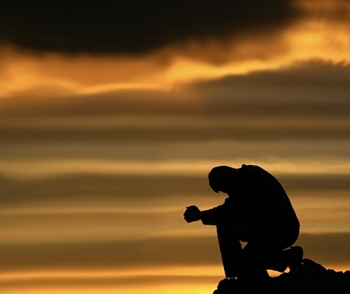
Prayer is the means of
having our needs met

Slide 8
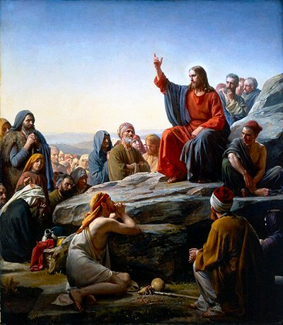
“Ask, and it will be given to you; seek and you will find; knock and it will be opened to you. For everyone who asks receives, and he who seeks finds, and to him who knocks it will be opened.”
Matthew 7:7-8

Slide 9
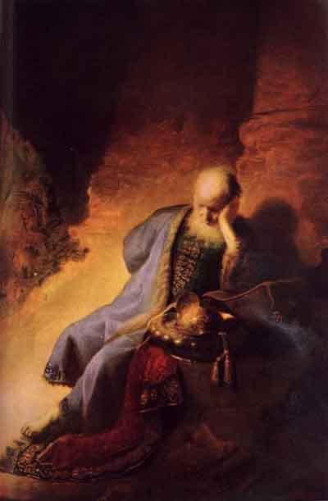
“Call unto me, and I will answer thee, and shew thee great and mighty things, which thou knowest not.” Jer. 33:3

Slide 10
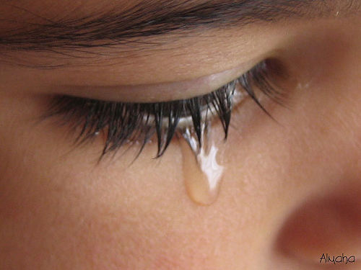
19 reasons our prayers are not answered
“Then shall they cry unto the LORD, but he will not hear them: he will even hide his face from them at that time, as they have behaved themselves ill in their doings.” Mic. 3:4

Slide 11

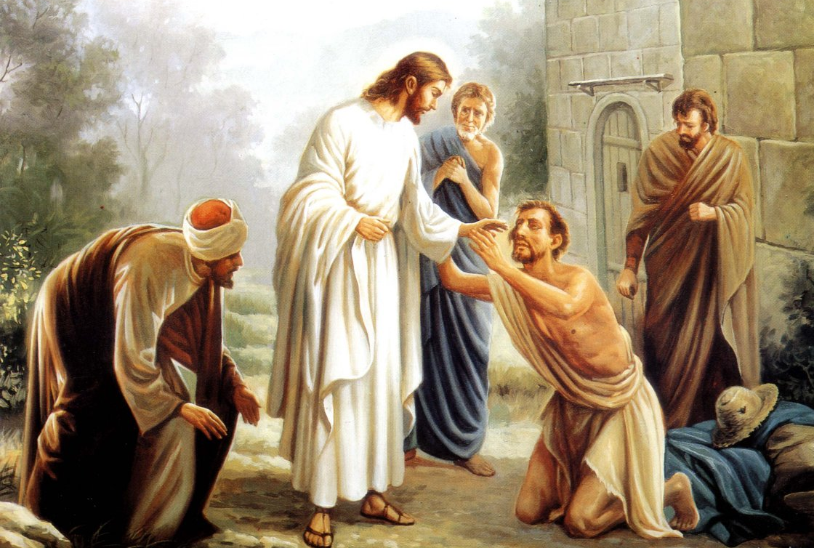
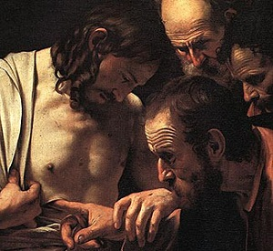


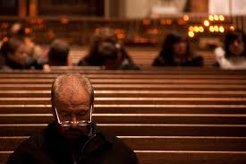
1) Unforgiveness – Mark 11:25-26
2) An Ungrateful Heart – I Thess. 5:16-19
3) Unbelief – James 1:6-7
4) Selfishness – James 4:1-3
5) Disobedience – I John 3:22
6) Not asking others to pray for you and with you – Matthew 18:19

Slide 12

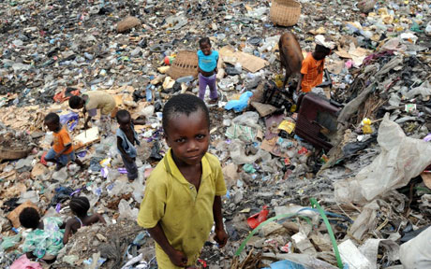



7) Idols – Ezekiel 14:2-5
8) Neglecting the poor and needy – Proverbs 21:13
9) Lack of reconciliation - Matthew 5:23-24
10) Not wanting to wait on God for the answer – Isa. 30:18, Isa. 40:31
11) Wrong motives – Matthew 6:5-6, James 4:3

Slide 13


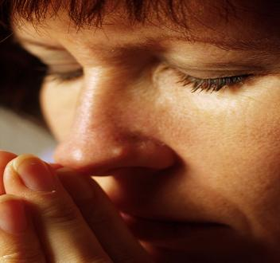
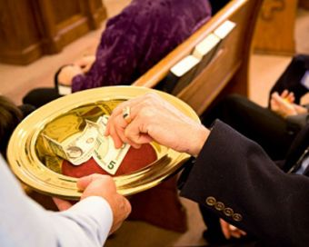
12) Not praying according to the will of God – I John 5:14-15
13) Judgmental and critical spirit – Matthew 7:1-5, 7
14) Not being persistent in prayer – Luke 18:1-7
15) Stinginess in giving – Proverbs 3:9-10

Slide 14
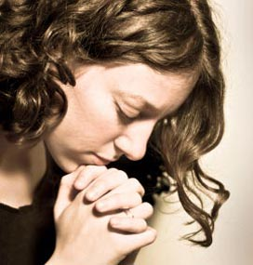
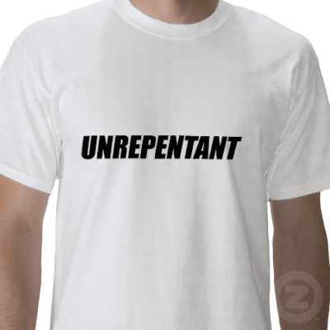
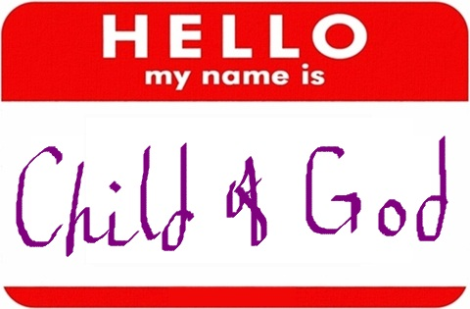
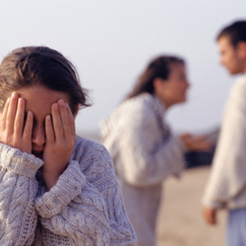
16) Not praying in Jesus name - John 14:13-14; 15:16; 16:23-24
17) Iniquity – Isaiah 59:2; Ps. 66:18
18) Not being a child of God – Matt. 7:7-11
19) Bad relationship between husband and wife – I Peter 3:7

Slide 15
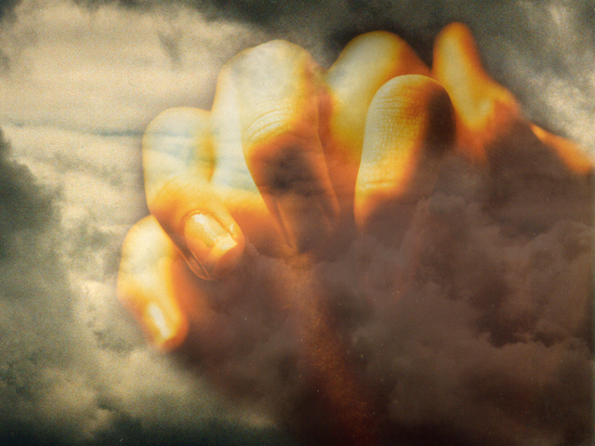
“The effectual fervent prayer of a righteous man availeth much…”
James 5:16
Effectual - That which is capable of or successful in producing a desired effect.
Fervent - Intensely passionate; having or showing great emotion or zeal.

Slide 16

“If ye abide in me, and my words abide in you, ye shall ask what ye will, and it shall be done unto you.” John 15:7

